Slide 1
Automation Using Generative AI? Evidence from a Teacher Hiring Pipeline
Kobbina Awuah (U Zurich)
Urša Krenk (U Zurich)
David Yanagizawa-Drott (U Zurich)

Slide 2
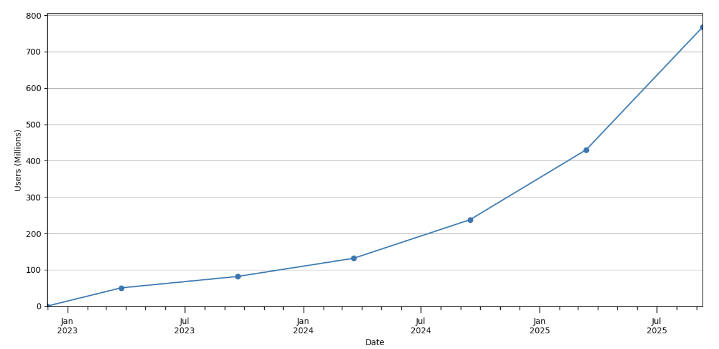
Motivation
The rise of generative AI
Weekly active ChatGPT users on consumer plans (Chatterji et al., 2025)

Slide 3
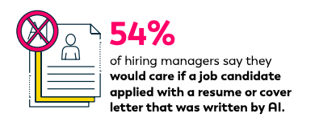
Motivation
High prevalence of AI in hiring and job search
The rise of generative AI
92% of US hiring managers say they use AI in the screening process
88% say they can tell if the candidate used AI in their application materials
40% of job seekers use AI in their application materials
Source: Insight Global Survey 2025, US respondents
Weekly active ChatGPT users on consumer plans (Chatterji et al., 2025)

Slide 4
This Paper
We assess three distinct policy-relevant pipelines in the context of grading applications:
Human-Only
AI-Assistance
Automation

Slide 5
This Paper
We assess three distinct policy-relevant pipelines in the context of grading applications:
Human-Only
AI-Assistance
Automation
Automation vs. Augmentation of Humans using GenAI?

Slide 6
This Paper
We assess three distinct policy-relevant pipelines in the context of grading applications:
Human-Only
AI-Assistance
Automation
Automation vs. Augmentation of Humans using GenAI?
The first RCT to test these three pipelines using generative AI in a real-world labor market

Slide 7
Related Literature
Automation vs. Augmentation (eg. Acemoglu, Autor, and Johnson, 2023; Acemoglu and Restrepo, 2019; Agarwal et al., 2024; Noy and Zhang, 2023; Brynjolfsson, Li, and Raymond, 2025)
AI in Hiring (eg. Avery, Leibbrandt, and Vecci, 2023; Li et al., 2024; Agan et al., 2023; Cowgill, 2020; Chalfin et al., 2016; Wiles, Munyikwa, and Horton, 2025)
GenAI & Productivity (Brynjolfsson, Li, and Raymond, 2025; Bubeck et al., 2023; Dell’Acqua et al., 2023; Noy and Zhang, 2023; Peng et al., 2023; Kumar et al., 2023)
Systematic disagreement between algorithms & Humans (Dietvorst, Simmons, and Massey, 2015; Agarwal et al., 2024; Vafa, Rambachan, and Mullainathan, 2024, Parshakov et al., 2025, Kim et al. 2024)

Slide 8
The Context: Screening for Teachers
Collaborate with an education non-profit in Ghana
Embed a two-month experiment into their recruitment process at the application evaluation stage a few weeks after GPT-4 was commercially rolled out
Task: Evaluate six application essays based on grading criteria provided by the NGO (grade 1-5)

Slide 9
The Context: Screening for Teachers
Collaborate with an education non-profit in Ghana
Embed a two-month experiment into their recruitment process at the application evaluation stage a few weeks after GPT-4 was commercially rolled out
Task: Evaluate six application essays based on grading criteria provided by the NGO (grade 1-5)
Why this context?
Adoption of AI technologies is widespread in hiring
GenAI might handle the complex task better
GenAI does not get tired or care about weak incentives
A task where “human touch” and tacit knowledge may be important

Slide 10
Preview of Main Results

Slide 11
Preview of Main Results
AI-Only:
AI-Assistance:

Slide 12
Preview of Main Results
AI-Only:
Downstream offer rates and hiring success increase by 73% and 84%, respectively
AI-Assistance:

Slide 13
Preview of Main Results
AI-Only:
Downstream offer rates and hiring success increase by 73% and 84%, respectively
AI-Assistance:
No effects on downstream outcomes

Slide 14
Preview of Main Results
AI-Only:
Downstream offer rates and hiring success increase by 73% and 84%, respectively
AI-Assistance:
No effects on downstream outcomes
Automation of the task appears viable, even superior

Slide 15
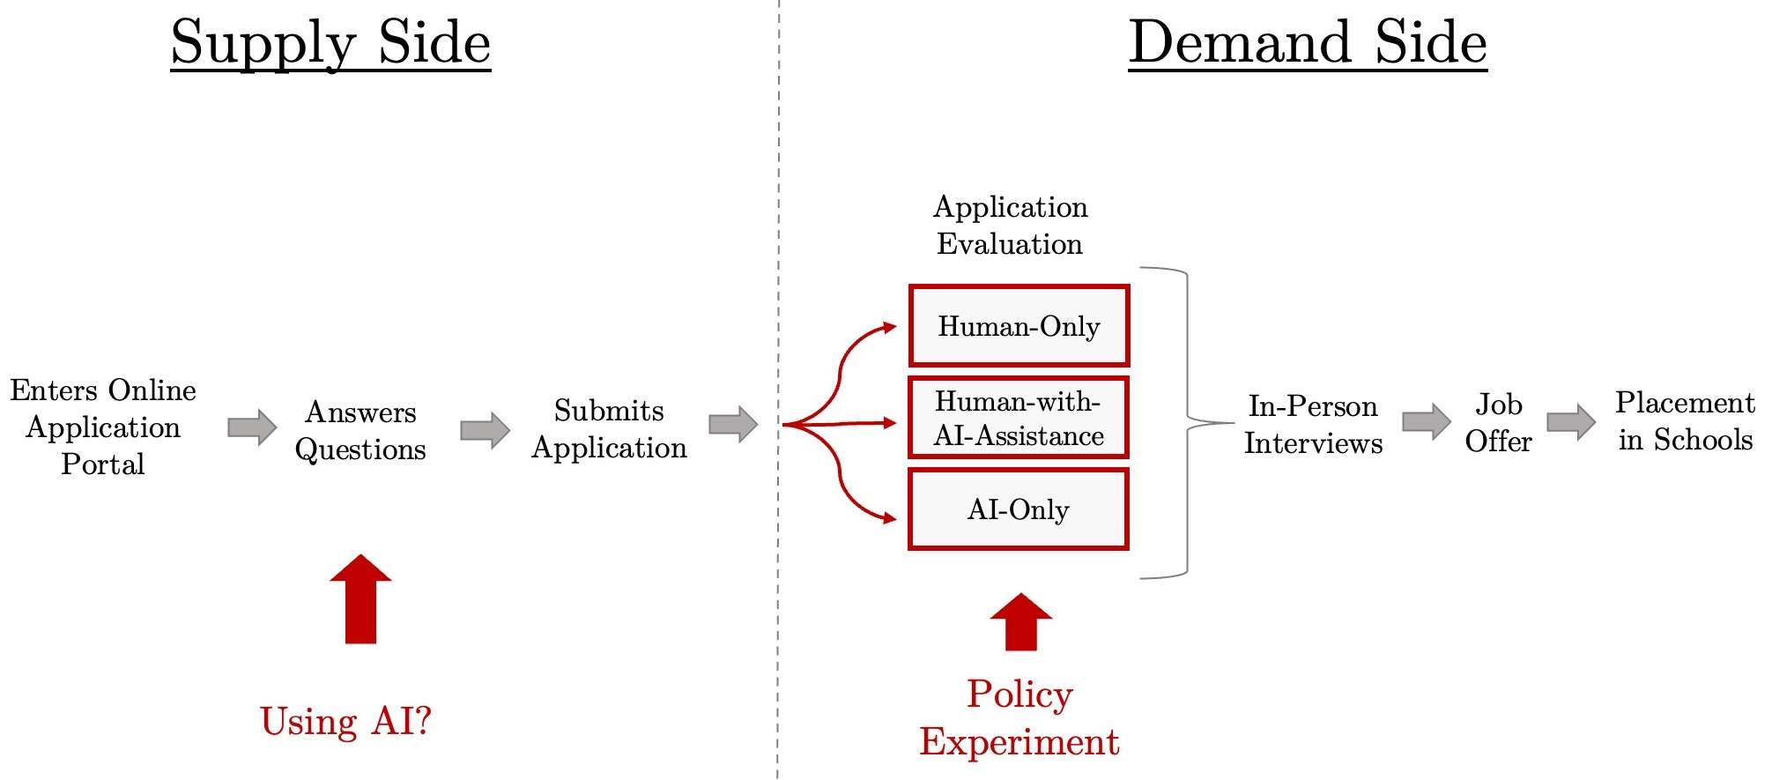
Design
Downstream
outcomes

Slide 16
Design
Downstream
outcomes

Slide 17
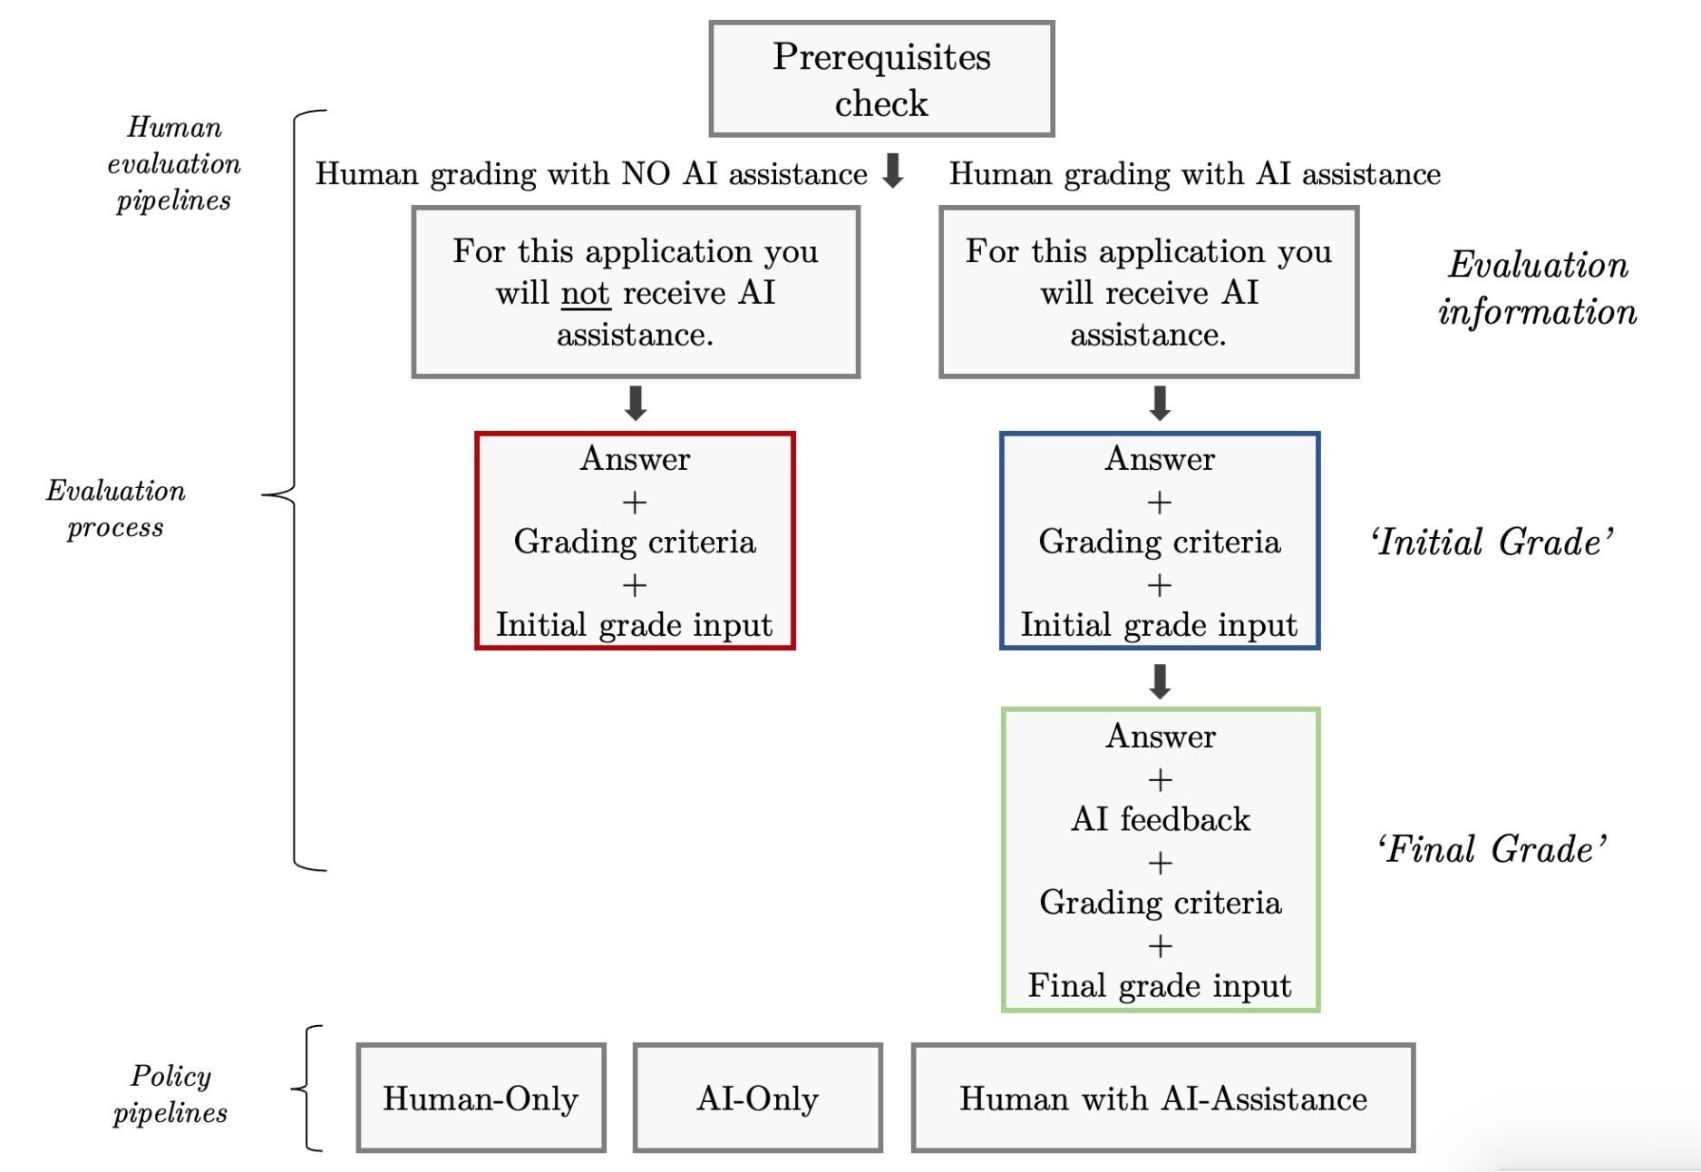
Design: Grading

Slide 18
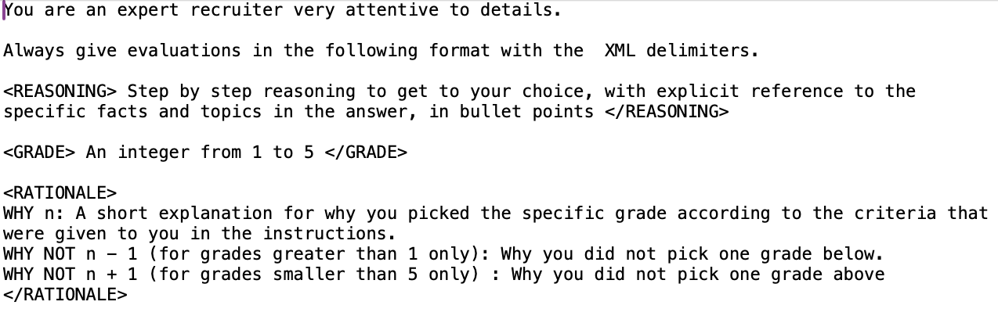
AI Design
“Zero-Shot” via GPT-4 API
System Prompt
Content Prompt

Slide 19
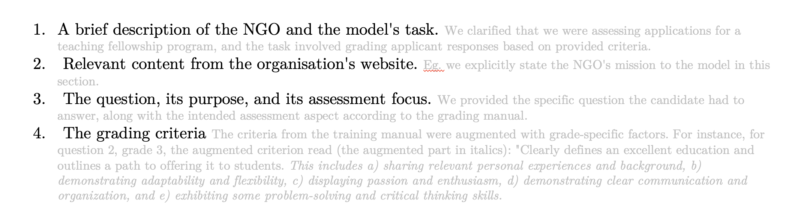
AI Design
“Zero-Shot” via GPT-4 API
System Prompt
Content Prompt

Slide 20
Descriptive Results Grading

Slide 21
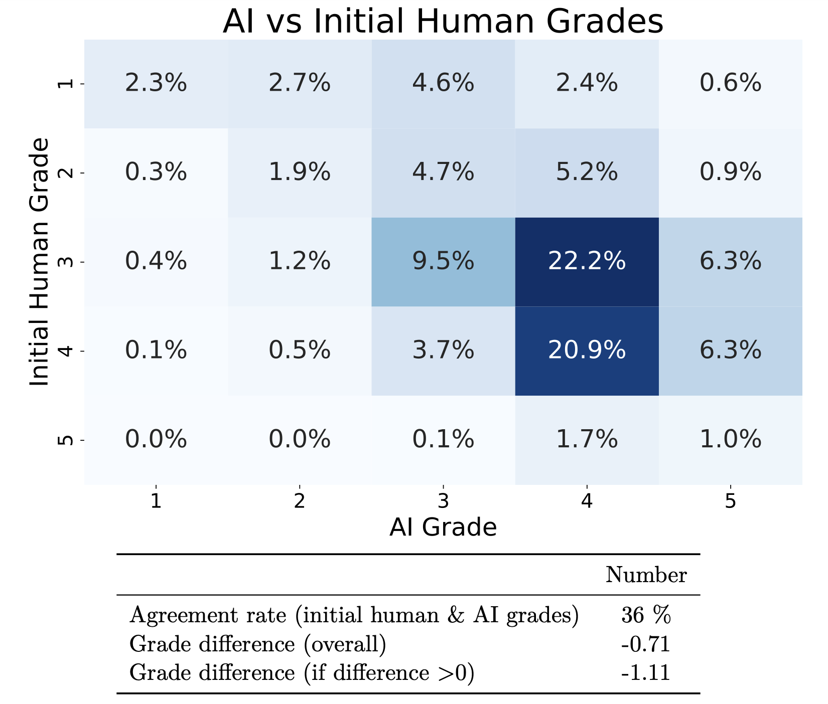
Agreement Rates: human grades vs. AI grades

Slide 22
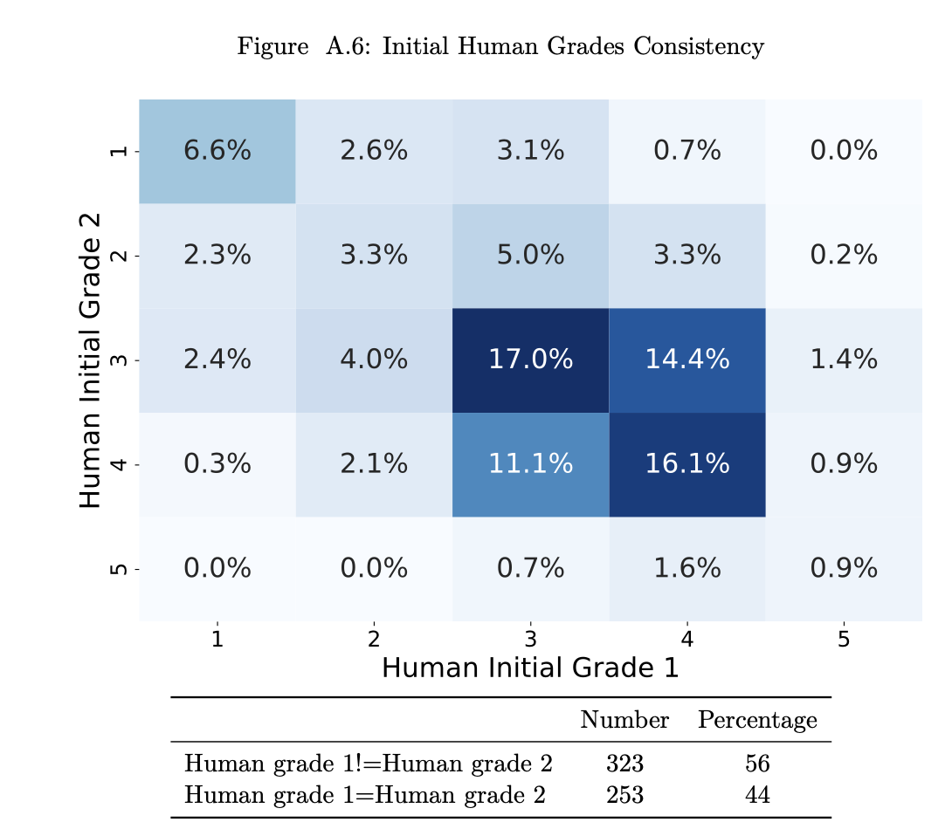
Agreement Rates: human vs. human grades

Slide 23
Main Results: The Policy Pipelines

Slide 24
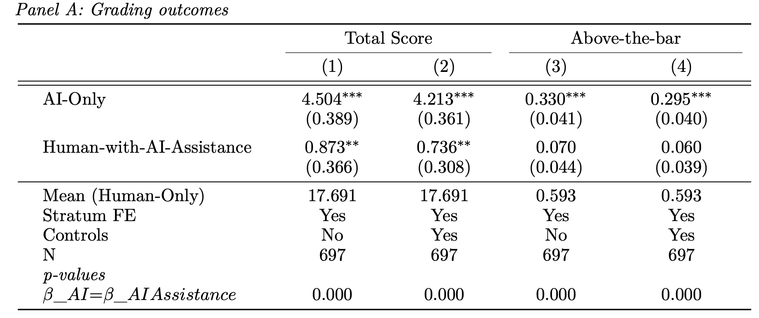
Effects on Grading

Slide 25
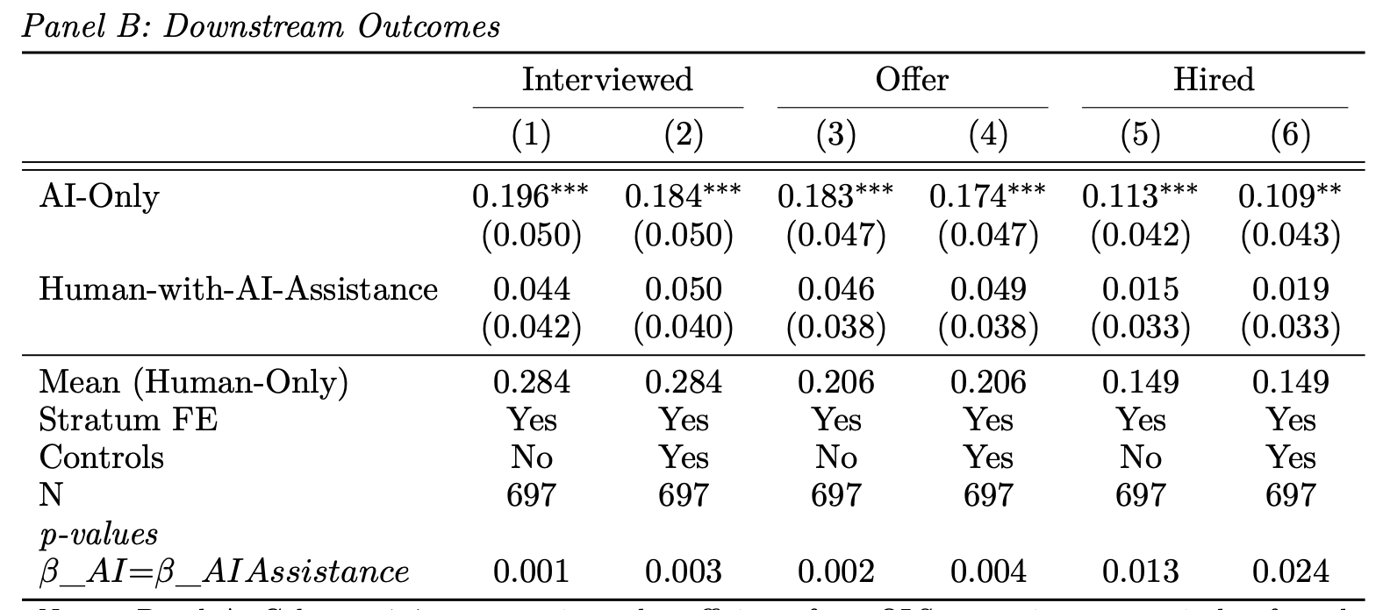
Effects on Downstream Outcomes

Slide 26
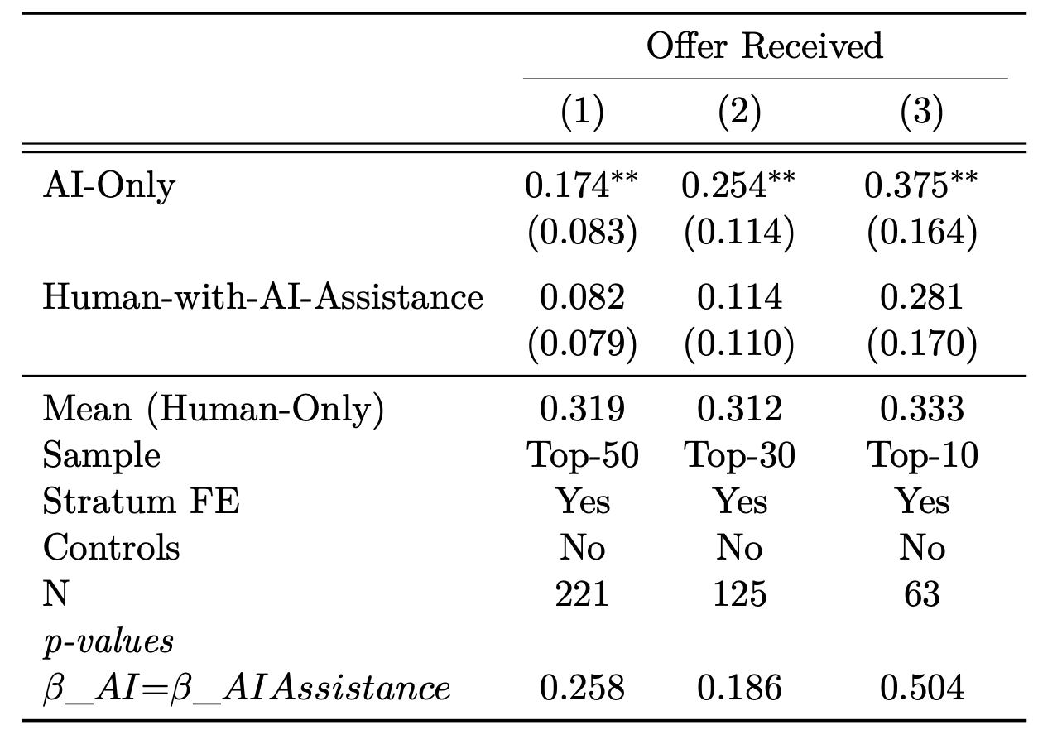
Effects on Downstream Hiring Outcomes

Slide 27
Mechanisms

Slide 28
Mechanisms
Why does AI-Only do better than Human-Only?
Why does AI-Assistance do no-better than Human-Only?

Slide 29
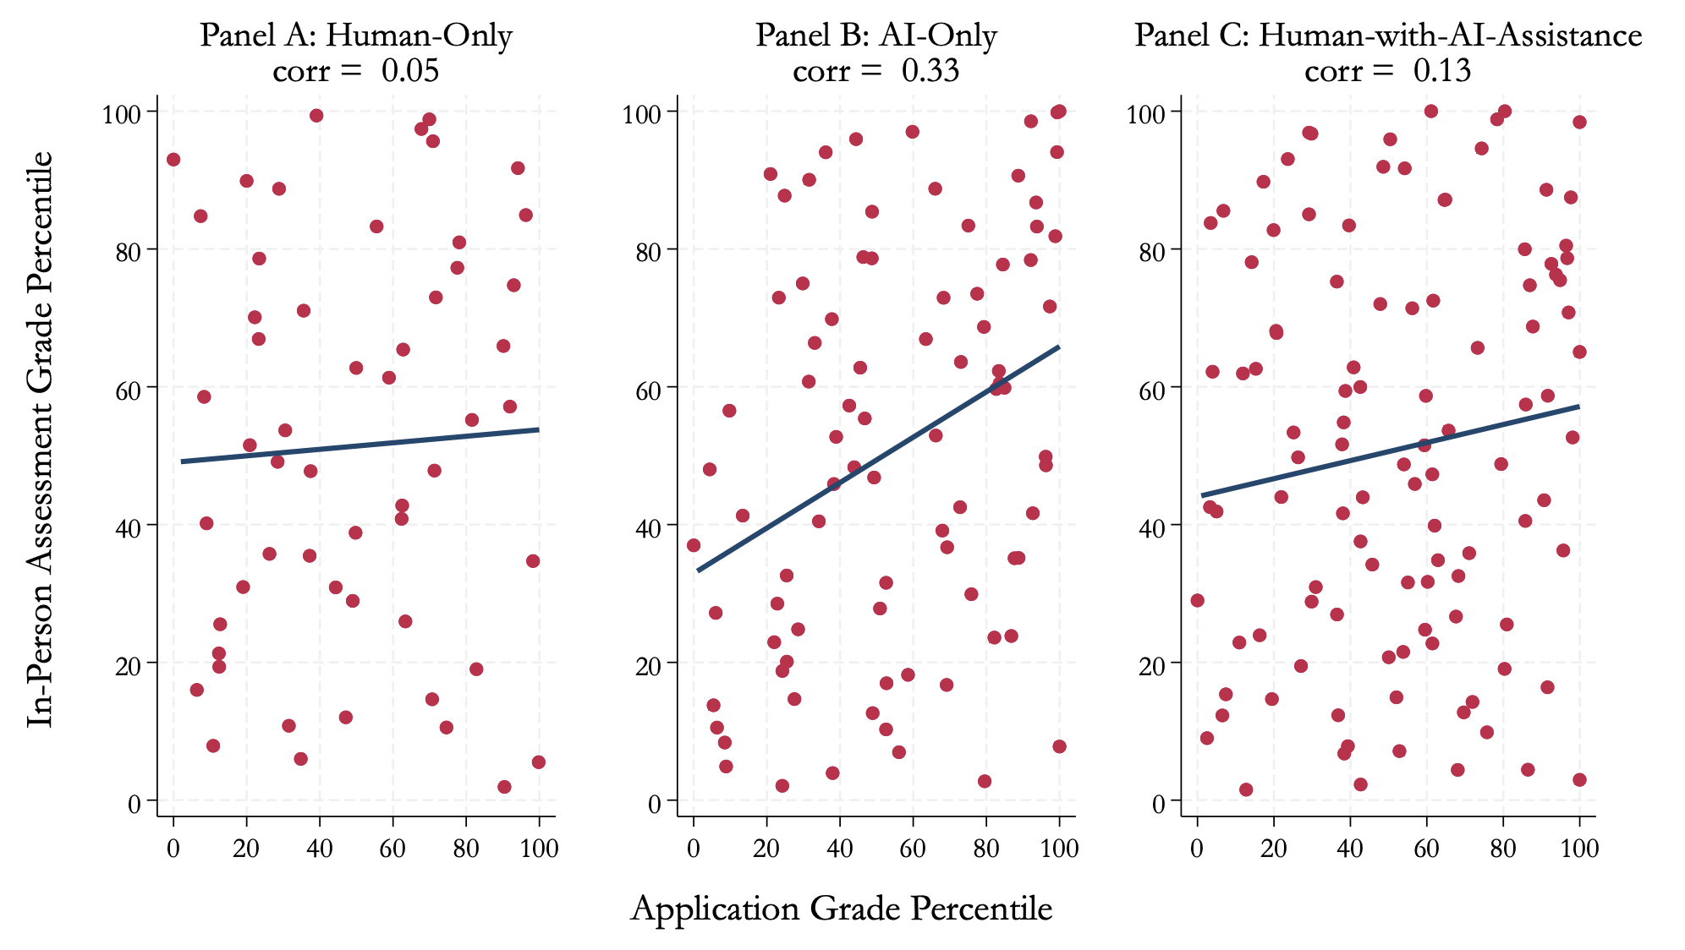
Mechanisms
Why does AI-Only do better than Human-Only? Higher “signal” in grade

Slide 30
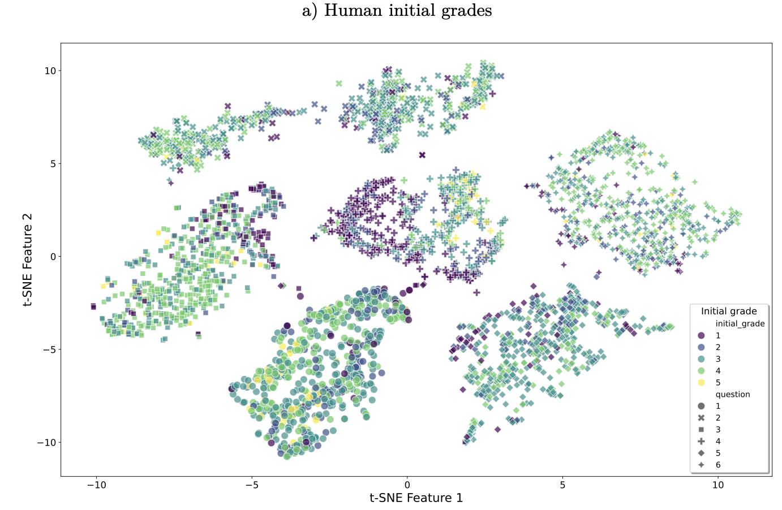
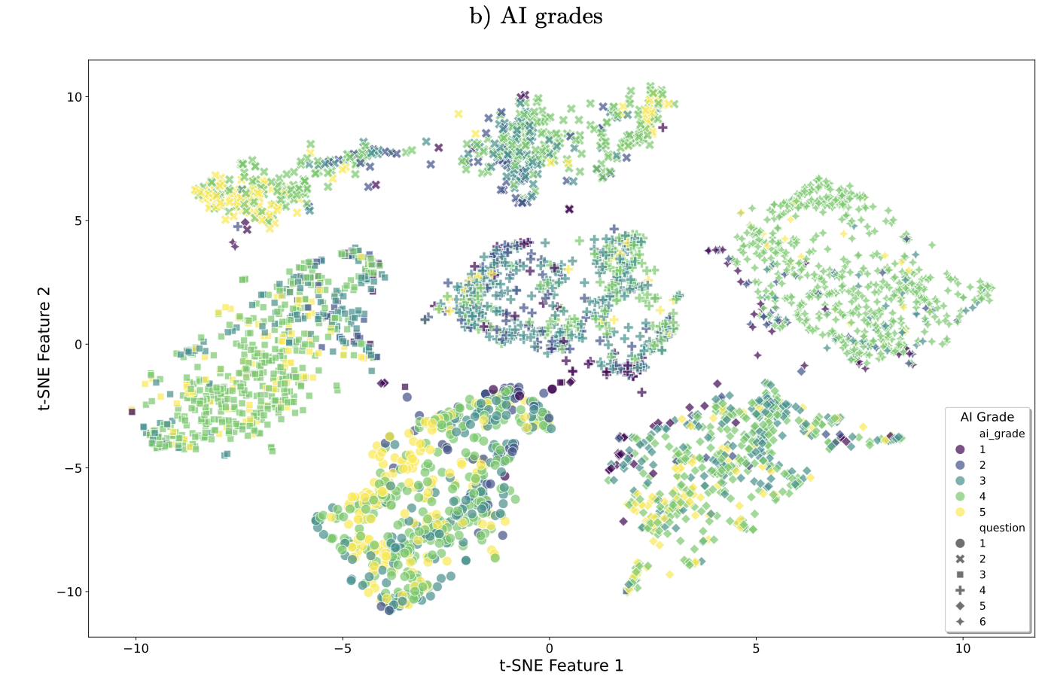
Mechanisms
Why does AI-Only do better than Human-Only? Higher “signal” in grade
Train a RF classifier on the answer text embeddings to predict grade->
Out of sample accuracy higher with AI grades (0.6) than with human grades (0.5)

Slide 31
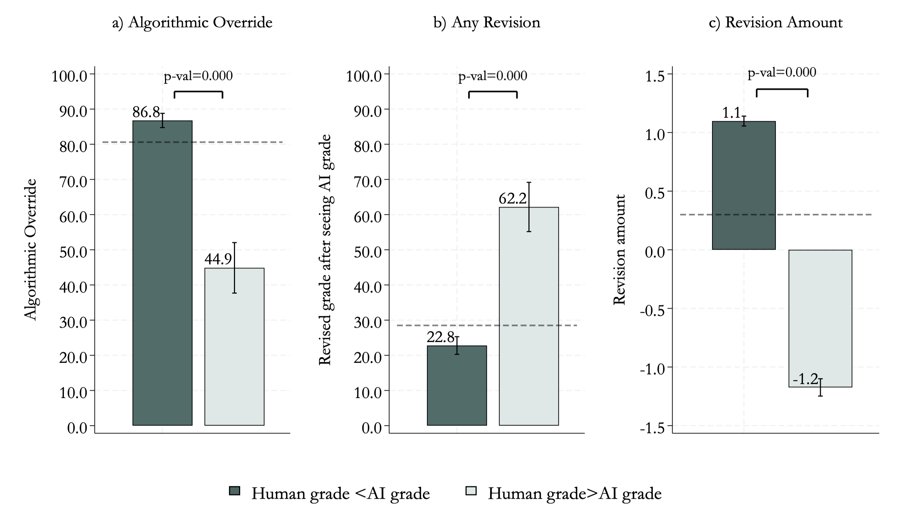
Mechanisms
2. Why does AI-Assistance do no-better than Human-Only? a) low compliance

Slide 32
Mechanisms
2. Why does AI-Assistance do no-better than Human-Only? b) Humans discount LLM-written essays and overwrite the algorithm more when grading LLM-essays->translates into downstream outcomes

Slide 33
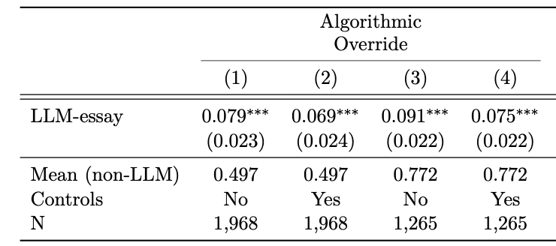
Mechanisms
2. Why does AI-Assistance do no-better than Human-Only? b) Humans discount LLM-written essays and overwrite the algorithm more when grading LLM-essays->translates into downstream outcomes

Slide 34
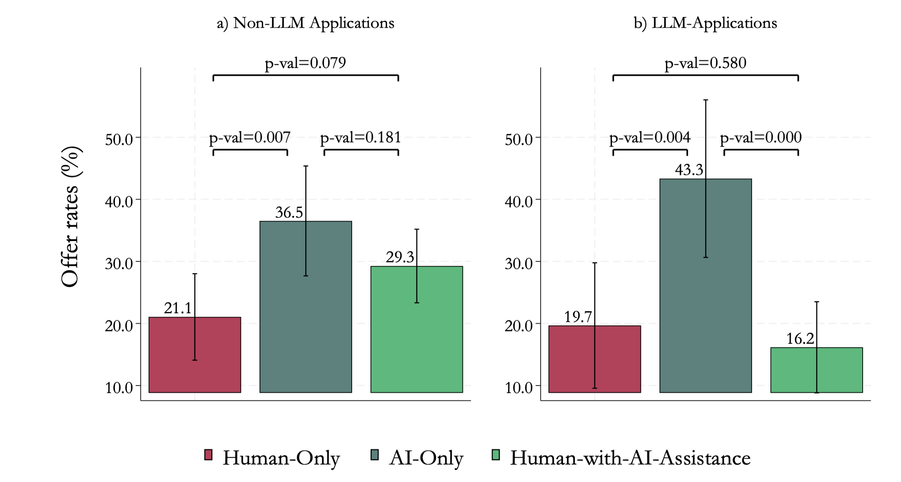
Mechanisms
2. Why does AI-Assistance do no-better than Human-Only? b) Humans discount LLM-written essays and overwrite the algorithm more when grading LLM-essays->translates into downstream outcomes

Slide 35
Conclusion
We provide evidence from a real labor market on the relative effectiveness of the three policy-relevant pipelines-> Automation is, at least in this context superior
Evidence that AI usage on the supply side may affect decision-making on the demand-side
We study this phenomenon in the early days – over time markets might adjust

Slide 36
Thank You!

