Slide 1



From Human Counselors to AI Agents: Preliminary Results from a Large-Scale RCT Scaling Career Guidance in Chile using AI
Gregory Elacqua
IDB | education division
Nicolas Ajzenman, Ana Teresa Del Toro Mijares, Gregory Elacqua,
Catalina Hermosilla, Santiago Veleda

Slide 2




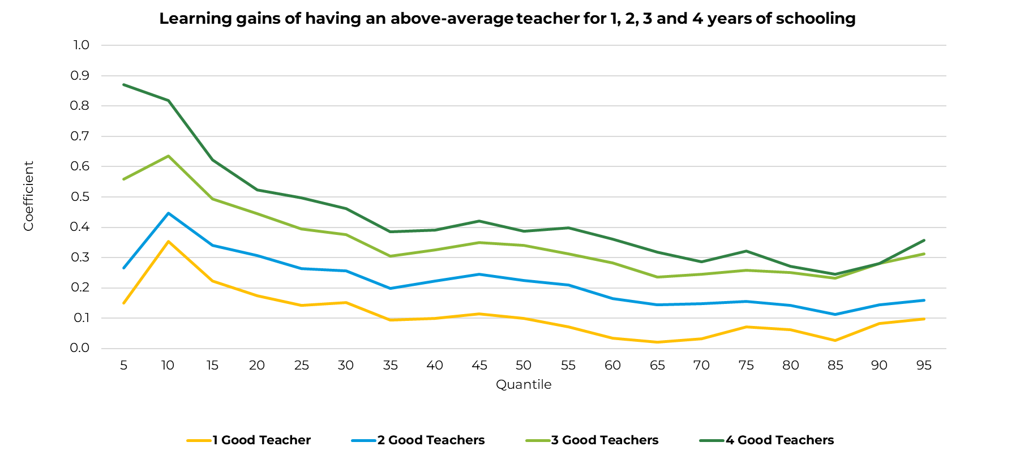





Education landscape in LAC
ENROLLMENT GAINS X LOW PERFORMANCE
LEARNING INEQUALITIES
TEACHERS
Despite enrollment gains in LAC, quality lags significantly
Learning inequalities persist both between and within countries
Evidence shows that closing the learning gap is possible and it relies on having a good teacher
ENROLLMENT
% LOW PERFORMING IN MATH
94%
56%
73%
92%
78%
PRIMARY
SECONDARY
% LOW PERFORMING IN MATH
92%
55%
POOREST QUNTILE
WEALTHIEST QUNTILE
75%
LAC AVERAGE
30%
OECD AVERAGE

Slide 3


Two major challenges that stand in the way
TEACHER SHORTAGE
LOW PRESTIGE PROFESSION
Notes:
.

Slide 4

+3.2
million teachers
by 2030 to meet the SDG Goal #4
58%
CHALLENGE
due to retirement
01
Teacher shortage
  Growing high school enrollments
Chile faces a projected teacher shortage of 33,000 by 2030

Slide 5
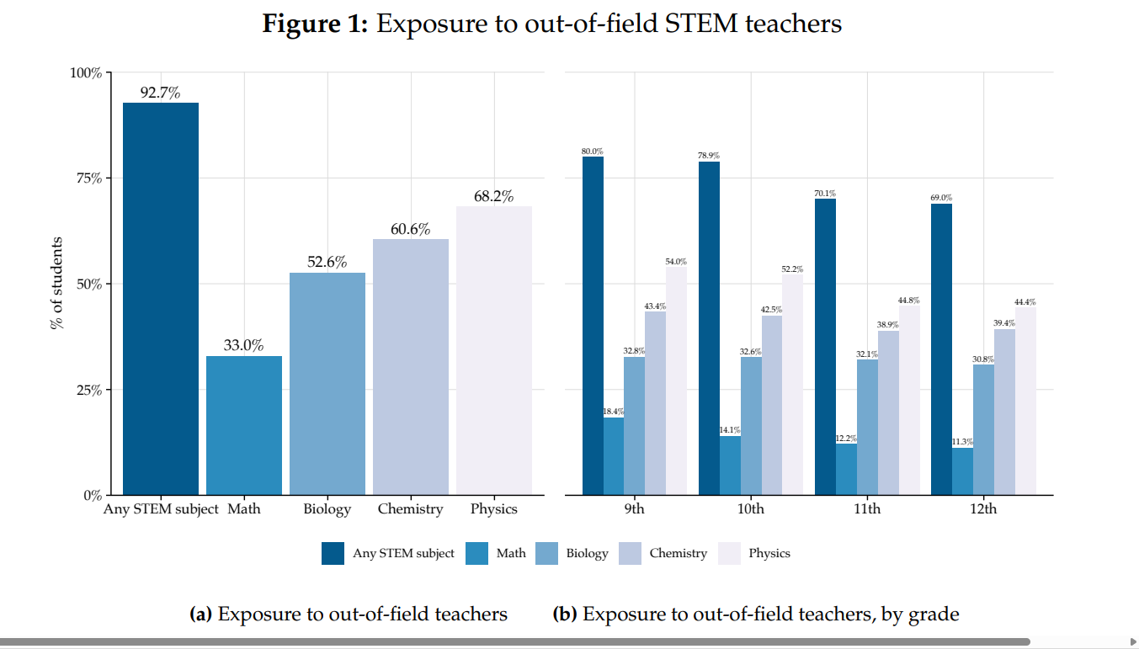
…The teacher shortage is most acute in specific subject areas
93% - Any STEM
17% - Spanish, History
CHALLENGE
01
Teacher shortage
IMPACT OF OUT-OF-FIELD TEACHERS
Less likely to take college entrance exams, enroll in college, and pursue STEM degrees
Source: Aburto, Elacqua, and Kutscher, forthcoming

Slide 6

In LAC, the teaching profession struggles to attract the best high school candidates
Chile
Colombia
Brazil
Highest scores
MEDICINE
MEDICINE
MEDICINE
CHALLENGE
LAW
02
ENGINEERING
ENGINEERING
LAW
LAW
ENGINEERING
JOURNALISM
JOURNALISM
NURSING
Prestige of the teaching profession
NURSING
PSYCHOLOGY
PSYCHOLOGY
PSYCHOLOGY
NURSING
JOURNALISM
Lowest scores
EDUCATION
EDUCATION
EDUCATION
Source: ELACQUA et al. (2022) Who studies pedagogy? Trends in the profile of future teachers in Latin America & the Caribbean . Brazil: Enem minimum scores for SISU policy.

Slide 7
How to attract more and better candidates into teaching?
TWO APPROACHES IN CHILE:
Scholarships
Career counseling

Slide 8
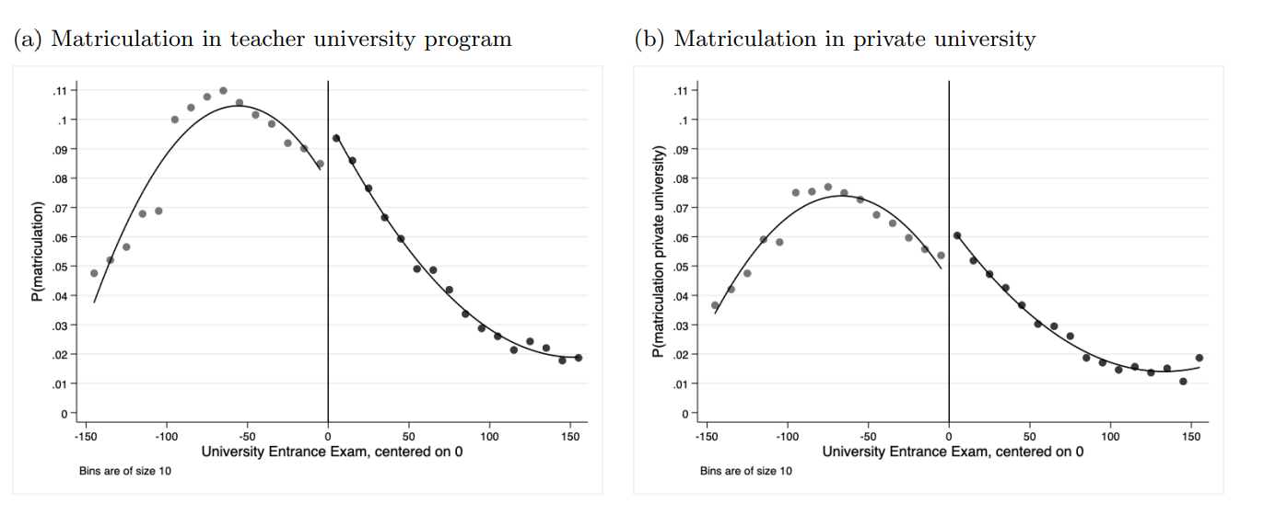


Chile’s “Beca Vocación Profesor” scholarship program increases recruitment and attainment but strains budgets
RD Analysis: Effect of Chile’s BVP on matriculation into teacher education programs
(at program eligibility cutoff threshold)
BECA VOCACIÓN PROFESOR PROGRAM
US$ 37,672
cost per new teacher
+2 p.p.
increase in enrollment in education majors
+2 p.p.
increase in graduation rates
Multiple countries in the region and globally use scholarships
Mais Professores (Brazil)
Beca Vocación de Maestro (Peru)
Free Teacher Education Policy (FTEP) (China)
Source: Perez-Nunez, 2020.

Slide 9
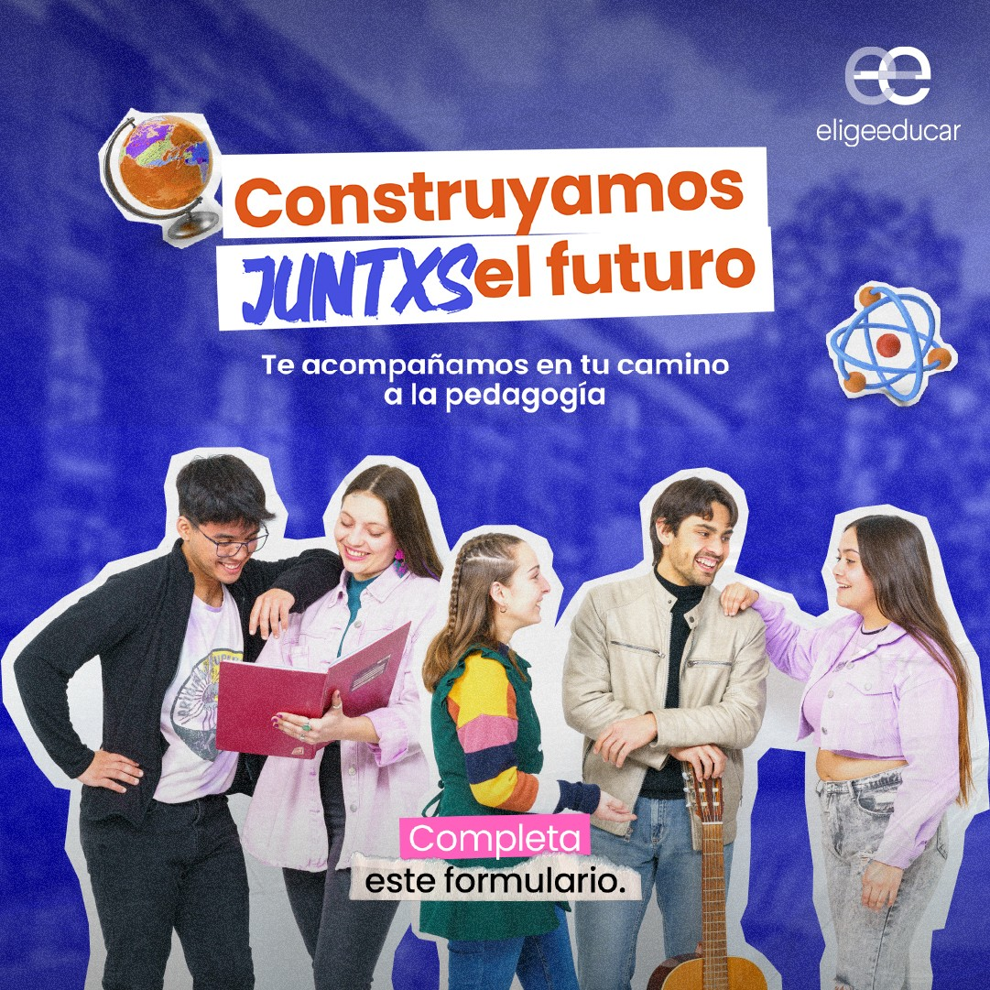







“Quiero Ser Profe” – Education career counseling in Chile
GOAL
SOLUTION
METHODOLOGY
RESULTS
Increase enrollments and quality of applicants in college teaching programs
Personalized career counseling via WhatsApp connects high school students with trained counselors (2010)
High school students paired with counselors who:
Descriptive evidence: Students more likely to consider education majors
No causal evidence. Hard to scale. In 2019, the program reached 3,000-4,000 students (<10%) due to
limited availability of counselors and high costs
Help students identify their interest in teaching
Provide practical information about the profession and application processes for teaching programs
Motivate students to apply to teaching-focused college majors

Slide 10







Five scaling challenges in human-intensive education interventions like QSP
Human capital constraints
Dosage reduction
Implementation fidelity
Data utilization
Cost & sustainability
Too few expert counselors; limited recruitment/training capacity
Support becomes less frequent or intensive when programs expand
Quality drops at scale due to inconsistent delivery across counselors and contexts
Humans cannot process or track large volumes of data, which makes it difficult to personalize support
High marginal cost – each additional counselor; few economies of scale
SCALING
BARRIER
AI solutions directly address the five key scaling barriers
AI extends expert knowledge to many
High-frequency, on-demand support 24/7
Standardized delivery of best practices with high fidelity in every interaction.
AI analyzes data at scale to generate timely, personalized feedback
Low marginal cost after development; highly scalable
AI POTENTIAL

Slide 11


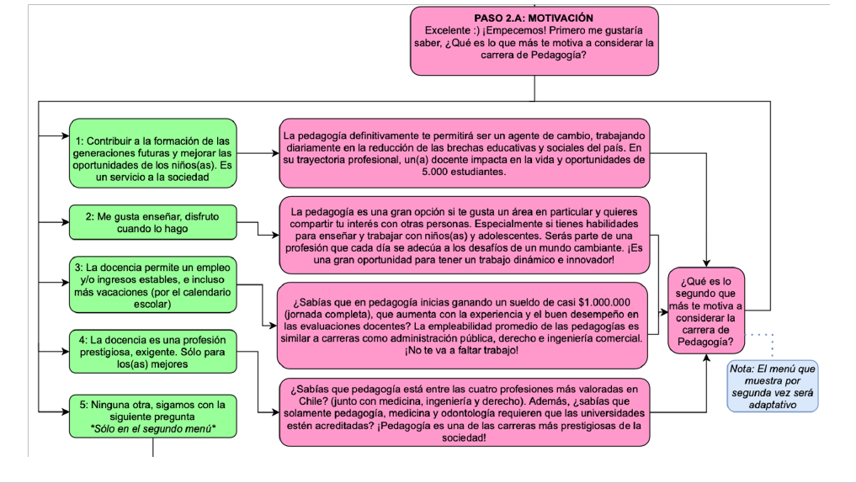
First attempt at scaling "Quiero Ser Profe": Scripted chatbot – RCT (2021)
GOAL
Fully scripted button-based chatbot
Evaluate program and support its expansion to reach more students
Pre-defined scripts and branching scenarios. Students can only respond by selecting from pre-defined options rather than using free-form natural language
SOLUTION
Scripted button-based chatbot to provide counseling support through WhatsApp with similar script to that of the mentor.
        RCT with N=40,813
        Evaluation with expanded human arm
        Group 1: Human counseling (N=8,161)
        Group 2: Scripted chatbot (N=16,326)
        Group 3: Control (N=16,326)
Source: Ajzenman et al, forthcoming. JPE – Microeconomics.

Slide 12
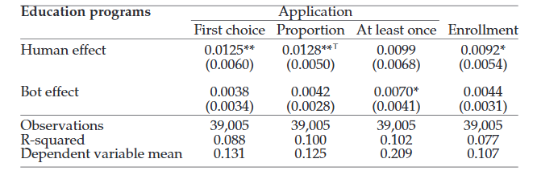
"Quiero Ser Profe" scripted chatbot RCT: Results
Fully scripted button-based chatbot was successful in expanding reach (scale) of program to 16,000+ students at a low cost
        Group 1: Human counseling (N=8,161)
        Group 2: Scripted chatbot (N=16,326)
POSITIVE AND SIGNIFICANT RESULTS
POSITIVE AND NON-SIGNIFICANT RESULTS
Preferences and enrollment in education programs
+1.25 p.p.
increase in probability of ranking an education major first, increase of 9.5% compared to baseline of 13.1%
+0.38 p.p.
increase in probability of ranking an education major first,
only 1/3
of the effect of the human arm
Unable to tailor content to the needs of the student, ultimately leading to lower engagement levels
Notes: All regressions control for gender, high school characteristics (public, private-subsidized, or private), a dummy indicating if the student was initially interested in education or social sciences, and a top 30% high school GPA dummy. ᵀ means that a point estimate is significant at the 5% level when applying Holm (1979)’s correction for multiple hypotheses. Robust standard errors in parentheses. *** p<0.01, ** p<0.05, * p<0.1.
Source: Ajzenman et al, forthcoming. JPE – Microeconomics.

Slide 13

How can AI help increase the scale and impact of Quiero Ser Profe?
Hi, I'm Kai
AI-powered chatbot to provide career counseling to high school students, to motivate them to pursue a teaching career.

Slide 14

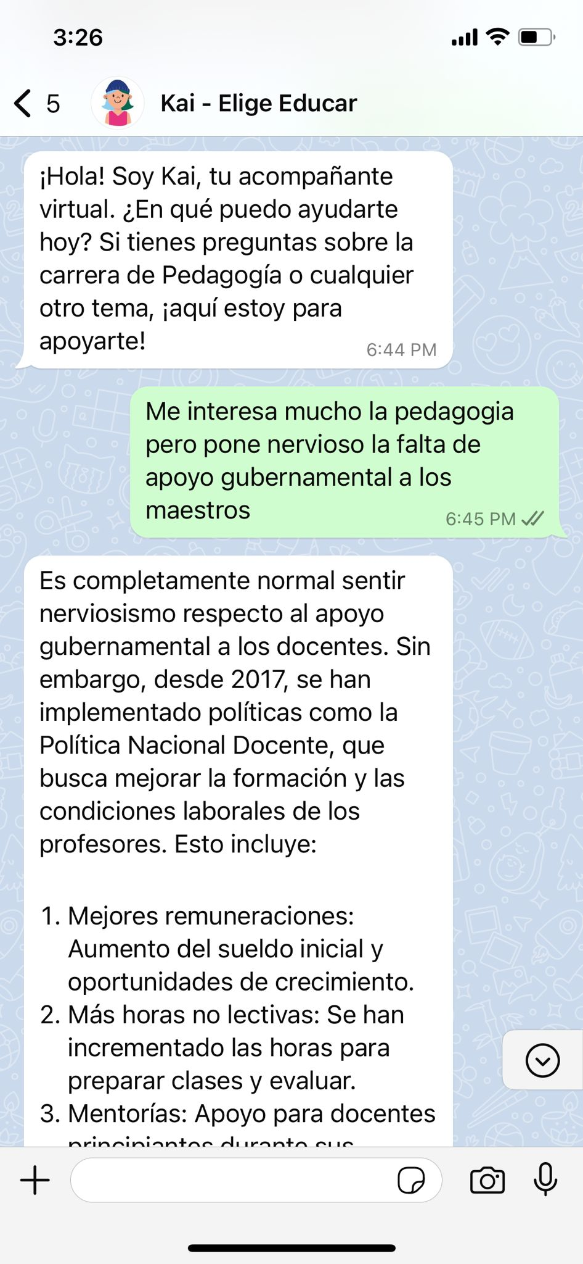
Kai: AI-powered education career counseling to increase teacher recruitment
GOAL
Support the expansion of program to reach more students and increase engagement.
SOLUTION
Smart virtual assistant that more closely mimics the human career counselor.
Kai starts by contacting the student a few weeks before the university application period, to offer career mentorship through WhatsApp
CONTACT
Kai seeks to provide information about why to consider a teaching career and how to apply to a pedagogy major, answering any questions or doubts the student may have about this choice
INFORMATION
INTERACTION
The student can interact with Kai through natural language, in a fluid, interactive and dynamic conversation
Kai is available 24/7 until the deadline during the application process to answer any questions or talk through any issues the student may have
Developed and trained on a content bank of Elige Educar’s “Quiero Ser Profe" program
AVAILABILITY

Slide 15
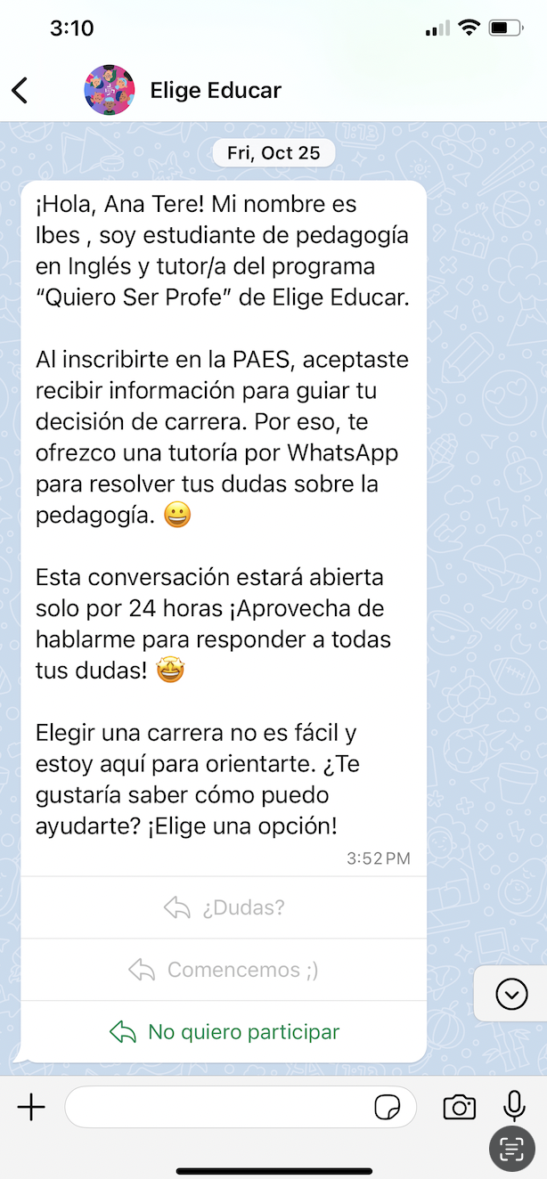
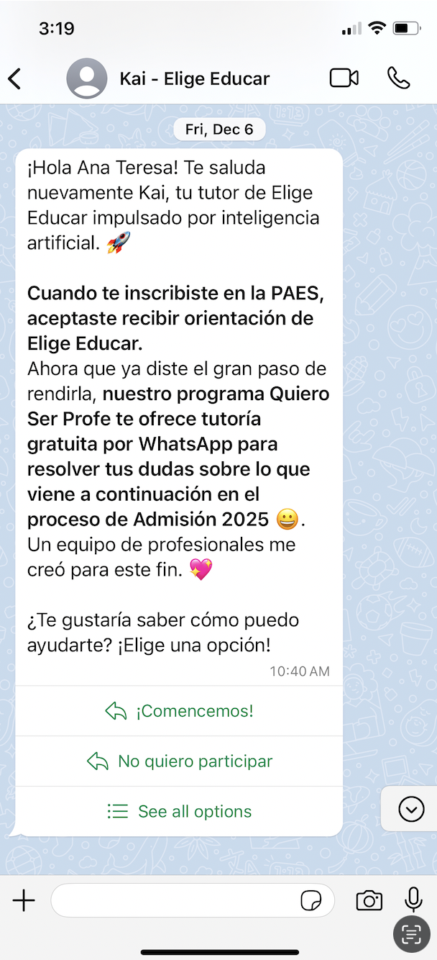


“Quiero Ser Profe” human counselors and “Kai” AI-powered chatbot - RCT (2024-25)
        Group 1: Human counseling, via WhatsApp (N=9,000)
        Group 2: Kai counseling, via WhatsApp (N=20,000)
        Group 3: Control (N=14,539)
Conducted during the 2025 University Admission Process (October 2024 – January 2025).
43,539 high school students
who indicated interest in education or social science careers

Slide 16





Kai: Initial results - Summary data
        Group 1: Human counseling, via WhatsApp (N=9,000)
        Group 2: Kai counseling, via WhatsApp (N=20,000)
MESSAGES
28.1%
RESPONSE RATE
5.93
STUDENT MESSAGES ON AVERAGE PER CHAT
35.2%
RESPONSE RATE
3.74
STUDENT MESSAGES ON AVERAGE PER CHAT
lower engagement cost?
31.6%
STUDENTS WHO ENGAGE + SEND ONLY 1 MESSAGE
35.4%
STUDENTS WHO ENGAGE + SEND 6+ MESSAGES
40.7%
STUDENTS WHO ENGAGE + SEND ONLY 1 MESSAGE
17.9%
STUDENTS WHO ENGAGE + SEND 6+ MESSAGES
ENGAGEMENT
2.41 hours
LENGTH OF CONVERSATION
97%
SATISFACTION WITH COUNSELOR
0.34 hours
LENGTH OF CONVERSATION
75%
SATISFACTION WITH MENTOR
INTERACTION

Slide 17
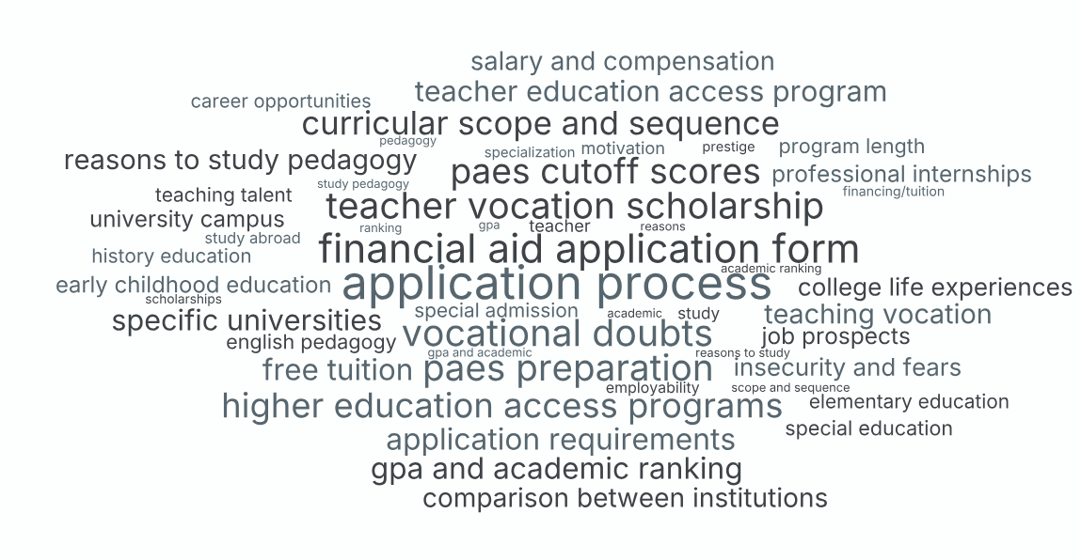
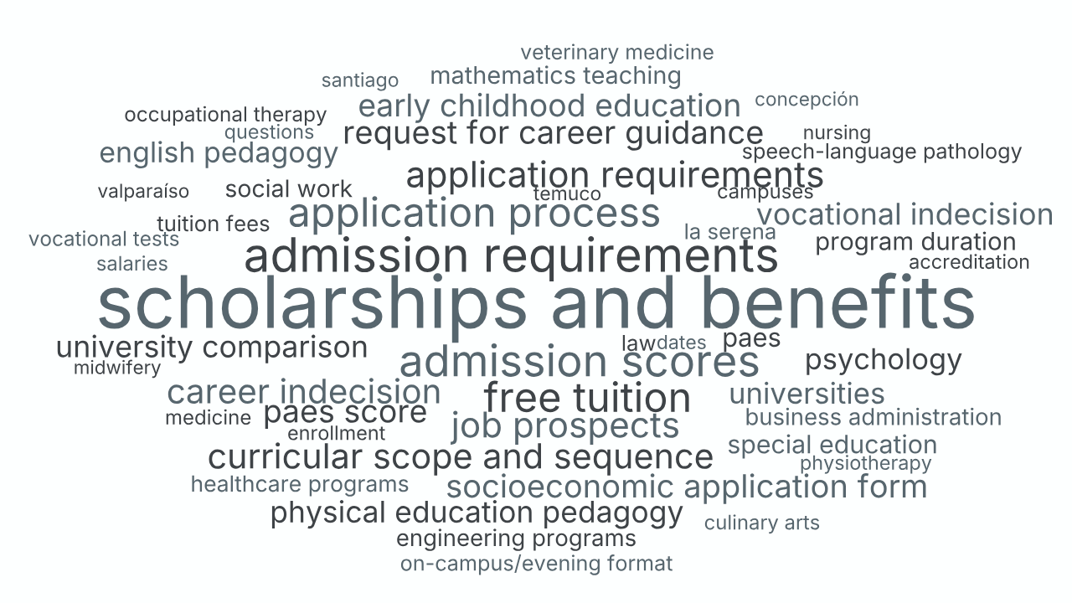


Kai: Initial results – Divergent conversation topics
        Group 1: Human counseling, via WhatsApp
        (N=9,000)
        Group 2: Kai counseling, via WhatsApp
        (N=20,000)
1st Application process
2nd Vocational doubts
3rd Scholarships
4th PAES preparation
5th PAES cutoff scores
1st Scholarships and benefits
2nd Admission requirements
3rd Admission scores
4th Free tuition
5th Application process

Slide 18
Kai: Initial results – Sampling of initial queries and communication styles
        Group 1: Human counseling, via WhatsApp
        (N=9,000)
        Group 2: Kai counseling, via WhatsApp
        (N=20,000)
En qué universidad estudiaste?
Students tend to ask Kai very concrete fact-based queries
Universidades en la localidad de los ángeles y cuanto es el puntaje de corte en cada una de ellas
Students often ask human counselors about their personal experiences and backgrounds
Como fue su experiencia durante la universidad correspondiente a su carrera?
Cual es la mejor universidad? Que tal la usach y que puntaje necesito
Students seem to bring up anxieties and concerns more with the human counselor, than with Kai
Realmente estoy bien ansioso de la prueba, especialmente la parte de mate, siento que me voy a bloquear
Quiero saber como prepararme en este ultimo mes para la prueba de lenguaje, matemáticas e historia
Students tend to use more acronyms and emojis with the human counselor, than with Kai
No sé si me puedas aiudar mucho en esto NWKDKWKDK 🧍‍♀es qe estoy como en una gran duda sobre pedagogía en enseñanza básica o pedagogía en historia 🦆 KSKSKS
Me gustaría saber más sobre la carrera de pedagogía en historia

Slide 19

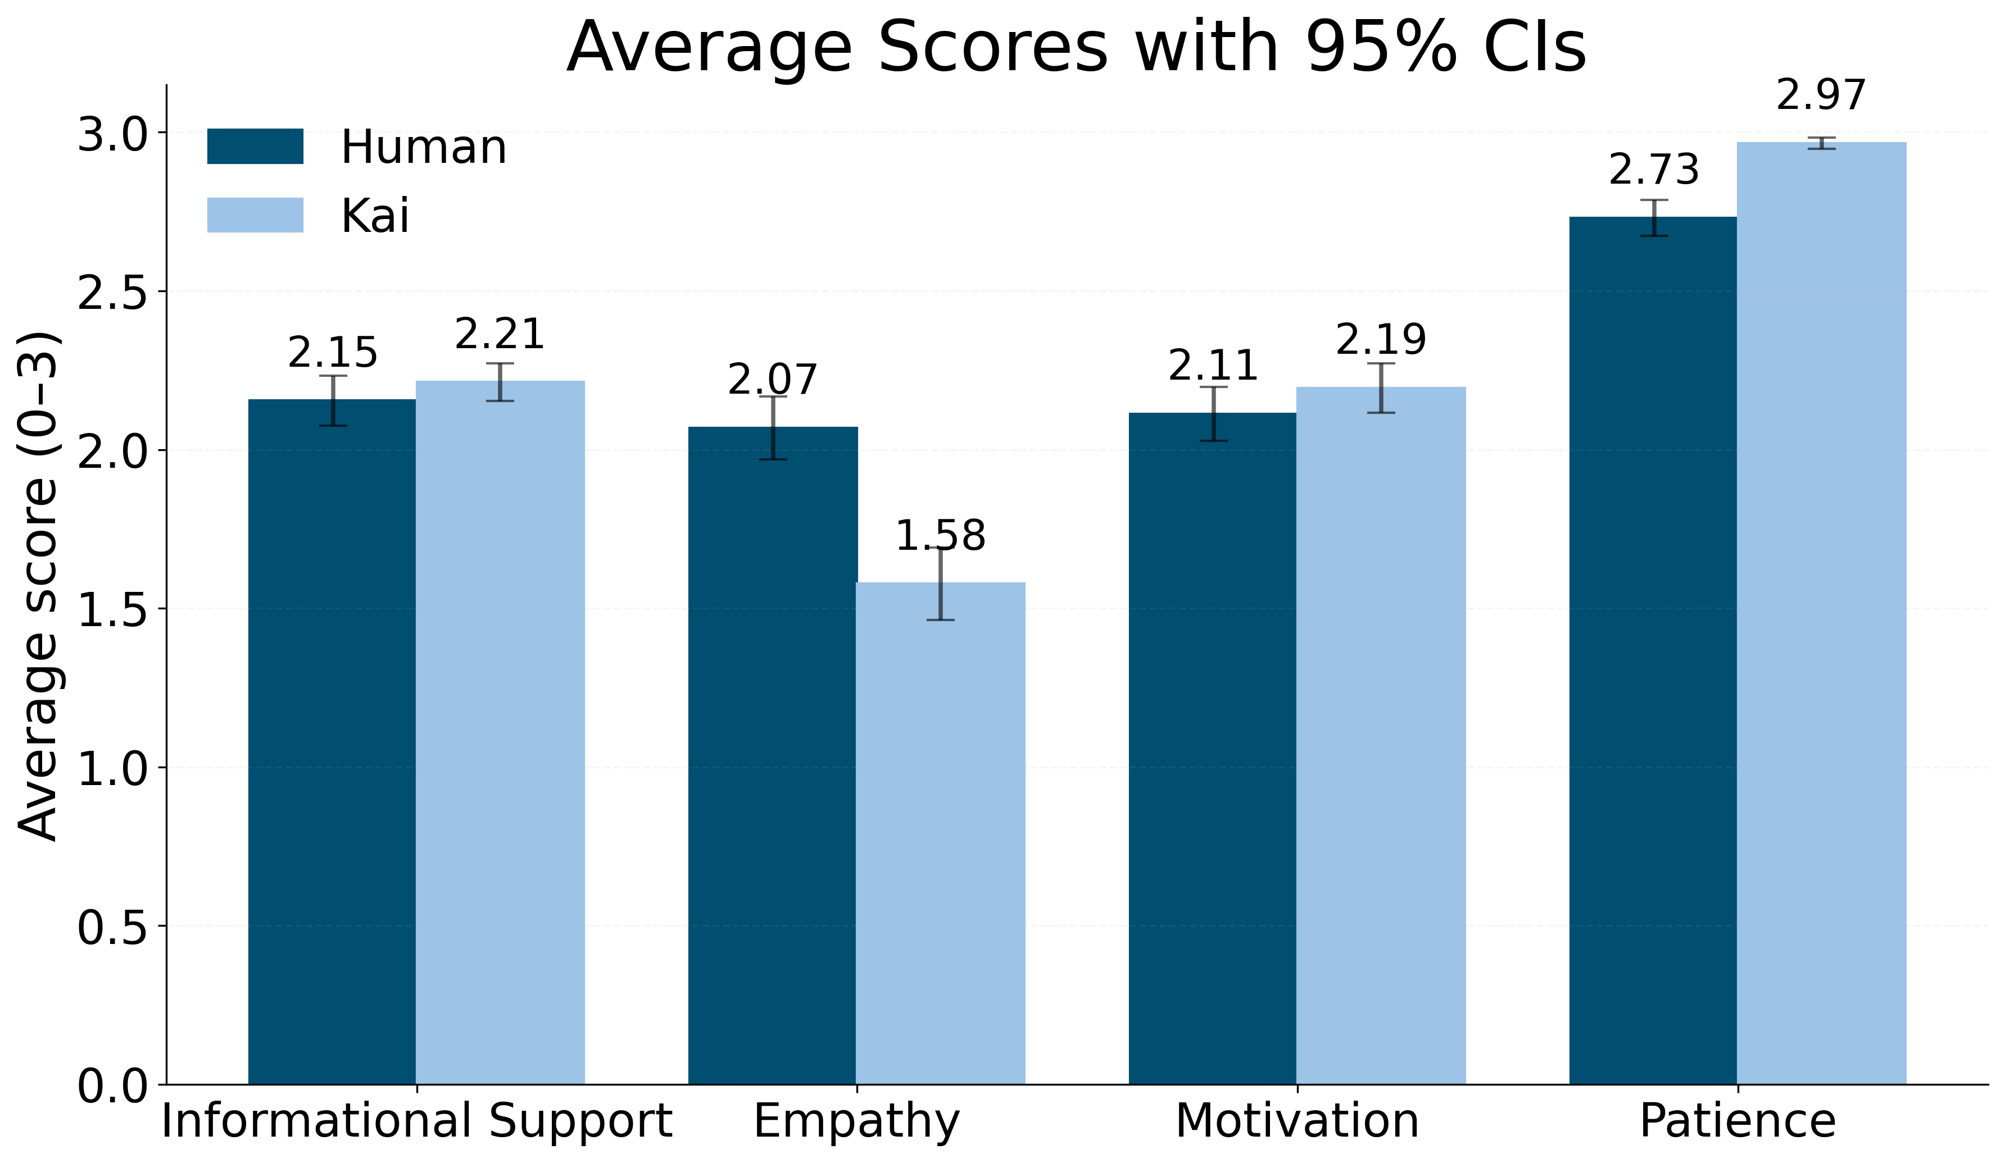
Kai: Comparing counseling across four dimensions (rated 1,000 conversations)
Empathy
Patience

Slide 20


Human vs. AI mentors: Complementary strengths
HUMAN COUNSELORS
AI COUNSELORS
Empathy, emotional support, and encouragement
24/7 availability and instant responses to queries, with lower initial engagement costs that can reduce access gaps
Deeper contextual understanding of the high school student situation
Memory of and access to vast knowledge base; can analyze large data (e.g., university rankings) quickly for objective patterns
Share personal experience and background to build rapport, trust and credibility
Builds credibility through data and consistency
Ability to tailor and improvise strategies when something isn’t working
Consistent application of protocols and rubrics (no variation in quality), pre-tested messages
Expertise to handle complex, novel, or sensitive challenges (e.g., anxiety)
24/7 availability amplifies scope of potential support

Slide 21
Kai: Evaluation underway to assess impact
        What outcome indicators are we capturing?
        (Fall 2025)
        We will also continue to analyze engagement and interaction metrics with Kai and human counselors
Major choice (teaching vs. others)
Response rates
Preference ranking
Number of messages, words, and response times
Major Assignment
Length and duration of conversations
Types of queries
Language analysis (conversations)

Slide 22
Final reflections: Realizing the potential of AI career counseling tools
Key inputs and user experience
Looking ahead: The potential of emerging AI capabilities
General LLM foundation augmented with curated content repository that captures a documented, structured methodology (e.g., counselor protocols, validated pedagogical frameworks, etc.).
User experience matters: How the tools are introduced, accessed, and facilitated shapes adoption and sustained use –reminders/nudges.
Expand the scope of support—such as targeting critical shortage areas like STEM and ECD
Voice-based bots and avatars could offer more natural, emotionally resonant engagement
Emotion-sensitive and adaptive AI may better triage when human counselors should step in
These advances can help bridge the gap between scale and depth

Slide 23
From Human Counselors to AI Agents: Preliminary Results from a Large-Scale RCT Scaling Career Guidance in Chile using AI
Gregory Elacqua
IDB | education division
Nicolas Ajzenman, Ana Teresa Del Toro Mijares, Gregory Elacqua,
Catalina Hermosilla, Santiago Veleda

