Slide 1
Comments to
“Does countercyclical fiscal policy pay?
The relevance of fiscal acyclicality”
Authors: Rodrigo Fuentes and Raimundo Soto
Comments: Guillermo Vuletin

Slide 2
Literature review

Slide 3
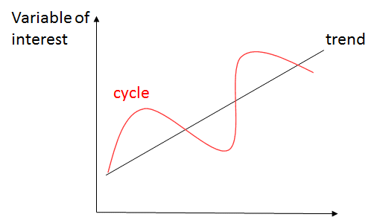
Literature review
Large macroeconomic literature studying how short-term fluctuations in public spending (and taxes) could help stabilize output, increasing people’s welfare.
Evaluate the second order impact on growth (via reduction in output volatility).
No causal relation with debt sustainability (more to come later).
How to operationalize the fiscal policy cyclicality stance?
1. Calculate the cyclical component of variables of interest (e.g., G and GDP):
2. Estimate relationship between cycle of G and cycle of GDP.
time

Slide 4
Literature review
Main findings. Example, looking at “big G” in two usual suspects:
Sweden Argentina

Slide 5
Literature review
Main findings. Example, looking at “big G” in two usual suspects:
Sweden Argentina
negative correlation (counter-cyclical)

Slide 6
Literature review
Main findings. Example, looking at “big G” in two usual suspects:
Sweden Argentina
negative correlation (counter-cyclical) positive correlation (pro-cyclical)

Slide 7
Literature review
Main findings. Example, looking at “big G” in two usual suspects:
Sweden Argentina
negative correlation (counter-cyclical) positive correlation (pro-cyclical)
a-cyclicality

Slide 8
Literature review
Main findings. Example, looking at “big G” in two usual suspects:
Sweden Argentina
negative correlation (counter-cyclical) positive correlation (pro-cyclical)
a-cyclicality
What does a-cyclicality mean?
No systematic relationship between cycle of G and cycle of GDP
Cycle of G
0
Cycle of GDP
time

Slide 9
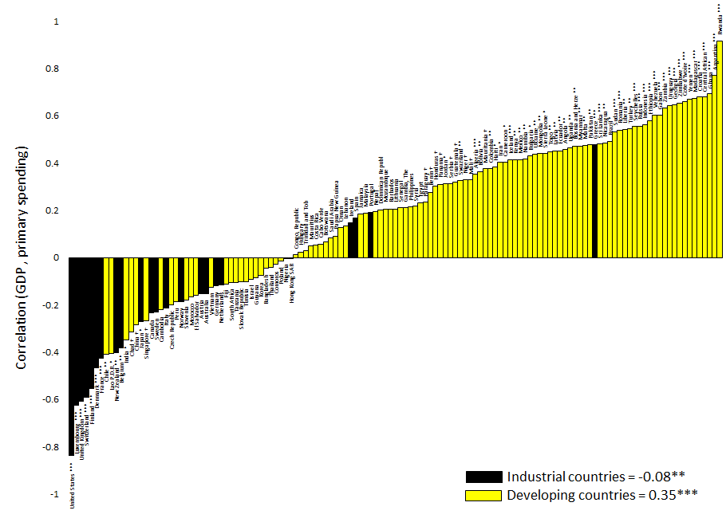
Literature review
Main findings. Strong empirical regularity. Example using G for period 1960-1999
Pro-cyclical
Counter-cyclical
→ counter-cyclical
→ pro-cyclical
Update from Frankel, Vegh and Vuletin, (2013), “On graduation from fiscal procyclicality,” JDE

Slide 10
Literature review
Main findings. Strong empirical regularity. Example using G for period 1960-1999
Caveat: We also use very serious analysis including panel regressions controlling for possible endogeneity (using IV approach)
Pro-cyclical
Counter-cyclical
→ counter-cyclical
→ pro-cyclical
Update from Frankel, Vegh and Vuletin, (2013), “On graduation from fiscal procyclicality,” JDE

Slide 11
Literature review
Main findings. Strong empirical regularity. Example using G for period 1960-1999
Pro-cyclical
Counter-cyclical
→ counter-cyclical
→ pro-cyclical
Update from Frankel, Vegh and Vuletin, (2013), “On graduation from fiscal procyclicality,” JDE

Slide 12
Literature review
Main findings. Strong empirical regularity. Example using G for period 1960-1999
WTF?
Pro-cyclical
Counter-cyclical
→ counter-cyclical
→ pro-cyclical
Update from Frankel, Vegh and Vuletin, (2013), “On graduation from fiscal procyclicality,” JDE

Slide 13
Literature review
Main findings. Strong empirical regularity. Example using G for period 1960-1999
Where is The Failure?
WTF?
Pro-cyclical
Counter-cyclical
→ counter-cyclical
→ pro-cyclical
Update from Frankel, Vegh and Vuletin, (2013), “On graduation from fiscal procyclicality,” JDE

Slide 14
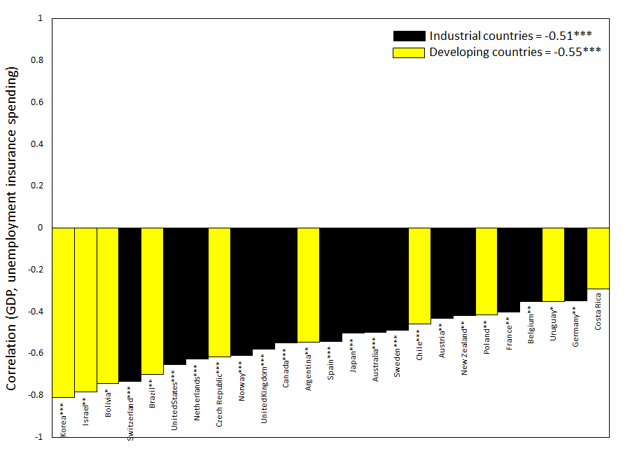
Literature review
Main drivers of counter-cyclicality
- Public investment: Classical Keynesian argument
- Automatic stabilizers like unemployment insurance (UI)
→ counter-cyclical
→ counter-cyclical
Galeano, Izquierdo, Puig, Vegh, and Vuletin, (2021), “Can automatic government spending be procyclical?,” R&R JMCB

Slide 15
Literature review
Main drivers of counter-cyclicality
- Public investment: Classical Keynesian argument
- Automatic stabilizers like unemployment insurance (UI)
→ counter-cyclical
→ counter-cyclical
Galeano, Izquierdo, Puig, Vegh, and Vuletin, (2021), “Can automatic government spending be procyclical?,” R&R JMCB

Slide 16
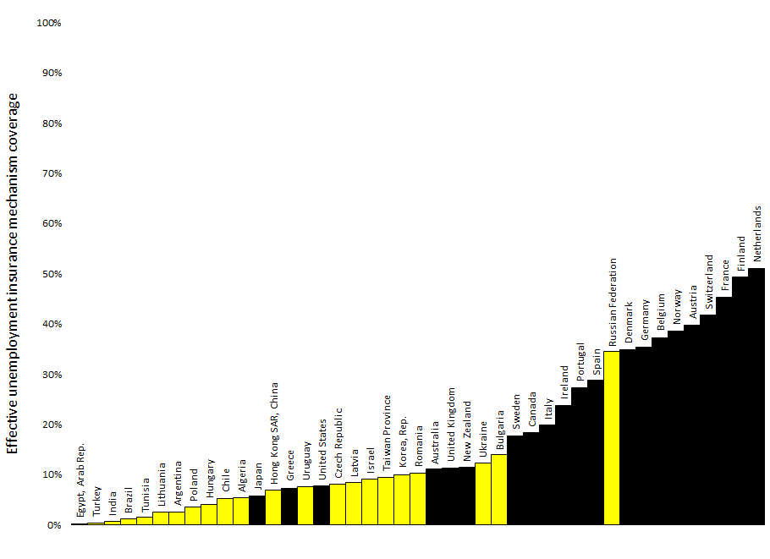
Literature review
Main drivers of counter-cyclicality
- Public investment: Classical Keynesian argument
- Automatic stabilizers like unemployment insurance (UI)
→ counter-cyclical
→ counter-cyclical
Effective coverage = Extensive margin (unemployed people covered by the unemployment insurance program) x Intensive margin (UI gross replacement rate)
Galeano, Izquierdo, Puig, Vegh, and Vuletin, (2021), “Can automatic government spending be procyclical?,” R&R JMCB

Slide 17
Literature review
Main drivers of Pro-cyclicality. WTF?
- Political distortions and weak institutions: Policymakers short-sightedness and
political pressure to spend when resources are available, among many other
varieties of political economy-based reasons, encourage “excessive public”
spending during boom periods, leaving few resources to spend in bad times.
- Limited access to international credit markets, particularly in bad times.
- Over-optimism in output forecasts
Gavin, Hausmann, Perotti, and Talvi (1996), Gavin and Perotti (1997), Velasco (1997), Tornell and
Lane (1999), Kaminsky, Reinhart, and Vegh (2004), Talvi and Vegh (2005), Alesina, Campante and
Tabellini (2008), Frankel (2011), Frankel, Vegh, and Vuletin (2013), Avellan and Vuletin (2015)

Slide 18
Literature review
Main findings regarding the impact of cyclicality of fiscal policy.
- Counter-cyclical fiscal policy reduces output volatility.

Slide 19
Literature review
Main findings regarding the impact of cyclicality of fiscal policy.
- Counter-cyclical fiscal policy reduces output volatility.
- Counter-cyclical fiscal policy increases growth (via reduction in output volatility).

Slide 20
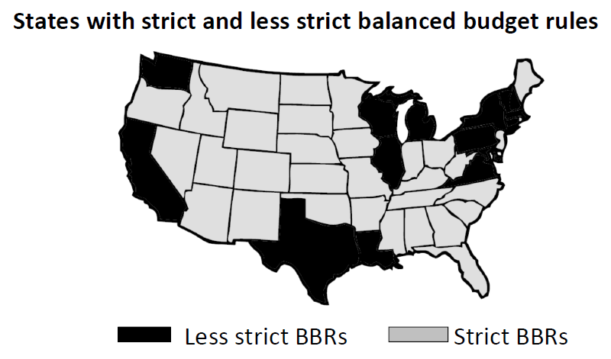
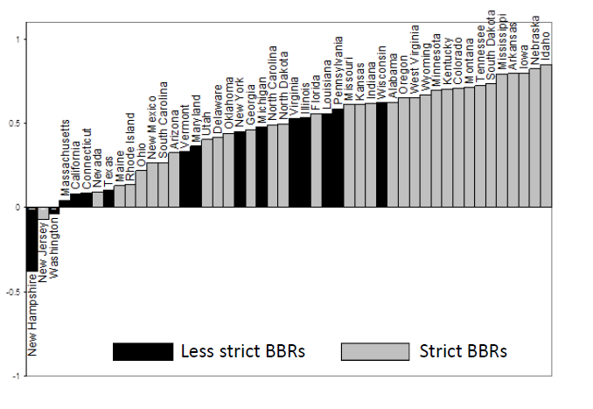
Literature review
Main findings regarding the impact of cyclicality of fiscal policy.
- Counter-cyclical fiscal policy reduces output volatility.
- Counter-cyclical fiscal policy increases growth (via reduction in output volatility).
- No causal relation with debt sustainability:
Proof: Some fiscal rules (e.g., Balanced budget rule where G=revenues) reduce
debt sustainability concerns, yet are procyclical.

Slide 21
Comments to paper

Slide 22
What does the paper do?
Creates a conceptual framework to rationalize a-cyclicality:
- If government does not incur in cost from deviating from $\overline{g}$, it will be optimal to
intervene to smooth output every time.
- If government does incur in cost from deviating from $\overline{g}$, it might be optimal not
to intervene when output deviations are small. This is labeled as a-cyclical.
Using data for 148 countries covering period 1990-2020 and subperiods, countries are classified countries in pro-, counter-, and a-cyclical. Very short time span
3. Analyzes relationship between cyclicality of spending policy and several outcomes

Slide 23
Technical comments
Creates a conceptual framework to rationalize a-cyclicality:
- If government does not incur in cost from deviating from $\overline{g}$, it will be optimal to
intervene to smooth output every time.
- If government does incur in cost from deviating from $\overline{g}$, it might be optimal not
to intervene when output deviations are small. This is labeled as a-cyclical.
Using data for 148 countries covering period 1990-2020 and subperiods, countries are classified countries in pro-, counter-, and a-cyclical. Very short time span
3. Analyzes relationship between cyclicality of spending policy and several outcomes

Slide 24
Technical comments
Creates a conceptual framework to rationalize a-cyclicality:
- If government does not incur in cost from deviating from $\overline{g}$, it will be optimal to
intervene to smooth output every time.
- If government does incur in cost from deviating from $\overline{g}$, it might be optimal not
to intervene when output deviations are small. This is labeled as a-cyclical.
Using data for 148 countries covering period 1990-2020 and subperiods, countries are classified countries in pro-, counter-, and a-cyclical. Very short time span
3. Analyzes relationship between cyclicality of spending policy and several outcomes

Slide 25
Technical comments
Creates a conceptual framework to rationalize a-cyclicality:
- If government does not incur in cost from deviating from $\overline{g}$, it will be optimal to
intervene to smooth output every time.
- If government does incur in cost from deviating from $\overline{g}$, it might be optimal not
to intervene when output deviations are small. This is labeled as a-cyclical.
Using data for 148 countries covering period 1990-2020 and subperiods, countries are classified countries in pro-, counter-, and a-cyclical. Very short time span
3. Analyzes relationship between cyclicality of spending policy and several outcomes
Tons of endogeneity?

Slide 26
Technical comments
Creates a conceptual framework to rationalize a-cyclicality:
- If government does not incur in cost from deviating from $\overline{g}$, it will be optimal to
intervene to smooth output every time.
- If government does incur in cost from deviating from $\overline{g}$, it might be optimal not
to intervene when output deviations are small. This is labeled as a-cyclical.
Using data for 148 countries covering period 1990-2020 and subperiods, countries are classified countries in pro-, counter-, and a-cyclical. Very short time span
3. Analyzes relationship between cyclicality of spending policy and several outcomes
Tons of endogeneity?
Relevance of analysis

Slide 27
Conceptual comments
Creates a conceptual framework to rationalize a-cyclicality:
- If government does not incur in cost from deviating from $\overline{g}$, it will be optimal to
intervene to smooth output every time.
- If government does incur in cost from deviating from $\overline{g}$, it might be optimal not
to intervene when output deviations are small. This is labeled as a-cyclical.
Using data for 148 countries covering period 1990-2020 and subperiods, countries are classified countries in pro-, counter-, and a-cyclical.
3. Analyzes relationship between cyclicality of spending policy and several outcomes
Some model to help rationalize implications?

Slide 28
Conceptual comments
Creates a conceptual framework to rationalize a-cyclicality:
- If government does not incur in cost from deviating from $\overline{g}$, it will be optimal to
intervene to smooth output every time.
- If government does incur in cost from deviating from $\overline{g}$, it might be optimal not
to intervene when output deviations are small. This is labeled as a-cyclical.
How well does this framework help rationalize procyclicality…objective function
How well does it help rationalize automatic stabilizers…cost of intervention
Mismatch between framework and empirics:
A-cyclicality versus no short-term spending intervention…
…from our recent JIMF paper on social indicators

Slide 29
Comments to
“Does countercyclical fiscal policy pay?
The relevance of fiscal acyclicality”
Authors: Rodrigo Fuentes and Raimundo Soto
Comments: Guillermo Vuletin

