Slide 1
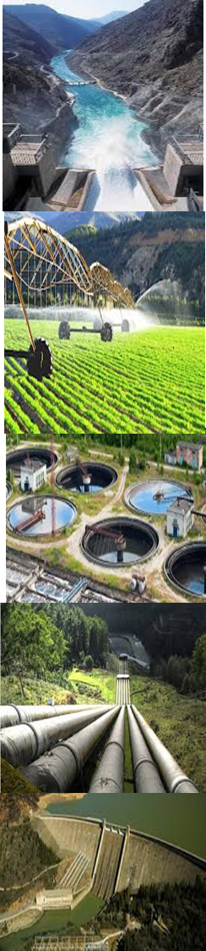

Introduction to Financial Modeling

Slide 2
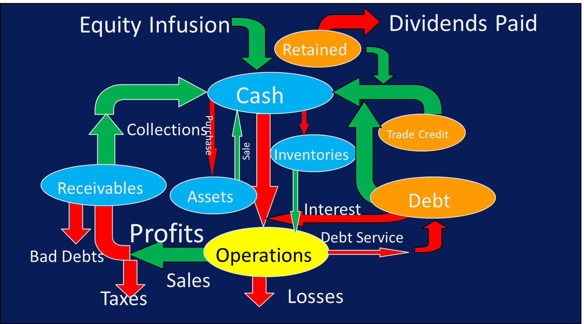
The Modeler’s Key Objective is to
Best Reproduce the Utilities Fund Flow System

Slide 3

Organization
Reduces the Madness!!

Slide 4
Key Components of a WSS Financial Model
Financial Module
Income Statement Cash Flow Balance Sheet Investment Program Borrowing Summary Account Movements
Operations Module
Installed Capacity Revs. & Production Operating Expenses Financial Management Assumptions Projected Returns

Slide 5
Conceptual Design of Regional Company Financial Model

Slide 6
How I Organize Models
Title
Dashboard
Project Data Sheet
Opening Balance Sheet
Management Assumptions
Demand, Production & Operations
Investment (CAPEX) Program
Financing Options
Output Statements
Movement of Accounts
Rate of Return Calculations

Slide 7
The Dashboard
Extremely useful schedule as it allows to view a summary of indicators and carry out simulations directly.
Should include:
  Demographic data
  Average tariffs
  Key performance indicators
  Financing Options & Results
  Cash flow Results
  Project probability indicators
  Projected key indicators

Slide 8
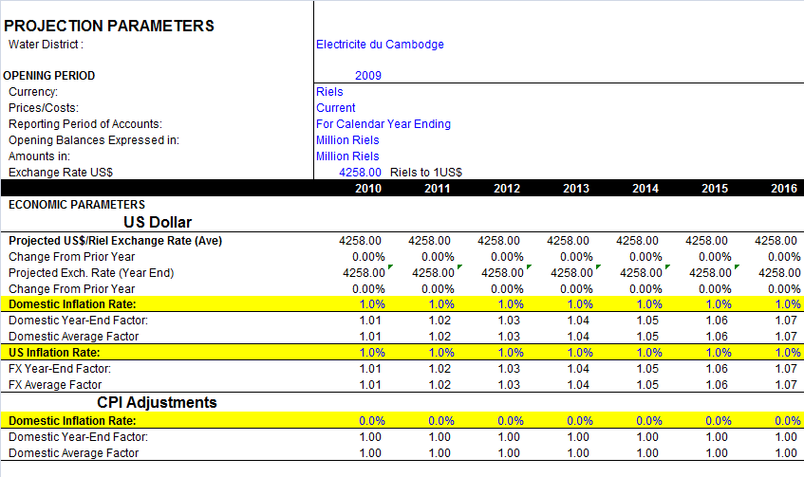
Project Data Sheet

Slide 9
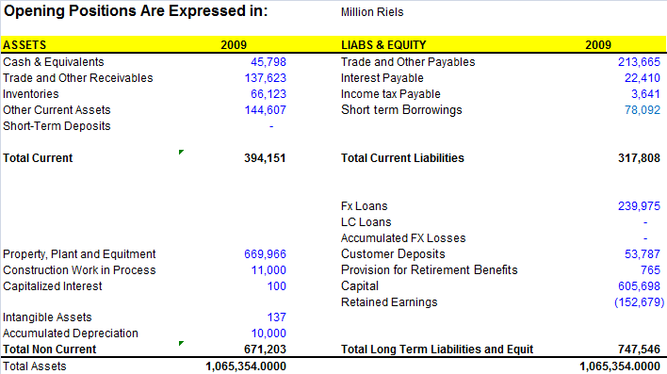
Opening Balance Sheet

Slide 10
Movement of BS Accounts

Slide 11
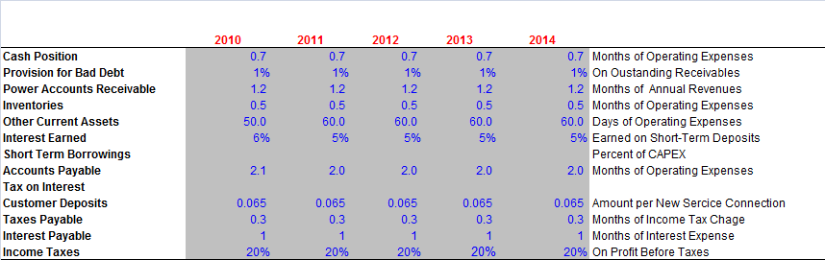
Financial Management Parameters

Slide 12
Demand, Production & Operation

Slide 13
The Financial Statements
Income Statement
Cash flow
Balance Sheet

Slide 14
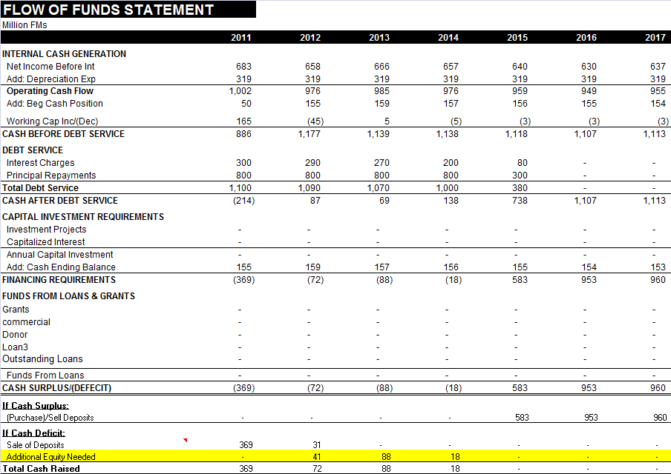
Waterfall Cash Flow
1st Priority
2nd Priority
The waterfall format allows the financial analyst to review the cash position according to financial management priorities.
A financial cashflow solution is derived only if the yellow line is zero.
3rd Priority
4th Priority
5th Priority

Slide 17
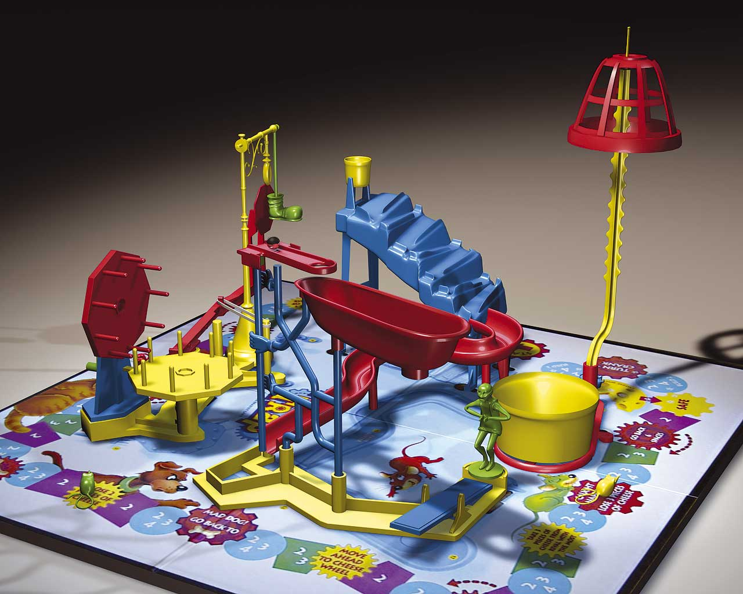

Useful Tips & Common Mistakes

Slide 18
Useful Tips
Instead of putting all the assumptions on one sheets, apply assumptions where they are most needed for review and use a Dashboard.
Be methodical and make full use of the required steps.
Color code inputs values and key variables and lock formula cells, especially if used by third party.
All statements should be protected.
Statements and schedules should all be on the same columns.
Data availability should drive the complexity of the model.
If formulas are overly complex, divide into steps.

Slide 19
Color Coding Legend

Slide 20
Common Mistakes
The model becomes the End Goal, not the financial results.
The model tries to do too many things, tariff structure, trend analysis, volume forecasts, demand elasticity. Develop separate subsidiary models.
Not properly organized.
Cutting corners.
Detailed breakdown/elaboration on non material variables.
Requiring inordinate amounts of data.
Add historical presentation to projections
Investment period should be no longer than 5-years (7 for hydropower).
Projection period should be no more than 25 years.
Escalating revenues with expenses.
Accumulating cash or negative cash balances.
Linking to other workbooks.

Slide 21
Steps for Developing a Financial Projection
Step 1: Assess data information accessibility of WSS entity.
Step 2: Determine key indicators that require focus. Use the Audit Reports.
Step 3: Populate Opening Balance Sheet Position from most current audit report
Step 4: Determine which Balance Sheet Accounts that are immaterial and do not require movement
Step 5: Determine Financial Management Parameters by calculating historical ratios. Check balance sheet accounts in first year projection against historical values. Recalibrate if material difference.
Step 6: Work with WSP to develop complete 5-year investment program and new financing sources and terms. Develop amortization of existing loans associated with balance sheets balances.
Step 7: Develop detailed schedule for WSS production, sales and revenues and OPEX. This is the most custom worksheets. Key technical parameters need to coincide with investment program.
Step 8: Develop base projection in constant costs and check results: (i) annual cash flow positions by priority, (ii) movements of balance sheet accounts; (iii) statistical indicators.
Step 9: Perform Tariff Adequacy analysis
Step 10: Make modifications if necessary and finalize
Step 11: Review with management for buy-in and to various technical and management assumptions.
Step 12: Develop a list of agreed action items for monitoring during project implementation.

