Slide 1
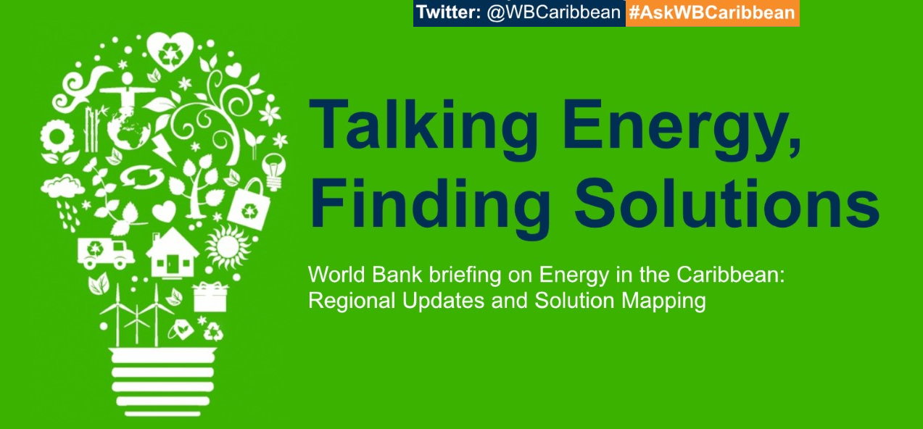
WORLD BANK LATIN AMERICA AND The Caribbean
OPPORTUNITIES IN CLEAN ENERGY
Stephanie Gil, Energy Manager for Latin America and the Caribbean
Tuesday, October 25th, 2022

Slide 2
Outline
The World Bank Group: Mission, Instruments and Climate Commitment
Regional Trends: Energy Challenges and Opportunities in the Caribbean
World Bank Engagement in Energy in the Caribbean
Finding Solutions Together

Slide 3
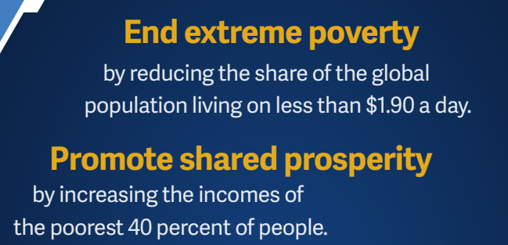
World Bank Group (WBG): Mission and Instruments
The WBG Twin Goals
WBG
Notes:
Since 1947, the World Bank has funded over 12,000 development projects, via traditional loans, interest-free credits, and grants.
IBRD provides financial development and policy financing
IDA provides zero-to low-interest loans and grants
IFC mobilizes private sector investment and provides advice
MIGA provides political risk insurance (guarantees)
ICSID settles investment disputes
more than 12,000 development projects, since 1947.
First WB loan: France Reconstruction Project, 250m$, 9 May 1947
The Loan Administration Project for France will assist in the reconstruction of its war torn economy, as well as finance the import of specific goods and equipment necessary to its economic rehabilitation. A portion of the proceeds; will be devoted to the modernization of the steel industry, and to improve the transportation system by the purchase of locomotives, freight cars, cargo ships, canal barges, and commercial airplanes, and France will be free to purchase in the international markets at prices that are most advantageous. Because of its size and productive capacity, the economic future of France is pivotal in Western Europe. The economic rehabilitation of France through its industrial reconstruction and expansion in trade will help the economic recovery of surrounding countries, and it will indirectly benefit industrial integration in Europe that is essential if maximum production and rising living standards are to be achieved on that Continent.

Slide 4
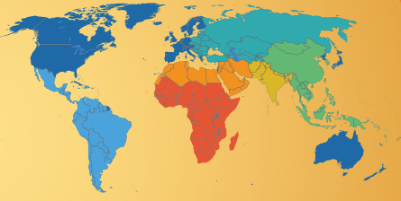
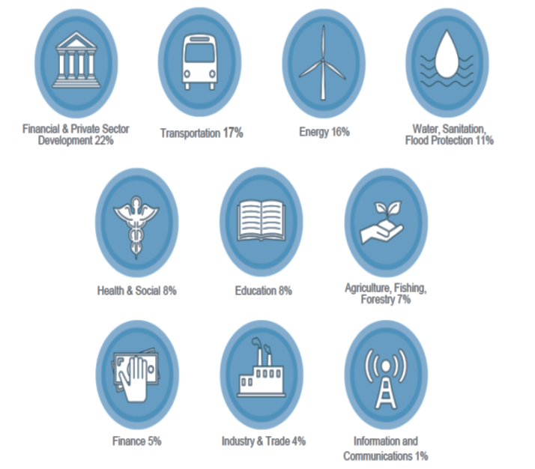
World Bank Group: Key Engagement Areas
Key areas of Engagement
189 Member Countries
Over 12,000 Staff from 170 countries
Offices in over 130 locations

Slide 5
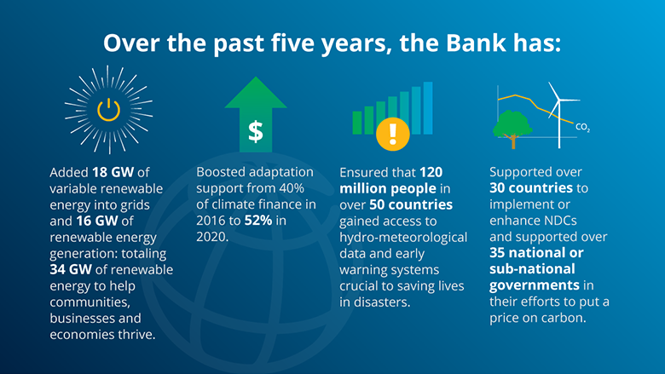
2015-2020: WBG First Climate Action Plan
5 Years of WBG Climate Leadership

Slide 6
2021-2025: WBG’s Second Climate Action Plan
Scaling Up The Ambition
$31.7 FY21, 36% of lending
In practice this means:
Country Climate and Development Reports (CCDR), to jointly outline green growth approaches;
A pre-screening of WBG operations to assess the climate co-benefits;
A rapid scale up of the WBG skills to include the climate fundamentals (GHG accounting, carbon tax monitoring, clean technology skills development).
Notes:
The 2021-2025 Action Plan is:
A Covid-19 Recovery plan to match the urgency of the climate and Covid-19 crises;
A green, resilient and inclusive development plan to tackle poverty, inequality and climate change simultaneously.

Slide 7
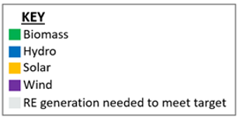
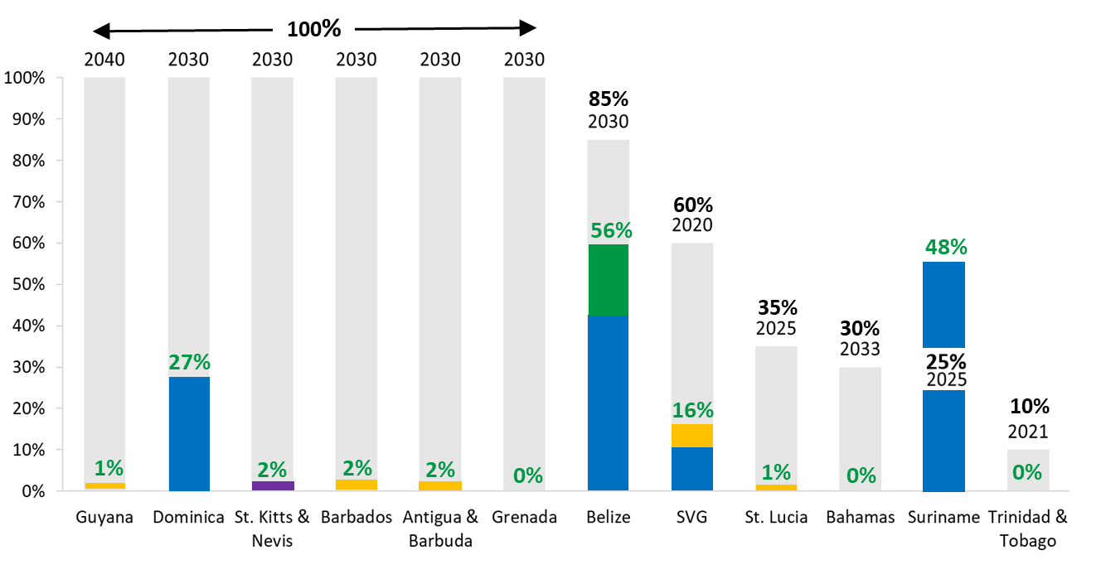
Energy challenges in the Caribbean
High dependence on imported fossil fuels
Some of the highest electricity tariffs globally
Constraint on affordability for households and on competitiveness of businesses
High levels of debt call for role of private sector
Lack of legal, regulatory, institutional framework for renewable energy and energy efficiency
Small scale, low capacity and high climate vulnerability
Notes:
Average access and quality of service hide strong disparities and inequalities within countries, affecting economic opportunities for the poor
The modern measure of access to electricity does not consider just the connection to the power grid but the access to quality energy services
While 84% of the households in Honduras are connected to the power grid, 56% of them have more than 4 power interruptions per week of more than two hours, affecting the use of appliances, lighting and access to basic services.

Slide 8
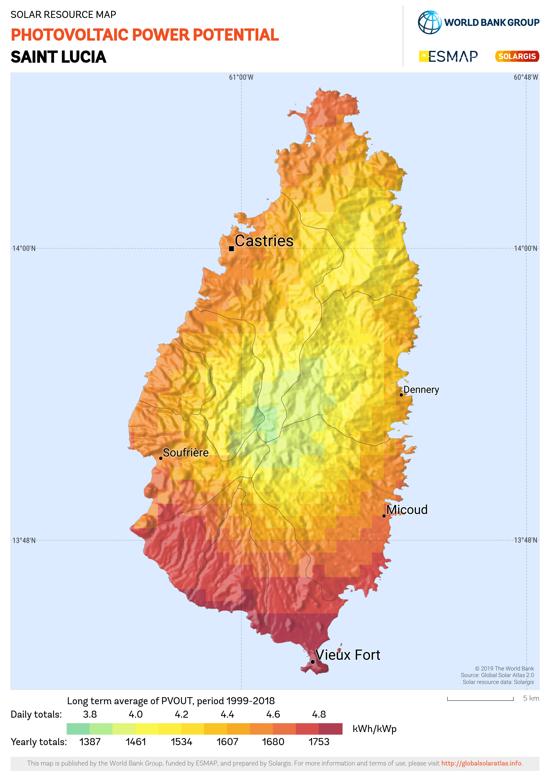


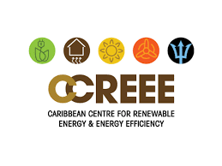

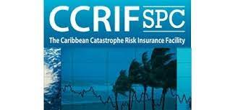
Energy opportunities in the Caribbean
Excellent solar, wind, geothermal and energy efficiency potential.
Strong national and regional champions that can support key initiatives.
Precedent in attracting innovative regional financing instruments such as the CCRIF.
Notes:
Average access and quality of service hide strong disparities and inequalities within countries, affecting economic opportunities for the poor
The modern measure of access to electricity does not consider just the connection to the power grid but the access to quality energy services
While 84% of the households in Honduras are connected to the power grid, 56% of them have more than 4 power interruptions per week of more than two hours, affecting the use of appliances, lighting and access to basic services.

Slide 9
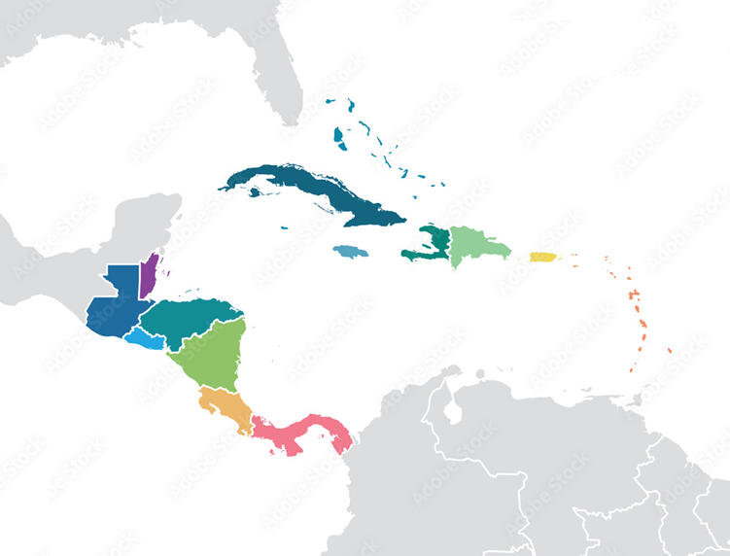
World Bank Energy Engagement in the Caribbean
Fostering conducive legal, regulatory, institutional frameworks for the clean energy transition
Support national energy policies.
Improving climate resilience through 360 approaches.
Capacity building and regulatory development for renewable energy (IPPs, distributed generation, energy storage, etc.) and energy efficiency (green building codes, etc.).
Jamaica
St Lucia
Haiti
Dominica
St Lucia
SVG
Grenada
Notes:
Average access and quality of service hide strong disparities and inequalities within countries, affecting economic opportunities for the poor
The modern measure of access to electricity does not consider just the connection to the power grid but the access to quality energy services
While 84% of the households in Honduras are connected to the power grid, 56% of them have more than 4 power interruptions per week of more than two hours, affecting the use of appliances, lighting and access to basic services.

Slide 10
World Bank Energy Engagement in the Caribbean
Partner of choice for country-based solutions that promote resilience and sustainability
Belize: grid resilience and private renewable energy integration.
Haiti: private sector-led mini-grids with renewable energy solutions for households and critical public services (health and education).
Dominica, St Lucia, Grenada: de-risking of geothermal resource to attract public and private sector investment.
Belize
Haiti
Dominica
St Lucia
Grenada
9
Notes:
Average access and quality of service hide strong disparities and inequalities within countries, affecting economic opportunities for the poor
The modern measure of access to electricity does not consider just the connection to the power grid but the access to quality energy services
While 84% of the households in Honduras are connected to the power grid, 56% of them have more than 4 power interruptions per week of more than two hours, affecting the use of appliances, lighting and access to basic services.

Slide 11
World Bank Energy Engagement in the Caribbean
Bringing innovative regional solutions that can overcome scale and attract private financing.
Regional energy efficiency: share best practices, consolidate procurement, deliver solutions for Caribbean public sector, provide demonstration effect at scale.
Regional renewable energy financing facility: develop pipeline of bankable projects, propose an aggregation mechanism to achieve scale, design a financing facility to attract private financing.
Notes:
Average access and quality of service hide strong disparities and inequalities within countries, affecting economic opportunities for the poor
The modern measure of access to electricity does not consider just the connection to the power grid but the access to quality energy services
While 84% of the households in Honduras are connected to the power grid, 56% of them have more than 4 power interruptions per week of more than two hours, affecting the use of appliances, lighting and access to basic services.

Slide 12
Working Together towards RE Scale Up in the Caribbean
Practical and Tailored Solutions for the Caribbean Countries Needed
Momentum for Caribbean Renewable Energy (RE) scale up at its highest point: multiple crises leading to high oil price , RE technology costs keep going down, RE markets in North and South America ramp up (more suppliers) and financing available.
Prepare the enabling environment today: from ambition (IRP and NDC targets) to implementation, many building bricks are essential and can be prepared in advance: regulatory framework, technical guidelines and financial mechanisms for RE infrastructure (large grid-scale and small embedded generation).
RE in the Caribbean at Scale means more cooperation: synchronized tenders among countries to aggregate markets and attract more competitors, coordinated public/private finance to de-risk the respective projects, joint support from DFIs and philanthropy partners to avoid overlaps and provide additionality.
Energy Efficiency (EE) for resilience: a critical complement for RE scale up, and the most cost-effective investment in oil-dependent SIDS. RE and EE policies to be designed and implemented jointly.
Notes:
With the RE and EE facilities, the World Bank intends to respond to all these action items.

Slide 13
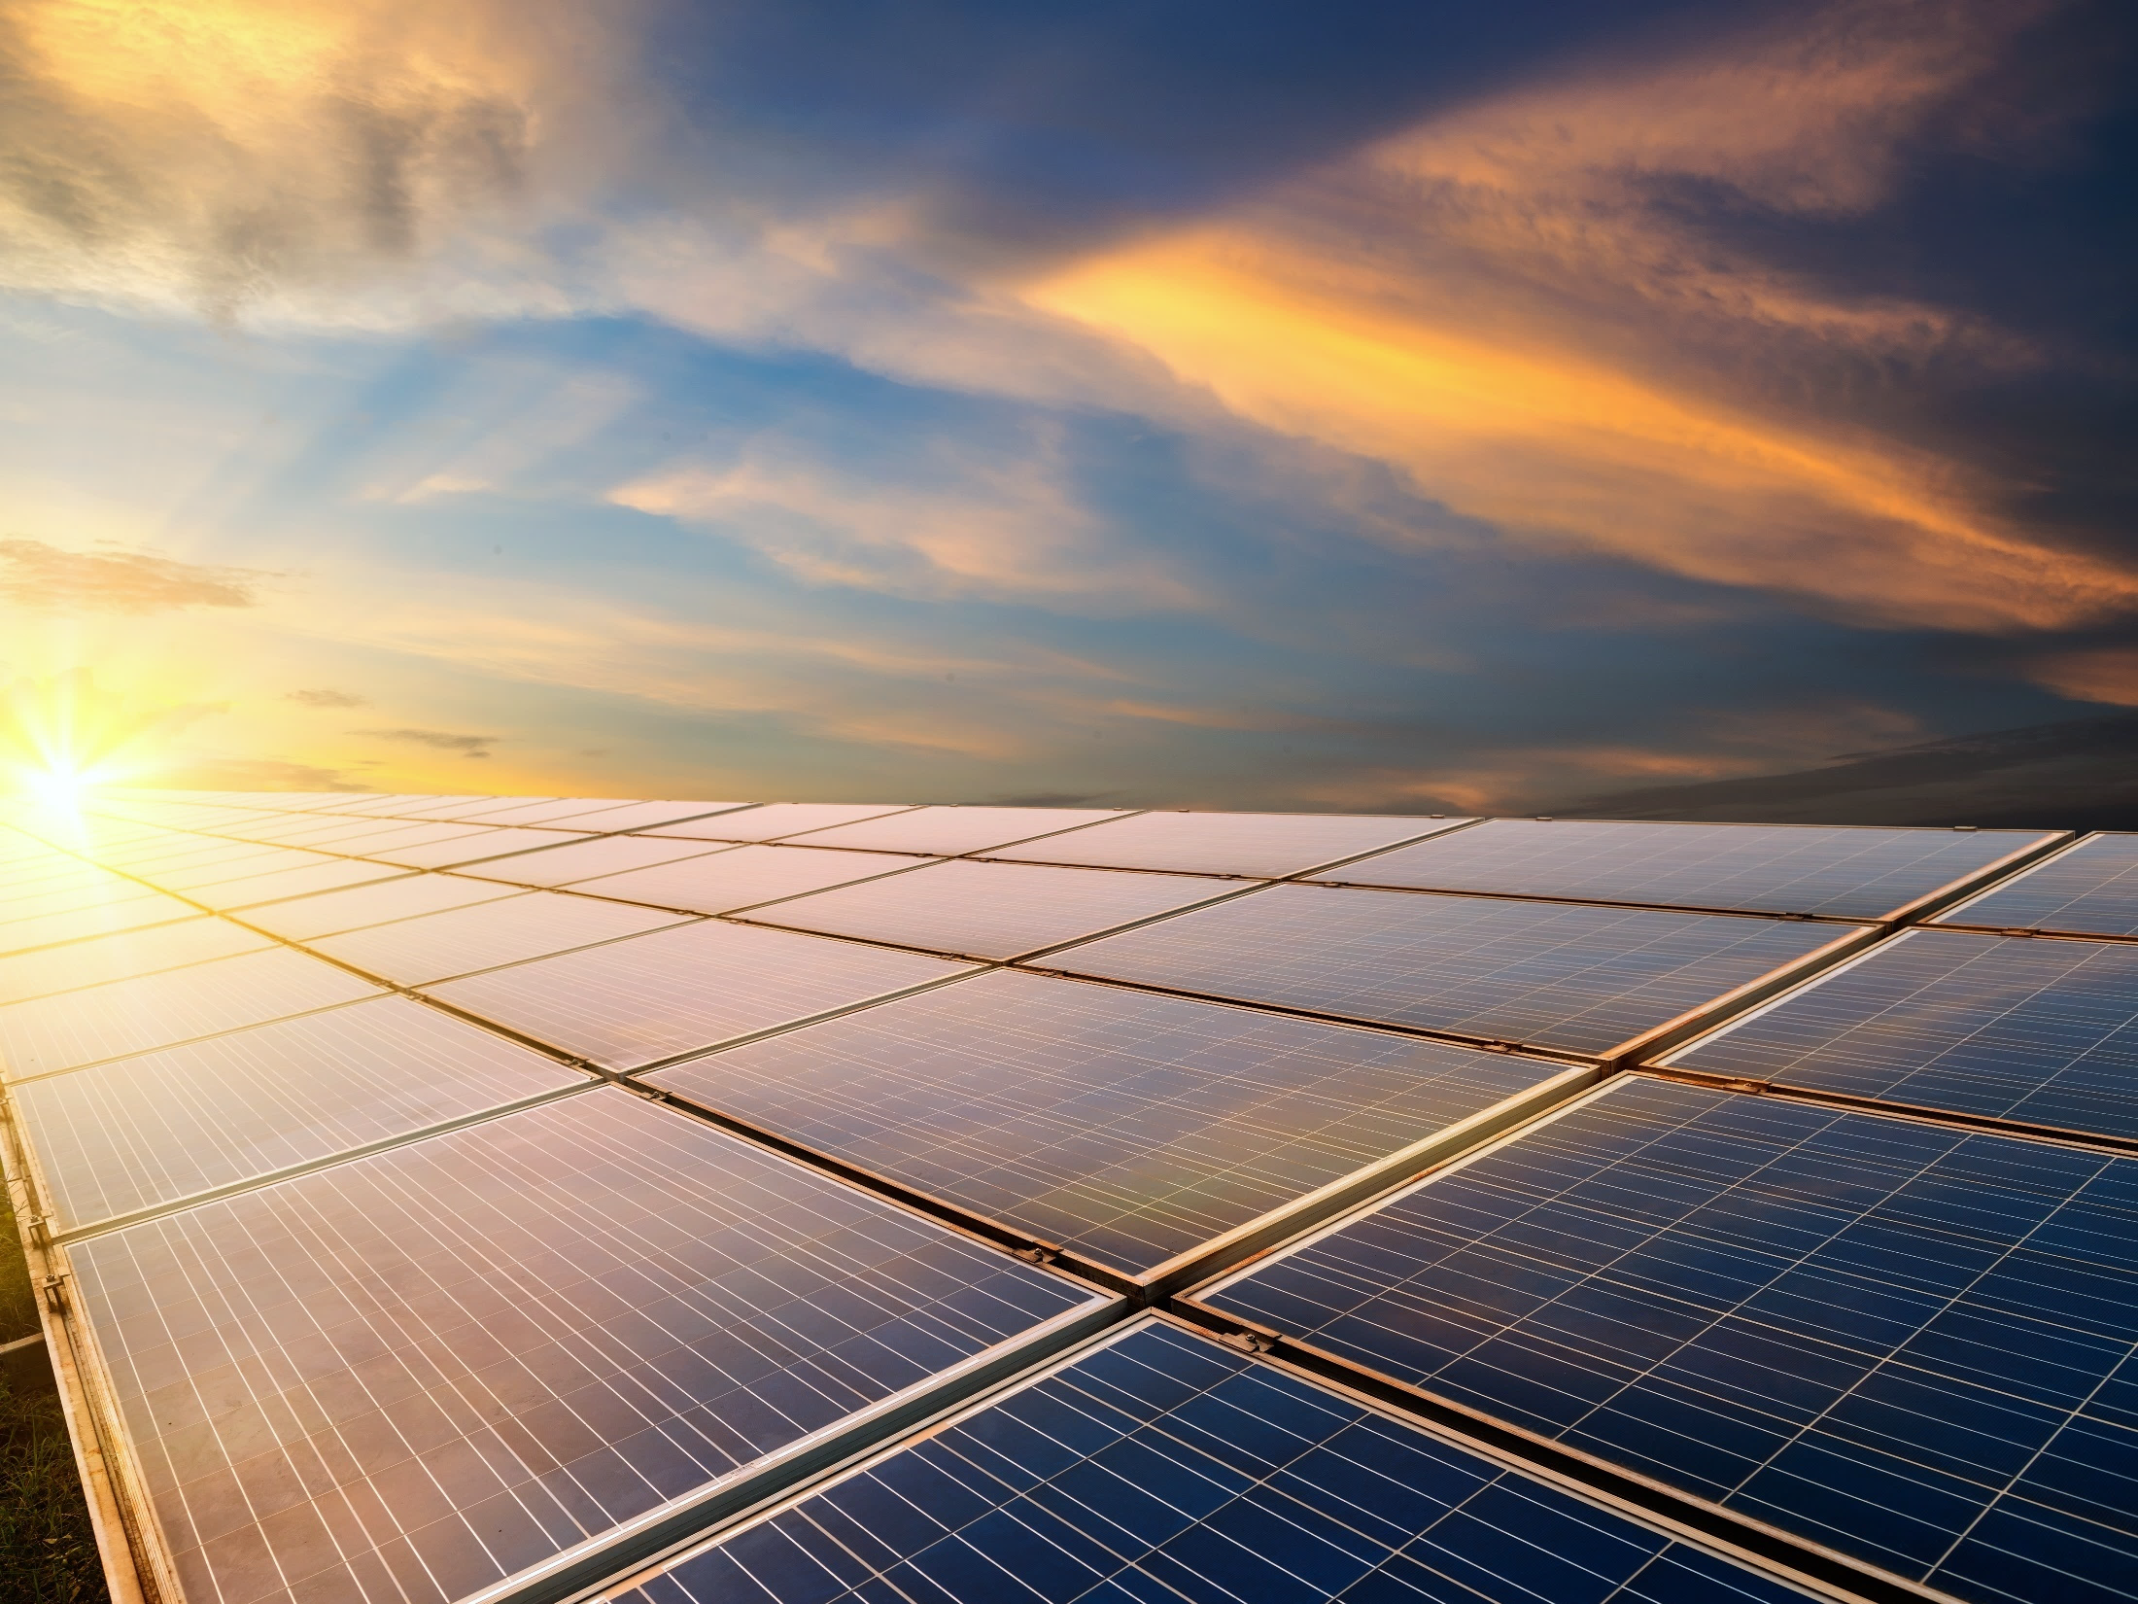

THANK YOU
b
Frederic Verdol
Infrastructure Program Leader for the Caribbean
Latin America and the Caribbean Region
T +1 876-960-0459
E fverdol@worldbank.org
T @FredericVerdol
b
b
b
Anh Pham
Senior Energy Specialist
Latin America and the Caribbean Region
T +1 202 473 9886
E npham@worldbank.org
W www.worldbank.org
Neha Mukhi
Senior Energy Specialist
Latin America and the Caribbean Region
T +1 202 458 4120
E nmukhi@worldbank.org
W www.worldbank.org
Jose Perez
Senior Energy Specialist
Latin America and the Caribbean Region
T +509 2812 2200
E nmukhi@worldbank.org
W www.worldbank.org

