Slide 1
Global Economic Prospects June 2022 www.worldbank.org/gep

Slide 2
Global Economic Prospects – June 2022

Slide 3
Global Economic Prospects – June 2022
Underlying data and charts can be found at
www.worldbank.org/gep

Slide 4
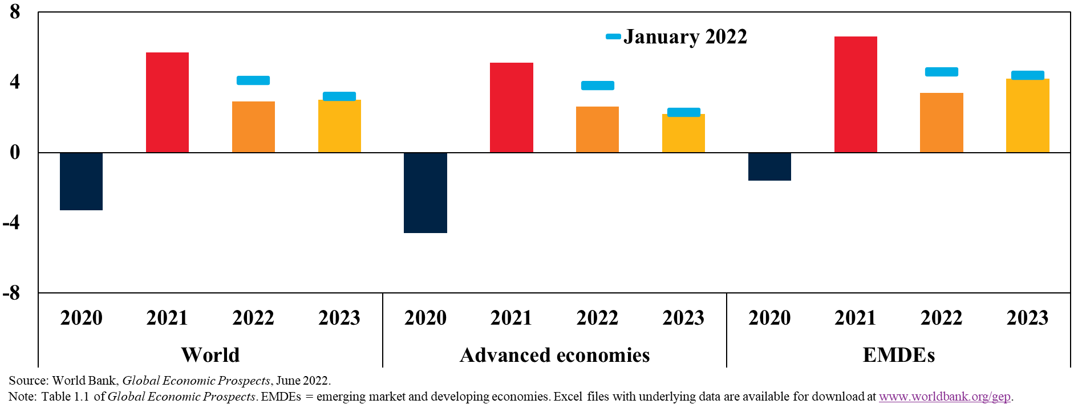
Global Growth Forecasts Sharper Slowdown in 2022-23
GDP growth
(Percent)

Slide 5
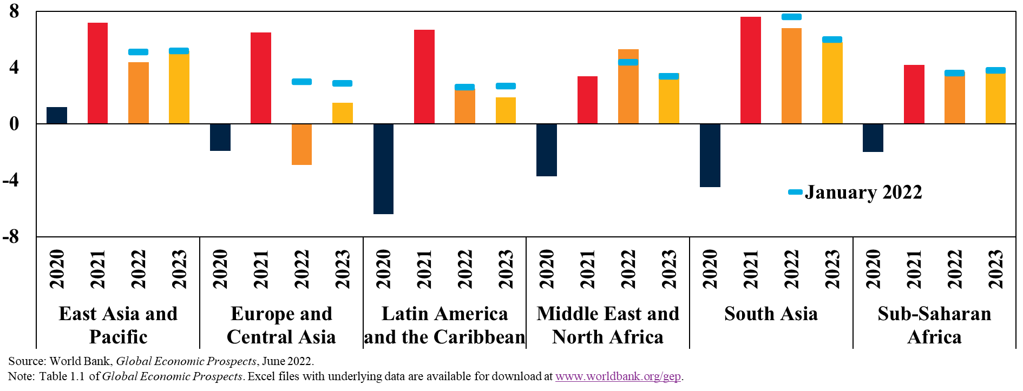
Regional Growth Forecasts Slowing Growth in Most Regions
GDP growth
(Percent)

Slide 6
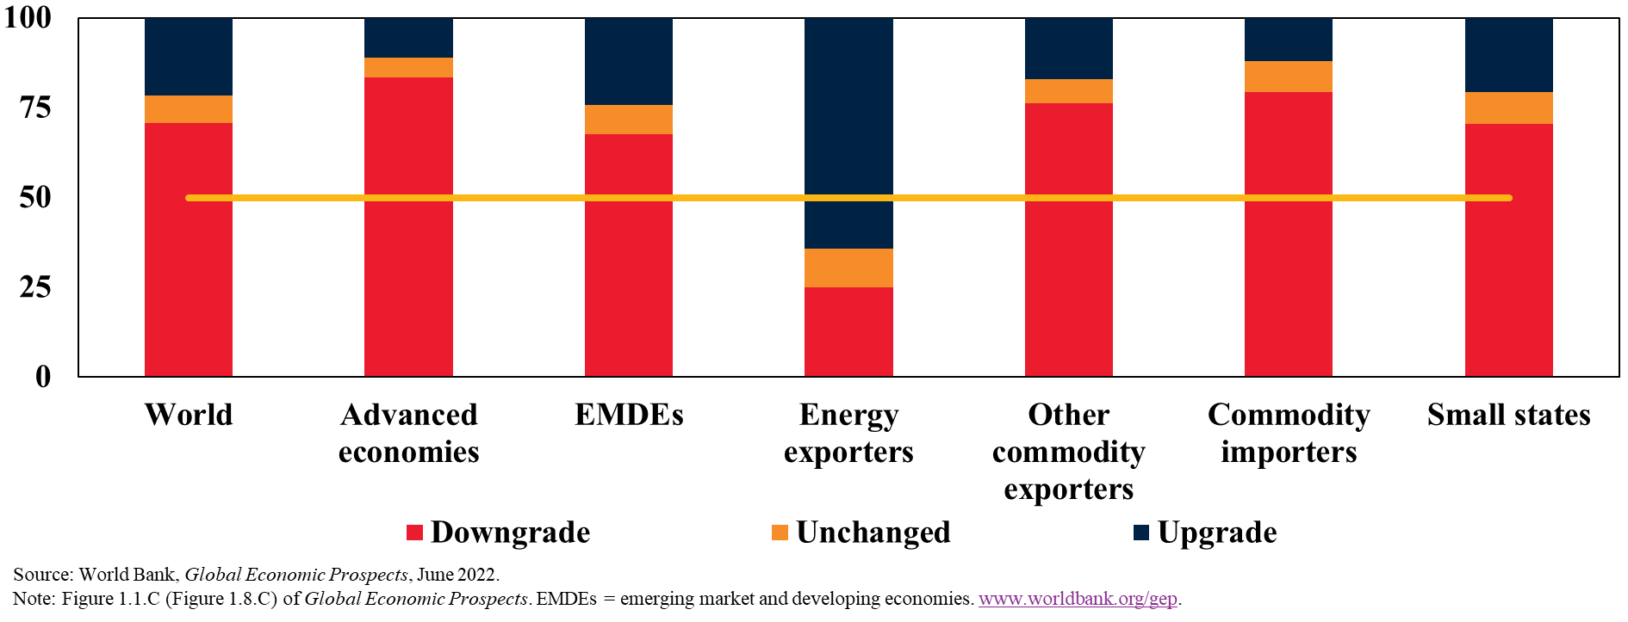
Changes in Growth Forecasts for 2022 Downgrades for Most Countries
Countries by the type of growth forecast revisions since January for 2022
(Percent of countries)

Slide 7
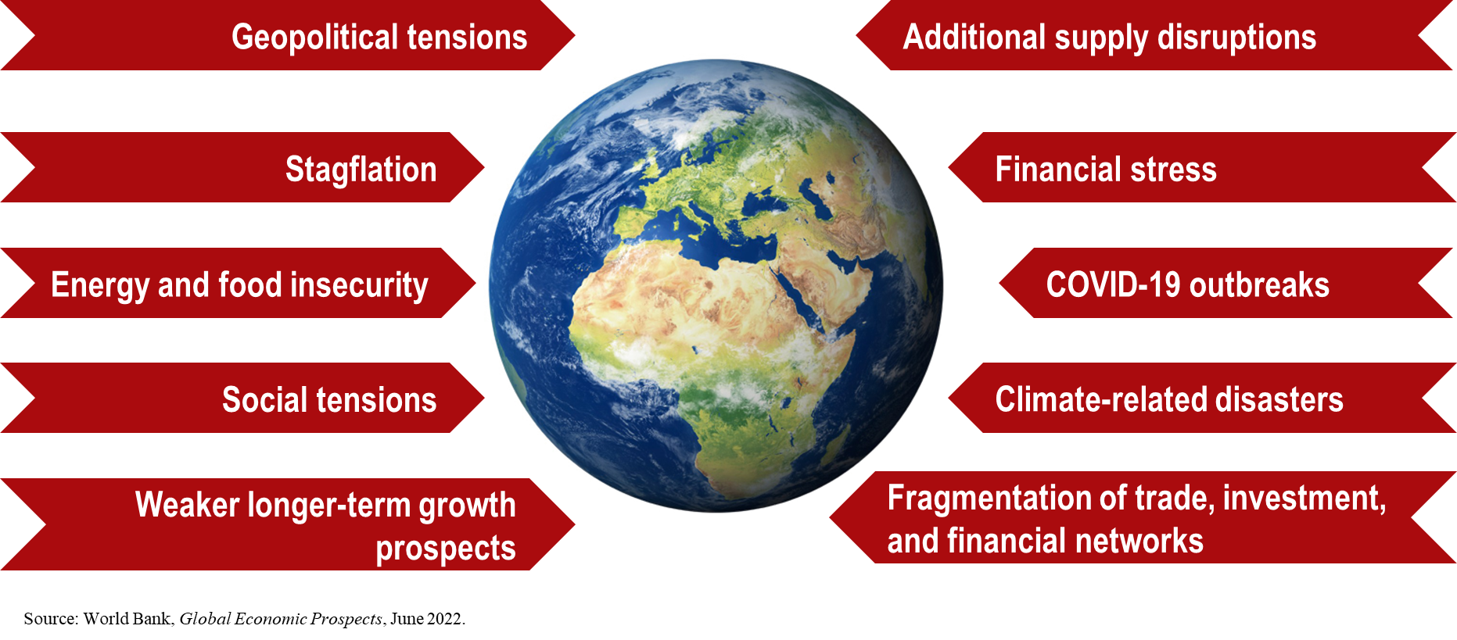
Risks Mutually Amplifying Downside Risks

Slide 8
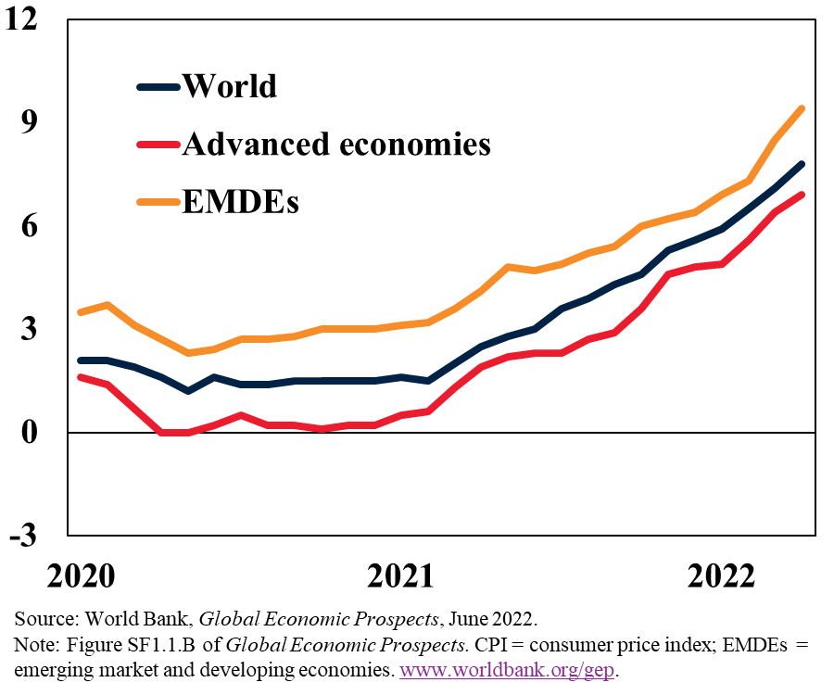
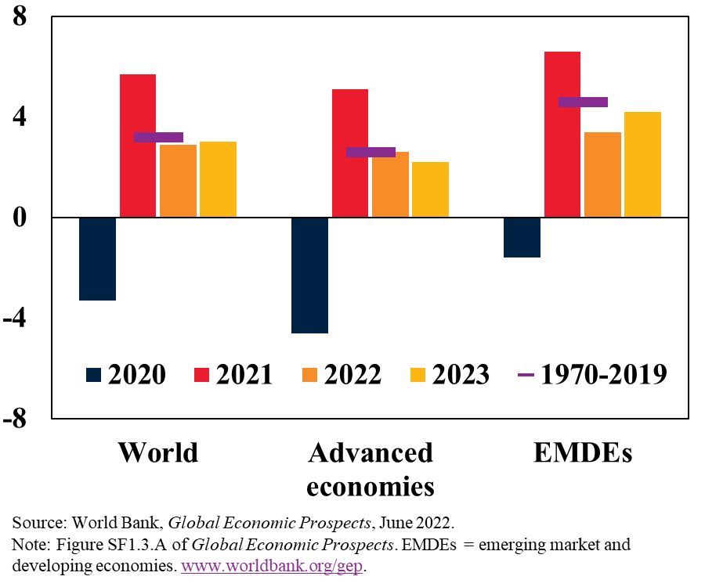
Rising Risk of Protracted Stagflation High Inflation, Tepid Growth
Monthly CPI inflation
(Percent, year-on-year)
GDP growth
(Percent)

Slide 9
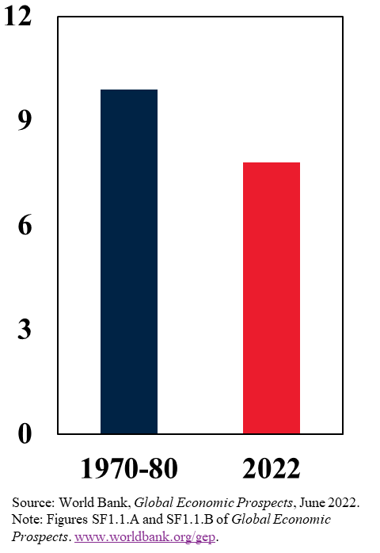
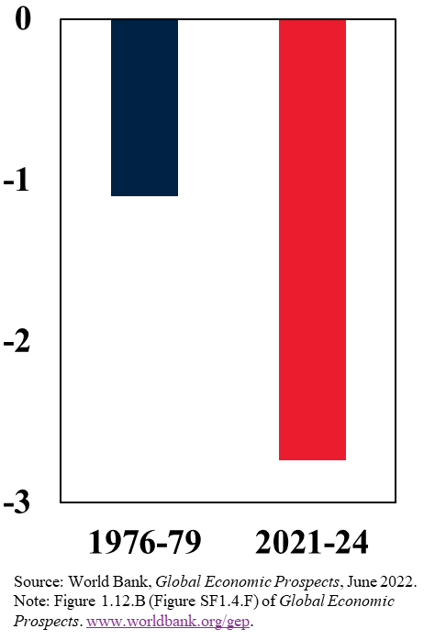
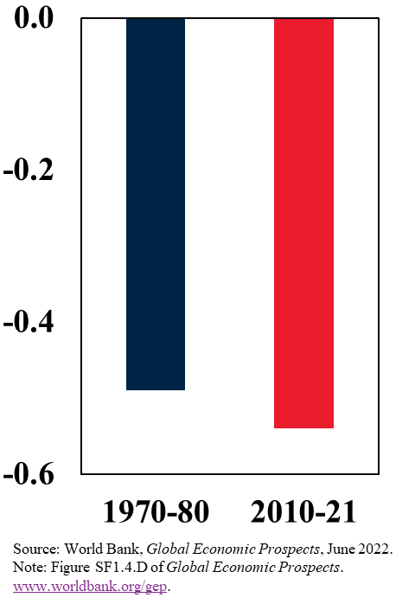
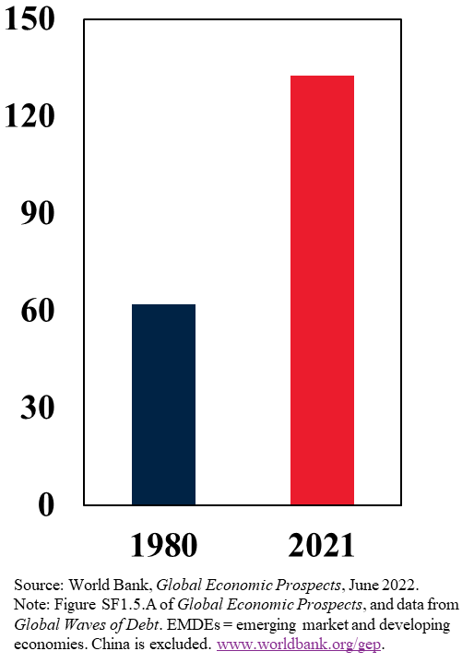
Similarities with the 1970s High Inflation; Weak Growth; Accommodative Monetary Policy; Elevated Debt in EMDEs
Global inflation
(Percent)
Global growth slowdown
(Percentage points)
Global real interest rates
(Percent)
Total debt in EMDEs
(Percent of GDP)

Slide 10
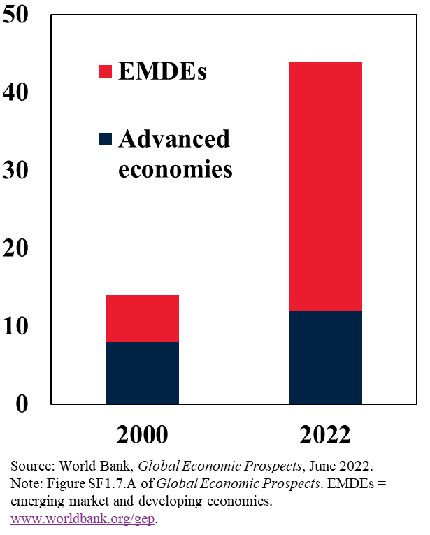
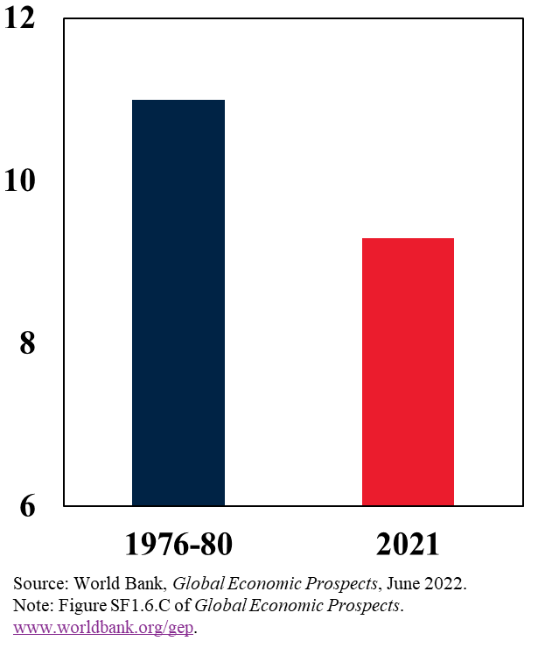
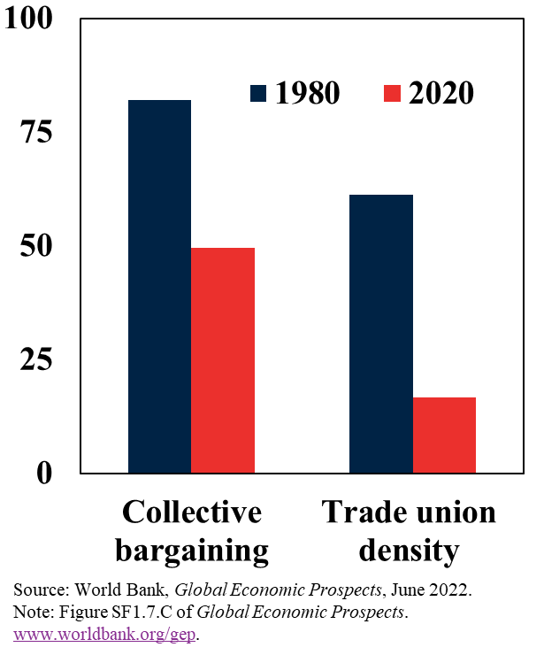
Differences from the 1970s Better Monetary Policy Frameworks; Lower Wage Pressures; More Flexible Markets
Countries with inflation targeting
(Number of countries)
Wage growth in the United States
(Percent)
Labor market flexibility
(Percent)

Slide 11
Global Policy Priorities Alleviate Short-Term Pressures; Build Long-Term Foundations

Slide 12
National Policy Priorities Manage Short-Term Policy Tradeoffs; Build Long-Term Foundations

Slide 13
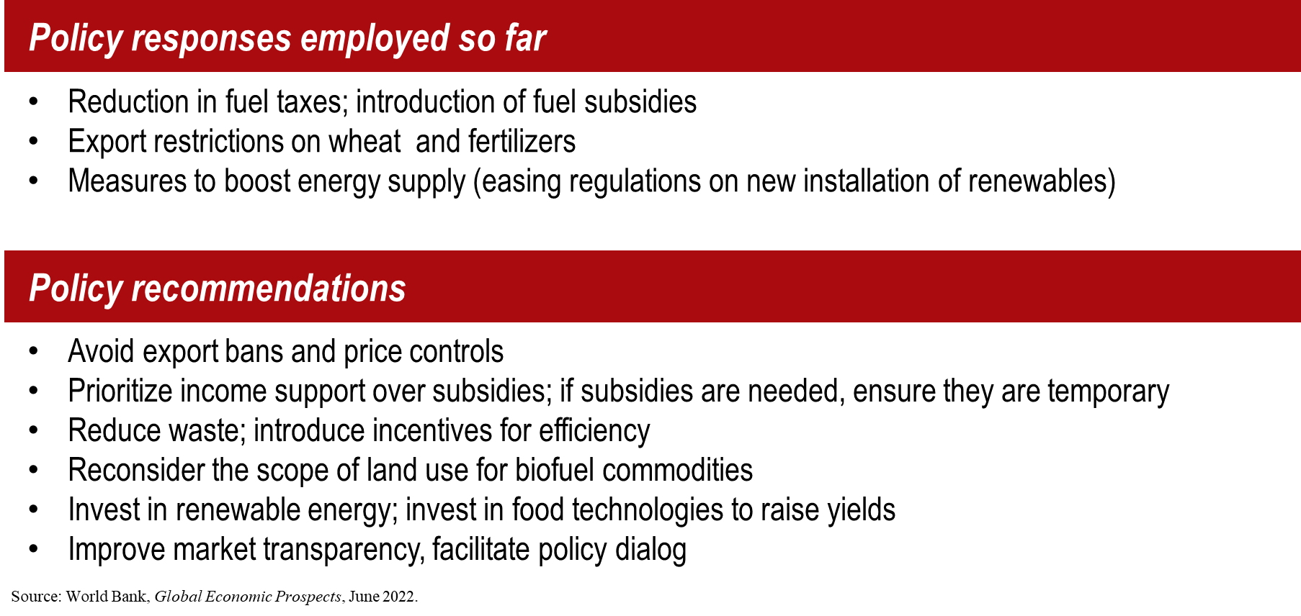
Coping with High Food and Energy Prices Mostly Distortive Policies Employed so far; Better Options Available

Slide 14
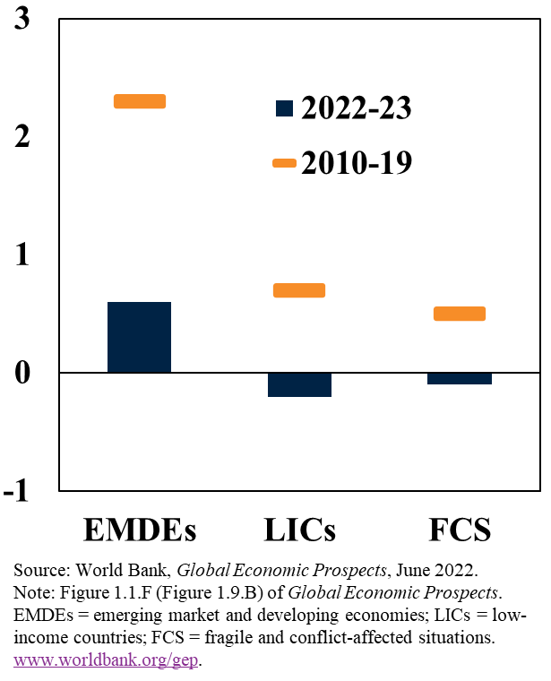
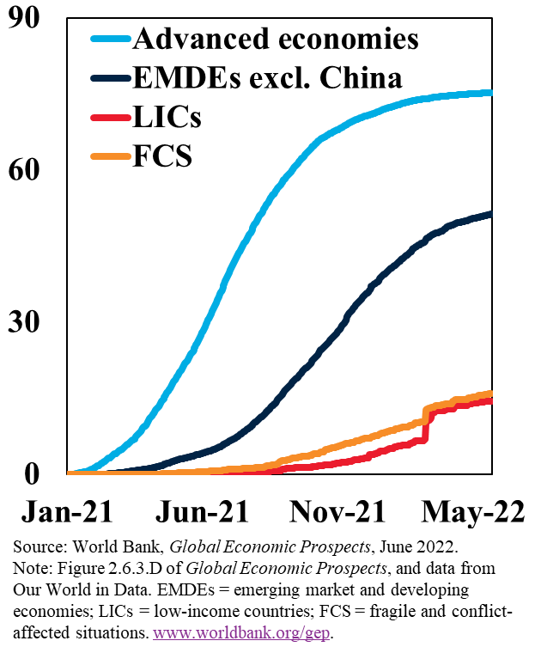
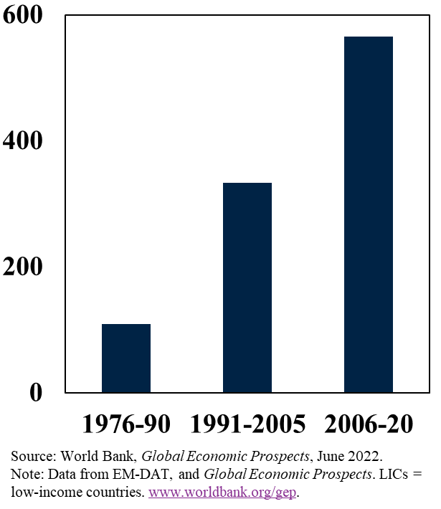
Income Growth, Vaccination, and Climate Challenges in LICs Slower Income Convergence; Lower Rates of Vaccination; More Extreme Weather Events
Per capita income growth differentials
(Percentage points, relative to adv. econ.)
Vaccination rates
(Per 100 people)
Extreme weather events affecting LICs
(Number of events)

Slide 15
Global Economic Prospects June 2022
www.worldbank.org/gep

Slide 16
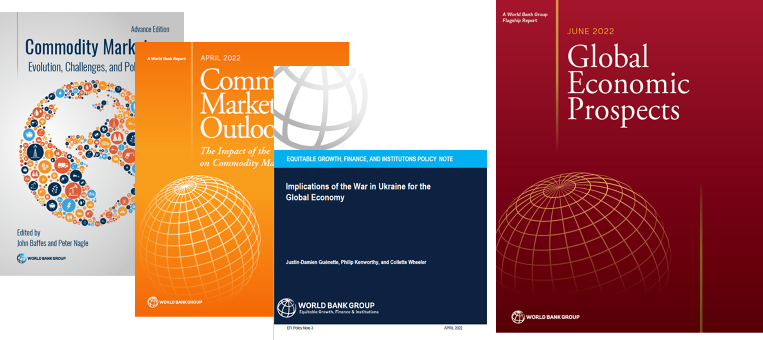
Recent Publications by EFI Prospects Group

