Slide 1
RENEWING
THE WORLD BANK GROUP
VISION AND MISSION
AN OVERVIEW OF WBG EVOLUTION

Slide 2
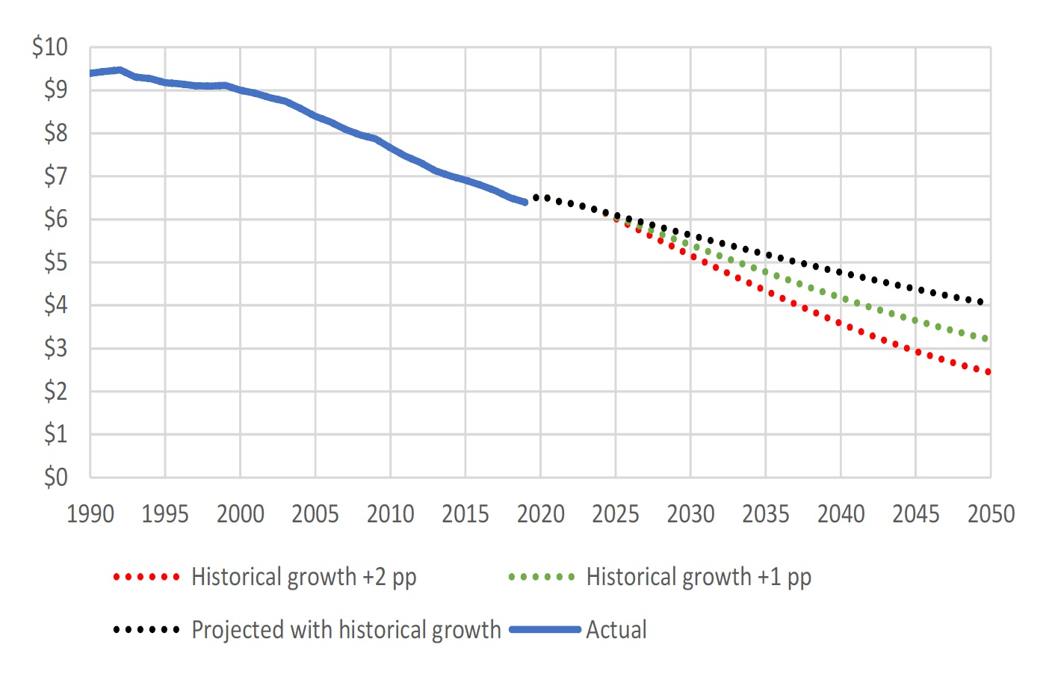
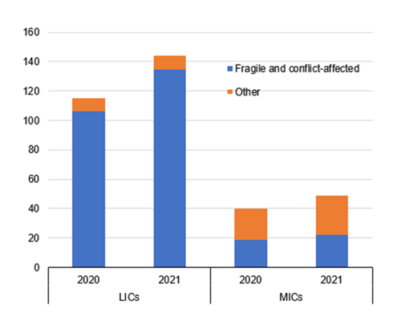
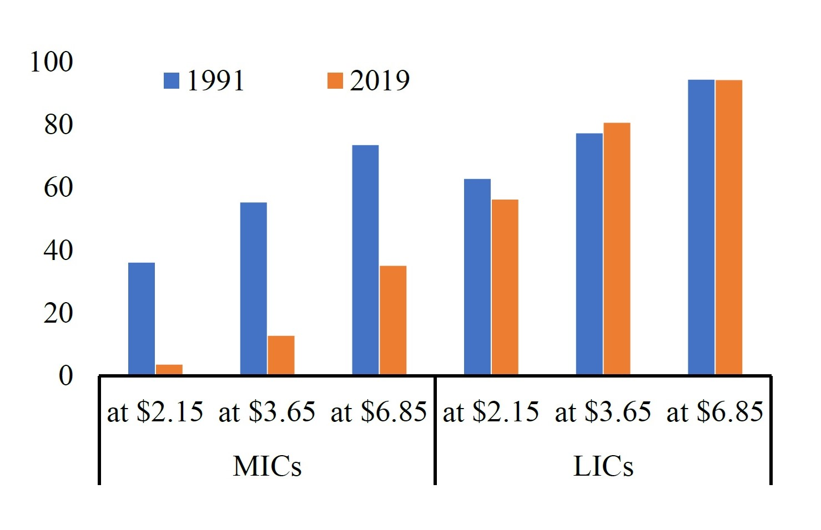
A RAPIDLY CHANGING
LANDSCAPE
The world is tremendously off track to achieve the Sustainable Development Goals (SDGs)
Over the last few years, we have experienced:
Global Prosperity Gap
(2017 US$/Day at PPP)
Multiple overlapping crises
Increase in poverty
Declines in growth
Reversals in hard-won human development gains
Threats to prosperity from global challenges
Food Insecure, by FCS Status
(Millions)
Poverty Rate
(Percent of Population)

Slide 3
A CALL TO
ACTION
WBG Governors requested “… a systematic dialogue to enhance our shared vision for the WBG, including strategic priorities, strengths and gaps, incentives, operational approach, and financial capacity to bolster and scale the response to global challenges and move toward achieving the Twin Goals and the SDGs in all client countries.”
The global community—including many of you—have called on MDBs to step up support for the world’s polycrises; lend substantially more to governments and do more to mobilize private financing; and do more on mitigation and adaptation to fight climate change.

Slide 4
3 PILLARS
WBG
EVOLUTION
OF
Expand our Vision and Mission to reflect global challenges; strengthen emphasis on resilience and sustainability
Review our Operating Model and consider enhancements to our country engagement model, analytics, financing instruments, and incentives, within an enhanced One WBG approach
Explore options to expand our resources and enhance our Financial Model

Slide 5
WBG
EVOLUTION
BUILDING BLOCKS
Knowledge & Outcome Orientation
Speed & Simplification
New Programs & Instruments
Client Engagement
Crisis Response Toolkit
Domestic Resource Mobilization
Partnerships
Private Sector Mobilization & One WBG

Slide 6
PROPOSALS TO EVOLVE THE
FINANCIAL MODEL
Concessionality Framework for the WBG
Principles of WBG Concessionality (IBRD, IFC, MIGA), including fundraising coordination
Allocation Framework for determining where Concessionality is most needed based on the Principles (considerations will include vulnerability, small states, regional support for IBRD countries, etc.
Sources of Concessionality for IBRD, including the Global Public Goods Fund
Sources of Concessionality for the private sector, including new donors and a multi donor, replenishable fund
Enhancement of Financial Model
Enhanced callable capital
GEMs: Modalities of making data available externally with appropriate safeguards
Portfolio guarantee platform
IDA options for strengthening short and medium-term financing capacity
Update on further utilizing MIGA’s financial model for overall capital efficiency
Shareholder hybrid capital
Establishment of IDA Crisis Facility (Board approved May 18)

Slide 7
QUESTIONS
FOR FEEDBACK
& DISCUSSION?

Slide 8
What are your views on the direction and ambition of the new mission statement?
Do you agree with the enhancements to the operating model, and are there specific improvements you consider as priorities?
Do you agree with the recommendations to adapt the financial model, and the suggested financial proposals to be explored further, to address the wide gap between needs and resources?
What do you expect by the 2023 Annual Meetings with regard to the WBG evolution, and do you support the proposed next steps for WBG Management and the Bank Group’s Executive Directors to advance the agenda?
Do you have any other views you would like to share?
WBG
EVOLUTION

