Slide 1
Non-experimental methods for transport impact evaluation

Slide 2
overview
In this sessions, we will discuss:
the logic of impact evaluation
The various methods of non-experimental impact evaluation
A case study, to which all major non-experimental methods will be applied

Slide 3
overview
Today: non-experimental methods for impact evaluation
Tomorrow: randomized controlled trials (RCTs)
Wednesday: sampling and power calculations for impact evaluation

Slide 4
Why impact evaluation?
We want to implement the most effective policies and programs
So we need a method that enables us to understand what works and what does not work
The means we need to understand cause and effect
We must measure what happened
We must also find a way to measure the counterfactual (what would have happened if we had not implemented the program)

Slide 5
M&E versus impact evaluation
Monitoring and evaluation
Tracks whether project activities were conducted (inputs)
Counts the project outputs that were delivered/constructed
Was the road built? Was it on time, and did it meet technical standards?
Are people/vehicles using the road?

Slide 6
M&E versus impact evaluation
This standard M&E approach remains very important
But it does not tell us:
Did the road lead to increased economic growth/reduced poverty?
What is the most precise estimate of this economic growth? How does it compare to alternate uses of scarce resources?
Did all groups benefit? Were their winners and losers? To what extent?

Slide 7
Causal inference and counterfactuals
Fundamentally, to know the effect of our project, we want to observe something that is fundamentally unobservable: the counterfactual
What happened to the village where we built a road, compared to what would have happened to the same village if we did not build the road

Slide 8
Causal inference and counterfactuals
Since we can never observe the same village at the same time both with and without the road, we must use other methods to develop a valid comparison group

Slide 9
impact evaluation
A historical example:
Did the expansion of railways in the late 19th century US contribute to economic growth?
The Fogel hypothesis:

Slide 10
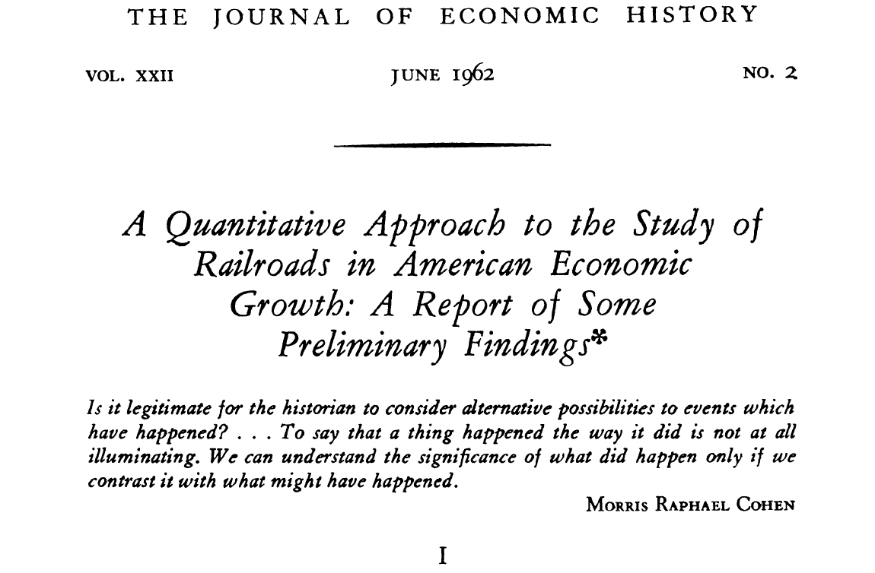
Notes:
Massive railway expansion of late 19th century in the US was correlated with economic expansion, but it made only a marginal contribution to the expansion. It was only slightly cheaper than the next best shipping method (canals and rivers) and so only made the economy slightly more efficient.

Slide 11
Building a road (or a railroad) is probably a good thing. But how good, relative to other investments?
“the level of per capita income achieved by January 1, 1890 would have been reached by March 31, 1890, if railroads had never been invented.”
Source: Lance Davis, https://eh.net/book_reviews/railroads-and-american-economic-growth-essays-in-econometric-history

Slide 12
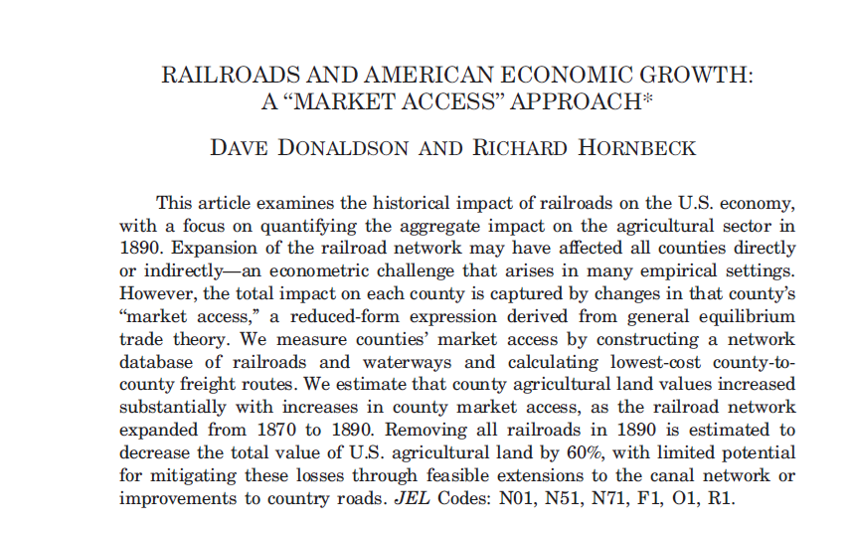
By contrast, new data sources and methods give a very different answer. (Donaldson and Hornbeck 2016)

Slide 13
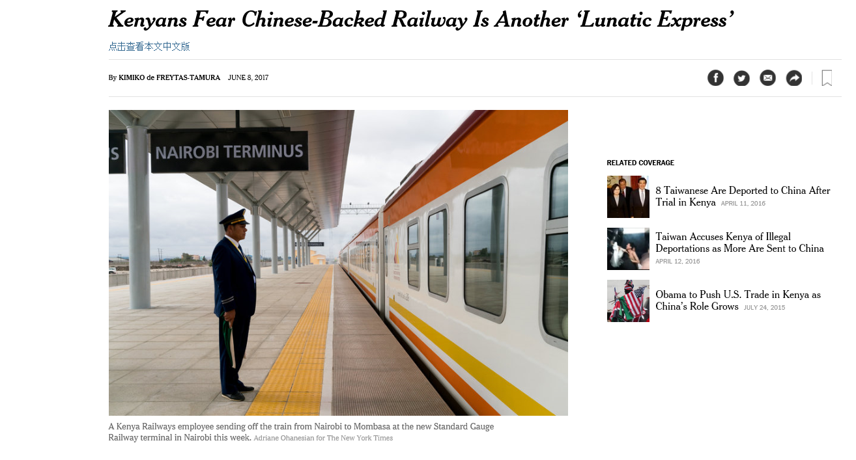
New York Times, June 8, 2017: the Fogel hypothesis revisited?

Slide 14
Case study
The Republic of Atlantis is planning a rural road rehabilitation program
Agricultural households cannot sell goods at market because poor roads, high transport costs → no profit for cash crop production
If you fix the roads, they can produce and sell crops at market -- > higher household incomes and consumption, less poverty

Slide 15
Case study: the program
First they class all villages into groups:
9,000 villages in the country qualify as high priority for road rehabilitation
Given budget limits, the Dept of Transportation opens up the program to 2,000 villages and invites them to apply.
Eligible villages must apply by a certain date, otherwise cannot receive program
By program deadline, 1,021 villages have applied out of 2,000 → these villages receive the program

Slide 16
Case study: the evaluation
Minister of Finance:
Roads are expensive – if they want this program to be scaled up, he wants evidence on the economic return
So the team consults with researchers at Atlantis National University on how to design an evaluation that can inform this decision
What is the main question that they must answer with this evaluation?

Slide 17
Case study: the evaluation
Project team has done detailed M&E on previous projects
Tracked that roads were actually built up to standard in project villages
Also measured that, in project villages:
travel time to market centers decreased
Vehicle operating costs for car owners decreased
Did it have any effect incomes or poverty?

Slide 18
Case study: the evaluation
Based on conversation with evaluation team, they improve methods:
Collect information not just about travel times, but collect detailed household consumption data from households
They collect this data in both the program villages (“treatment”) and the comparison villages

Slide 19
Method 1: Single difference
 |  | treated villages | comparison villages | Estimated Impact
Average per capita consumption (Atlantis dollars) | 301.6 |  | 219.1 | 82.5*
* = statistically significant at 5% level

Slide 20
Method 1: Single difference
What does this method tell us about the impact of road upgrading on households’ welfare?

Slide 21
Method 1: Single difference
Is it possible that the villages that are part of phase one are different from those that did not? If so, in which ways?

Slide 22
Method 1: Single difference
 | Method 1: Simple Difference
 | Treatment | Comparison | Difference
Number of users | 44.26 | 31.83 | 12.43*
Pop. density | 111.90 | 109.46 | 2.44*
Local market [1= Yes] | 0.86 | 0.85 | 0.01
Number of children per HH | 4.83 | 5.27 | -0.44*
Diversification (%) | 25.90 | 25.33 | 0.57
Sample size | 1021 | 979

Slide 23
Method 2: matching
To address these issues, we can us an approach called “matching” (or propensity score matching)
Use what you know about the villages (observable characteristics) to create treatment and control groups that are similar on these characteristics.

Slide 24
Method 2: matching
Based on what we know about the villages, (population, distance to market, etc), we estimate a probability that they participated in the program.
Example: for each village in treatment group with a (25%/50%/75%) probability of participation, you include one in the control group with (25%/50%/75%) probability of participation

Slide 25
Method 2: matching
Result:
“matched” treatment and control groups which are similar across a broad range of characteristics
but which differ on whether or not they took part in the program

Slide 26
Method 2: matching
 | Method 1: Simple Difference |  |  | Method 2: Propensity Score Matching
 | Treatment | Comparison | Difference | Treatment | Comparison | Difference
Number of users | 44.26 | 31.83 | 12.43* | 43.31 | 34.18 | 9.13*
Pop. density | 111.90 | 109.46 | 2.44* | 111.40 | 110.14 | 1.26
Local market [1= Yes] | 0.86 | 0.85 | 0.01 | 0.86 | 0.85 | 0.02
Number of children per HH | 4.83 | 5.27 | -0.44* | 4.95 | 5.18 | -0.23*
Diversification (%) | 25.90 | 25.33 | 0.57 | 26.01 | 25.41 | 0.60
Sample size | 1021 | 979 |  | 886 | 751
* = statistically significant at 5% level

Slide 27
Method 2: matching
From Table 2, what do you notice about the difference in observable characteristics between the treatment and comparison groups when you switch from using Method 1, Simple Difference, to Method 2, Propensity Score Matching?
Why do you think that is?

Slide 28
Method 2: matching
 | Treated villages | Comparison group | Estimated Impact
Average per capita consumption (Atlantis dollars) | 290.23 | 234.41 | 55.8*

Slide 29
Method 2: matching
Why do you think that the estimated impact of the upgrading using Method 2 is smaller than the impact estimated using Method 1?

Slide 30
Method 2: matching
Notes:
This only accounts for observable traits
May lose sample size
(e.g if you have villages with 99% probability in treatment group but none in control, these will be dropped, and vice versa)

Slide 31
Propensity score for participants and non-participants
Method 2: matching
Density
Non-Participants
Participants
Common Support
0
Propensity score
1

Slide 32
Method 3: Difference-in-difference
There is still the possibility that the two groups are fundamentally different
The difference-in-difference method can help when this is the case.
We measure household consumption before and after the program, and focus on the change over time, rather than the absolute difference

Slide 33
Method 3: Difference-in-difference
We compare the difference between the change over time for both groups
$DD=\left(T_{2016}−T_{2014}\right)−(C_{2016}−C_{2014})$.
This means that even unobservable factors are accounted for, as long as they do not change over time in a way that is correlated with the program

Slide 34
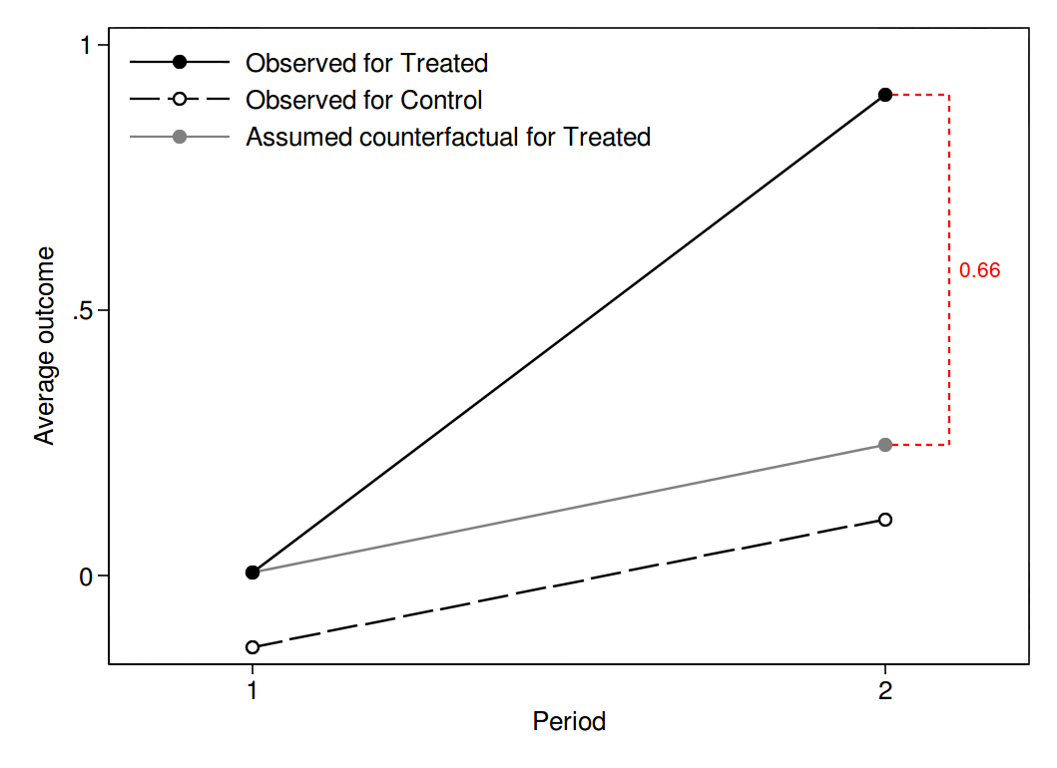
Key assumption: parallel trends
Treatment Effect

Slide 35
Method 3: Difference-in-difference
 | TREATMENT upgraded villages | COMPARISON Non upgraded villages | Difference
POST-rural roads upgrading Consumption per capita 2016 | 301.6 | 219.1 | 82.5
PRE- rural roads upgrading Consumption per capita 2014 | 274.4 | 219 | 55.4
PRE- rural roads upgrading Consumption per capita 2012 | 273.4 | 218 | 55.4
Difference in consumption per capita between 2016 and 2014 | 27.2 (301.6-274.4) | 0.1 (219.1-219) | 27.1* (301.6-274.4)-(219.1-219) =(Difference-in-Difference)

Slide 36
Method 3: Difference-in-difference
How could you use this data on consumption per capita in 2012 to improve your analysis? Based on the information in Table 4, what would be your new estimate of the impact of the rural road upgrades on consumption per capita?
Compare your new estimate to the estimates you obtained with Methods 1 and 2. Is the estimated impact lower or higher? Why do you think this is?
Notes:
Can you correct the weaknesses of Method 1 by taking a random sample of municipalities that participated in the rural road upgrading and a random sample of those that did not?
Using the data described above, can you come up with some more convincing methods for estimating the impact of the rural roads upgrades? What kind of information would be helpful?

Slide 37
Method 3: Difference-in-difference
Extra notes
Can also use triple difference
matching + DD is a common method
More powerful when there is significant data before treatment so trends can be examined (and controlled for).
important weakness:
Projects often deliberately targeted based on expectations of differential rates of change
“we targeted roads at villages with especially high potential for agricultural growth.”

Slide 38
Method 4: Regression discontinuity (RD)
Now imagine that instead of allocating the road project to villages that applied on time, the team instead ranked eligible villages
based on relevant criteria such as poverty, distance to markets, condition of existing roads
All 2,000 villages are ranked, and all villages with scores above some threshold receive the program, and those below it do not.

Slide 39
Method 4: Regression discontinuity (RD)
Treatment and control will be very different in general, except immediately above and below the threshold
Imagine that the cutoff is 500
Wealthy village near the capital = ranked 995
Poor remote village 1,000 km from capital = ranked 15
These cannot be meaningfully compared

Slide 40
Method 4: Regression discontinuity (RD)
But what about villages 498, 499, 500, 501, 502?
Presence above or below treatment threshold is essentially arbitrary, (close to) random.
Villages 499 and 501 are likely very good comparators for each other

Slide 41
Method 4: Regression discontinuity (RD)
Assignment to the treatment depends on continuous “score” or ranking
observations ordered by looking at the score
there is a cut-off point for “eligibility” – clearly defined criterion determined ex ante
cut-off determines the assignment to treatment

Slide 42
conclusions
High quality non-experimental IE is data-intensive
Advances in big data (remote sensing, high frequency/high resolution administrative data, new survey methods) are making this more feasible
Many examples in forthcoming presentations

Slide 43
conclusions
To design conduct high quality impact evaluations of major transport infrastructure projects, we may need the full toolkit of IE methods

Slide 44
conclusions
In Phase 1 of ieConnect, we have IEs which have:
A non-experimental component which estimates the impact of transport infrastructure (a road, a corridor, a BRT system)
Complementary experimental interventions which test key components of program logic

