Slide 1

Introduction to TARIFF REFORM Simulations using UTAs January 2022, Pakistan Business Council
Federico Ganz
fganz@worldbank.org

Slide 2
Before we begin...
Please, mute your microphone
If you have a question, please raise your virtual hand

Slide 3
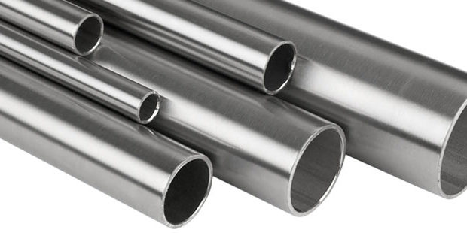

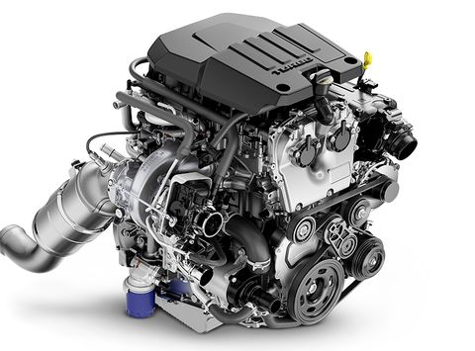
THE “CAR ECONOMY” EXAMPLE Assume we have a very simple economy that has only three industries: Steel production, Engine manufacturing and Car manufacturing. Let’s also assume that the Steel industry uses no inputs (all the output is value added), that the Engine industry uses steel (only input) and value added, and that the Car industry uses engines (only input) and value added. Assume that steel and engines can be imported, and that cars are only sold to final consumers (cars are not used as production inputs).
DOMESTIC Steel
(100% va)
DOMESTIC Car
(60% engine, 40% va)
DOMESTIC Engine
(80% steel, 20% va)
VA: VALUE ADDED

Slide 4
EXAMPLES OF QUESTIONS THAT CAN BE ADDRESSED WITH UTAS Assume that tariffs on imported steel are raised... How would that affect the production costs of the domestic engine industry? And of the domestic car industry?
DOMESTIC Steel
(100% va)
DOMESTIC Car
(60% engine, 40% va)
???
+TARIFF ON IMPORTED STEEL
???
DOMESTIC Engine
(80% steel, 20% va)
VA: VALUE ADDED

Slide 5
EXAMPLES OF QUESTIONS THAT CAN BE ADDRESSED WITH UTAS Assume that tariffs on imported steel are raised... How would that affect the effective protection of the domestic steel industry? And of the domestic engine and car industries?
DOMESTIC Steel
(100% va)
DOMESTIC Car
(60% engine, 40% va)
+TARIFF ON IMPORTED STEEL
COSTS?
TARIFF?
COSTS?
TARIFF?
EFFECTIVE PROTECTION?
EFFECTIVE PROTECTION?
COSTS?
TARIFF?
EFFECTIVE PROTECTION?
DOMESTIC Engine
(80% steel, 20% va)

Slide 6
THREE KEY CONCEPTS
1. Output tariff: tariff applied to the imported variety.
Example of the engine industry: the tariff applied to imported engines.
2. Upstream tariff: tariffs applied to inputs used to produce the good.
Example of the engine industry: the tariff applied to imported steel.
3. Effective protection: is the difference between the output tariff and the upstream tariff.

Slide 7
DIRECT AND INDIRECT INPUTS… While the car does not use steel directly, it does have steel embedded in the engine…
Does a tariff on steel affect the cost of producing cars?
It depends on whether domestic and foreign engines are perfect substitutes or not…
DOMESTIC Steel
(100% va)
DOMESTIC Car
(60% engine, 40% va)
???
+TARIFF ON IMPORTED STEEL
DOMESTIC Engine
(80% steel, 20% va)
VA: VALUE ADDED

Slide 8
UTAS offers two frameworks:
Product homogeneity: Domestic and imported inputs are perfect substitutes.
Example: the tariff on steel will not affect the cost of engines car manufacturers face (they can always buy the imported variety, which is unaffected by the tariff imposed on steel). Therefore, the cost of producing cars is not affected.
An industry’s production costs are only affected by direct inputs.
Product differentiation: Domestic and imported inputs are imperfect substitutes.
Example: the tariff on steel will affect the cost of imported engines, and therefore the cost of producing cars is affected.
An industry’s production costs are affected by direct AND indirect inputs.

Slide 9
What inputs do we need to analyze the impact of a tariff reform on production costs and on effective protection?

Slide 10
(1) Tariffs (customs data) (2) “Structure” of the economy (input-output tables) (3) Parameters (chosen by the researcher)
Steel INDUSTRY
(100% va)
Car INDUSTRY
(60% engine, 40% va)
TARIFF (70%)
TARIFF (5%)
TARIFF (20%)
An input-output table allows us to decompose each sector’s output into intermediate consumption (inputs from other sectors) and value added by the sector
Parameters
Remember that for the product differentiation framework we needed to specify the initial varieties mix, the substitution elasticity and the domestic variety’s supply elasticity.
Engine INDUSTRY
(80% steel, 20% va)

Slide 11
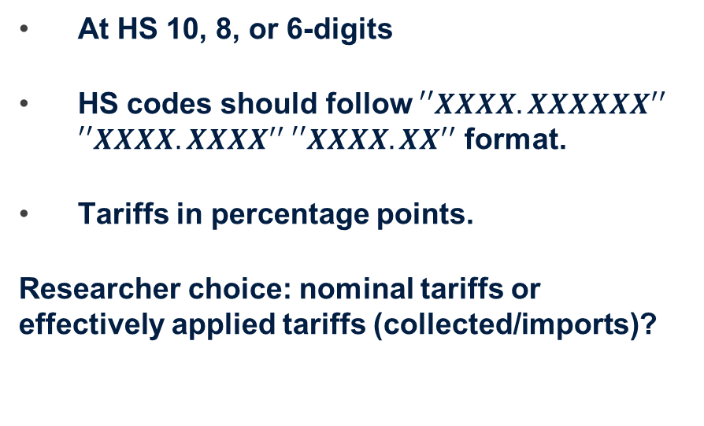
Formatting of the tariff schedule
The tariff-schedule needs to be formatted in a specific way to load into UTAS
At HS 10, 8, or 6-digits
HS codes should follow ${′′XXXX.XXXXXX}^{′′}$ ${′′XXXX.XXXX}^{′′} {′′XXXX.XX}^{′′}$ format.
Tariffs in percentage points.
Researcher choice: nominal tariffs or effectively applied tariffs (collected/imports)?
Column A - HS product code | Column B - Baseline Tariff
"0101.2100" | 7.7
"0101.2900" | 3.0
"0101.3000" | 0.0
"0101.9000" | 4.7
"0102.2110" | 0.0
"0102.2120" | 5.0
"0102.2130" | 0.0

Slide 12
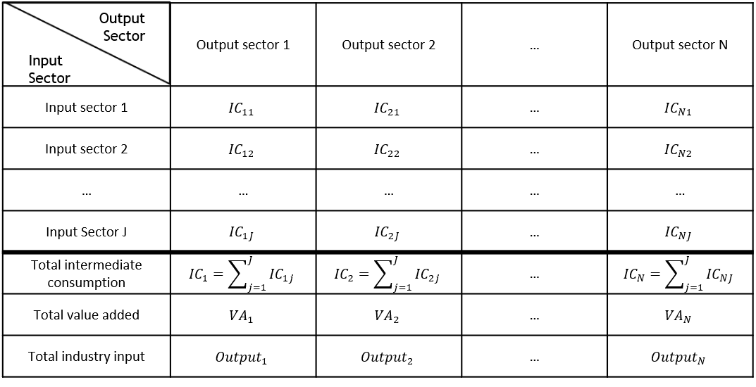
input-output tables: what are they?
Input-Output tables represent how different sectors in an economy depend one other via input-output relationships.
UTAS is flexible with respect to the industry classification that can be used, presenting three alternatives: GTAP, ISIC or NAICS.
However, the data must be formatted in a specific way: if there are N sectors (57 in the GTAP case), then the matrix should have N columns and N+3 rows (one row per sector + total intermediate consumption, total value added and total industry output).
Moreover, the names of the industries must be exactly equal to the names UTAS uses (they vary according to the classification chosen). We will provide an Excel file with this information.

Slide 13
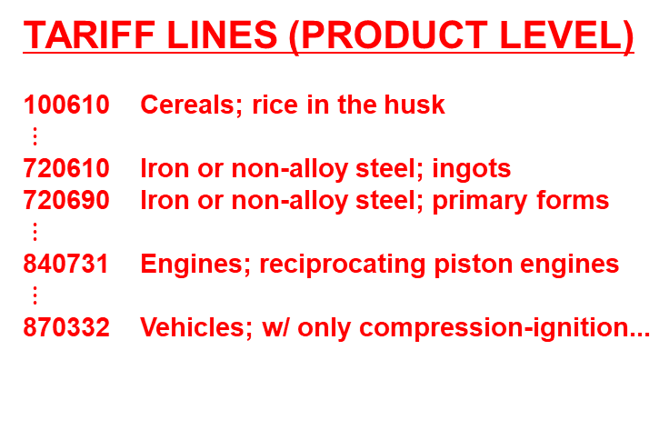
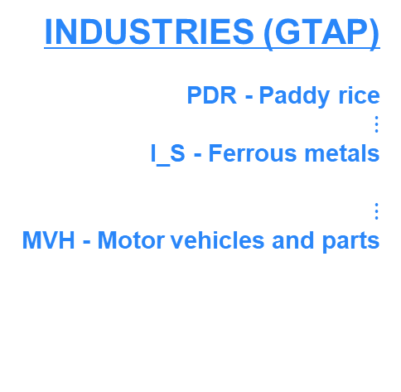
CONCORDANCE FROM PRODUCTS TO SECTORS Note that tariff data is available at the product level (e.g., HS 6 or 8 digit), while input-output tables are at the GTAP sector (industry) level.
THE UTAS TOOL MATCHES THE TARIFF DATA AT THE PRODUCT LEVEL WITH THE SECTORS USING A CONCORDANCE
TARIFF LINES (PRODUCT LEVEL)
100610 Cereals; rice in the husk
$⋮$
720610 Iron or non-alloy steel; ingots
720690 Iron or non-alloy steel; primary forms
$⋮$
840731 Engines; reciprocating piston engines
$⋮$
870332 Vehicles; w/ only compression-ignition...
INDUSTRIES (GTAP)
PDR - Paddy rice
$⋮$
I_S - Ferrous metals
$⋮$
MVH - Motor vehicles and parts
CONCORDANCE
Practical note. Unfortunately, there is no perfect match for the industries in our example (“Steel”, “Engine” and “Car”) and the 57 sectors available in GTAP (the IO table we have available for Pakistan). For example, both finished vehicles and car parts are classified in the same broad sector “Motor vehicles and parts” in GTAP. Moreover, steel products are classified in the broad category “Ferrous metals”. This is one of the limitations of the tool: the level of disaggregation of the results will be limited by the sectors included in the classification chosen (GTAP in this case).

Slide 14
Structure of the tool
INPUT | Assumptions | Modules | Output
Input-Output data
Tariff-Ranking
HS code tariff ranking
Simulator 1
Sector specific analysis
Baseline tariff data
Framework choice & parameters
Simulator 2
Cross-sector analysis
Tariff reform scenarios
Simulator 3
Tariff scenario analysis

Slide 15
Simulation modules
UTAS has four simulation modules that allow us to answer four different questions:
Tariff-ranking module: What tariff lines of the HS tariff schedule have a particularly large impact on the cost structure in a prioritized sector?
SIM I module: How does a change in input tariffs affect the cost structure and the effective protection in one specific sector?
SIM II module: What is the impact of a change in input tariffs across several sectors?
SIM III module: What is the impact of a change in the tariff schedule at the product level?

