Slide 1
Pension design and older worker labor supply in LMIC
Clement Joubert
DECHD

Slide 2
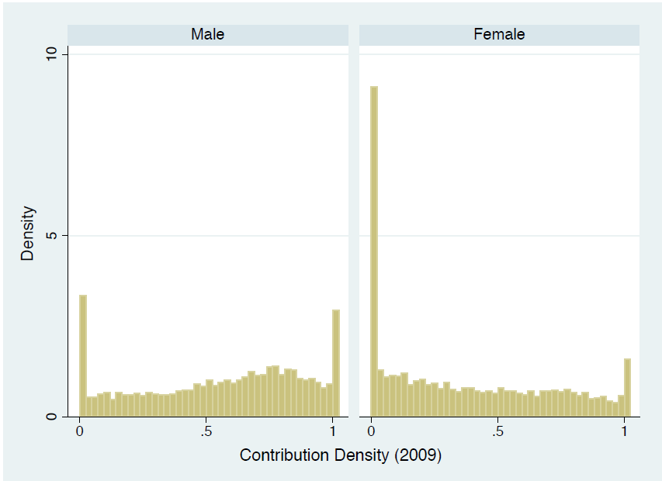
Low pension coverage across people and over lifetimes
2/3 workers worldwide do not contribute to a formal pension scheme
Even fewer consistent contributors, particularly among women
Source: Pallares-Miralles et al. (2012) using World Bank Pension database
Source: EPS and Chilean pension system data

Slide 3
Low earners have lower contribution densities
Continuous formal employment histories tend to be associated with high earners
Low earners are more likely to contribute infrequently or not at all, leading to low replacement rates
E.g.: Fraction with over 80% contribution densities in Peru’s SPP
Top income quintile: ¾
Bottom income quintile: ¼
Source: Freudenberg & Toscani 2019

Slide 4
High LFP after age 65
Male LFP by education level
Male LFP by self-reported health

Slide 5
Pension design challenge 1: Covering infrequent contributors
In HI countries:
Infrequent contributors tend to be married women
Typically married to a consistent contributor
Main instrument: survivorship pensions
In LMI countries:
Infrequent contributors tend to be lower earning men and women
Many households lack a consistent contributor, so survivorship pensions are not sufficient
High rates labor force participation after age 65
=> lower health levels, low productivity and high disutility of labor
Main instrument: broad non-contributory benefits

Slide 6
Pension design challenge 2: Keeping (skilled) workers in the formal labor force longer
Fast aging in LMIC implies rising dependency ratios, lower GDP per capita growth and increasing pension deficits
Need to keep skilled workers in the formal labor force longer
Many generous/unsustainable formal pension systems
small coverage often limited to public and large formal company workers
covers highly educated workers
Disincentives for formal force participation (similar to HIC pension systems)
High replacement rates
Low retirement ages
Actuarially unfair early retirement provisions
Legal hindrance to delaying retirement past legal retirement age or combining pension receipt with labor supply

Slide 7
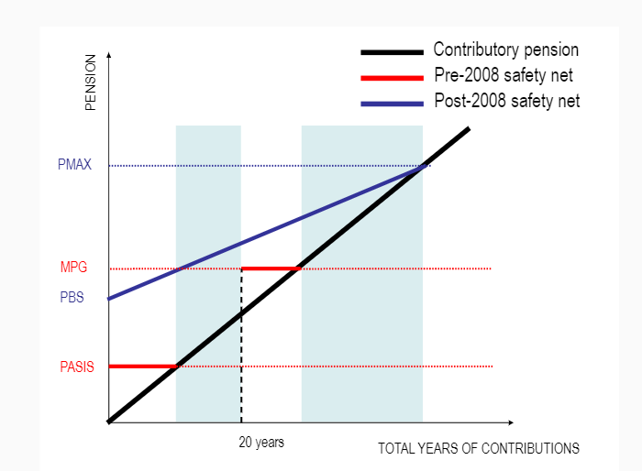
Integrating contributory and non-contributory pensions: Chile’s 2008 reform
Main parameters defining an integrated minimum pension:
Level of basic pension
Claw-back rate/Implicit tax rate
Years of contribution requirement
Means test
Wealth effect:
Larger government transfers lower the marginal utility of wealth which reduces lifetime labor force participation
Substitution effect:
“Claw-back” lowers pension accrual rates affect labor force participation and formality by altering the effective wage in the formal sector.
Impacts analyzed in Joubert & Todd (2023)

Slide 8
Data: Linking administrative records and longitudinal survey data
Pension research requires long panels! => administrative pension records
Full formal labor histories,
Earnings can be backed out from contributions (up to the taxable limit)
Usually accurate
Limited socio demographics
No information on informal jobs
Chile: linked longitudinal survey (Encuesta de Proteccion Social)
Admin pension records as sampling frame, representative of all affiliates
Completed sample with non-contributors to obtain representative sample
Retrospective self-reported employment histories can be checked against admin records
Additional information on household wealth, health, family history, pension and financial knowledge etc.

Slide 9
Policy analysis using an estimated structural model
Develop a model
Develop a dynamic model of households’ labor supply and saving decisions
Rich observed and unobserved heterogeneity to capture the formal/informal margin
Estimate parameters
Estimate the model’s parameters using panel data on Chilean households
Identification from panel data (Taber & Vejlin (2020))
Validate model prediction with quasi-experimental variation or literature
Simulate policies
(Micro)-simulate labor supply, saving decisions, pension benefits, government costs under different pension designs to isolate their effect

Slide 10
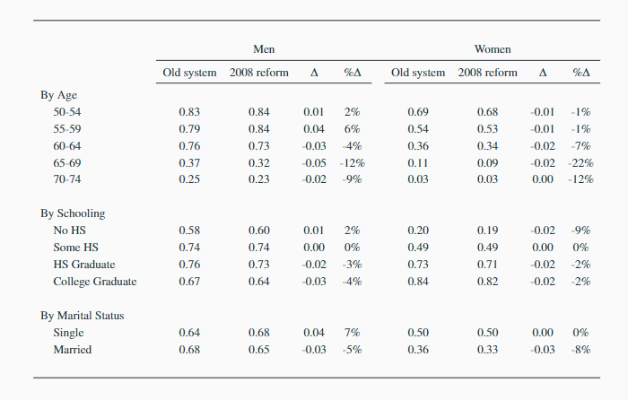
Impacts of Chile’s 2008 reform on labor supply (Joubert & Todd 2023)
New design appears to improve incentives for work before age 60
lower implicit tax,
less stringent means-test
Negative wealth effect dominates after age 60
Moderate impact magnitudes (-/+ 5 percentage points),
consistent with non-structural studies: triple diff (Behrman et al., 2011), DinD with matching (Encina, 2013), reduced-form modelling of pension incentives (Attanasio et al., 2011, Becerra, 2019)

Slide 11
Impacts of Chile’s 2008 reform on labor supply (Joubert & Todd 2023)
Negative effect concentrated on married men and women and higher schooling levels:
Transfers increase most for non-poor households with non-working women
Important to consider household structures in pension design!

Slide 12
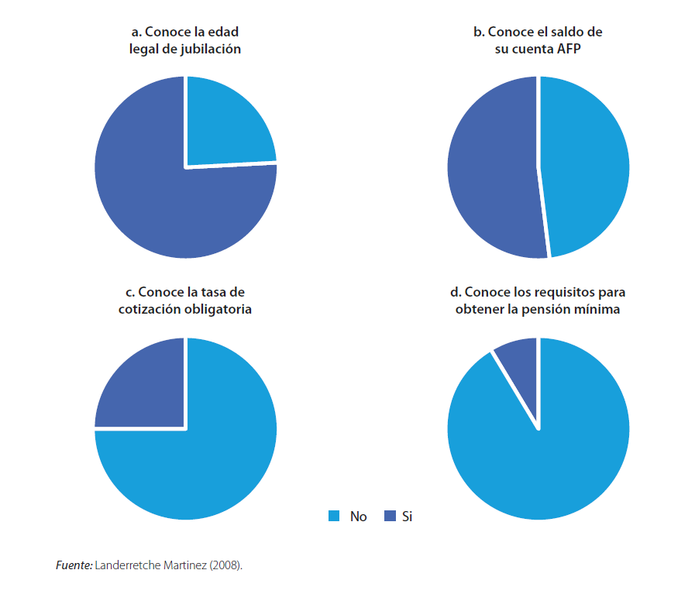
Additional challenge: Pension knowledge levels are low
Fewer than 1 in 8 Chilean workers knew the eligibility requirements for a minimum pension in 2008

Slide 13
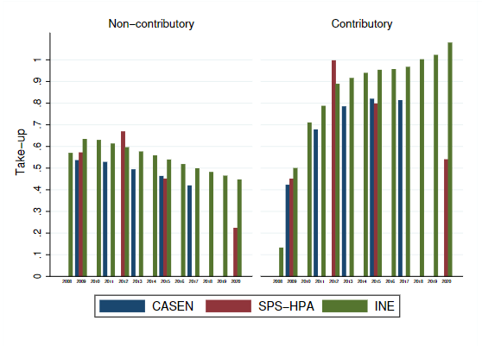
Imperfect take- up of pension benefits (Joubert & Troncoso 2023)
Combine administrative records and linked survey to measure and analyze the take up of non-contributory pension benefits
Preliminary results show that less than 60% of those eligible for the non-contributory minimum pension in Chile actually receive it
Implications for:
Incentives for labor supply
Old age poverty
Inequality/Effective targeting
Political support for the system

