Slide 1
Labor Supply at Older Ages: Pension Institutions and Care Arrangements John Giles (DECHD)

Slide 2
Outline of Talk
CHARLS and HRS-type Observational Data (DECRG collaboration since 2007)
Descriptive Evidence on Factors Influencing Labor Supply
Family Care Arrangements: Impacts on the Well-Being and Labor Supply of Care Providers
Ongoing work using observational data
Possible area for collaboration in project evaluations?

Slide 3
HRS Family of Surveys and other Health Surveys in China
International “HRS” Surveys
Other Surveys in China
US：HRS，1992
UK：ELSA，2002
Europe：SHARE，2004
Japan：JSTAR，2007
Korea：KLoSA，2008
Indonesia: since 1998
India：LASI，2014
Mexico
Brazil
South Africa
Chinese Longitudinal Healthy Longevity Survey (CLHLS)
China Health and Nutrition Survey (CHNS)
China Kadoorie Biobank (CKB)
Not as representative
Gateway to Global Ageing: https://g2aging.org/

Slide 4
CHARLS Timeline
2008
2009
2010
2011
2012
2013
2014
2015
2016
2017
2018
2019
2020
2021-22
Two Province Baseline
National Baseline
Two-Province follow-up
2nd wave
Life History
3rd wave
Oral History
4th wave +HCAP
Covid-!9 Special Survey
5th wave

Slide 5
A variety of indicators
 | Indicators
👨 Demographics | Gender, age, education, marriage, household registration, migration, family
🏠 Socioeconomic status | Household income, employment/work, expenditure, wealth, pension, housing conditions, family structure
🏃‍️ Health status and behaviors | ADLs/IADLS, diagnostic histories, bio-markers, cognition, smoking, alcohol consumption, weight, exercise, sleep
📖 Health literacy | Knowledge of disease prevention and control, mental health literacy
🏥 Healthcare accessibility | Accessibility of medical facilities, health insurance, medical service utilization
🌲 Enviornmental factors | Air pollution, green space environment

Slide 6
CHARLS Publications

Slide 7
Retirement in China by Urban and Rural Registration Status

Slide 8
Retirement Rates by Hukou Status
Source: Giles et al (JPEF, 2023) using data from CHARLS (2018).

Slide 9
Retirement Rates in International Context
Source: Gateway to Global Aging and CHARLS 2018.

Slide 10
Unconditional Retirement Hazard Rates
Hazard rates at each age are defined as the percentages of those who exited employment at the age among those who exited no earlier than the age.
Source: Giles et al (JPEF, 2023) using data from CHARLS (2018).

Slide 11
Evidence from Labor Supply Models
Retirement patterns are very different in urban and rural China
Rural elderly “work until dropping”
Retirement (Exit from Work) is strongly associated with
Mandatory retirement ages for workers covered under the urban employee pension (formal sector workers)
Greater coverage and generous pension in urban areas
Own health status => Disability hastens retirement in urban and rural areas
A significant urban-rural gap in economic resources
Policy implications for an aging China
Urban residents should be encouraged to stay on the labor force longer: raising retirement age? facilitating gradual retirement?
More generous social pensions for informal and rural workers, allowing the freedom to retire
Joint retirement preferences: Raising women’s retirement ages may lead to longer working lives for men as well.
Source: Giles et al (JPEF, 2023) using data from CHARLS (2018).

Slide 12
Care Provision and Work/Employment

Slide 13
Policy Related to Long-Term Care
China emphasizes a 90-7-3 model for provision of LTC.
90% in home (family support)
7% from community
3% institutional care
Considerable effort to develop community care centers, with various models. Often started with substantial subsidies, but not self-sustaining. In rural areas often very few services.
Recent developments in telephone hotline and web-based services in urban areas.
Cost, financing and staffing remain important problems for both community-based and institutional care

Slide 14
Strain on Traditional Care Arrangements
Traditionally responsibility for care of infirm older persons has rested with the family.
Children and spouses remain dominant care providers
Older men needing assistance receive care from spouses
Older women tend to receive more care from adult children
Significant gender differences in extent to which care needs are met
Only 1.5% of CHARLS 2020 respondents receive care from hired care providers (including facilities)
Failure to meet care needs can have serious consequences for well-being: greater incidence of depression, psychological distress, more hospital admissions
Notes:
Note Filial Piety, and

Slide 15
“Consequences” of Out-Migration for Older Persons in Rural Areas
As of 2011, 59% of older people (60 and above) live in empty nests.
Living in an “empty nest” is associated with poorer health and cognition (Lei et al, 2015).
Living alone is associated with poorer health compared with those living either with a spouse or children (Zhou et al, 2018).
Those living alone may yet have children nearby, but those this will change as the extended family size of older people continues to decline.
Share of children of older persons living outside their home county increased from 48% in 2011 to 57% in 2018.

Slide 16
With Migration of Younger Cohorts, Population Aging is More Pronounced in Rural Areas
Projected Dependency Ratios for
Urban and Rural China, 2008-2030
Source: Cai, Giles, O’Keefe and Wang (2012)

Slide 17
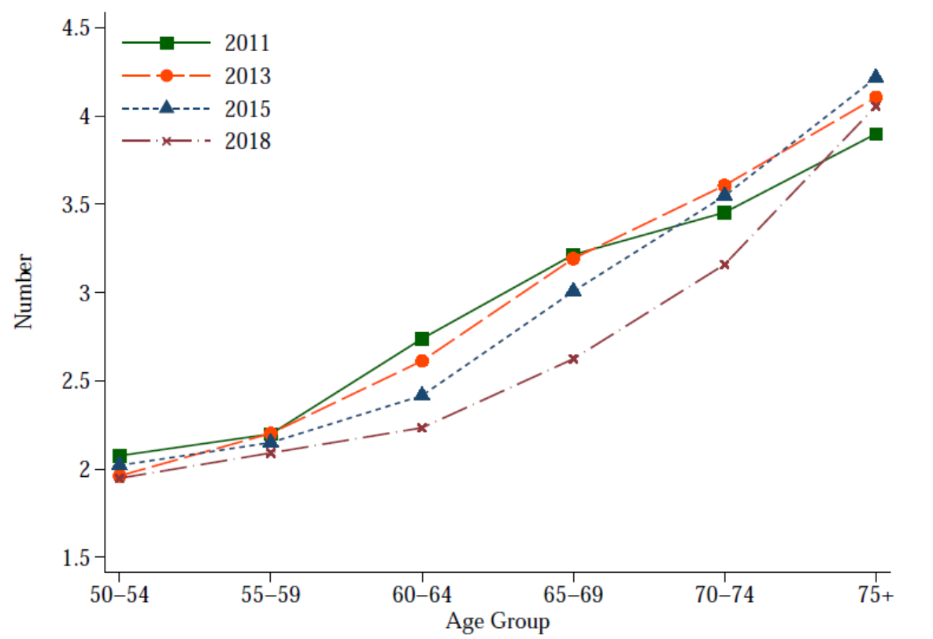
Number of living children among the adults aged 50+ from CHARLS data
Source: Chen et al 2022 (The Path to Healthy Aging in China, Lancet)

Slide 18
Where Should Older Persons Live?
When an older parent becomes infirm, there is a strong return migration response (Giles and Mu, 2007), and this has significant consequences for family earnings.
Several factors complicate movement of older persons to the city with adult children:
Geographic fragmentation of health insurance and pension systems
Remaining vestiges of the residential registration (hukou) system (access to public LTC facilities based on hukou status)
Fear of losing option value of access to land (weakness in the land tenure system)
Cost of housing in urban areas

Slide 19
Evidence of Effects of Providing Care on Care Providers
US HRS: Long-term care provision may be associated with increases in depressive symptoms and poor self-rated health (Coe and Van Houtven, 2009)
Overall international evidence seems mixed: Providing care is a prosocial behavior and may yield “stress buffering” adaptations (e.g., Roth et al, 2018).
In China, providing care yields an additional source of stress as it draws care-providers out of the work force.
Evidence from the "oldest-old" survey using 895 matched pairs: a caregiver's low income and status as an "eldest son" increased the likelihood of suffering economic stress

Slide 20
Impacts of Providing Care on Spouses
Spousal care providers often provide higher quality care and have fewer other commitments (already out of workforce).
Women frequently outlive spouses and are less likely to have spousal care providers.
Ai and Feng (2020) use propensity score and differencing with CHARLS data in an attempt to examine impacts of providing care on health status of care providers.
Significant impacts on well-being of women
Appear to be attenuated when additional assistance is available

Slide 21
Impact of Providing Care on Spouse Well-Being
Source: Ai and Feng (2020) using data from CHARLS (2011, 2013 and 2015)
Notes:
Source: CHARLS (2013 and 2015) developed from Ai and Feng (2020), Table 4.
Notes on Estimation:
1) Estimated impacts using propensity score matching using caliper one-to-one matching with a caliper set to 0.01. Whiskers show 95 percent confidence intervals around bars signifying point estimates of each health effect on providers of providing care.
2) Chronic diseases include hypertension, dyslipidemia, diabetes or high blood sugar, cancer or malignant tumor, chronic lung diseases, liver diseases, heart diseases, stroke, kidney diseases, stomach or other digestive diseases, emotional, nervous, or psychiatric problems, memory-related disease, arthritis or rheumatism, asthma.
3) "Good self-rated health" means self-rated health of the individual is "Excellent," "very good," "good"; "extreme BMI" means the BMI is above 25 or below 18.5; "depression" means the score of CESD is above 10.

Slide 22
Impact of Providing Care on Spouse Well-Being with Additional Assistance
Source: Ai and Feng (2020) using data from CHARLS (2011, 2013 and 2015)

Slide 23
Is Presence or Absence of Someone Requiring Care Associated with Labor Supply Decisions?¹
Exploit the 2011 and 2013 Waves of the CHARLS Survey
For those aged 45-65,
Examine Change in Work Status (and other outcomes0 with Change in Number of Elderly Parents In Home, and then in Neighborhood or Home. (Why both?)
Change in Elderly in Poor Health more Relevant.
Not necessarily a negative effect on labor supply
If additional health costs are imposed by providing care, one might expect an “added worker effect” and an increase in labor supply
Grandparents and other older relatives may be providing housing or childcare and facilitating work.
An older person with minor disability may yet be providing some childcare.
Does incidence of depression (CESD-10) change with presence of parents? Allocation of time to leisure/social activities?
¹Giles, Jiang and Zhao (in process)

Slide 24
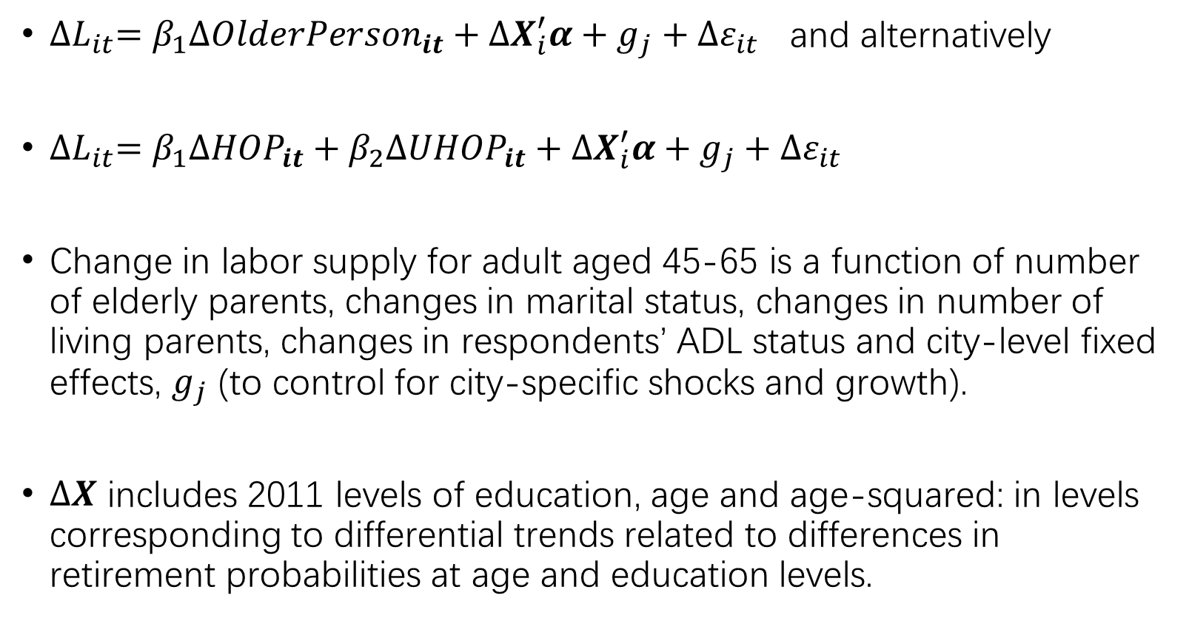
Estimate First-Differenced Models at Household and Neighborhood (Village) Level
${∆L}_{it}={β_{1}{∆OlderPerson}_{it}+∆X}_{i}^{′}α+g_{j}+{∆ε}_{it}$ and alternatively
${∆L}_{it}={β_{1}{∆HOP}_{it}+β_{2}{∆UHOP}_{it}+∆X}_{i}^{′}α+g_{j}+{∆ε}_{it}$
Change in labor supply for adult aged 45-65 is a function of number of elderly parents, changes in marital status, changes in number of living parents, changes in respondents’ ADL status and city-level fixed effects, $g_{j}$ (to control for city-specific shocks and growth).
$∆X$ includes 2011 levels of education, age and age-squared: in levels corresponding to differential trends related to differences in retirement probabilities at age and education levels.

Slide 25
When an Infirm Parent or in-Law Lives in the Home:
Urban Areas
Presence of older person, whether healthy or not, is not associated with decrease in work. (Retirement occurs first)
Men and women report spending 16.9 and 13.9 more hours per week providing care, respectively.
Women spend 61% less time on social activities outside the home when an infirm parent or in-law lives in the home. No difference for men.
Women are 14% more likely to be suffering from depressive symptoms. No difference for men.
Results are attenuated and less significant if expanding to include parents or in-laws in the neighborhood.

Slide 26
When an Infirm Parent or In-Law Lives in the Home:
Rural Areas
Men and women are 11% and 8% less likely to work, respectively.
Women work 6 hours less per week if parent or in-law is village (including home). No change in work hours of men.
Men and women report spending 21.8 and 15.6 more hours per week providing care.
No impacts on reported depressive symptoms nor on leisure activities outside the house.

Slide 27
Possible Area for DEC – Operations Collaboration
Identification problems when examining impacts of care provision with observational data are daunting.
D-i-D with phase in of long-term care insurance? Not convincing in China.
Introduce randomization into pilot programs supporting care (social care, light care) in home or community, examine impacts on labor supply and well-being:
Subsidies to pay for assistance
Placement of community activity centers
Training of volunteers among young retirees
More formal, “Time Banks” and their operation. (An almost project in Guizhou China)

Slide 28
Extra Slides

Slide 29
Pension Type, Coverage (%) and Monthly Benefit (Yuan): ages above 60
Pension Type | Urban | Rural | Total | Benefit
Employee Pension | 78.8 | 4.8 | 26.9 | 2,880
Firm's Pension | 59.1 | 3.5 | 20.2 | 2,600
Government or Institutions' Pension | 18.5 | 0.8 | 6.1 | 4,000
Resident Pension | 20.3 | 84.3 | 65.1 | 95
New Rural Social Pension | 2.3 | 62.4 | 44.4 | 90
Urban Residents' Pension | 5.3 | 1.1 | 2.3 | 1,000
Urban and Rural Residents' Pension | 5.6 | 17.6 | 14.0 | 100
Commercial Pension | 5.3 | 2.4 | 3.3 | 500
Other Pension | 3.1 | 3.9 | 3.7 | 900
Any Pension | 94.4 | 88.3 | 90.1 | 125
Source: Giles et al (JPEF, 2023) using data from CHARLS (2018).

Slide 30
Rural and Urban Residents Differ in Expected Primary Source of Financial Support
Expected Source of Financial Support Type (%)
 | Total |  | Men |  | Women
Type | Urban | Rural | Urban | Rural | Urban | Rural
Children | 12.4 | 67.6 | 9.7 | 64.2 | 15.4 | 70.8
Savings | 1.8 | 4.2 | 2.3 | 5.6 | 1.3 | 2.9
Pension | 82.8 | 20.8 | 85.6 | 22.0 | 79.7 | 19.6
Other | 3.0 | 7.3 | 2.5 | 8.1 | 3.6 | 6.7
Observations | 3,317 | 13,023 | 1,777 | 6,121 | 1,540 | 6,902
Data source: CHARLS survey, 2018. All numbers are weighted.

