Slide 1



THAILAND SYSTEMATIC COUNTRY DIAGNOSTIC UPDATE 2024
Shifting gears:
Toward sustainable growth and inclusive prosperity

Slide 2
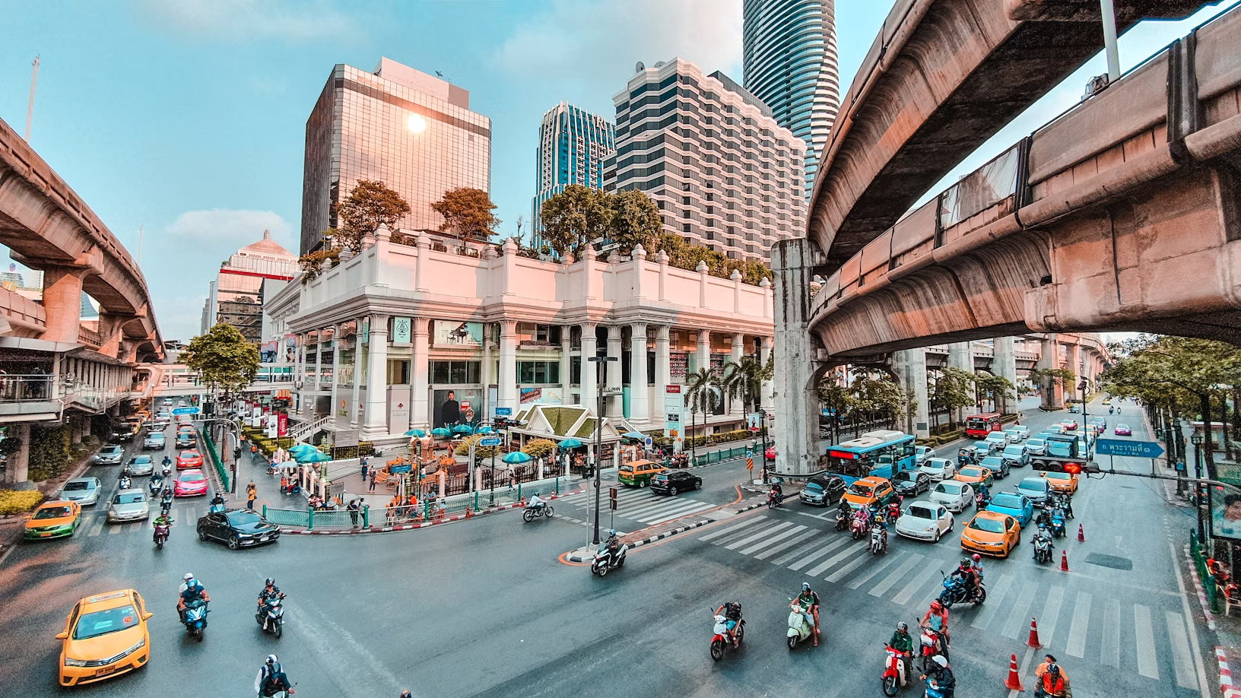

How has Thailand performed from a big-picture perspective?

Slide 3
Impressive Growth and Poverty Reduction
GDP per capita
Structural transformation
Source: Haver Analytics; World Bank.
Left panel: Figure shows GDP per capita (constant price PPP) in 1980 and in 2019. Gray lines show 45-degree lines crossing the origin and Thailand. The latter line indicates constant income gap with Thailand. The sample includes countries with a population of more than two million. Right panel: 1980–2019 for Thailand, China, and Korea. 2020 for other countries. ILO Modelled Estimates.

Slide 4
Economic Slowdown Amid Shocks
GDP demand components
Trajectory of income growth
Poverty and inequality trends
Source: Haver Analytics; Penn World Table, version 10; International Monetary Fund; WDI; Thailand’s Labor Force Survey and Household Socio-Economic Survey. World Bank staff calculations.
Left panel: Investment stands for Gross Capital formation. Middle panel: Y-axis shows GDP per capita (constant PPP basis), and X-axis shows years since the country reached US$15,000 (Thailand is in 2012). The latest datapoint is 2022.

Slide 5
Future Growth Projections
Potential growth, baseline scenario
Potential growth, illustrative reform scenario
Source: Kose and Ohnsorge (2023); World Bank.
Left panel: EMDE = emerging market and developing economies. Right panel: ASEAN5 includes Thailand (THA), Indonesia (IDN), Malaysia (MYS), and the Philippines (PHL). For Thailand, the structural transformation scenario assumes that the share of employment in agriculture will fall by five percentage points over 10 years starting in 2022 and be equally redistributed to the more productive manufacturing and services sector.

Slide 6
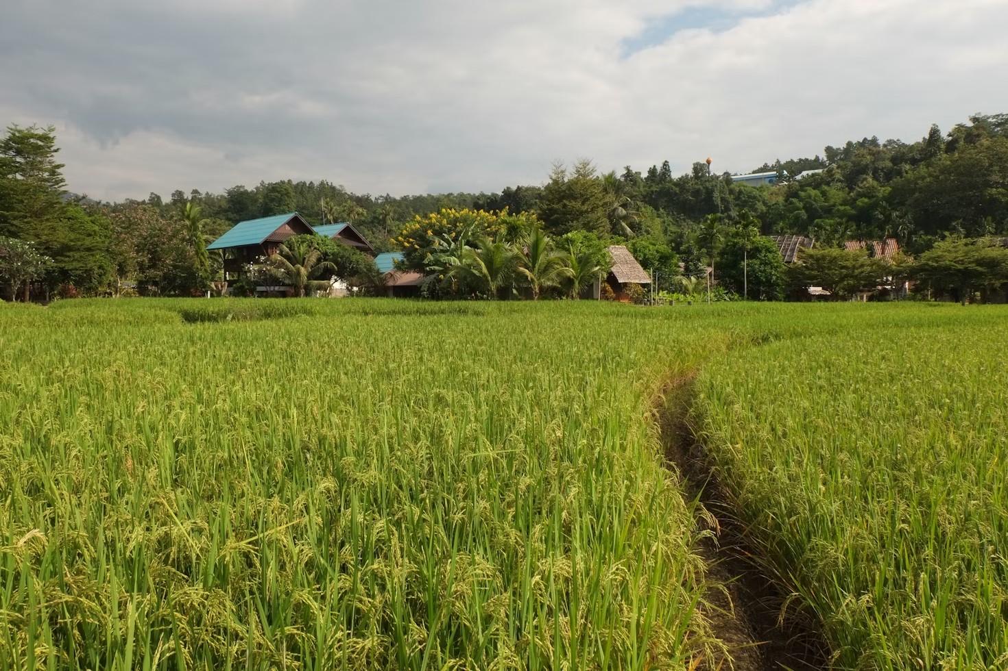
What challenges is Thailand encountering when viewed from a global perspective?

Slide 7
Inadequate and unequal human capital
Learning gap
Thailand is experiencing rapidly aging population and will become a super-aged society by 2030.
Thai students have the learning gap of 4 years, and the gap has widened.
Certain vulnerable groups face exclusion from resources and opportunities
Source: WDI, World Bank’s HCI.
Learning gap is the difference between the expected years of school and the learning-adjusted years of school.

Slide 8
Economic Inertia and Lagging Reforms
High tech exports
Thailand’s competitiveness in the global market has declined – underperformance in high-tech manufacturing and advanced service sectors.
Entry of small and innovative disruptors has declined, lagging regional peers
Source: WDI, World Bank.
2012-21 average growth rates.

Slide 9
Spatial disparity and connectivity gaps
Income and poverty by province
Centralization of resources and investment has resulted in infrastructural deficiencies outside Bangkok
More than half of Thailand’s provinces fall behind the upper-middle-income country (UMIC) threshold
Lack of integration between transportation and logistics networks, and between urban areas and border regions
Source: NESDC; World Development Indicator Database.
2012-21 average growth rates.
GDP per capita for Thailand provinces. GNI per capita for income group averages and thresholds. Poverty rate based on US$6.85 a day in 2017 PPP. The UMIC and HIC income thresholds as of July 2022 and US$ 4,256 and US$ 13,206, respectively.

Slide 10
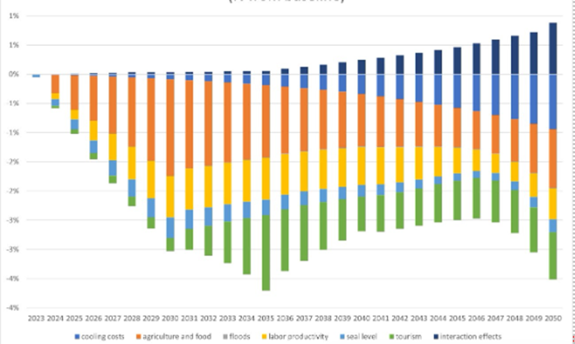
Environmental degradation and climate risks
Impact of different categories of climate damages on GDP (% from baseline)
Natural resources are being depleted, with deforestation and worsening air quality
Climate change could result in 4% GDP loss by 2050 (without considering extreme events)
GHS emissions have steadily increased, challenging carbon neutrality goal by 2050
Source: World Bank. Staff estimates

Slide 11
Institutional challenges
Public debt
Compared to aspirational peers, Thailand faces challenges in combating corruption, ensuring transparency, and promoting accountability
Low tax revenue compared to similar income countries, poses challenges to long-term fiscal sustainability
Control of fiscal resources in Thailand is mostly concentrated in Bangkok, which is leading to regional disparities
Public debt (% of GDP)
Source: PDMO; World Bank.

Slide 12
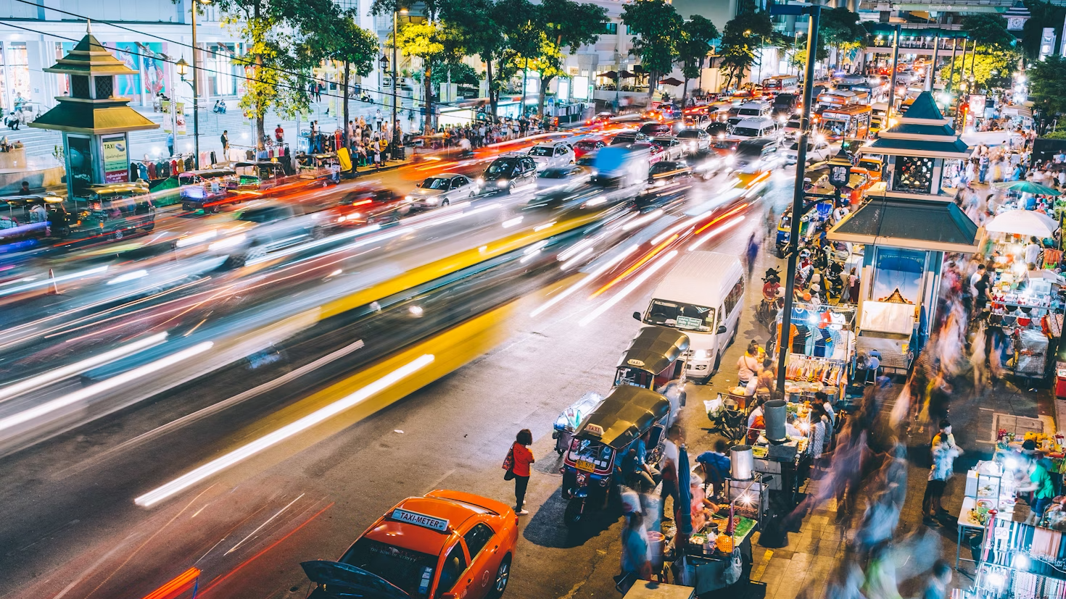
How can Thailand leverage this evolving global landscape to pivot towards sustainable growth and foster inclusive prosperity?

Slide 13
HLO 1: Strong human capital
Learning-adjusted years of schooling (Age 25+)
Equal and lifetime access to good quality education
Enhance social inclusion and safeguards for vulnerable populations
Strengthen the social protection, labour market, and health systems to address the impacts of the aging population and intensified shocks
Source: Haver Analytics; World Bank.
Distance from the global technological frontier is measured using the log TFP gap.

Slide 14
HLO 2: A competitive and innovative economy
Services exports, excluding tourism, global market share and growth
Promote competition, innovation, and technology adoption
Mobilize sustainable finance
Source: Haver Analytics; World Bank.
Circle size is proportional to export share in GDP. Average 2012-19.

Slide 15
HLO 3: Low carbon urban development and connectivity
Apply an area-based approach to development to unlock investment and growth potential
Close infrastructure gaps
Unlock the potential of digital data infrastructure
Source: Haver Analytics; World Bank.

Slide 16
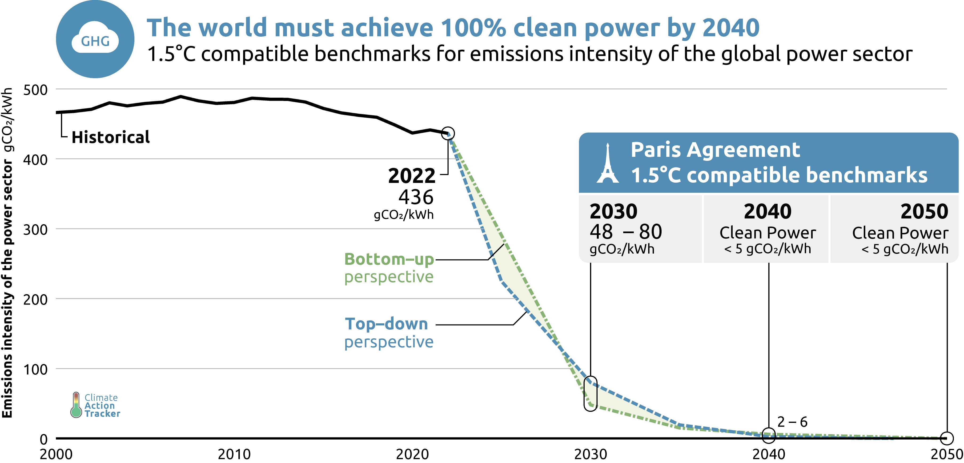
HLO 4: Sustainable development and protection against natural disasters and climate change
Promote environmental sustainability
Increase resilience to natural shocks and the effects of climate change
Support a sustainable energy transition
Source: Haver Analytics; World Bank.

Slide 17
HLO 5: Enabling institutions
Reform fiscal institutions and public finance
Move towards decentralization
Engage in open and participatory processes
Improve the governance of state-owned enterprises
Source: Haver Analytics; World Bank.

Slide 18
ขอบคุณค่ะ

