Slide 1


Slide 2


Slide 3

Notes:
Here we show ppp-ajsuted output per workers, relative to the US for the about last 60 years.
In 1920, output per worker in Latin America was around 20% of that in the US. Today the relative output per workers remains around similar levels. This lack of convergence contrasts with the experience of south Korea whose relative GDP was around 7% but at the end of the period reaches almost 70%.
The lack of convergence generalizes for other countries as seen in the graph.

Slide 4

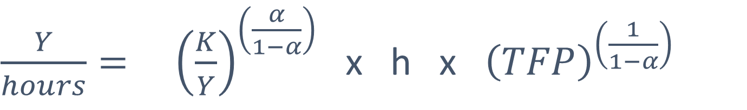
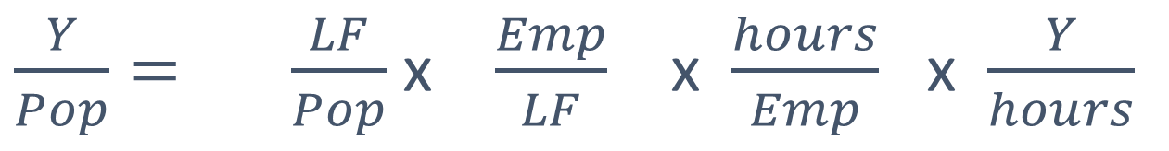
Decomposition of GDP per capita (PPP)
(average 2004-2014)
Hours/pop
$\frac{Y}{Pop}= \frac{LF}{Pop}$ x $\frac{Emp}{LF}$ x $\frac{hours}{Emp}$ x $\frac{Y}{hours}$
$\frac{Y}{hours}= {\left(\frac{K}{Y}\right)}^{\left(\frac{α}{1−α}\right)}$ x h x ${\left(TFP\right)}^{\left(\frac{1}{1−α}\right)}$
Composition of GDP per capita
(relative to USA)
Composition of output per hour
(relative to USA)
Closing the TFP gap would increase GDP per capita in Latin America from 26% to 70% of that in the United States
Hour / Pop $=1$

Slide 5


Slide 6


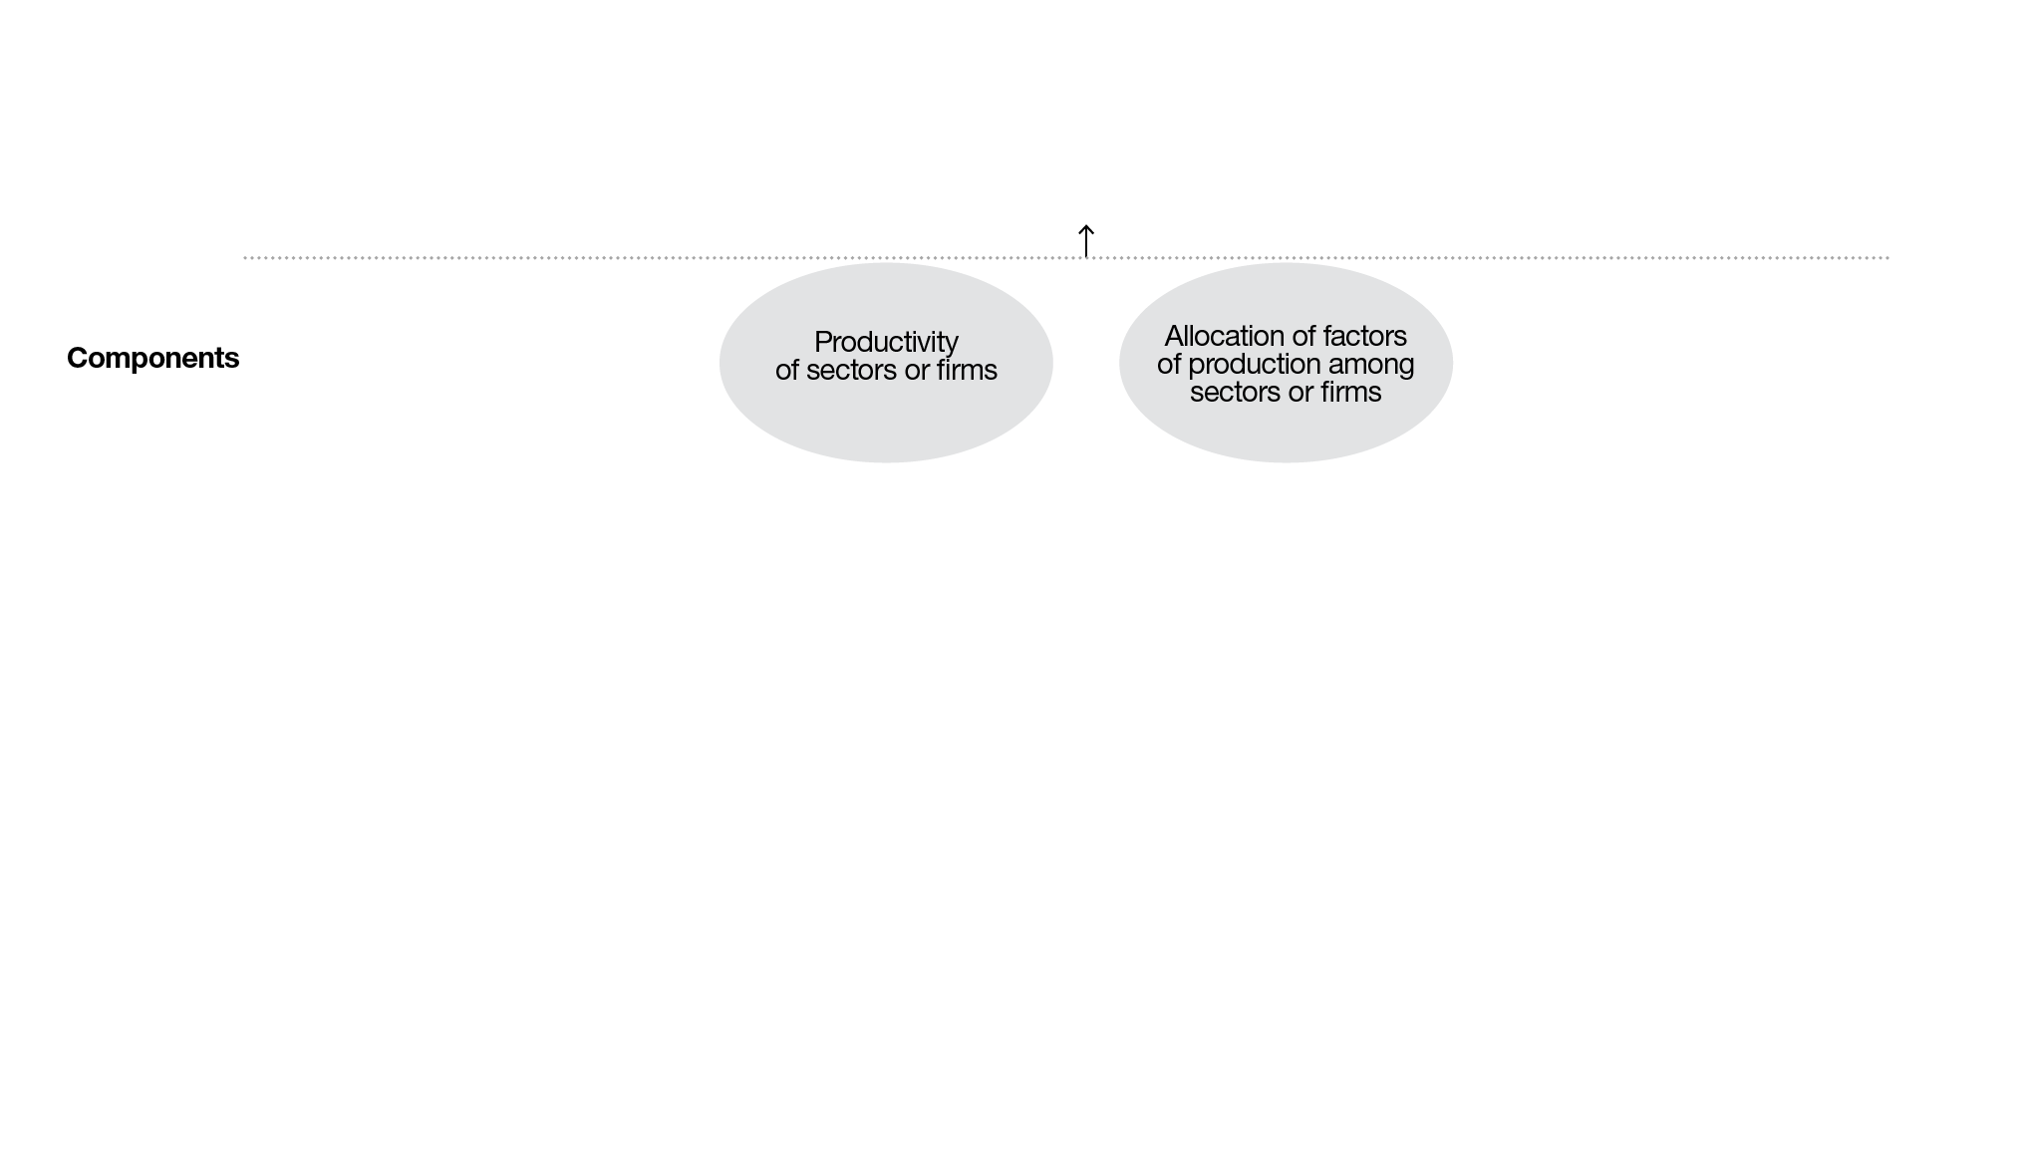
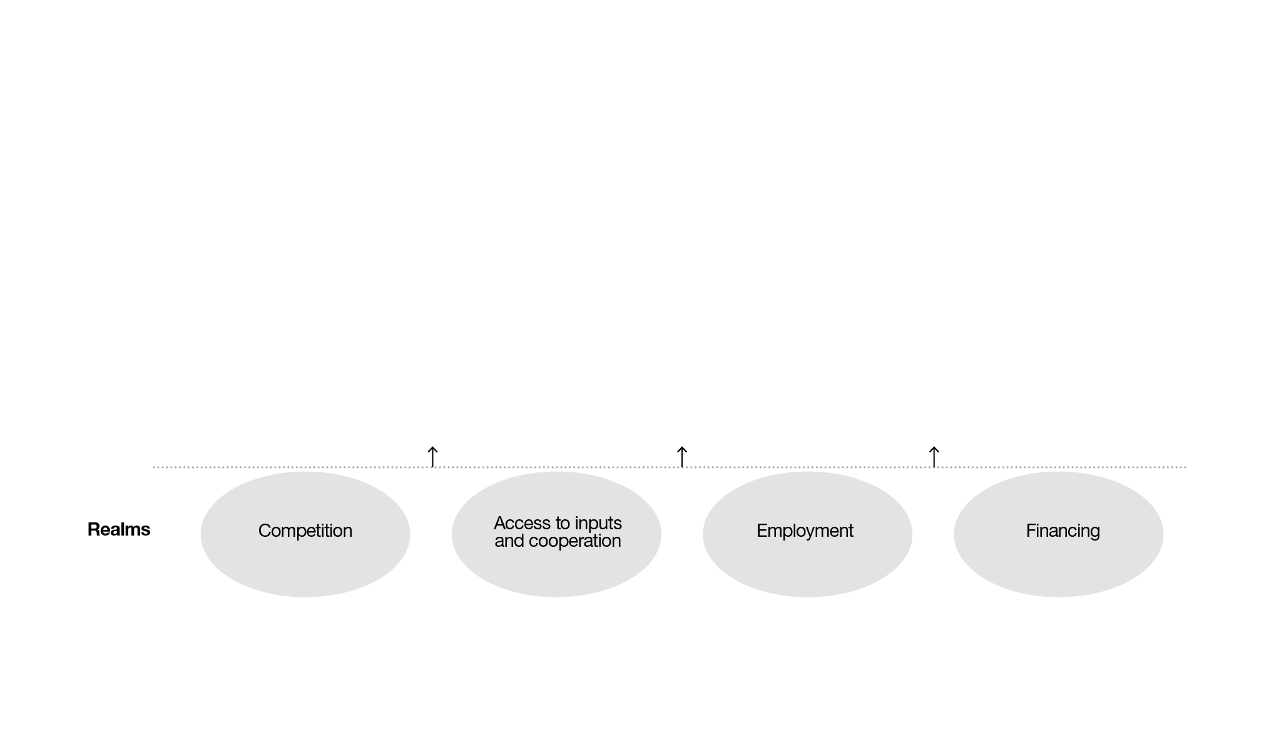
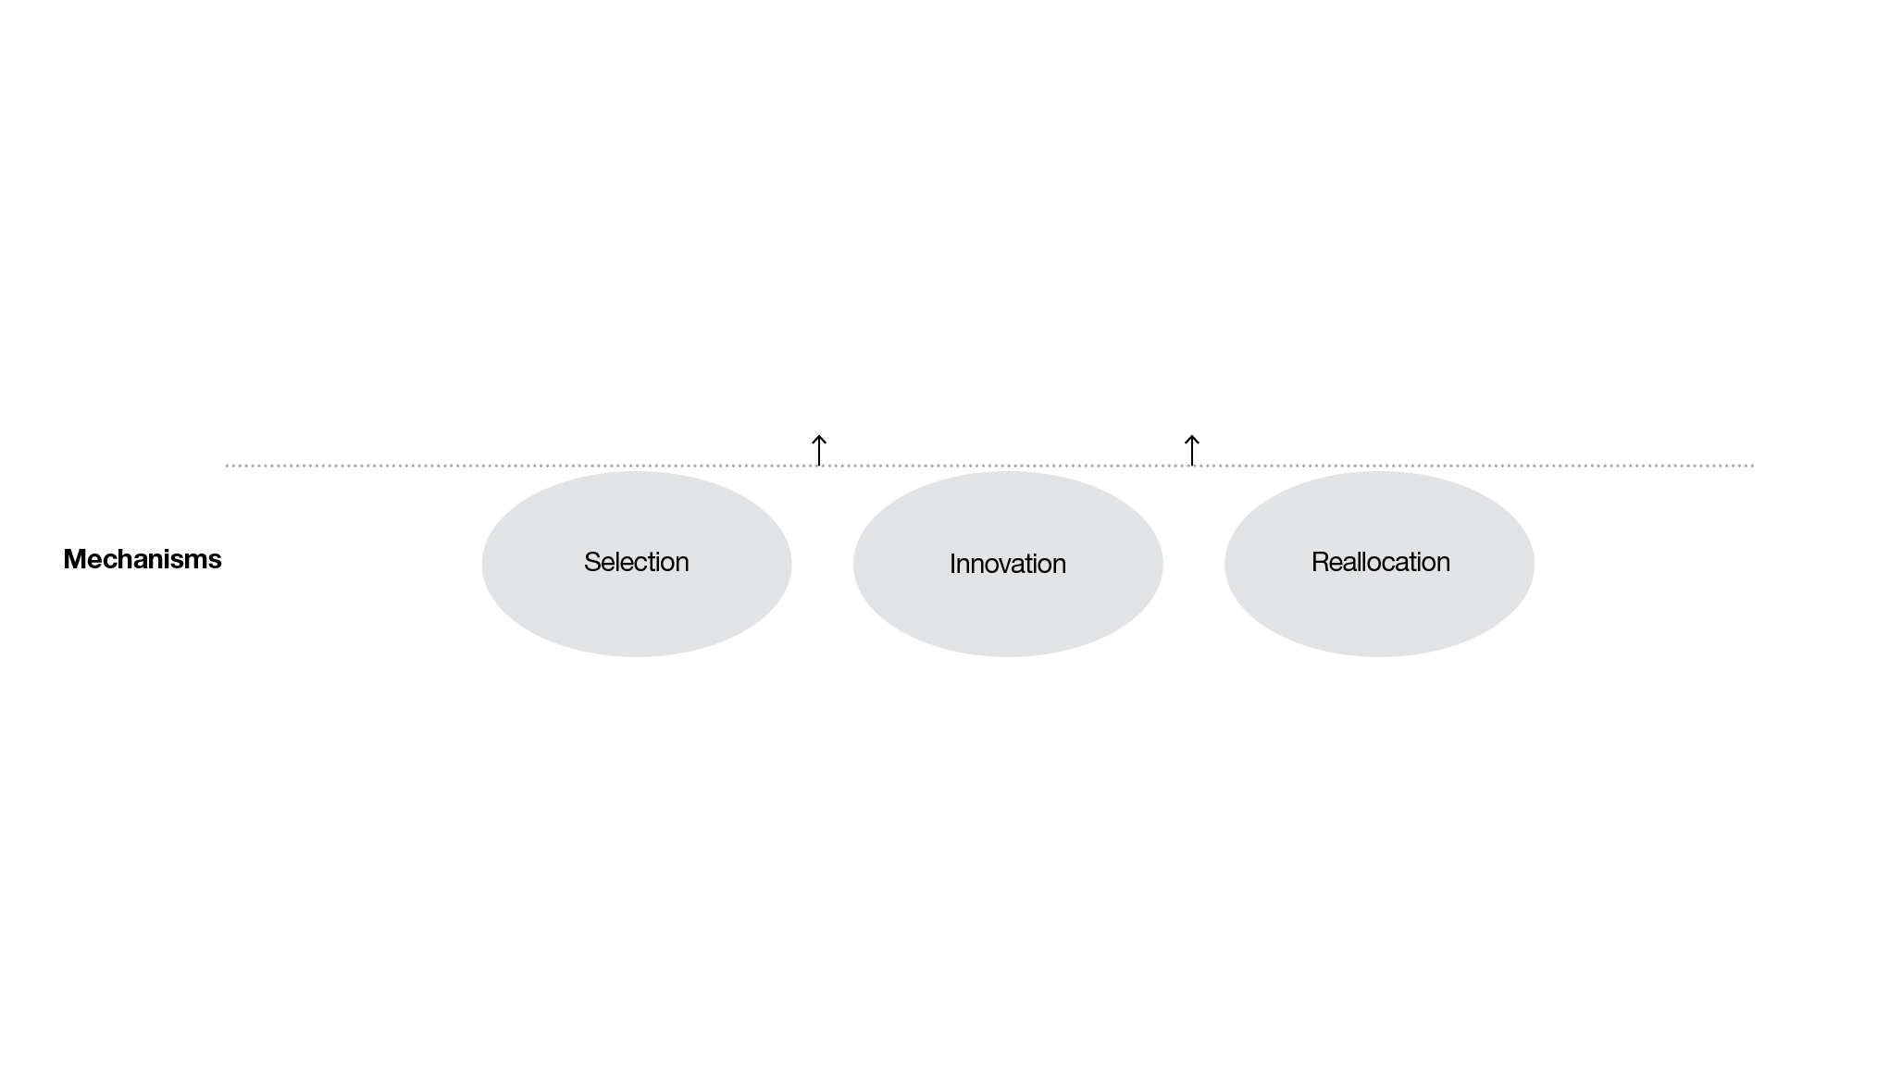
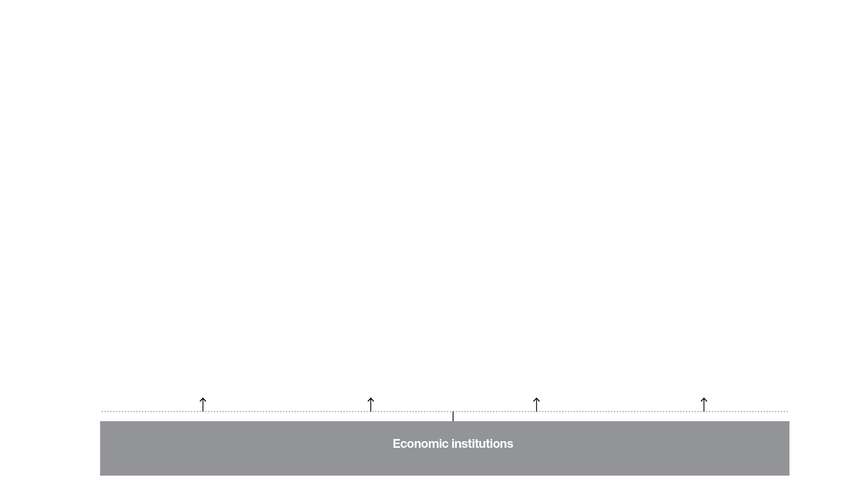
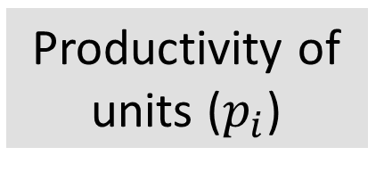
Aggregate productivity
Components
Productivity of units ($p_{i}$)
Allocation among units

Slide 7
Aggregate productivity
Components
Productivity of units ($p_{i}$)
Allocation among units
Mechanisms
Selection
Innovation
Reallocation

Slide 8
Aggregate productivity
Components
Productivity of units ($p_{i}$)
Allocation among units
Mechanisms
Selection
Innovation
Reallocation
Economic institutions

Slide 9
Aggregate productivity
Allocation among units
Productivity of units (pi)
Allocation among units
Components
Productivity of units ($p_{i}$)
Mechanisms
Selection
Innovation
Reallocation
Realms
Competition
Access to inputs and cooperation
Employment
Financing
Economic institutions
Economic institutions

Slide 10



Understanding the Productivity GAP
Part I:
Anatomy of productivity
  → Economic structure vs. average sector productivity
  → Understanding low productivity inside sectors
    → Quality of firms vs. resource allocation among them (among formal firms)
    → Micro-establishments and informality
  Part II:
  Economic institutions
  as fundamental determinants

Slide 11


Slide 12



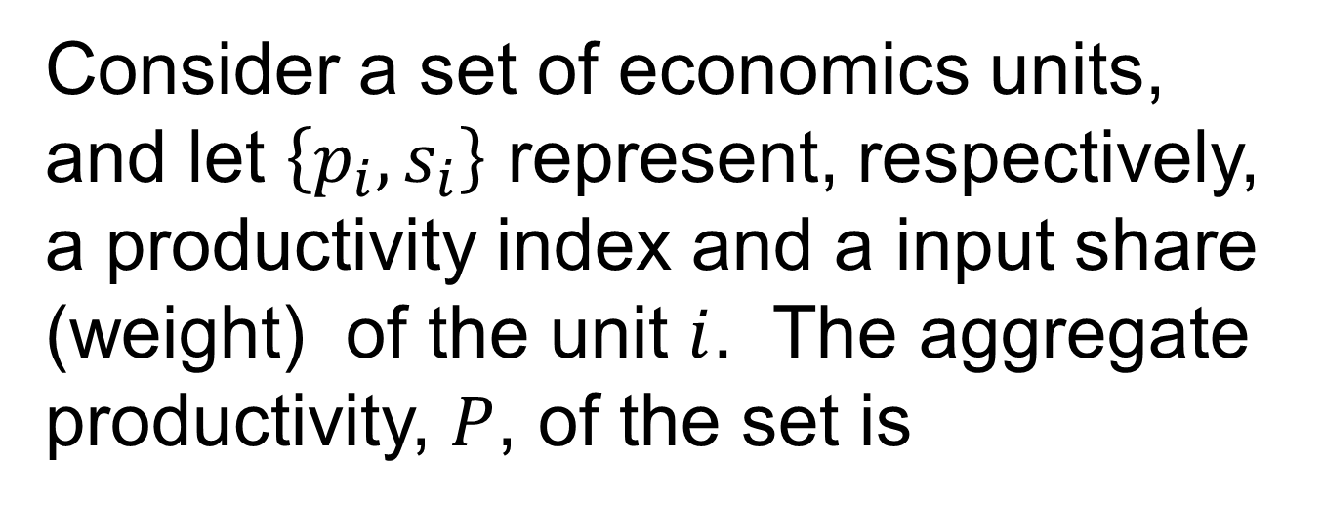
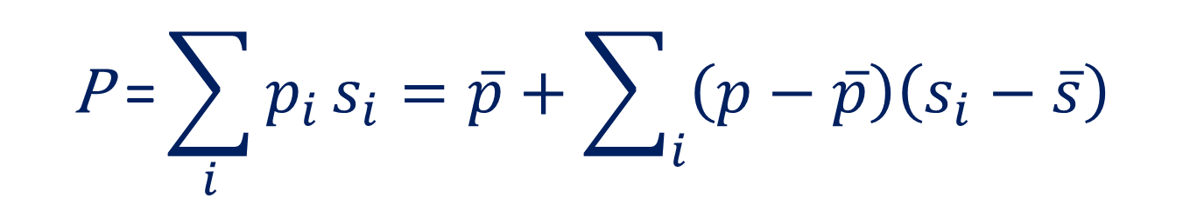
Data sources and productivity decomposition
Data
  → Sector-level analysis
  Data GGDC 10-Sector Database
  (Timmer, de Vries y de Vries, 2015)
→ Establishment-level analysis for manufacturing (excluding micro establishments) for Mexico, Chile, Colombia. Some data also for services sector.
  → Informality and micro establishments
  Official household surveys
Decomposition (OP)
Consider a set of economics units, and let $\left\{p_{i},s_{i}\right\}$ represent, respectively, a productivity index and a input share (weight) of the unit $i$. The aggregate productivity, $P$, of the set is
$$\text{P} \text{=}\sum_{i}{p_{i}}s_{i}=\overline{p}+\sum_{i}{\left(p−\overline{p}\right)\left(s_{i}−\overline{s}\right)}$$
Covariance term (ct)
Unweighted mean
of productivities
Notes:
In the diagnostic we use different data sets. Somehow one for each of the issues previously describe.
Part of the analysis is based on the olley pakes decomposition. Which implies the following. Consider a set………
…
When using establishment level data, the covariance terms is usually taken as a measure of the efficiency in the allocation of productive inputs. This is because the strong connection between firm size and ´productivity in the fist best allocation.
When working with more aggregate data (for instance at sector level) someone could question the efficiency interpretation. That is fine. Yet, at this level of aggregation, we think this terms represents an interesting moment reflecting somehow the role of the economy structure.
For instance, the usual statement that this “economy has low productivity because this particularly unproductive sector employs a large fraction of resources” would be capture by this terms.
Microdata de stattictics department. For Chile and Colombia census for establishment with 10 workers o rmore. For mexiso is not a census but a survey. Uruguay non comparable because information do not include onformal worlkesr as it is based on social security

Slide 13
Data sources and productivity decomposition
Data
  → Sector-level analysis
  Data GGDC 10-Sector Database
  (Timmer, de Vries y de Vries, 2015)
→ Establishment-level analysis for manufacturing (excluding micro establishments) for Mexico, Chile, Colombia. Some data also for services sector.
  → Informality and micro establishments
  Official household surveys
Notes:
In the diagnostic we use different data sets. Somehow one for each of the issues previously describe.
Part of the analysis is based on the olley pakes decomposition. Which implies the following. Consider a set………
…
When using establishment level data, the covariance terms is usually taken as a measure of the efficiency in the allocation of productive inputs. This is because the strong connection between firm size and ´productivity in the fist best allocation.
When working with more aggregate data (for instance at sector level) someone could question the efficiency interpretation. That is fine. Yet, at this level of aggregation, we think this terms represents an interesting moment reflecting somehow the role of the economy structure.
For instance, the usual statement that this “economy has low productivity because this particularly unproductive sector employs a large fraction of resources” would be capture by this terms.
Microdata de stattictics department. For Chile and Colombia census for establishment with 10 workers o rmore. For mexiso is not a census but a survey. Uruguay non comparable because information do not include onformal worlkesr as it is based on social security

Slide 14
Economic structure vs. average sector productivity
  → Sector-level productivity gap is large in all sectors.
  → Little room for large gains in productivity by reallocating inputs across sectors.
  → What does the OP decomposition say at this level of aggregation?
Notes:
Lest tale a frist look a the 10 serctor data set. Here we show for each sector the output per workers for 2010 as a fraction of the corresponding value for the US.
What do we see?

Slide 15
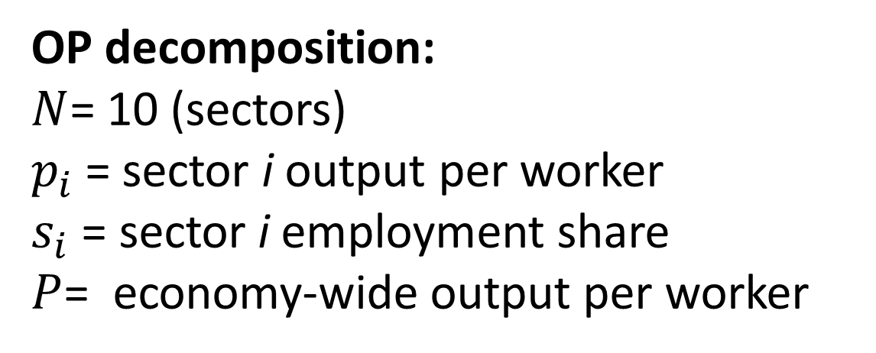
OP decomposition of output per worker
Latin America vs. the USA, 1950-2010
OP decomposition:
$N$= 10 (sectors)
$p_{i}$= sector i output per worker
$s_{i}$ = sector i employment share
$P$= economy-wide output per worker
LATAM | 0.26 | 0.44 | -0.18
USA | 0.77 | 1.23 | -0.45
  The covariance term is larger in Latin America.
Low aggregate productivity (output per workers) is due to low productivity across all sectors. Not much to the “economic structure” (covariance term).

Slide 16
Data sources and productivity decomposition
Data
  → Sector-level analysis
  Data GGDC 10-Sector Database
  (Timmer, de Vries y de Vries, 2015)
→ Establishment-level analysis for manufacturing (excluding micro establishments) for Mexico, Chile, Colombia. Some data also for services sector.
  → Informality and micro establishments
  Official household surveys
Notes:
In the diagnostic we use different data sets. Somehow one for each of the issues previously describe.
Part of the analysis is based on the olley pakes decomposition. Which implies the following. Consider a set………
…
When using establishment level data, the covariance terms is usually taken as a measure of the efficiency in the allocation of productive inputs. This is because the strong connection between firm size and ´productivity in the fist best allocation.
When working with more aggregate data (for instance at sector level) someone could question the efficiency interpretation. That is fine. Yet, at this level of aggregation, we think this terms represents an interesting moment reflecting somehow the role of the economy structure.
For instance, the usual statement that this “economy has low productivity because this particularly unproductive sector employs a large fraction of resources” would be capture by this terms.
Microdata de stattictics department. For Chile and Colombia census for establishment with 10 workers o rmore. For mexiso is not a census but a survey. Uruguay non comparable because information do not include onformal worlkesr as it is based on social security

Slide 17

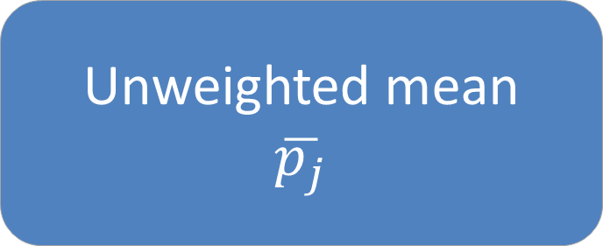

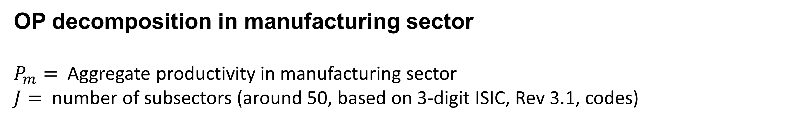
OP decomposition in manufacturing sector
$P_{m}=$ Aggregate productivity in manufacturing sector
$J=$ number of subsectors (around 50, based on 3-digit ISIC, Rev 3.1, codes)
$$P_{m}=CT+\frac{1}{J}\sum_{j}{{ct}_{j}}+\frac{1}{J}\sum_{j}{\overline{p_{j}}}$$
Covariance term (CT)
P_{m}
P₁
Covariance term
$$ctj$$
Unweighted mean of productivities
P_{j}
Unweighted mean
$$\overline{p_{j}}$$
P_{J}
| Level: subsectors |
| Level: establishments |

Slide 18
OP decomposition in manufacturing sector
CT is smaller in USA. The gap is not related to the covariance term at the subsector level but to the low unweighted mean of subsector productivities.
Average cv is larger in USA. Evidence of inefficiency in resource allocation across establishments within subsectors.
Implied gains in output per worker if efficiency were that of USA:
  Chile 18%
  Colombia 10%
  Mexico 30%
Decomposing productivity in manufacturing
Latin America vs. USA (2003-2007)
(establishments with 10 or more workers)
Relevant but modest in terms of the size of the gap. Low productivity at establishment is an important driver.
* Efficency term for USA taken from Bartelsman, Haltiwanger y Scarpetta (2009).
Notes:
Recall that for latin america the output pero workers in manufacture is around 34% od that in the US. A 20% gain will move to aroun 40%. Stil reamisn a Gap of 60 percentge points.
Nota: El cuadro reporta dos medidas de productividad –producto por trabajador y PTF– y su descomposición en los componentes: eficiencia asignativa entre subsectores, eficiencia asignativa entre establecimientos dentro del subsector promedio y componente interno al establecimiento promedio dentro del subsector promedio (sin ajustar y ajustando a PPA). En el caso de la PTF, la eficiencia en la asignación se calcula como la covarianza entre el logaritmo de la PTF y la participación en las ventas (en lugar del empleo). La PTF se computa suponiendo una participación del empleo en el producto de 0,7. Se excluye el subsector de procesamiento de metales básicos no ferrosos, excepto para Estados Unidos en donde su peso es mínimo. Todos los valores están reportados en unidades logarítmicas partiendo de valores monetarios en miles de dólares de 2014. Se excluyen establecimientos con menos de 10 empleados. Se excluyen los casos de Argentina y Uruguay porque los datos no permiten comparaciones en niveles.
a/ Para Estados Unidos se calcula la eficiencia de la asignación entre subsectores manufactureros usando un procedimiento análogo al empleado en los datos de América Latina a partir de datos de la base de datos de productividad manufacturera del National Bureau of Economic Research.
b/ El dato de eficiencia en la asignación entre establecimientos dentro de un subsector para Estados Unidos se toma de Bartelsman,
Haltiwanger y Scarpetta (2009).

Slide 19
Data sources and productivity decomposition
Data
  → Sector-level analysis
  Data GGDC 10-Sector Database
  (Timmer, de Vries y de Vries, 2015)
→ Establishment-level analysis for manufacturing (excluding micro establishments) for Mexico, Chile, Colombia. Some data also for services sector.
  → Informality and micro establishments
  Official household surveys
Notes:
In the diagnostic we use different data sets. Somehow one for each of the issues previously describe.
Part of the analysis is based on the olley pakes decomposition. Which implies the following. Consider a set………
…
When using establishment level data, the covariance terms is usually taken as a measure of the efficiency in the allocation of productive inputs. This is because the strong connection between firm size and ´productivity in the fist best allocation.
When working with more aggregate data (for instance at sector level) someone could question the efficiency interpretation. That is fine. Yet, at this level of aggregation, we think this terms represents an interesting moment reflecting somehow the role of the economy structure.
For instance, the usual statement that this “economy has low productivity because this particularly unproductive sector employs a large fraction of resources” would be capture by this terms.
Microdata de stattictics department. For Chile and Colombia census for establishment with 10 workers o rmore. For mexiso is not a census but a survey. Uruguay non comparable because information do not include onformal worlkesr as it is based on social security

Slide 20
Microestablishments and informality:
a burden for productivity
High share of employment
in small firms

Slide 21

Microestablishments and informality:
a burden for productivity
High share of employment
in small firms
Informality is prevalent
in small firms

Slide 22
Microestablishments and informality:
a burden for productivity
High share of employment
in small firms
Informality is prevalent
in small firms
And also in many sectors,
including manufacturing

Slide 23
Microestablishments and informality:
a burden for productivity
High share of employment
in small firms
Informality is prevalent
in small firms
And also in many sectors,
including manufacturing
Wage gap between formal
and informal jobs

Slide 24

Summarizing
The “Structure” is not the problem but low productivity across all sectors
Why?
  → High incidence of informality across the board
  → But also low productivity in the formal sector
      → Low productivity of “formal” establishments (more than 10 workers)
      → Factor misallocation among “formal” establishments
Notes:
Low productivity across all sector with limited possibilities of major gains from resources reallocation among sectors.

Slide 25


Slide 26

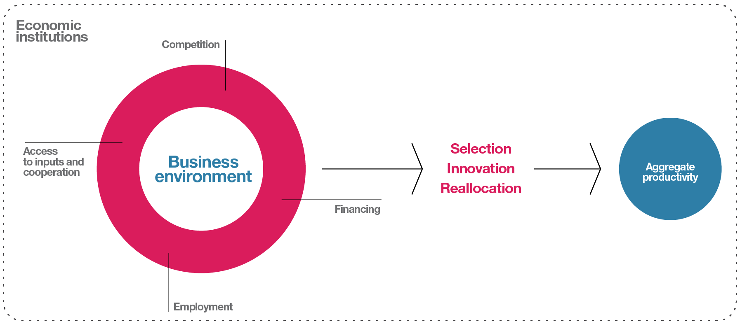
Part II:
Economic institutions as fundamental determinants

Slide 27


Slide 28

Evidence of high market power in Latin America
  Higher markups relative to developed economies are also observed across industries within countries
  (evidence for Colombia and Chile for manufacturing industries)
Notes:
El indice de Lerner esta definido como (P-CMg)/P, donde P es el precio y CMg representa el costo marginal.En el ejercicio se calculo especificamente el cociente (VA-W)/PQ, donde VA es valor agregado, W denota el total de sueldos y salarios, y PQ representa las ventas totales. Esto es equivalente a calcular (P-CMe)/P, donde P es el precio y CMe representa el costo medio o unitario. De este modo, el indicador se puede interpretar como margen de precio o tasa de rentabilidad. En cualquier caso, un valor elevado del indicador es senal de un bajo nivel de competencia.
Metodo alternative de mark ups (De locker y Warsysnky )
De acuerdo con esta metodologia, el margen de precios, μ, puede calcularse como el cociente entre la elasticidad de la produccion (neta de insumos intermedios, o sea, el valor agregado) con respecto al factor trabajo, ε, y los costos laborales como proporcion del valor agregado, W/VA. En mercados perfectamente competitivos donde las empresas son tomadoras de precios, la maximización de beneficios implica que ε = W/VA y, por lo tanto, μ = 1. Con poder de mercado, estas igualdades se rompen y se obtiene que μ > 1. A mayor poder de mercado, mayor μ. La intuicion es que si el trabajo esta siendo remunerado por debajo de lo que dicta la elasticidad ε, entonces la empresa esta obteniendo beneficios economicos extraordinarios que se asocian con contextos no competitivos.

Slide 29
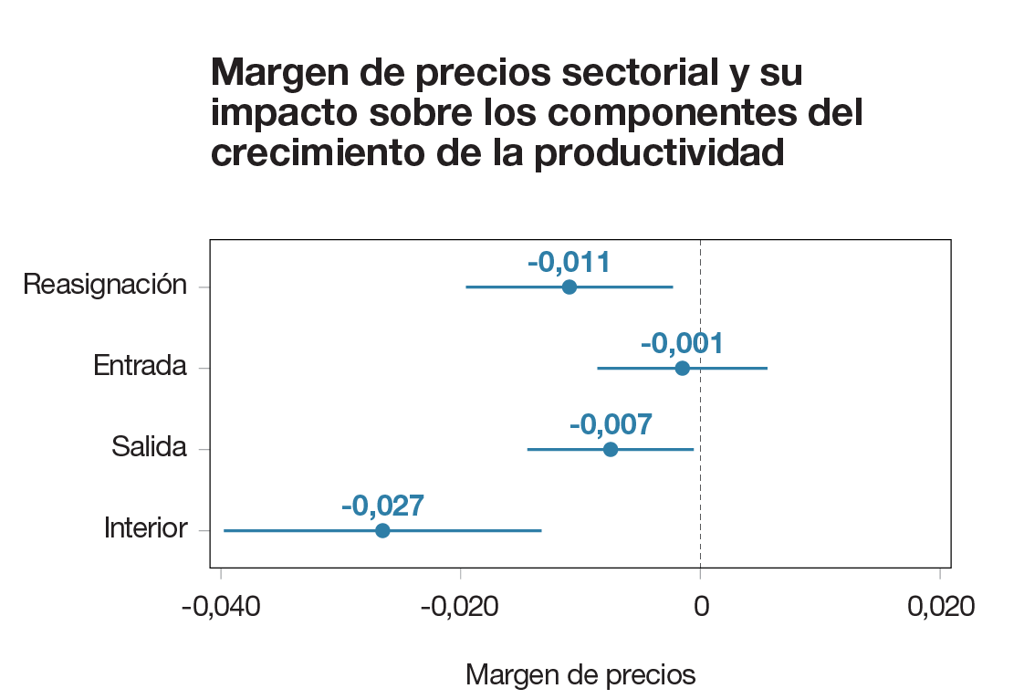
Markups negatively correlated with productivity growth
Sectoral markups and components of productivity growth
(manufacturing in Chile, Uruguay,
Mexico and Colombia, 2003-2007)
Sectors with greater market power show lower rate of productivity growth
→ Lower productivity gains within firms (i.e. less innovation)
→ Weaker intra-sectoral factor reallocation
Reallocation
Entry
Exit
Innovation
Price markup coefficients
Decomposition based on Foster, Haltiwanger, and Krizan (2001)
Notes:
For each sector we carried out the BHS (bartelman, Haltiwanger y krissan) didamyc decomposition using establesment data. It decomposes productivity growth between 2 period in 4 components:….
For Chile, Colombia, Mexico and Uruguay we regress each component against sector level market power index. Including time and country fix effects
El grafico muestra coeficientes estimados por minimos cuadrados ordinarios de la variable independiente margen de precios sectorial y sus respectivos intervalos de confianza de 95%. La variable dependiente en cada regresión es un componente de la descomposicion de Foster, Haltiwanger y Krizan (2006) de latasa de crecimiento sectorial de la PTFI. Estos son, de arriba a abajo: el efecto reasignacion, el aporte de los establecimientos que entran y salen, y el componente interno de los establecimientos existentes que continuan operando. La muestra incluye observaciones de Chile, Colombia, Mexico y Uruguay. Las unidades de observacion son los sectores manufactureros a 3 digitos segun la clasificacion CIIU, Rev. 3.1. En cada regresion se incluyen la constante y efectos fijos de interacciones de pais-ano y pais-sector a 2 digitos. Se descartan observaciones con valores extremos del margen de precios (fuera del rango p99-p1). Solo se incluyen establecimientos de sectores de manufactura con 10 o mas empleados.

Slide 30

Institutions for improving competition
Reduce entry barriers
Notes:
In Latin America a larger proportion of firm consider Lincence and permits as a major constraint for them

Slide 31
Institutions for improving competition
Reduce entry barriers
Notes:
In Latin America a larger proportion of firm consider Lincence and permits as a major constraint for them

Slide 32


Institutions for improving competition
Reduce entry barriers
Strengthen institutions that promote competition
Source: Global Competitiveness Report 2017-2018 (Schwab, 2017).
Notes:
In Latin America a larger proportion of firm consider Lincence and permits as a major constraint for them

Slide 33


Institutions for improving competition
Reduce entry barriers
Strengthen institutions that promote competition
Facilitate international trade
→ Reductions in tariffs but OTRI remains high.
Notes:
In Latin America a larger proportion of firm consider Lincence and permits as a major constraint for them

Slide 34


Slide 35

Why do we care about inter firm relationships?
    → Access to a wide variety of high quality inputs (goods and services) is key.
    → Frictions and productivity changes at the sector level are propagated through input-output linkages.
    → The degree of influence (of a supplier) allows us to identify key sectors.
    → Inter firm relationships favor cooperation as well as learning and knowledge spillovers, common in cluster contexts.

Slide 36


Why do we care about inter firm relationships?
  → Access to a wide variety of high quality inputs (goods and services) is key.
  → Frictions and productivity changes at the sector level are propagated through input-output linkages.
  → The degree of influence (of a supplier) allows us to identify key sectors.
  → Inter firm relationships favor cooperation as well as learning and knowledge spillovers, common in cluster contexts.
Institutions play a role
  → Low quality institutions (i.e. judicial system) reduce the amount of inputs and their variety (Boehm & Overfiedl, 2017; Acemoglu et al., 2007).
  → Specific regulations and policies can improve access to inputs (or affect their quality) and firm cooperation.

Slide 37
A view through input-output matrices
  → Intermediate consumption is depressed. Specially regarding to imported inputs
  and in industries in the primary and tertiary sectors.
Primary sector:
0,87
Secondary sector:
0,94
Tertiary sector:
0,87

Slide 38
Distortions at industry level and productivity losses
The relatively low intermediate consumption shares in some industries may reflect distortions.
They affect productivity through different channels: resources misallocation across sectors and Input-output linkages.
They are particularly harmful when they affect a sector with high degree of influence (as input provider)
Source: Leal (2017)
GE model with input output linkages find a moderate but relevant productivity cost of such distortions.

Slide 39
Degree of influence and key sectors
Sector ordering according to their push in Latin America and the Caribbean
  → The push (forward linkages) and the degree of influence are concepts that measure the direct and indirect role of a sector as input supplier.
  → They are estimated using input-output matrices.
  → Some sectors are relevant from this point of view.
Trade (retail and wholesale)
business services
transport services
financial services
Electricity
Unfortunately many of these key services sectors perform poorly in Latin America, and thus become a barrier to productivity growth
Notes:
“Otros servicios a los negocios” comprende “bienes raíces, alquiler y actividades de negocios”.
“Otros servicios de transporte” comprende “transporte por carretera, ferrocarril; oleoductos, actividades de transporte auxiliar; agencias de viajes”.
“Otros servicios financieros” comprende “intermediación financiera y sus actividades auxiliares, pero excluye seguros y fondos de pensiones”.

Slide 40
Institutions to improve
access to inputs and cooperation among firms
  → Evidence of large gains of trade openness through the inputs channel (Indonesia, Amiti & Koning 2007; India, Khandelwal & Topaloba 2011).
  → They can promote the creation of new products (India, Golberg et al. 2010) and technology transfers (Keller 2002)
  → Complementarities. Greater impact in sectors open to competition and to FDI. (Khandelwal & Topaloba 2011).
Trade and international integration

Slide 41
Institutions to improve
access to inputs and cooperation among firms
  → Potential improvements in the regulatory framework to promote competition in network sectors (energy, transportation, telecommunications) and Public-Private Partnerships
Trade and international integration
Regulatory frameworks in network services

Slide 42

Institutions to improve
access to inputs and cooperation among firms
  → Some key services for firms are strongly affected by high levels of corruption, e.g. custom services
  → (E-government) Customs reform in Colombia, based on ICT, favored the performance of firms that import
  → Reduction in the number of corruption cases
  → Positive effect on imports, capital level and value added of firms that use customs services
  (Laajaj et al., 2017)
Trade and international integration
Regulatory frameworks in network services
Fighting corruption

Slide 43

Institutions to improve
access to inputs and cooperation among firms
  To strengthen:
  → Key actors’ capabilities
  → Internal links
  → Connection to global markets
  Caution:
→ Avoid risks of other industrial policies
→ Focus on attacking coordination failures
→ Sectors must pass a market test
Trade and international integration
Regulatory frameworks in network services
Fighting corruption
Policies to strengthen clusters and value chains

Slide 44


Slide 45

Employment policies
and regulations affect productivity
Allocation of the labor force
  → Participation rate
  → Quality and frequency of job transitions
  → Informality
  Workers’ productivity within firms
  → Skills formation
  → Human resource management practices
  (e.g. pay for performance, cooperation vs. conflict)

Slide 46
Employment policies and regulations affect productivity
  Workers’ productivity within firms
  → Skills formation
  → Management practices, e.g., implementation of pay for performance.
Allocation of the labor force

Slide 47
Three characteristics of
employment allocation
Gender gap in
participation rates
Informality
Mismatch between
workers and jobs

Slide 48

Three characteristics of
employment allocation
Gender gap in
participation rates
Informality
Mismatch between
workers and jobs
  → 14 percentage points higher than in the OECD

Slide 49
Three characteristics of
employment allocation
Gender gap in
participation rates
Informality
Mismatch between
workers and jobs

Slide 50

Three characteristics of
employment allocation
Gender gap in
participation rates
Informality
Mismatch between
workers and jobs
  → 4 out of 10 workers report their qualifications do not match their position (ECAF 2015, 2017)

Slide 51
Relevant labor institution and policies
Employment protection policies
  Evidence of negative effects of employment protection policies, especially in high employee turnover industries

Slide 52
Relevant labor institution and policies
Employment protection policies
Wage setting policies

Slide 53
Relevant labor institution and policies
Employment protection policies
Wage setting policies
  Solid evidence on the relevance of policy design on informality:
  → Reduction of payroll taxes in Colombia
  → Expansion of health benefits for formal workers in Uruguay
  → Cash transfers for informal workers in Argentina
Taxes, social security contributions and (quality of) benefits of formal employment

Slide 54

Instituciones laborales y productividad
Employment protection policies
Wage setting policies
  Evidence shows:
  → Employment services (not widespread in the region) improve job matches
  → Apprenticeships for youth increase formal employment in the medium and long run (Berniell & De la Mata, 2016)
  → Well designed unemployment insurance could be an alternative to strict employment protection policies
Taxes, social security contributions and (quality of) benefits of formal employment
Active labor market policies

Slide 55
De jure and de facto regulations
  Poor enforcement reduces productivity via allocation (e.g. affecting larger,
  more visible firms) and productivity within firms (incentive to growth)

Slide 56


Slide 57

Financial markets in the region are underdeveloped
Low levels of domestic credit relative to GDP
High interest rate spreads
Low access to financial services
Latin America 50%
OECD 147%
USA 192%

Slide 58
Financial markets in the region are underdeveloped
Low levels of domestic credit relative to GDP
High interest rate spreads
Low access to financial services
Latin America 7pp
Japan 0,7pp
Canada 2,7pp

Slide 59
Financial markets in the region are underdeveloped
Low levels of domestic credit relative to GDP
High interest rate spreads
Low access to financial services
Latin America 56%
Japan 98%
USA 95%

Slide 60
Financial systems and productivity
Countries with lower financial development show greater levels
of self-employment
Countries with higher financial development display more firm entry and higher R&D investment
Financial crises affect selection
and reallocation mechanisms

Slide 61
Financial systems and productivity
Countries with lower financial development show greater levels
of self-employment
Countries with higher financial development display more firm entry and higher R&D investment
Financial crises affect selection
and reallocation mechanisms

Slide 62
Financial systems and productivity
Countries with lower financial development show greater levels
of self-employment
Countries with higher financial development display more firm entry and higher R&D investment
Financial crises affect selection
and reallocation mechanisms

Slide 63
Financial systems and productivity
Countries with lower financial development show greater levels
of self-employment
Countries with higher financial development display more firm entry and higher R&D investment
Financial crises affect selection
and reallocation mechanisms

Slide 64
Financial systems and productivity
Countries with lower financial development show greater levels
of self-employment
Countries with higher financial development display more firm entry and higher R&D investment
→ Following a financial crisis productivity is 4% lower (Buera, Fattal Jaef & Shin, 2015)
→ Firms that exit the market during a financial crisis are 15% more productive than firms that exit during periods of stability (Eslava, Maffioli & Arjona, 2015)
Financial crises affect selection
and reallocation mechanisms

Slide 65
Institutions to improve financing
Regulatory aspects
(e.g. bankruptcy laws)
Productive financing programs

Slide 66
Institutions to improve financing
Regulatory aspects
(e.g. bankruptcy laws)
Productive financing programs
USA (1)
More efficient bankruptcy processes improve credit availability
(Araujo, Ferreira & Funchal, 2012)

Slide 67
Institutions to improve financing
Regulatory aspects
(e.g. bankruptcy laws)
  Usual policies
  → Warranties
  → Interest rate subsidies
  → Direct credit programs (with or without technical assistance)
  → Fiscal credits
  Mixed results
  → Increase in investment and/or innovation with no clear impact on productivity
  → Targeting problems
  Risks of distortionary effects
  → Policy design and implementation are key, particularly in eligibility criteria
Productive financing programs

Slide 68

Take Away
”Structure” is not so much the problem but low productivity across all sectors and sub-sectors
Informality but also low productivity in formal firms is relevant (and some misallocation in the allocation of resources among them)
We focus on institutions affecting 4 critical transversal areas
    competition
    access to inputs and firm cooperation
    employment
    Financing
Horizontal approach but with application for vertical/sectoral analyses

Slide 69


www.caf.com
@AgendaCAF
#RED2018

Slide 70

Decomposition of GDP per capita
Latin America relative to the United States, 2004-2014
GDP per capita
26%
Hours worked per capita
100%
Output per hour
26%
Closing the TFP gap would increase GDP in Latin America from 26% to 70% of that in the United States
Total factor productivity
37%
Capital intensity
98%
Human capital
71%
Notes:
HorasxPersona=Participacion laboralxTasa EmpleoxHora por trabajador=0,93x0,99x1,1

Slide 71
Cause: poor resource allocation among establishments (including informality) and low productivity in formal firms

Slide 72
We focus on economic institutions that set firms’ incentives across all activity sectors

Slide 73
Institutions that affect: competition, access to inputs, employment and financing

Slide 74
There’s a far-reaching institutional reform agenda; countries in the region have shown progress in the last few decades

Slide 75
The way forward involves, not only policy reforms, but also improving implementation and enforcement

Slide 76
Further institutional reform requires two essential components: political consensus and State learning ability

Slide 77
Both aspects can benefit from a knowledge-based agenda allowing data-driven policy making

Slide 78
The report contributes to this research agenda on economic institutions and their impact on productivity

