Slide 1
Women’s Economic Empowerment in Iraq
Challenges, Strategies and Initiatives
January 2019

Slide 2
Content
Facts and figures
What does the data tell us?
Data and economic opportunities for women
Challenges of increasing women's economic opportunities
What are we doing?
Participation of Iraqi women in the economy within 5 years
This is how we will work
The broader commitment going forward

Slide 3
Facts and figures
male
female
Population Total | 38.124.000 | Female | 18.882.000
% of women of total population | 49.47% | Women from 15-49 years old | 35.17%
Female in urban areas | 12.189.679 | Female in rural areas | 5.672.250

Slide 4
What does the data tell us?
-Women constitute about 54% of those covered by the social welfare system, although they have recently declined due to the allowing heads of families to apply.
-Female segment of the urban population is larger than that of women living in rural areas by almost double, which requires giving attention to non-agricultural women's projects in peri-urban areas
-Women join the labor market late and drop out early
-Agriculture is the main sector of employment for women in rural areas (55%) while only 21.5% of male work in this sector
-Women's work is confined to low-paid jobs
-34.6% of working women are considered to be in unpaid work and in rural areas it increases to 79.3%, especially in agricultural sector, as well as unpaid domestic work
-Limited engagement of women in the areas of information and communications systems and government services such as water and electricity

Slide 5
Legislative, social, institutional and financial challenges are limiting economic opportunities for women
- Legislative reform is needed to support families and working mothers (such as flexible work programs and support for childcare); Implementation of the laws is weak
- Limited policies that protect women from sexual harassment in the workplace and public places; limited supporting services that take into account the needs of women as "mothers"
- Discriminatory practices that hinder women’s employment, especially in equal wages and promotion opportunities, particularly in the private sector
Scarcity of funding especially targeted to micro and small enterprises-
- Public budgets is not gender sensitive; the higher the oil revenues, the less attention is paid to women's economic empowerment
- Community culture and social norms are based on stereotyping the roles of women and men
- Unequal sharing of family and household responsibilities
- The imbalance of population distribution between rural and urban areas increases the demand on job opportunities, competition for resources and increasing damage to the environment, where agricultural lands are used for residency.

Slide 6
What are we doing?
Iraq has taken significant steps towards empowering women, such as:
-Amendments to the Labor Law which included provisions prohibiting sexual harassment in the workplace and mandating employers to provide childcare centers
-Second Poverty Reduction Strategy 2018-2022
-Iraq’s Vision in the Sustainable Development Plan 2030
- National Plan for the Implementation of Decision No. 1325
- Draft Social Insurance Law
- The National Strategy for the Reconstruction Plan of the Liberated Areas
- National Development Plan 2018-2022
-Strategy on Combating Violence Against Women 2018-2030
- Strategy on Development of the Private Sector
- National Strategy for Rural Development

Slide 7
Participation of Iraqi women in the economy within 5 years (2019-2023)
2019-2020
2021
2022
- Increase participation of women in entrepreneurship
2023
-Strength the social, legislative and administrative environment that can increase women’s economic empowerment
-Prepare detailed diagnostics on the social, legislative and administrative environment to empower women
-Increase women's access to financial resources and economic opportunities
-Increase the capacity of public and private sector employees on gender sensitization and empowerment of women
-Preparation of public gender- responsive budgets
- Integration of women’s housework and informal work in the national economy
-Reduce the gender gap in all aspects to empower women economically especially in education, political participation and decision making process
- Build capacity of women through expanding knowledge and skills to Increase the female labor force by 5%

Slide 8
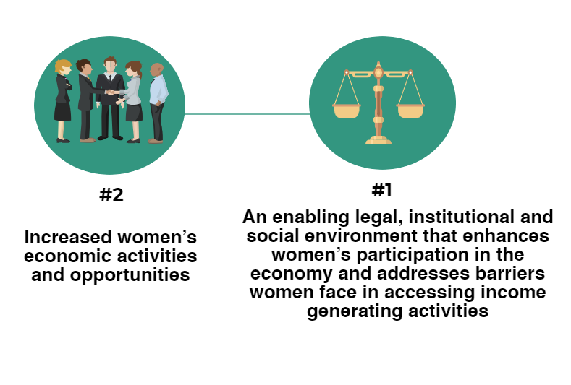
This is how we will work

Slide 9
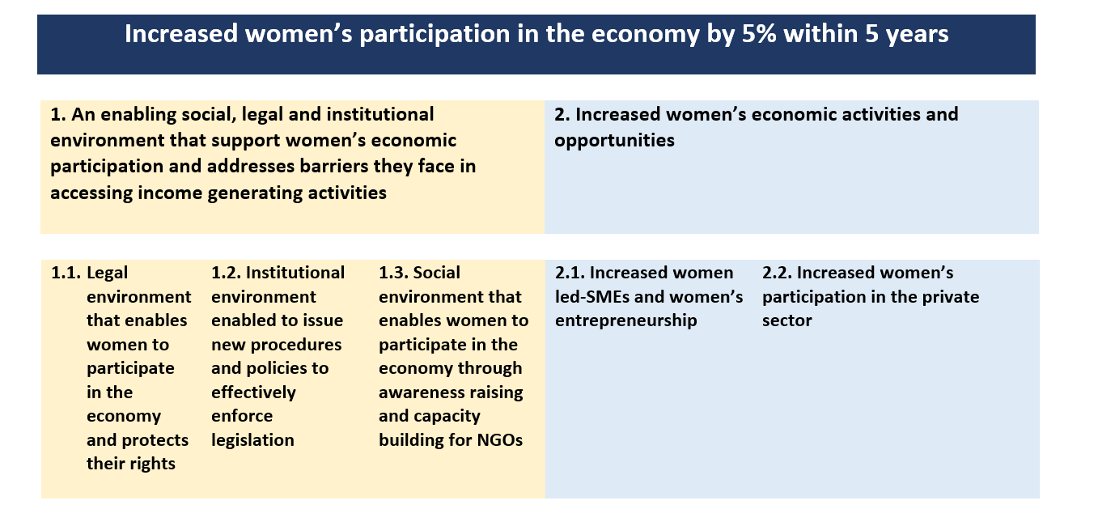
Gender logframe Iraq

Slide 10
Intermediate outcome: 1. An enabling social, legal and institutional environment that enhances women’s participation in the economy and addresses barriers women face in accessing income generating activities
Activities:
1.1.1. Introduce legislative reforms targeting women and families in the private sector. This includes: childcare support; flexible work arrangements; equal pay for work of equal value; and inclusion of domestic workers and family businesses in the Labor Law
1.1.2. Amend Law on Civil Society to facilitate the establishment and operations of NGOs (also to allow them to engage in paid activities)
1.1.3. Amend legislations to recognize vulnerable employment, such as unpaid work and non-monetary contributions provided by women and family members, particularly women’s work in agriculture in rural areas
Immediate outcome:
1.1. Legal environment that enables women to participate in the economy and protects women’s rights

Slide 11
Intermediate outcome: 1. An enabling social, legal and institutional environment that enhances women’s participation in the economy and addresses barriers women face in accessing income generating activities
Activities:
1.2.1. Issue instructions and regulations for the implementation of the legislative reform, such as instructions on prohibition of sexual harassment at the workplace and women’s ownership of agricultural land
1.2.2. Prepare gender responsive budgeting to enhance women’s access to financial resources
1.2.3. Strengthen existing statistical databases and classify them, particularly to reflect the informal sectors
Immediate outcome:
1.2. Institutional environment enabled to issue new procedures and policies to effectively enforce legislation

Slide 12
Intermediate outcome: 1. An enabling social, legal and institutional environment that enhances women’s participation in the economy and addresses barriers women face in accessing income generating activities
Activities:
1.3.1. Raise awareness through religious entities and individuals with NGOs on the value of women’s economic inclusion and to emphasize the importance of sharing family responsibilities between men and women
1.3.2. Launch media campaigns to raise women’s awareness on their legal rights in accessing and participating in economic activities
1.3.3. Amend educational curriculums to reflect equal economic opportunities for women and men; remove stereotypes on the role of women as mothers and caregivers only
1.3.4. Offer and increase vocational training opportunities to students at earlier stages of education (primary level)
1.3.5. Strengthen capacity of NGOs in areas related to advocacy, monitoring and evaluation and support NGOs to implement specialized programs within their scope of expertise
Immediate outcome:
1.3. A social environment that enables women to participate in the economy through awareness raising and capacity building for NGOs

Slide 13
Intermediate outcome: 2. Increased women’s economic activities and opportunities
Activities:
2.1.1. Set up business incubators in Baghdad and all governorates
2.1.2. Provide training for women with college degrees on the process of starting businesses and skill development to enhance their ability to start and operate businesses; and promote vocational training and applied studies
2.1.3. Facilitate women’s access to financial resources and loans through granting special loans, such as interest-free loans or loans without collateral and simplify procedures for engagement of women in business and agricultural activities
2.1.4. Establish a network for female business owners to exchange successful experiences and lessons learned
Immediate outcome:
2.1. Increased women led-SMEs and strengthened women’s entrepreneurship

Slide 14
Intermediate outcome: 2. Increased women’s economic activities and opportunities
Activities:
2.2.1. Support women’s entry and job retention in the private sector through encouraging a family-friendly environment to support women with family responsibilities
2.2.2. Support women’s employment through strengthening childcare services for working employees
2.2.3. Support capacity and activities of women’s associations
2.2.4. Use of technology to empower women economically (for marketing, remote work and finding jobs)
Immediate outcome:
2.2. Increased women’s participation in the private sector

Slide 15
The broader commitment going forward
The following key partners will be identified for commitment to achieve this change:
Government partners: Prime Minister, Ministry of Finance, Central Bank, Ministry of Planning, Ministry of Labor and Social Affairs, Ministry of Agriculture, Ministry of Commerce, Ministry of Industry, Ministry of Education, Ministry of Higher Education and Scientific Research, National Security Advisor, Ministry of Youth and Sports, Bureau of Financial Supervision, Endowment Diwan
Non-governmental partners: Parliament, private banks, the private sector, civil society organizations, universities, international organizations, media organizations, trade unions and professional associations
Iraqi families to allow women to participate in the economy as they are aware of the importance of the role of women in the national economy

Slide 16
Potential risks
Capacity:
The capacity of relevant Iraqi government institutions to facilitate the integration of women into the economy
Monitoring and evaluation
Capacity of civil society organizations
Women's ability to manage their own businesses
Financial:
Obstacles to the adoption of project budgets
Obstacles to financing initiatives
Political:
Internal and / or regional political stability
Delay in issuing and adopting reform legislation
Social:
Individual and family traditions and norms
Tribal views on empowering women

Slide 17
Proposed mitigating measures
-Strengthen the partnership between the central government, local government, private sector and civil society organizations as well as local media
-Inclusion of all stakeholders in dialogue on gender mainstreaming
- Capacity building of government institutions and civil society organizations to ensure the effective implementation of gender-sensitive policies
- Support gender mainstreaming in the state budget and allocate funding to support women's empowerment activities and to support the Women's Loan Fund
- Provide training courses to government officials, judges and police on gender awareness
-Raise awareness on the importance of equality between men and women in access to economic opportunities and protection from violence

Slide 18
Thank you for your attention!

