Slide 1


Forget Automation, Let’s Augment: Toward Human-centered AI
Hal Daumé III
University of Maryland

Slide 2
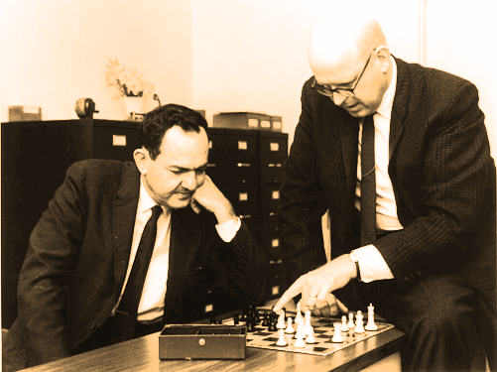
The allure of full automation
has a long history

Slide 3

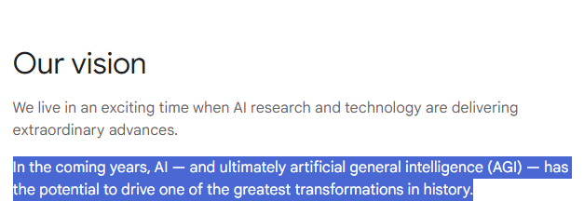

And it’s not going anywhere
any time soon…

Slide 4


Instead of:
How about:
image: sageev oore with dall-e
image: me with firefly

Slide 5
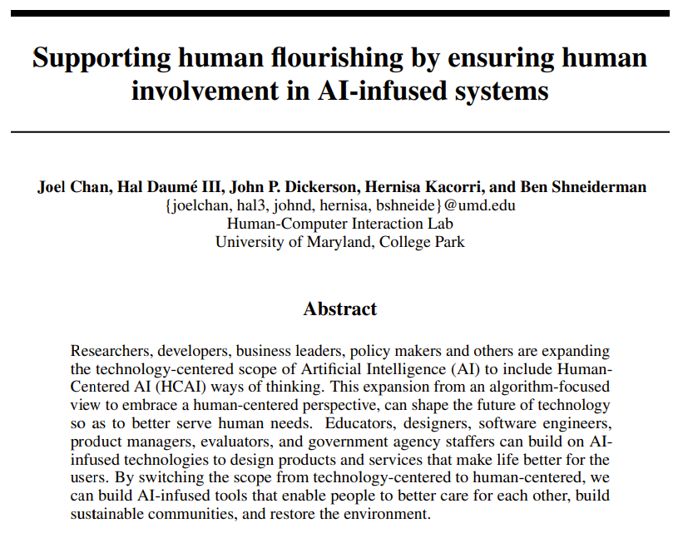



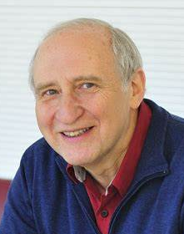
How can we design AI-infused systems that make our lives better?

Slide 6

image: me with firefly
Data for
help the person do the part they don’t want to do often requires an existing system
Data for replicate what the person does
is easy to come by.

Slide 7
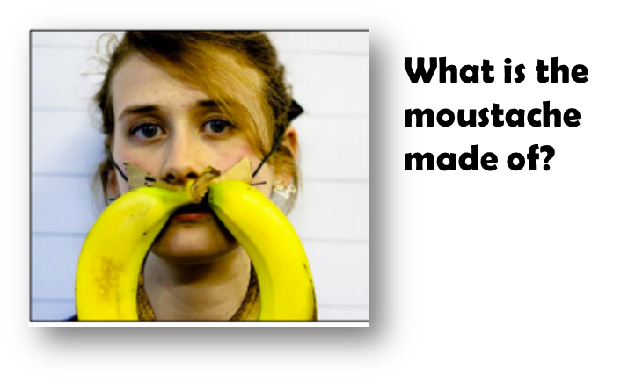
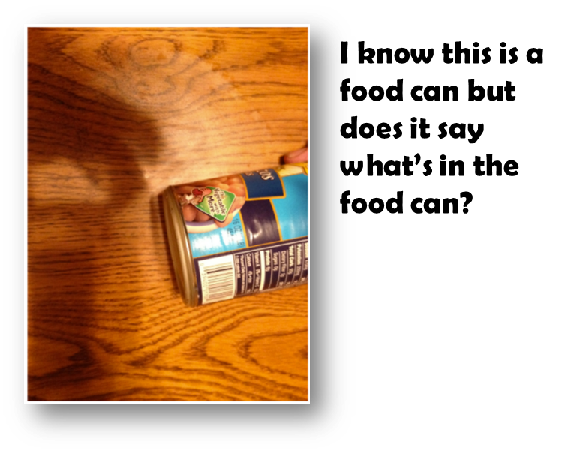
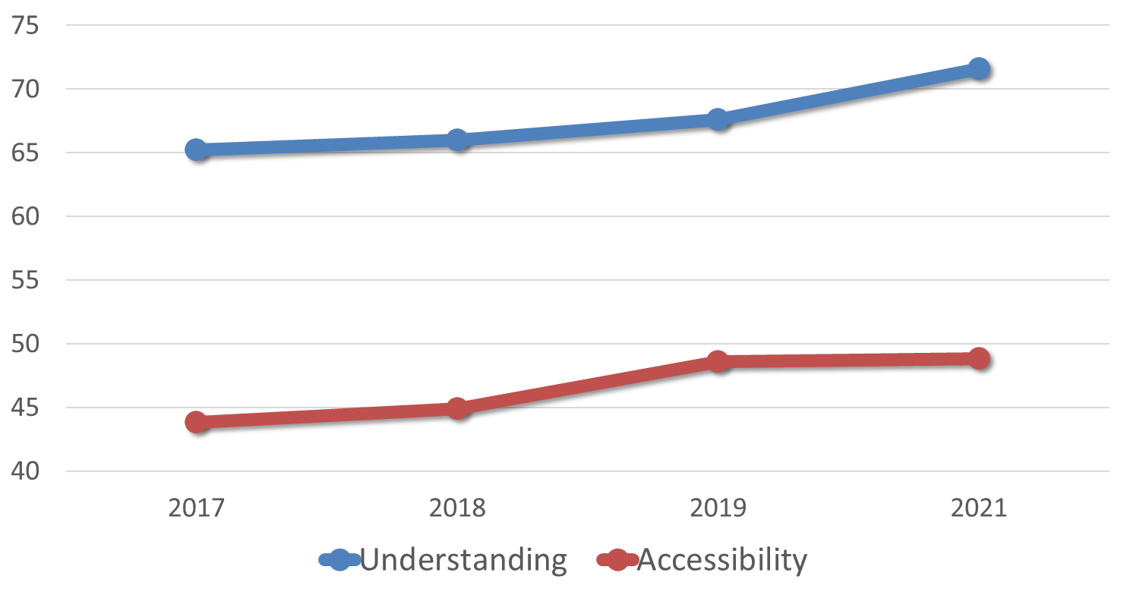
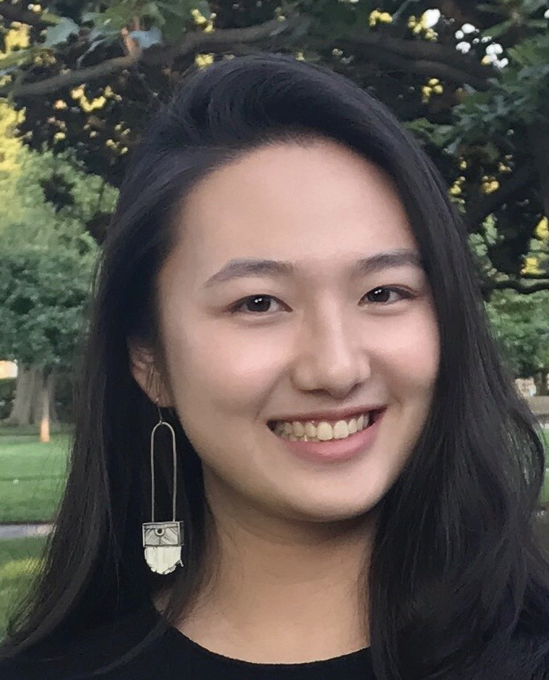

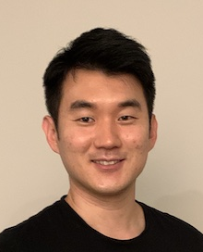
[Cao, Seelman, Lee, D; AACL’22]

Slide 8





Volunteer content moderators don’t want automated moderation
even if it would make them more “productive”
Volunteer content moderators
image: me with firefly

Slide 9
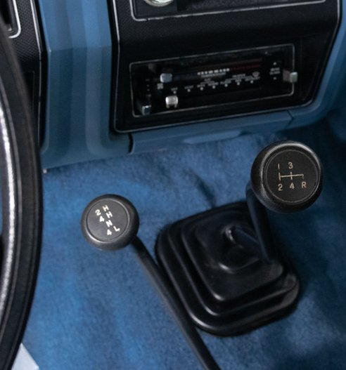
Even among a single “population” there is significant disagreement over what control is desired

Slide 10
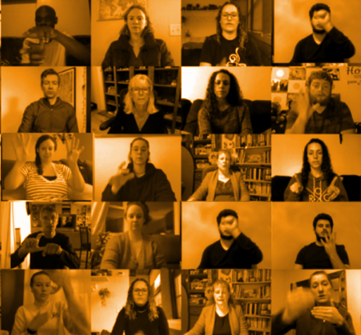
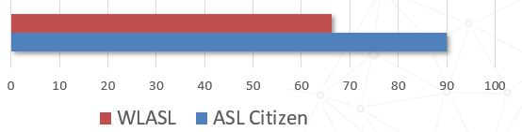





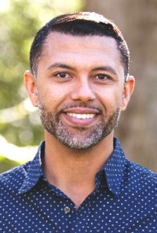



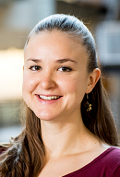
What is the alternative?
work with communities
collect data ethically
give users control
forget about automation
learn from less data
What is the alternative?
[Desai, Berger, Minakov, Milan, Singh, Pumphrey, Ladner, D, Lu, Caselli, Bragg; NeurIPS 2023]

