Slide 1


Systems Engineering and Artificial Intelligence
Zoe Szajnfarber
Professor of Engineering Management and Systems
Faculty lead, GW Trustworthy AI Initiative
Chief Scientist, Systems Engineering Research Center

Slide 2
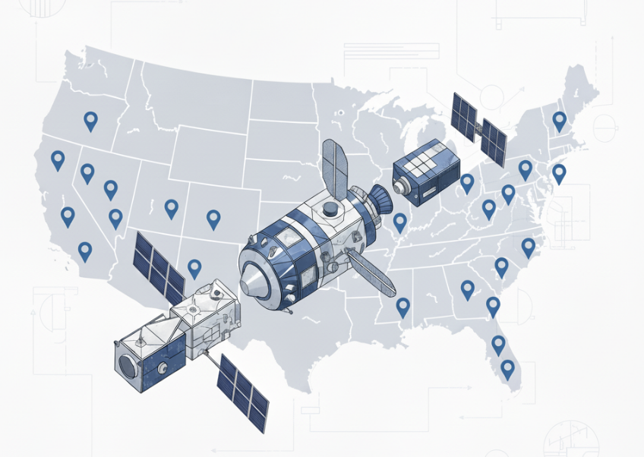

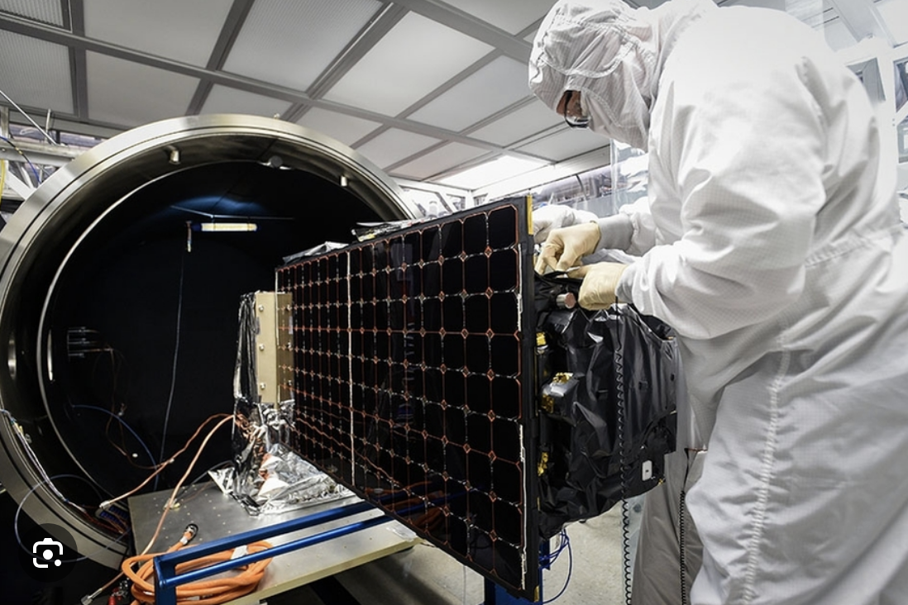
Why am I here?
Systems Engineer as… Paper Pusher
… architecting, integration and testing, under enormous uncertainty, with many technical and non-technical constraints
Images generated by Gemini 2.5 Flash
1
Notes:
https://www.astronomy.com/space-exploration/the-skycrane-how-nasas-perseverance-rover-will-land-on-mars/

Slide 3

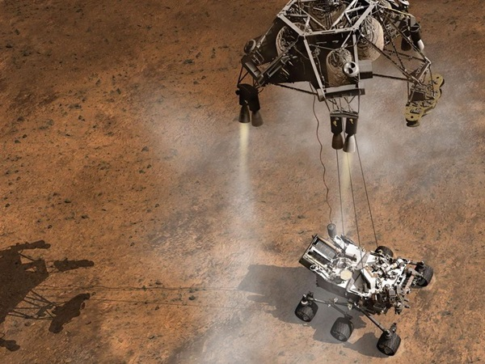
Landing Mars Rovers as Illustration
The architecting insight that led to airbags and sky crane required re-thinking functional blocks
Significant creativity needed to “test as you fly” and build confidence in overall system.
2

Slide 4

Same concepts are relevant to AI integration
Student advising use case (like customer service tasks)
This is a workflow architecture question!
“I pursued a career in student affairs because of my passion for helping students… Currently, I spend a significant amount of my time doing literal paperwork”
1. AI in the background
Student Records
Student
Advisor
Curriculum Sheets
HelperBot
2. AI as a choice
Advisor
Student Records
Student
Curriculum Sheets
AdvisBot
Important Differences:
Time to answer
Quality of interaction
Number and types of mistakes
Opportunities to catch mistakes
Ability to evolve allocation
AI can help, but how?
Images generated by Gemini 2.5 Flash
3

Slide 5
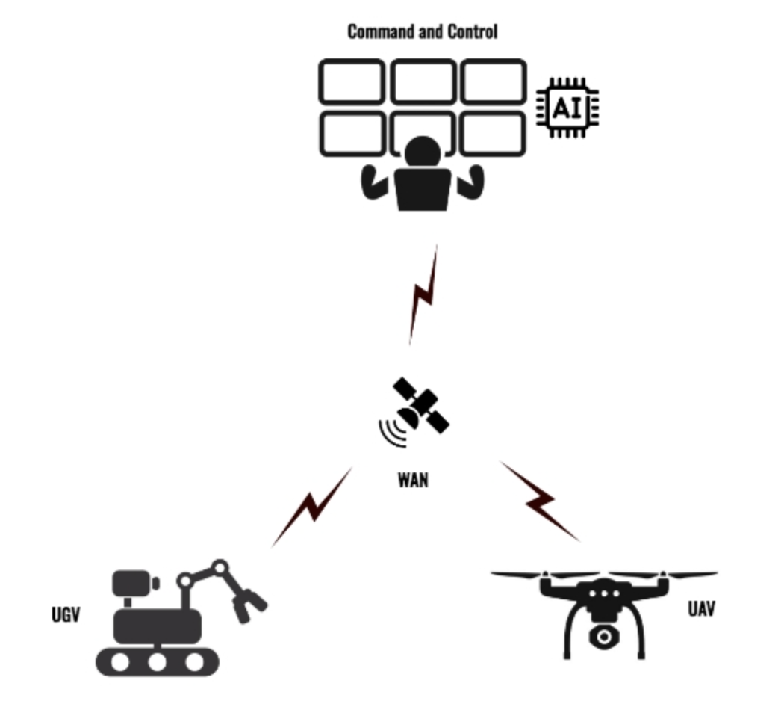
Research example: traversing mine-laden field
Threat probability
Classify images
Sufficient
Info?
Y
Plan
Path | Risk
Path
Y
Traverse
Acceptable?
Images
N
N
4

Slide 6
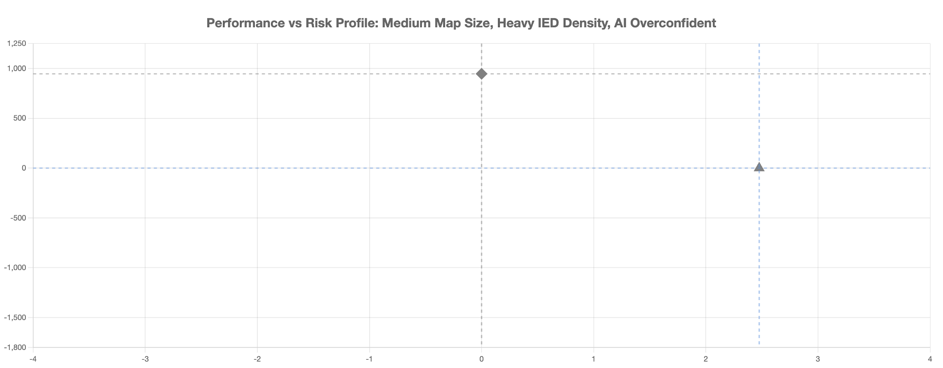


Research example: traversing mine-laden field
AI baseline, fast but risky
Faster Traversal
Human baseline, slow but safe
Fewer mines hit
5

Slide 7
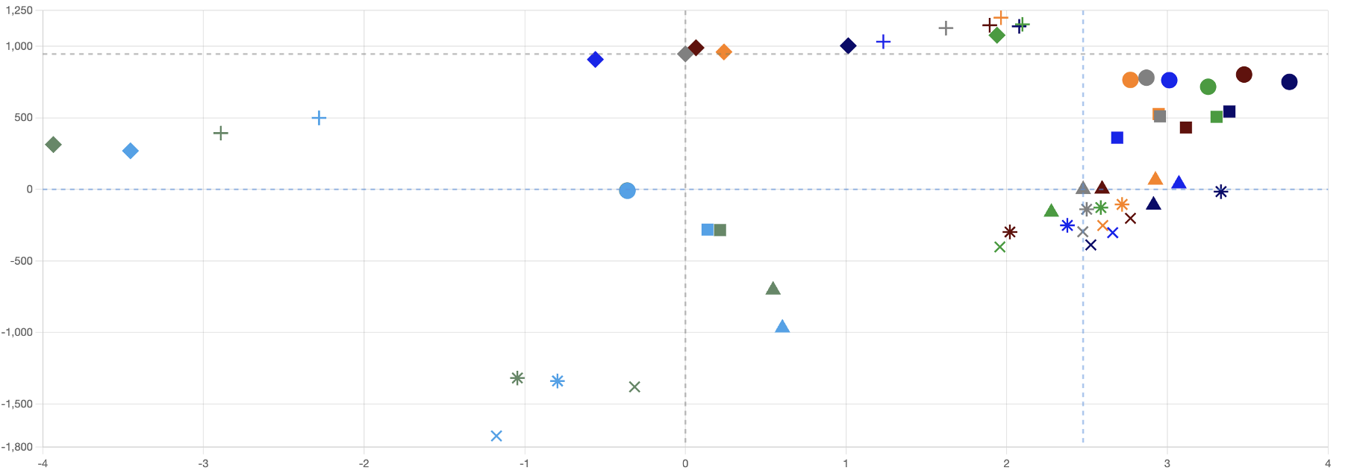
Research example: traversing mine-laden field
AI baseline, fast but risky
Faster Traversal
Human baseline, slow but safe
Fewer mines hit
5

Slide 8
Concluding Thoughts
Most “AI” are embedded in “systems”
The way AI is integrated can drastically change the behavior of the overall system, which is the level we care about.
Characterizing the “system” requires understanding the components, their interactions and the behavior at the system level.
Call a systems engineer!
SE discipline focuses on architecting tradeoffs across functions.
Decades of experience MacGyvering test rigs to build confidence on key variables.
6

Slide 9

Thanks!
zszajnfa@gwu.edu

