Slide 1
Defueling
Conflict
Defueling Conflict
ENVIRONMENT AND NATURAL
RESOURCE MANAGEMENT
AS A PATHWAY TO PEACE
Perspectives on
the MENA region
ENVIRONMENT AND NATURAL RESOURCE MANAGEMENT AS A PATHWAY TO PEACE
November 16, 2022
Phoebe Spencer
MENA Seminar Series
June 1, 2023
Tracy Hart
Phoebe Spencer
Shaadee Ahmadnia
Notes:
‘Defueling Conflict’ published last October
Today’s presentation: key findings & how this report engages with the work of the World Bank in the MENA region
Authors: Shaadee Ahmadnia, Agathe Marie Christien, Phoebe Spencer, Tracy Hart, Caio Cesar De Araujo Barbosa

Slide 2
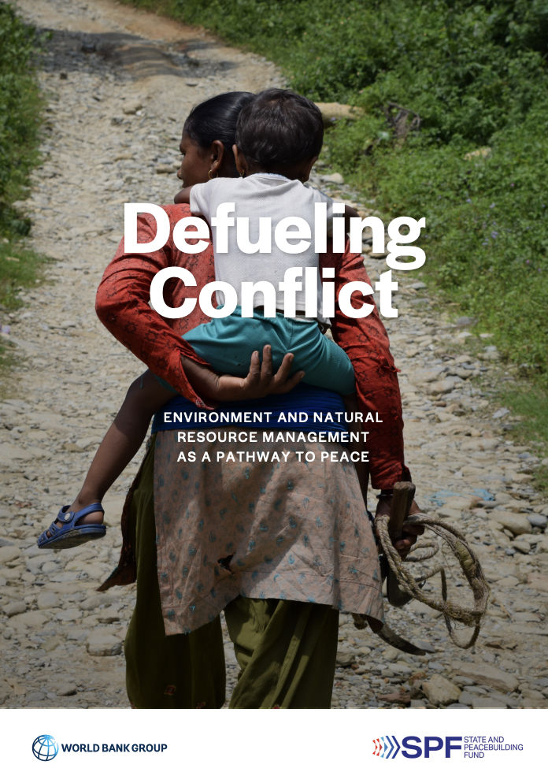
Objectives
Build a strong narrative on the need for the WBG to engage and invest in environment, NRM, and climate change resilience in FCS
Strengthen the conflict sensitivity of operations to account for linkages between conflict, fragility, and natural resources
Notes:
The two objectives are mutually reinforcing
Connected to:
Updated RRA methodology
New M&E Guidelines for FCS
Peace lenses/conflict filters
With SPF we scoped tools and captured lessons in Bank and crowding in to improve design and implementation
help operationalize the FCV strategy

Slide 3
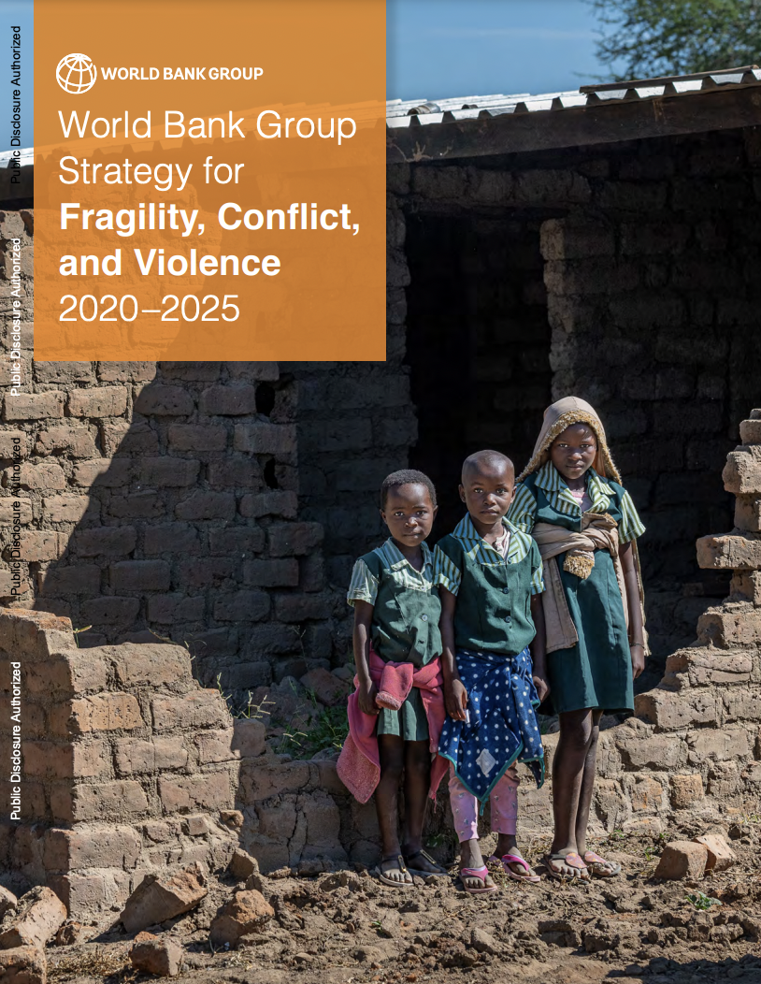
Wbg Strategy for Fragility, Conflict, and Violence 2020-2025
4 Pillars of engagement
Prevent violent escalation into conflict
Remaining engaged during conflicts and crisis situations to protect human capital and institutions
Helping countries transition out of fragility
Mitigating the spillovers and impacts of FCV
Objective
To enhance the World Bank Groups effectiveness to support countries in addressing the drivers and impacts of Fragility, Conflict, and Violence and strengthening their resilience, especially for their most vulnerable and marginalized populations.
Notes:
Across these 4 pillars of engagement, NRM and environment play a key role, both as possible threat multipliers or possible entry points for addressing FCV and strengthening the resilience of countries facing FCV
drivers and impacts often related to NR - UNEP: over a 60 year period, 40-60% of conflicts were resource-related (UNEP)
strengthen resilience: Conflicts linked to NR are more likely to relapse than others within 5 years of peace agreement, so extremely important to include these in dialogues and peacebuilding efforts

Slide 4
Building upon mena-specific peacebuilding approaches
Pillars of engagement
Prevention efforts: entry points for dialogue and confidence-building
Remaining engaged during conflicts: thinking about long term horizons, less politically charged issues, seizing entry points to build resilience
Transition out of fragility: diversifying the economy, mobilizing financing, and engaging formal and informal sectors to revitalize rural livelihoods.
Spillovers: improving conditions for refugees and host communities
Notes:
In addition to the FCV Strategy, MENA-specific efforts can help to frame the drivers and impacts of conflict and violence that relate to NR and environment as well as the opportunities that NR and env’t provide throughout the conflict cycle

Slide 5
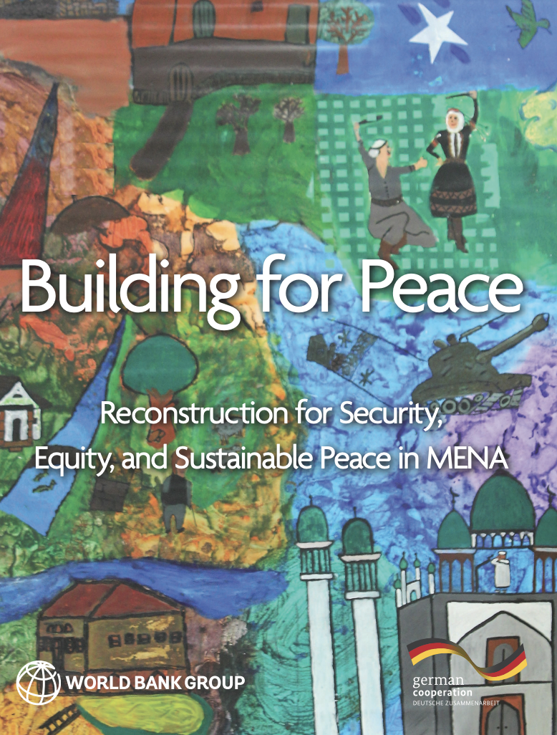
Building upon mena-specific peacebuilding approaches
Pillars of engagement
Prevention efforts: entry points for dialogue and confidence-building
Remaining engaged during conflicts: thinking about long term horizons, less politically charged issues, seizing entry points to build resilience
Transition out of fragility: diversifying the economy, mobilizing financing, and engaging formal and informal sectors to revitalize rural livelihoods.
Spillovers: improving conditions for refugees and host communities
Notes:
MENA-specific peacebuilding approaches have been explored by the Bank before, such as in the Building for Peace report
focus on remaining engaged during conflict and avoiding/breaking fragility traps
Rethink peacebuilding approach in MENA
Recommendations of BfP that speaks to the work we are doing on NRM and environment
BfP’s recommendation to focus on local interventions (as a complement to state-level approaches) is complemented by Defueling Conflict’s focus on rural livelihoods and resilience of the NR asset base
BfP’s highlights the need to be cautious when designing policy as each intervention introduced along a country’s path redistributes resources among actors, thereby altering the balance of power between these actors. Defueling highlights this issue in the context of NR the inclusion of conflict/peace lenses for NRM projects

Slide 6
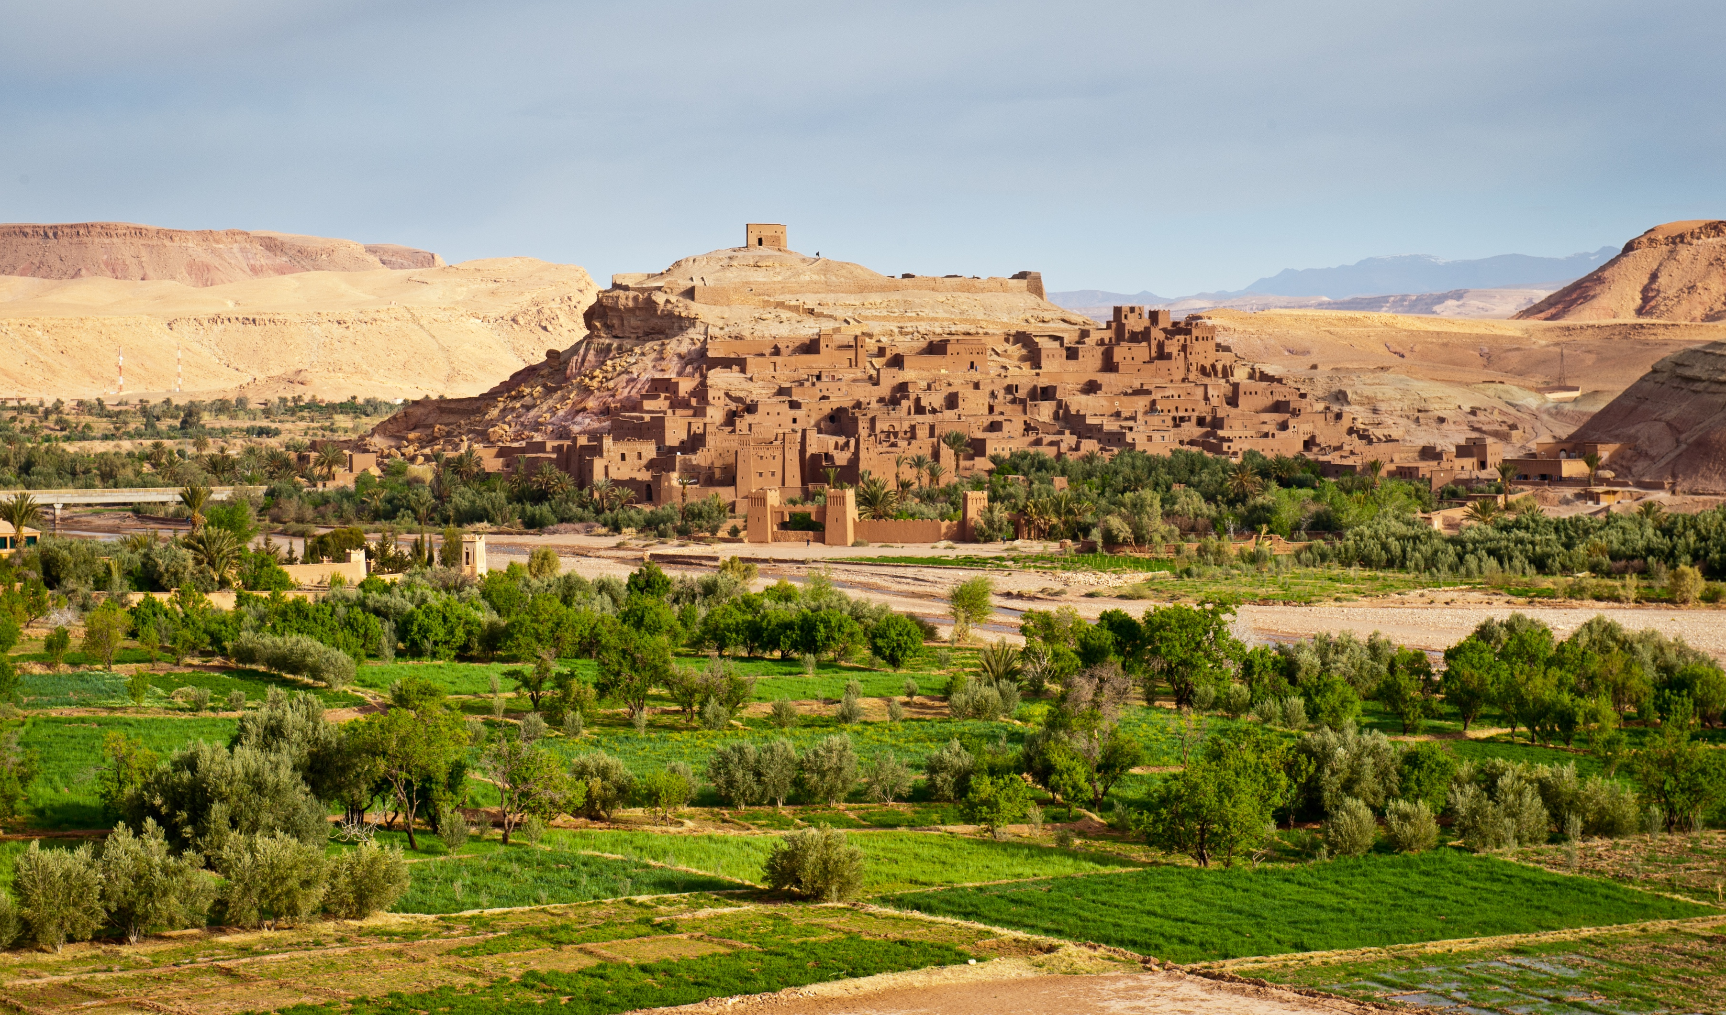
MENA CONTEXT
Environmental vulnerability
As a result of human activities and climate change impacts:
Increase in resource scarcity
Decline in resource quality
Acute exposure to sea level rise
FY23 FCS List
Conflict: Yemen, Syria, Iraq
Fragile: Lebanon, Libya, West Bank & Gaza
PHOTO CREDIT: WORLD BANK
Notes:
When we think of FCS in MENA at the Bank, the 6 countries on FCS List come to mind
- These also contribute to spillover effects across the region
one in five people in MENA already live within 60 km of conflict and the region is home to a quarter of forcibly displaced people in the world
MENA is facing environmental vulnerability from multiple angles
climate change hotspot
world’s most water stressed region
precipitation patterns: rainfall in Jordan is forecasted to decrease by 30 percent by the end of the current century
increase in the severity and frequency of droughts
desertification: projected to increase in MENA, reducing the amount of available arable lands
Desertification endangers almost half the land area in the Mashreq
Sea rise level impacts salinity of coastal aquifers
Soil degradation from temperature rise
That leads to higher dust-storm activity and worse air quality

Slide 7
MENA CLIMATE ROADMAP (2021-2025)
Notes:
On top of environmental vulnerability related to human activity, CC worsens these effects and their impacts on fragility and conflict
MENA Climate Roadmap identifies CC and the depletion of natural resources as a threat multiplier in the context of high socio-political instability:
drives forced displacement
exacerbates risks of violent conflict (both at the intercommunal level around resource competition, and possibly at the inter-state level)
poses a significant threat to vital ecosystems
Increases exposure of women and girls to climate-related hazards that can increase GBV

Slide 8
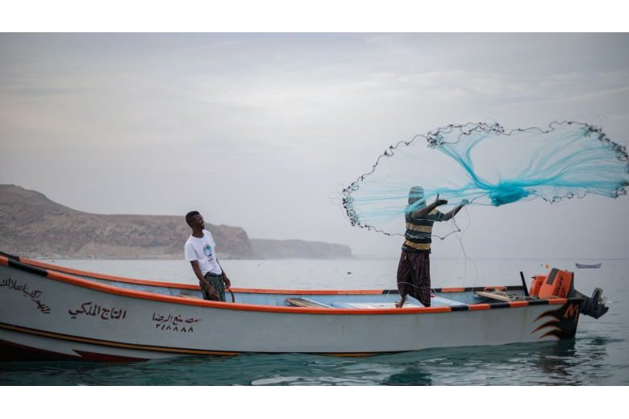
Targets:
Resilient societies
Inclusive development
Peace and stability in the region
Notes:
Defueling Conflict’s emphasis on rural livelihoods and improvement of the NR asset base is fully in line with the MENA Climate roadmap
Additionally, targets around resilient societies, inclusive development, and peace and stability are all bolstered by conflict-sensitive NRM

Slide 9
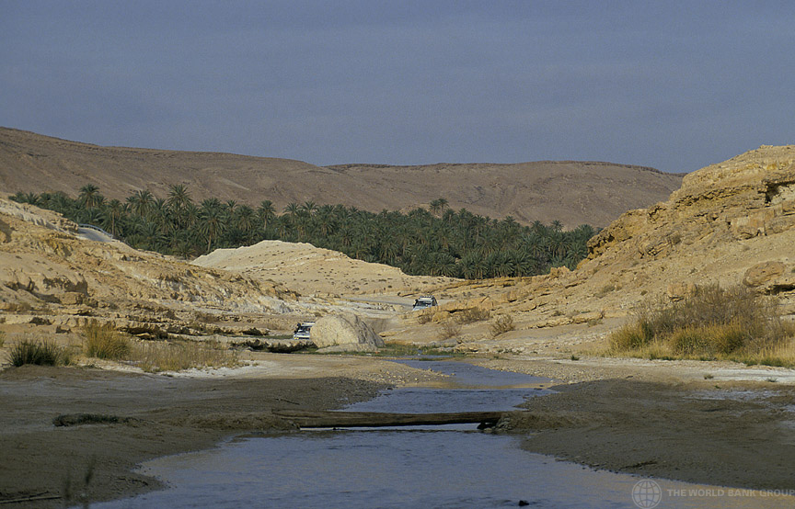
DIRECT IMPACTS
Acute, Site-Specific
Damaged by weapons or explosives
Used as a weapon of war
Exploited to finance and prolong conflict
Environmental Risks of
Active Conflict
Diminishes Assets that Facilitate Resilience to Shocks
Indirect impacts
Chronic and Long-Lasting
Governance vacuums
Large-scale displacement
Short-term coping strategies that undermine sustainability
Notes:
Conflict’s impacts on NR can be both direct and indirect
Direct impacts:
Damaged by weapons or explosives
Syria: targeted attacks on oil refineries contaminate soil and water and degrade vegetation
Iraq: contaminated environment with war related pollutants in cities
Used as a weapon of war
Libya: local militias have used water infrastructure, especially the Great Man-Made River, as a source of leverage against rivals or the central government; in Tripoli, a militia had turned off the flow of fresh water getting into the city to pressure a rival militia into releasing an imprisoned leader
Exploited to finance and prolong conflict
ISIS levied a water tax in Raqqa to buy new weapons; exploited oil for domestic consumption, and sold and/or smuggled into neighboring territories (this probably peaked in 2015)
Indirect impacts on governance/livelihood impacts
Vacuum in governance
Unregulated overfishing in Yemen’s Exclusive Economic Zone: main damage come from large-scale international fleets < lack of state enforcement of regulations
Large-scale displacement
Syria: conflict’s environmental impact expands to countries that have witnessed an influx of refugees, often adding pressure on water, waste management and land and energy
Short-term coping strategies can undermine sustainability
Yemen: surge in deforestation as a result of severe fuel shortages (more than 5M trees cut down since 2018)

Slide 10
Abundant Resources and Dependence
Notes:
Why does it matter if conflict affects resources? MENA is a region of both abundance and scarcity when it comes to natural resources
Resource abundance can easily become resource dependence
Conflicts can arise/sustain through the control of key resources
The unsustainable use of the resources, or global price fluctuations in the resources, can also contribute to fragility
Critical areas:
Good governance of natural resources
redistribution of benefits/profits to promote equity
reinvestment of profits toward non-resource dependent sectors to move away from resource dependence
Broader than a sectoral conversation - goes more toward why NR-dependent economies are more susceptible to fragility
Causal linkages between conflict and resources in resource-rich/dependent countries look different than others

Slide 11
Resource Scarcity and Conflict
Notes:
Countries that are resource scarce behave differently
Example: trans-boundary water conflicts, land encroachment due to degradation
Scarcity works along very different pathways toward fragility and conflict than abundance/dependence does

Slide 12
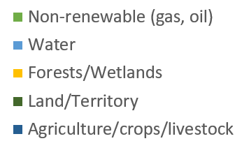
Recurrent Resource Pathways in MENA Conflicts
Natural Resources in Major Armed Conflicts (1989-2018) in the MENA Region [N = 16], derived from Bruch et al., 2019
Notes:
Beyond the economic implications of environmental damage due to conflict and unsustainable resource use, NR in MENA, and globally, have complex and varied interactions with conflict
Non-renewable resources play a critical role as a cause, target, financing mechanism, and bargaining chip for conflict
Yes renewable, water, and land resources also play crucial roles
Climate change and global market shifts are likely to change these relationships – land and water may become even more valuable and contentious as desertification and water scarcity increase
Figures derived from “The Changing Nature of Conflict, Peacebuilding, and Environmental Cooperation”, by Carl Bruch, David Jensen, Mikiyasu Nakayama, and Jon Unruh, 2019

Slide 13
Operationalization | NRM in FCV Questionnaire
Upstream Analytics
RRA, CCDR, CPF, SCD development at a strategic level
NR dependence
Changes to availability and quality of NR
Conflict dynamics and climate trends
Coping capacity and resilience
Situational Analysis
NRM in FCV: Questionnaire for Upstream Analytics and Downstream Operations
Conflict
NR
Fragility
Gender
Inclusion
Climate
Downstream Operations
Task teams working on NR/climate-related projects/programs in FCS
Objectives and components
Site-level factors
Risk management
Stakeholder engagement
M&E
Project Design
Notes:
How do we operationalize conflict sensitive approaches to NRM in FCV settings?
The report presents a number of useful tools to support operationalization
I’m going to delve into the Natural Resource Management in FCV: Questionnaire for Upstream Analytics and Downstream Operations
We designed it to allow teams to translate the findings of defueling conflict into their work, considering the interplay between conflict, climate, natural resources, and fragility, along with social inclusion and gender considerations
This is not intended to be a checklist, but a tool to help teams ask the right questions to integrate these complex dimensions in their work, to help them:
acknowledge environment conflict linkages
Think about the role of their interventions in light of these linkages
And advocate for their importance
The questionnaire is divided into two sections
First, the Situational analysis
Helps uncover a big picture view of natural resource and conflict dynamics and explores critical linkages that establish the grounds for attention to natural resources
The situational analysis is useful for risk and resilience assessments, country climate and development reports, country partnership frameworks, and systematic country diagnostics development at a strategic level
while on the ground operations also benefit from the linkages covered in the situational analysis,
The second set of questions related to Project Design go a step further to support the integration of these dynamics downstream into project preparation for teams working directly or indirectly with NR or climate-related projects, from objectives to M&E

Slide 14
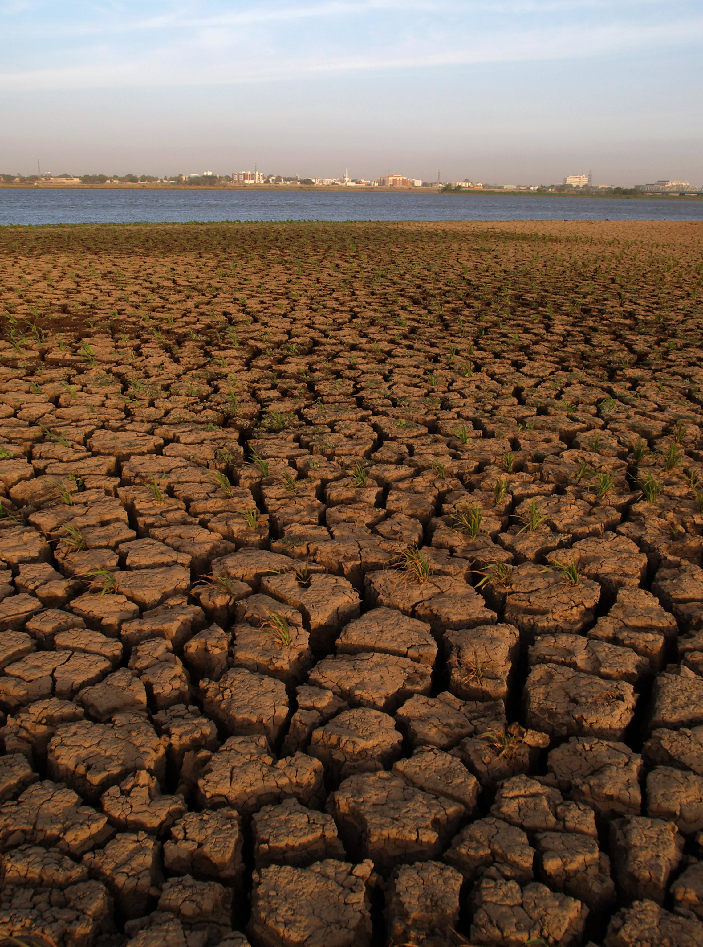
Sample Questions
Overall, any change in the quantity and quality of natural resources poses risks whether its value is being decreased or increased
Climate Change
What are the current and projected climate-change related stressors?
Changes to Availability/Quality of NR
How has the management, access, availability, and quality of these resources changed?
Have conflict, demographic growth and displacement, climate, or global markets changed natural resource availability or value?
Conflict can happen over scarce and abundant natural resources
PHOTO CREDIT: WORLD BANK
Notes:
In addition to climate change and resource impacts, this questionnaire looks more broadly at changes to the availability and quality of NR
overall, changes in the quantity and quality of natural resources pose risks for fragile countries, whether value decreases because of degradation or increases due to market demand
In FCV, even the most degraded land can have value as a social safety net for vulnerable users (for passage, grazing, livestock, women gather wood)
So planting trees, restoring land can prompt -
displacing the local population
Elite capture
Increasing the vulnerability of the vulnerable and resource dependent

Slide 15
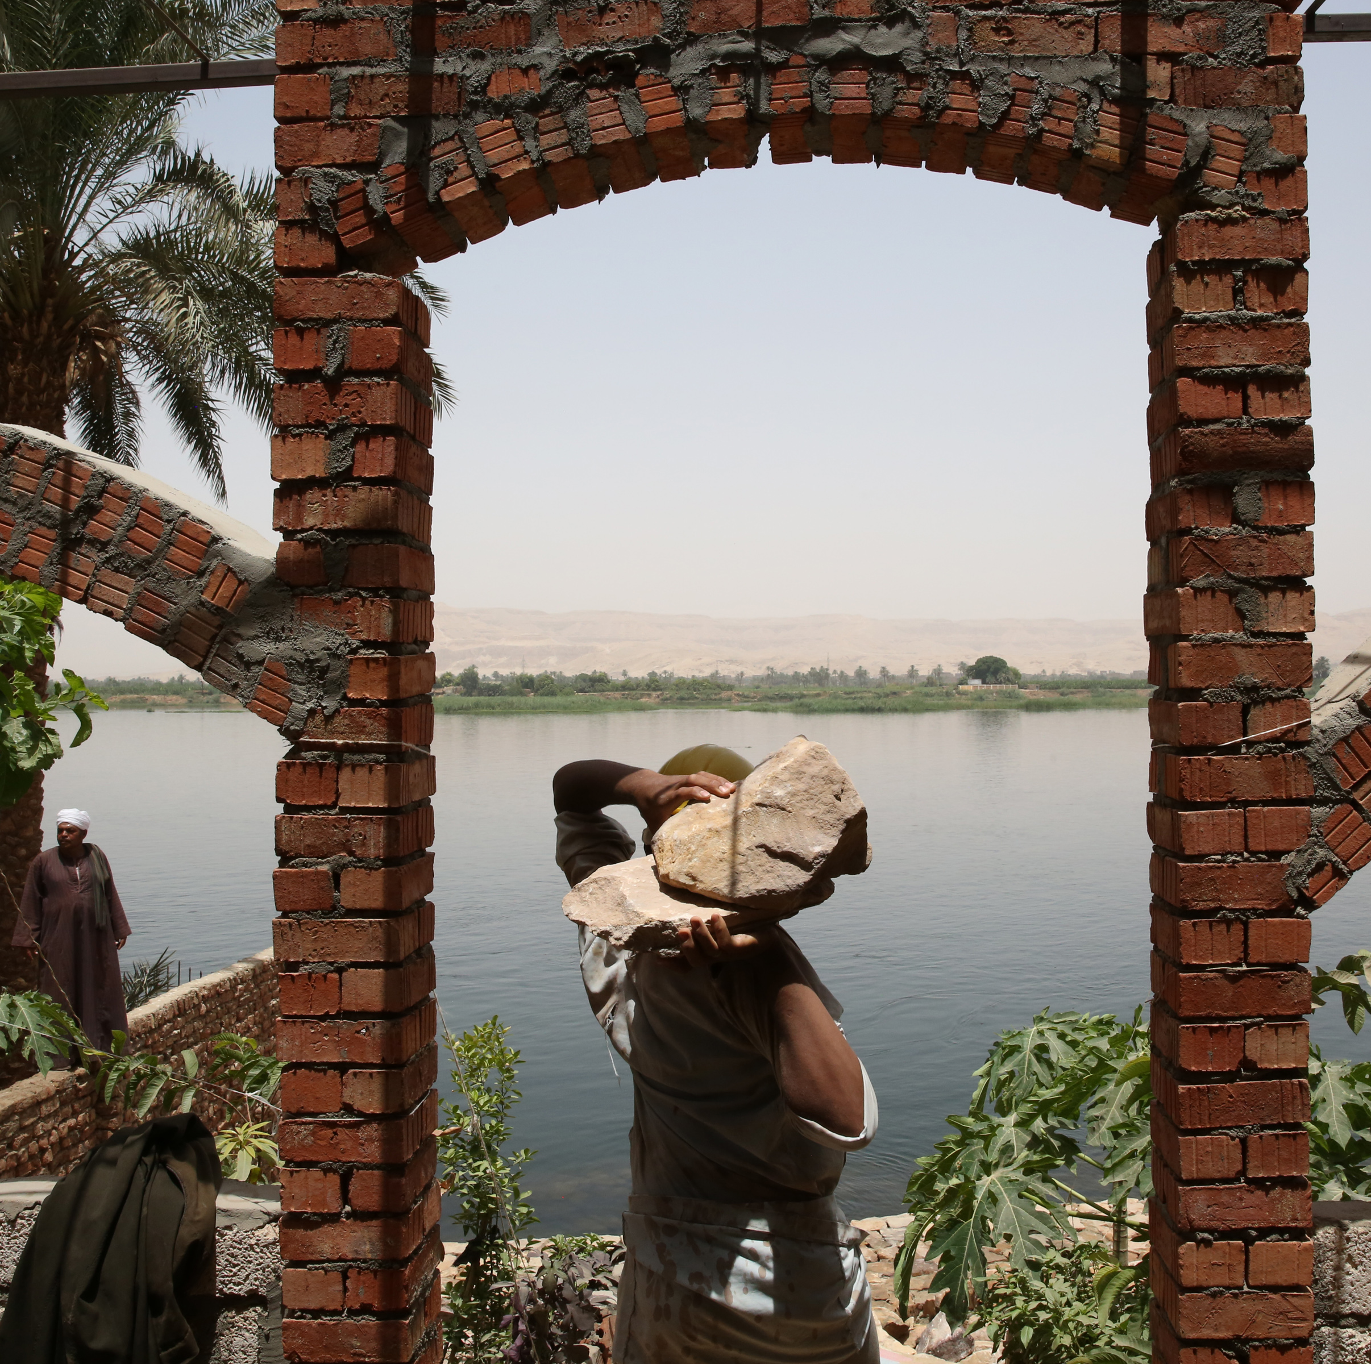
Next Steps to Operationalize Defueling Conflict for MENA
Map regional environment-fragility-conflict linkages
Identify environment-FCV hotspots
Develop region-specific tools and recommendations for using natural resources as pathways to resilience and peace
Notes:
In applying this tool and others to the MENA region, we’re also looking forward to additional steps to help build and target knowledge toward improved conflict sensitivity and peacebuilding
Image source: https://www.flickr.com/photos/worldbank/18453329279/in/album-72157601463981149/

Slide 16
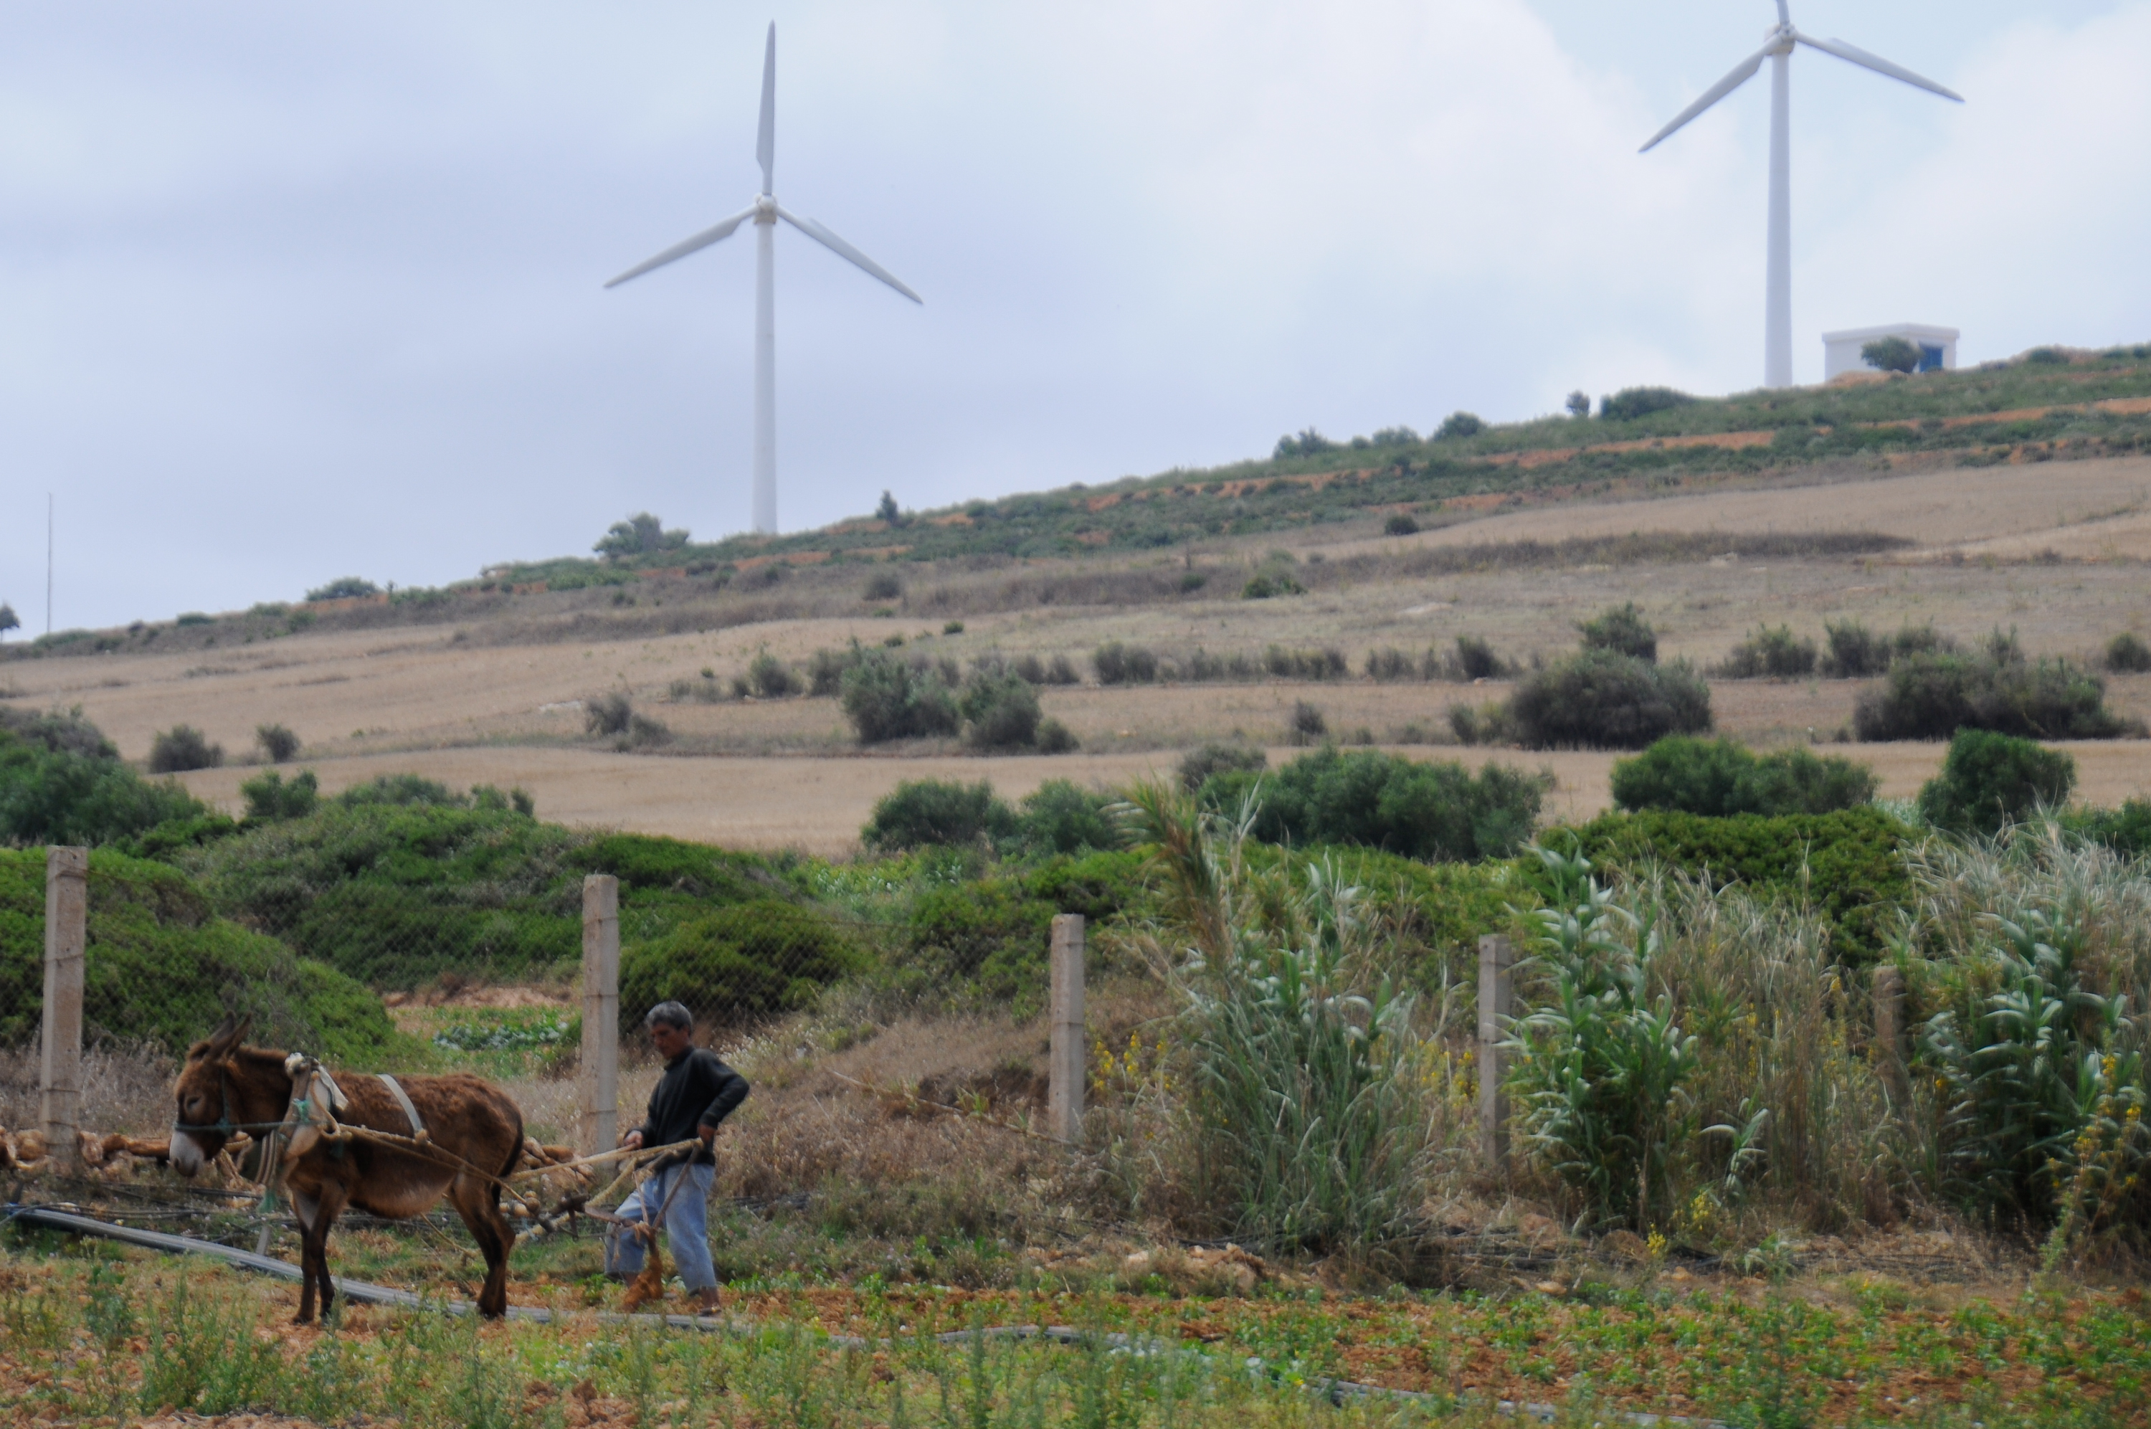
defueling conflict knowledge products
Papers and Reports
Defueling Conflict: Environment and NRM as a Pathway to Peace
Environment and NR Supplementary Guidance Note for RRAs
Scaling-Up Climate Resilience Investment in FCV: Considerations for World Bank Engagement in FCS
Presentations
Defueling Conflict: NR Governance as a Pathway to Peace
Dirt, Sweat, and Fears: ENB Staff Share Strategies for Working in Uncertain Contexts
How to Improve Results in Fragile and Uncertain Contexts: 12 Recommendations for ENB
Scaling Up from Small to Transformational Interventions
Addressing Gender, Conflict, and Environment Linkages
PHOTO CREDIT: WORLD BANK
Notes:
Knowledge products resulting from this work include:
Defueling Conflict, the full report
An environment and natural resources supplementary guidance note for Risk and Resilience Assessments
This is a shorter, more digestible format of the full report, including an adapted version of the questionnaire to support RRA development and guide discussions with country and task teams
Lastly, Scaling Up Climate Resilience and Investment in FCV delves into the climate change dimensions of the environment conflict nexus
We have also set up a number of presentations to learn directly from the experience of task team leads encountering and addressing these issues in their work

Slide 17
additional resources
Courses
Environmental Peacebuilding Knowledge Platform
Internal and external strategies and toolkits
Analyses and lessons learned
Knowledge Platform on Gender, Natural Resources, Climate, and Peace
Resource-specific tools
Gender
Policy briefs and checklists
Notes:
We’ve also curated additional resources to allow for a deep dive into the issues presented
as well as two knowledge platforms that are regularly updated reflect the dynamic, growing field of environmental peacebuilding
Academia and humanitarian spheres have explored these connections in depth for more than a decade,
and we used this effort to crowd in the vast experience from a web of organizations like mercy corps, usaid, unep just to name a few
to learn from their tools and lessons learned and adapt resources to directly speak to a Bank audience
Defueling Conflict and its knowledge products are a result of engagement with leaders in the NRM-environment-FCV space
and now that we’ve clarified where the Bank’s opportunities and entry points are, we look forward to the Bank being a leader in its own right in the field.

Slide 18
Thank You!
Tracy Hart, thart@worldbank.org
Phoebe Spencer, pspencer1@worldbank.org
Shaadee Ahmadnia, sahmadnia@worldbank.org

