Slide 1
Brought to you by Geodata: Responsible Banana Supply Chains Introduction of the DT4D Pilot Project

Slide 2
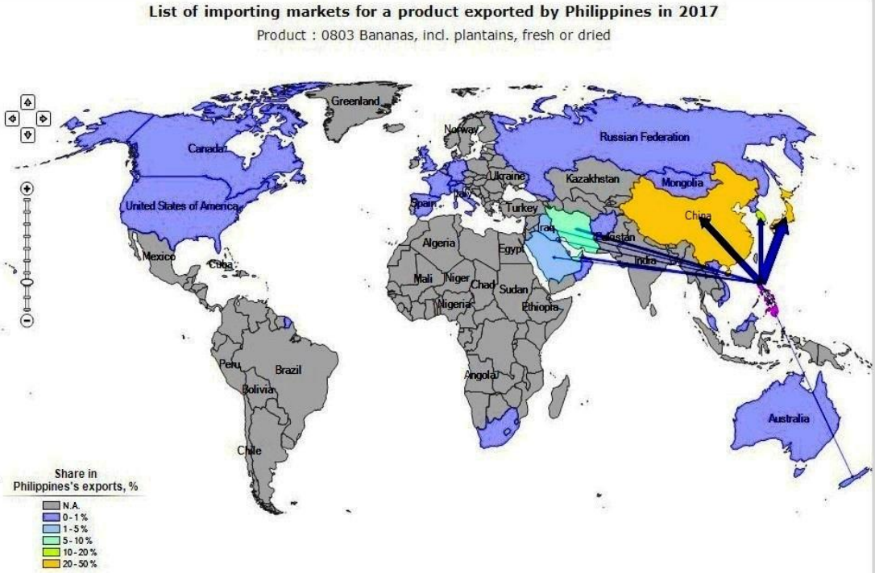
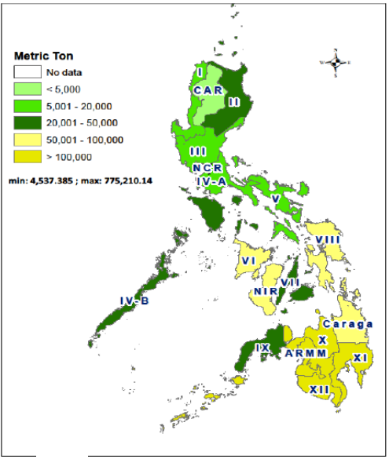
Banana production and sustainability context
The Philippines is the 2nd largest exporter of bananas in the World
2014-2018
2019
2020
4.40 M TONS
2.61 M TONS
3.72 M
TONS
FAO, 2020
www.trademark.org; 2018
Banana Production By region
Prevalent Sustainability Risks and Concerns
Environment – Deforestation | Land-use conversion | Climate change issues | Soil degradation | Biodiversity loss | Proliferation & use of illegal chemicals | Pest and disease | High Pesticide use | Water resources
Social and Labor – Land disputes | Decent wages | Child labor | Forced labor | Operational Health and Safety | Gender discrimination and sexual harassment
Source: Philippines Statistics Authority, 2014-2017
Notes:
Industry information conveys that banana exports from the Philippines were affected by severe production difficulties arising from the spread of plant diseases, which were worsened by the movement restrictions implemented to contain COVID-19. This reportedly had a particularly detrimental effect on small-scale banana producers, which were faced with cancelled orders due to quality concerns.
Shipments to China, the largest destination for bananas from the Philippines, procuring one third of total Philippine exports in 2019, reportedly fell by 25 percent in 2020, to 1.2 million tonnes. (50 – 75% of bananas in China are from the Philippines; 80 – 85% of bananas in Japan – has increased considerably imports from Central and South America)
Higher consumer demand for nutritious fruits.
Businesses that operate globally develop a streamlined corporate-level approach to comply with the new legal requirements across all operations, and are required to conduct risk-based due diligence.
Decline in both production and wasytage
ITC data analyzed by the BusinessMirror showed that the Philippines’s market share for bananas in China, Japan, and South Korea has been shrinking in recent years, as domestic exporters have warned.
Banana Industry Stakeholders and Enablers
National Government Agencies | Special Projects | State Colleges and Univ. | Private Sectors
Banana Industry Strategic Action Plan
Improvement in Productivity Level | Expansion of Production Areas | Moving up in the value chain | Ensuring Market Awareness | Resource generation and Financing Strategies | R&D | Industry Cluster Organizational development & Human Resource Development

Slide 3
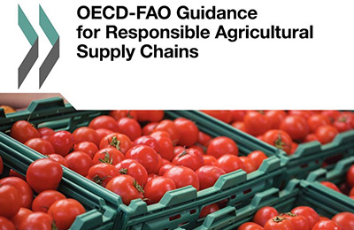
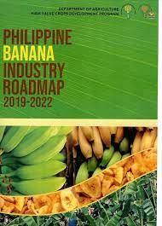
The case for Responsible Banana Supply Chains
Philippines’ Banana Industry Challenges and Opportunities
Access to markets and impacts of regulatory compliance E&S Standards are Common Requirements for Agricultural enterprises Access to markets - obtain financing from investors - maintain a strong brand and reputation – rising consumer demands for responsibly-sourced products Countries around the world (see EU Member States) are increasingly introducing new E&S legal requirements
Unlocking opportunities for local economic development For Smallholder farmers, adherence to E&S standards increase business opportunities, give access to international markets & higher returns
Philippine Banana Industry Roadmap (2019 – 2022)
Promote inclusive growth through a value chain approach | Increase quality and sustainability levels | Upscaling strategies for sustainability | Improvement in Productivity Level | Moving up in the value chain | Ensuring Market Awareness | Resource generation and Financing Strategies | R&D
Notes:
The Philippines is a major producer of bananas. Aside from the Cavendish banana
for export, it also produces other varieties of bananas and plantains such as the Lakatan and the Saba/ Cardaba varieties. While Cavendish is mainly produced as an export product, the Lakatan is consumed mostly as fresh fruit in the domestic market while a good portion of the Saba/ Cardaba variety is processed into banana chips and other products for domestic use and export.
The Philippine production of bananas since 2010 peaked in 2012 with more than 9.2 million metric tons followed by a sharp decline in 2013 as a direct result of the damage wrought by Typhoon Pablo. In terms of area planted, from a high of about 454,000 hectares in 2012, this declined to about 446,000 hectares in 2013 and further down to 443,000 hectares in 2014 and 2015. (Philippine Statistics Authority, 2014 - 2017)
The top players in the Banana Export industry are: Unifrutti, Dole, Sumifru, Lapanday, TADECO, and Del Monte. The map shows the location of these players
in Mindanao where the bulk of bananas for export are produced. There are other smaller independent exporters such as MBFEA. Mega, among others.
Other value chain players include processors under the Organization of Banana Chips Exporters and other independent processors.

Slide 4
DT4D Grant Overview
Objective: provide government, private sector, farmers and other stakeholders with improved information on actual and potential social and environmental adverse impacts for banana production in Mindanao
Problem
Identification
Digitized & location-based risks
E&S risk visualization live platform
Lack of common and interactive platform for current and potential E&S Risks
Prevalent environmental, social and labor risks
Lack of shared understanding between Business, Government, Farmers
Paper-based
E&S risk assessment
POST PROJECT IMPLEMENTATION
Enhanced Social and Environmental Sustainability
Enhanced RAI with an integrated platform that visualizes E&S Risks and voice to farmers
Enhanced Responsible Agriculture Investment (RAI)
Integrated and visualized
E&S risk assessment platform in pilot areas
E&S risks are identified and digitized

Slide 5
Disruptive Technology and List of Potential Indicators
Disruptive Technology & Potential E&S indicators
ENV indicator | % change of land surface used for banana cultivation
 | % change in forested area
 | Volume of pesticides used
 | Volume of fertilizer used
 | Water quality measurement results
 | % change in availability of water for agricultural purposes
 | % change in availability of water for community use
 | Soil testing results
DISRUPTIVE TECH
E&S indicators
EO
Env. Risk Indicators
Social and Labor indicator | Number of workers (including by gender)
 | % of workers who are unionized
 | Number of grievances reported by workers
 | Number of training and refresher sessions held on OHS
 | Number of stakeholder engagement meetings held
 | Number of grievances reported by communities
 | Number of children reportedly working on site
 | Number of security incidents reported
 | Number of OHS incidents, accidents, illnesses reported
 | Number of households physically displaced
 | Number of community members economically displaced
 | Wages paid to workers (minimum, maximum and average, including by gender)
 | Smallholder income (minimum, maximum and average, including by gender)
App
remote sensing/radar data
Social Risk indicators
Crowdsourced from GEMS tool with location
Base map
Pilot area
Existing map and/or EO data
Indicators extracted based on international standards, including OECD-FAO Guidance for Responsible Agriculture Supply Chains and IFC Performance Standards

Slide 6
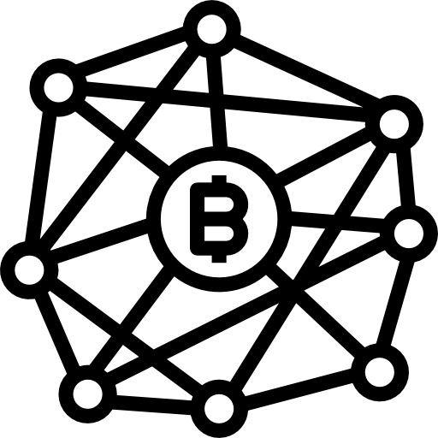
Agricultural enterprises and Disruptive Technology
Satellite imagery & geospatial information uses mages captured by satellites to monitor environmental risks and impacts related to land use change, deforestation, landscape changes. Often relies on other tools to support the analysis and reporting of what the satellite images are capturing
Mobile technology is increasingly used by companies to support the monitoring of social risks, in particular labor and working conditions, all the way to the farm level. It is often used to support access to grievance mechanisms
Blockchain supports traceability of commodities from downstream to upstream production and allows decentralized real-time information to be gathered and shared within a ‘network’ of authorized users
Data visualization methods Dashboards are commonly used by businesses to obtain an overview of both E&S risks in their supply chains and inform responsible sourcing decisions
Notes:
These are often used disjointly or in isolation

Slide 7
DT4D Pilot Sequencing
Completed
Engagement with Government
Prevalent risk identification
Technology literature review
External partner consultation
DT4D Challenge 2.0 Pilot project for E&S risks mitigation for sustainable banana production
Tech Provider
Environmental risks
Visualize and Store in appropriate platform (Implementation)
1. Show case
Government
Businesses
Civil Society
Identify Pilot area, and E&S indicators
Engagement with:
Government
Businesses
Farmers’ associations and/or CSOs
Identify, strategize, and mitigate risks
2. Adopt/expand our technical solutions (Advisory)
Social risks
3. Disseminate for replication for other supply chains at scale
Tech Provider

Slide 8
Next steps
Businesses
Government
Strategy for engaging with business stakeholders in the Philippines and abroad (business associations and enterprises)
Current uses of disruptive technologies for responsible agricultural supply chains
Counterpart: Department of Agriculture for Responsible Agricultural Supply Chains
Identification of most pressing challenges for the sustainability of banana production, and priority regions
Civil Society
External Partnerships
Strategy for engaging with civil society organizations and relevant farmers’ associations
Identifying modalities for the piloting of crowdsourced mobile data
European Space Agency Earth Observation Clinic and procurement of satellite imagery for environmental risk monitoring Technical consultations with FAO and World Banana Forum
Notes:
Engaging businesses
To understand the following:
Current E&S challenges they face in the banana supply chain (in the Philippines and abroad)
How businesses sourcing from the Philippines think about and address E&S challenges in their supply chain
What businesses in the Philippines are already doing to address E&S challenges, in particular among smallholder producers
Current uses of technology in the context of E&S sustainability risk management (challenges, opportunities and gaps)

Slide 9
Thank you

