Slide 1
Global Economic Prospects January 2024
www.worldbank.org/gep

Slide 2
Global Economic Prospects – January 2024

Slide 3
Global Economic Prospects – January 2024
Underlying data and charts can be found at
www.worldbank.org/gep

Slide 4
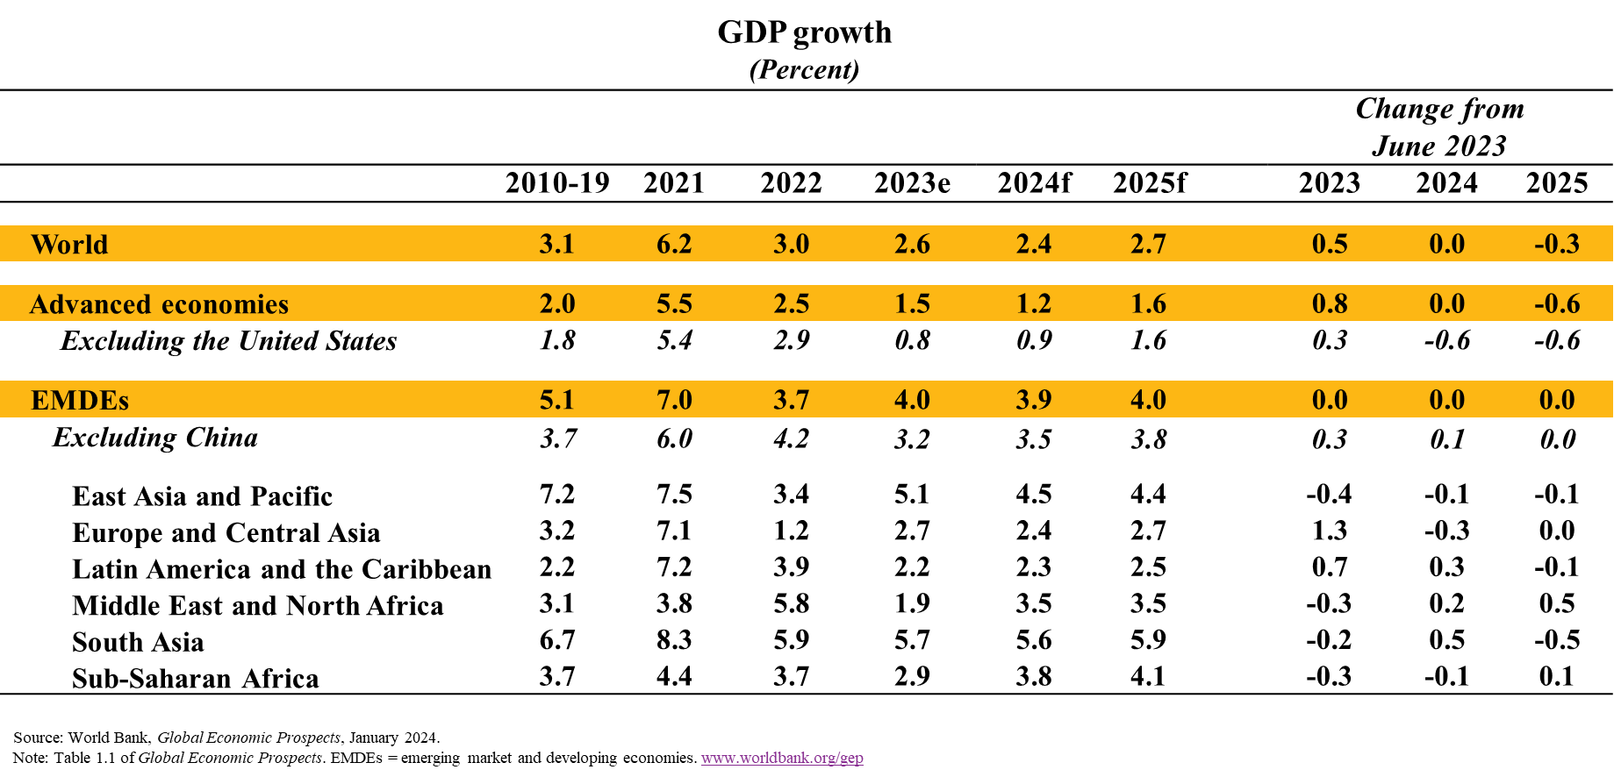
Global Growth Forecasts Slowdown in 2024 for Third Consecutive Year

Slide 5
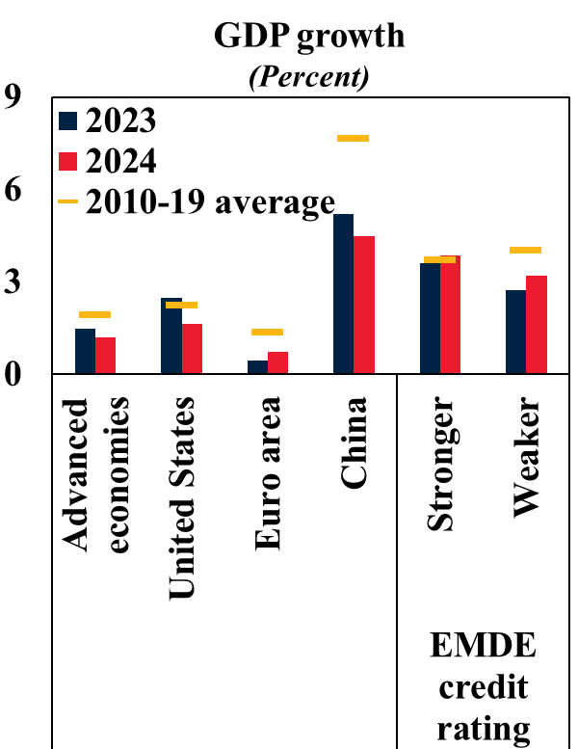
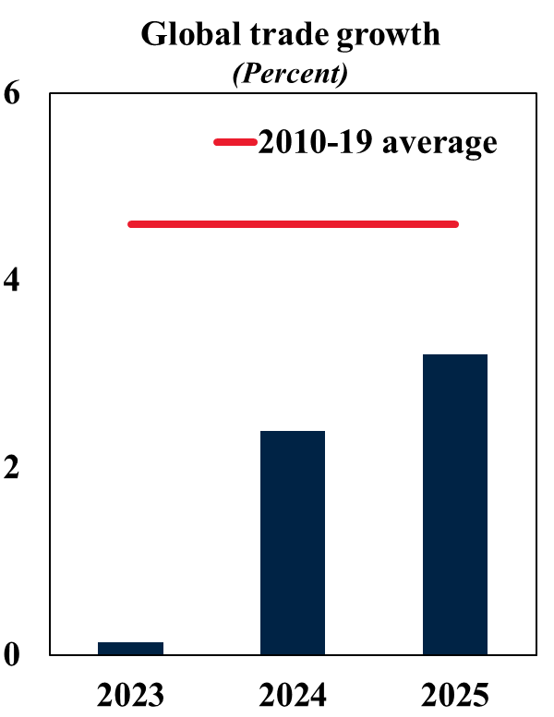
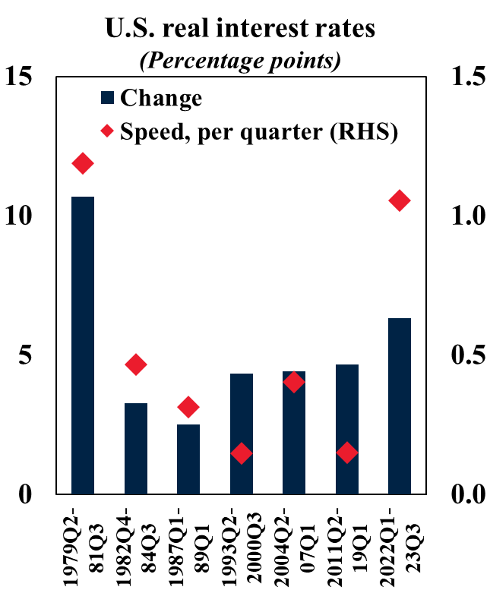
Global Backdrop Divergent Growth; Weak Trade; High Real Rates

Slide 6
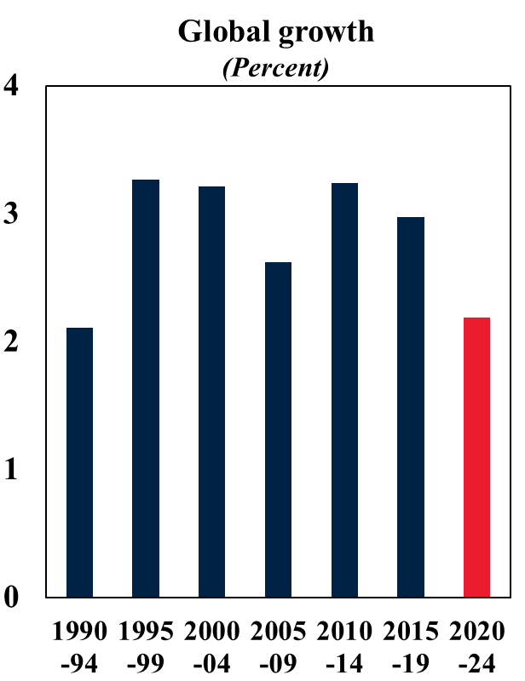
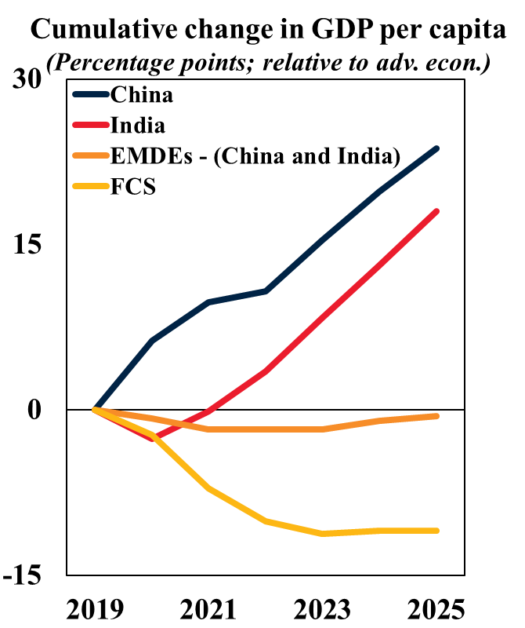
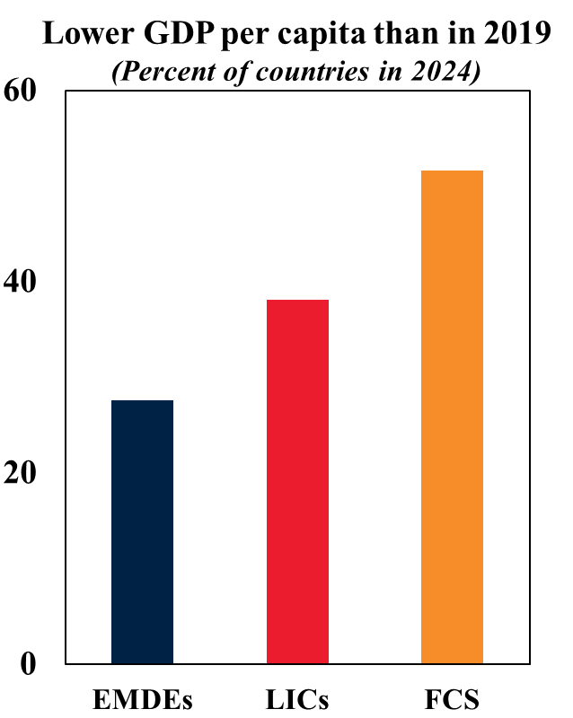
Growth and Income Weakest Half-Decade Growth since 1995; Many EMDEs Losing Ground; Stagnation in Income

Slide 7
Risks to the Global Outlook Multiple Downside Risks Clouding Outlook

Slide 8
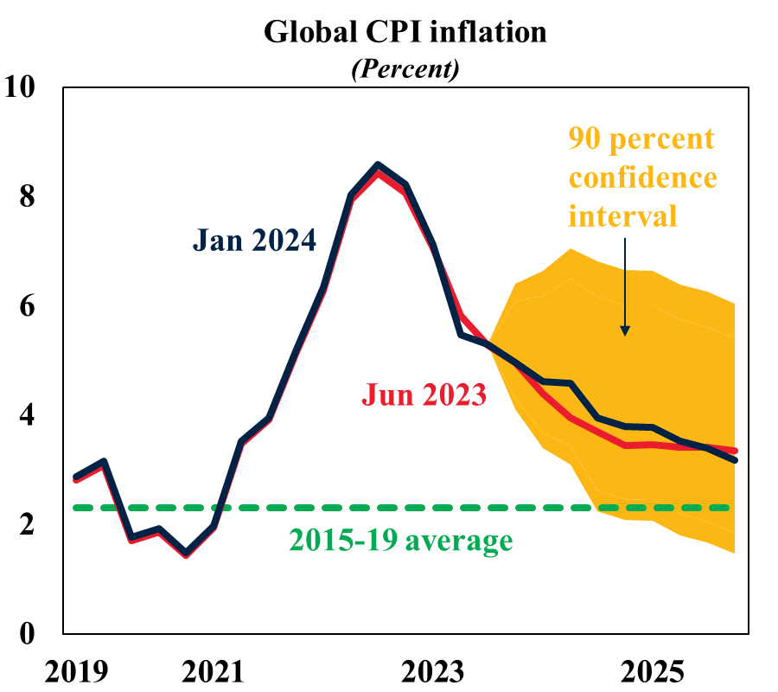
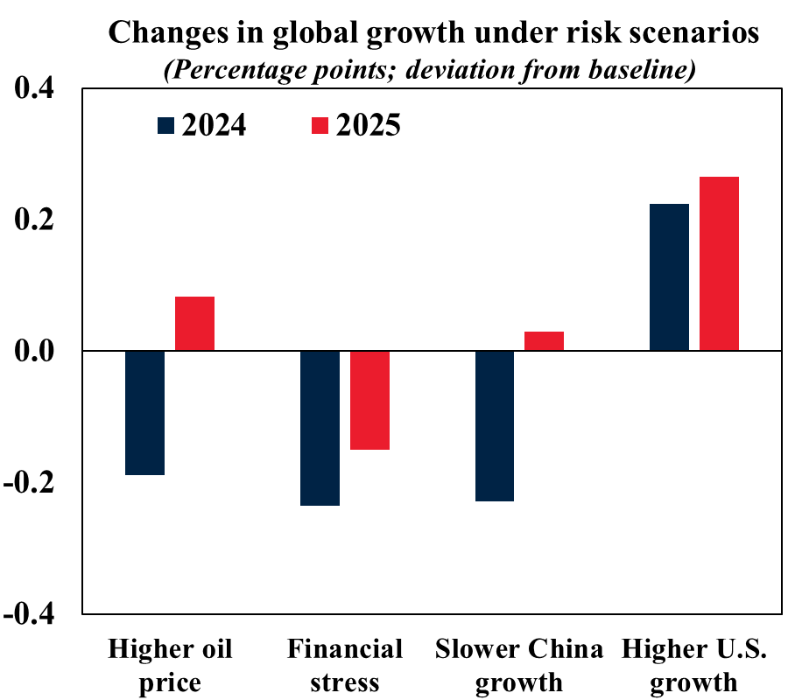
Global Inflation and Alternative Risk Scenarios Declining but Elevated Inflation; Weaker Growth Outcomes If Risks Materialize

Slide 9
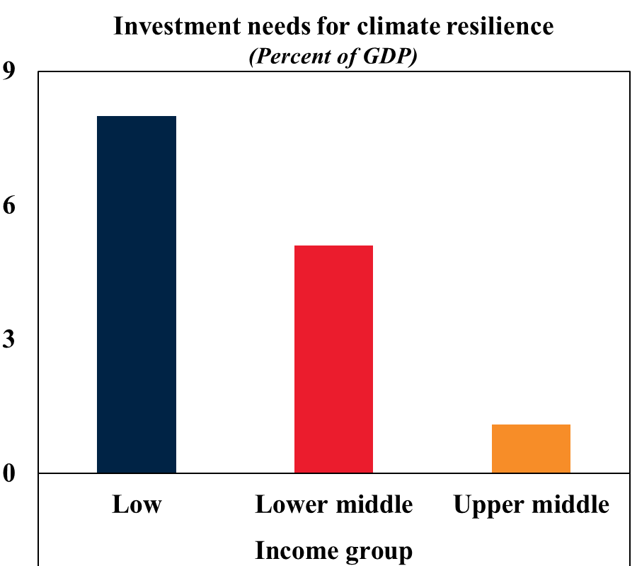
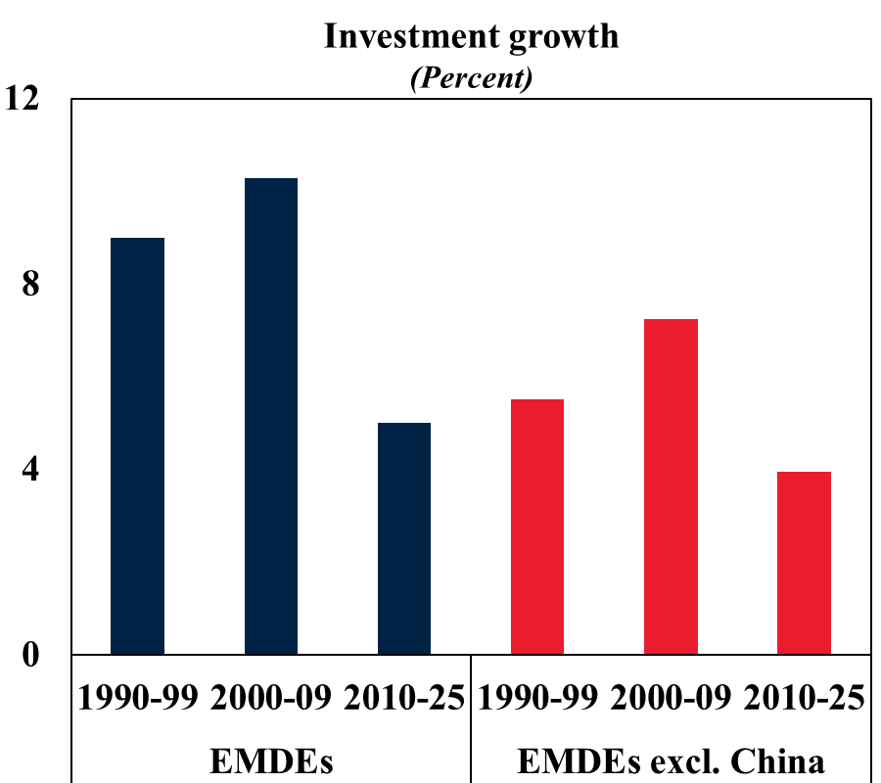
Climate Needs and Investment Growth Large Needs; Weaker Growth

Slide 10
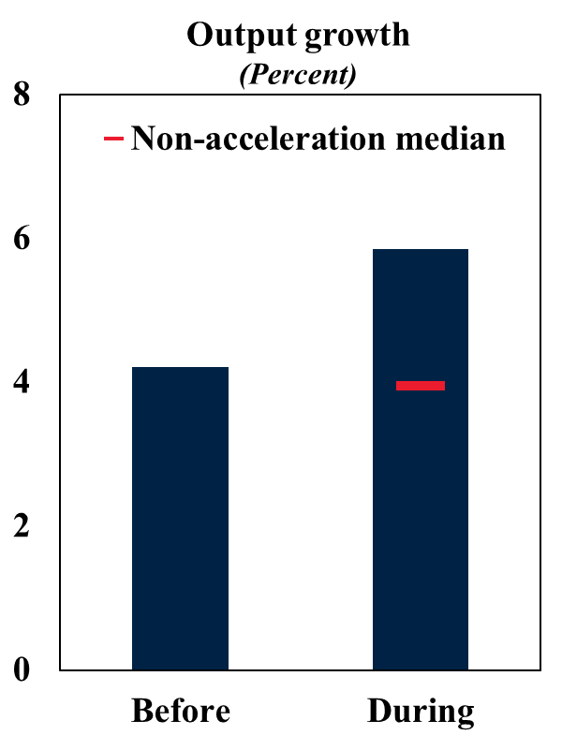
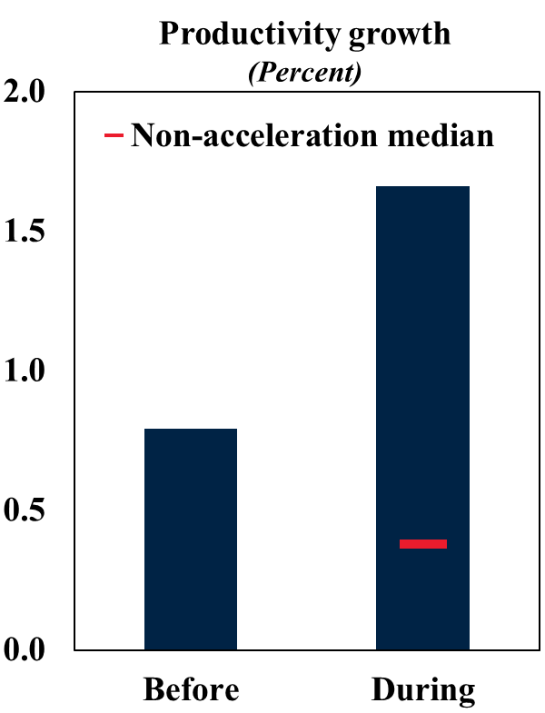
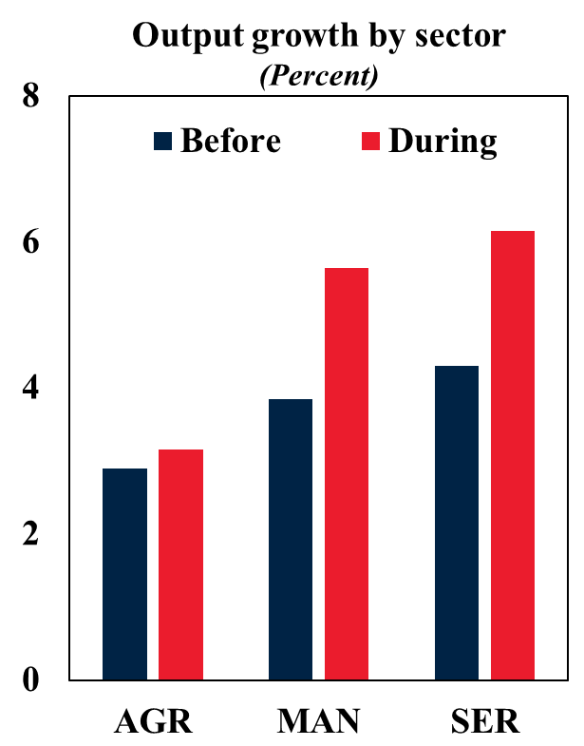
Growth During Investment Accelerations Faster Output and Productivity Growth; Rapid Expansion of Manufacturing and Services

Slide 11
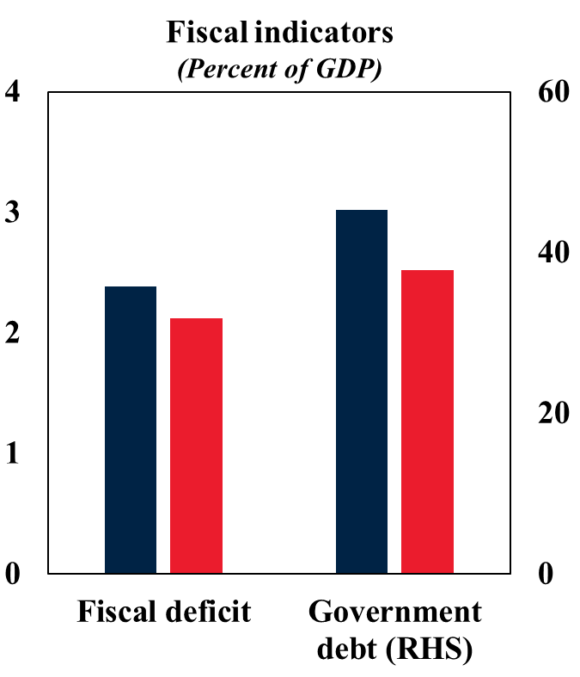
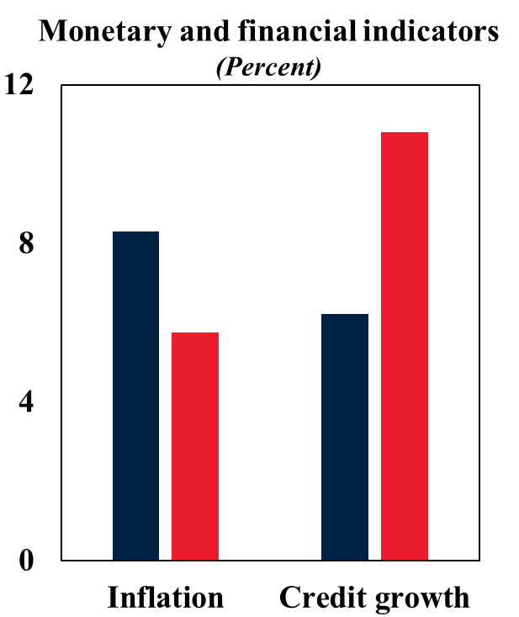
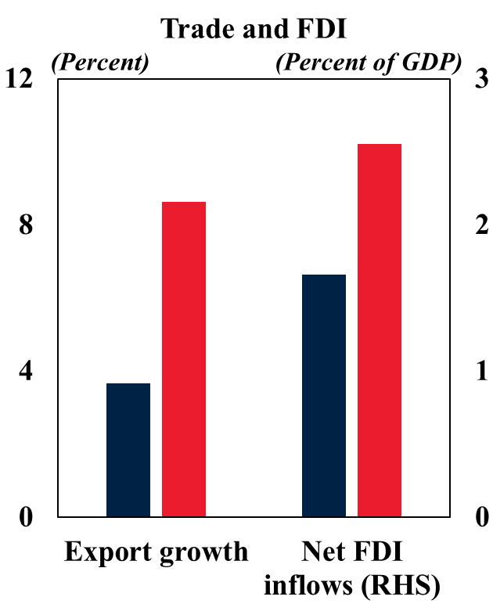
Macroeconomic Developments During Accelerations Improvements in Fiscal, Monetary, and Financial Conditions; Higher Trade and FDI

Slide 12
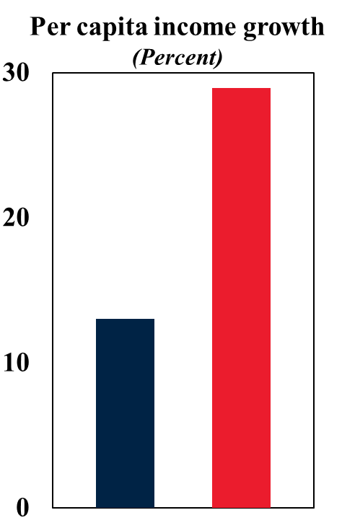
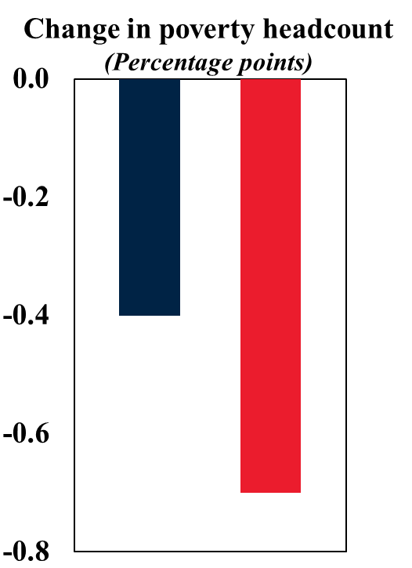
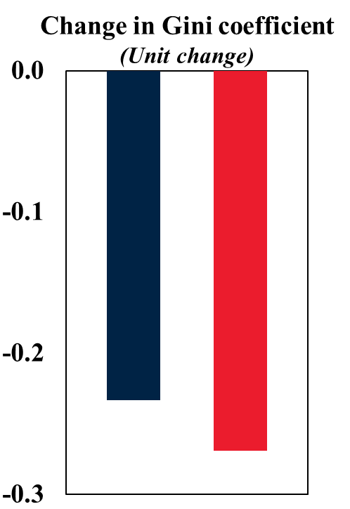
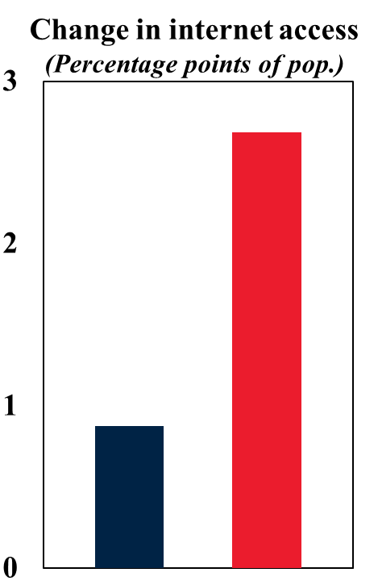
Development Outcomes During Accelerations Faster Income Growth; Sharper Poverty Reduction; Access to Infrastructure

Slide 13
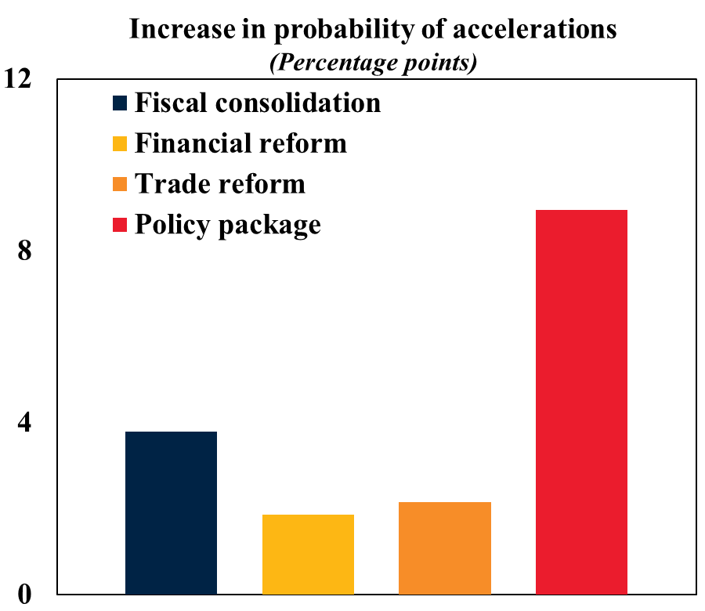
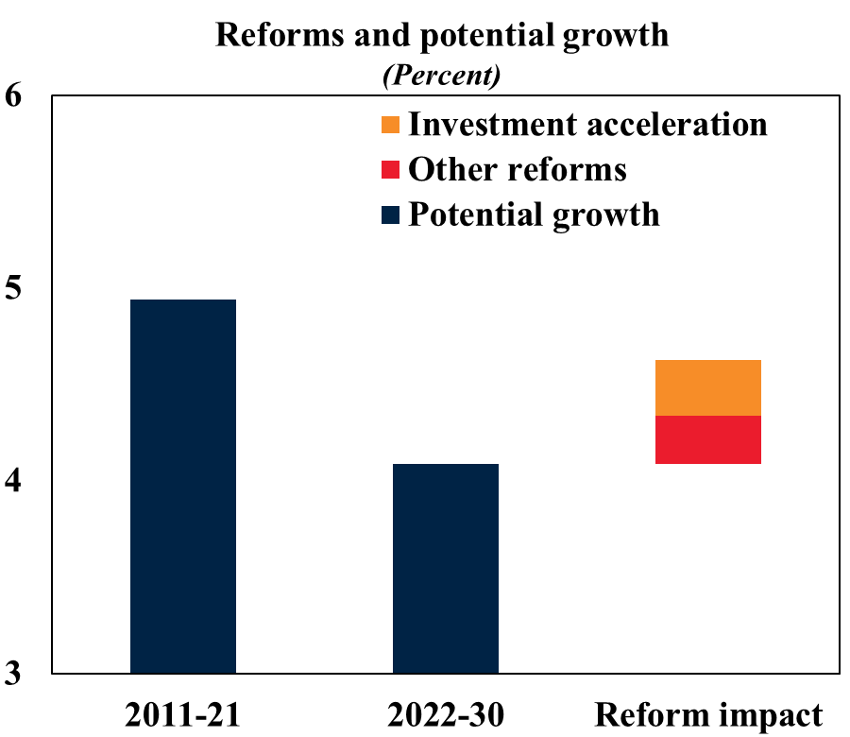
Reforms and Investment Accelerations Accelerations More Likely with Bold Reforms; Critical to Mitigate the Growth Slowdown

Slide 14
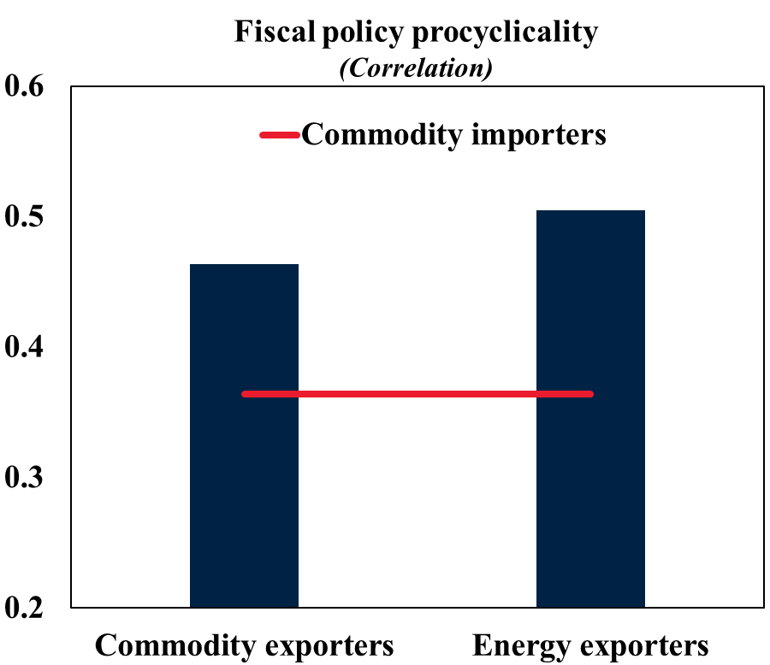
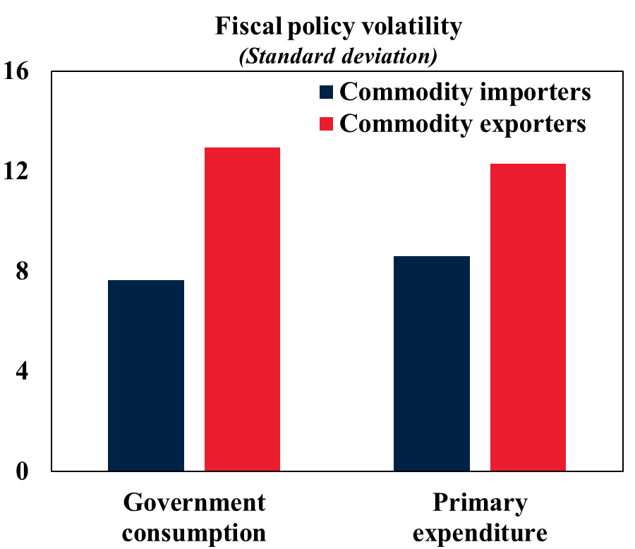
Fiscal Policy in EMDEs More Procyclical and More Volatile in Commodity Exporters

Slide 15
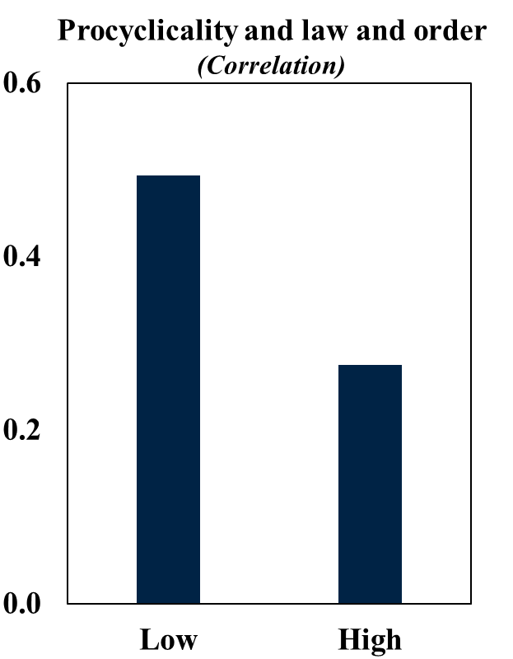
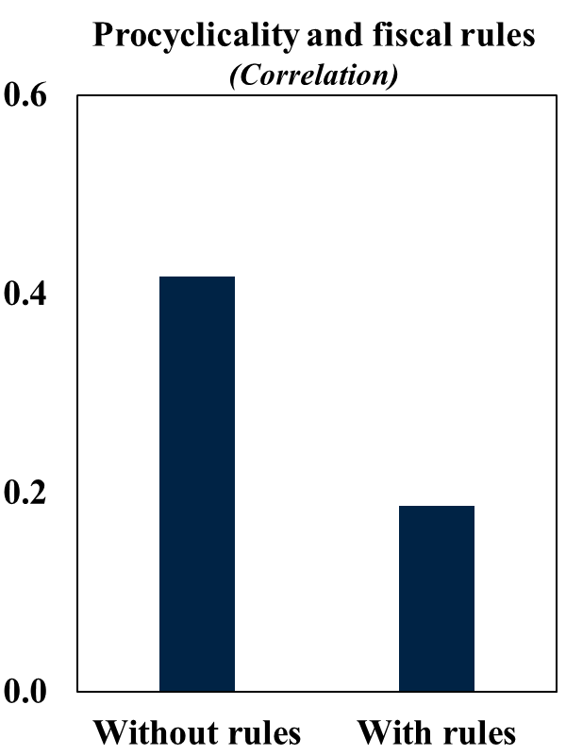
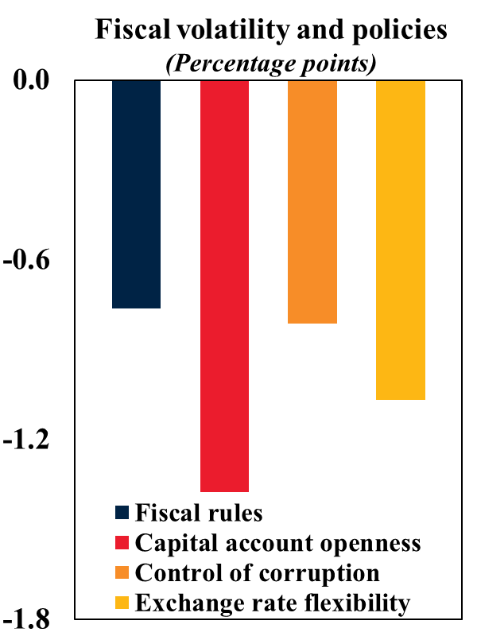
Fiscal Procyclicality, Volatility, and Policies Institutions, Fiscal Rules, Capital Account Openness, and Exchange Rate Flexibility Matter

Slide 16
Questions & Comments January 2024
www.worldbank.org/gep

Slide 17
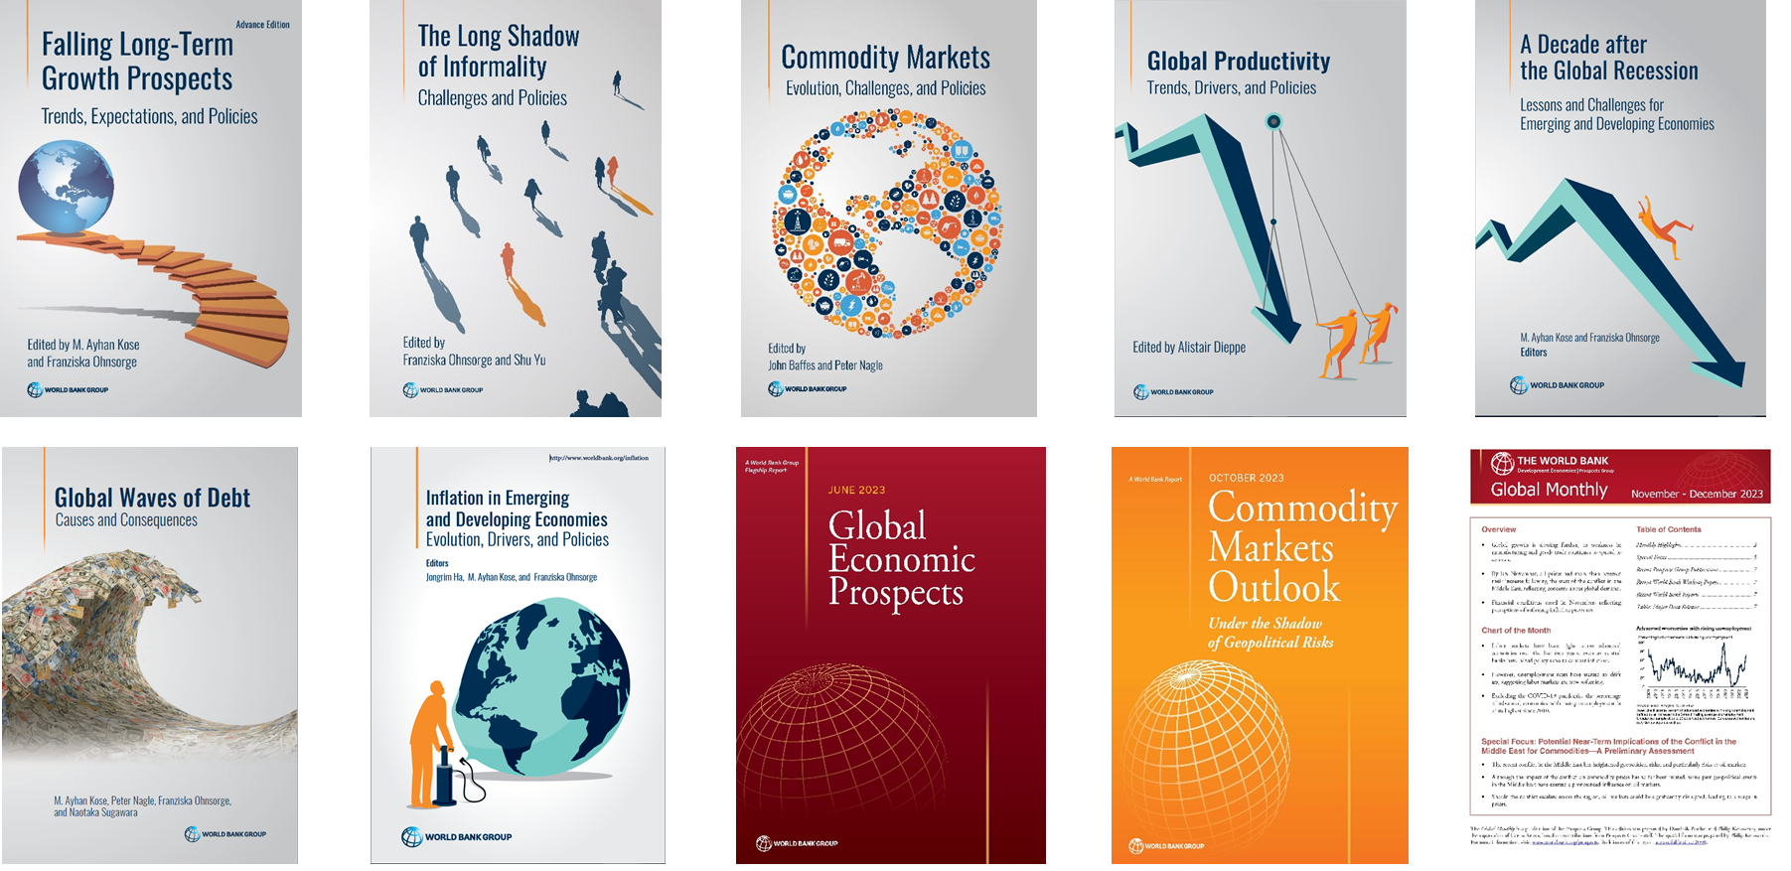
Studies by the World Bank Prospects Group

