Slide 1
Public Sector Enterprise Architecture Development in Botswana: Concept to Practice and Optimization Opportunities
Topic:
REPUBLIC OF
BOTSWANA
International Conference on e-Government Enterprise Architecture and Cloud Computing 2018 (eGEAC 2018)
Conference:
Presenter:
Christopher B. Mokone,
Former GBEA Project Manager
KAIST ITTP PhD Candidate
Date:
11th December 2018

Slide 2
Introduction
PhD Candidate, ITTP KAIST:
Areas of Interest: Digital Platforms, and Ecosystems
Project Manager, GBEA (0 – 1.5years) – Government Wide
MSc Computer Information Systems, University of Botswana
BEng Computer (Software Eng) Engineering, University of Victoria, Canada
Principal Systems Analyst (DSM/MLH, e-Gov/OP, & DIT/MTC)
Certified TOGAF 9.1

Slide 3
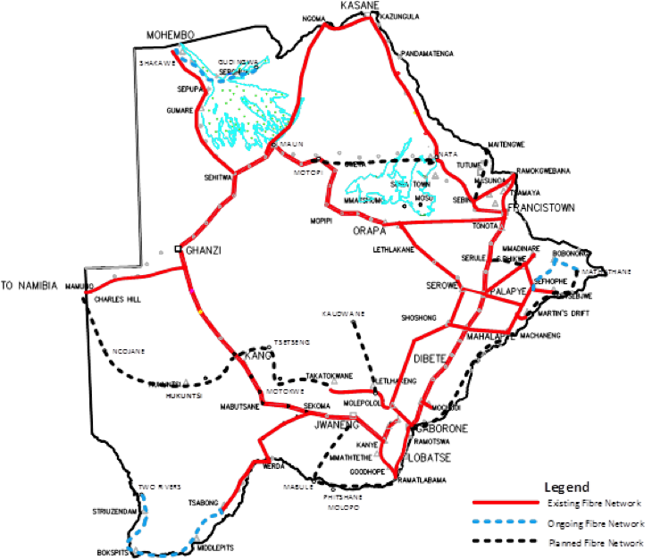
Introduction
International Connectivity
ICT Indicators
Number Telecom Operators: 4
Number of ISPs: 68
Facility Based Operator: 1
Internet Penetration: 22%
Mobile Penetration: 169.9%
Mobile Broadband Penetration: 68.4%
Fixed Telephony: 7.9%
Fixed Internet Penetration: 1.8%
Submarine Cables: EASSy, WACS
e-Government Development Index:127/193
e-Citizen Participation Index: 168/193
Domain name: .BW
Regulator: BOCRA

Slide 4
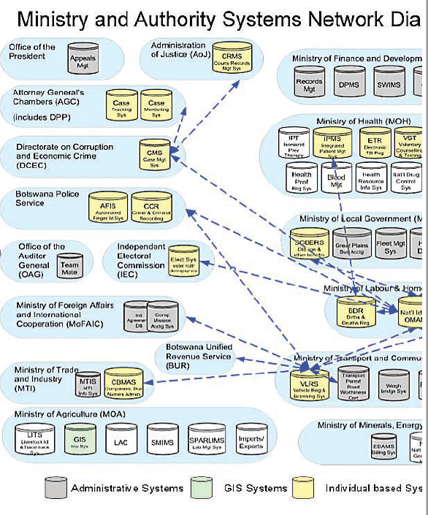
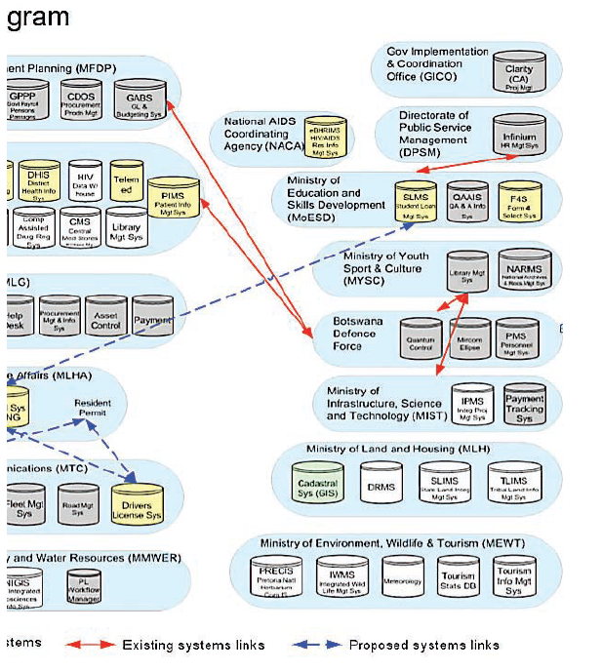
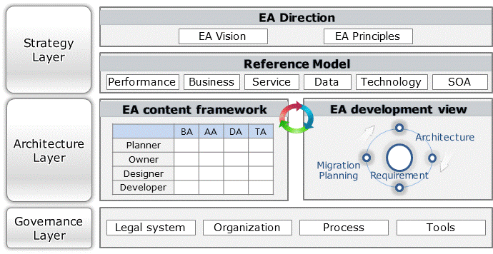
Why EA
An architecture to comprehensively analyze an enterprise’s business, application, data and technology, according to the standards and procedure, and to structure their relationships
Unplanned
Planned
removal of technical conflicts
systematic IT resources management
seamless information flow
removal of business, system and data duplication

Slide 5
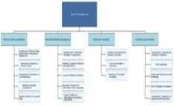
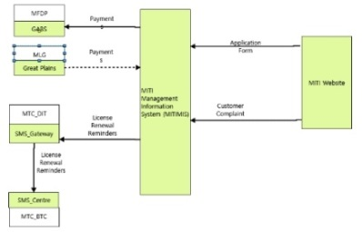
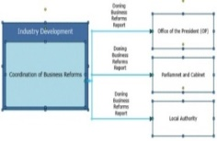
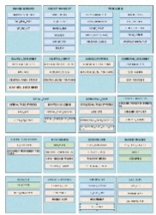
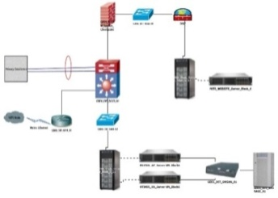
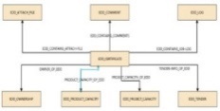
Concept of EA in Botswana
Conforming to GBEA standards, the architectures of the all ministries are developed for business, application, data and technology.
GBEA vision
Realize business-driven transparent service for improved citizen’s life and global competitiveness
GBEA Framework, GBIF
Apply
Ministry
GBEA Reference Model
Organisation
Business functions
Relation between business functions
Application system configuration
Application functions
Relation between application functions
Business
Application
Data configuration
Conceptual data
Data interface
Data center
Network
Hardware / software
Data
Technology
GBEA Principles

Slide 6
Best Practice and Benchmarking
2016
Results
Implications
Summary
Initial EA was driven by Zachman Framework, TAFIM, FEAF, TOGAF, DoDAF. Most countries developed EA based on those initial EA frameworks.
Government of Botswana Enterprise Architecture Framework needs to adopt advantage of mainstream framework of initial EA.
Major Frameworks commonly have the definition of Principles, Architecture Model, Standard, Deliverables as their key Framework components
Korean government took the advantages from FEAF, TEAF, DoDAF, and TOGAF in conceptual or philosophy perspective. Most EA Framework components were established based on this adoption
Government of Botswana Enterprise Architecture Framework should follow the best practices and define Architecture Model, Standard, and Deliverables Framework components.

Slide 7
Project Scoping
Provide customized TOGAF architectural framework for Botswana e-Government, detailed SOEA with reference model by each domain, e-GIF and SOEAMS.
Scope of Work
Scoped Organizational Units (All Ministries)
Duration: Thirty-Six(36) months
MOPAPA
MTC
Botswana e-Government Architecture (Service Oriented Enterprise Architecture)
Architecture Framework based on TOGAF
Architecture Vision
Architecture Vision
MNIG
MITI
Business Architecture
Business Architecture
Information System Architecture
Information System Architecture
MoA
MLGRD
Technology Architecture
Technology Architecture
MIH
MOBE
Opportunities and Solutions
Integration and Tailoring
Opportunities and Solutions
Migration Plan
Migration Plan
MENR
MFED
Implementation Governance
Implementation Governance
MITAC
MOH
Architecture Change Management
Architecture Change Management
Interoperability Requirements for Architecture
MELS
MLWS
Botswana e-Government Interoperability Framework(e-GIF)
MLGRD
MMGE
Policy, Standards, and Procedures
IT Infrastructure
Support Services
Metadata Management
MYSC
MTE

Slide 8
Phased Approach
The project consisted of 5 phases
2016
2017
2018
1
2
3
4
5
Planning
Foundation
Expansion 1
Expansion 2
Expansion 3
1 . Planning phase
2 . Foundation phase
3 . Expansion phases
EA training & architecture development for MITI, MOA & MTC
Data collection & As-is analysis
Baseline & target architectures
Transition plan
EA governance (Government-wide), GBIF (e-GIF)
Applying to 3 Ministries (EA framework)
Project start & team building
EA training & EAMS installation
Leadership training in Korea
Data collection & As-is analysis
EA vision & principles, EA framework
EA reference models
EA training & architecture development for MFED, MLGRD, MNIG, MYSC & MLWS for Expansion 1
Data collection & As-is analysis
Baseline & target architectures
Derive initiatives

Slide 9
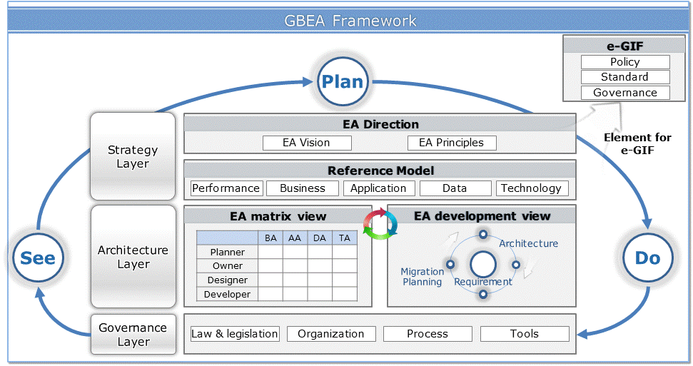
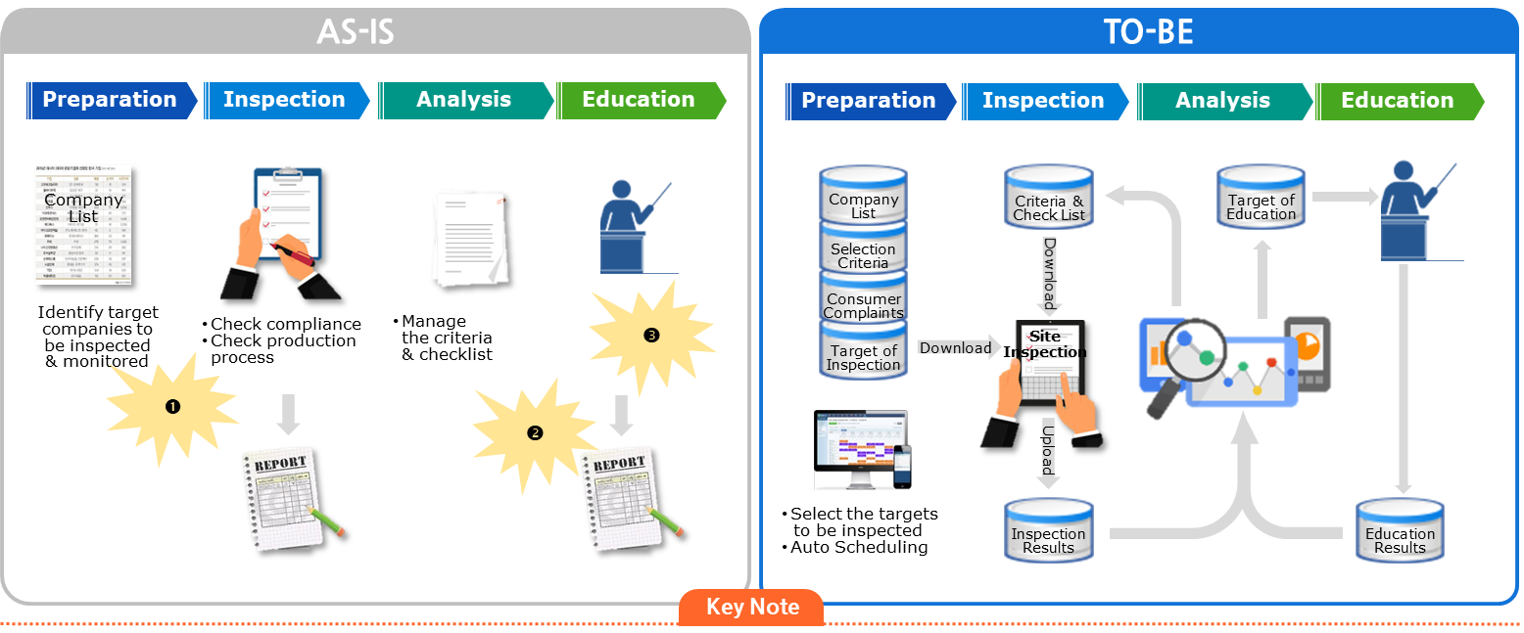
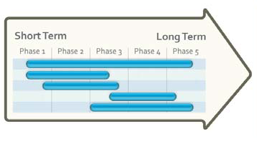
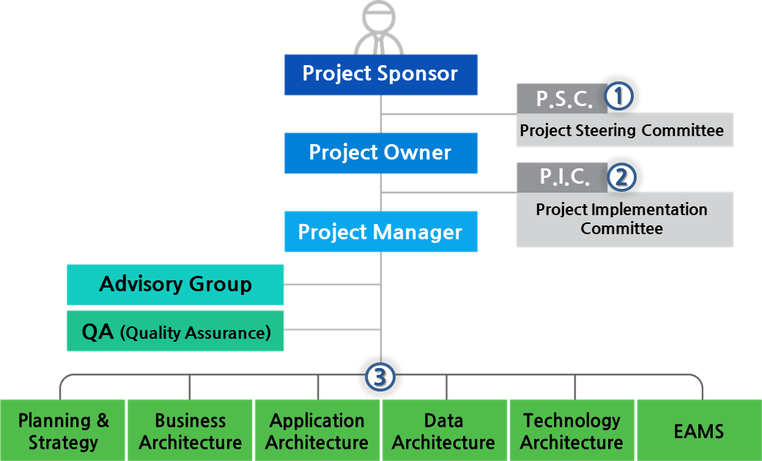
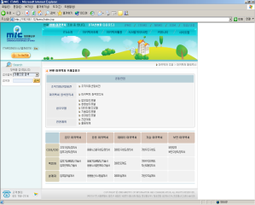
Components and artifacts
Reference Models
PRM
BRM
SRM
DRM
TRM
Mapping and Utilization
Business Architecture
Application Architecture
Date Architecture
Technical Architecture
Current and Target Architecture
EA Framework
EA Information
BA
DA
TA
AA
Transition Plan
CURRENT
TARGET
Business
Application
Business
Application
Data
Technology
Data
Technology
EA Governance
(Organizational structure, Process, System)
Government-wide processes
Ministry processes
EA Repository
Utilization processes
EA Team
EA Processes & Guidelines
EA Management System

Slide 10
Target Architecture – All Ministries
Key :
Gov-wide
Min-spec
Upgrade
MITI
MOA
MTC
Planning & Coordination
Planning & Food Security
Planning & Coordination
DSS
FSIS
DSS
DSS
Industrial Development
Crop Produce
Telecom. & Postal Services
BIMS
MITIMIS
NeMS
MOA-LMS
SMMIMS
HFRS
MOA-GIS
CODAS
Transport Services
Trade Development
Livestock Produce
FTMMS
MTC-LMS
DTTS
MOA-LMS
BAITS
MOA-GIS
FMS
DLS
CODIWE
MITIMIS
LACPOS
DMQR
SILAB
IBRMS
VRLS
RTMS
Investment / EDD
Agricultural Support Services
ICT Services
MOA-KMS
SPALIM
IISC
EAMS
Service
Desk
MOPAGPA
MLWS
HRM
Legal
Audit
Procurement
Finance
Accounting
Administration
Corporate
Communications
Mission Support
DWMS
ITASSET
MITIWEB
MITI-VOC
VOC-Portal
NGIS
MITIINTRA
QPR
MOAWEB
MOA-VOC
LMS
GLPI
Gov. Portal
MTC-VOC

Slide 11
GBEA Framework
Integrated EA Meta model
Legend
Alignment
Govt-wide
Ministry
Reference
Model
Govt-wide
Application Taxonomy
1
Vision
2036 Goals
Service Domain
Ministry
App service1
App service2
e-Service
Data Taxonomy
NDP(11)
Thematic area
Performance
Taxonomy
Business
Taxonomy
Biz Domain
Domain
Programme
Area
Sector
Biz Group
Subject
Category
Area
Biz Channel
Topic
Long Term Plan
Govt- Indicator
Function
Activity
Integration
Ministry(MIAC)
3
Transformation
2
IT Project Plan
System
IT Project
Function1
Database
Technology
Taxonomy
Conceptual Data
Area
Performance Indicator
Function N
H/W
Category
Technical Detail
Evaluation Plan
External System
S/W
SP
Evaluation Result
N/W
[Planning]
[Project]
[IT Resource]

Slide 12
EA Practice
EA Quality
EA Ownership
Skills Transfer
EA Experts
Data Owner
MOBE
GBEA
Project
Team
MOTE
Co-work
MOHW
MIH
MMGE
Working Group
As-is Information
Target Architecture
Co-work & Verification
Designate officers
responsible for each stream (P&S, BA, AA, DA & TA) & focal officer
responsible for management of EAMS system
Promptly submit As-is information required for EA
organization & business function
system documents
system configuration
Suggest ideas for To-be architecture
interviews & meetings
plans already made or under developing
ideas for the future
Enhancement of EA understanding through co-work with consultants
Verification of EA artifacts in the EAMS system as the future enhancements

Slide 13
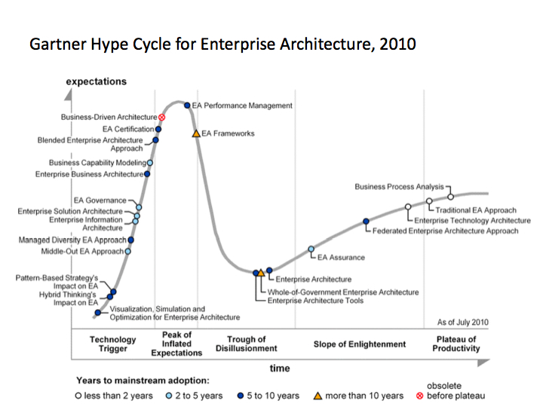
Challenges of Practice
Governance Models
Govern slow to implement EA Processes, Structure and Legislation
Keeping architecture information updated
Business and Information Systems changing outside EA Portal
Development of new systems not following EA guidelines
System budget not informed by EA
Facing the Slope of Enlightenment

Slide 14
Optimization Opportunities
GBEA vision
Realize business-driven transparent service for improved citizen’s life and global competitiveness
Demonstrate benefits of EA
Realize systems from blue prints
Reduce system analysis cost
Reduce system duplication cost
Improving customer satisfaction through shared data across ministries
EA maturity Assessments based on
Maturity Model
Performance Reference Model
EAMS Utilization
Expand EA coverage to other Government funded organizations
Local Government
Government Agencies
Develop GBEA based training & certification plan
Mainstream EA development progress updates to grow entire EA Ecosystem

Slide 15
Optimization Opportunities
AS-IS
Ministry_1
Ministry_2
Ministry_3
EAMS
METAMODEL
(BRM, SRM, DRM,TRM)
Requirements
Requirements
ITT/ RFP
ITT/ RFP
ITT/ RFP
<<Offline >>
Enforcement of Architecture
Vendor A
Vendor B
Vendor C
Platform 1
Platform 2
Platform 3
Main issues:
Offline enforcement
Developer free to interpret high level blue prints
Different development frameworks
Application 1
Application 2
Application 3
Silos again

Slide 16
TO-BE
Explore Paas for System Development
FEASIBILITY STUDIES NEEDED
Ministry_1
Ministry_2
Ministry_3
GEAMS
METAMODEL
(BRM, SRM, DRM,TRM)
Requirements
Requirements
Requirements
ITT/ RFP
ITT/ RFP
ITT/ RFP
Vendor A
Vendor B
Vendor C
<<Online >>
Enforcement of Architecture
(Online Contract Enforcement of EA Metamodel &
Common components)
Integrated System Development Platform (i-SDP)
Requirements
<<Online>>
Enforcement of Architecture
Application 1
Application 2
Application 3
Legend
Private Platforms
Existing information flow
New Online Information Flow
End-to-End Business-IT alignment optimization

Slide 17
Conclusions
The Concept for EA is now fully developed in Botswana
The challenge is how to move from concept into Practice
With EA in place, Botswana is looking for ways to consolidate her investments
Need for skills development
Turn blueprints into System
EA & EAMS maintenance
Korean e-Government Standard Framework is an interesting Project
Botswana needs EA Friends
REPUBLIC OF
BOTSWANA

Slide 18
Questions?
chris.Mokone@kaist.ac.kr cbmokone@gov.bw

