Slide 1
Gender Equality Matters for Growth in MNA
Middle East and North Africa
Gender Innovation Lab (MNAGIL)
Middle East and North Africa Vice Presidency

Slide 2
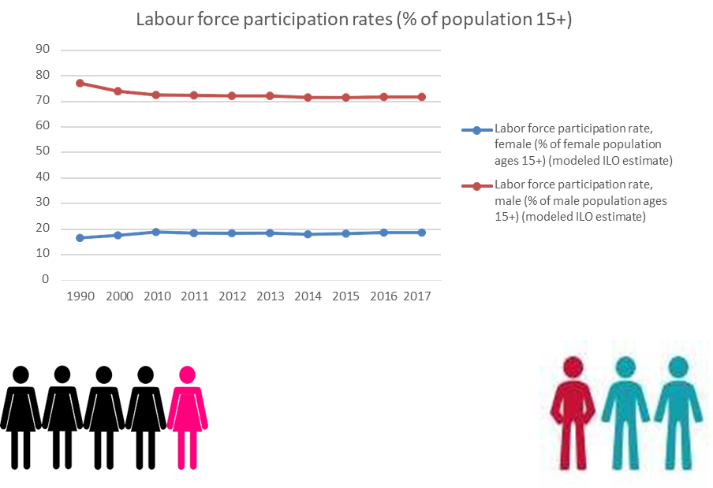
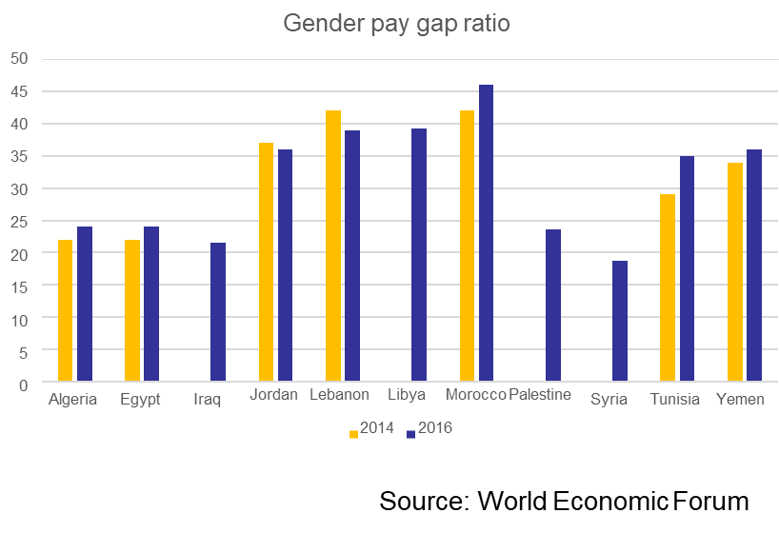
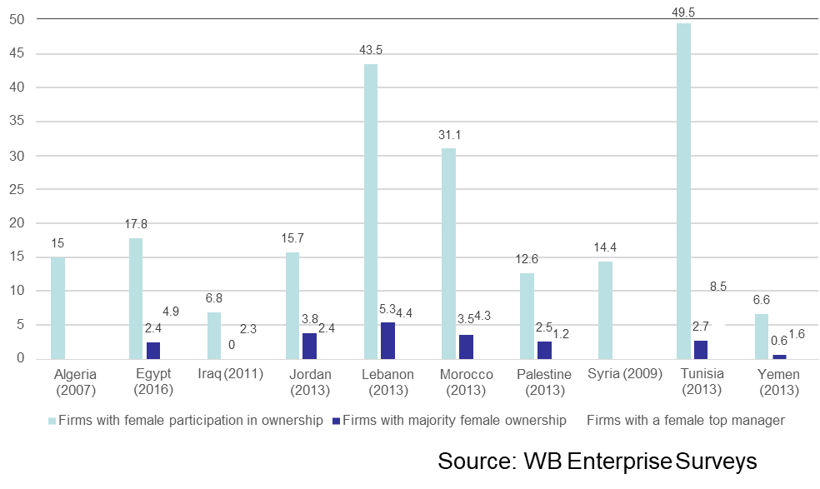
MENA faces wide gender gaps in …
Labor force participation rate
Access to digital technology
Access to financial and digital payment services
Assets ownership
Legal provisions
Wages
Gender-based job restriction
Source: World Bank
Women in business
Notes:
In the Middle East and North Africa, opportunities to increase financial inclusion are particularly strong among women. Today 52 percent of men but only 35 percent of women have an account, the largest gender gap of any region. Relatively high mobile phone ownership offers an avenue for expanding financial inclusion: among the unbanked, 86 percent of men and 75 percent of women have a mobile phone. Up to 20 million unbanked adults in the region send or receive domestic remittances using cash or an over-the-counter service, including 7 million in the Arab Republic of Egypt.
Most countries have policies that make it harder for women to work: more than one hundred countries have at least one gender-based job restriction, while fifty-nine have no legal protection against workplace sexual harassment, and eighteen require a husband's permission for women to work outside the home.

Slide 3
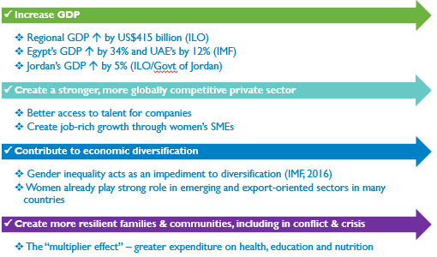
Economic Impacts of Gender Equality in MNA
About ¼ of total regional GDP
https://www.cfr.org/interactive/womens-participation-in-global-economy/
Source: UN Women, 2016

Slide 4
World Bank’s Evidence for Policy Design Hub Evidence-based research to find what works and what does not to shape policies that increase women participation in the economy

Slide 5
Overview
Objective, strategic areas, and design
How the lab works
Where do we focus and how
MNAGIL in practice
Technical review process
The overall approach
Middle East and North Africa
Gender Innovation Lab (MNAGIL)

Slide 6
MNAGIL objectives
Invest in a research agenda focused on how to increase women’s access to economic, social and political opportunities
Close gender gaps in outcomes
Make key contributions to inform policy dialogue and bring innovations
Seeks to be instrumental in engaging with policymakers in the region
Encourage the use of evidence and learning for policy design, implementation, and reform

Slide 7
Strategic areas (3 As)
A2
Accelerate access to financial capital, digital, and assets ownership
A3
Advance
agency and voice
A1
Advance
women's workforce development
Do Things Differently
Delving into what works and what does not to generate knowledge and create smart evidence-based policy interventions

Slide 8
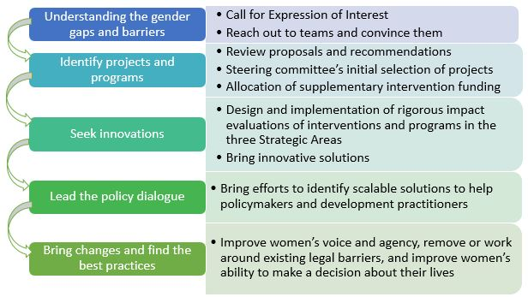
Design of the MNAGIL

Slide 9
How the lab works
Rigorous evidence
More than inform policy: research uptake = scaling up what works and scaling back or changing what does not
Concrete policy advice to support moving from advocacy to action
Partnerships –government agencies, operations teams within the World Bank, NGO staff, donor staff in other agencies, private companies, and academics (global)
Leverage: relatively small investment in building knowledge pays off in policy and project changes – in Africa GIL so far $1 directly shifts $46 in development spending plus: policy changes, more $ for projects, scaling down ineffective projects, innovation with firms

Slide 10
Where do we focus and how
Country coverage
Algeria, Iran, Iraq, Syria, Libya, Yemen, Egypt, Tunisia, Morocco, West Bank & Gaza, Lebanon, Jordan, and Djibouti, and countries of the Gulf Cooperation Council
Deliverables
published peer-reviewed research papers, open access data sets, innovative methodologies, systematic reviews of evidence, policy briefs and an online platform for compilation, dissemination and outreach

Slide 11
MNAGIL in practice
Two ways:
Call for Expression of Interests
Interested teams submit their EOIs and we will support to do an impact evaluation
Work with WB projects in the first phase
Offer a package of technical and financial support; top-up money for innovations
Opportunistically
Active seeking out of projects and convincing them
Work with DIME’s gender team to find projects with potential IE and gender elements in MENA region

Slide 12
Technical Review Process
Estimating the funding amounts; need-based assessment; and disbursement
Pre-analysis plan and finalizing the deliverable (Evidence and paper review)
First call for EOI by 15 May, 2019; forming MNAGIL’s steering committee
Expression of Interest (EOI)
Reviews on EOIs
Submit GFR for RVP approval
Concept Note (CN) Technical Review
Register IE projects
Internal review for feasibility and relevance; steering committees’ decisions and comments on EOI
Review on IE design and methodology, share feedback and finalize the teams for measuring the impact

Slide 13
Recap: How the lab works
Understanding the underlying constraints
Diagnosis and Synthesis
Innovation
Informing national policy dialogues
Taking what works to scale

Slide 14
Only one IE project in MENA so far…
Title: Enhancing female entrepreneurship of vulnerable women through an unconditional cash grant (P164699); IE P code: kk8y45
TTL: Eric Mvukiyehe
Country: Tunisia
Global Practice: Social Protection; Pillar: Growth, Risk & Vulnerability
Brief: Together with the Tunisian Ministry of Vocational Training and Employment, the World Bank supported the Community Works and Local Participation Project (CWLP), a pilot public works program in Jendouba, Tunisia; the objective is to generate evidence on gender impacts of a cash grants add-on to a public works program (PWP) in Tunisia
Key intervention: To provide cash to unemployed workers through short-term employment opportunities
Theory of Change: IE investigates the effects of deepening the CWLP project by offering small business grants to a random sample of female participants after finishing with CWLP to invest in a livelihood activity such physical, or human capital

Slide 15
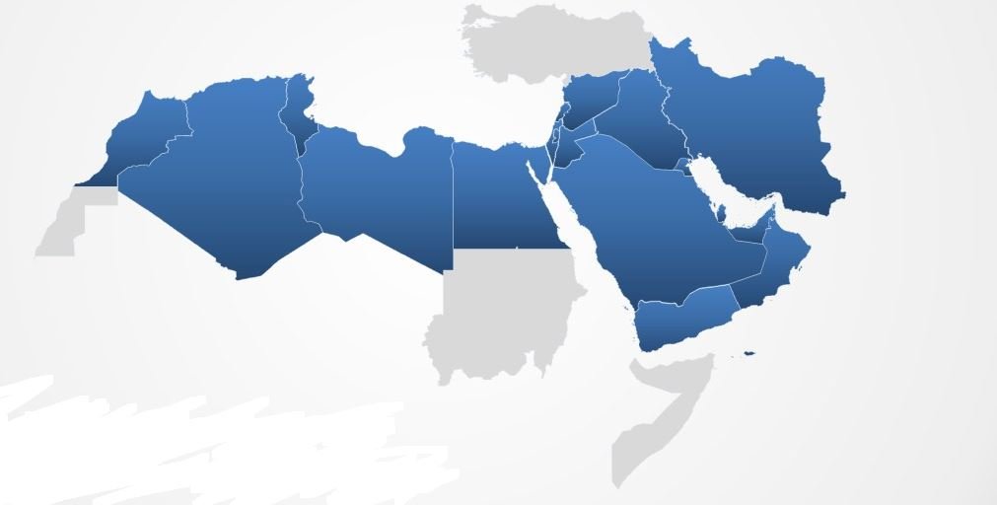
Learn more:
http://www.worldbank.org/en/programs/mena-gender-innovation-lab#1

