Slide 1
Determinants of macroeconomic resilience in the euro area: An empirical assessment of policy levers
Maya Jollès, Eric Meyermans and Bořek Vašíček
DG Economic and Financial affairs, European Commission
2d Conference on structural reforms IMF-OECD-World Bank
September 12, 2019, Washington
Disclaimer: The authors are writing in their personal capacity and their opinions should not be attributed to the European Commission.

Slide 2
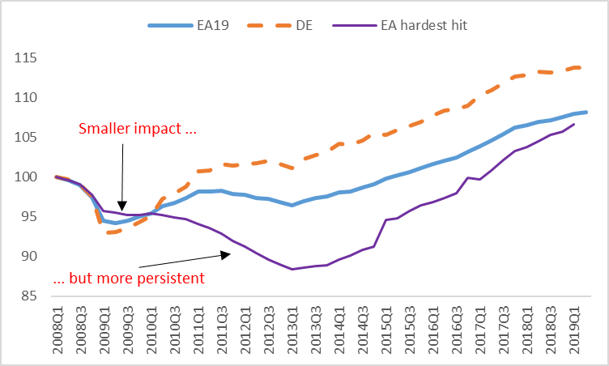
Real GDP level
(2008=100)
Notes: EA=Euro area, EA hardest hit= Cyprus, Greece, Ireland, Portugal and Spain
Source: Eurostat
2

Slide 3
Why is economic resilience so important in the euro area ?
Necessary (but not sufficient) to
absorb economic shocks via internal adjustment
reduce amplitude and persistence business cycle
Promote convergence across euro area
Short-term gains
less unemployment, higher income, …
Long-term gains
averts hysteresis risks (Labour market, capital formation …)
averts socio-political risks (political support for reforms, … )
creates incentives to invest, innovate, compete, grow, ….
3

Slide 4
Overall objective:
assess determinants of macroeconomic resilience in the face of common shocks
4

Slide 5
Economic resilience framework: Components of resilience
Vulnerability (i.e. likelihood being hit by a shock)
Absorption (i.e. ability to cushion the impact of shock)
Recovery
(i.e. persistence of the effects of shock)
Potential growth
RESILIENCE
CONVERGENCE
(cyclical and real)
5

Slide 6
Methodologies to evaluate the impact of structural features
Estimation of common shocks (17 countries)
II. a) Panel regression (17 countries, 20 explanatory variables): reduced form output gap equation
II. b) Bayesian Model Averaging (BMA) in panel (40 + variables)
6

Slide 7
Variables by category in the econometric analysis
Disaggregated level
Labour markets – employment protection legislation, Labour Market policies such as training, public employment services (PES), composition, …
Product markets / business environment – product market regulation related to barriers to domestic and foreign entry and state involvement such as price control (OECD PMR)
Financial markets – bank competition (WB Lerner-index), Non-performing loans (NPL), …
Institutional quality - corruption, rule of law, …
Structural factors - diversification of production, economic openness, …
Macroeconomic conditions - interest rate, real effective exchange rate,…
7

Slide 8
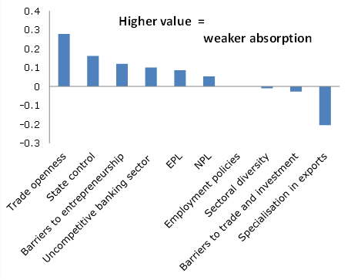
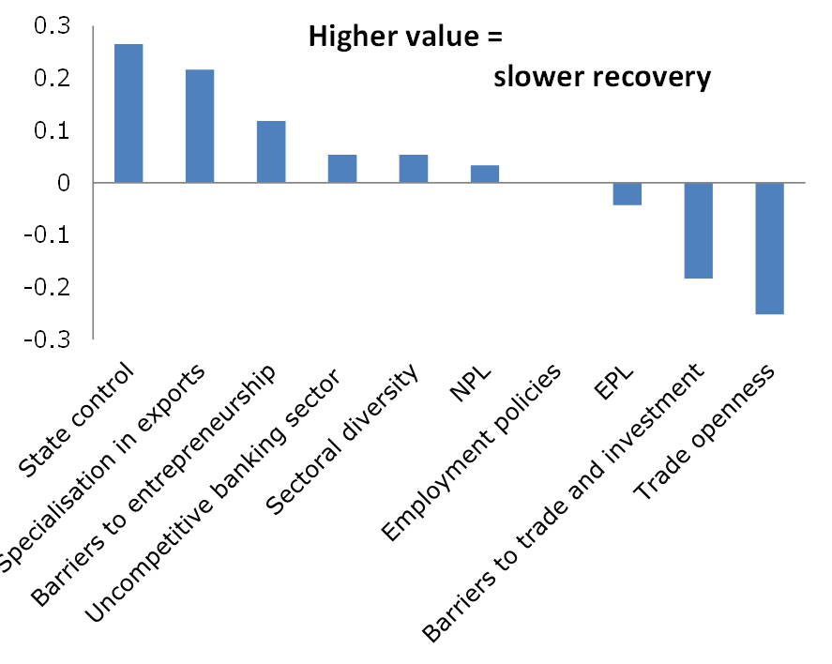
Results: by drivers
Factors affecting ABSORPTION of common shocks
(2008-2014)
Factors affecting RECOVERY from common shocks
(2008-2014)
Source: Based on QREA III-2018
8

Slide 9
Results: Bayesian Modelling Averaging
Factors affecting ABSORPTION of common shocks
(2008-2014)
Factors affecting RECOVERY from common shocks
(2008-2014)
Higher value = probability indicating that the variable belongs to the true model.
Higher value = probability indicating that the variable belongs to the true model.
9
Source: Based on QREA III-2018
9

Slide 10
Conclusion
Determinants of macroeconomic resilience in the face of common shocks at a more disaggregated level can provide some guidance for structural reforms.
Notable differences among the euro area Member States, with regards to absorption and recovery too.
Absorption and recovery capacity not always in sync.
The functioning of markets - well-functioning product and financial markets - appear as key determinant of resilience.
10

Slide 11
Thank you!
E-mails:
maya.jolles@ec.europa.eu, eric.meyermans@ec.europa.eu, borek.vasicek@ec.europa.eu
11

Slide 12
Recent publications on economic resilience by the European Commission
'How to make the Economic and Monetary Union more resilient?' QREA 2016, Vol 15, N.3
'Sustainable convergence in the euro area: A multidimensional process' QREA 2017 Vol. 16, No. 3
'Economic resilience in EMU’ QREA 2018, Vol.17, No.2.
'Economic Resilience, the Single market and EMU', QREA 2018, Vol. 17, No. 1
‘Digitalisation of the euro area economy and impact on resilience’, QREA 2018, Vol.17, No. 2.
'An empirical assessment of policy levers', QREA 2018, Vol.18, No. 3.
'Economic resilience and Capital Markets Union', QREA 2018, Vol. 17, No. 4.
Alessi, L., P. Benczur, F. Campolongo, J. Cariboni, A.R. Manca, B. Menyhert and A. Pagano (2018), 'The resilience of EU Member States to the financial and economic crisis. What are the characteristics of resilient behaviour?', JRC Working Papers JRC111606.
12

Slide 13
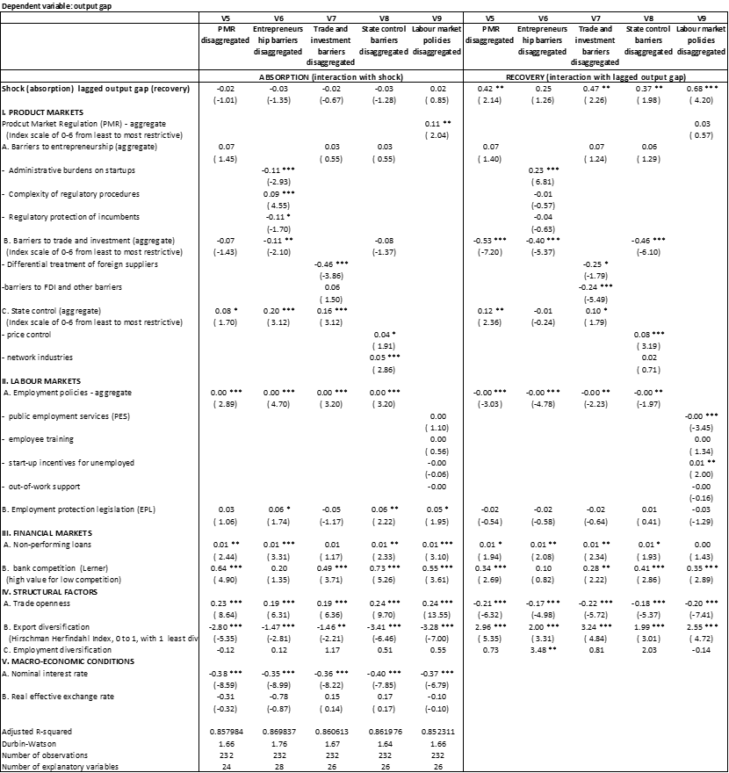
Results : Panel regression
13

Slide 14
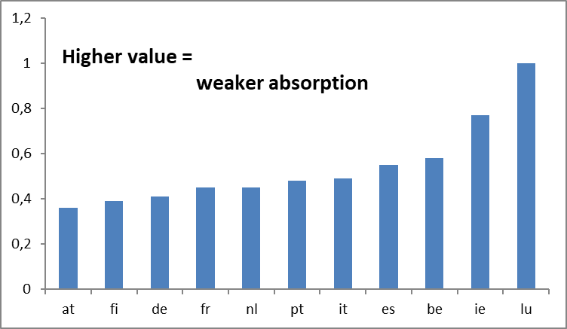
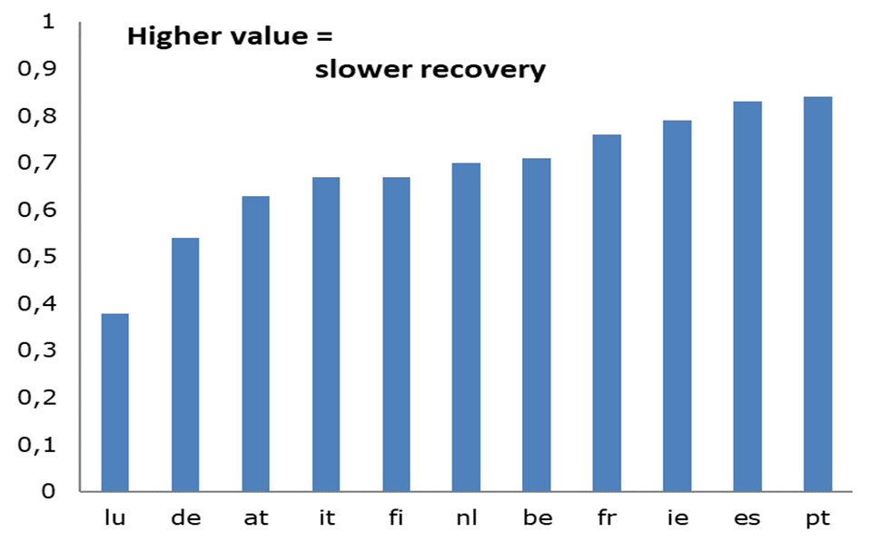
Results: by countries
ABSORPTION capacity of common shocks
(2008-2014)
RECOVERY capacity from common shocks
(2008-2014)
Source: Based on QREA III-2018
14

Slide 15
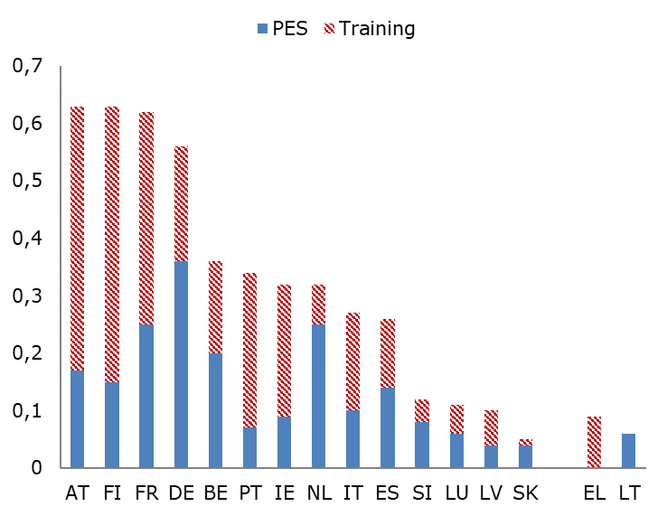
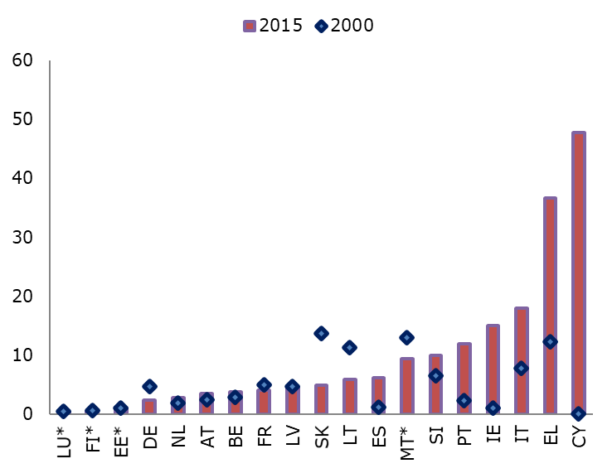
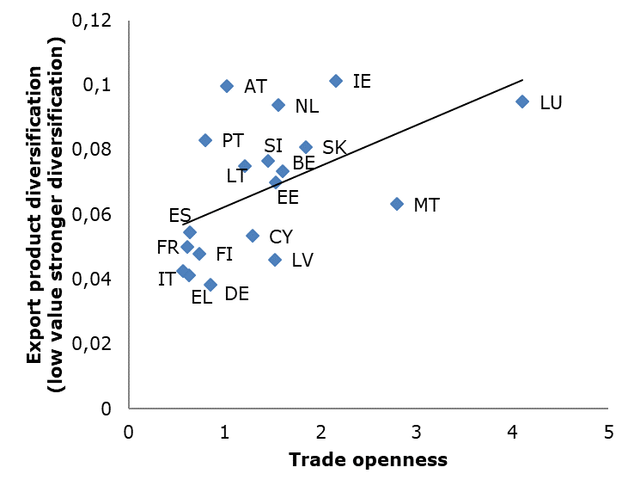
Data: some examples
Data sources for 40+ variables: EC, OECD, WORLD BANK, ICTWSS
Gross non-performing debt instruments
Expenditure on PES and training
Trade openness and export diversification
15

Slide 16
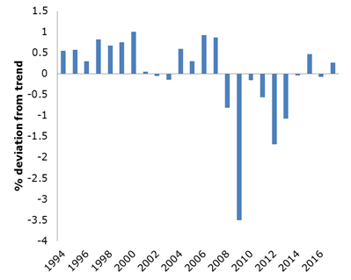
Empirical approach
I. Estimation of common shocks (17 countries)
16
Notes:
So far the literature on the macro and structural drivers of resilience is relatively limited:
- OECD: A lot on the vulnerability component of resilience
- ECB: Sondermann – looks at structural factors
- Czech National Bank
- CPB in the Netherlands
Our recent empirical work investigates which structural characteristics matter most for a country economic resilience
The factors include:
- The macroeconomic conditions
- The economies' structural characteristics such as their openness to international trade.
For the euro area Member States, it was reported that well-functioning labour and product markets are key to economic resilience
But political or judiciary institutions may also improve an economy's recovery

Slide 17
Empirical approach
II.a) Panel regression (17 countries, 20 explanatory variables)
Reduced form output gap equation:
Degrees of freedom
Multicollinearity/simultaneity: significance/bias
17
Notes:
So far the literature on the macro and structural drivers of resilience is relatively limited:
- OECD: A lot on the vulnerability component of resilience
- ECB: Sondermann – looks at structural factors
- Czech National Bank
- CPB in the Netherlands
Our recent empirical work investigates which structural characteristics matter most for a country economic resilience
The factors include:
- The macroeconomic conditions
- The economies' structural characteristics such as their openness to international trade.
For the euro area Member States, it was reported that well-functioning labour and product markets are key to economic resilience
But political or judiciary institutions may also improve an economy's recovery

Slide 18
Empirical approach
II.b) Bayesian Model Averaging (BMA) in panel (40 + variables)
Many potential explanatory variables (not feasible in one regression, nor sequential testing)
The robustness of a variable in explaining the dependent variable can be expressed by the probability that a given variable is included in the regression. Variable ranking by posterior inclusion probability (robust determinants)
18
Notes:
So far the literature on the macro and structural drivers of resilience is relatively limited:
- OECD: A lot on the vulnerability component of resilience
- ECB: Sondermann – looks at structural factors
- Czech National Bank
- CPB in the Netherlands
Our recent empirical work investigates which structural characteristics matter most for a country economic resilience
The factors include:
- The macroeconomic conditions
- The economies' structural characteristics such as their openness to international trade.
For the euro area Member States, it was reported that well-functioning labour and product markets are key to economic resilience
But political or judiciary institutions may also improve an economy's recovery

