Slide 1
Quel est l’impact du système Bus Rapid Transit à DAR es Salaam ?
Équipe
Ronald Lwakatare, John Shauri (Retd.), Ami Srivastava (DART)
Yonas Mchomvu, Bilal Siddiqi, Naira Kalra, Jessica Mahoney, Amen Jalal (World Bank)
Gharad Bryan, Clare Balboni (London School of Economics)
Melanie Morten (Stanford University)
Joao Araujo (Harvard University)

Slide 2
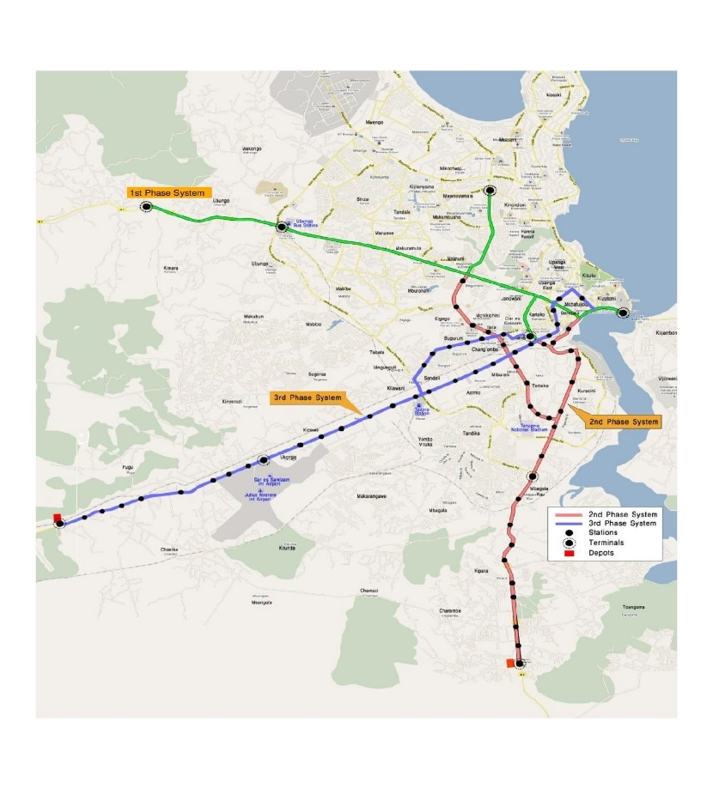
Est ce que le BRT…
Améliore la mobilité urbaine?
Cause un report modal de transport?
Améliore l’accès à l’emploi?
Bénéficie aux plus pauvres?
Bénéficie aux femmes?
Notes:
*3ie reasoning and expectations behind this slide
Expectation:
3ie expects the research and implementation teams to make efforts to understand the context and associated complexities that may affect the roll-out of the intervention/programme/policy and/or the evaluation, as well as those that may affect the use of the results for policy and programmatic decision-making at the end of the evaluation.
****************************************
*Guidance on presentation:
Duration: 1 minutes
Suggested presenter: IA representative
Content:
This slide is to help the audience understand the setting and complexity of the issue to be addressed.
Use the context description to bring out the issue and situate it by providing details focused on the following factors as relevant:
Political details, including political priorities and , decision-making processes, and political and policy realities that contribute to the need for the intervention and/or the study.
Economic details, including current income levels, major income-generating activities, poverty levels and distribution
Social and cultural details, human capital, social capital, and social divisions (such as ethnicity, religion/sect, caste),
Structural details, including power, inequity, and vulnerability (such as gender)
Suggestion: A map or picture may help the audience better understand the location of the intervention

Slide 3
L’approche d’évaluation…
Permet d’estimer les impacts de la ^{1ere} phase du BRT et leur mécanisme
  Par ex: relocalisation des entreprises, meilleure mobilité…
Prépare le terrain pour l'évaluation des phases suivantes
Renforce la connaissance pour des BRT dans d’autres contextes
Pour cela:
  Trouver les lieux et les individus qui sont comme ceux affectés par le BRT
  Compare le groupe « traité » et le groupe de contrôle.
  => Triple différence, proche et loin, phase 1 et phase 2 et dans le temps
Notes:
Make sure that changes were not caused by other things
If BRT was constructed in high-growth neighborhoods, we would see more jobs, higher income – but not caused by BRT!
If BRT attracts low-income people to move closer, we would see drop in income – but not because BRT made people poorer!

Slide 4
Résultats préliminaires
Le BRT a amélioré la mobilité et la satisfaction des usagers
Les plus pauvres et vulnérables font face à des contraintes:
  Les usagers du BRT sont moins pauvres, plus jeunes plus souvent des hommes
  Les loyers ont augmenté rapidement autour de la ligne de BRT
  Les individus sur la ligne 1 voient les coûts financiers de transport augmenter
Notes:
32% of survey respondents used the BRT in the last week
Increased satisfaction with public transport along Phase 1 corridor

Slide 5
Est ce que le BRT améliore la mobilité urbaine?
 | Moyenne | Changement | Magnitude | % | ⬇⬇⬇
Temps navette | 48 mins | ❑ | 2.8 mins | 5.7%
Coût navette | 2,000 Tsh | ❐ | 109 Tsh | 5.4%
Satisfaction | 5.43 | ❐ | 0.21 | 3.8% | ⬇⬇

Slide 6
Est ce que le BRT change les modes de transport?
 | Jan 2016 | Sep 2017 | Changement | ⬇⬇⬇
Daladala | 49.7 | 42.0 | ❑ 7.7 | ⬇⬇⬇
Autre commercial | 7.2 | 8.8 | ❐ 1.6 | ⬇⬇
Véhicule privé | 5.9 | 3.3 | ❑ 2.6 | ⬇⬇⬇
A pied | 37.3 | 41.5 | ❐ 4.3 | ⬇⬇⬇
BRT | 0.0 | 4.5 | ❐ 4.5 | ⬇⬇⬇

