Slide 1
ENRM / Rural Development Staff directorate
Last Update: February 2019

Slide 2
Rural Dev.
& Agriculture (SUSTENTA)
Pedro Arlindo, Focal Point Agricultural Economist (Maputo)
Norman Piccioni
Senior Agriculture Economist (Maputo)
Karin Kaechele, Focal Point
Carbon Finance Specialist (D.C.)
Arnela Mausse Senior Community Development Specialist Consultant (Maputo)
Aniceto Bila
Senior Agriculture Economist (Maputo)
Celine Lim
Natural Resources Management Specialist Consultant (D.C.)
André Aquino
Senior Natural Resource Management Specialist (Maputo)
Andres Espejo
Senior Carbon Finance Specialist (D.C.)
Ivan Remane
MRV Specialist Consultant (Maputo)
João Moura, Focal Point
Natural Resources Management Specialist (Maputo)
Forestry (MozFip, DGM, REDD+, Zambezia ER Payments)
Amelia Cumbi
Program Assistant
(Maputo)
Team Leader
Katie Jacobs
Communications Specialist Consultant (Maputo)
Fisheries (SwioFish and FischCC)
Muino Taquidir
Senior Forestry Specialist Consultant (Maputo)
Alicia Peduzzi
Senior MRV Specialist Consultant (D.C.)
Amanda Jerneck
Natural Resources Management Specialist Consultant (Maputo)
Marina Mwanga
Team Assistant Consultant (Maputo)
ACS
Communication
Gabriella Morandi Communications Specialist Consultant (Maputo)
Aurore Simbananiye
Program Assistant (D.C.)
Francisco Campos
Senior Economist (Maputo)
Cross Cutting Issues
Sarah Hillware, Focal Point
Communications Specialist Consultant (D.C.)
Simeão Lopes
Fisheries Especialist Consultant (Maputo)
Safeguards
Fiduciary
Carmen Lahoz
Senior Social Development Specialist Consultant (Madrid)
Amos Malate Procurement Specialist (Maputo)
Antonio Chamuço Senior Procurement Specialist (Maputo)
Bruno Nhancale
Environmental Specialist (Maputo)
Eldio Mapoissa
Financial Analyst Consultant (Maputo)
Amanda Jerneck, Focal Point
Natural Resources Management Specialist Consultant (Maputo)
Maria Isabel Nhassengo
Procurement Assistance (Maputo)
Climate Change
(Tech Assist)
Biodiversity and Wildlife (MozBio)
Isabel Ramos, Focal Point
Senior Climate Change Specialist Consultant (Maputo)
Bartolomeu Soto, Environmental Specialist Consultant (Maputo)
Carolina Giovanelli
Operation Analyst (D.C.)

Slide 3
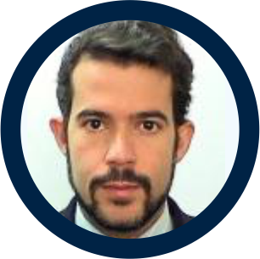
Cross Cutting Issues
TEAM LEADER
André Aquino, Task Team Leader
Senior Natural Resource Management Specialist
(Maputo)
I manage the ENRM portfolio in Mozambique, including the green (forestry, biodiversity), blue (fisheries, oceans) lines and climate change; and collaborate with broader rural development portfolio. Lead dialogue with Government and develop partners.
COMMUNICATION
Katie Jacobs, Communications
Gabriella Morandi, Communications
Sarah Hillware, Communications
Communications Specialist Consultant (Maputo)
Communications Specialist Consultant (Maputo)
Communications Specialist Consultant (D.C.)
Responsible for knowledge management, including publication design and production, blog writing and copy-editing.
Responsible for conceptualizing and promoting materials relevant to the ILFM Portfolio, providing TA to government partners and assisting with all communications related tasks.
Responsible for developing outreach and knowledge products, preparation for major seasonal events, writing, and support for the effective engagement of stakeholders through consultations and other means of communication.

Slide 4
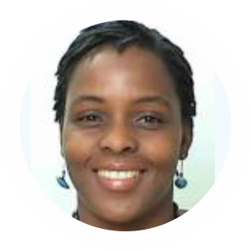
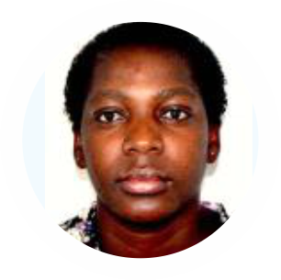
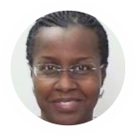
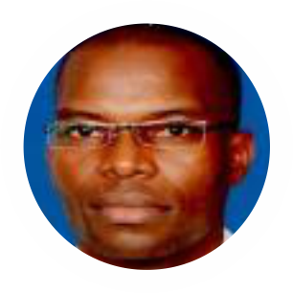
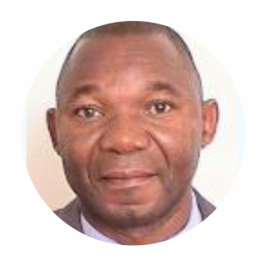
Cross Cutting Issues
ACS
Amelia Cumbi
Marina Mwanga
Aurore Simbananiye
Program Assistant (Maputo)
Team Assistant Consultant (Maputo)
Program Assistant (D.C.)
Provide primary assistance in the implementation of the ENR Mozambique work program, including, but not limited to, operational support, administrative and logistics support etc.
Provide organizational support the blue line, also responsible for overall logistical support for workshops, and events.
Provide primary assistance, including, but not limited to, operational support, administrative and logistics support etc.
FIDUCIARY
Antonio Chamuço, Procurement
Maria Isabel Nhassengo, Procurement
Eldio Mapoissa, Financial Management
Senior Procurement Specialist (Maputo)
Procurement Assistant (Maputo)
Financial Analyst Consultant (Maputo)
Procurement officer for the Fisheries portfolio.
Overall Procurement support.
FM officer for the blue and green portfolios.
Amos Malate, Procurement
Procurement Specialist (Maputo)
Procurement officer for the Green line portfolio.

Slide 5
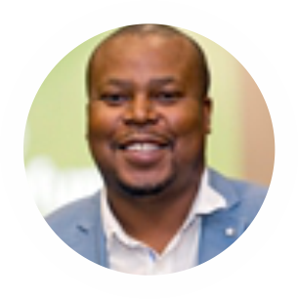
Cross Cutting Issues
SAFEGUARDS
Carmen Lahoz, Safeguards
Bruno Nhancale, Safeguards
Senior Social Development Specialist Consultant
(Madrid)
Environmental Specialist (Maputo)
I support the overseeing and deal with day-to-day implementation and monitoring issues of environmental safeguards policies and instruments for the entire projects of the ENR portfolio in Mozambique, including Sustenta, MozFIP, MozBio 1 & 2, SwioFish, FishCC and Zambezia ERP.
Provide social safeguards support to the blue line and rural development, in addition to day to day support on social development issues of the MozBio, Sustenta and MozFIP projects

Slide 6
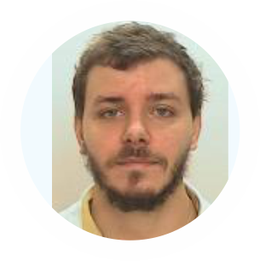
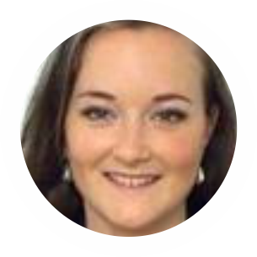
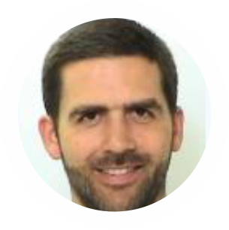
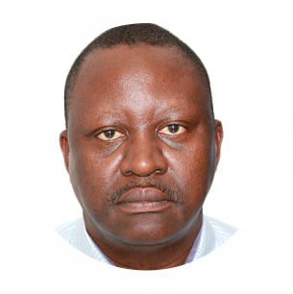
Blue Business Line (SwioFish and FischCC)
João Moura, Focal Point
Amanda Jerneck
Natural Resources Management Specialist (Maputo)
Natural Resources Management Specialist Consultant
(Maputo)
Focal point for the blue line (SWIOFish, FishCC). Also supporting the green line (Sustenta, MozFIP, Zambezia Program), with focus and interest on sustainable private sector development and ILM issues.
Operational and technical support to the blue line (SWIOFish, FishCC) and climate change agenda (MDTF, NDCP-SF).
Francisco Campos
Simeão Lopes
Senior Economist (Maputo)
Fisheries Especialist Consultant (Maputo)
Leading discussions on private sector engagement in fisheries.
Technical and operational support to the fisheries sector work, including co-management initiatives, monitoring, control and surveillance (MCS), fisheries support infrastructure and value chain development linked to small-scale fisheries, licensing and others relevant aspects.

Slide 7
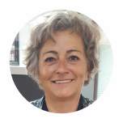
Climate Change (Technical Assistance)
Isabel Ramos, Focal Point
Senior Climate Change Specialist Consultant (Maputo)
Focal point for Climate Change and for the National Spatial Development Program (PNDT). Supervising FNDS capacity building program and partners coordination role. Also supporting SWIOFish, with a focus on the Marine Spatial Planning and the development of resilient infrastructures.

Slide 8
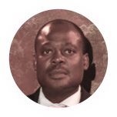
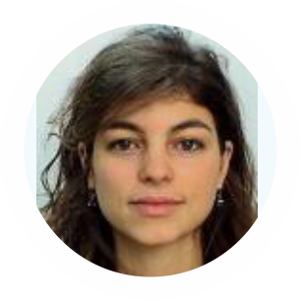
Green Business Line - Biodiversity and Wildlife (MozBio)
Amanda Jerneck, Focal Point
Bartolomeu Soto
Natural Resources Management Specialist Consultant
(Maputo)
Environmental Specialist Consultant (Maputo)
Focal point for conservation/biodiversity, including supervision of the MozBio 1 and 2 Projects, in particular to institutional strengthening of ANAC and the Conservation Leadership Program; support to south-south collaboration initiatives and gender mainstreaming for NRM.
Support to the portfolio of biodiversity conservation and wildlife management in Mozambique and Angola.
Carolina Giovanelli
Operation Analyst (D.C.)
Support to project preparation for MozBio2; And support to activities relating to sustainable private sector development within the green (MozFIP, Zambezia Program) and blue (SWIOFish, FishCC) business lines.

Slide 9
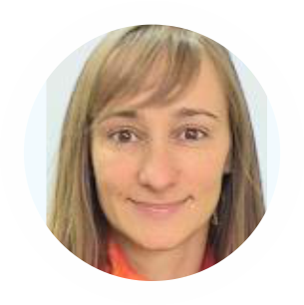
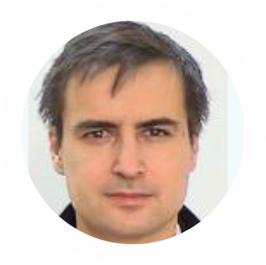
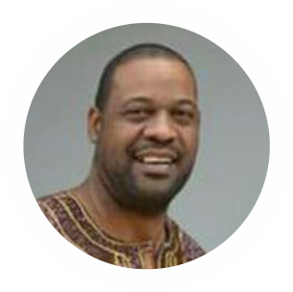
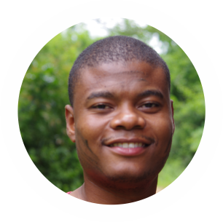
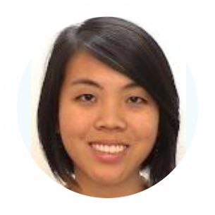
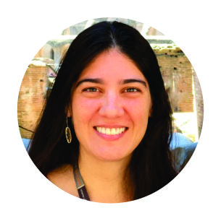
Green Business Line, Forestry (MozFIP, DGM, REDD+, Zambezia ER Payments)
Karin Kaechele, Focal Point
Andres Espejo
Arnela Mausse
Carbon Finance Specialist (D.C.)
Senior Carbon Finance Specialist (D.C.)
Senior Community Development Specialist Consultant
(Maputo)
Focal point for the Green Business Line – Forestry. TTL of the FCPF REDD+ project, and co-TTL of the MozFIP and Zambezia ER payment projects; also supports the whole ENRM team management.
Senior TA on carbon accounting and reporting issues.
I work on community development issues in the MozFIP and MozDGM projects, and conduct analytical work on the broader rural development agenda.
Muino Taquidir
Ivan Remane
Celine Lim
Senior Forestry Specialist Consultant (Maputo)
MRV Specialist Consultant (Maputo)
Natural Resources Management Specialist Consultant (D.C.)
Liaise with forestry authorities, (native forest management; forest law enforcement) also initiatives to support to private sector and partnership with local communities (MozFIP); follow preparation of Agenda 2035 for forest sector (PROFOR)
I am responsible for GIS, Remote Sensing and Carbon account with focus on forest dynamics and Agriculture.
I co-manage MozDGM, support supervision of MozFIP. One of the focal points for natural forests in the portfolio and supporting the Cabo Delgado Program.
Alicia Peduzzi
Senior MRV Specialist Consultant (D.C.)
Provide support to WB's task team and DINAF/FNDS on the design and implementation of the Monitoring, Reporting and Verification (MRV) system.

Slide 10
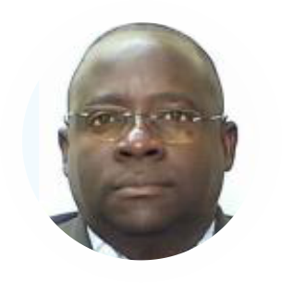
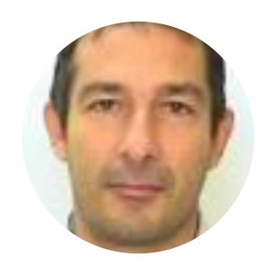
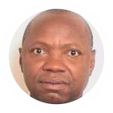
Rural Development & Agriculture (Sustenta / Landscape project)
Pedro Arlindo, Focal Point
Norman Piccioni
Aniceto Bila
Agricultural Economist (Maputo)
Senior Agriculture Economist (Maputo)
Senior Agriculture Specialist (Maputo)
I co-manage the MZ Ag and NRM Project, which supports inclusion of small and emerging farmers in agriculture and non-timber forest-based value chains and stimulates sustainable NRM including land, restoration, and water.
CO-TTL for the Sustenta project, and leading dialogiue with development partners.
TTL for the PROIRRI and Irriga projects

