Slide 1
#PressforProgress Photo Contest Winners

Slide 2
Above 35

Slide 3
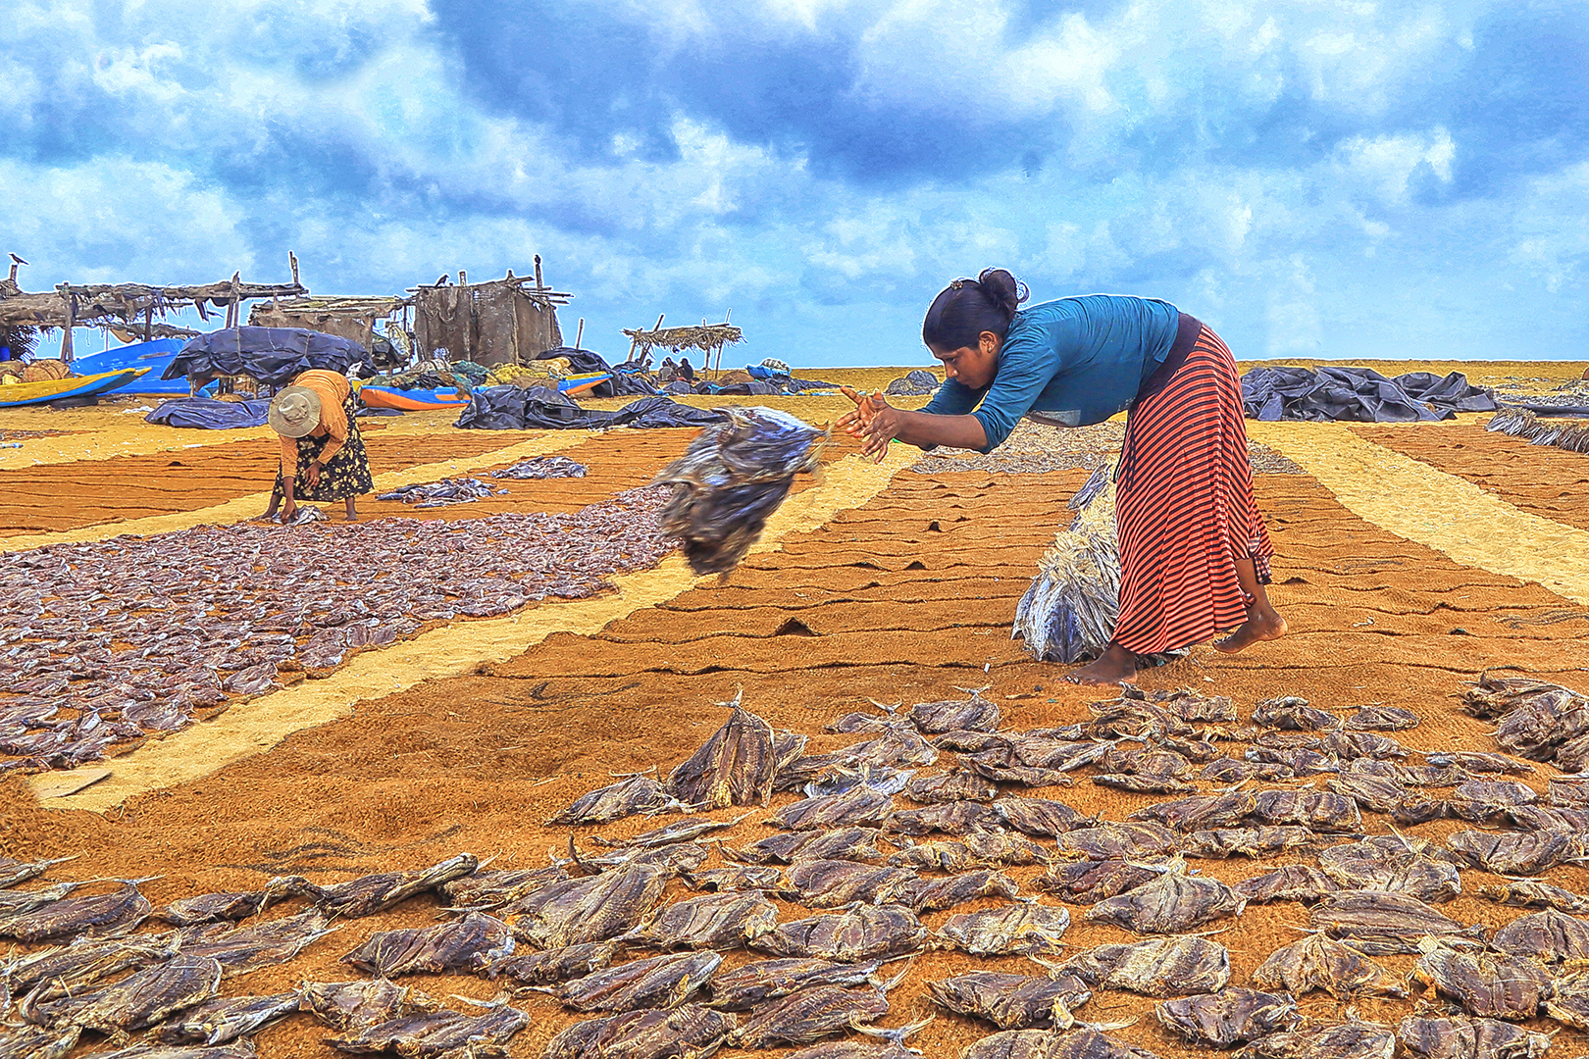
1st Place – Ayesha Bulathgama
Ayesha Bulathgama started her journey in photography about 5 years ago as a student in the Hagoda School of Photography. After successfully completing a certificate course in photography, she joined the National Photographic Art Society of Sri Lanka and completed a 3-year diploma course in photography last year. Moreover, Ayesha became a member of Photographic Society of Sri Lanka. She currently competes in local and international photographic competitions and has been awarded many times.
The art of preservation

Slide 4
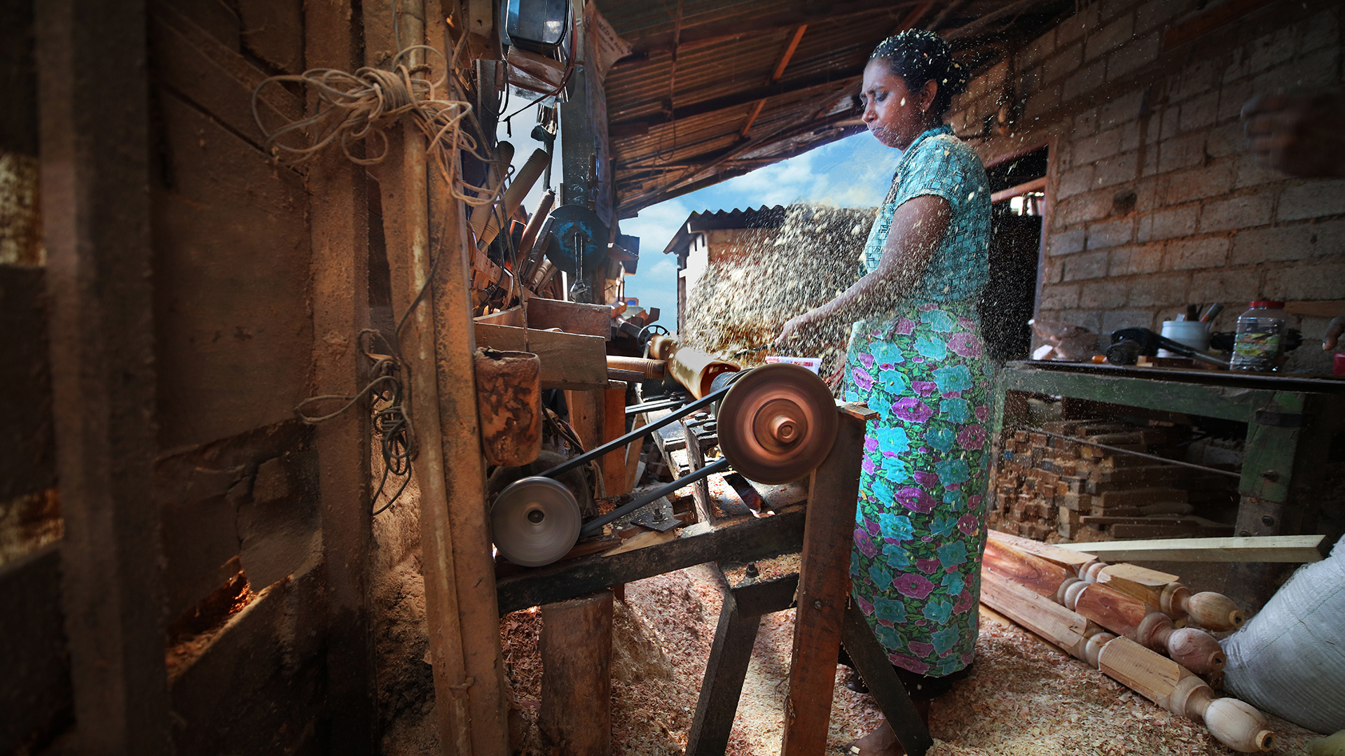
2nd Place - Ranjani Perera
Retired official of the Central Bank of Sri Lanka. After a hectic work period at the Central Bank she started to live up to her dream hobby. Since she started photography, she has achieved so many International awards and several Distinctions such as,LRPS from Royal Photographic Society UK, AFIAP from Francen, APSS from Photographic Society of Singapore AICS, ASWAN, LUSPA, of USA, AISF from France, Hon. PESGSPC , Cyprus, AISLP Institute of SriLankan Photographers , ANPAS National Photographic Art Society of Sri Lanka and many other awards
Carving out a livelihood

Slide 5
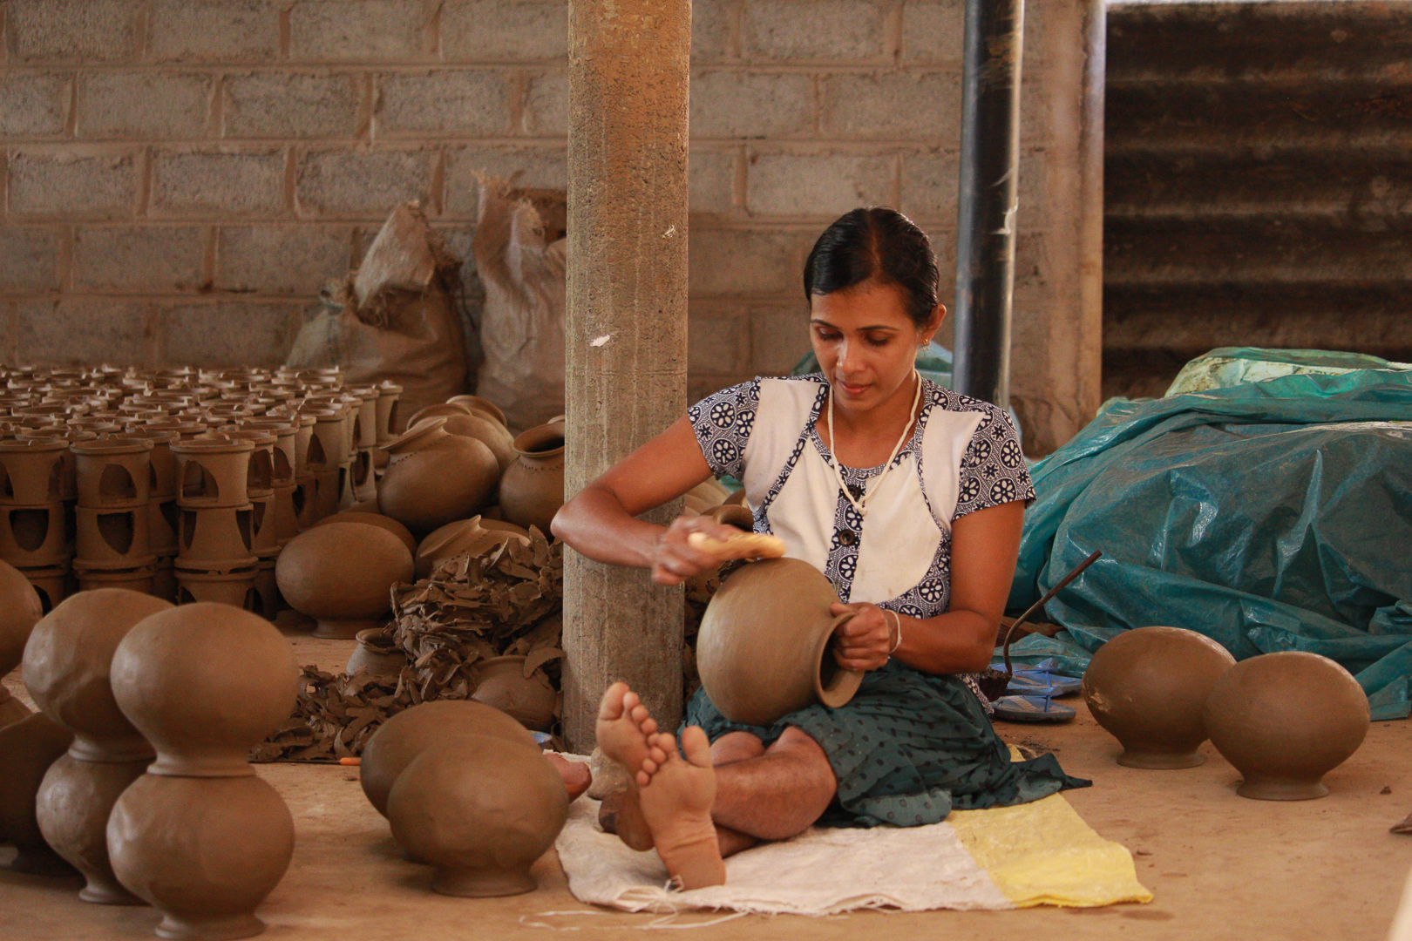
3rd Place – Indunil Usgoda Arachchi
Indunil Usgoda Arachchi is a journalist for the Ravaya newspaper. Her home town is Matara, Southern province in Sri Lanka. She is studying for the Bachelor of Technology in Film and Television Production Technology at University of Vocational Technology, Sri Lanka. She works hard to give voice to marginalized groups through her reporting
The art of living II

Slide 6
Below 35

Slide 7
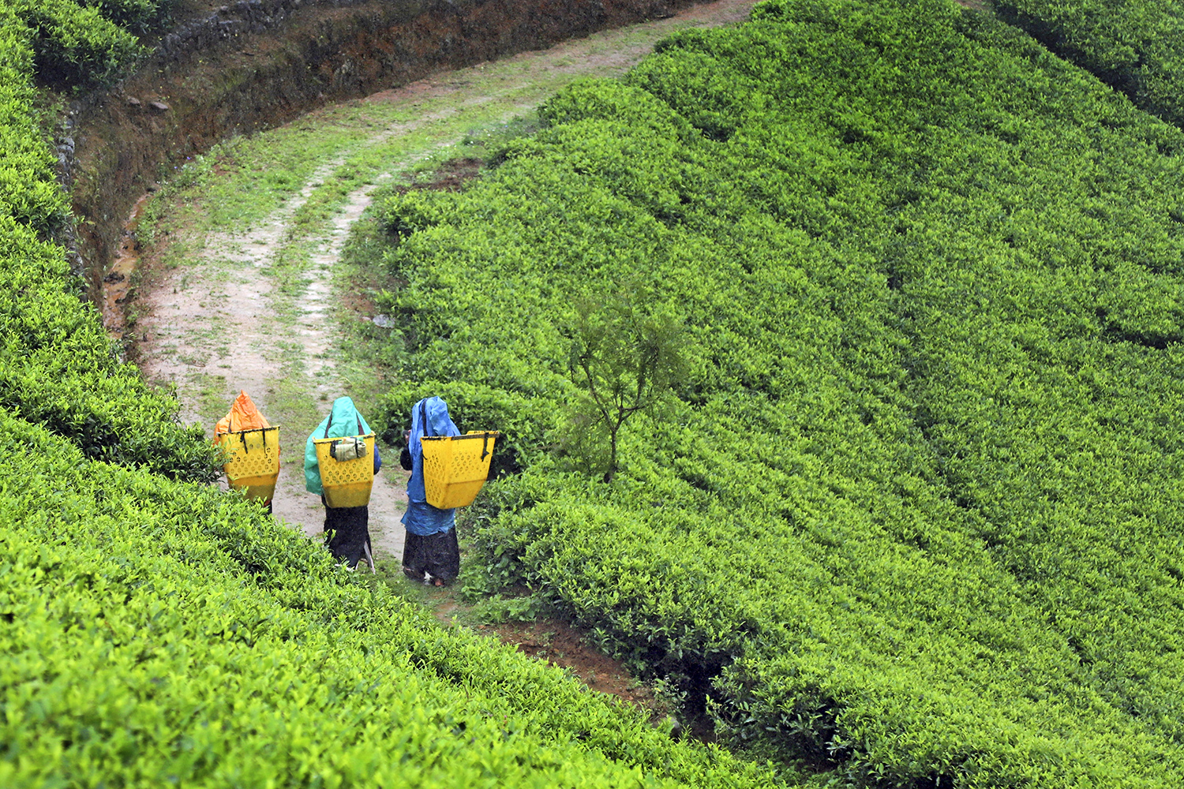
1st Place – Nayomi Thomas
Born in 1983 in Teldeniya , Nayomi Thomas studied at Girls’ High School – Kandy. She is currently working as an Executive Company attached to a group of Companies based in Colombo. She started photography as a hobby in 2013. Interested in street photography she loves capturing moods of people. Her favorite place to take photographs is upcountry – Nuwara Eliya, especially in the tea estates.
Morning March

Slide 8
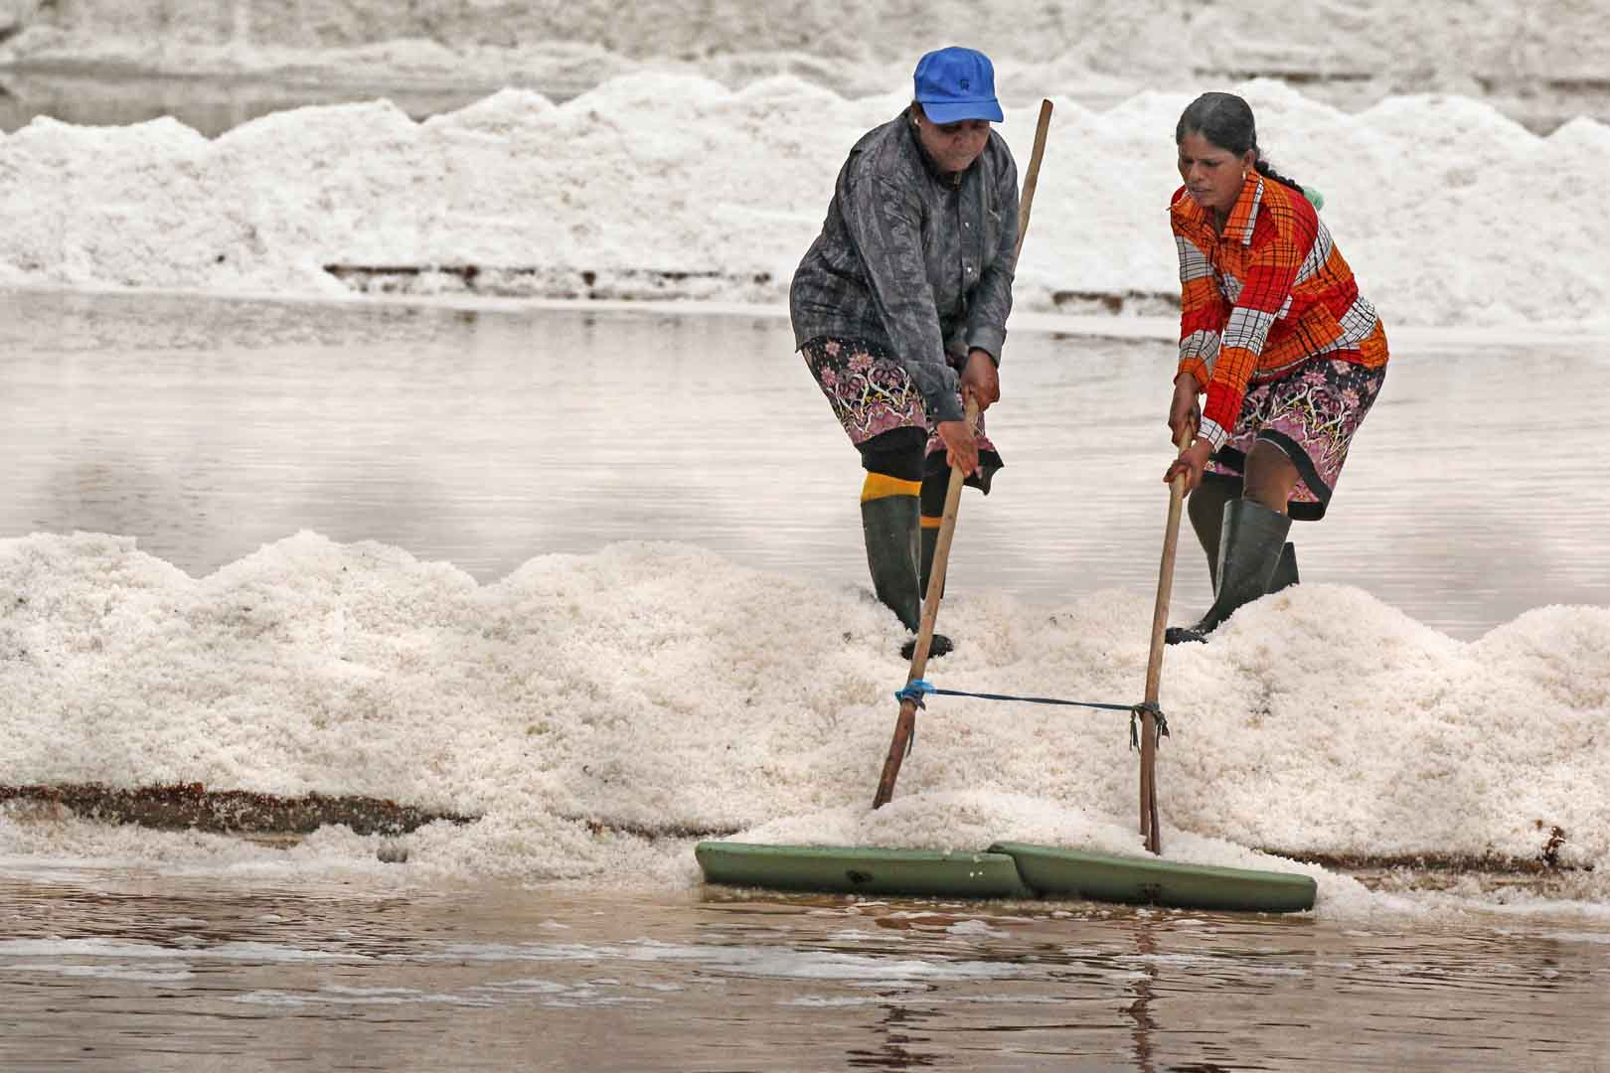
^{2rd} Place – Sahanaya Perera
Shanaya Perera is a 17 years old student of St. Bridget’s Convent. Currently She studies for A/level in Art stream and wishes to qualify in Law studies with Economics. She is a school prefect, the president of the Photographic club and Secretary, ModelUN. Photography is something very close to her and her sister because of a project called “photocause.lk”, a cancer engagement project. They believe photography can make people view the world differently.
Salt

Slide 9
3rd Place – Nethmie Ranasinghe
Nethmie Ranasinghe is currently studying for her attorneys at Sri Lanka Law College. She is currently working as a trainee at LegalBase- Colombo. She is an amateur photographer who practices photography as a hobby. She loves to capture moments and life. The theme of this competition encouraged her to participate as it's a topic of research interest and she believes in the cause.
Breaking new ground

