Slide 1
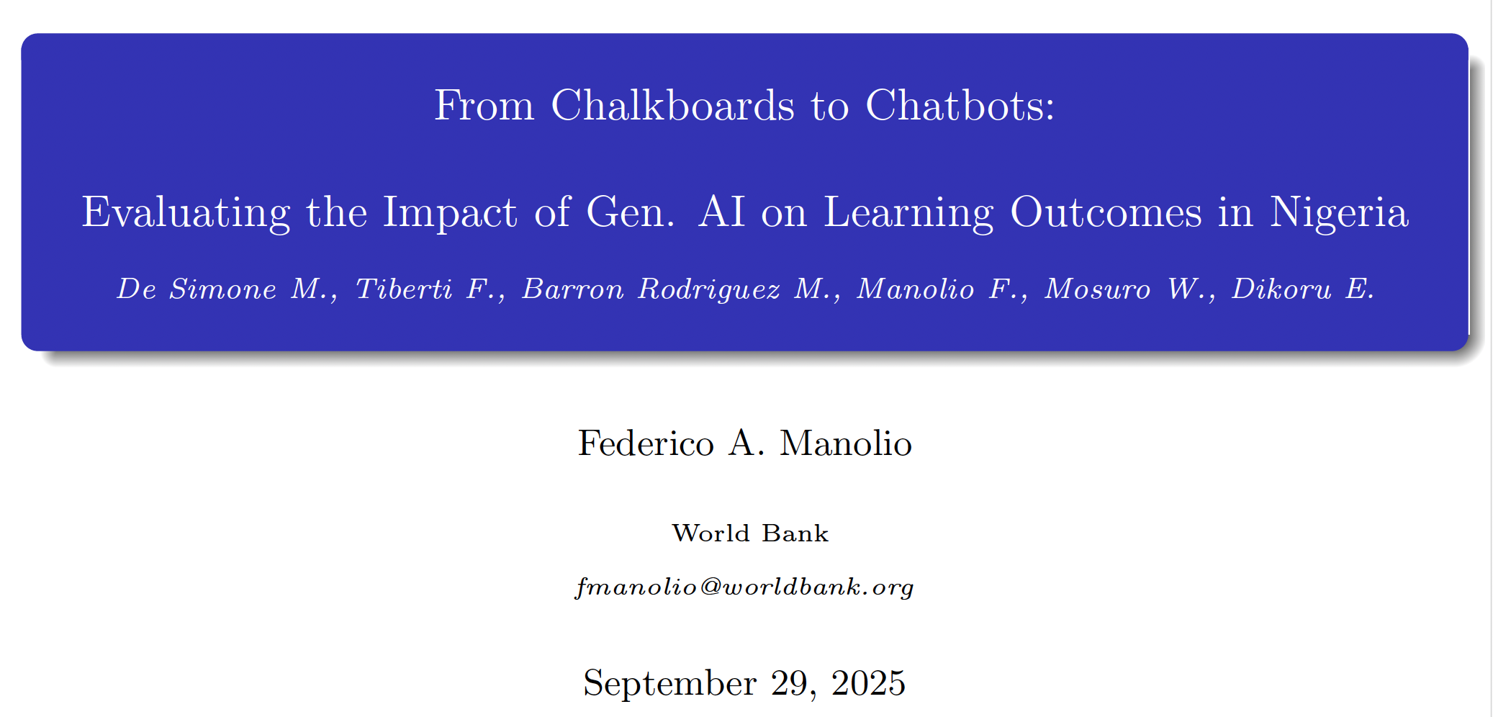
From Chalkboards to Chatbots

Slide 2
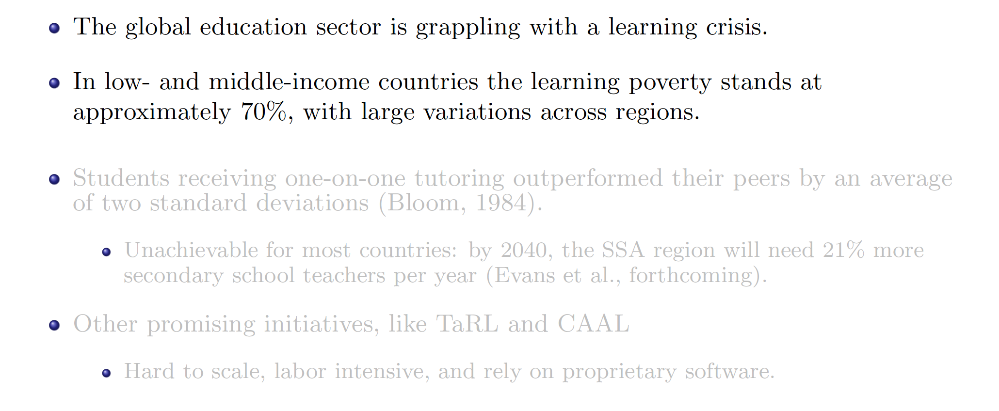
Motivation - The problem
From Chalkboards to Chatbots

Slide 3
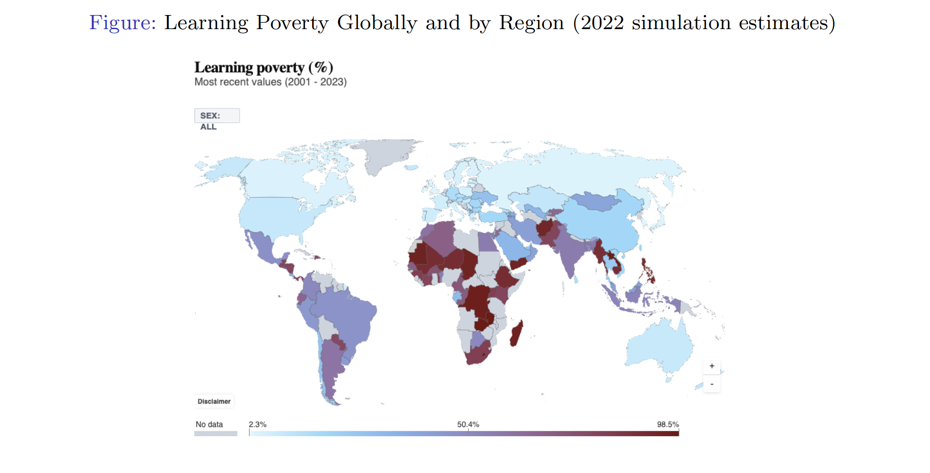
Motivation - The problem
From Chalkboards to Chatbots

Slide 4
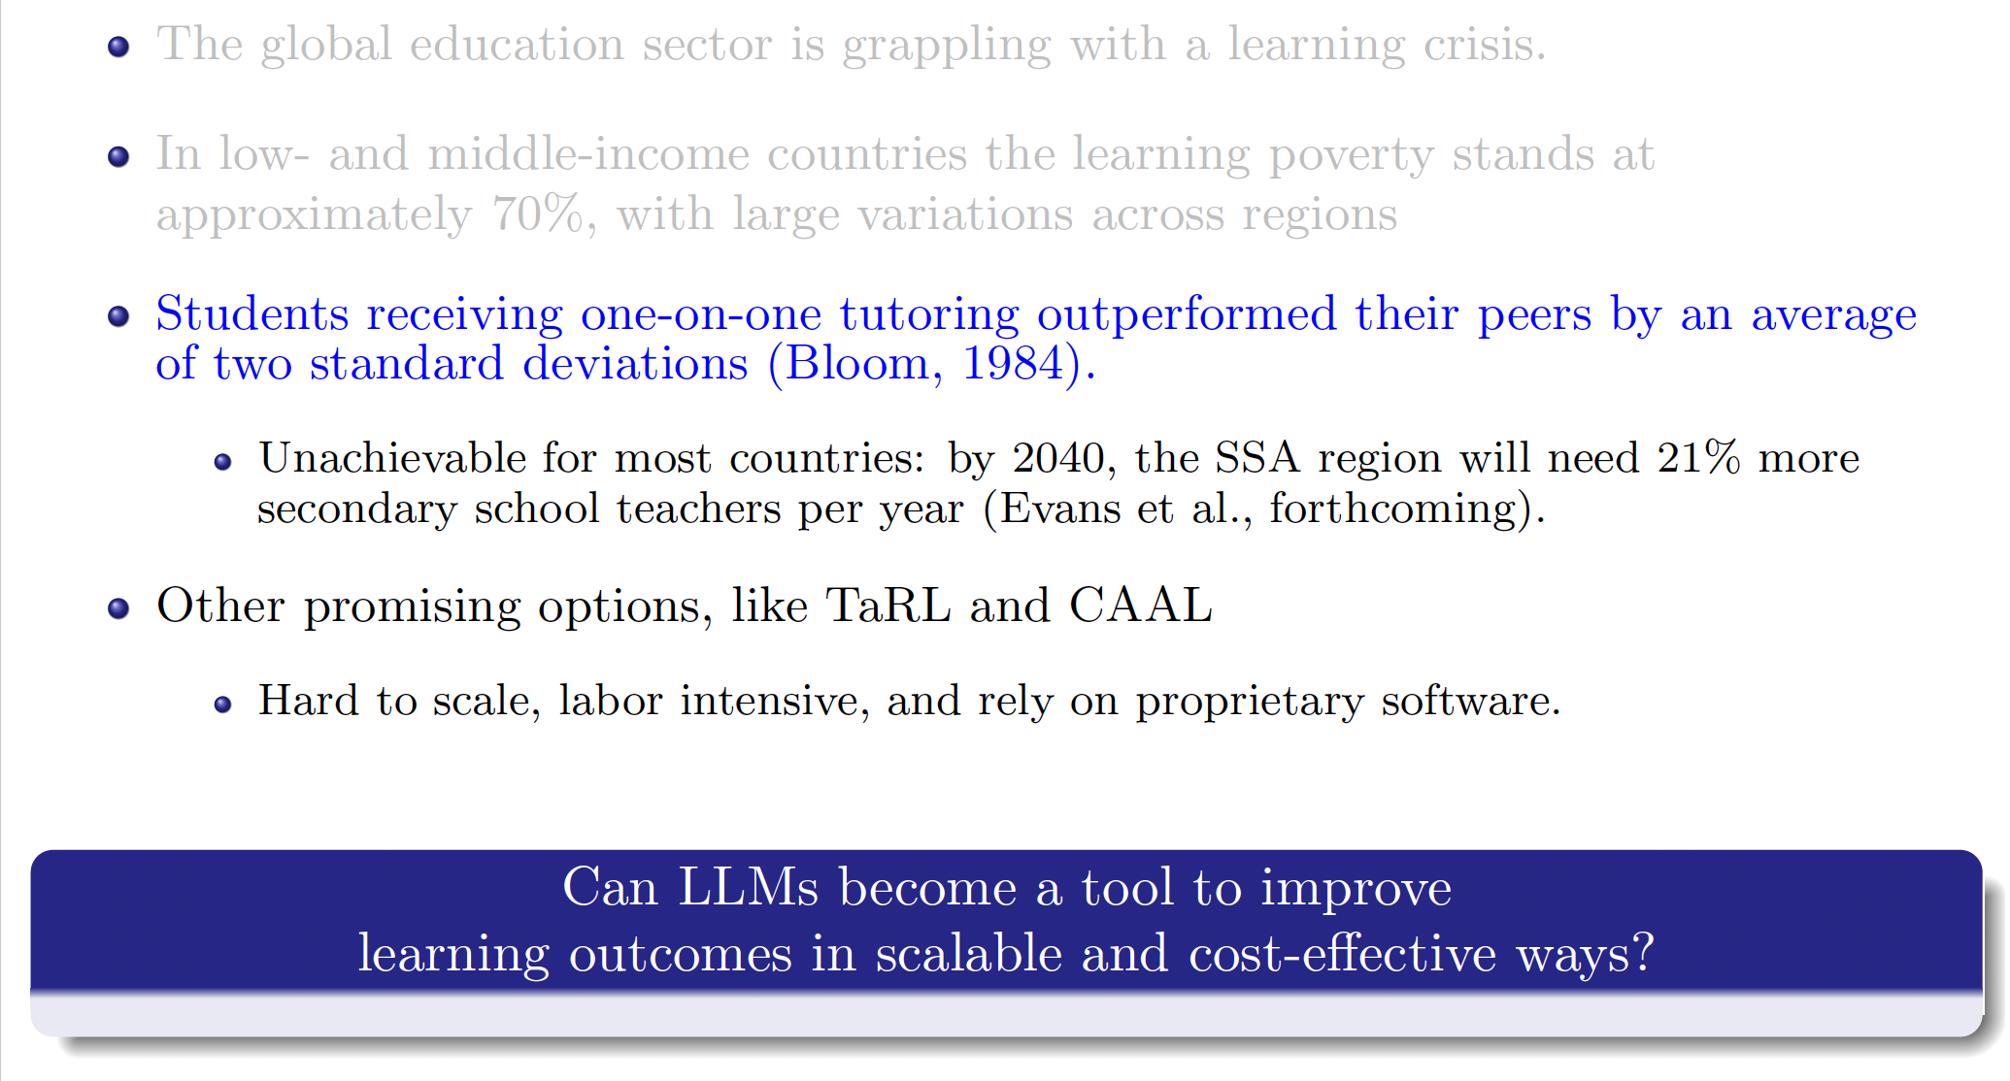
Motivation
From Chalkboards to Chatbots

Slide 5
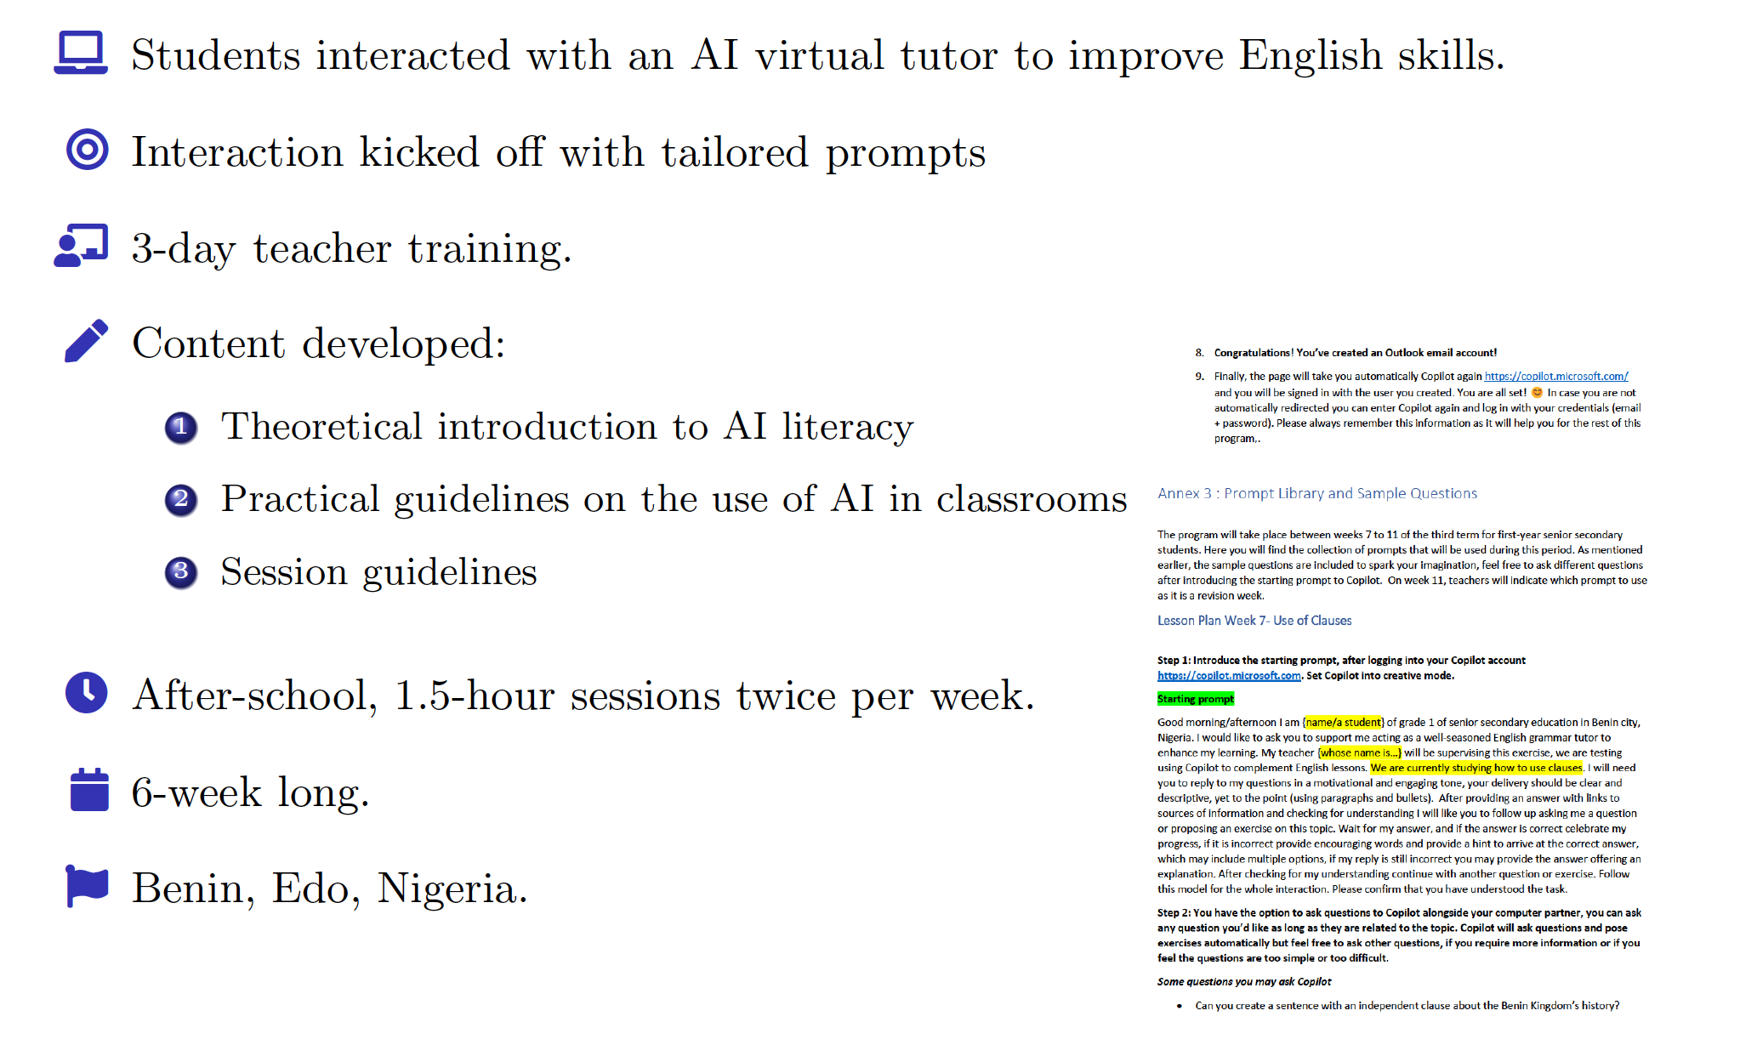
What we did – Overview of the Pilot
From Chalkboards to Chatbots

Slide 6
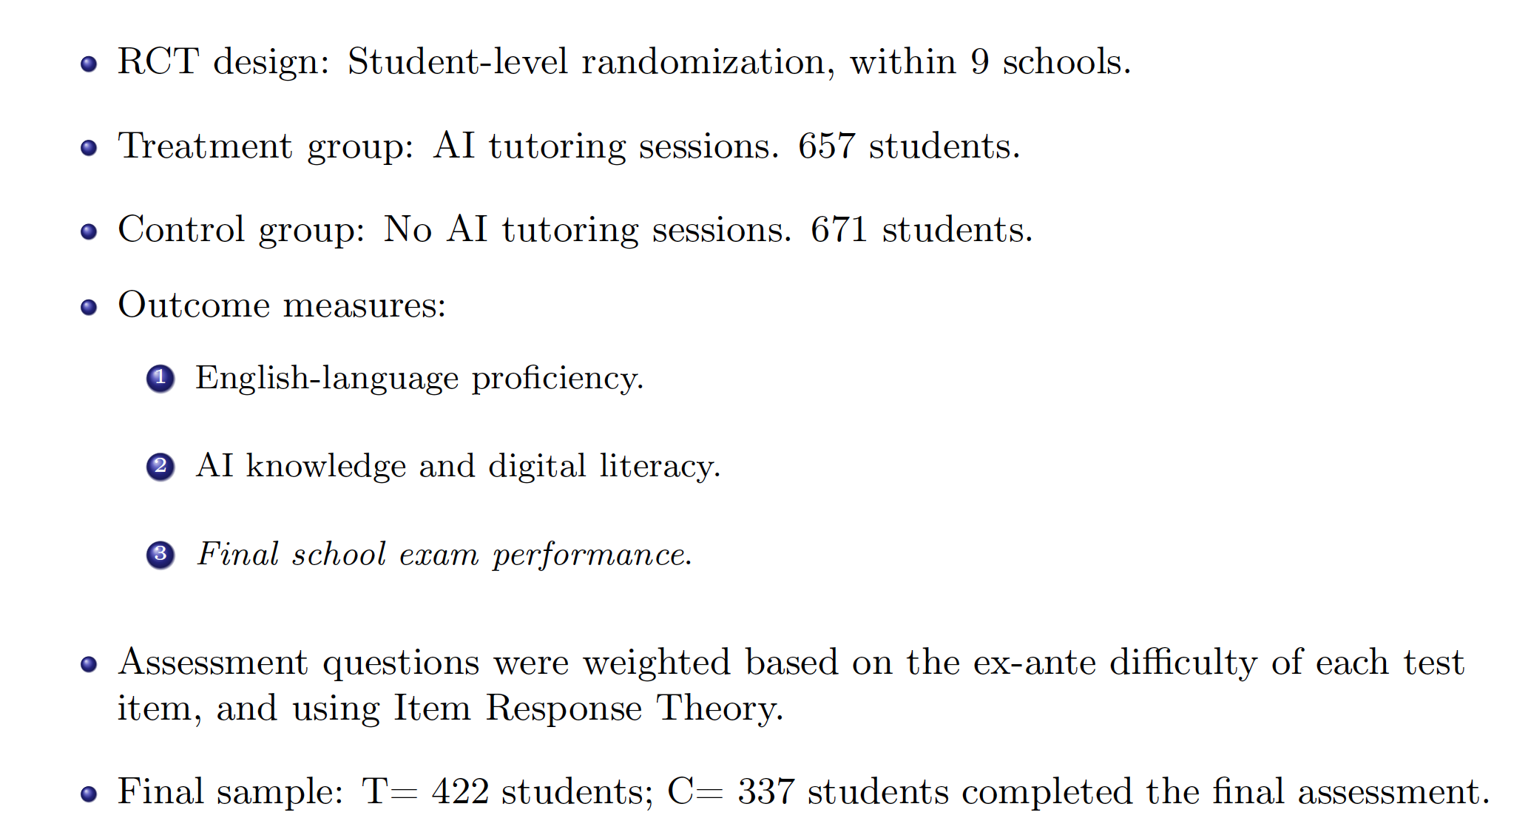
Evaluation Design
From Chalkboards to Chatbots

Slide 7
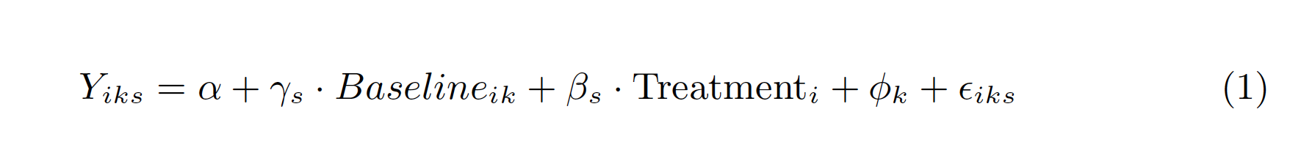
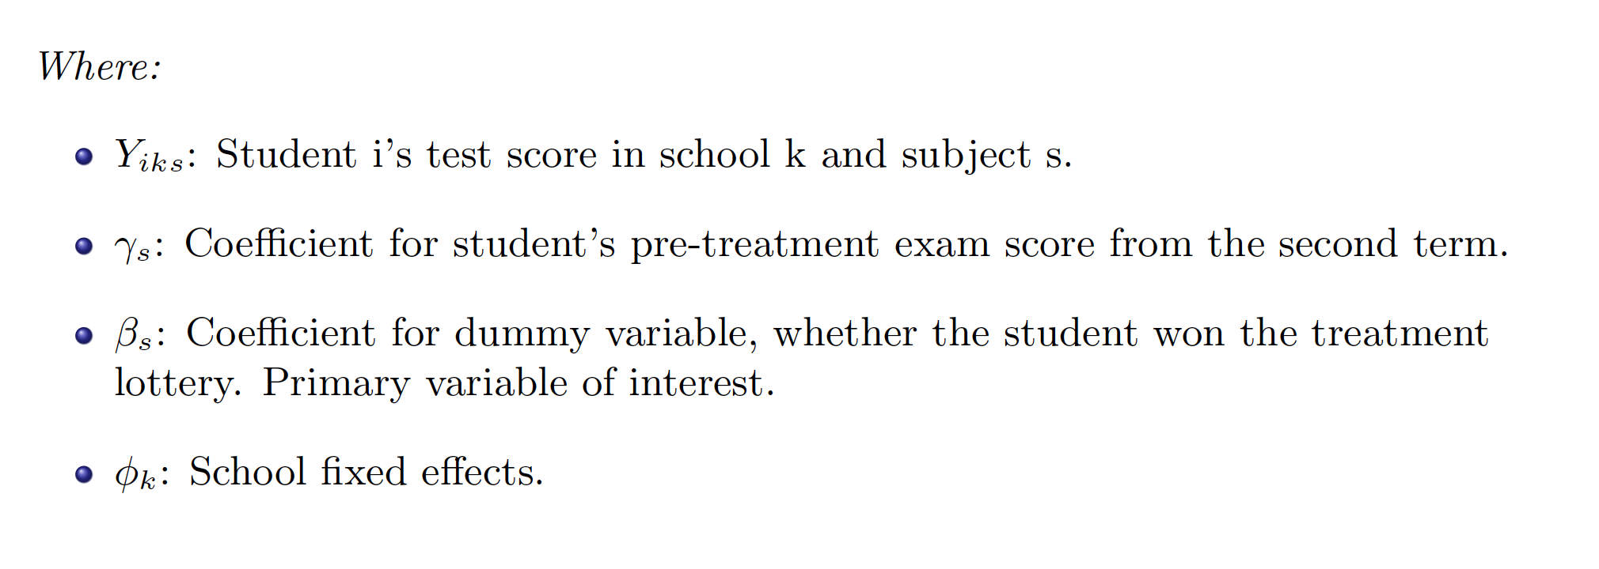
Model specification
From Chalkboards to Chatbots

Slide 8
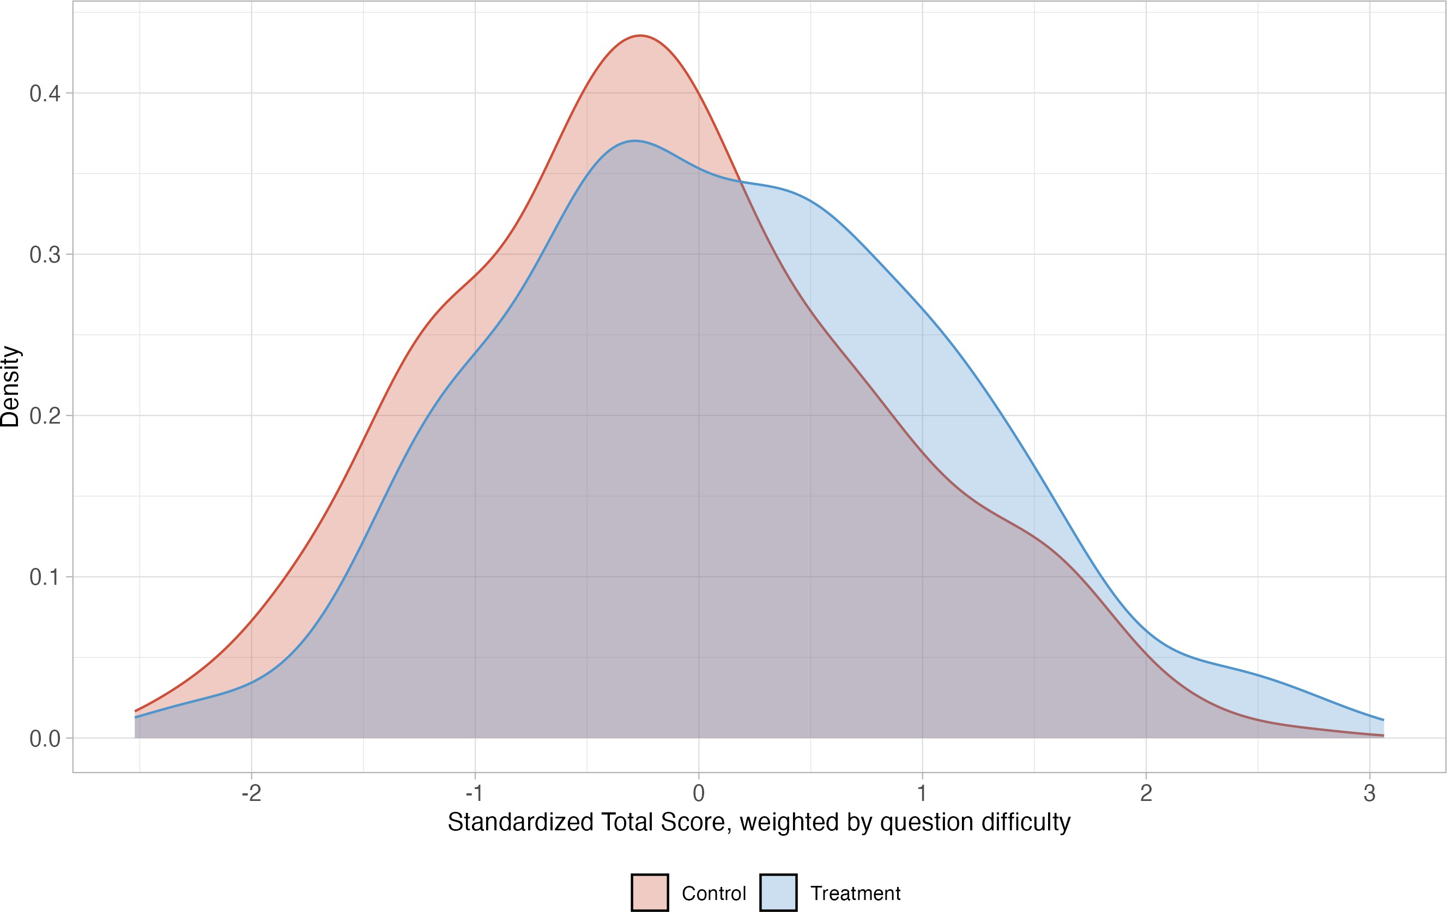
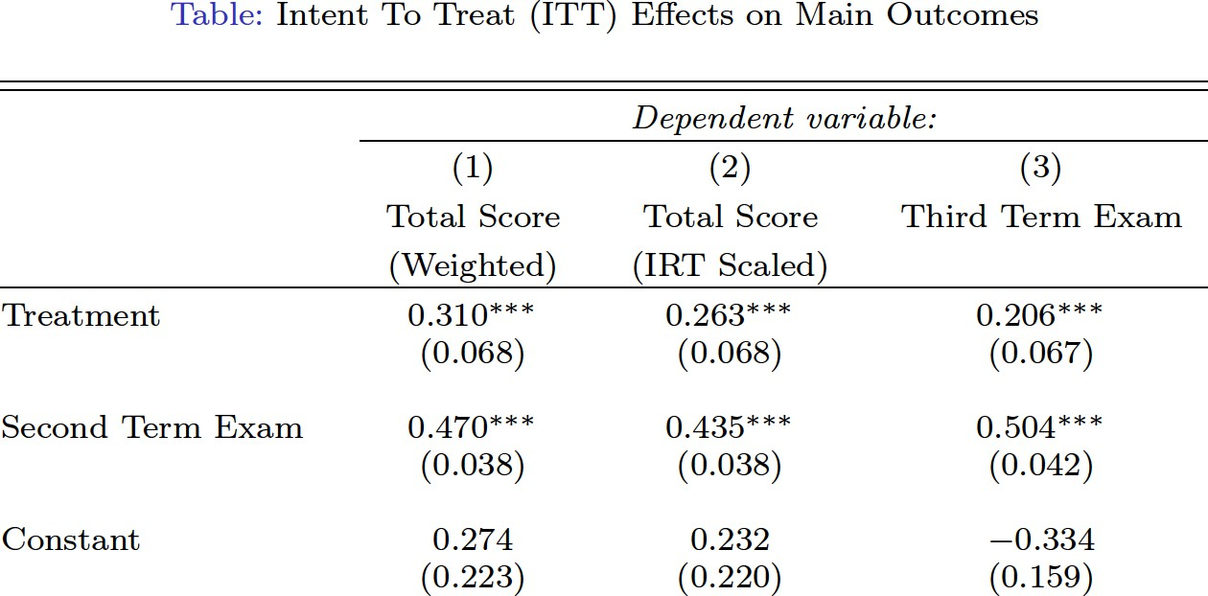
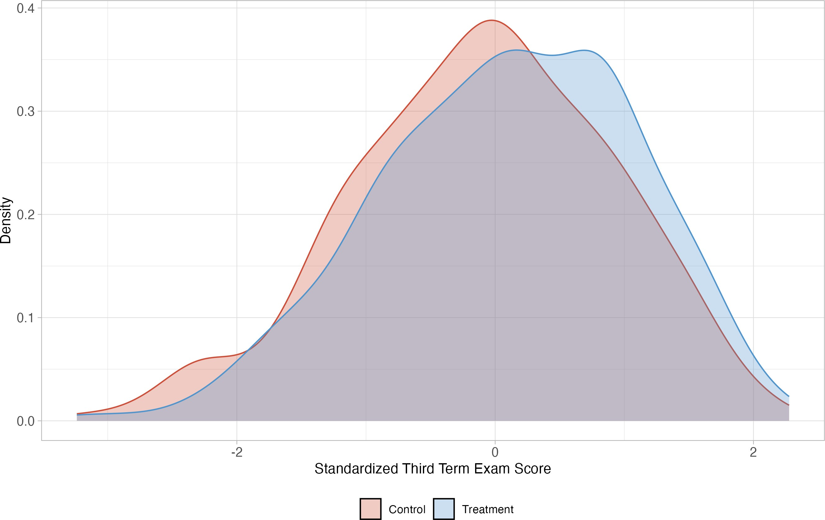
Key Results
From Chalkboards to Chatbots

Slide 9
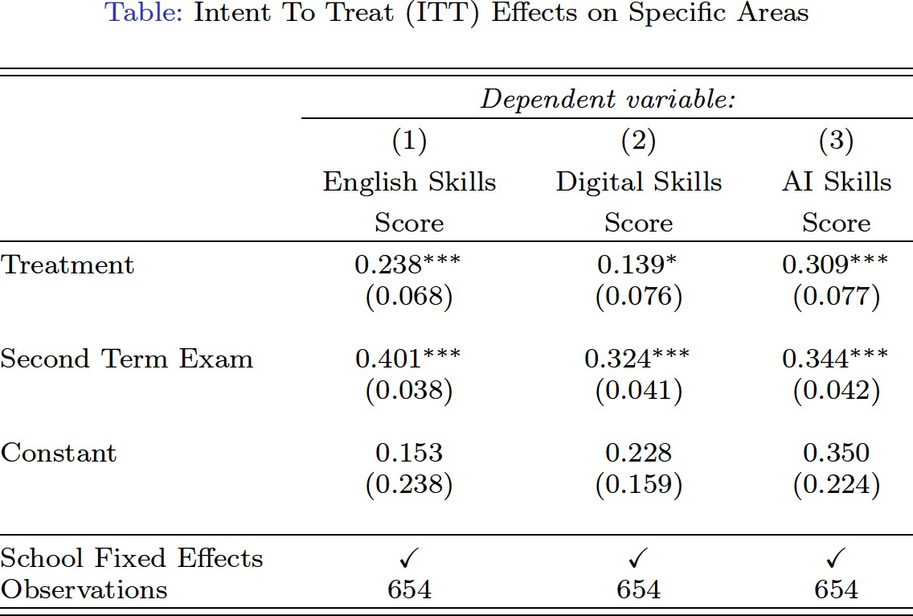
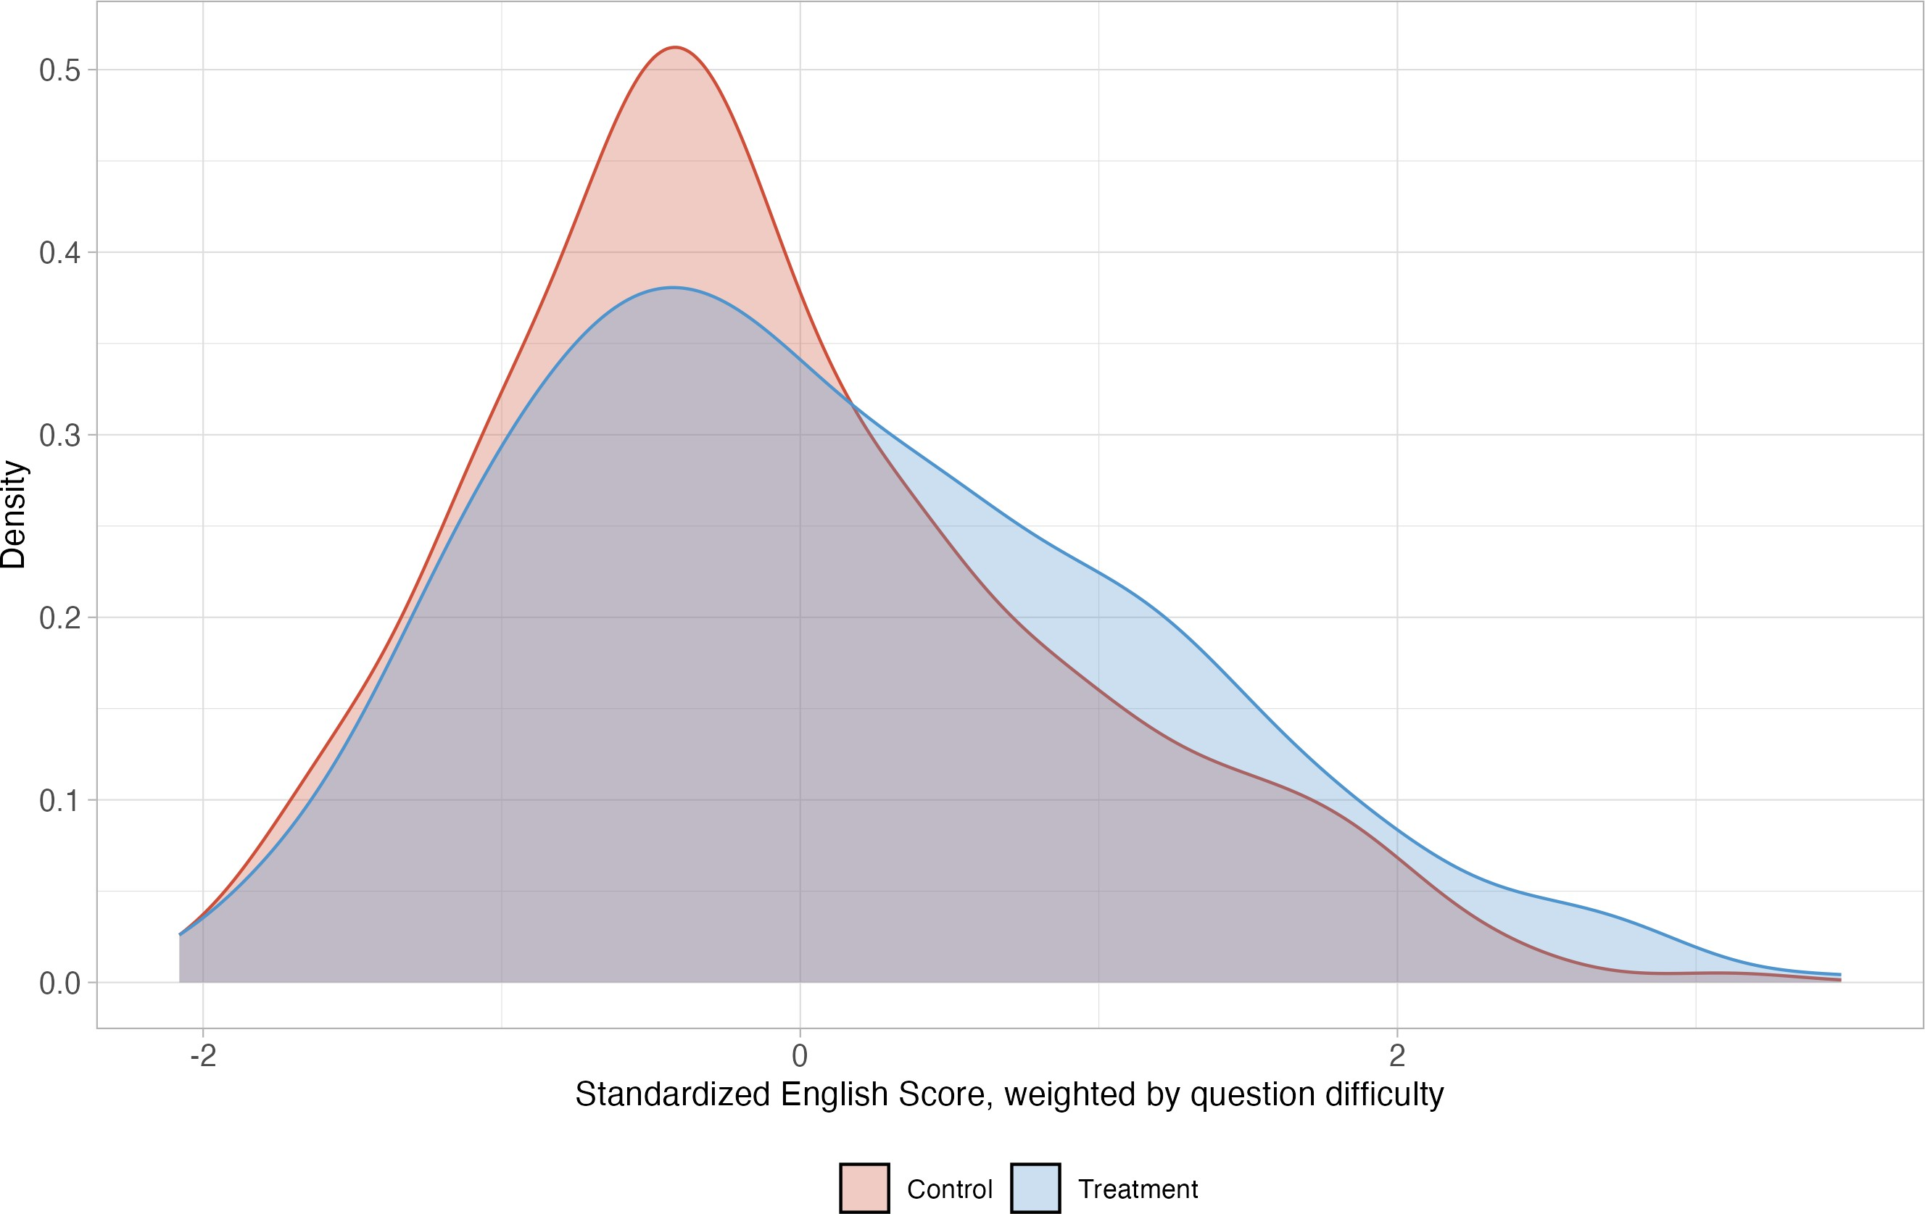
Key Results
From Chalkboards to Chatbots

Slide 10
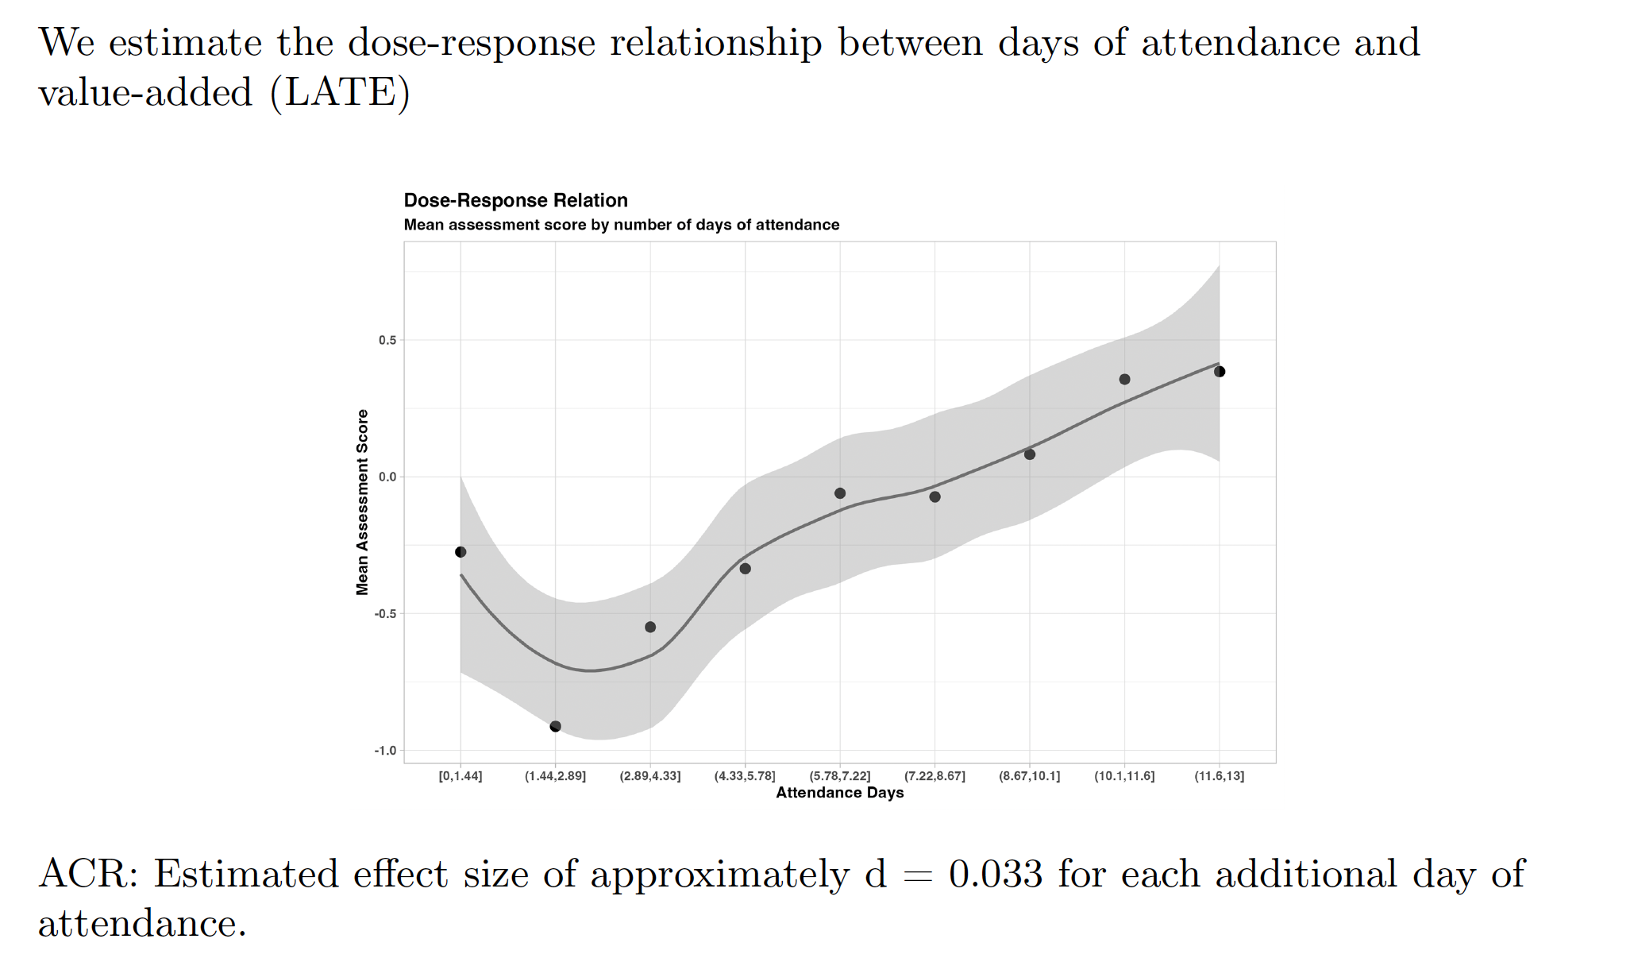
Key Results
From Chalkoards to Chatbots
From Chalkboards to Chatbots

Slide 11
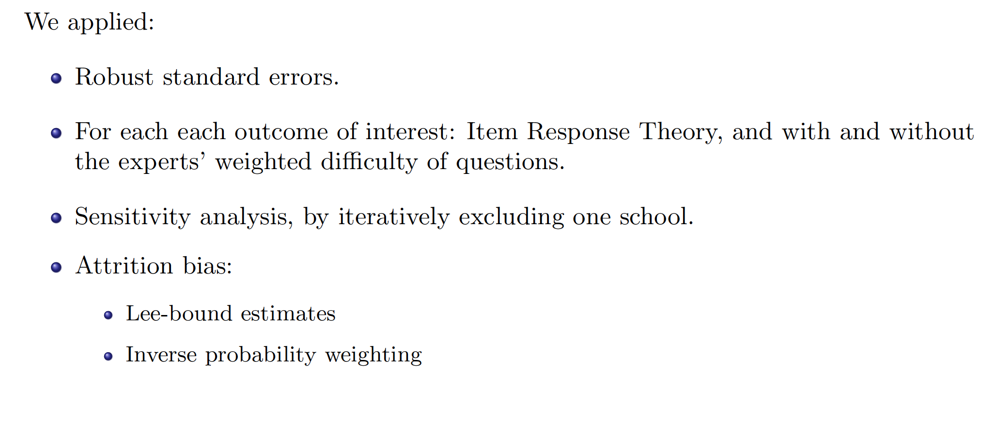
Robustness
From Chalkboards to Chatbots

Slide 12
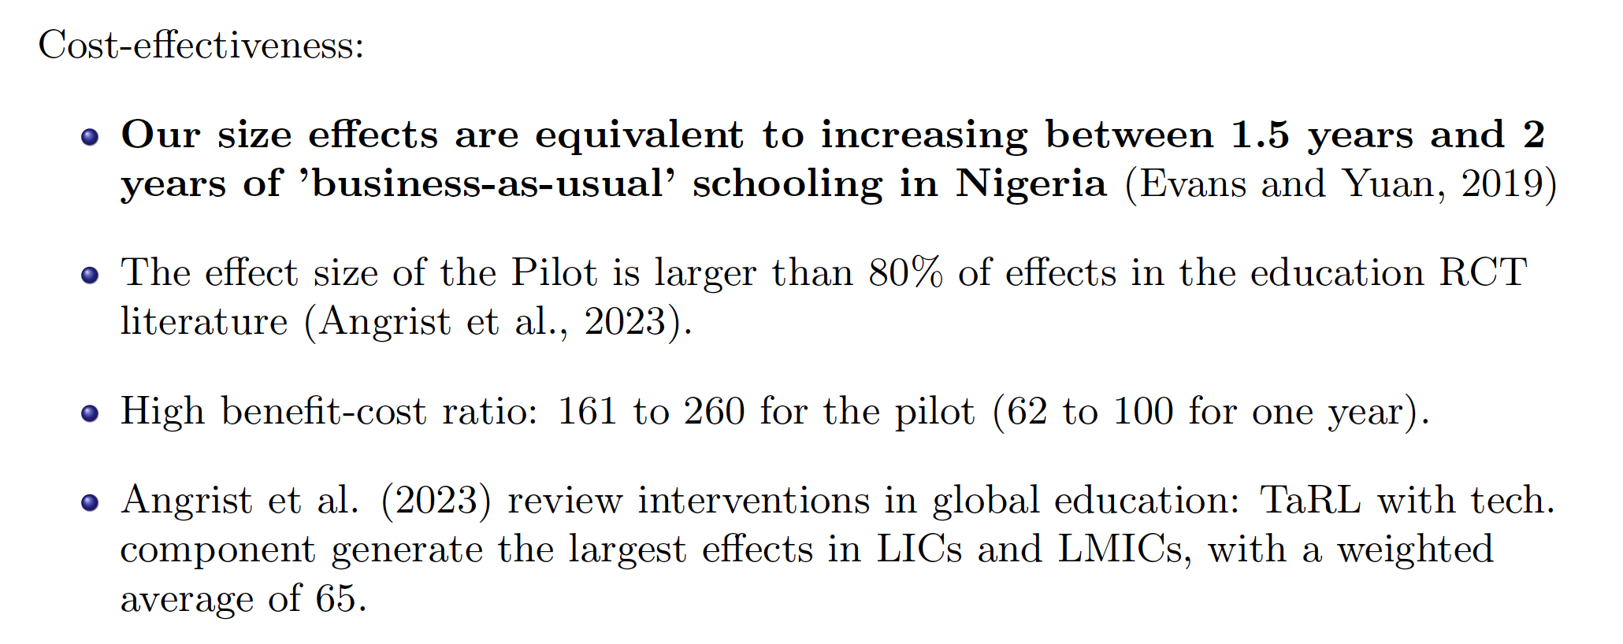
Discussion
From Chalkboards to Chatbots

Slide 13
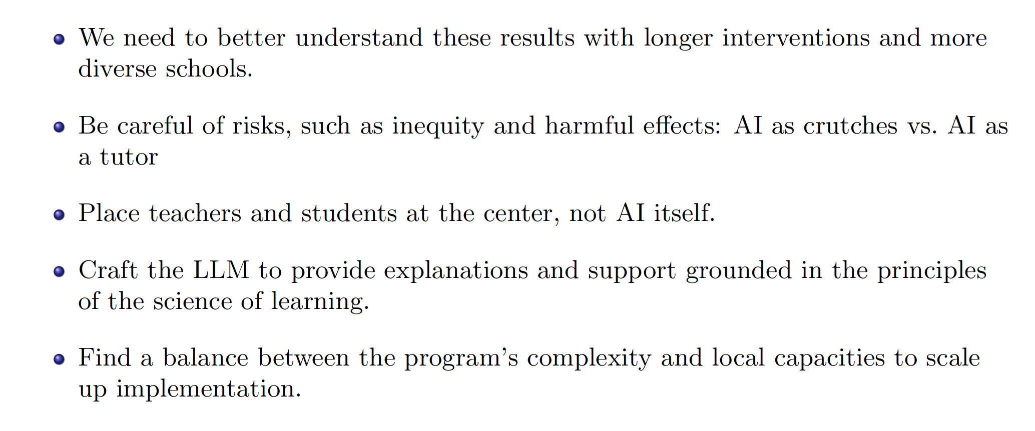
Discussion
From Chalkboards to Chatbots

Slide 14

From Chalkboards to Chatbots

Slide 15
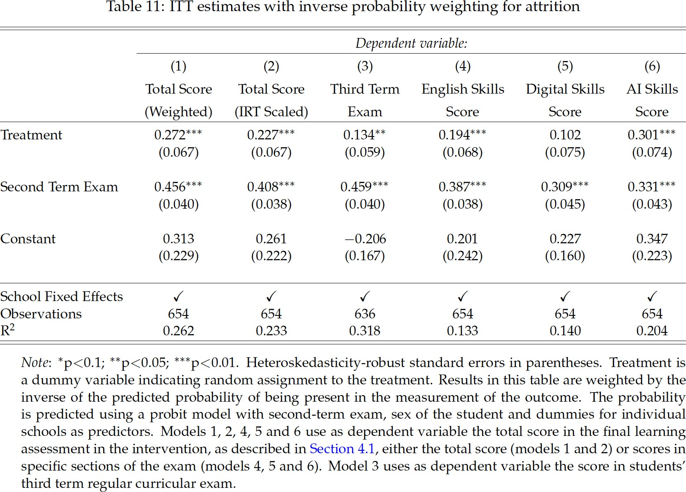
Appendix: Robustness Checks
From Chalkboards to Chatbots

Slide 16
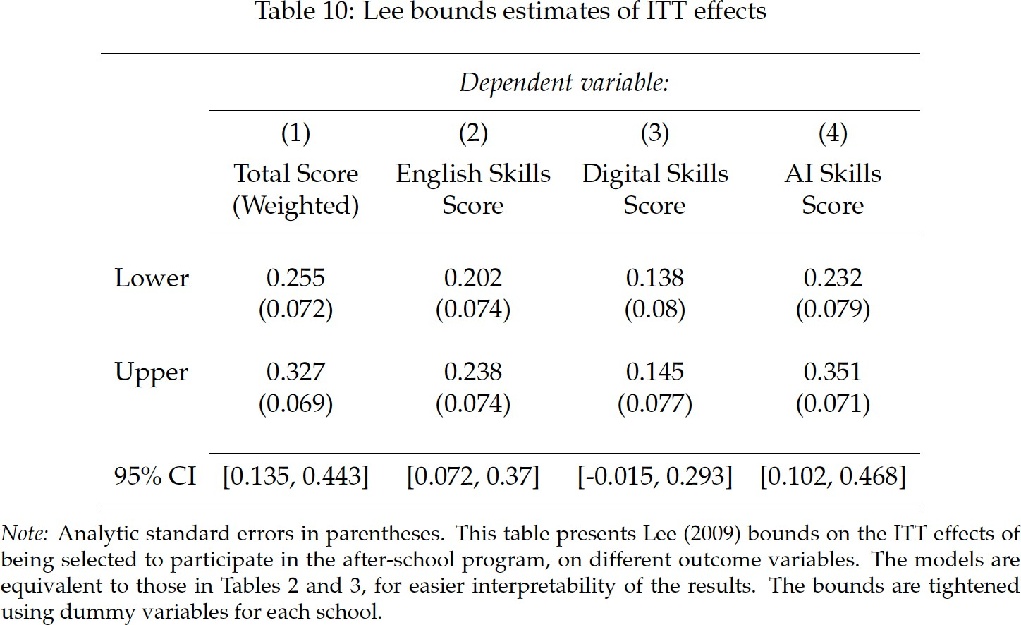
Appendix: Robustness Checks
From Chalkboards to Chatbots

Slide 17
Appendix: Key Results
Table: Intent To Treat (ITT) Effects on Main Outcomes
Dependent variable:
 | (1) | (2) | (3)
 | Total Score | Total Score | Third Term Exam
 | (Weighted) | (IRT Scaled)
Treatment | 0.310∗∗∗ (0.068) | 0.263∗∗∗ (0.068) | 0.206∗∗∗ (0.067)
Second Term Exam | 0.470∗∗∗ (0.038) | 0.435∗∗∗ (0.038) | 0.504∗∗∗ (0.042)
Constant | 0.274 | 0.232 | −0.334
 | (0.223) | (0.220) | (0.159)
School Fixed Effects | C | C | C
Observations | 654 | 654 | 636
Note: ∗p<0.1; ∗∗p<0.05; ∗∗∗p<0.01. Heteroskedasticity-robust standard errors in parenthesis. Treatment is a dummy variable indicating whether a student is assigned to attend the sessions.
From Chalkboards to Chatbots

