Slide 1
MNAGIL UPDATE COVID-19 IMPACTS AND RESPONSES
Lili Mottaghi
Program Lead
April 21, 2020

Slide 2
Roadmap
Economic, social, and gendered impacts of the COVID-19 crisis in MENA
WBG MENA new platform to respond to the COVID-19 crisis
MNAGIL current projects and responses to the COVID-19 crisis
MNAGIL new COVID-19 activity and other projects

Slide 3
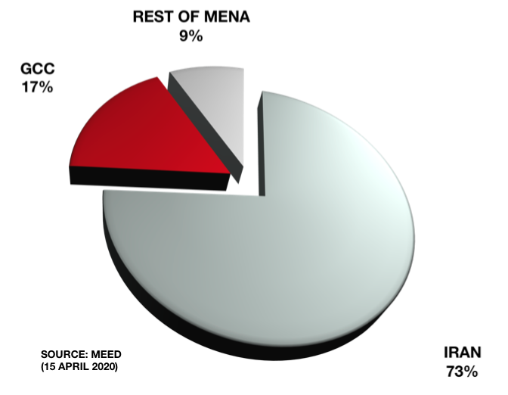
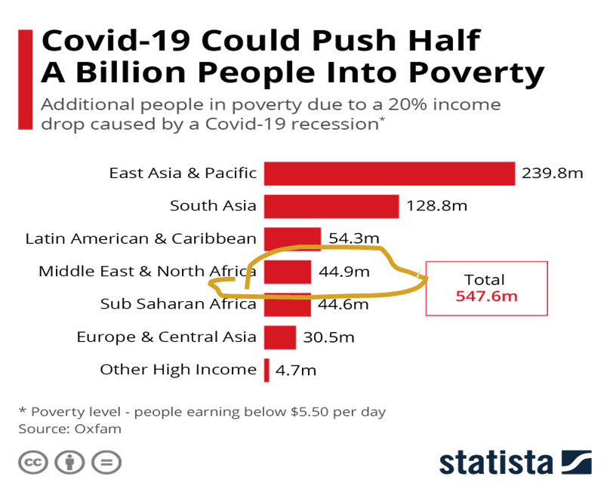
Worse Economic Fallout from the COVID-19 Crisis
Coronavirus has triggered triple economic shocks in the MENA region: Falling global demand for the region’s goods and services, declining domestic demand and supply due to the lockdown, and falling oil prices due to the large glut, could cost the region more than $100 bn.
Number of Covid-19 cases in MENA: 105,447 (2.1 mln globally)
COVID-19 could push 45m more people into poverty in MENA
Notes:
MENA has 173 million poor already at 5.5 p/d and 44.7% HC. Total pop. 387 mln. 12% more poor due to the pandemic.

Slide 4
COVID-19 Crisis Hits Women More than Men
Increase in female unemployment: The pandemic has hit the services sector: food services, retail, accommodation industries, education and health sector, personal care, informal sector, and other social services where women comprise the majority of workers.
Lower female labor force participation: Increased exposure to gender bias as they are expected to undertake unpaid work during the pandemic such as looking after children, providing care for elderly and other unpaid work that limit female labor force participation.
Female owned businesses at risk: Female entrepreneurs may face additional obstacles to resume their operations or start a business in the post-pandemic due to their limited access to finance.
Health issues and increase in violence: women are more likely to be exposed and infected by the virus, given their predominant roles as caregivers within families and as front-line health-care workers. Lockdowns have also increased domestic violence cases across the region. Lebanon reported cases doubled in March compared to the previous month.
Notes:
women make up 75% of health care practitioners, 87% of health care support staff and 90% of nurses. Women in are more represented in social or services sector. For example, 68% of community and social services workers are women, 70% of educators are women and 77% of personal care and health service workers are women.

Slide 5
WBG MENA Responses to the COVID-19 Crisis Set up a platform for coordinating policies, programs, and resources to mitigate the worst socioeconomic consequences of the crisis.
Strengthening and expanding social safety nets to mitigate the impacts on small businesses with a focus on women including through more effective targeting and piloting innovative mechanisms for cash transfers and employment-for-work programs.
Enhancing social protection programs to support vulnerable groups through emergency cash transfers and broader programs such as public works programs that aim to promote productive inclusion and human capital development.
High frequency data monitoring and update particularly investing in and expanding the collection of gender disaggregated data during the crisis and post crisis.

Slide 6
MNAGIL Activities are Aligned with MENA’s New Platform objectives
EGYPT Using Digital Technology to Expand Markets for Female Entrepreneurs with the DEC team
EGYPT Assessing the Impact of Providing Access to Nurseries on Female Labor Force Participation with the JPAL team
TUNISIA Enhancing Female Entrepreneurship through Public Works Program and Capital Injections Intervention with the DIME team
YEMEN Evaluating the Impact of SMEPS Training and Livestock Interventions on Women’s Entrepreneurship with the SP team
Digital training access
The digital training intervention can be useful in helping firms bounce back and get new customers once movement restrictions are removed
Cash transfers
Training
Cash transfers
Employment-for-work programs
Public works programs
Training
Cash transfer

Slide 7
MNAGIL Response to the COVID-19 Crisis
SURVEY
1- Innovative COVID-19-specific module on existing projects? | Yes, all MNAGIL projects plan to have a COVID-related questionnaire on knowledge, attitudes, practices; perceptions of health facility and community preparedness; trust in government; and how COVID has impacted female business and entrepreneurship activities, including impacts on employment and earnings. Teams will incorporate questions about the Coronavirus in their questionnaire to test the impact of the virus on female labor force participation as well as the infection control practices on a household level, shocks and coping strategies module of the survey instrument.
2- COVID-19 impact on project timelines and designs | All plans to carry out fieldwork in April are paused in compliance with the Bank, DIME, and JPALs’ policies suspending all impact evaluations fieldwork until this crisis is under control or over. Instead, teams are using this time to finalize data collection instruments and prepare for the procurement of the survey firm.
3- Status of in-person data collection, how do you work around suspensions? | All in-person data collection is suspended due to the lockdown. Teams are continuing with non-field based activities, including finalizing survey instruments/other research tools and preparing for procurement and contracting of the survey firm. JPAL will start in-person interviews after the pandemic is over. If this will take longer, JPAL plans on using phone surveys or online forms.
4- Do you implement any phone surveys? Any specific strategies/practices to ensure optimal data collection? | JPAL is currently running the data collection for one of the surveys using phone surveys. However, JPAL is still working on refining this system with all other JPAL offices. JPAL India is taking the lead in testing this system. Other MNAGIL project teams are contemplating the possibility of carrying out a relatively shorter (10-15 minutes), COVID-focused to collect in real-time COVID-related shocks that participants will be experiencing and to provide timely inputs into any CMU’s responses.
5- Innovative change to the designs of group or in-person delivery interventions? | The nature of interventions of all our projects requires at least initial in-person contact for beneficiary identification, training, etc. Some of our proposed interventions that require in-person delivery (in Yemen) have been adapted to enforce social distancing norms.
6- Main challenges that COVID-19 pose | The main challenge is that in-person interventions are temporarily paused in the current environment. Teams are using the time in between to solve some technical issues they are facing and to get ready for using interventions to help firms build up customers again when the time is right.

Slide 8
MNAGIL Response to the COVID-19 Crisis
New initiatives
COVID-19 gendered impact analysis by teaming up with LSMS and poverty team working on a high-frequency phone survey on COVID impacts, and the WVS's "Values in a Crisis" online survey team in six countries of Lebanon, Jordan, Egypt, Iraq, Yemen, and Morocco. Using randomized experimental tools to see how COVID-19 restrictions and lockdowns have affected jobs, female-owned businesses, finances, health, income, etc., at HH and individual level for men and women and how they react to varying stimuli that depict the crisis in different degrees of severity.
Land security and ownership to educate women about their land rights and evaluate the impact on women’s employability and agency in collaboration with the DEC team working on gender issues in regard to access to land.
Multi country IE project on assessing public transportation constraints on female labor force participation (supply side) and jobs (demand side) including restrictive norms, safety and security of using public transportation.

Slide 9
THANK YOU!

