Slide 1
Tech savvy
Advancing govtech reforms in public administration
Donna Andrews, Global Lead Public Administration Reform, Governance Global Practice
Zahid Hasnain, Global Lead Public Administration Reform,
Governance Global Practice

Slide 2
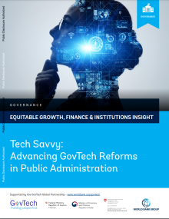
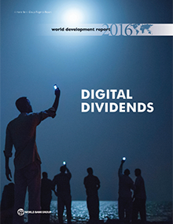
Digital transformation requires “analog complements”

Slide 3
Tech Savvy Report focuses on three key institutional analog complements
Whole-of-Government Coordination Approach
Building GovTech Skills in Public Administration
Leadership and Culture for Innovation

Slide 4
A lack of digital talent almost guarantees failure
“More than anything else, digital transformation requires talent. Indeed, assembling the right team of technology, data and process people who can work together – with a strong leader who can bring about change – may be the single most important step that a company contemplating digital transformation can take. Of course, even the best talent does not
guarantee success. But a lack of it almost guarantees failure.”
Davenport, T., Redman, T., Digital Transformation Comes Down to Talent in 4 Key Areas. Harvard Business Review, May 21, 2020.

Slide 5
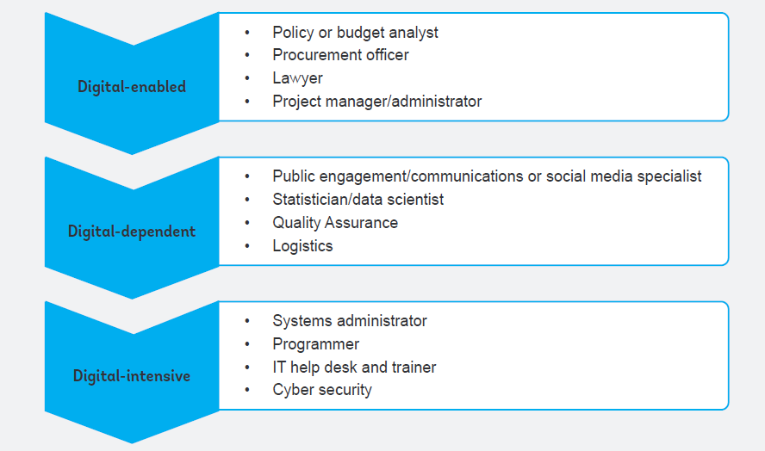
Technology is shaping the nature of jobs

Slide 6
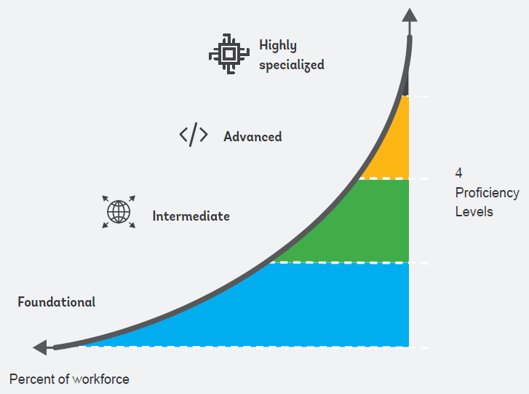
Not all staff need specialized digital skills

Slide 7
Extent of the digital skills problem
66% of IT decision-makers reported skills gap ( from 76% in 2020)
Why? Recruitment & retention
Difficult to hire skilled candidates (44%)
Hard to retain skilled staff (33%)
Difficult to attract skilled candidates (34%)
Multiple strategies to address the gap but with a focus on training
Training existing staff (55%)
Hiring new staff with skills needed (18%)
Hiring third-party staff (14%)
2022 Global Knowledge IT Skills and Salary Report
Notes:
In 2022, 66 percent of global IT decision-makers reported skill gaps and 45 percent of IT leaders reported talent attraction and retention as their biggest challenge.
2020 Global Knowledge IT Skills and Salary Report, accessed August 9, 2021. https://go.globalknowledge.com/2020salaryreport.
IT decision-makers are most concerned about talent recruitment and retention.
REASONS BEHIND SKILLS GAPS
We struggle to hire candidates with the skills we need 44%
We struggle to retain employees 33%
It’s difficult to attract candidates with the skills we need to our organization's industry 32%
More than 55% plan to train existing employees to close skills gaps. Eighteen percent will hire new staff with the skills they need, and 14% will hire third-party support.

Slide 8
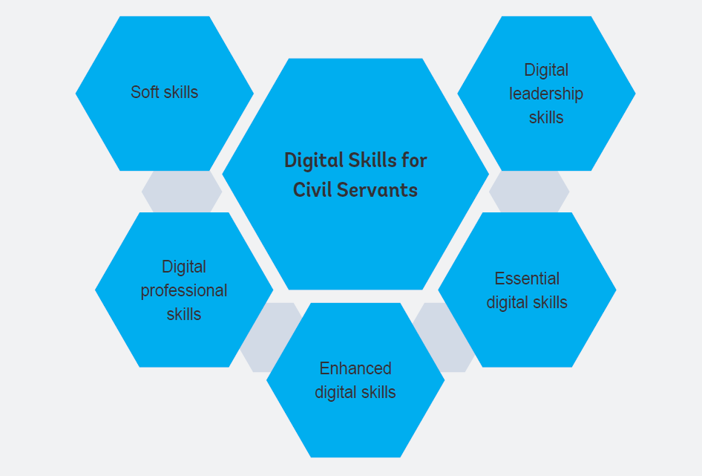
Digital Skills for Civil Servants

Slide 9
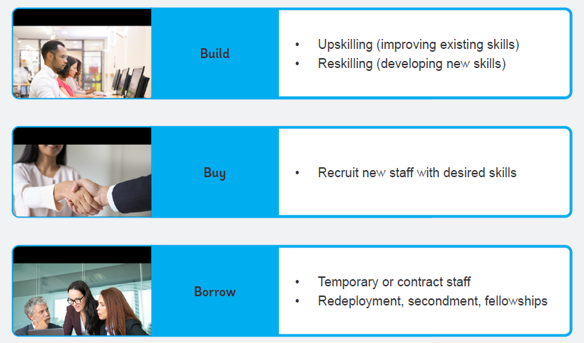
Approaches to closing digital skills gaps

Slide 10
Emerging lessons for building digital skills in GovTech
Elevate the Importance of and Investment in Digital Skills
Modernize HRM Policies and Practices
Incentivize Quality and Sustainable Learning, Training and Development
Support Continued Research and Data on the Digital Labor Market and Skills for Public Administration

Slide 11
Leadership and organizational culture

Slide 12
The Theory
Leadership
Goal setting
Goal alignment
Performance feedback
Training and development
Gov Tech adoption
Organizational Culture
Motivation and effort
Teamwork and collaboration
Trust
Openness

Slide 13
Evidence from the literature
OECD PIACC Surveys
“High performing work practices” most important correlate in the use of digital technologies at work
Studies of private sector firms
Complementarities between the use of management information systems, performance pay, and human resource data analytics

Slide 14
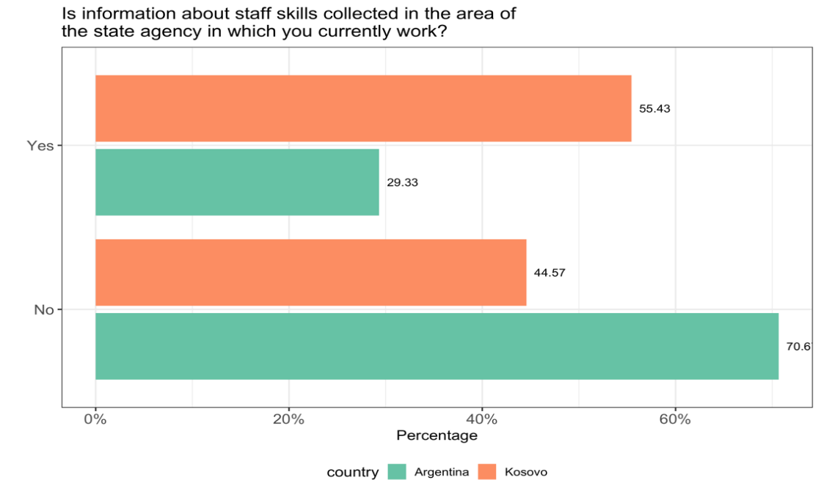
Evidence from WB surveys on a simple measure of leadership quality

Slide 15
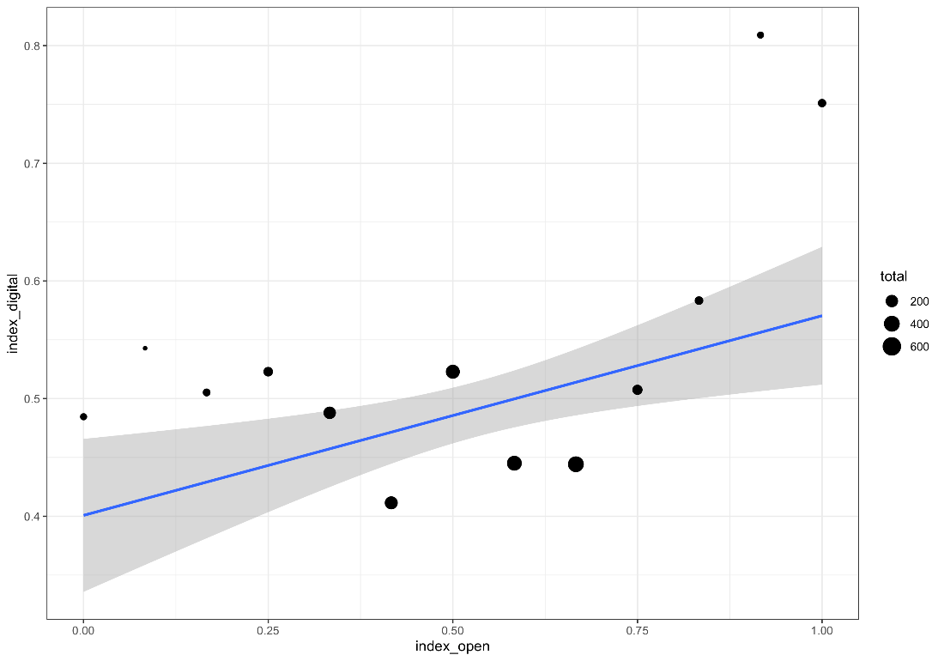
Correlation between organizational culture conducive to innovation and GovTech adoption

Slide 16
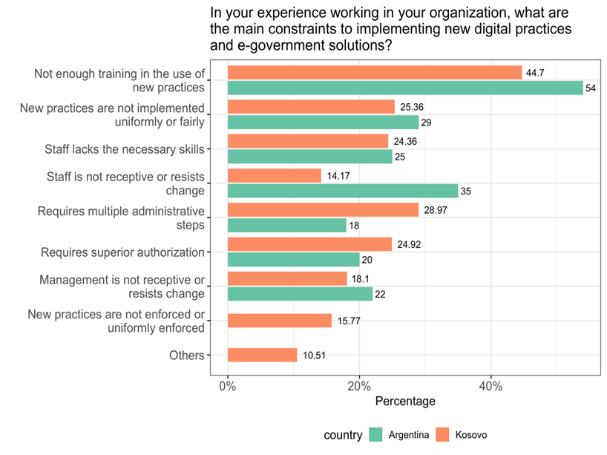
Staff views of main constraints to implementing GovTech

Slide 17
Actions to improve leadership & encourage an innovation culture
Leadership
Management training
Incentives
Culture
Greater citizen-orientation
Improving engagement
Innovation awards
Fostering communities of practice

Slide 18
Thank You.

