Slide 1
3rd Meeting of the ICP
Governing Board
October 25, 2018
Dubai, UAE

Slide 2
Welcome Address
UAE Federal Competitiveness
And Statistics Authority

Slide 3
Opening Remarks and Adoption of the Agenda
Meeting Chair

Slide 4
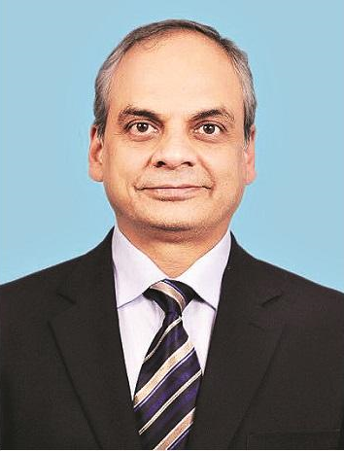
Introducing the Governing Board Co-Chair
Mr. Pravin Srivastava
Chief Statistician of India
Secretary of the Ministry of Statistics and Programme Implementation, Government of India

Slide 5
Meeting Agenda
Welcome address
Opening remarks and adoption of the agenda
Overall progress in the implementation of ICP 2017 cycle
Regional progress reports
Outstanding risks and mitigation measures
Beyond the ICP 2017 cycle: Preparations for the ICP 2020 cycle
Date and venue of the next meeting and any other business
Closing remarks

Slide 6
Overall Progress in the Implementation of ICP 2017 Cycle
Global ICP Unit, World Bank

Slide 7
Progress Summary (1)
Country Participation
175 countries participating
Argentina, Iran, Georgia, Ukraine and 22 Caribbean islands
Data Submission
Household consumption data from 165/175 countries
Gross capital formation data from 130/175 countries
Quality
Regional data validation underway in all regions
Global data validation launched in September 2018
Quality of input price data promising

Slide 8
Progress Summary (2)
Governance
GB/TAG/IACG convening per work plan
GB Co-Chairs letter to all countries in May 2018 to support the ICP 2017 cycle
Permanent Global ICP Unit at the WB
Capacity Building
Increase in capacity-building workshops and technical assistance in all regions
Global ICP Unit providing specialized technical support, where needed
Research Agenda
4 Task Forces/Teams working on 6/13 research agenda items
TAG examined 3 technical proposals and recommended additional work

Slide 9
Progress Summary (3)
Knowledge
eLearning course released – good uptake
ICP Blog series launched
Outreach
Increased visibility – 50th anniversary events
Newsletter – wider distribution
Comprehensive website
Uses
WB Dynamic Quota Formula
Indicators for 5/17 SDG goals
Use in competitiveness, climate, energy, productivity, etc.

Slide 10
Progress Summary (4)
Openness
Streamlined data sharing among IACG
IACG criteria for extending the ICP publication level beyond ICP 2011, where appropriate
2020 Cycle Preparations
IACG tentative plan for the 2020 cycle
Funding
New contribution from AFESD
Contribution from the WB capital budget
Initial discussions with the IADB

Slide 11
ICP 2017 Cycle Outputs
Revised 2011 Results
Interpolate between 2011 and 2017 results
2017 Results
Incorporate interim regional results
Global PPP Time Series for 2011-2017

Slide 12
Participating Countries
Region | Interim [Years] | 2017 Cycle
Africa | 47 [2015-16] ¹ | 50
Asia | 20 [2016] | 22
CIS | 8 [2014] | 8
LAC | - | 35 ⁴
Western Asia | 12 [2012-16] | 12
Eurostat-OECD | 47 [Annual] | 49 ⁵
Special participation ² | - | 3
Dual participation ³ | (4) | (4)
Total | 130 | 175
¹ Household consumption only
² Iran [linked through Western Asia], and Georgia and Ukraine [linked through Eurostat]
³ Includes Egypt, Morocco, Russia and Sudan
⁴ Does not include Guatemala and Sint Maarten, whose participation status is still unclear
⁵ Includes Costa Rica and Colombia in the OECD comparison

Slide 13
ICP 2017 Timetable (1)
Activity | 2017 |  |  |  | 2018 |  |  |  | 2019
 | Q1 | Q2 | Q3 | Q4 | Q1 | Q2 | Q3 | Q4 | Q1 | Q2 | Q3 | Q4
Governance Meetings and Reports
GB meetings |  |  | Sep |  |  |  |  | Oct | Mar |  |  | Oct
IACG meetings | Mar |  |  | Oct | Mar |  | Sep |  |  | Apr | Sep
TAG meetings |  | May |  |  |  | May |  |  |  | May |  | Oct
TF01-03 meetings |  |  |  | Oct | Mar |  | Sep |  |  | May |  | Oct
TF04-05 meetings |  |  |  |  |  |  |  |  |  | Jun
TT DQ meetings |  |  |  |  |  | Jun | Sep |  | Feb |  | Sep
Reports to UNSC |  |  |  | Nov |  |  |  | Nov |  |  |  | Nov
Acronyms: Governing Board (GB), Inter-Agency Coordination Group (IACG), Technical Advisory Group (TAG), Task Force (TF), Task Team on Data Quality (TT DQ), United Nations Statistical Commission (UNSC)

Slide 14
ICP 2017 Timetable (2)
Regions | 2016 |  |  |  | 2017 |  |  |  | 2018
 | Q1 | Q2 | Q3 | Q4 | Q1 | Q2 | Q3 | Q4 | Q1 | Q2 | Q3 | Q4
Price surveys
Western Asia | H | H | H | H |  | H+R +G | C | H+R +M |  | R
Eurostat-OECD |  | H |  | H |  | H+R | M+C | H+G |  | H+R |  | H
Asia |  |  |  |  |  | H | H | H+M | H+M+C | H+R+M+C | H+R+G | G
CIS |  |  |  |  |  | H | H+M +C | H+M +C |  |  |  | R+G
Africa |  |  |  |  |  |  | H | H | H | H | H+R+M+C | H+R+G+M+C
LAC |  |  |  |  |  |  | H | H | H | H | H+R+G+M+C | H+R+G+M+C
Acronyms: Household consumption (H), Housing (R), Government (G), Machinery and Equipment (M), Construction (C)

Slide 15
ICP 2017 Timetable (3)
Activity | 2017 |  |  |  | 2018 |  |  |  | 2019
 | Q1 | Q2 | Q3 | Q4 | Q1 | Q2 | Q3 | Q4 | Q1 | Q2 | Q3 | Q4
National account expenditures
GDP Expenditures
Data submission and validation
Data & Metadata to GIU |  |  |  |  |  |  | Jul |  | Jan |  | Jul
Global validation
Results and publication
Regional 2017 results |  |  |  |  |  |  |  |  |  |  |  | FR+P
Global 2017 results |  |  |  |  |  |  |  |  |  |  |  | FR+P
PPP time series (2011-2017) |  |  |  |  |  |  |  |  |  |  |  | FR+P
Acronyms: Global ICP Unit (GIU), Final Results (FR), Publication (P)

Slide 16
ICP 2017 Data Submission Status
Region | Years | HHC | HOU ¹ | GOV | GFCF | EXP | POP/ XR
AFR [50] | 2017-18 | 40 ² | 10 | − | 48 (M) 50 (C) | − | −
ASI [22] | 2017-18 | 22 | − | − | 22 | − | 22/22
CIS [8] | 2017 | 8 | − | − | − | − | 8/8
LAC [35] ³ | 2017-18 | 35 | − | − | − | − | 35/35
WAS [12] | 2017 | 12 | 11 | 11 | 12 | − | 10/10
EUO [49] | 2017 | 47 ⁴ | − | − | 49 (M) | − | 49/49
SP [3] ⁵ | 2017 | 1 | 1 | 1 | 1 | − | −
¹ Housing rentals, not covering housing volume
² Does not include Angola, Burkina Faso, Cape Verde, Equatorial Guinea, Gabon, Ghana, Guinea, Liberia, Madagascar and Nigeria
³ Does not include Guatemala and Sint Maarten
⁴ Does not include Colombia and Costa Rica (OECD)
⁵ Special Participation: Iran, Georgia and Ukraine

Slide 17
Capacity-Building Activities
ICP Region | Regional/ Sub-Regional Workshops | Country Workshops/ TA Missions | Forthcoming Activities
Africa | 4 | 6 | Q1/Q2 2019 – RW
Asia | 5 | 1 | Dec 2018 – RW
CIS | 2 | 1 | Dec 2018 – RW Apr 2019 – RW
LAC | 2 | 2 | Dec 2018 – RW
Western Asia | 5 | 2 | Q4 2018 – RW Q4 2018 – SRW Q4 2018 – Libya
Eurostat-OECD | 4
SP* |  | 7 | May 2019 – Iran
* Special Participation: Iran, Georgia and Ukraine

Slide 18
Governance Activities
Meetings Conducted (2018)
Upcoming Meetings (2019)
IACG Principles Meeting, NY, Mar 2018
5th IACG & 2nd Task Forces Meetings, DC, Mar 2018
Prep Meeting for the Poverty and PPPs Task Force, DC, May 2018
2nd TAG Meeting, DC, May 2018
1st Task Team on Data Quality Meeting, DC, Jun 2018
6th IACG, 3rd Task Forces, & 2nd Task Team Meetings, DC, Sept 2018
3rd GB Meeting, Dubai, Oct 2018
3rd Task Team Meeting, DC, Feb 2019
4th GB Meeting & ICP Session at the 50th UNSC, NY, Mar 2019
7th IACG Meeting, DC, Apr 2019
3rd TAG & 4th Task Forces Meetings, Paris, May 2019
8th IACG & 4th Task Team Meetings, DC, Sept 2019
4th TAG & 5th Task Forces Meetings, DC, Oct 2019
5th GB Meeting, DC, Oct 2019

Slide 19
Progress Reports
Governance Reporting
Donor Reporting
Report to the 50th UNSC session - for discussion
Deadline: Nov 2018
Report to Donors
Deadline: Mar 2019

Slide 20
Research Agenda Activities (1)
TF_01 PPP Compilation and Computation (Ongoing)
Linking interim regional updates into a global comparison | Proposal to incorporate interim regional results into global PPP time series underway
Building PPP time series for the interim period | Proposal to interpolate between 2011 and 2017 underway
Fine tuning global linking procedures
Productivity adjustment for government and construction labor | Proposal to improve data sources underway
TF_02 Housing (Ongoing)
PPPs and real expenditures for dwelling services | Proposal to improve data sources underway

Slide 21
Research Agenda Activities (2)
TF_03 Country Operational Guidelines and Procedures (Ongoing)
Moving towards rolling price surveys | Guidelines underway
CPI-ICP synergies to improve spatial and temporal price consistency | Guidelines underway
Sub-national PPPs | Guidelines underway
TF_04 PPP Uses (upcoming)
Uses of PPPs and ICP data for policy making | Background research conducted
TF_05 PPPs and Poverty (upcoming)
ICP PPPs and global poverty measurement | Prep meeting with the WB’s global poverty measurement team

Slide 22
Research Agenda Activities (3)
TF_06 PPP Quality and Reliability
Quality of data and results | Task Team on Data Quality; TAG to review quality of results
Reliability measures for PPPs
TF_07 New Data Sources
Exploring innovations in technology and data sources | Background research conducted
TF_08 Exports and Imports
PPPs for exports and imports
TF_09 Non-Market Services
PPPs for health and education
TF_10 Construction
PPPs for construction

Slide 23
Publication Objective
Objective
increase the ICP value proposition
Data derived from the ICP should be utilized to the maximum extent possible for statistical, research, and analytical purposes
Extend publication level beyond what was published through ICP 2005 and 2011
ICP 2005 and ICP 2011: 24/26 headings covering main aggregates and categories, and additional aggregates (e.g. actual individual consumption, domestic absorption)
Eurostat, OECD and CIS currently publish their results at a finer level of detail, covering 61, 50 and 50 headings, respectively
ICP should follow suit and extend the publication of its results to more detailed levels, where appropriate

Slide 24
Publication Criteria
The proposed criteria for extending the publication of ICP results comprises three data quality and reliability elements
#01
Assessment of the quality and reliability of the expenditure data for the aggregates to publish
#02
Assessment of the quality and reliability of the PPPs for the aggregates to publish
#03
Assessment of potential differences in approaches/ classifications across regions that could impact the aggregates to publish

Slide 25
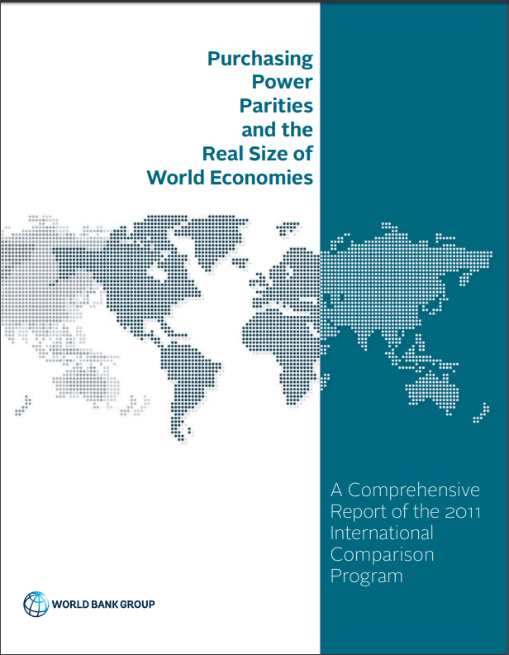
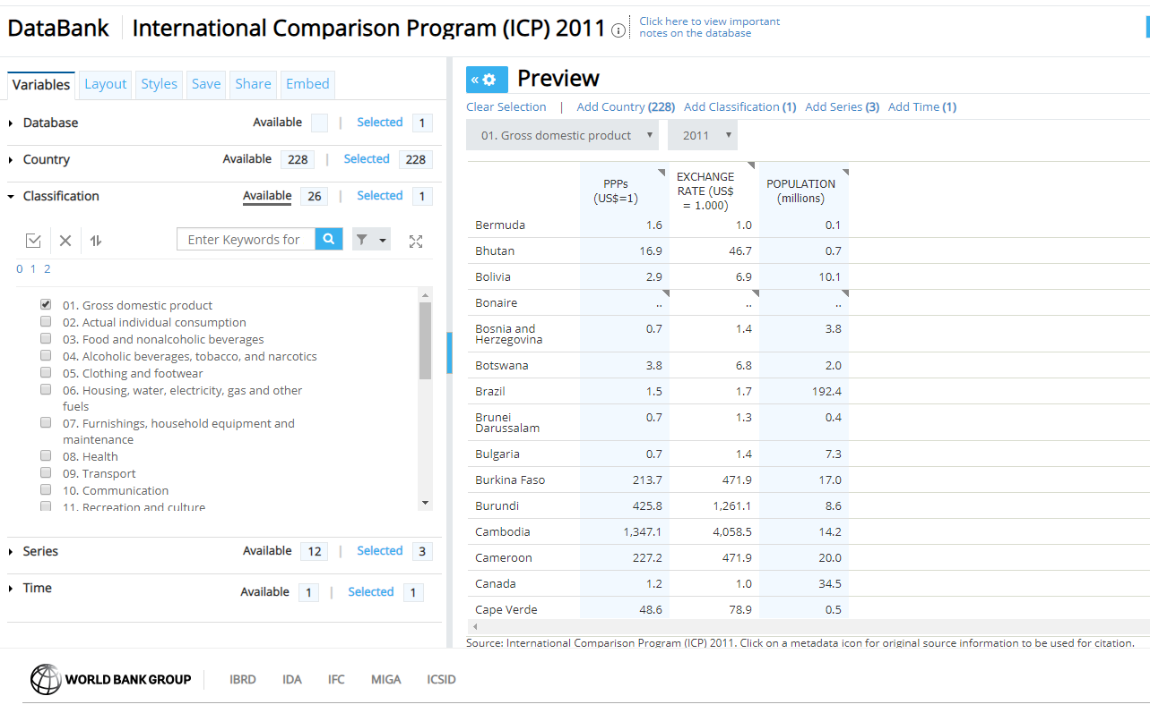
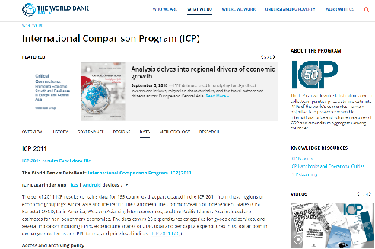
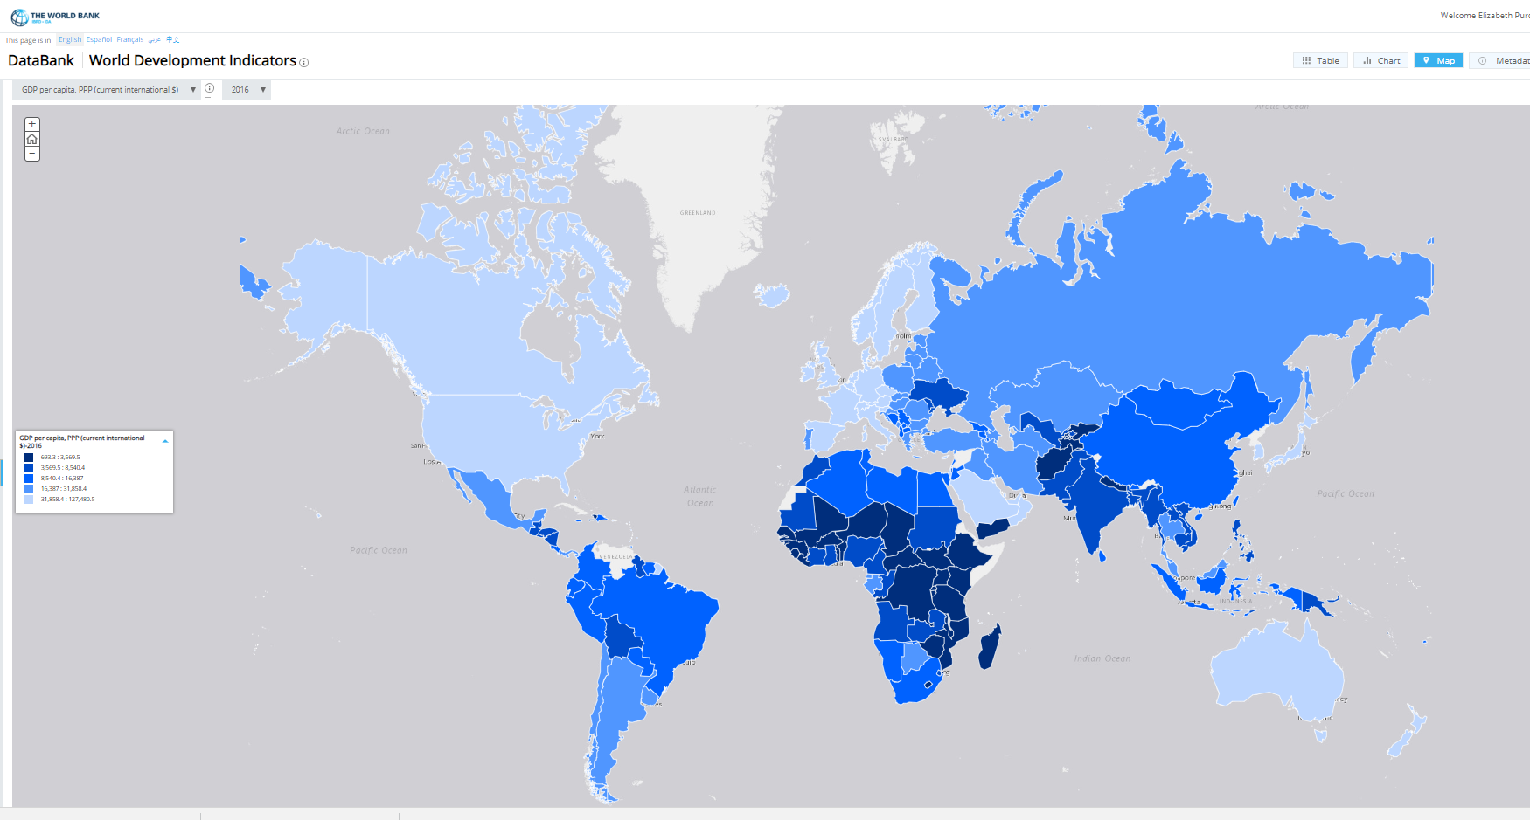
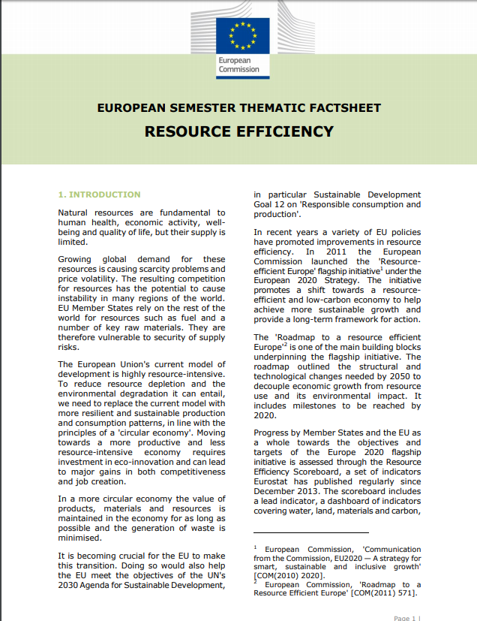
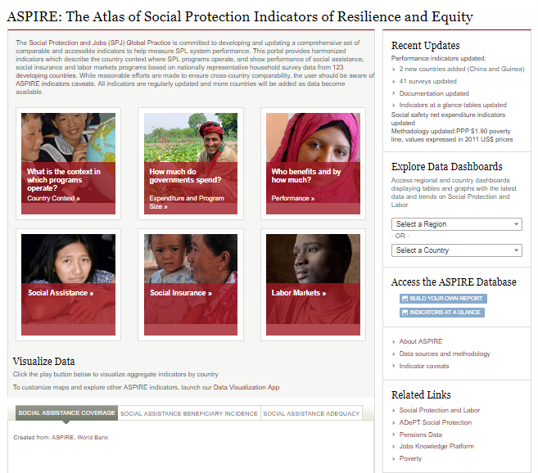
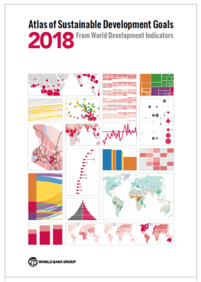
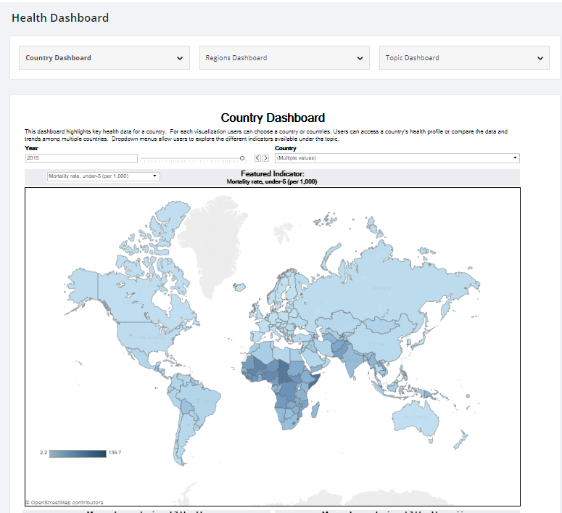
Dissemination Plans
World Bank DataBank
2011 PPP results available through…
ICP Reports
World Development Indicators
ICP website
Capitalize on new dissemination tools…
Country and topic-specific profiles
Dashboards and portals
Visual analyses

Slide 26
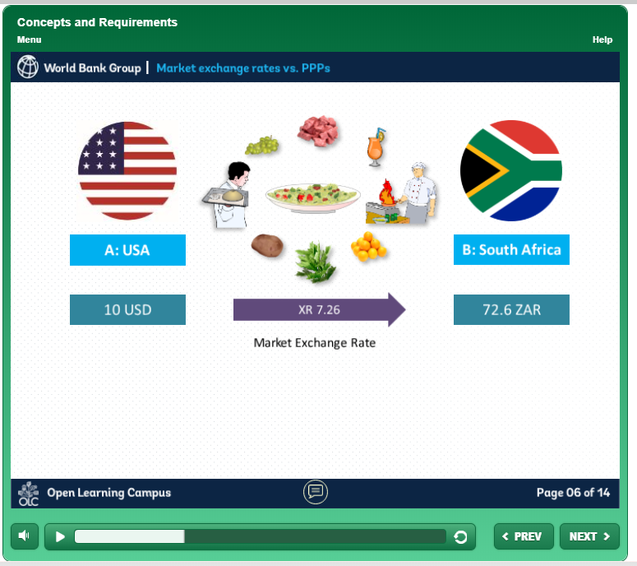
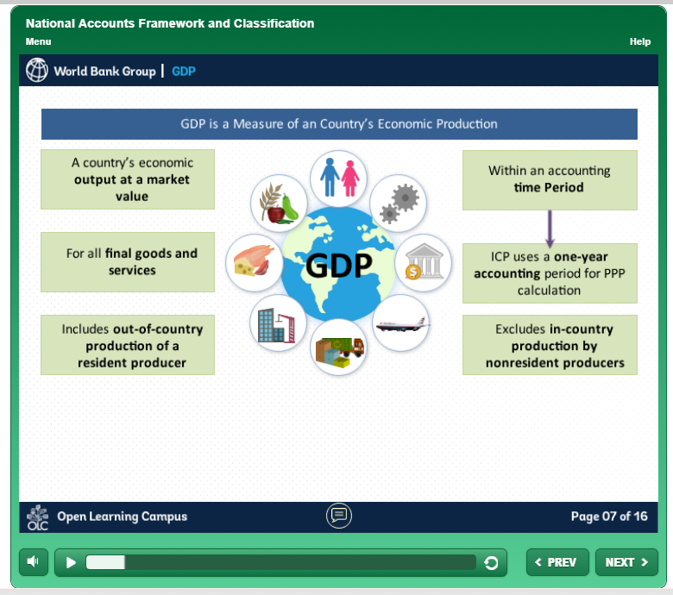
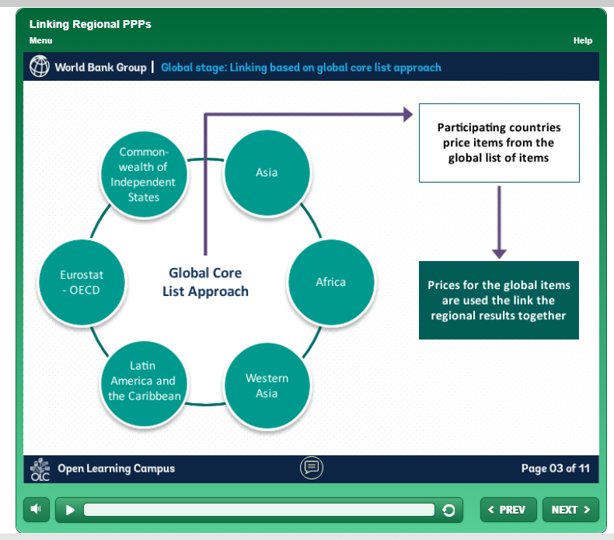
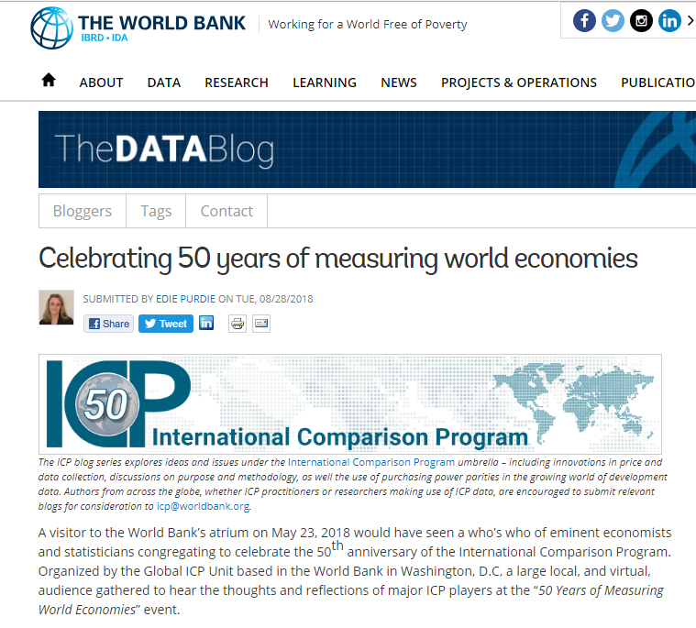
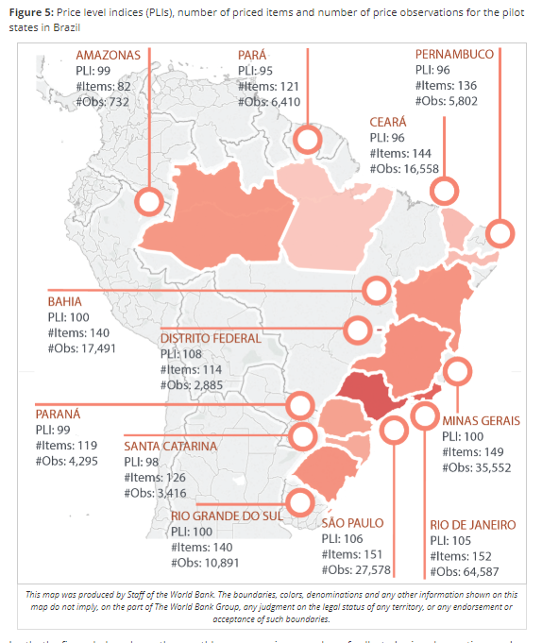
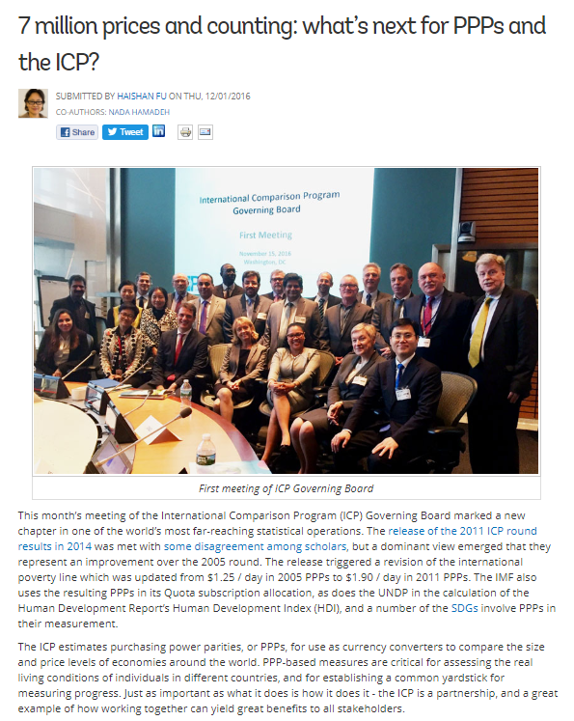
Knowledge Activities
PPP eLearning
Launched in March 2018
Around 300 trainees enrolled online
Used as well in regional and national workshops
ICP Blog series
ICP branded, within World Bank Data Blog series
Wide audience through social media
Invites authors: research, methodology, uses etc.

Slide 27
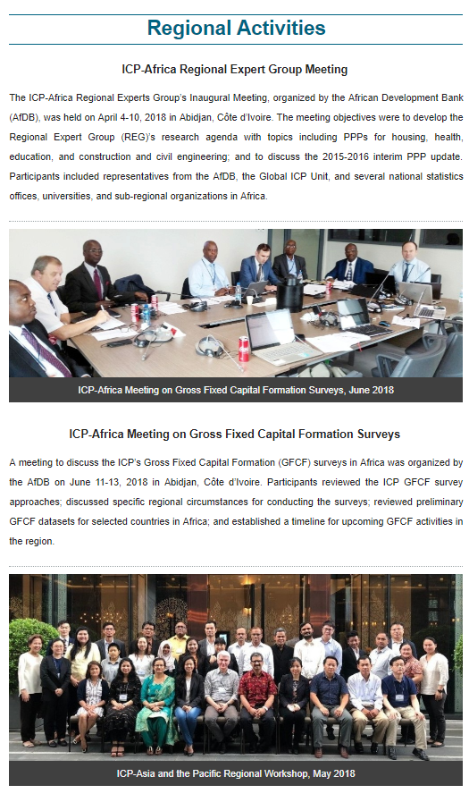
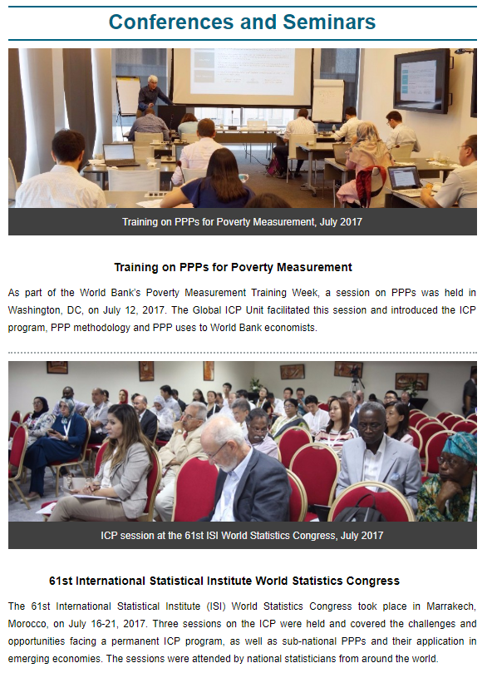
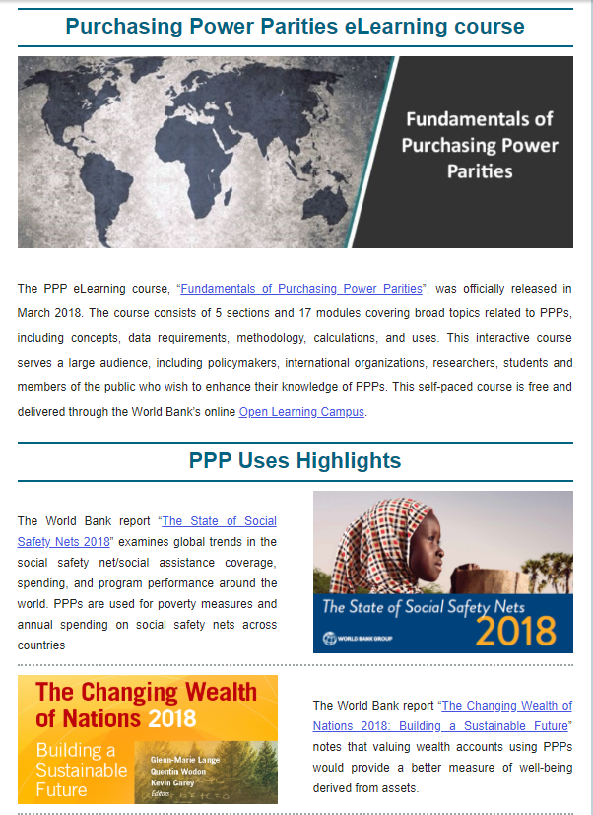
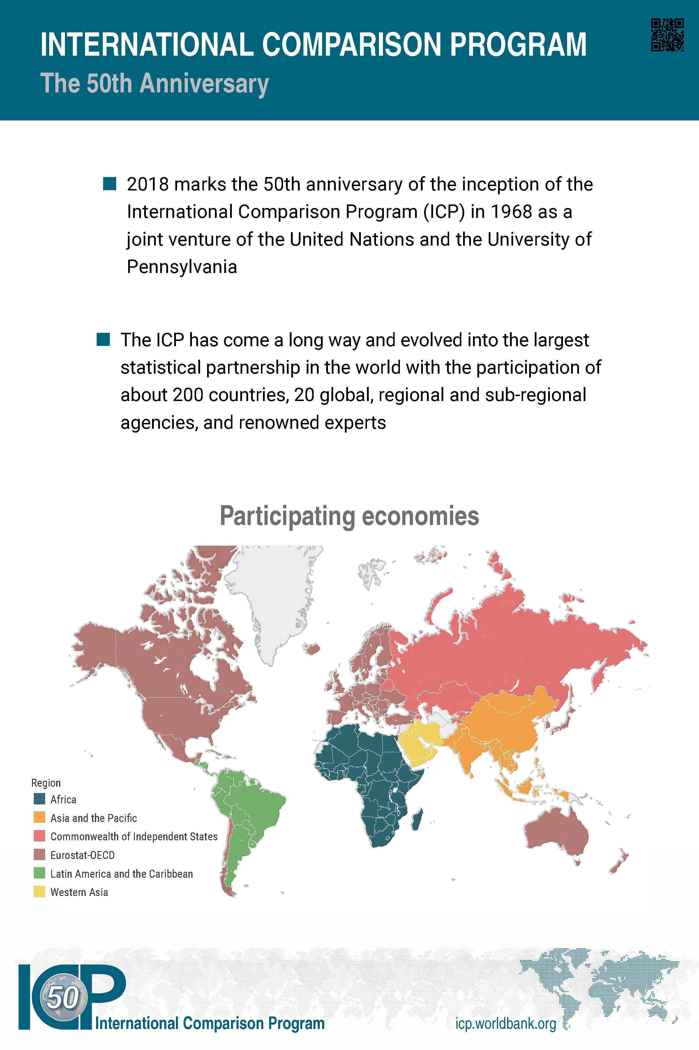
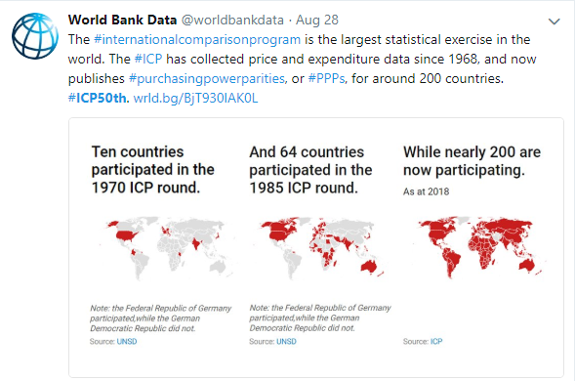
Outreach Activities
ICP Highlights
Quarterly newsletter
1,500 recipients worldwide
National, regional and global activities
PPP uses
50th Anniversary
Events at the United Nations and the World Bank
Posters, video and blogs
Wide audience on social media - #ICP50th

Slide 28
International Conferences
ICP at the World Bank Booth at the UN World Data Forum, Dubai, Oct 2018
Conference “Fifty Years of International Comparison Program: Achievements and Moving Forward”, Beijing, Oct 2018
Intra-country comparisons of poverty and living conditions: Measuring well-being at local level for public policy with focus on China, Beijing, Dec 2018
International Comparisons Conference, Groningen, May 2019
Session on PPP/CPI Synergies at the Ottawa Group meeting, Rio de Janeiro, May 2019
Session on PPP-based comparisons at the IARIW special conference, Moscow, Sept 2019

Slide 29
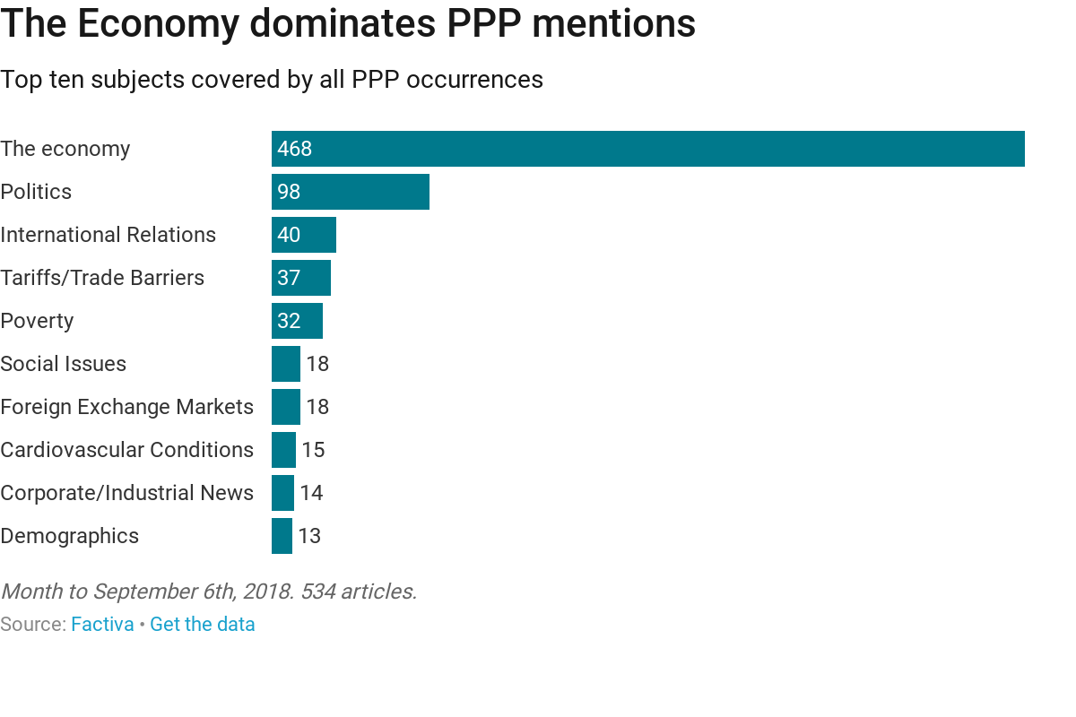
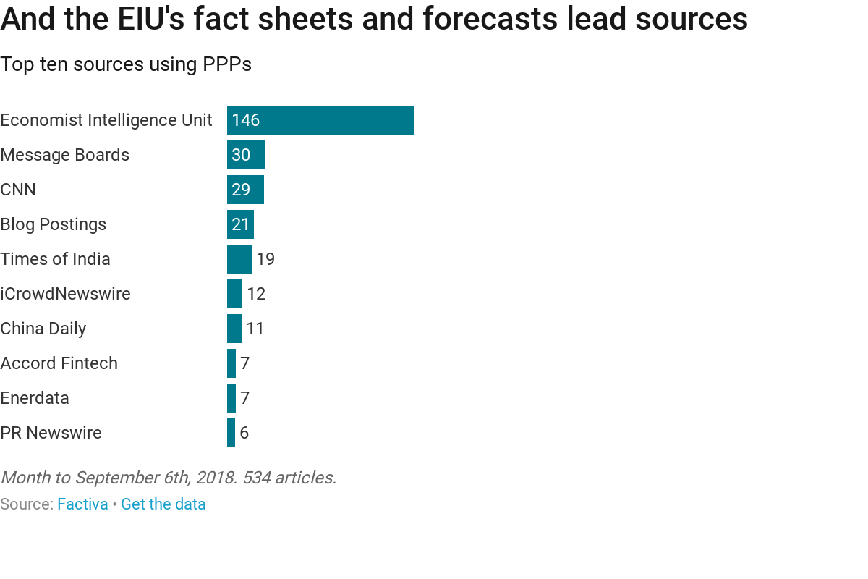
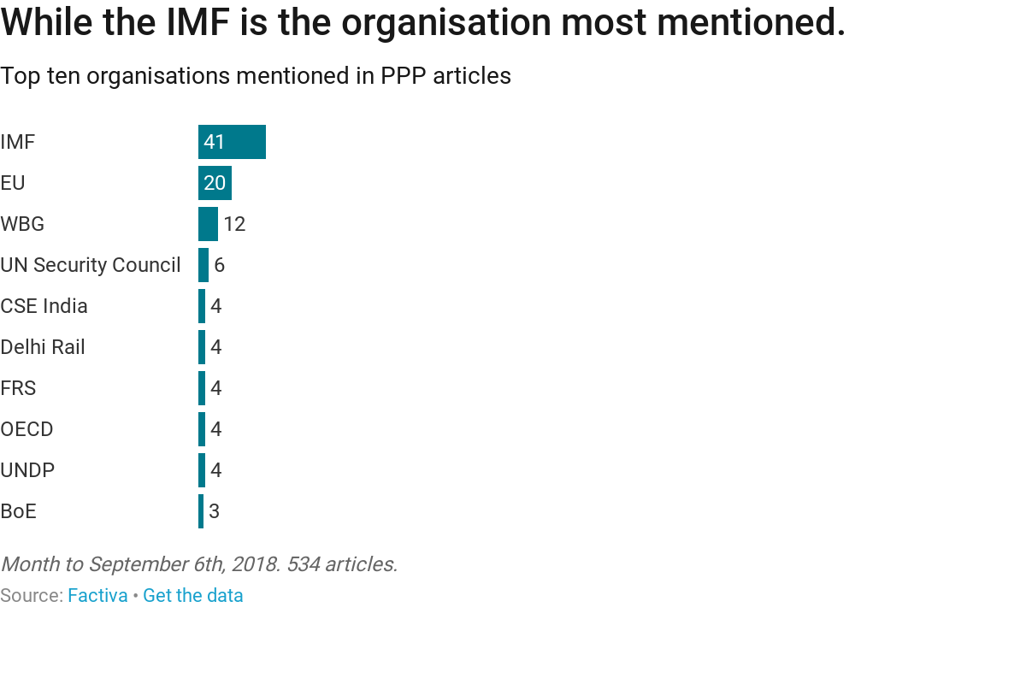
A month of PPPs - 500+ articles via Factiva
70 major media news outlets ran 115 PPP articles
India, China and the USA dominate coverage ..but 80 other countries are featured

Slide 30
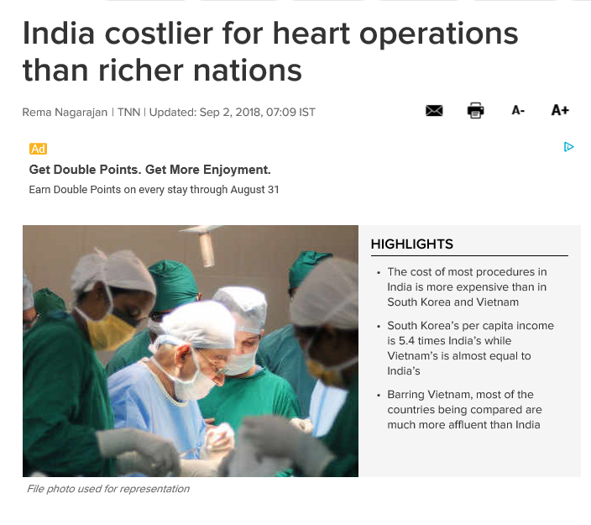
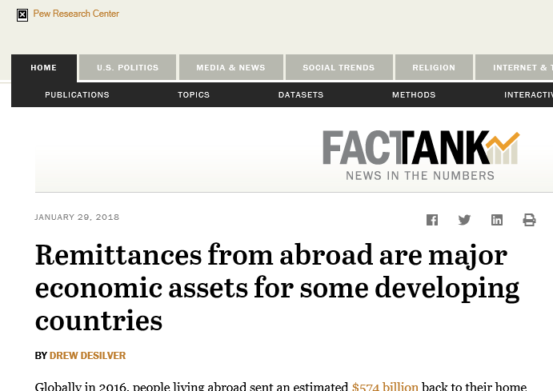
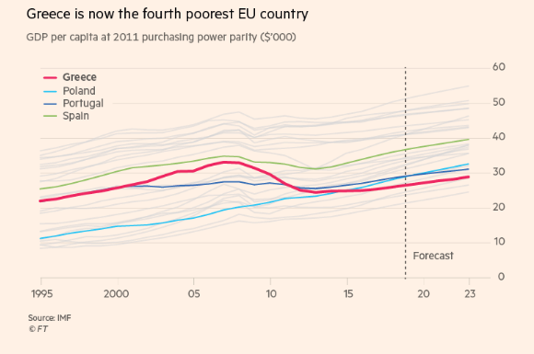
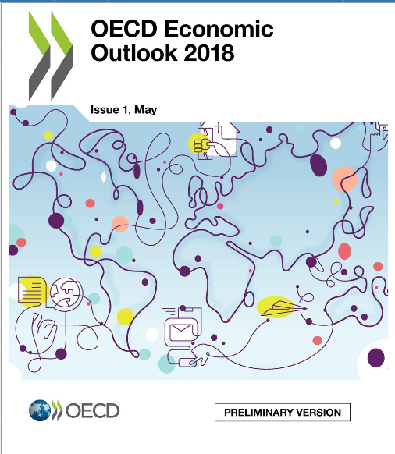
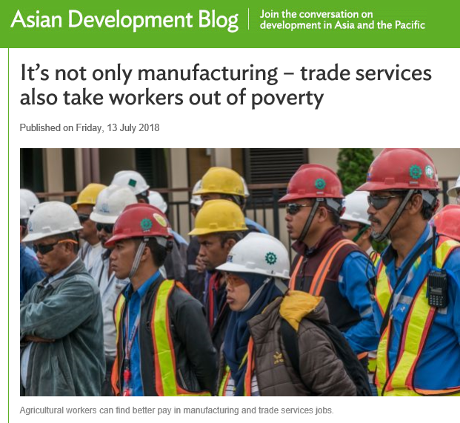
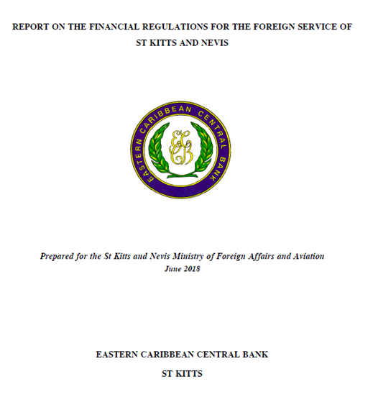
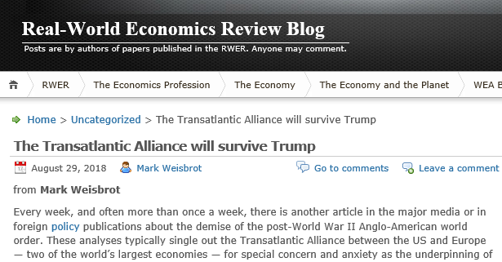
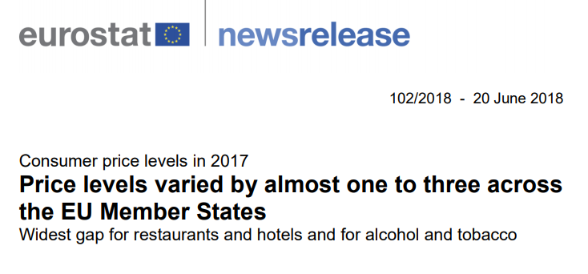
PPPs feature in…
….research papers
…media articles
….development reports
…. analyses
….blogs

Slide 31
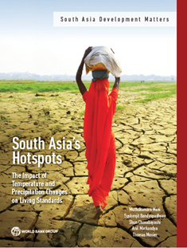
PPPs inform development by…
..calculating poverty rates and spending on social safety nets
….valuing unpaid care work as a share of GDP (PPP)
…estimating the impact on GDP per capita (PPP) of dire climate scenarios
…measuring productivity by comparing GDP per capita (PPP) with nighttime lights data
…analyzing FDI inflows, migration and travel patterns into ECA.
..comparing growth rates of electrical and electronic equipment

Slide 32
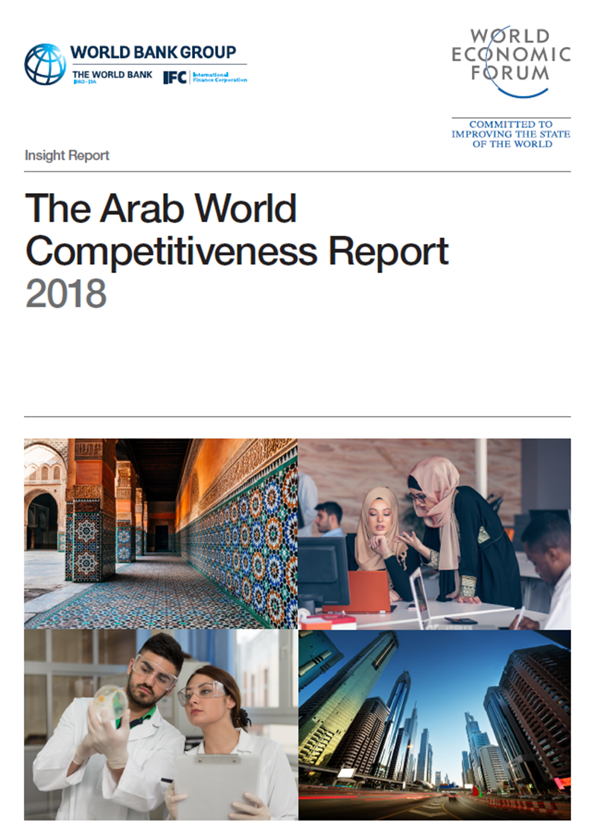
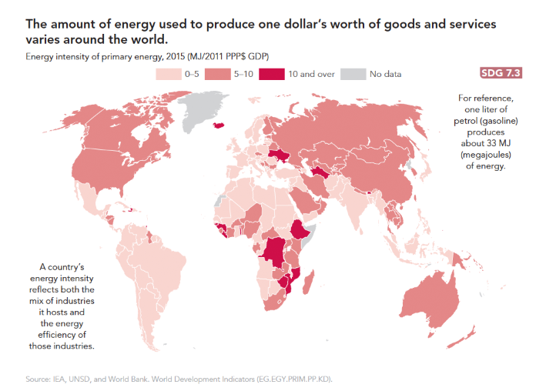
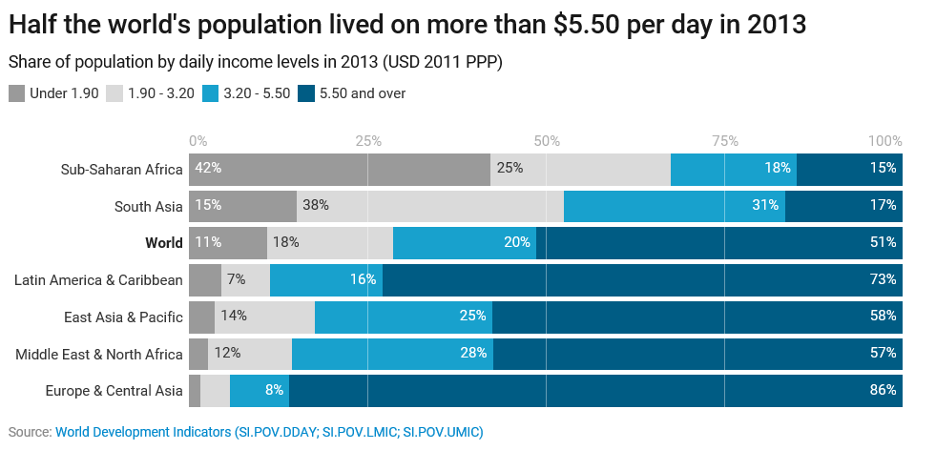
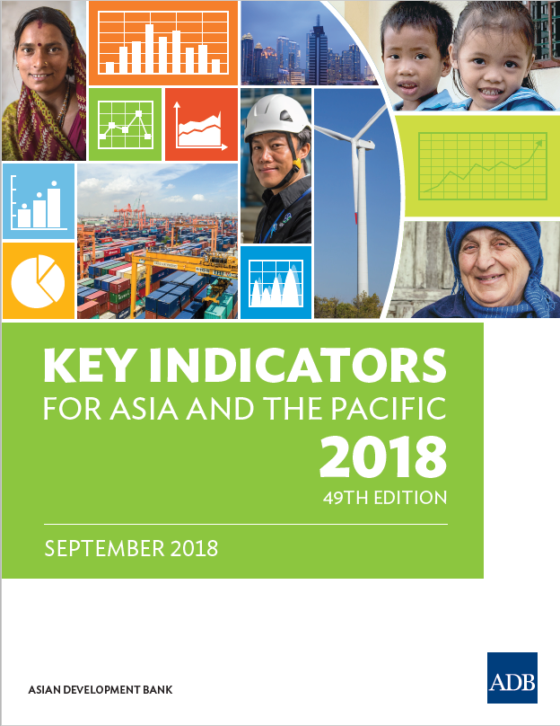
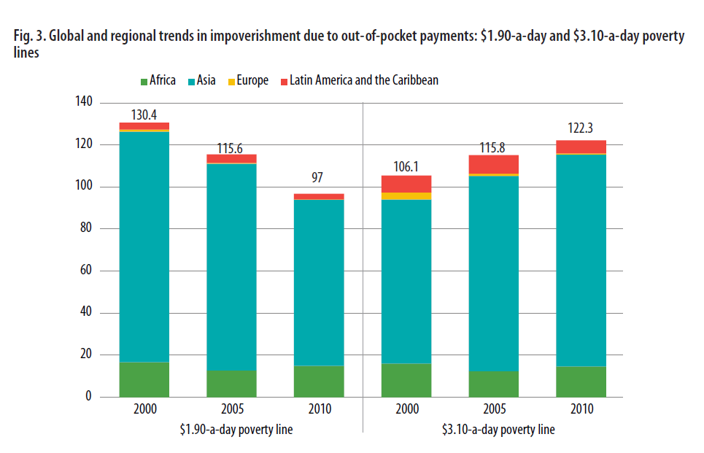
..and are crucial to data analyses
43 indicators in WDI rely on PPPs
SDG target 7.3 measures energy intensity with PPPs
The Global Competitiveness Index uses PPPs in its 10th pillar measure – market size
AfDB uses PPPs to establish poverty headcounts
WHO and WBG assess health cost impacts using PPPs
ADB’s “Key Indicators” uses PPPs in SDGs 1, 7 and 9

Slide 33
Regional Progress Reports
Regional Implementing Agencies

Slide 34
Regional Progress Reports
Africa [African Development Bank]
Asia [Asian Development Bank]
Eurostat–OECD PPP program [Eurostat and OECD]
Commonwealth of Independent States [CIS-STAT]
Latin America and the Caribbean [UN-ECLAC]
Western Asia [UN-ESCWA]

Slide 35
Outstanding Risks and Mitigation Measures
ICP Global Unit, World Bank

Slide 36
Outstanding Risks (1)
Timeliness Risks
Participation Risks
Delay in initiating ICP 2017 survey activities and data submission for selected regions/countries
Outstanding ICP 2017 activities – non-household surveys, backcasting and annualizing, regional and global validation, and results calculation and assessment – require time
What can be published by end of 2019?
Uncertainty regarding 10 outstanding countries that are yet to submit data
Difficulties in securing the full participation of some fragile states; however, they participate in capacity-building activities where possible

Slide 37
Outstanding Risks (2)
Quality and Comparability Risks
Openness Risks
Regional data quality still needs improvement; more validation workshops and technical assistance needed
Delay in initiating global data validation; however, quality of initial data is promising
Comparability over time is crucial; impact of countries migrating from LAC to OECD
Need to demonstrate more openness and transparency than ICP 2011, while respecting country confidentiality laws

Slide 38
Outstanding Risks (3)
Sustainable Funding Risks
Sustainable Institutional Risks
Sustainable funding for the permanent ICP hinges upon countries and multilateral agencies incorporating ICP into their regular work programs/budgets
Need permanent teams at country and regional level
Strenuous processes in many agencies for channeling funding and organizing activities

Slide 39
Governing Board Asks
Political Support
Continue to advocate with countries and multilateral agencies to:
Funding Support
Advocate with regional development banks/donors to support the ICP in your region
Openness Support
Advocate for more openness and transperancy
incorporate ICP into their regular work programs/budgets
meet the ICP 2017 cycle deadlines and gear up for the 2020 cycle

Slide 40
Beyond the ICP 2017 cycle
Global ICP Unit, World Bank

Slide 41
ICP 2020 Preparations
Technical Preparations
The IACG discussed the plan for the ICP 2020 cycle
Institutional Preparations
Funding Preparations
ICP 2020 cycle budget underway
The ICP Global Core List will be updated in early 2019; regional item lists will be subsequently updated
National, regional and global agencies to include the ICP in their work programs for 2019-2022
Need to multiply our collective fund-raising efforts in 2019

Slide 42
ICP 2020 Plan (1)
AFRICA* | ICP 2020 CYCLE
 | 2019 | 2020 | 2021 | 2022
Household Consumption (H) |  | H |  | PUBLICATION OF 2020 RESULTS
Housing Rentals (R) and Volume (V) |  | R | V (2020)
Government Compensation (G) |  |  | G (2020)
Construction (C) and Machinery (M) |  | C & M
National Account Expenditures (E) | E | E | E
CPIs, Deflators, Population and XRs | X | X | X
* Africa is planning to produce results every 3 years

Slide 43
ICP 2020 Plan (2)
ASIA* | ICP 2020 CYCLE
 | 2019 | 2020 | 2021 | 2022
Household Consumption (H) |  | H |  | PUBLICATION OF 2020 RESULTS
Housing Rentals (R) and Volume (V) |  | R | V (2020)
Government Compensation (G) |  |  | G (2020)
Construction (C) and Machinery (M) |  | C & M
National Account Expenditures (E) | E | E | E
CPIs, Deflators, Population and XRs | X | X | X
* Asia is planning to produce results every 3 years

Slide 44
ICP 2020 Plan (3)
COMMONWEALTH OF INDEPENDENT STATES* | ICP 2020 CYCLE
 | 2019 | 2020 | 2021 | 2022
Household Consumption (H) |  | H |  | PUBLICATION OF 2020 RESULTS
Housing Rentals (R) and Volume (V) |  | R | V (2020)
Government Compensation (G) |  |  | G (2020)
Construction (C) and Machinery (M) |  | C & M
National Account Expenditures (E) | E | E | E
CPIs, Deflators, Population and XRs | X | X | X
* The Commonwealth of Independent States is planning to produce results every 3 years

Slide 45
ICP 2020 Plan (4)
LATIN AMERICA AND THE CARRIBEAN* | ICP 2020 CYCLE
 | 2019 | 2020 | 2021 | 2022
Household Consumption (H) | H (1/3) | H (1/3) | H (1/3) | PUBLICATION OF 2020 RESULTS
Housing Rentals (R) and Volume (V) |  | R | V (2020)
Government Compensation (G) |  |  | G (2020)
Construction (C) and Machinery (M) |  | C & M
National Account Expenditures (E) | E | E | E
CPIs, Deflators, Population and XRs | X | X | X
* Latin America and the Caribbean is planning to produce results every 3 years

Slide 46
ICP 2020 Plan (5)
WESTERN ASIA* | ICP 2020 CYCLE
 | 2019 | 2020 | 2021 | 2022
Household Consumption (H) |  | H |  | PUBLICATION OF 2020 RESULTS
Housing Rentals (R) and Volume (V) | R | R | R & V (2020)
Government Compensation (G) | G | G | G
Construction (C) and Machinery (M) | C & M | C & M | C & M
National Account Expenditures (E) | E | E | E
CPIs, Deflators, Population and XRs | X | X | X
* Western Asia is planning to produce annual results

Slide 47
ICP 2020 Plan (6)
EUROSTAT-OECD* | ICP 2020 CYCLE
 | 2019 | 2020 | 2021 | 2022
Household Consumption (H) | H (1/3) | H (1/3) | H (1/3) | PUBLICATION OF 2020 RESULTS
Housing Rentals (R) and Volume (V) | R & V | R & V | R & V
Government Compensation (G) | G | G | G
Construction (C) and Machinery (M) | C & M | C & M | C & M
National Account Expenditures (E) | E | E | E
CPIs, Deflators, Population and XRs | X | X | X
* Eurostat and OECD are producing annual results

Slide 48
Looking Ahead
Embracing the benefits of the digital revolution
Capitalizing on the potential of data integration
Incorporate disruptive technology
Make use of new data sources
Form new partnerships
Develop new methods
Survey data
Admin/Census data
Scanner data
Web scaping
Private sector (E-commerce, sharing economy)
Building national capacity and infrastructure

Slide 49
Innovations – In Practice (1)
Scanner data
Web scraping
Use in CPIs & PPPs (Various countries)
Methods for scanner data in CPIs & PPPs (Ottawa Group, UN, Academia)
Collection of web scraped rents and prices (ECLAC and various countries)
PPPs from the Billion Prices Project (Academia)
Admin/Census data
Crowdsourcing
Government salaries (ICP)
Housing stock data (ICP)
Public utility prices (World Bank)
Pilot studies (World Bank)

Slide 50
Innovations – In Practice (2)
Intl. Databases
Private sector data
Housing quality indicators from WASH database (ADB)
Education quality indicators database (World Bank)
GFCF data (AFDB)
Data collaboratives with e-commerce and sharing economy firms (World Bank)
AI/Machine Learning
Visualization tools
Image recognition for housing quality (Academia)
Improve data quality assurance processes (World Bank)

Slide 51
Date and venue of the next meeting and any other business
Meeting Chair

Slide 52
4th ICP GB meeting
Proposed Date and Venue:
Around the UNSC 50th Session
Sunday March 3, 2019
New York
Proposed Agenda:
Progress Updates:
ICP 2017 cycle
ICP 2020 cycle prep
ICP 2017 results
Release timetable
Communication and dissemination strategy
Data access policy

Slide 53
Closing Remarks
Governing Board Co-Chairs
World Bank

Slide 54
Thank you

