Slide 1
Structural Transformation and Implications for Youth Employment
BLUE ECONOMY:
S4YE’s Discussion Note (April 2023)
Namita Datta, Gianluigi Nico, and Elena Mendoza
Notes:
Today, I'll be delving into some empirical findings regarding the role of the blue economy in generating employment opportunities. Before diving into the specifics, allow me to provide a brief preview of what you can expect in the next 10 minutes

Slide 2
Outline
1
A prolonged youth employment crisis: from structural to exogenous factors
What is the Blue Economy?
2
3
Framing the Blue Economy within the process of structural transformation
4
Findings: How does the Blue Economy create jobs for young people?
5
Challenges and opportunities
Notes:
I'll begin by addressing the structural challenges confronting young people in the labor market, highlighting how these challenges have been amplified by various external factors. Following this, I'll provide a definition of the blue economy, as outlined by the World Bank, and explore its integration within the framework of structural transformation. Next, I'll present concise empirical findings derived from our analysis. Finally, I'll conclude by discussing some challenge and how these challenges can be turned into opportunities.

Slide 3
A prolonged youth employment crisis
1

Slide 4
In 2023, young people (15-24) were more than three times more likely to be unemployed compared to adults (25+)
Pre-existing structural youth labor market challenges, such as temporary, part-time, and precarious jobs, have been exacerbated by the COVID-19 pandemic.
1. During COVID-19, the rate of discouraged young people increased, with the inactivity rate rising from 58.8% in 2018 to 60.7% in 2020, contributing to an already rising trend (48.7% in 2000).
2. Compared to the pre-COVID period, youth unemployment rates increased faster than adult rates across all income groups (Panel a and b).
3. In 2023, over 65.5 million young people (aged 15-24) were unemployed, down from the peak of 75 million during COVID-19 (ILOSTAT).
4. However, ILO projections indicate a concerning trend, with an expected rise to 67.7 million unemployed young people by 2025 (ILOSTAT, 2024).
5. Young people are disproportionately affected, being over three times more likely to be unemployed compared to adults (Panel c).
a
b
3:1
1:1
c
Notes:
To underscore the potential of blue economy sectors, let's begin by shedding light on the structural challenges confronting young individuals in the labor market, particularly exacerbated by the Covid-19 pandemic. These challenges can be summarized by the stark reality that young people are often the last to secure employment and the first to lose it when external crisis occur. Currently, an estimated 65 million individuals are unemployed, on a globl scale—a figure which is lower than that during the peak of the pandemic. However, alarming projections suggest that an additional two million individuals may join the ranks of the unemployed by 2025.
A critical metric illustrating the plight of young individuals in the labor market is the youth-to-adult unemployment ratio, which paints a distressing picture. On average, young people are three times more likely than their adult counterparts to face unemployment. This statistic underscores the obstacles young people encounter in securing stable employment opportunities

Slide 5
What is the blue economy?
2

Slide 6
What is the blue economy?
Restore, protect, and maintain the diversity, productivity, resilience, core functions, and intrinsic value of marine ecosystems
Social and economic benefits for current and future generations
Based on clean technologies, renewable energy, and circular material flows that will reduce waste and promote recycling of materials
A range of economic activities* that promote the "sustainable use of ocean resources for economic growth, improved livelihoods, and jobs while preserving the health of ocean ecosystem” (World Bank, 2017)
*Blue economy sectors include traditional maritime industries and emerging new ones. Traditional sectors involve activities like fisheries, tourism, and maritime transport. Emerging sectors cover ocean renewable energy, marine biotechnology, and offshore renewable energy.

Slide 7
Why is the blue economy important for reducing youth unemployment?
Aquatic sectors interact closely with the environment, which it affects, and by which it is affected
Direct externalities
Indirect externalities
Degradation of aquatic resource
Overfishing
GHG emissions
Human-induced climate change
shifts in the distribution of fish species
Extraction and use of marine non-living resource (non-renewable)
e.g. Maritime transportation
Increased fish mortality
Direct and indirect externalities impact aquatic resources, jobs, and livelihoods
‘Blueing’ aquatic sectors: entry points
Conservation
Mitigation
Adaptation
Generation of (off-shore) renewable energy
Aquaculture
Develop fish farming to provide alternative livelihoods
Seaweed farming
Can provide employment opportunity for young people and help reduce the youth-to-adult unemployment gap
Notes:
A

Slide 8
Framing the Blue Economy within the process of structural transformation
3

Slide 9
Framing the Blue Economy within the process of structural transformation
Production stage | Aggregate sector | -ISIC code- Detailed sector
Fish harvesting (Primary sector) | Fisheries | 0311 - Marine fishing
 |  | 0312 - Freshwater fishing
 | Aquaculture | 0321 - Marine aquaculture
 |  | 0322 - Freshwater aquaculture
Fish processing (Industry sector) | Fisheries | 1020 - Processing and preserving of
Manufacture of transport equipment (Industry sector) | Building of ships and boats | 3011 - Building of ships and floating structures
 |  | 3012 - Building of pleasure and sporting boats
Water transport (Service sector) | Sea and coastal water transport | 5011 - Sea and coastal passenger wat
 |  | 5012 - Sea and coastal freight water
 | Inland water transport | 5021 - Inland passenger water trans
 |  | 5022 - Inland freight water transport
 | support activities for transportation | 5222 - Service activities incidental to water transportation
Water supply (Service sector) | Water supply | 3600 - Water collection, treatment and supply
Sectors of the Blue Economy identified for operational purposes in 18 labor force surveys (LFS) and household income and expenditure surveys (HIES) that shows which sector we have included
Sure, table updated!
Sectoral
Spatial
Occupational
Organizational
High income
Upper-middle income
Lower-middle income
Low income
Increased fishery productivity creates the scope for reallocation and reorganization of work within Blue Economy sector. Employment shifts occurs along four dimensions (Kuznets, 1977): sectoral, spatial, occupational and organizational
As fishery productivity increases, the sector provides more fish to be processed in the food processing sector while demanding more inputs from the manufacturing sector (e.g., ships, boats, and other floating structures for transportation or commercial purposes related to fisheries)
Fisheries | Urban | High | Employees
Aquaculture | Rural | Medium-high | Employers
Fish processing |  | Medium-low | Own-account Workers
Building of ship |  | Low | Contributing famly workers
Water transport
Water collection, supply, and treatment
Source: own elaboration based on 18 surveys
Notes:
In our operational analysis, we've identified nine economic sectors directly linked to the Blue economy across 18 labor force surveys spanning low, lower income, and upper-middle-income countries. Our focus was on understanding the structural transformation of the Blue economy concerning employment as countries develop.
This framing exercise indicates that as labor productivity in fisheries increases, it triggers a transformation in the Blue economy labor market. The fishery and aquaculture sectors not only provide more fish for processing in the food processing industry but also demand increased inputs from the manufacturing sector (e.g., ships, boats, and other floating structures) to enhance the efficiency of fishery operations.
Furthermore, the process of structural transformation fuels the growth of ancillary activities for transporting passengers or freight on vessels designed for operations on sea, coastal, or inland waters. In general, as countries develop the blue economy sectors drives better labor market outcomes

Slide 10
Findings: How does the Blue Economy create jobs for young people?
4

Slide 11
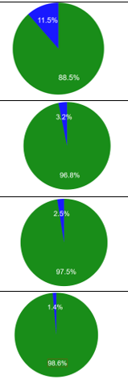
Fisheries and aquaculture plays a key role for youth employment creation
Drivers of employment growth as countries develop:
1. Demand for more protein and nutrient-rich food (such fish)
Increasing demand for jobs in fisheries and aquaculture.
2. Increased fishery productivity
Stimulates structural transformation within food production sectors, driving:
3. Shift in employment patterns
Transition from low-productivity activities --crop and livestock farming-- to higher-productivity aquatic food sectors --fisheries and aquaculture--.
4. Throughout the economic transformation of food production systems, fisheries and aquaculture plays a key role in job creation for young people
Sectoral employment shift is larger for young people than for adults
Total
Adult
Youth
High income
Upper-middle income
Lower-middle income
Low income
Fisheries and aquaculture | Fisheries and aquaculture | Fisheries and aquaculture
Crop and livestock | Crop and livestock | Crop and livestock
Source: based on ILOSTAT data (2023) for 104 countries.
Notes:
But while the importance of fisheries within the Blue economy decreases as countries develop, it increases within food production sectors As countries develop, employment in growing and harvesting food shifts from relatively low-productivity activities, like crop and livestock farming, to relatively higher-productivity aquatic food activities, such as fisheries and aquaculture. This sectoral shift is larger for young people (Figure 1).

Slide 12
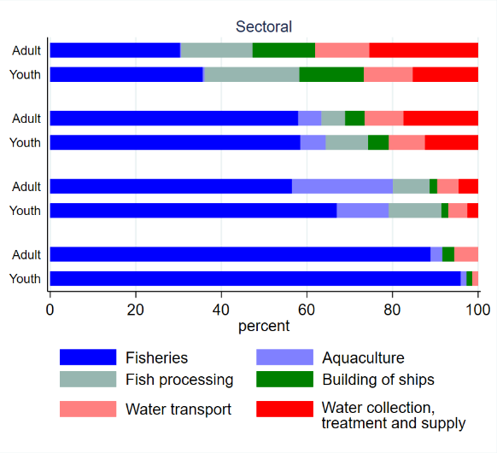
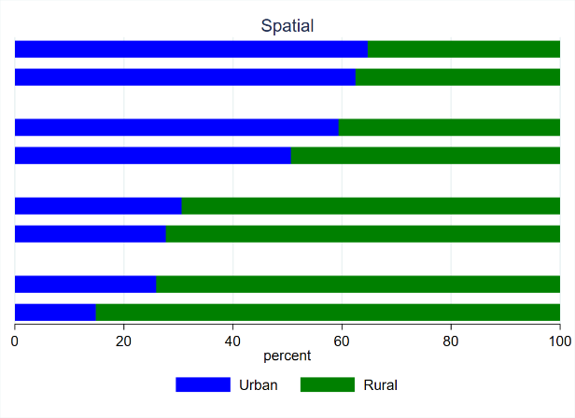
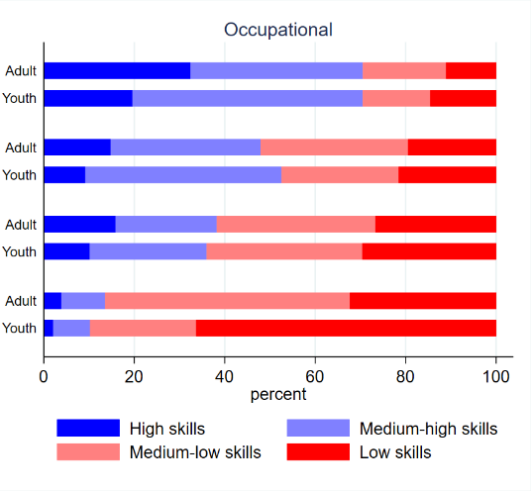
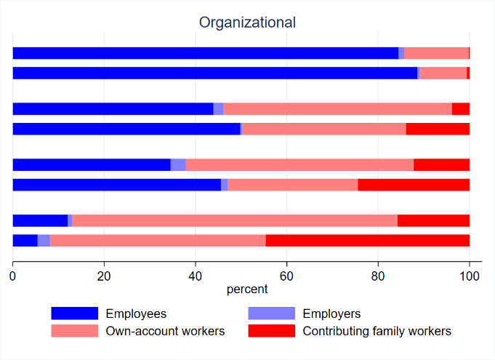
Youth employment in the Blue Economy on the four dimensions of structural transformation
Within Blue economy sectors
High income
Upper-middle income
Lower-middle income
Low income
Sectoral: participation in fisheries tends to decrease as countries develop. However, young people have a higher likelihood of employment in the fisheries sector of the Blue Economy compared to their adult counterparts
Spatial: The Blue Economy is also a dominant source of employment for rural young people who tend to be represented more than their adult counterparts
High income
Upper-middle income
Lower-middle income
Low income
Occupational: Youth employment in the Blue Economy tends to be concentrated in medium-high skill occupations compared to adults, except in low-income countries.
Organizational: Youth employment in the Blue Economy tends to be more concentrated in paid-employment jobs compared to adults, with the exception of low-income countries
Source: own estimates based on LFSs and HIESs
Notes:
But in general the Blue economy generate improve LM outcomes for young people. Youth employment in the Blue Economy tends to be concentrated in medium-high skill occupations compared to adults, except in low-income countries. Youth employment in the Blue Economy tends to be more concentrated in paid-employment jobs compared to adults, with the exception of low-income countries

Slide 13
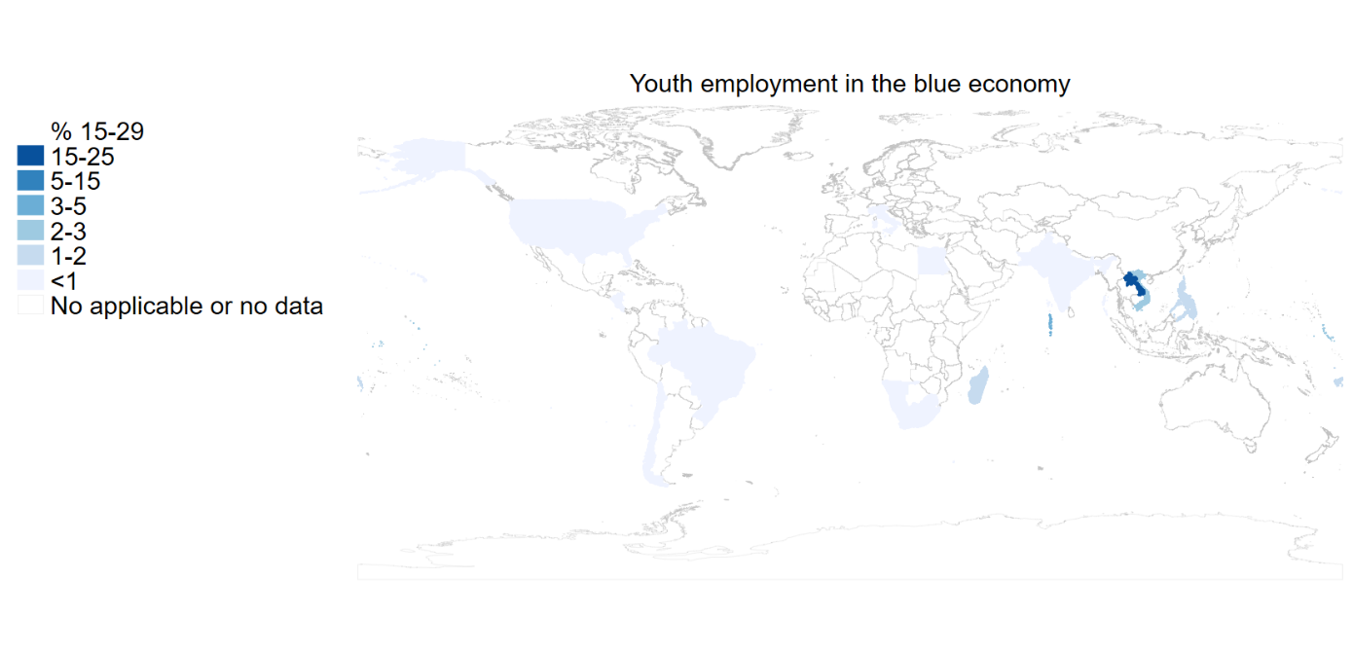
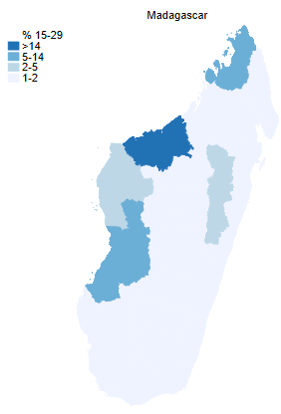
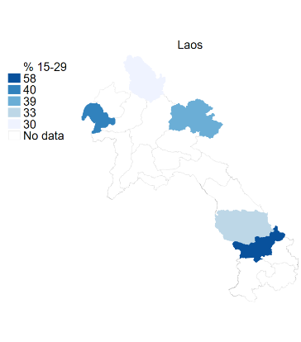
The Blue Economy plays a key role for ‘local’ youth employment creation
Within Blue economy sectors
National estimates obscure the geographic concentration and local significance of Blue Economy subsectors in job creation.
Across eighteen countries, youth employment in the Blue Economy averaged only 2.3%
However, it plays a substantial role in employment creation at subnational level,
In some areas, like the village of Tereitannano (in Tabuaeran atoll in Kiribati) and the Province of Savarane in Laos, 6 out of 10 young people are employed in Blue Economy sectors.
In the Region of Boeny (Madagascar), the youth employment rate in the Blue Economy stands at 14.2%, which is 9 times higher than the national rate
Source: own estimates based on LFSs and HIESs
Notes:
The Blue Economy plays a key role for local employment creation. As with any economic activity, the relative importance of the Blue Economy for youth employment creation depends, to some extent, upon the level at which this is measured (global, national, local, etc.). While employment in the Blue Economy may account for a relatively small fraction of national . employment in a given country, it may form a much larger share of employment for certain subnational area, especially those more proximate to water bodies.
The significance of the Blue economy for local employment creation is particularly pronounced for young people. In the Province of Savarane in Laos, for instance, statistics reveal a compelling narrative: Six out of every ten young individuals are gainfully employed within Blue Economy sectors

Slide 14
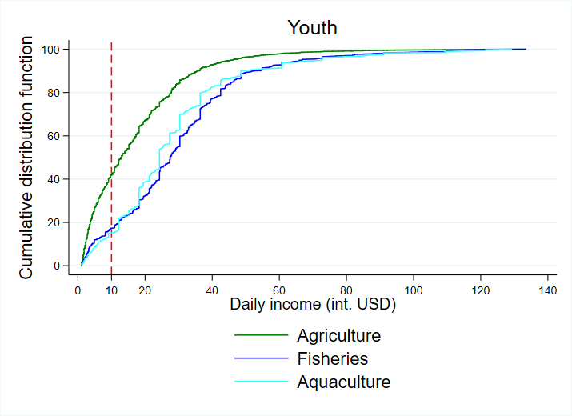
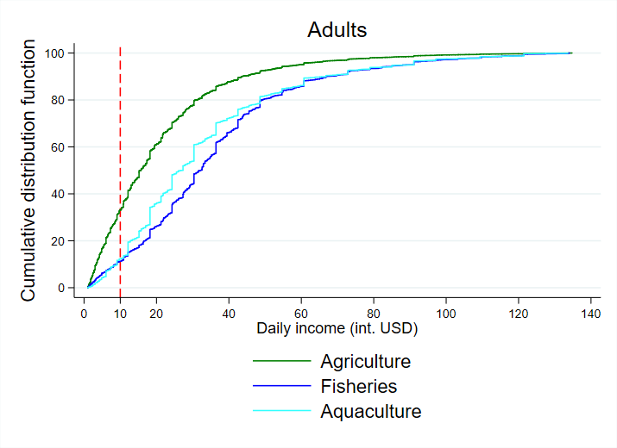
In addition to driving the process of structural transformation, growth in fisheries and aquaculture has a greater poverty-reducing impact
1. Young people in fisheries and aquaculture earn lower incomes compared to their adult counterparts
Across 18 countries, young people in fisheries or aquaculture earn, on average, lower incomes than their adult counterparts (by approximately -18% and -15% respectively)
2. Yet, young people in fisheries and aquaculture earn higher incomes than their peers in agriculture
75% and 66% higher, respectively, than their peers in agriculture, driving lower poverty rates:
3. Impact on poverty:
The share of young workers in fisheries and aquaculture earning an income that is below the extreme poverty line (international USD 1.9) is lower compared to young workers in agriculture (3% and 2.3% respectively vs. 7.8%).
Young people in agriculture are 2.5 and 3.4 times more likely to live in extreme poverty than their peers in fishing and aquaculture.
Source: own estimates based on LFSs and HIESs
Notes:
+Increasing the income threshold to USD 10 per day
41.9% of young people in agriculture earn less than that threshold, which is 24.6 p.p. higher than the share of youth in fishing (17.3%) and 26.7 p.p. higher than the share in aquaculture (15.2%).

Slide 15
Challenges and opportunities
5

Slide 16
A multi-pronged approach is key to fully realizing the sector’s promise
Challenges
Feature policy interventions
Young people lack technical skills demanded by companies in blue industries
Technical and Vocational Education and Training (TVET) can address skill shortages among youth
Mismatch between the training offered by TVET organizations and the skills demanded in blue economy labor markets
Targeted (TVET) aimed at enhancing the employability of young people in blue industries. Modular, flexible TVET programs, rather than fixed ones, might better engage youth in upskilling and reskilling activities
Lack of digital skills
Deliver TVET responsive to the increased demand for digital skills in blue labor markets. For instance, in Mediterranean ports, the majority of job openings are in professions such as data analyst, cybersecurity manager, cold supply chain expert, energy transition manager, onshore-power-supply manager, and circular economy manager.
Blue economy careers are unattractive to young people
Governments should work with research organizations, higher education institutions and non-governmental bodies to raise awareness. For example, Intergovernmental Oceanographic Commission (IOC) is working to create greater ocean literacy among youth through its Ocean Literacy Portal, a global one-stop shop that gives access to resources and content to help to improve ocean culture worldwide.

Slide 17
A multi-pronged approach is key to fully realizing the sector’s promise (cont’d)
Challenges
Feature policy interventions
Inadequate doing business conditions hindering entrepreneurship in the blue economy
Promoting youth entrepreneurship and innovation in blue economy sectors. For example, designing business regulations that strengthen blue entrepreneurial ecosystems (e.g. shortening business registration timelines, simplifying procedures, establishing “one-stop shops” to help new blue entrepreneurs save time and money, etc.)
Little official data that capture the participation of youth in the Blue Economy
Improve data collection on youth participation in traditional and emerging blue economy industries to design youth- and gender-sensitive policies. Data collection should also track employment that is seasonal, sporadic or informal in a way that disaggregated by age group, sex, and disability

Slide 18
Thank you

