Slide 1
Information and Social Norms:
Experimental Evidence on the Labor Market Aspirations of Saudi Women
MONIRA ESSA ALOUD, SARA AL-RASHOOD, INA GANGULI and BASIT ZAFAR
King Saud Univ. King Saud Univ. UMass Amherst Univ. of Michigan
The World Bank, MENA Seminar Series
September 21, 2023

Slide 2
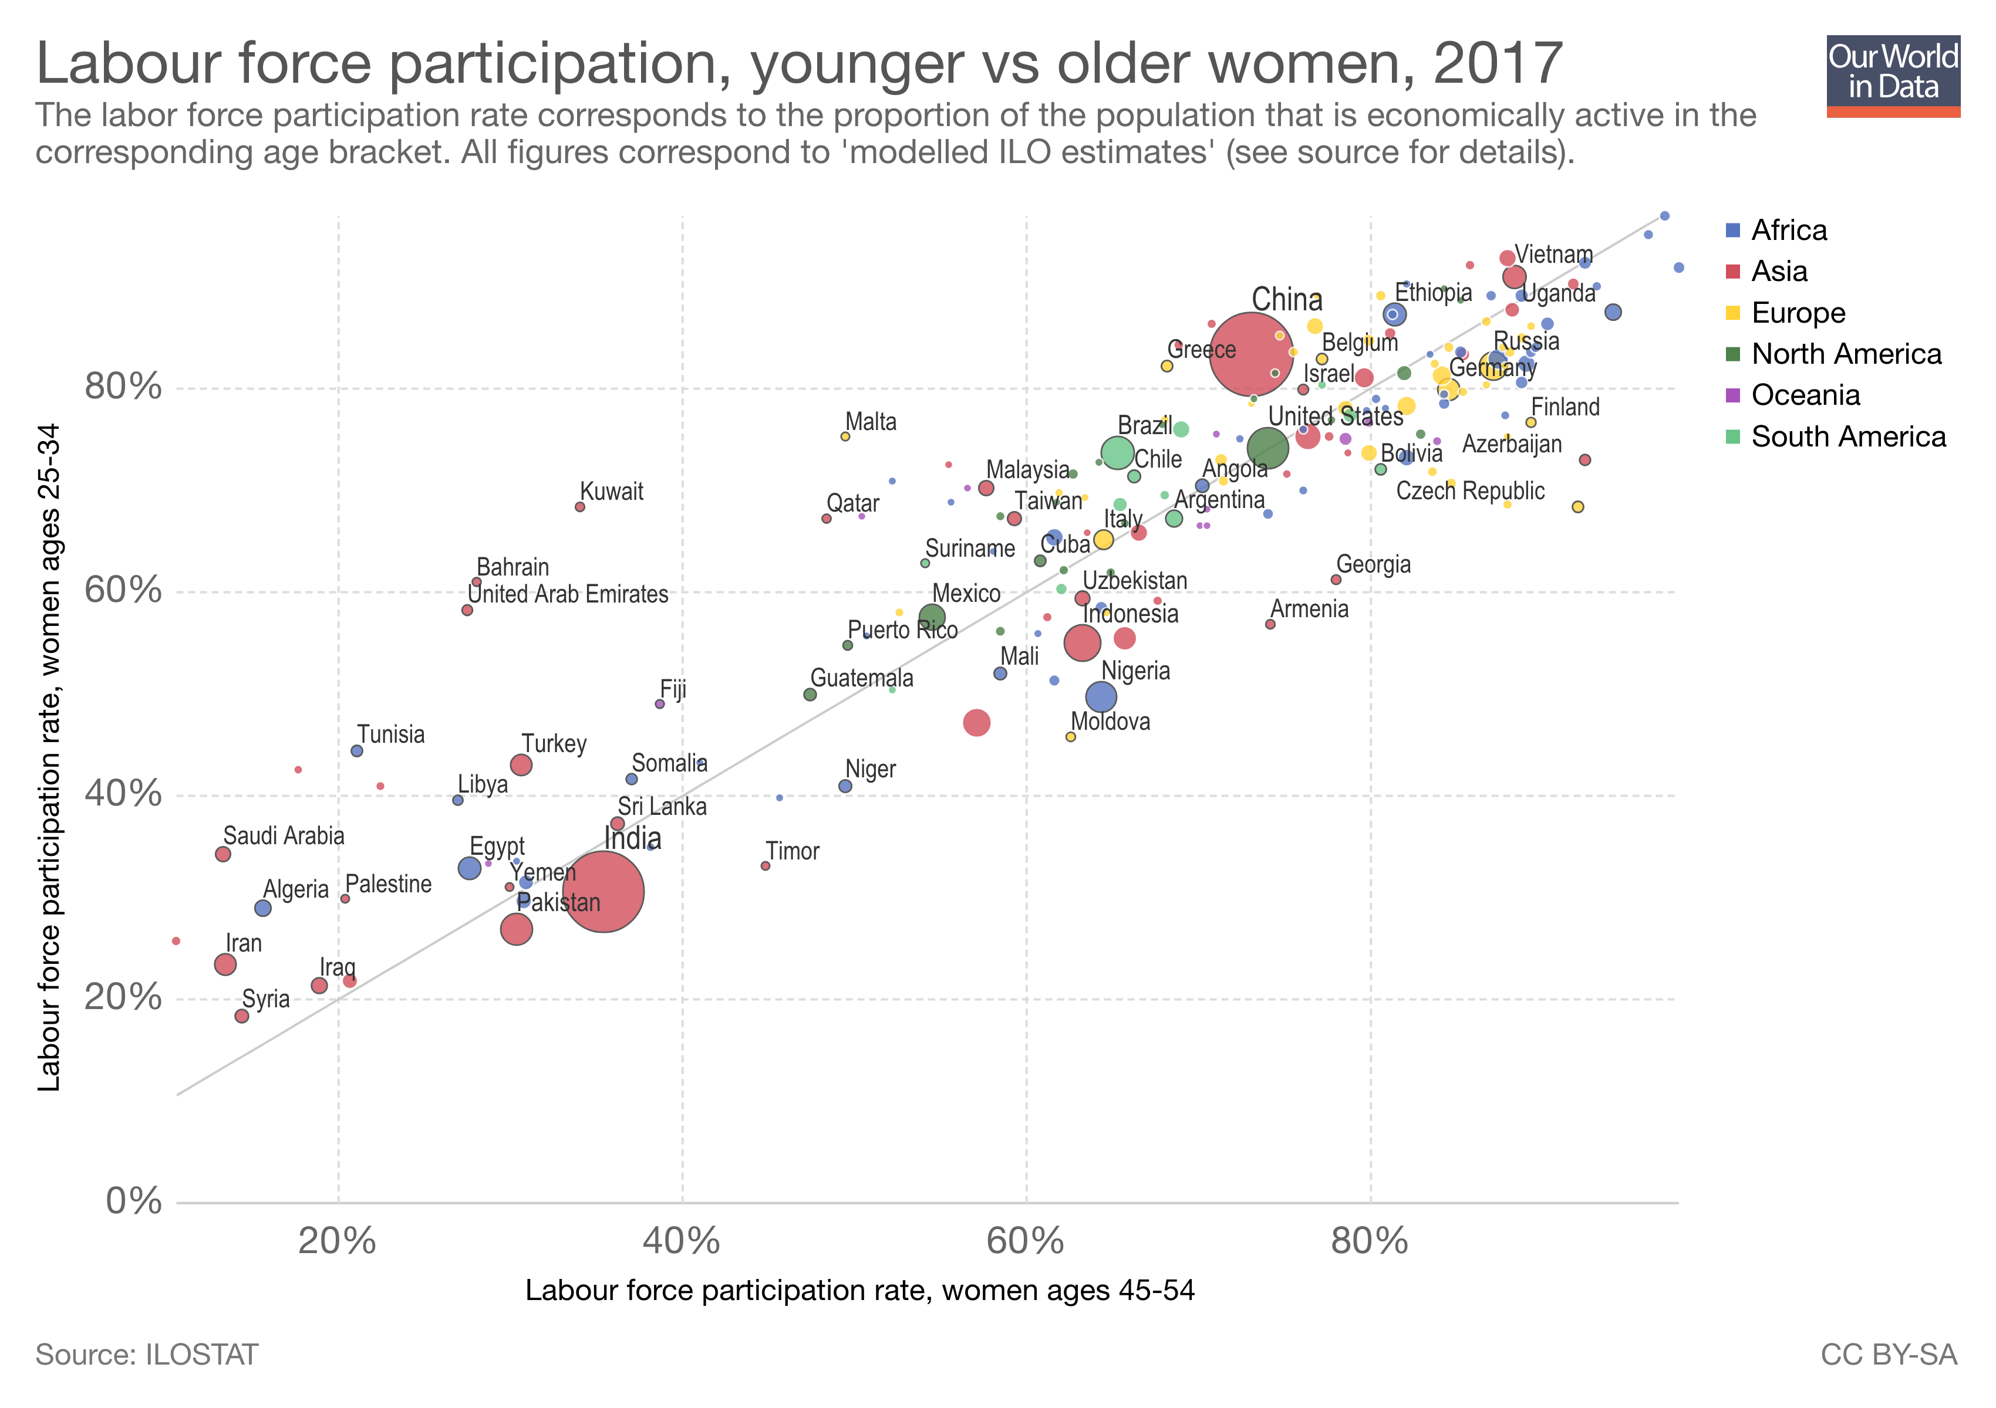
Female Labor Force Participation in Saudi Arabia
1990: 14%
2010: 18%
2018: 23%
27% increase (5-ppt) – over less than a decade
Notes:
could providing labor market information or information about peers have an impact on women’s career and family aspirations? Will this information impact aspirations if they are not consistent with the prevailing social norms?

Slide 3
Why is Women’s Labor Force Participation so low?
  In a rapidly changing environment, there is good reason to believe that women lack information about the labor market and prevailing social norms (Fernandez, 2013)
Biased beliefs – incomplete information:
  Growing literature showing students and parents are not fully informed about the labor market when making educational choices
  Choices can be impacted by the provision of labor market information (e.g. Dizon-Ross, 2018; Wiswall and Zafar, 2015)
Notes:
where opportunities for women to work outside of the home are increasing and the stigma surrounding FLFP is declining -- there is good reason to believe that young women may be misinformed about labor market opportunities or underestimate the pace of social change.

Slide 4
Social norms:
  Cultural attitudes toward women working may constrain LFP (e.g. Jayachandran, 2019; Miller, Peck and Seflek, 2019; Fernandez and Fogli, 2009)
  Women or their families (husbands, parents) may misperceive social norms (Bursztyn et al., 2020)
Interaction of information and social norms:
  It may be that information will only be effective if there aren’t other barriers – here, info about the labor market may only impact aspirations if they are consistent with social norms
Notes:
Bursztyn, Gonzalez and Yanagizawa-Drott (2018) show that correcting misperceptions of social norms among Saudi husbands leads to greater labor force participation among their wives. Miller, Peck and Seflek (2019), meanwhile, focus on the demand-side factors, and show that a policy increasing gender-neutral quotas for Saudi employment at private sector firms increased female employment. Importantly, they find impacts even for firms where quotas were not binding – suggesting that the policy led to changed norms about women working. While these studies look at the role of norms through Saudi men and the impact of policies on firms, in this paper we provide complementary evidence on the aspirations of Saudi women themselves and how information and cultural norms can impact these aspirations.

Slide 5
Could providing information on the pace of progress have an impact on women’s labor market aspirations?
Or would they still be constrained by their families’ expectations and prevailing longstanding social norms?

Slide 6
Our study
Experiment at King Saud University
We conducted a survey of approximately 1,000 female bachelor’s students in 2018 at a large public university
We measure:
  Aspirations prior to entering labor market (supply-side)
  Expectations about marriage and fertility
  Educational experiences
We randomize:
  the provision of labor market and social information
  the same information + prime to make family and social norms more salient

Slide 7
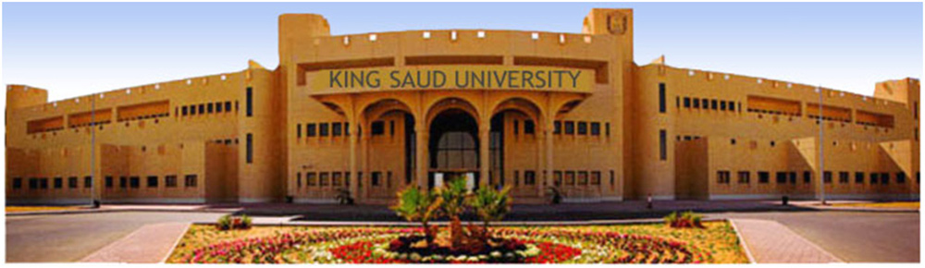
Why Focus on KSU Female Students?
KSU is the largest public university in Saudi Arabia
One of 2 Saudi universities in the top 150 universities in the Shanghai (AWRU) ranking in 2018

Slide 8
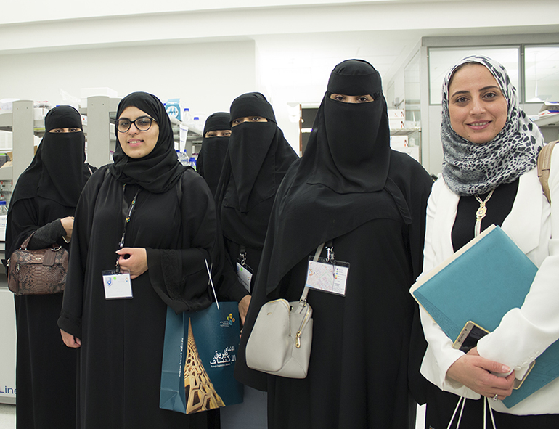
Why Focus on KSU Female Students?
Tertiary enrollment has increased from 39% in 2010 to 68% in 2017
Women’s employment rates are highest among university graduates
These are women most likely to be on margin of deciding whether to enter the labor force in the coming years
Notes:
The employment rate for women with University degrees is 38% overall, and 25% among 25-34 year olds and 67% for 25-44 year olds (2017 Labor Force survey conducted by the General Authority of Statistics, GaStat).

Slide 9
Study Design
First ask students their perceptions of labor market returns and perceptions of their female peers’ career and family expectations (“population” beliefs)
Randomly provide 2 subgroups with:
  [T1] Social and labor market information (average earnings, unemployment assistance program, aspirations of female peers)
  [T2] Same plus a prime to make their parents salient (“Would you be interested in having a summary of your answers be shared with your parents?”)
Ask students about their own career and family aspirations (“self” beliefs)
Control group receives same survey apart from stage 2 information

Slide 10
T1: Info about labor market
Here is some information about your KSU peers’ plans:
In a survey we conducted earlier this year , female students at KSU reported a very high likelihood, 80%, of working for pay when they are 25 years old. We also found that KSU female students, on average, expect to get married by age 25, and to have their first child by age 28.
Here are some statistics about monthly wages.
The average monthly wages of Saudi female workers with a college degree in 2017 was 10,072 riyals per month.
Here is some information about the Hafiz job assistance program administered by the Human Resources Development Fund (HRDF):
The Hafiz ‘Searching for Employment’ program provides training and motivational services and financial assistance of up to 2,000 SAR monthly in order to support and enable job search among Saudis. Job seekers enrolled in Hafiz gain access to job placement centers, TAQAT-online job postings, Liqaat career fairs, numerous education and training offerings, and many more services. They also receive financial support, provided for a period of 1 year, to ease the financial strain of unemployment and allow them to fully focus on finding work.

Slide 11
T2: Info + parents prime
“The answers you provide in this section might be helpful for you in discussing your post-college plans and career options with your parents.”
“Would you be interested in having a summary of your answers be shared with your parents?”
“What would be the best way of sharing this information with your parents?”
Note that the students’ answers were not actually shared with their parents

Slide 12
Results
High labor market aspirations
Students have much higher expectations of working than the actual female LFP among older generations
Respondents’ beliefs about themselves are significantly higher than their corresponding population beliefs
  Self-belief of working at the age of 25 was 67.7%
  Belief of other KSU students working at age 25 was 54.2%

Slide 13
Population Beliefs
 | All | Control | T1 | T2 | pvalue
 | (1) | (2) | (3) | (3) | (4)
Belief about % Female Working | 54.38 | 54.22 | 54.44 | 54.48 | 0.9833
Belief % Fem Working FT| Work | 47.59 | 48.04 | 47.38 | 47.33 | 0.8898
Belief about % Females Working FT | 27.88 | 27.97 | 27.81 | 27.85 | 0.9933
Belief about Monthly Earnings | 6027.13 | 6098.31 | 6031.25 | 5948.75 | 0.8261
Notes:
6,000 riyals is about $1,600 per month – so about $20,000 per year

Slide 14
Self Beliefs
 | All | Control | T1 | T2 | pvalue
 | (2) | (3) | (4) | (5) | (6)
Self Beliefs
% Chance of Working at Age 25 | 69.40*** | 67.74*** | 70.38*** | 70.17*** | 0.2746
%Chance of Working FT| Working | 64.48*** | 60.95*** | 64.77*** | 67.89*** | 0.0027
% Chance of Working Full-Time | 47.91*** | 43.93*** | 49.07*** | 50.94*** | 0.0049
Expected Monthly Salary (Riyals) | 8701.13*** | 8517.52*** | 9005.01*** | 8589.52*** | 0.3313
Notes:
Same comment as in previous slide. Simplify.

Slide 15
Experiment Results
Information matters
  Relative to the Control group, expectations about labor force participation are significantly higher in the T1 (info only) group
  T2 (making parents salient) increases students’ labor market expectations relative to the Control group
  Effects are often larger than in T1 (info only) group
Cultural norms still matter:
  T2 leads to an increase in expectation of working in Education and Public sector

Slide 16
Results
Information and parents prime effects

Slide 17
Results: Expectations of Working
Information and parents prime effects
 | Prob Work FT| Work | Prob Work FT
 | (1) | (2)
Constant | 60.95*** | 43.93***
 | (1.40) | (1.49)
Treatment1 | 3.82** | 5.15**
 | (2.06) | (2.20)
Treatment2 | 6.94*** | 7.01***
 | (1.97) | (2.21)
p-value | 0.13 | 0.42
Observations | 892 | 892
Mean of Dep var | 64.48 | 47.91
R2 | 0.01 | 0.01
Notes:
Just show fewer columns.

Slide 18
Results: Expectations of Working in Sectors
Information and parents prime effects
 | Education | Health | Services | Public Sector
 | (1) | (2) | (3) | (4)
Constant | 20.34*** | 14.37*** | 3.73*** | 52.77***
 | (1.24) | (1.19) | (0.41) | (1.28)
Treatment1 | 1.24 | 2.19 | -0.81 | 3.54*
 | (1.82) | (1.85) | (0.54) | (1.85)
Treatment2 | 3.96** | -0.79 | -1.24** | 5.13***
 | (1.91) | (1.72) | (0.55) | (1.86)
p-value | 0.17 | 0.11 | 0.40 | 0.40
Observations | 966 | 956 | 958 | 965
Mean of Dep var | 22.04 | 14.82 | 3.06 | 55.60
R2 | 0.00 | 0.00 | 0.01 | 0.01
Notes:
If you are working full time when you are 25 years old, what do you think is the percent chance (or chances out of 100) that you will be working in each of the following sectors?

Slide 19
Who does it impact most?
Students who under-estimate the expectations of their peers are most impacted by the treatment
  Impacts mainly due to new information about peers’ aspirations
T2 impacts are driven by students who want to share their responses with their parents

Slide 20
Who does it impact most?

Slide 21
Why did T2 have such large effects?
Follow-up survey with 150 KSU students
Almost all believe their parents expect them to work
Many would like the opportunity to discuss their future plans with their parents:
  79% would share their responses with parents
  71% would share the information with at least one parent
Why?
  “inform them about how Saudi society is changing” (65%)
  “make them happy to know that more people think like me” (29%)

Slide 22
Follow-up survey: Spring 2019, 150 students
Reasons to/not Share Info: | Inform How Saudi Society is Changing | 65%
 | Let Me Work and Delay Marriage | 7%
 | Inform Them Others are Like Me | 29%
 | Not Share: Upset/Disappoint Them | 7%
Reactions to Share Info: | Make Parents Happy | 39%
 | Make Parents Disappointed | 5%
 | No Change | 34%
 | Not Sure | 23%
Notes:
BZ: simplify table- only show lower rows?

Slide 23
Summary of key results
Students have much higher expectations of working than the actual female LFP among older generations
Receiving information about peers’ aspirations leads to higher expectations of working
Making parents salient also increases students’ labor market expectations, likely because they think their parents want them to work
But norms still matter: making parents salient leads to higher expectations of working in education and the public sector - sectors that are more culturally accepted for women.
Most students would like to discuss their future plans and the information with their parents

Slide 24
Future Research Questions
More research is needed to understand:
The preferences and beliefs of parents regarding their children’s future plans
The process of decision-making between the students and their parents
If these effects would be different in a broader sample of youth (our results are from a college-going sample)
The link between expectations and behavior – we show that information impacts aspirations. To what extent actual behavior is impacted is unclear (and requires long-term panel studies).

