Slide 1
Managing Forest Fires - Lessons Learned and Good Practices India and Kazakhstan
Andrea Kutter
Sr. Natural Resources Management Specialist
May 27, 2021

Slide 2
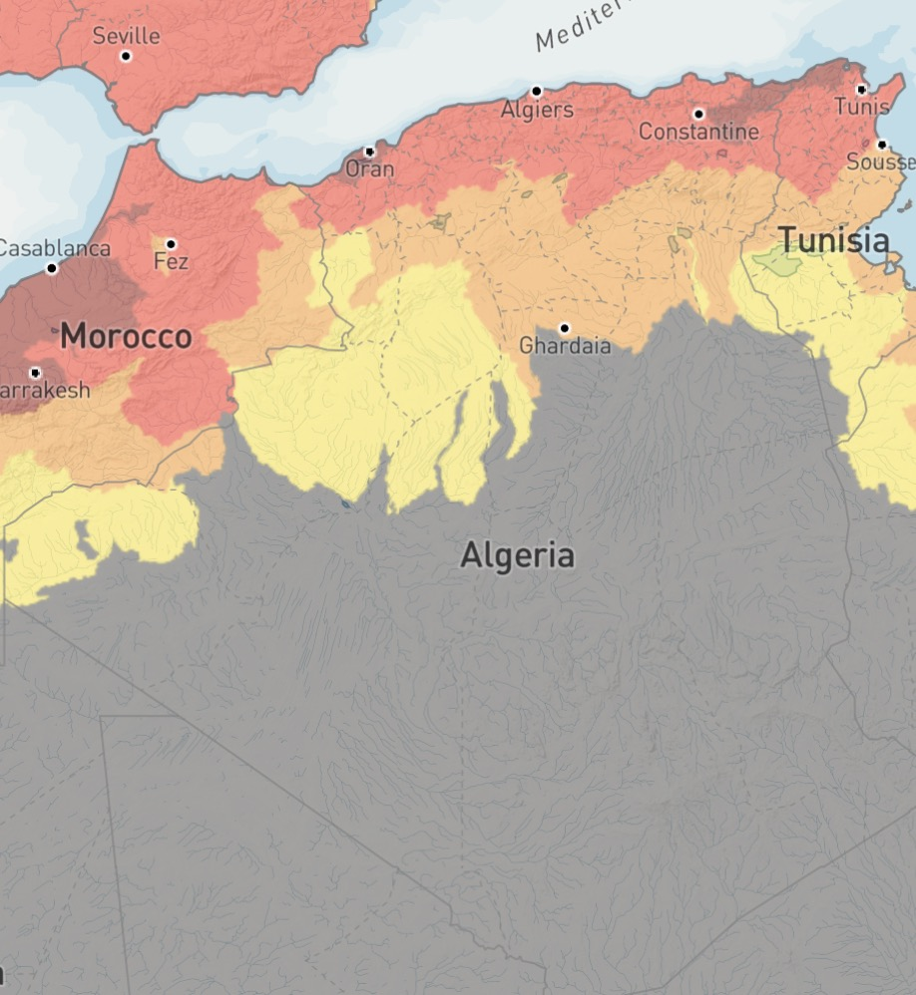
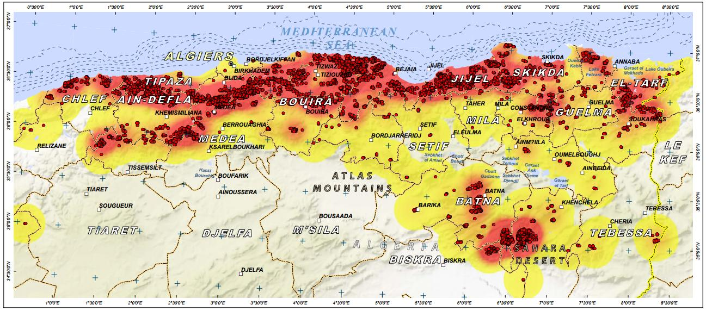
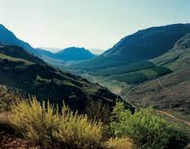
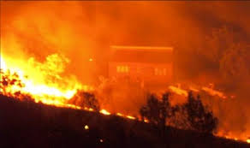
Overview
Forest Fires and Sustainable Forest Management
Lessons Learned:
India Experience
Kazakhstan Experience
Considerations for the Government of Algeria
Drought Risk

Slide 3
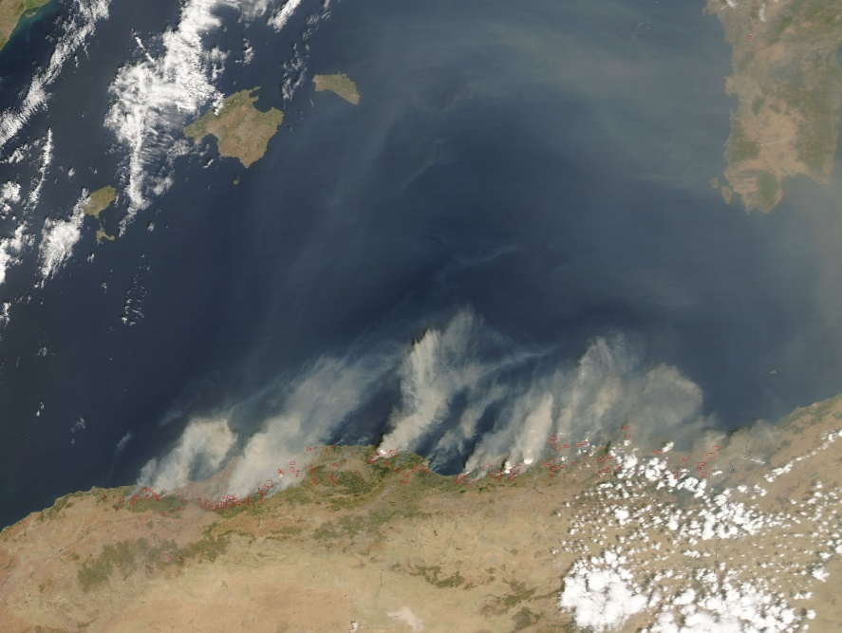
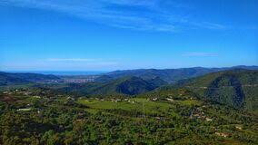
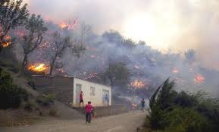
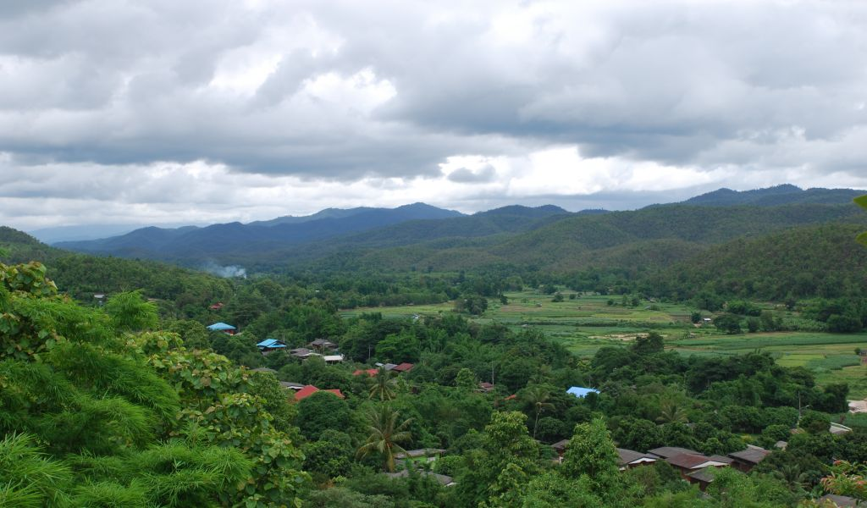
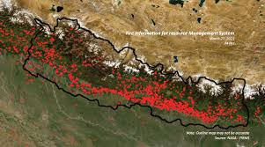
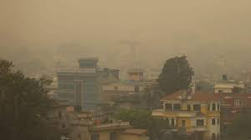
Forest Fires – Algeria and Nepal (2021)
Text
Notes:
Forest fires are a global phenomenon: images from Algeria and Nepal
Similar landscapes, similar problems, similar outcomes

Slide 4
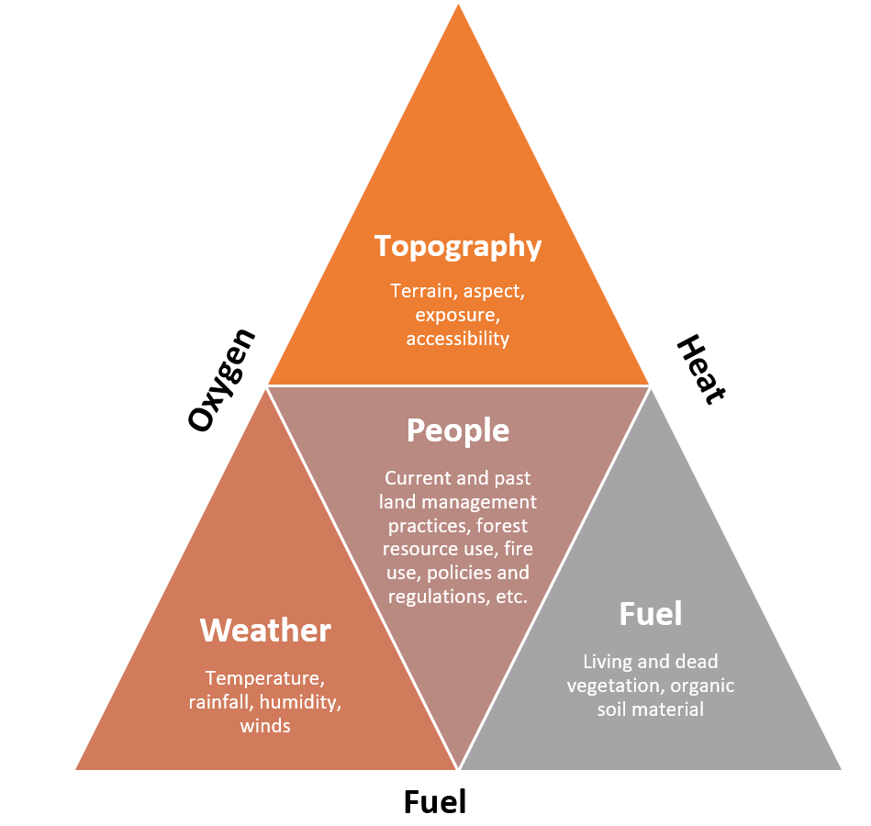
Common Features of Forest Fires
Forest Fires are
widespread yet concentrated, with distinct regional patterns
often a seasonal phenomenon linked to high temperatures, drought conditions and high winds
caused by a combination of natural and social factors
exacerbated by climate change
leading cause of forest degradation in many countries
costly to put out (e.g. 2009 Victoria, Australia bushfires: cost $593 million)
often not considered as part of sustainable forest management
two sides of a coin: have benefits (if managed) and can be disastrous (if not managed)
Notes:
Forest fires have common features …

Slide 5
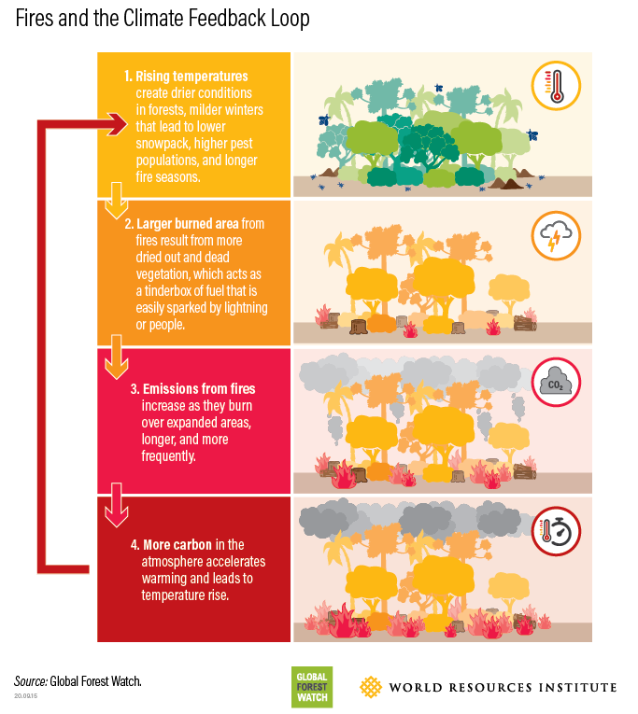
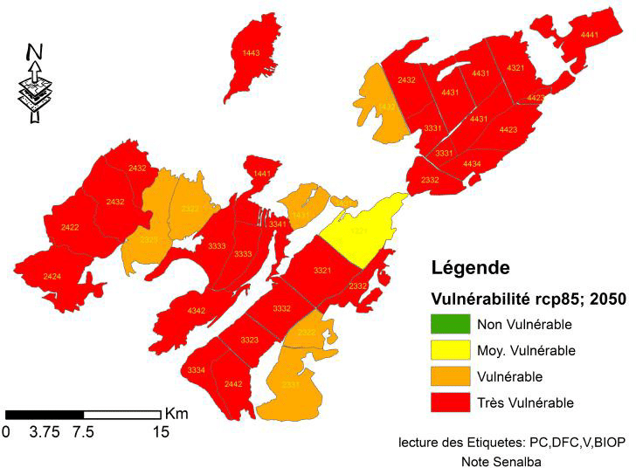
Forest Fires and Climate Feedback Loop
Vulnerability to climate change of the Senalba forest
Notes:
Forest fires have been part of history and ecological cycles for thousands of years
But forest fires have been increasing dramatically, as global warming is leading to longer, harsher droughts and more extreme weather events.
The smoke and carbon released into the atmosphere from these fires also act to accelerate further warming and temperature rise.
Hence, it is vital that forest fires, and the wider climate crisis is managed to avoid the increasing frequency and severity of natural disasters happening around the world.

Slide 6
Impacts of Forest Fires
Detailed assessments of ecological impacts of fires and economic losses are limited
Available evidence suggests that most fires are degrading forests, reducing species richness and harming regeneration
Annual forest fires pose a risk to countries’ policy goal of reducing GHG emissions and enhancing forest carbon sinks (Algeria NDC: afforestation, reforestation and prevention of forest fires as well as improving means to fight them)
Negative economic impacts incl. loss of revenue from burned forests (timber and non-timber forest products); loss of ecosystem services; high costs to put out fires and reforest; loss of lives (animals, people)
Social impacts:
health impacts due to poor air quality (PM increase)(smoke-related economic damages: $0.5-1.2million per fire event)
Causes loss and gain of work opportunities
Need for evacuations, loss of homes
Notes:
We also know that forest fires have multiple impacts – ecological, economic and social

Slide 7
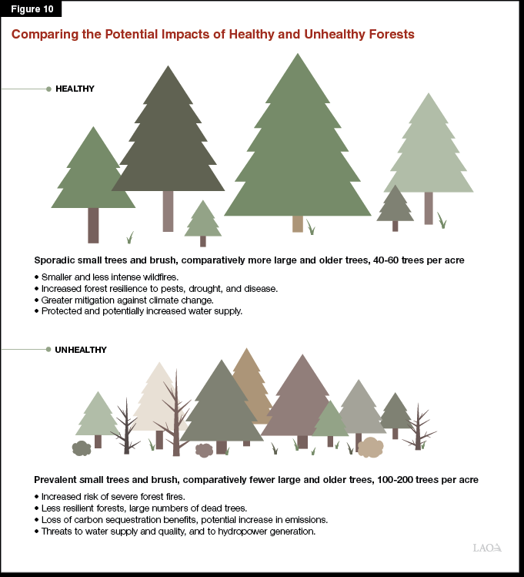
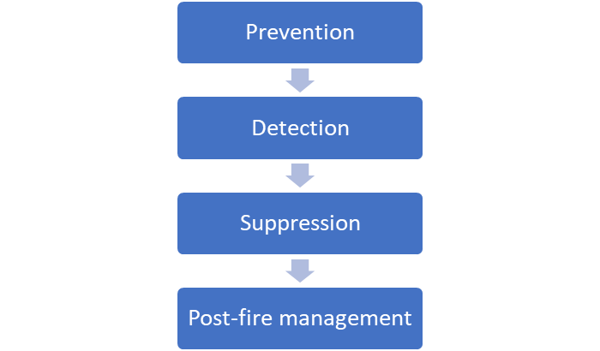
Fire-Smart Sustainable Forest Management
In fire-dominated ecosystems, sustainable forest management requires simultaneously minimizing the socioeconomic impacts of fire and maximizing its ecological benefits.
A pragmatic approach to addressing these seemingly conflicting objectives is fire-smart forest management.
This involves planning and conducting forest management and fire management activities in a fully integrated manner at both the stand and landscape levels.
Notes:
Reactive approaches to forest fires need to be replaced by proactive approaches integrating fire management into sustainable forest management – forest fires can be prevented, detected early and suppressed effectively. Each step can be improved if post-fire management data informs the forest fire management cycle which also allows identifying investment needs for each step – e.g. forest fire relevant data collection (incl. national forest inventory), system development (satellite based early warning systems for forest fires) and suppression equipment (helicopters, tools).
What is of utmost importance is that forests need to be managed to sustain its ecological integrity and ability to provide important forest ecosystem goods and services. A healthy forest is much more resilient to natural or man-made challenges compared with a forest that is impacted by pests and diseases, by too high tree density, by lack of diversity.

Slide 8
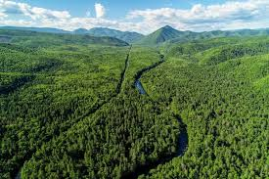
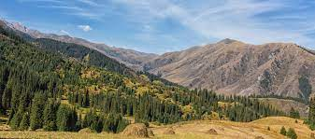
Forest Fire Management - Lessons Learned
Sharing Experiences from India and Kazakhstan

Slide 9
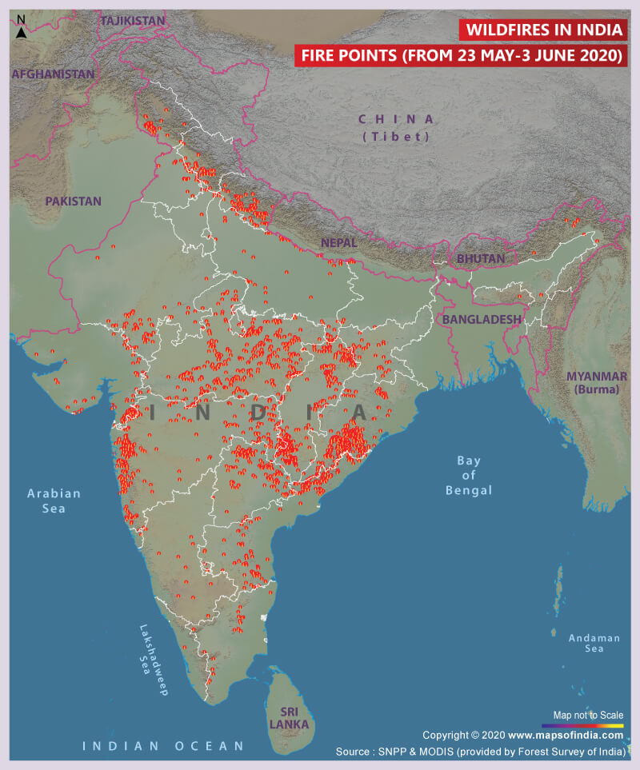
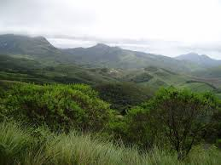
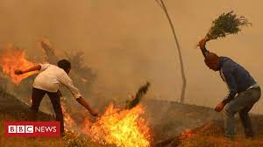
Fire Management – Lessons from India
Notes:
A first example from India:
As of 2019, the total forest cover in India is 712,249 Sq km (71.22 million hectares), which is 21.67 percent of the total geographical area. Indian forests types include tropical evergreens, tropical deciduous, swamps, mangroves, sub-tropical, montane, scrub, sub-alpine and alpine forests.
The World Bank has reengaged in the sector after 10 years of absence

Slide 10
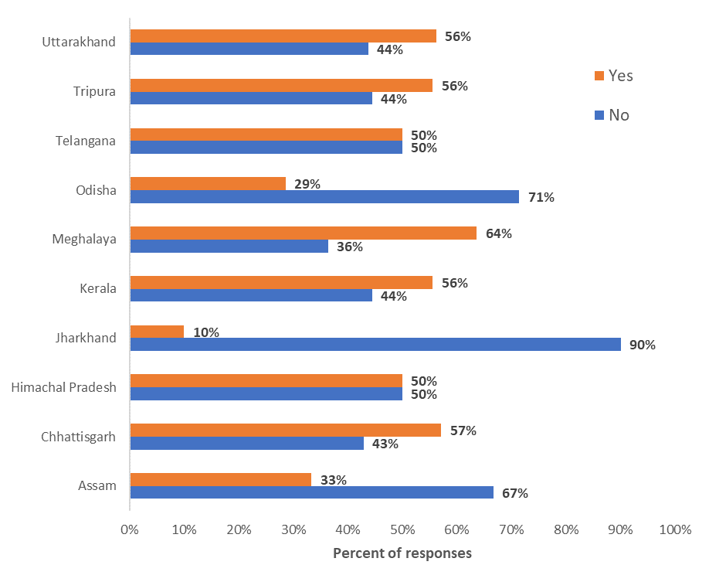
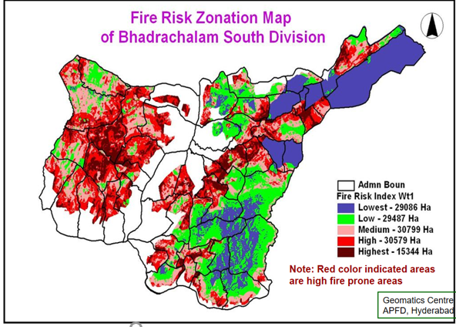
Prevention not sufficiently emphasized
Fire Management – Lessons from India
Fire line Maintenance?
Telangana - Fire Risk Zonation
Limited practice of controlled burning, thinning of fuel loads
Early warning and Fire Danger Rating System under preparation
Notes:
Early warning indicates impending hazardous conditions in the coming weeks and months
Fire danger rating indicates potential for intense fire behavior under current or forecasted conditions in the near term

Slide 11
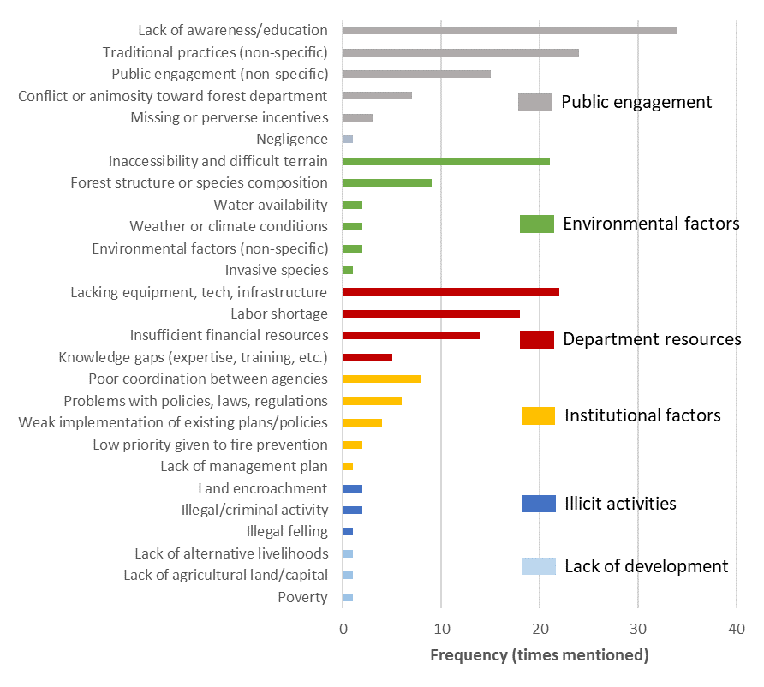
Biggest Challenges to Fire Prevention
Fire Management – Lessons from India
Notes:
Biggest challenges to fire prevention:
Lack of awareness and education
Inaccessibility of terrain affected by fires
Lack of equipment, technology and infrastructure
Labor shortage
Insufficient financial resources
Poor agency coordination

Slide 12
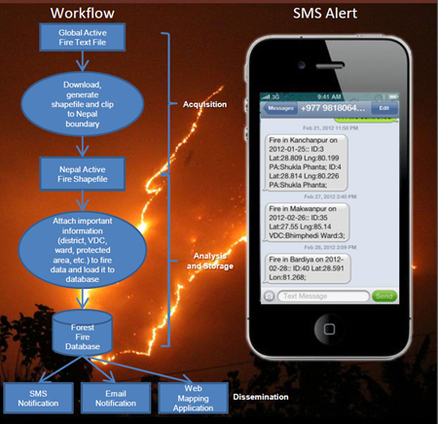
Investing in Fire Detection
Fire Management – Lessons from India
India began use in 2004 with impressive impacts on the ground:
Madhya Pradesh – Forest Fire Messaging System (2007)
Average burnt area has continued to drop to a low of 3.0 hectares in 2019
 | Before | After
Time to extinguish | 11-12 hours | 2-4 hours
Average area burnt | 12.9 hectares | 7.1 hectare

Slide 13
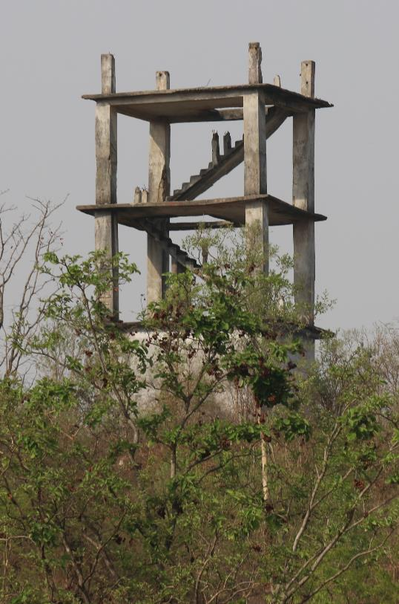
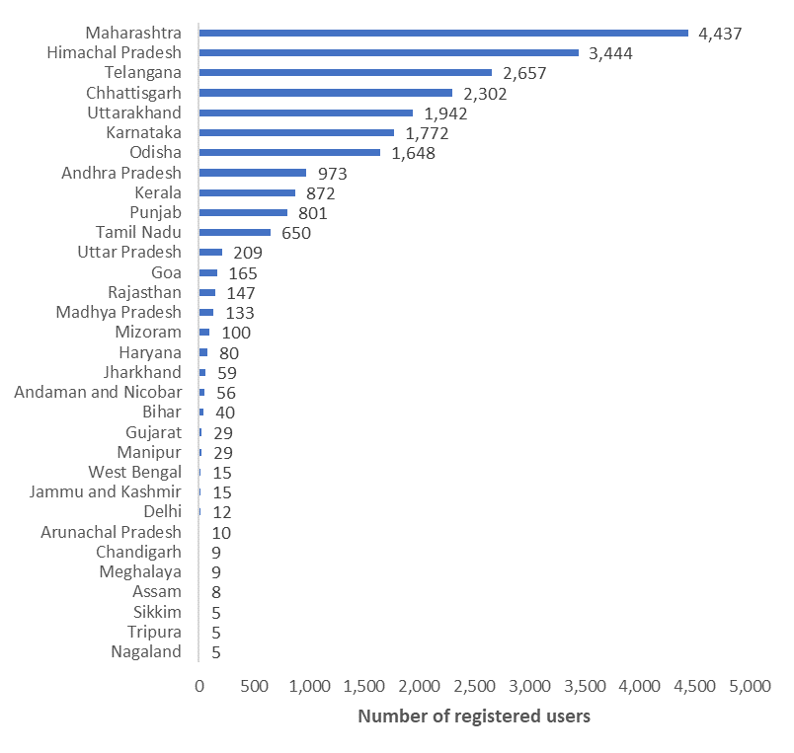
Forest fire detection, some challenges remain:
Fire Management – Lessons from India
Under-used FSI Alert System
Figure 2.7: Unstaffed watchtower
Source: Ross Smith, World Bank
Ground based system under-resourced

Slide 14
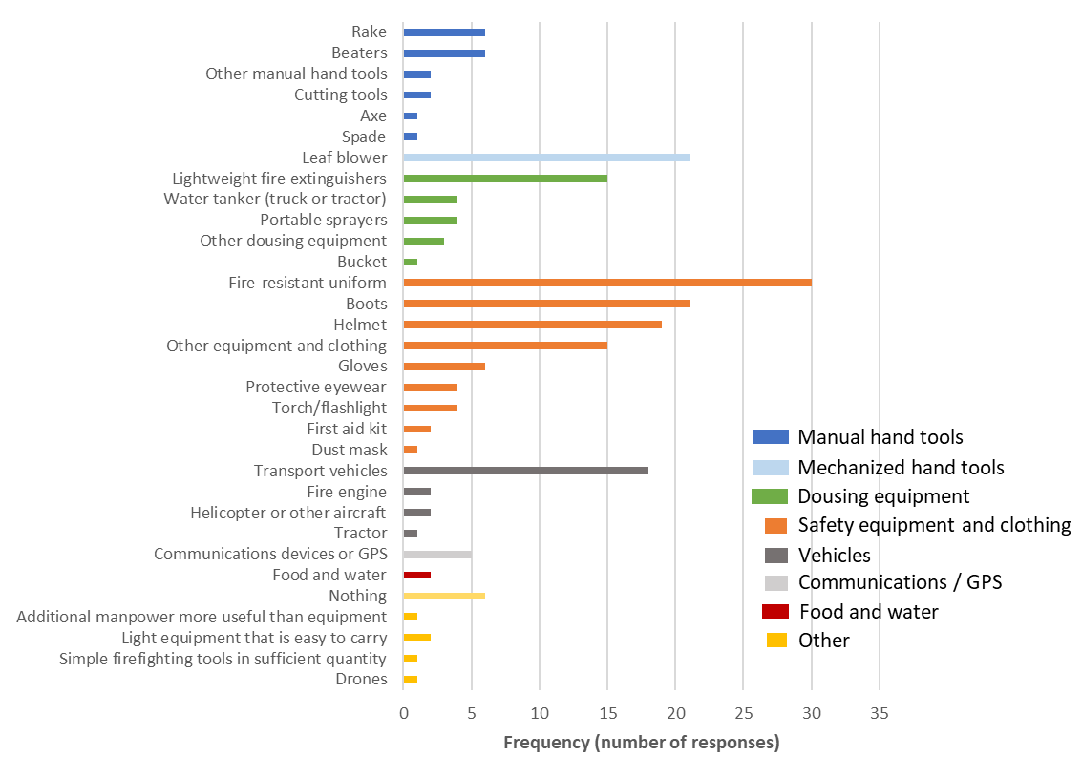
Few suppression techniques, many needs…
Fire Management – Lessons from India
Additional equipment needs
Principle techniques used to extinguish fires

Slide 15
FSI is experimenting with new techniques in Odisha:
Fire Management – Lessons from India

Slide 16
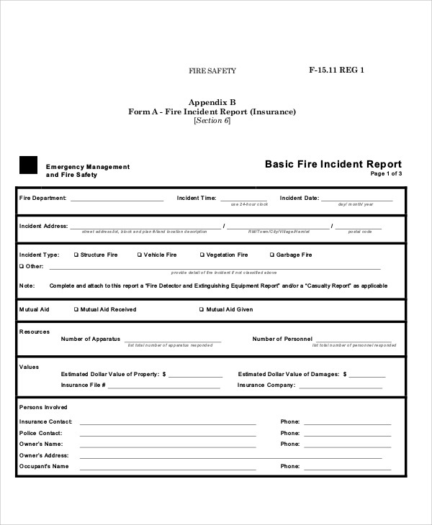
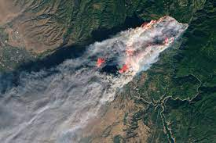
Post-fire Reporting and Rehabilitation
Fire Management – Lessons from India
Himachal Pradesh – Guidelines for assessing costs
Institutional disincentive to report
Lack of common classification scheme and methodology for assessment of economic costs (including carbon emissions)
Limited rehabilitation
Type of loss | Loss calculation (INR) | Remarks
Plantation areas (1st year) | Area burnt in ha x plants/ha x% survival rate x cost/plant
Plantation areas (2nd – 10th year) | Total expenditure on plantation up to date, including maintenance x plants burnt x (1 + .10 x years beyond the 1st year after planting)
Area under natural regeneration (seedling loss) | For fully stocked areas, assessed as for plantations | Loss of natural regenerated seedlings due to fire
Area consisting of pole-stage, middle-age, or mature crop | 50% value of dried or salvage trees | Loss is assessed after the rainy season; for salvage timber, royalty is taken as 50% total market value of the tree
Resin blazes | As per royalty rate fixed by the state government
Fodder and grasses | None | Fodder is a renewable resource, so loss is not calculated; grasses are usually cut by right holders before the fire season, so losses are usually not sustained; little fodder/grass production in chir pine forests
Beneficial herbs, shrubs, wild fruits | Loss of harvest equal to area burnt in ha x average annual yield per ha x unit price (according to permit issued in the past or local market prices)
Domestic losses | Not considered | Domestic losses include physical property (structures, livestock, etc.) as well as injuries to people or loss of life; these losses are calculated separately by the revenue department
Fire prevention costs | Expenditures for controlled burning, clearance of fire lines, etc. | Cost is based on average cost in previous years; focus of prevention activities is typically pine forest
Other environmental and wildlife losses | Not considered | Difficult to assess due to lack of requisite methodology

Slide 17
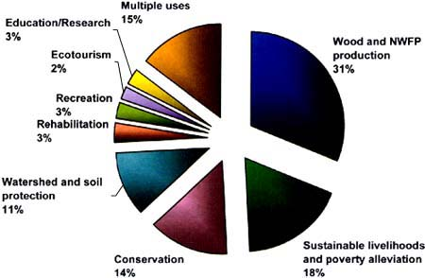
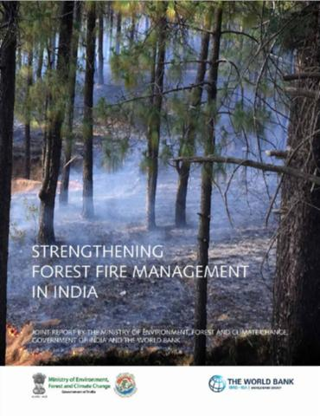
Investing in India’s Forests and Forest Landscapes
World Bank and Government of India have now a programmatic long-term forest landscape engagement with analytical work, technical assistance and investment operations

Slide 18
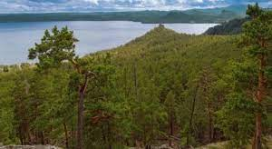
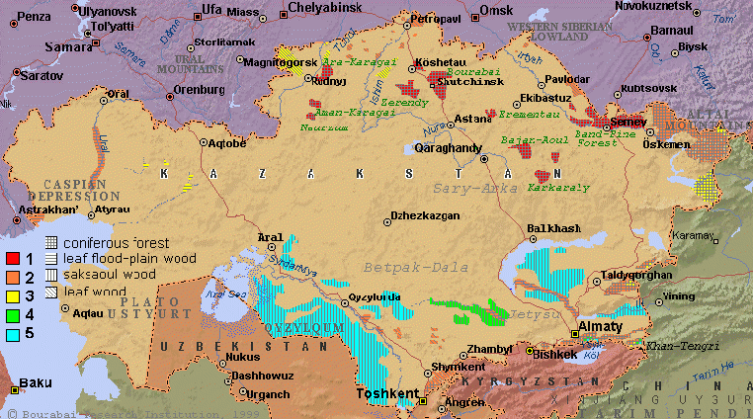
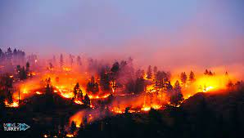
Fire Management – Lessons from Kazakhstan
Notes:
A second short example from Kazakhstan:
Kazakhstan is the ninth largest country in the world. Forest cover in the country is 4.7% (29 million hectares), an area the size of Great Britain. Almost 90% of the land in Kazakhstan is made up of steppe, desert and semi-desert. Coniferous species account for two-thirds of the growing stock volume, with pines and spruces the most important. Among the commonest broadleaved species are birch, alder, willow and maple.

Slide 19
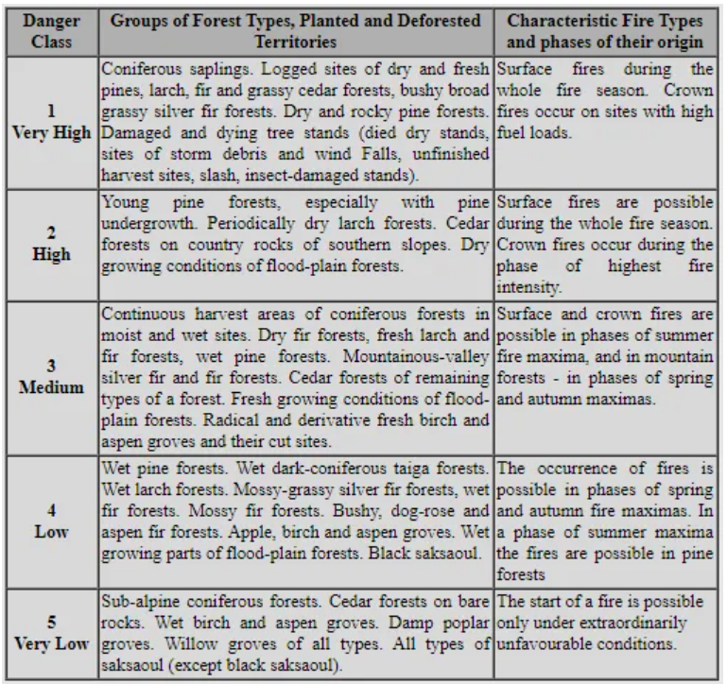
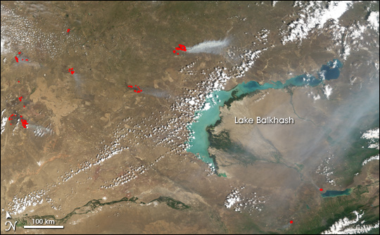
Fire Management – Lessons from Kazakhstan
The climate of Kazakhstan is extremely continental: dry and hot summers; dusty storms and dry winds are very common.
Struggle with fires is hampered because of inaccessibility of wood sites.
Fire hazard and flammability are highest in the following forest types: very dry stony-rocky pine forests, dry stony lichen-pine forests, dry cereals-berry pine forest.
Average annual amount of fires here is about hundred, the average area of one fire is 5.4 ha during an average fire season.
60% fires caused by humans: violation of the fire prevention rules (incl. camping sites) and by the local population (see Tab.4). Lightning represents only a minor fraction of all fire starts.
High flammability: coniferous stands, wood combustible materials
Lack of preventive maintenance of fires and regulating recreational activities.

Slide 20
Fire Management – Lessons from Kazakhstan
Forest Protection and Reforestation Project ($64million)
Project objective: to develop cost effective and sustainable environmental rehabilitation and management of forest lands and associated rangelands.
Interventions related to fire management:
Development and implementation of improved forest fire management of 642,000 ha through:
information, consultation, and training support to further strengthen the fire management strategy,
improved facilities for fire prevention and detection, including lookout towers, communications equipment, and rejuvenation of the firebreak network, and
improved facilities for fire suppression including road rehabilitation, fire station equipment, and fast-attack vehicles.
Other: Program of thinning and clearing, vehicles for more effective patrolling to reduce illegal activities, and capacity building in integrated pest management.

Slide 21
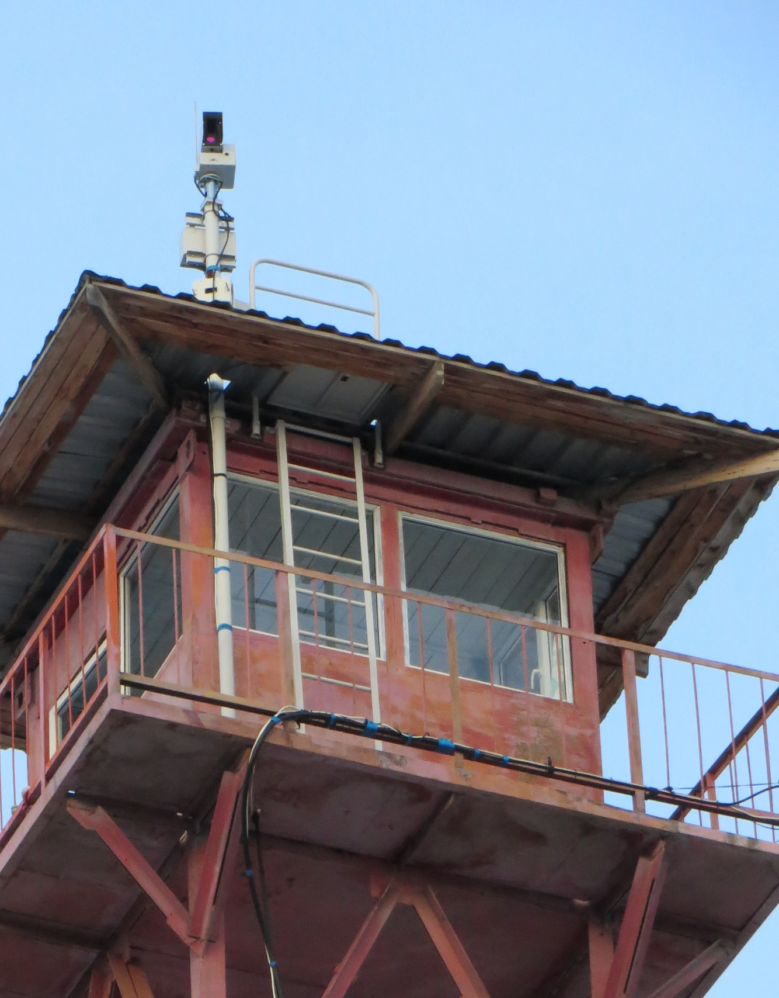
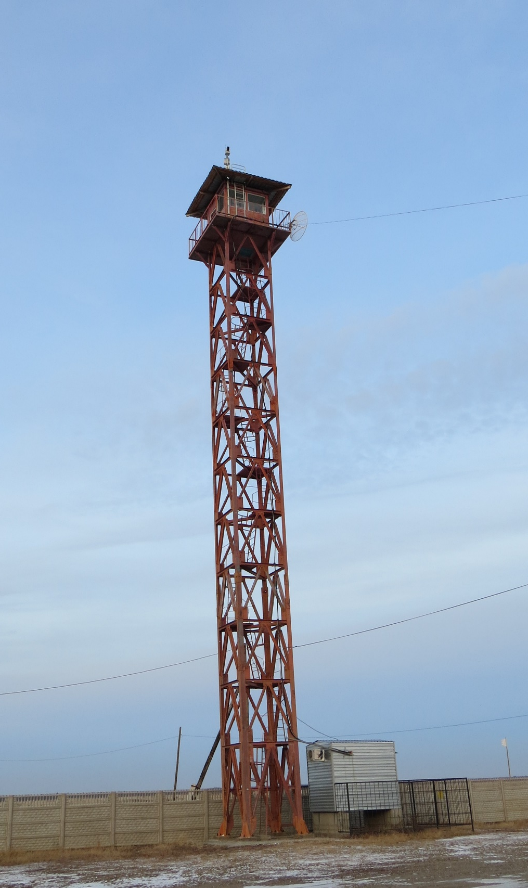
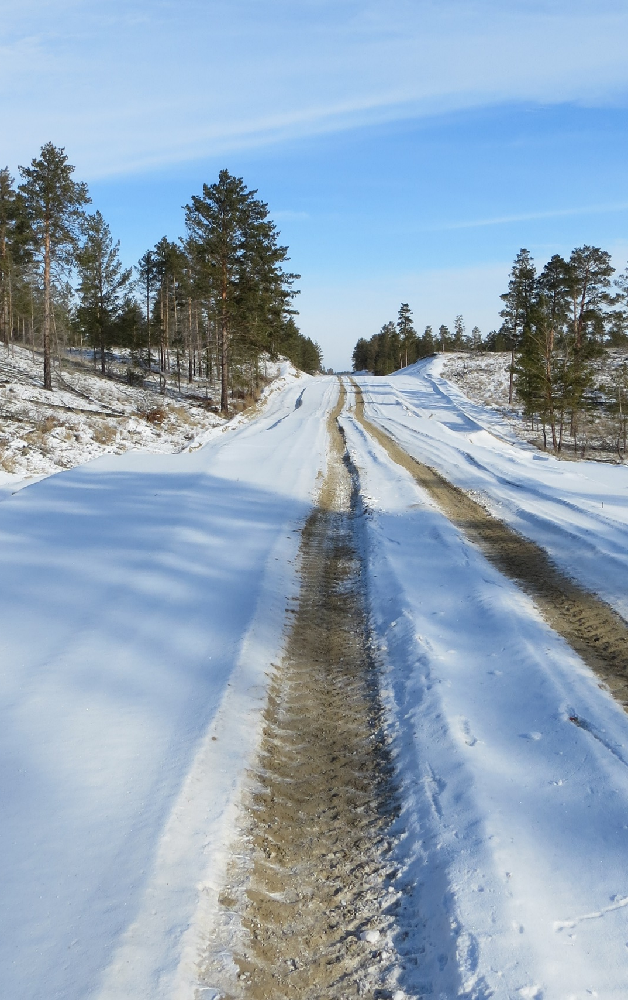
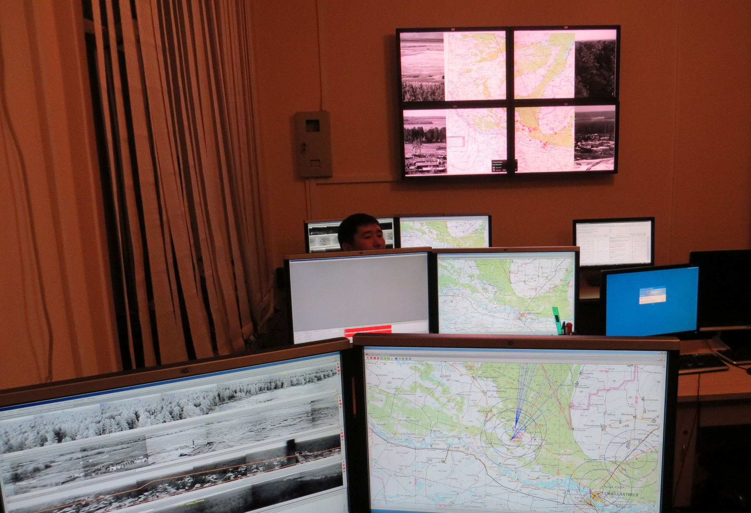
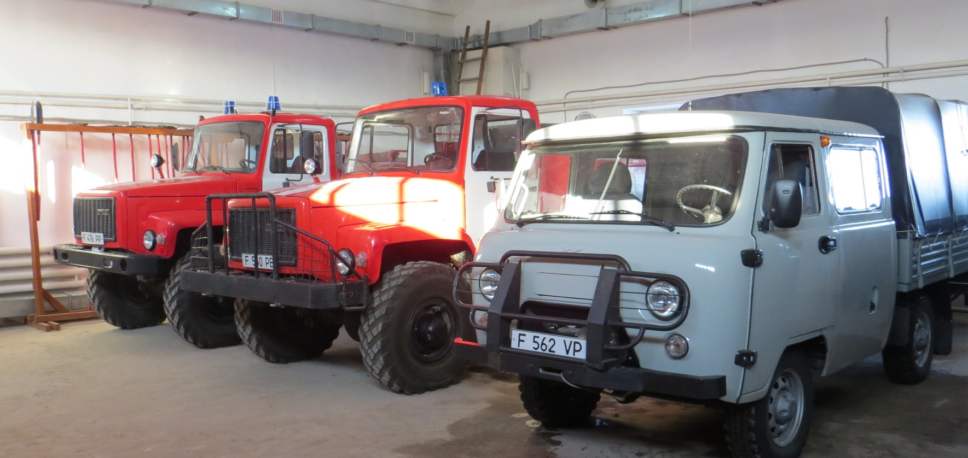

Slide 22
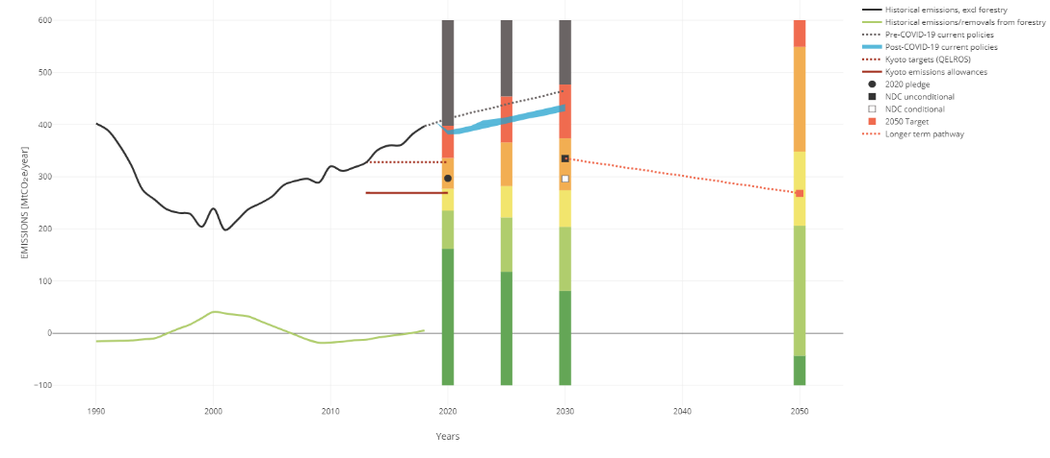
Fire Management – Lessons from Kazakhstan
Forest Protection and Reforestation Project ($64million)
Results:
Optical sensors detect fires ~ 15 mins sooner than human operators
20% less fires over all
Fires caused by humans dropped from 60 to 35%
Average fire size dropped from 23.7 ha before installation to 1.7 ha
Follow on Project Requested

Slide 23
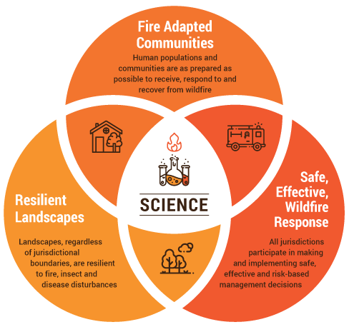
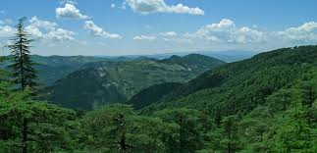
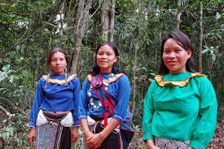
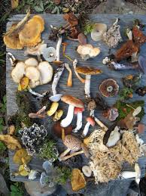
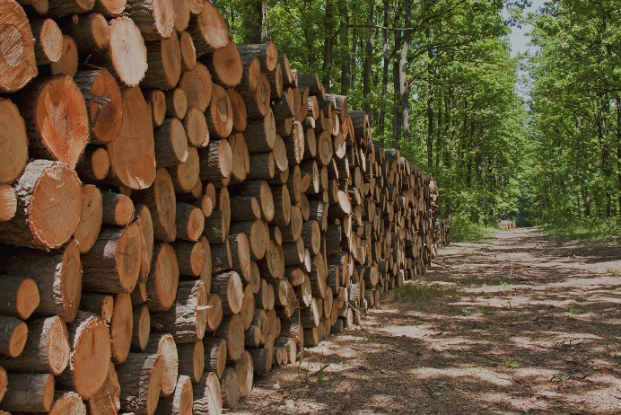
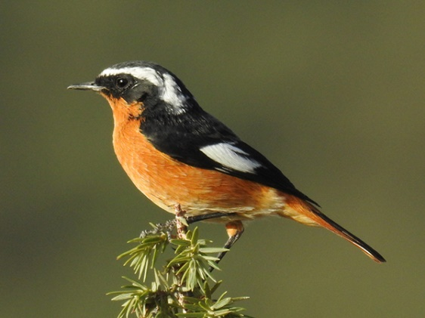
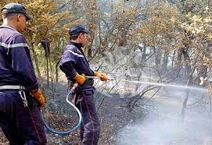
Fire Management – Recommendations

Slide 24
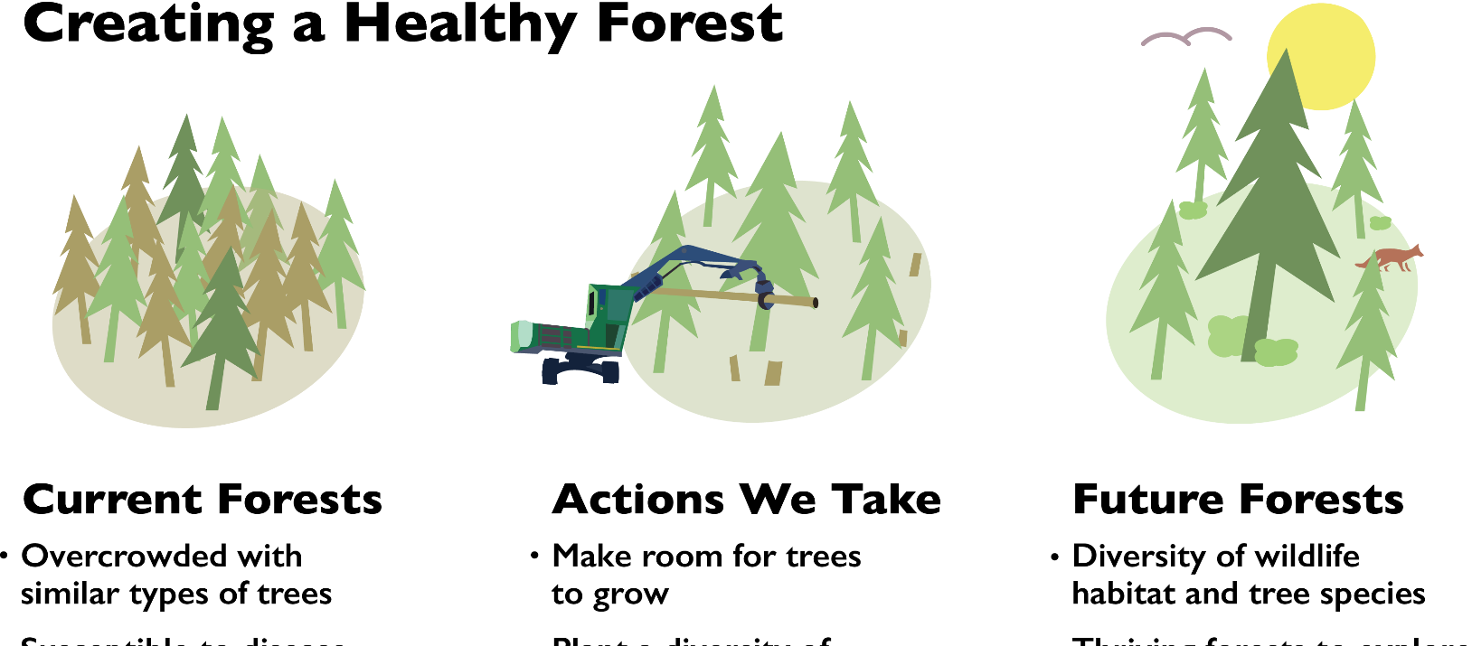
Integrating Fire Management with Sustainable Forest Management

Slide 25
Develop a National Forest Fire Prevention and Management Action Plan
Define goals and objectives
Define roles and responsibilities
National FFPM Action Plan (incentivize performance)
Issue comprehensive guidelines
Process needs to be open, consultative, time-bound

Slide 26
Invest in Staffing, Capacity and Management Practices
Ensure adequate, reliable funding
Ensure sufficient workforce by filling vacancies for front line staff
Ensure workforce is trained
Institute standard management practices, balance prevention, and post-fire reporting

Slide 27
Invest in and Update Technology
Early warning and forest fire detection technology
Use available technology, including cell phones, social media
Test, experiment and scale up best practices

Slide 28
Engage and Incentivize Communities
Work with communities to ensure that fire is used in a responsible way while seeking to avoid damaging fires
Give communities greater voice in decision-making process
Incentivize communities (employment, small cash rewards, public recognition)

Slide 29
Invest in Data and Information
National Forest Fire Information Database
National research agenda (public institutes and agencies, universities, NGOs)
Forum for province-to-province learning
Opportunities for South-South Learning

Slide 30
Thank You

