Slide 1
Impacts of COVID-19 on Multinational Enterprises (MNEs):
Evidence from the WBG Global MNE Pulse Surveys
Presentation by:
Abhishek Saurav
Global Investment Climate Unit
World Bank
April 2021

Slide 2
Outline
1 | MNE Pulse Survey research
2 | MNE operations and investment plans
3 | GVC shifts – any evidence?
4 | Coping mechanisms in a crisis
5 | Lessons for policymakers

Slide 3
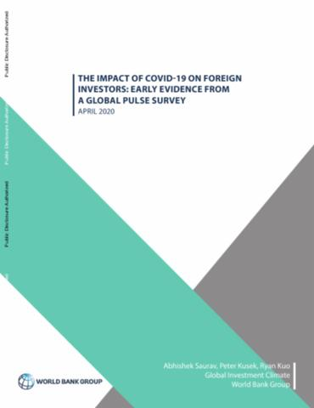
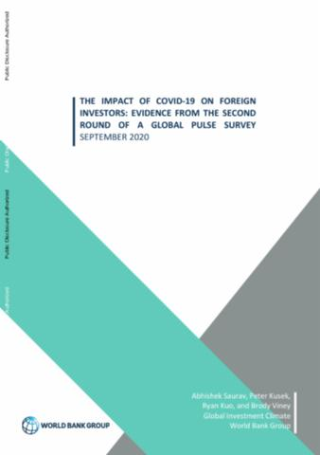
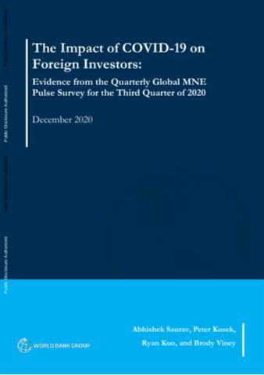
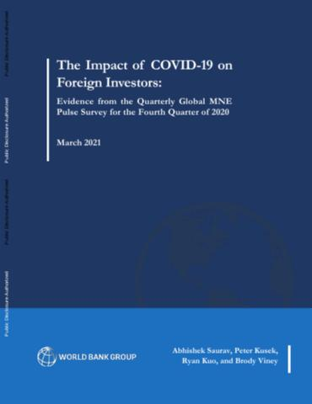
Background on the MNE Pulse Survey
We have run quarterly MNE surveys since April 2020 to understand the effects of the crisis on MNEs affiliates, providing real-time insights
First two rounds (Q1 and Q2 2020) were pilots, with ~100 respondents each
More recent rounds (Q3 and Q4 2020) have increased in size and scope
Each survey has >300 MNE affiliates (50 per WBG region)
50/50 split of manufacturing and services
Respondents are senior executives in MNE affiliates operating in developing countries.

Slide 4
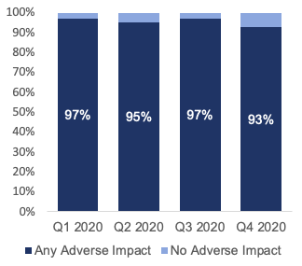
MNEs experienced a severe and prolonged shock in 2020
The MNE Pulse Survey asks firms about their performance relative to 2019 across a range of business dimensions (e.g., supply chain, demand, output, profit)
Results indicate the adverse effects of the pandemic have been widespread and prolonged
More than 95% of firms reported adverse effects in Q1 through Q3, improving slightly in Q4
Notably, magnitude of impacts has eased gradually
Our results indicate that MNE affiliates in manufacturing have been more affected than those in business services (e.g., IT, finance, professional services, and logistics).
Share of respondents affected by the pandemic on at least one business dimension (Q1 n = 105; Q2 n = 78; Q3: n = 305; Q4: n = 329)

Slide 5
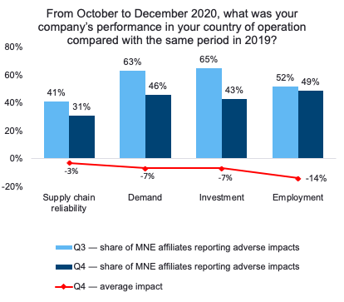
Q4 results suggest supply and demand shocks are easing
Share reporting adverse supply chain, demand, investment, and employment effects in Q4 (n = 329)
The share of firms reporting adverse supply chain and demand effects in Q4 improved from Q3 2020
the incidence of adverse supply chain effects has decreased by 10 percentage points
the incidence of adverse demand effects has decreased by 17 percentage points
The share of firms reporting that they reduced investment in Q4 also improved from Q3 – but around half still reported reduced employment
Despite signs of improvement, around two-thirds still reported that output, revenue and profits were down (largely unchanged from Q3)

Slide 6
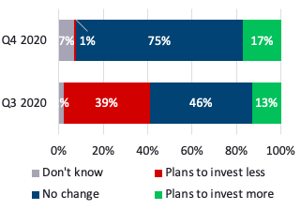
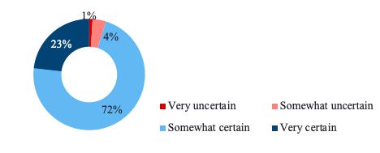
Investment plans are stabilizing – but uncertainty remains
Share of respondents expecting their parent to change its
level of investment in the host country in the next 1-3 years (Q3: n = 305; Q4: n = 329)
The investment outlook was negative in Q3, with many MNEs planning to reduce investment in the host country.
Q4 data suggest that the investment outlook is stabilizing
75% of firms expect to maintain their current investment levels
Very few (1%) plan to reduce investment
Uncertainty about the recovery will naturally prevent firms from committing to new investments
Only a quarter of firms are 'very certain' about their investment plans – most are only 'somewhat certain'
This is consistent with the collapse in new greenfield FDI announcements (down 35% globally in 2020).
Share of respondents certain/uncertain about their parent's investment plans in Q4 (n = 329)

Slide 7
What about major GVC reorganization?
So far, survey results offer limited evidence of a major reorganization of GVCs prompted by the pandemic.
Most respondents (92%) reported they were not changing their input sourcing in Q4...
...and similarly, most did not expect there to be a change in the role of their host country operations in their supply chain
Among firms expecting investment to increase (17% of total), only a third cited nearshoring as a reason (6% of total)​...
...and even fewer (one-fourth) cited reshoring as a reason (4% of total)​
92%
34%
83%
25%
Changes to sourcing and GVC structures require time, months or even years.
Our forthcoming Global Investment Competitiveness Survey will investigate these shifts at the MNE HQ level.​​

Slide 8
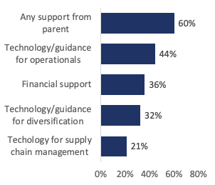
MNEs supported their affiliates to cope with the crisis
Networks of relationships between MNE parents, affiliates, and suppliers can generate benefits including technology transfer and finance. This occurred during crisis.
Q3 survey results indicate that around 60% of MNE affiliates received some support from their foreign parent, mainly technology and guidance for operational continuity.
Many MNE affiliates, in turn, provided support to their local suppliers (55%)
Affiliates receiving support from HQ were more likely, by about 20 percentage points, to provide support to their suppliers.
Share of respondents that received support from their foreign parent during the COVID crisis (Q3, n = 305)

Slide 9
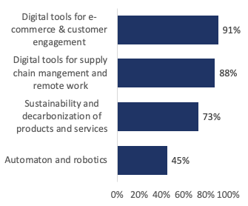
COVID has increased adoption of technology and sustainability
Nine-in-ten MNE affiliates increased their use of digital tools during the pandemic, for:
E-commerce and customer engagement
Managing supply chains
Tools for remote working
The focus on sustainability and decarbonization is now mainstream
Automation and robotics are rapidly being adopted, particularly by affiliates that are HQed in developed countries (48% vs. 27%)
Share of respondents that adopted new technologies and approaches during the COVID crisis (Q4, n = 329)

Slide 10
Opportunities for policymakers
Government support has been and remains important for most MNEs to manage the pandemic's impacts and restart production and investment
We find that FDI Policy has a key role in shaping investment plans. This is consistent with literature.
MNE affiliates that expect to invest more in the coming years, 9 out of 10 times identify the policy environment as a key driver
The investment environment is uncertain and expected to be competitive. But policymakers have a real opportunity -to undertake investment policy reforms that boost investor confidence.
Attracting FDI will be critical to underpin a robust recovery.
Share of respondents that expect their parent to invest more, that cite realised or expected changes in the policy environment as a reason (Q4, n = 56)
91%

Slide 11
Recap
1 | MNE Pulse Survey research (monitor MNEs, Q1 2021 underway)
2 | MNE operations and investment plans (gradually improving, uncertainty)
3 | GVC shifts – any evidence? (limited nearshoring or reshoring)
4 | Coping mechanisms in a crisis (technology and sustainability)
5 | Lessons for policymakers (FDI reforms to support recovery)

