Slide 1

OPCS 2023
Delivering ESF through
Sustainable Public Procurement

Slide 2
Workshop Approach
Learning Objectives:
    Attendees should leave the workshop knowing:
      What is Sustainable Public Procurement (SPP)?
      What does SPP mean for the Bank?
      How ESF, GRID, Climate Change Action Plan and Procurement Framework fit together to support SPP?
      How best to engage with E&S colleagues and the TTL on SPP?
      How to implement SPP through procurement-related actions?

Slide 3
Agenda
Day One
Part One: Introduction to Sustainable Public Procurement
Part Two: Understanding the ESF and Procurement Framework
Part Three: The Bank’s Project Cycle, ESF vis a vis Operations Procurement
Part Four: Preparation Stage – Identification / Concept
Day Two
Part Five: Preparation Stage – Appraisal
Part Six: Implementation

Slide 4
Overview of Group Exercises
Introduction:
    Implementing Sustainable Public Procurement: Challenges and Opportunities
    ESF cascade to Contractors
    Pop quiz on ESF
SPP Approach will be built step by step:
    Risk identification and mitigation
    Procurement-related actions
    Prepare bidding documents
    Engaging the Supervising Engineer

Slide 5
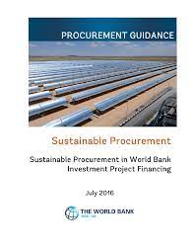


Rollout of SPP Training and Support
Steps to integrate E&S thinking into procurement
Procurement and E&S Practitioners may find the following support and advice helpful:
Integrated Guidance
F2F and e-Learning
Practical Tools
Master document, all in one place
Tailored, shorter versions for different audiences e.g.
  Borrowers
  TTLs
  Procurement / E&S practitioners
  Contractors / suppliers
In-person 2-day training on SP/ESF targeting procurement practitioners
In-person 2-day training on Procurement for E&S staff e.g. How SPDs, FIDIC work etc.
e-Learning, TTLs, Borrowers
‘Cascade Tool’ being developed to show how specific ESF topics are addressed in Project Cycle and Procurement e.g. Safety
Fact sheets to provide example KPIs, specifications, rated criteria etc.

Slide 6

Part 1 - Introduction to Sustainable Public Procurement

Slide 7
Introduction to Sustainable Public Procurement
Part 1: Learning Objectives
Define Sustainable Public Procurement (SPP)
The three key categories of SPP, and the benefits of each
The role of sustainability in the Bank’s Procurement Framework
Potential SPP approaches for different operation’s contexts and sectors
Connections between SPP and the Environmental and Social Framework Green, Resilient and Inclusive Development and Climate Change Action Plan
Introduce new SPP Master Guidance Document
Procurement’s role in responding to climate change and Paris alignment
National government’s enablers for successful SPP
Part One
Part Two
Part Three
Part Four
Part Five
Part Six

Slide 8
What is Sustainable Public Procurement?
“A process whereby public organizations meet their needs for goods, services, works, and utilities in a way that achieves value for money on a whole lifecycle basis in terms of generating benefits not only to the organization, but also to society and the economy, whilst minimizing damage to the environment”
Procuring the Future (2006)

Slide 9
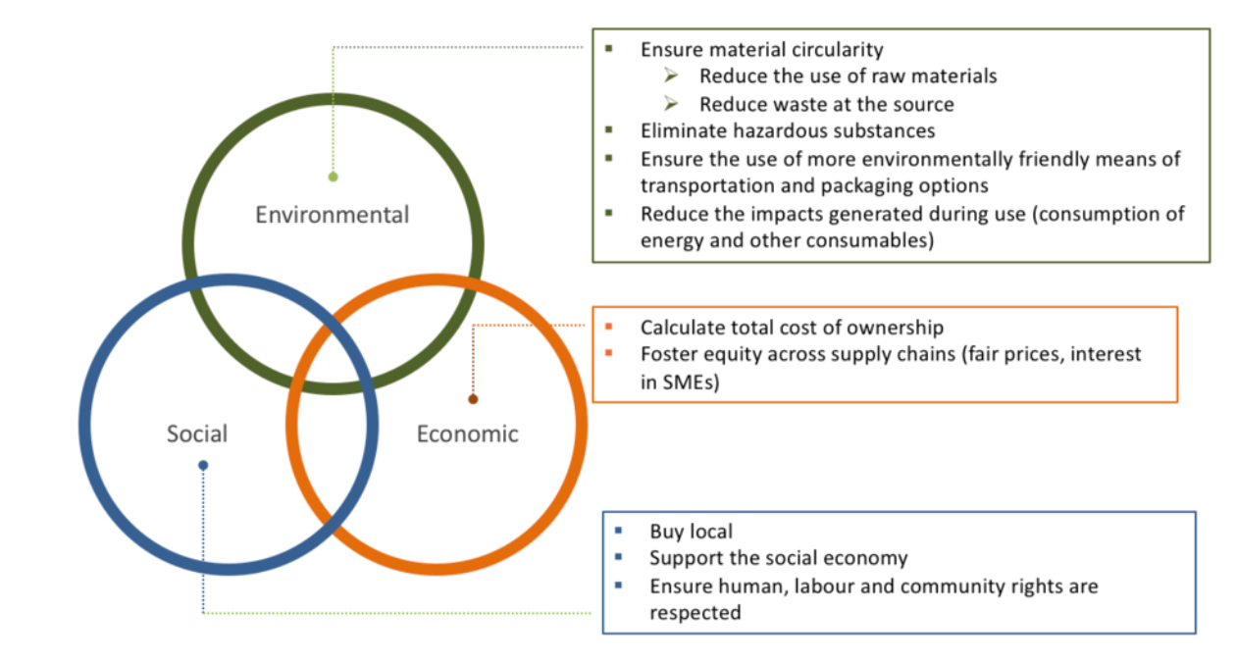
Consider domestic preference

Slide 10
Evolution of Sustainable Public Procurement
US Government launches Energy Star as a tool to influence buyers to consider sustainability
UNEP publishes ‘Sustainable Public Procurement Implementation Guidelines
UNEP Global Review of SPP finds that all 45 surveyed governments have national SPP policies
2006 – 2011
2020
1992
2012
2022
United Nations launches Marrakech Task Force on SPP led by Swiss Government
UK Government launches Procuring the Future,
SPP Strategy
COVID-19 highlights need for public spending to build resilience and achieve green, sustainable development

Slide 11
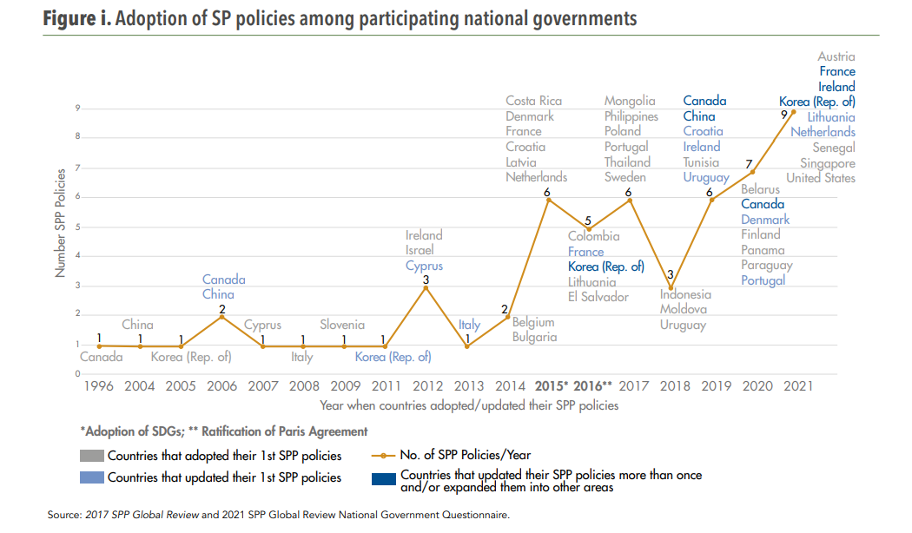
Overview of International Practice
Includes the following Borrowers:
Belarus
China
El Salvador
Indonesia
Latvia
Lithuania
Mongolia
Panama
Paraguay
Philippines
Poland
Senegal
Slovenia
Thailand
Tunisia
Uruguay

Slide 12
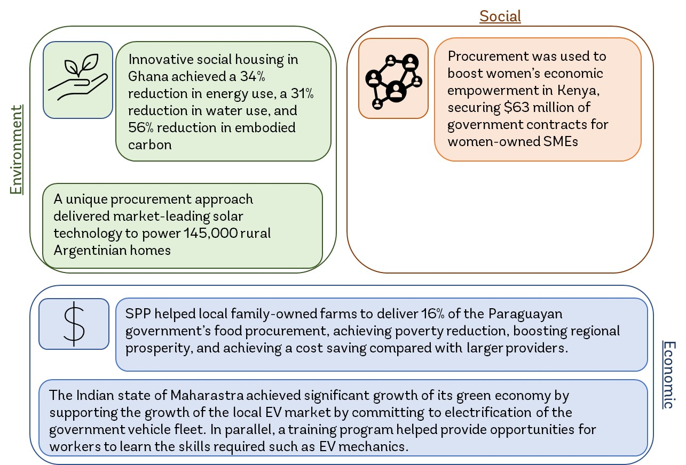
Borrower SPP Practices

Slide 13
Procurement’s role in responding to climate change
To keep global warming to no more than 1.5°C – as called for in the United Nations Paris Agreement – emissions need to be reduced by 45% by 2030 and reach net zero by 2050
Scope 1
Direct emissions arising from owned or controlled sources e.g. owned vehicles, combustion of fuel in facilities
Scope 2
Indirect emissions from purchased energy e.g. electricity, heating, cooling
Scope 3
All other indirect emissions that occur in the organisation’s value chain e.g. procurement of works, goods and services, waste, business travel, staff commuting, water

Slide 14
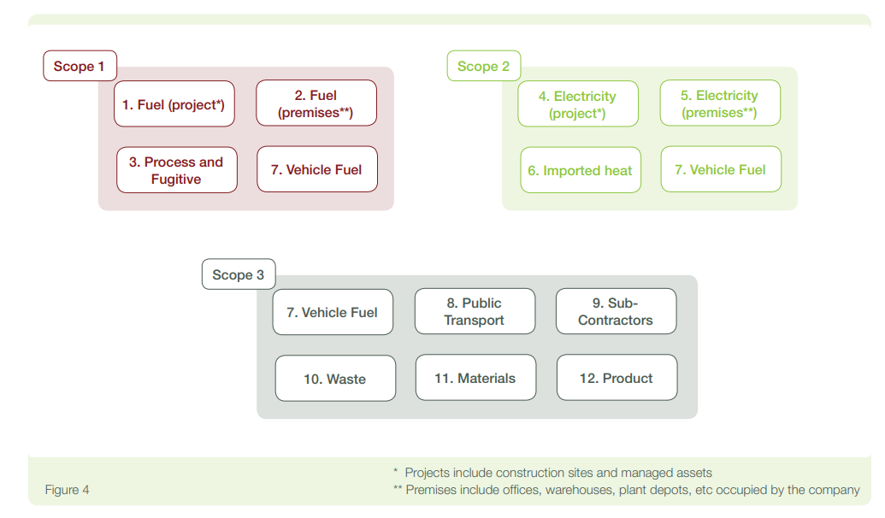
Example - Construction related emissions

Slide 15



World Bank’s sustainability agenda
Environmental and Social Framework (ESF)
Green, Resilient and Inclusive Development (GRID)
Ten standards covering c. 50 procurement-related E&S issues
Flexible, risk-based approach to mitigate a project’s biggest risks
Implemented using a range of ‘instruments’ including ESMP, ESCP
Plus Good Practice Notes, Technical Notes and Guidance
GRID promotes economic growth that goes hand in hand with environmental goals and social inclusion
Ensures Bank investment meets criteria to be green, resilient and inclusive
Sustainable Procurement
Climate Change Action Plan
Seeks to achieve alignment with 2015 Paris Agreement through 3 priorities:
Integrating climate and development
Identifying and prioritizing mitigation and adaptation opportunities
Drive climate finance and leverage private capital to deliver results
*Now reinforced by Paris Alignment mandate from 1 July

Slide 16
Integrating ESF, GRID and Climate
Sustainable Public Procurement
ESF
Identify the project’s E&S risks
Work with E&S team to identify those that require action by procurement and develop mitigations
Embed mitigations throughout procurement cycle
GRID
Consider how procurement can contribute to PDOs
Explore opportunities to grow economy by investing in SMEs for example
Identify opportunities to pilot new and innovative approaches that support green growth
Climate
Understand project’s emissions impacts
Consider how they can be reduced
  Low-carbon construction options in specifications
  Reduction proposals from Contractors

Slide 17


Perceptions of SPP
Perceptions of SPP
SPP is more costly
SPP makes corruption more likely
SPP is impossible to measure
Contractors don’t have the capacity to deliver SPP
SPP favors larger Bidders from HiC’s
Reality of SPP
SPP takes a broader view of cost, consider whole of life and broader economic factors
Risk of corruption can be mitigated through transparency and a clear evaluation methodology; SPP makes collusion harder by introducing additional evaluation factors beyond cost
Given the number of benefits that can be achieved, there are even more possibilities for procurement to measure value
SPP may involve developing Contractor capacity, as SPP is often used to lift standards in the private sector
SPP often explicitly targets local SMEs and marginalized businesses to support socio-economic development

Slide 18
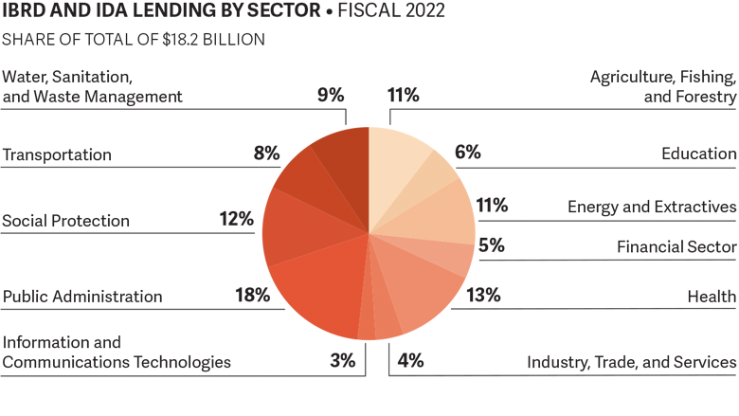
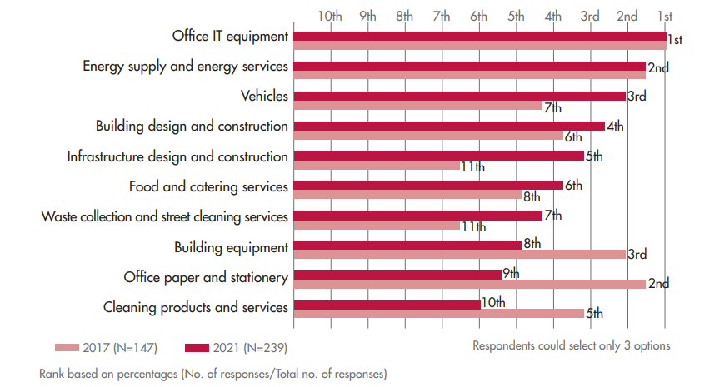
SPP in different sectors and categories
World Bank project sectors
Common focus categories for SPP
Source: World Bank Annual Report 2022
Source: UNEP Global Review 2022
Notes:
Different sectors involve different sustainability risks and opportunities given the nature of competition in the market, the inherent scale and severity of environmental impact, supply chain complexity, local and national laws and controls, and availability of standards and evaluation techniques in the sector. Supply chains typically originate with the mining or harvesting of some form of raw material. The processes to refine or enhance those raw materials can present different social or environmental risks, depending on the nature of the physical labor involved, the natural environment, the energy or water required, the geographic location and a number of other factors. Additionally, some supply chains may be harder to determine and monitor due to the number of firms involved, and their maturity to transparently and accurately record or monitor activity, making it difficult to ascertain if environmental and social standards are being met.
Owing to the complexity and global nature of modern supply chains, even sectors that on face value do not appear resource intensive, in fact, after deeper investigation be found to present considerable environmental or social impacts. The information and communications technology (ICT) industry, for example, could use 20% of all electricity produced by 2025, and emit up to 5.5% of the world’s carbon emissions. Given that environmental and social risks present themselves in all significant industries and sectors, it is useful to consider the opportunities for procurement processes to pursue sustainability benefits for different investment projects.
The US Government’s Bureau of International Labor Affairs maintains a List of Goods Produced by Child Labor or Forced Labor, which also highlights the regions where these issues are most likely to arise

Slide 19
Risk prominence across sectors
Illustrative example of 4 key risks and the industry sectors they are most prevalent in
 | Environmental Risks |  | Social risks
Risk type | Net zero carbon | Pollution (air, water, soil, light and noise) |  | Forced Labor | Occupational Health & Safety
Description | “Harder to-abate” sectors serve as a barrier to achieving net zero carbon. Heavy industry and transport currently account for 10Gt (30%) of total global CO₂ emissions | There are five main types of pollution troubling our planet: air, water, soil, light, and noise. Air pollution and water pollution pose the biggest threat, with air pollution contributing close to 8.7 million deaths globally and water pollution contributing to 1.5 million children’s deaths and the poisoning of our waterways and sea life |  | Of the 24.9 million global victims of forced labor, 16 million were in the private economy, 4.8 million were in forced sexual exploitation, and 4.1 million were in forced labor imposed by state authorities | The European Union collates data on fatal accidents at work across member countries by sector
Sectors | Cement Steel Plastics Heavy Road Transport Shipping Aviation | Fuel Agriculture Fashion Food retail Transport Construction Technology |  | Domestic work (24%) Construction (18%) Manufacturing (15%) Agriculture, forestry and fishing (11%) | Construction (22%) Transportation and storage (15%) Manufacturing (15%) Agriculture, forestry and fishing (12%)
Notes:
Different sectors involve different sustainability risks and opportunities given the nature of competition in the market, the inherent scale and severity of environmental impact, supply chain complexity, local and national laws and controls, and availability of standards and evaluation techniques in the sector. Supply chains typically originate with the mining or harvesting of some form of raw material. The processes to refine or enhance those raw materials can present different social or environmental risks, depending on the nature of the physical labor involved, the natural environment, the energy or water required, the geographic location and a number of other factors. Additionally, some supply chains may be harder to determine and monitor due to the number of firms involved, and their maturity to transparently and accurately record or monitor activity, making it difficult to ascertain if environmental and social standards are being met.
Owing to the complexity and global nature of modern supply chains, even sectors that on face value do not appear resource intensive, in fact, after deeper investigation be found to present considerable environmental or social impacts. The information and communications technology (ICT) industry, for example, could use 20% of all electricity produced by 2025, and emit up to 5.5% of the world’s carbon emissions. Given that environmental and social risks present themselves in all significant industries and sectors, it is useful to consider the opportunities for procurement processes to pursue sustainability benefits for different investment projects.
The US Government’s Bureau of International Labor Affairs maintains a List of Goods Produced by Child Labor or Forced Labor, which also highlights the regions where these issues are most likely to arise

Slide 20
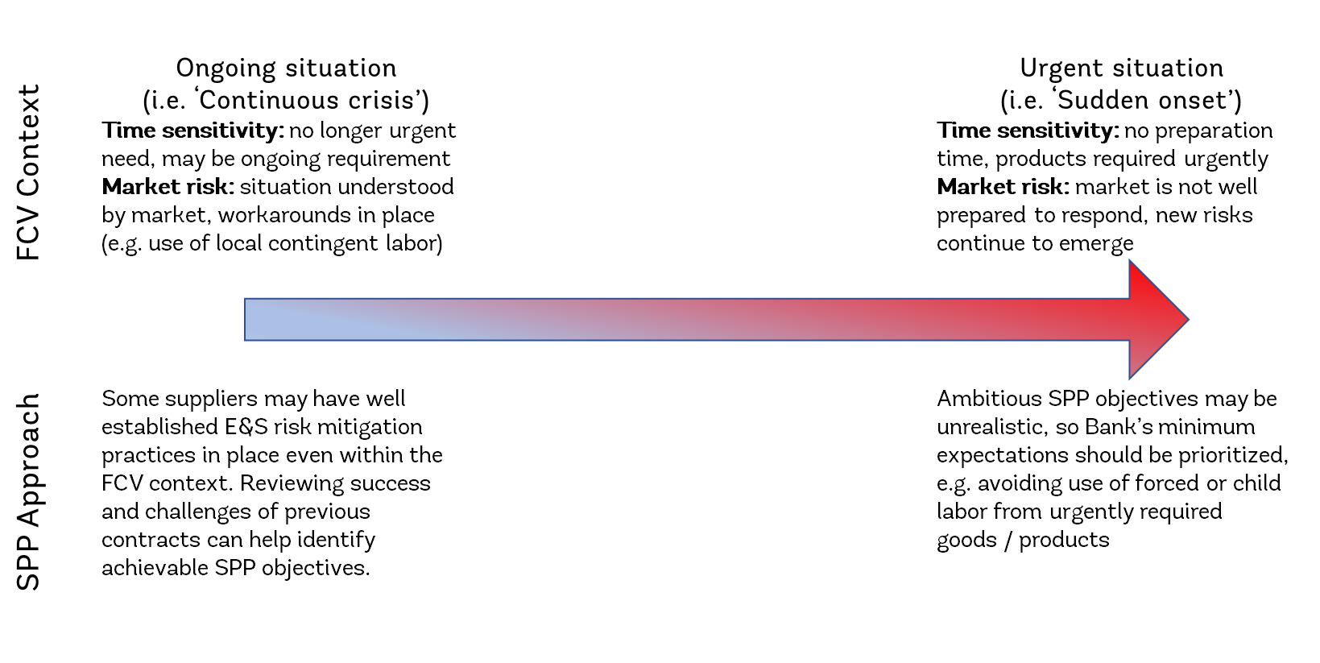
Achieving SPP in FCV
Notes:
Different sectors involve different sustainability risks and opportunities given the nature of competition in the market, the inherent scale and severity of environmental impact, supply chain complexity, local and national laws and controls, and availability of standards and evaluation techniques in the sector. Supply chains typically originate with the mining or harvesting of some form of raw material. The processes to refine or enhance those raw materials can present different social or environmental risks, depending on the nature of the physical labor involved, the natural environment, the energy or water required, the geographic location and a number of other factors. Additionally, some supply chains may be harder to determine and monitor due to the number of firms involved, and their maturity to transparently and accurately record or monitor activity, making it difficult to ascertain if environmental and social standards are being met.
Owing to the complexity and global nature of modern supply chains, even sectors that on face value do not appear resource intensive, in fact, after deeper investigation be found to present considerable environmental or social impacts. The information and communications technology (ICT) industry, for example, could use 20% of all electricity produced by 2025, and emit up to 5.5% of the world’s carbon emissions. Given that environmental and social risks present themselves in all significant industries and sectors, it is useful to consider the opportunities for procurement processes to pursue sustainability benefits for different investment projects.
The US Government’s Bureau of International Labor Affairs maintains a List of Goods Produced by Child Labor or Forced Labor, which also highlights the regions where these issues are most likely to arise

Slide 21
Example - Achieving SPP in Yemen (FCV)
Background: After five years of escalating conflict, Yemen continues to face an unprecedented humanitarian, social, and economic crisis with about 80% of the population (24.1 million people) requiring humanitarian assistance.
Approach: The Bank and UNOPS are working together on a number of projects to repair critical infrastructure in Yemen, including rehabilitation of sewers across the capital city, Sana’a. Bidders were still asked how they would ensure environmental and social protections were in place, using an Environmental and Social Management Framework that met national laws and aligned with the ESF. Each project would then involve an ESMP, which assessed risks and impacts and necessary mitigations. Procurement supported this approach by including:
An SEA/SH requirement for Bidders to agree to a set of principles and a template SEA/SH Action Plan for protecting beneficiaries
Market engagement exercises to build capacity of local contractors and build awareness of E&S and OHS requirements
Pre-biding meetings to discuss contract terms
Outcome: A number of benefits were achieved, including:
Increased participation among women during ESMP consultation
Increased understanding of SEA/SH requirements among Contractors
Increased accountability for SEA/SH grievance mechanisms, including use of multiple channels (complaints boxes, What’s App)

Slide 22






Borrower roadmap towards SPP
Policy settings
Legal framework
Performance monitoring and data
Budgeting processes
eProcurement
Procurement processes
Market capacity
Capacity building

Slide 23

Key messages
SPP involves seeking economic, environmental and social benefits from public procurement
SPP in the Bank involves implementing the ESF, and supporting Bank priorities such as GRID and the Climate Change Action Plan
Approaches to SPP vary by sector and context, but core ESF requirements must be achieved in any setting
To mainstream SPP, Borrowers need to work towards implementing appropriate legal, policy, capacity building and technology measures
Part One
Part Two
Part Three
Part Four
Part Five
Part Six
23

Slide 24
Part 1 - Introduction to SPP (continued)
Julie Farmer

Slide 25
Progress Group Exercises
Introduction:
    Implementing SPP: Challenges and Opportunities
    ESF cascade to Contractors
    Pop quiz on ESF
SPP Approach will be built step by step:
    Risk identification and mitigation
    Procurement-related actions
    Prepare bidding documents
    Engaging the Supervising Engineer

Slide 26
Group Exercise: Implementing SPP – Challenges and Opportunities
Half of the groups will consider challenges, and the other half will consider opportunities for SPP generally in Bank-financed projects. Spend 20 minutes.
Groups looking at Challenges: In small groups, please outline the key challenges to implementing SPP in Bank-financed projects and rank them according to importance.
Groups looking at Opportunities: In small groups, please outline the key opportunities to implement SPP in Bank-financed projects and rank them according to importance.
We will then have a facilitated discussion to consolidate challenges and opportunities, and everyone will have the opportunity to add to each other’s lists.

Slide 27

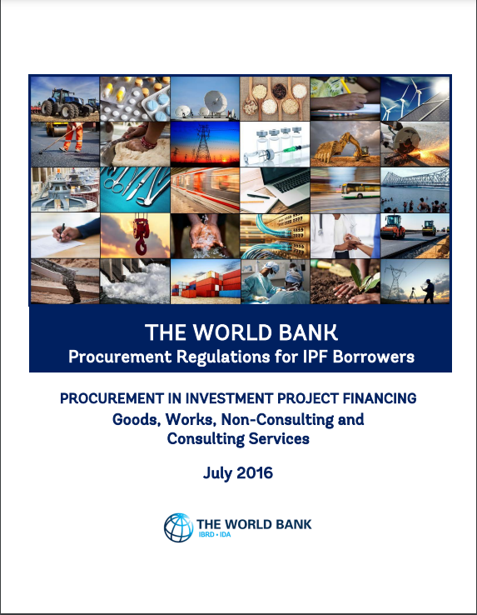
Part 2
The ESF and Procurement Framework

Slide 28
The ESF and Procurement
Part 2: Learning Objectives
What is the ESF?
The topics covered by the ten Environmental and Social Standards (ESSs)
How the ESF is applied to World Bank financed projects
The role that procurement related actions play in achieving the Environmental and Social Standards
How E&S risks can be mitigated through bidding/proposal documents
Part One
Part Two
Part Three
Part Four
Part Five
Part Six

Slide 29
The ESF
The ESF applies to all IPF projects regardless of value, but “uses a risk-based and proportionate approach that applies increased oversight and resources to complex projects and allows for greater responsiveness to changes in project circumstances through adaptive risk management and stakeholder engagement”
World Bank (2018)

Slide 30
Scope of ESF application
All IPF projects initiated on or after October 1, 2018 must apply the ESF (ten ESSs) and the Procurement Framework
Co-financed projects with MDBs or delivered with UN agree a ‘common approach’
As a first step, the Borrower’s own E&S legislative and policy framework is assessed to identify any potential gaps relating to project E&S risks
Most Borrowers have signed international standards consistent with ESSs as part of ILO treaties or other obligations e.g. forced labor, child labor, climate change
ESS1 sets out the ‘how’ of the ESF (i.e., analysis, processes and documents that may be required), whereas ESS2–10 sets out the ‘what’ (main links to Procurement)
Changes to (or waivers from) the ESF require Board approval
Management cannot change ESF without Board approval, whereas Board delegated CPO responsibility to change/waive Procurement Regulation’s (E&S have far less flexibility than Procurement)

Slide 31
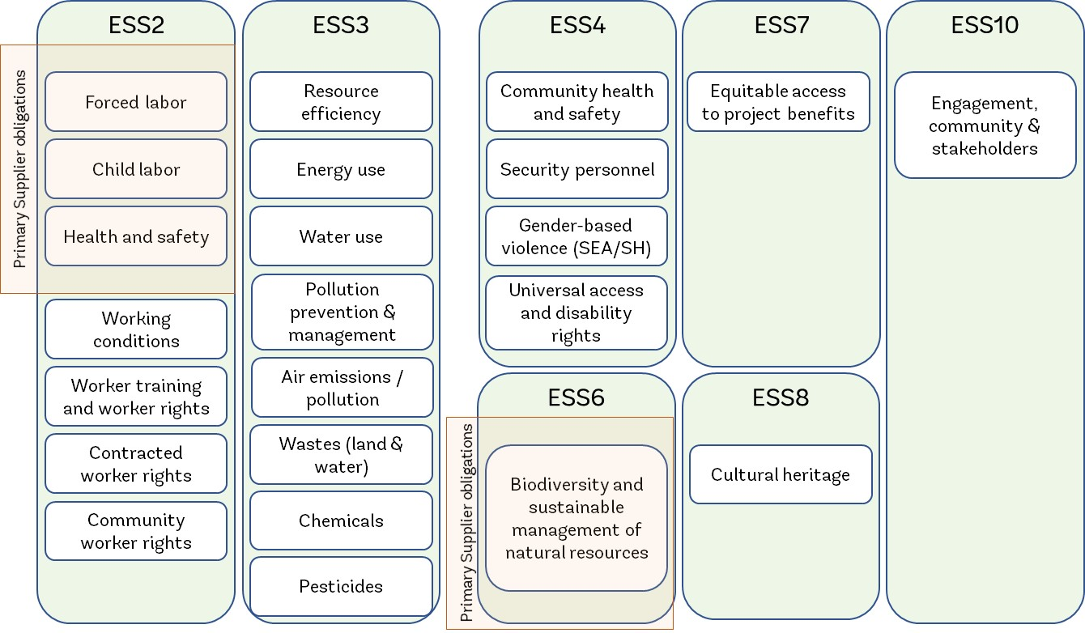
ESS1 - Sets out the Borrower’s responsibilities for assessing, managing and monitoring environmental and social risks and impacts associated with each stage of a Project, using a set of instruments and procedures
ESSs with Procurement Aspects

Slide 32
Applying the ESF to the project’s supply chain
Under the Legal Agreement, the Borrower is accountable for complying with the ESSs (regardless of procurement approach)
Most IPF projects involve procurement of Contractors, Suppliers or Consultants. In most cases, they will need to manage at least some (if not most) of the project’s E&S risks
Needs a great deal of coordination between the Borrower, Contractors, Suppliers and Consultants to manage E&S risks (some may be outside the Borrower’s country)
Many contracts involve sub-contractors, sub-suppliers, sub-consultants, who in turn may also subcontract to other parties, creating a long and sometimes complex supply chain
The [main] Contractor in a Works contract is singly responsible for all the actions of their sub-contractors and other parties within their supply chain (the ESF cascades certain requirements)

Slide 33
Cascade of E&S obligations

Slide 34
ESS1 Annex 3
“The Borrower will require that all contractors engaged on the project operate in a manner consistent with the requirements of the ESSs, including the specific requirements set out in the ESCP. The Borrower will manage all contractors in an effective manner, including:
(a) Assessing the environmental and social risks and impacts associated with such contracts;
(b) Ascertaining that contractors engaged in connection with the project are legitimate and reliable enterprises, and have knowledge and skills to perform their project tasks in accordance with their contractual commitments;
(c) Incorporating all relevant aspects of the ESCP into tender documents;
(d) Contractually requiring contractors to apply the relevant aspects of the ESCP and the relevant management tools, and including appropriate and effective non-compliance remedies;
(e) Monitoring contractor compliance with their contractual commitments; and
(f) In the case of subcontracting, requiring contractors to have equivalent arrangements with their sub-contractors.” See ESF Page 29

Slide 35
Obvious E&S links with procurement
ESS1
Borrower’s responsibilities
The Borrower’s overall responsibilities are to:
assess
manage
monitor
the E&S risks and impacts at each stage in the project
Obligations passed on to contractors
The Borrower must ensure that all Contractors operate in a manner consistent with the ESSs, including project-specific requirements set out in the Environmental and Social Commitment Plan (ESCP)
This means the Borrower must include relevant E&S obligations in contracts and require that relevant E&S obligations are included by contractors in their sub-contracts (page 29)
Cascading E&S obligations
ESS1 Annex 3 means:
The Borrower must include relevant E&S obligations in its contracts with the:
Contractor who will deliver the works
Supervising Engineer
The Contractor must impose similar E&S obligations (as appropriate) on its sub-contractors
Special E&S provisions apply to Primary Suppliers
ESS1 – Annex 3

Slide 36
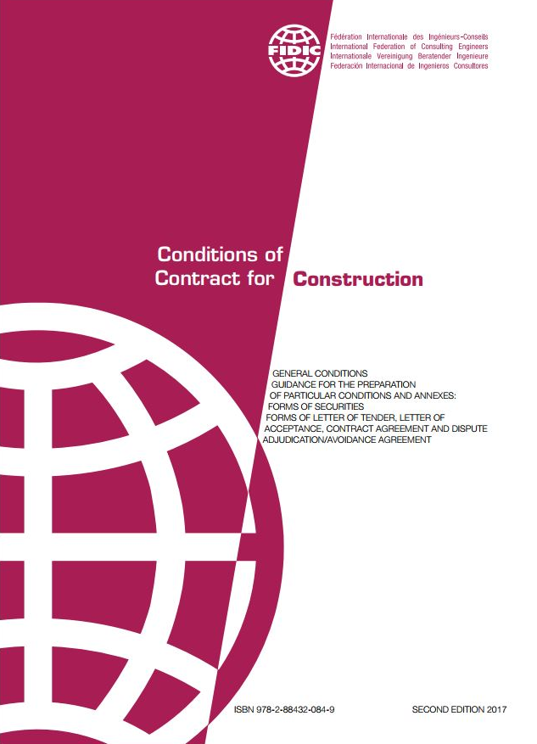
Standard Contract for large works (Red Book)
For large works projects the Bank uses the
FIDIC Conditions of Contract for Construction (2017)
The conditions of contract that apply comprise:
FIDIC General Conditions (GCs) | Bank’s Particular Conditions (PCs)
FIDIC “Red Book” stipulates industry standard E&S provisions | Conditions that supplement the FIDIC “Red Book” to reflect Bank Policy. These include ESF related provisions
The Bank’s PCs have been updated to reflect the ESF for general construction E&S matters
Fédération Internationale des Ingénieurs-Conseils

Slide 37
Types of E&S contract conditions
Industry standard E&S
FIDIC GCs, general
Bank specific E&S
Bank’s PCs, general
Project specific E&S
Requirements that need instruction
OHS obligations
Protection of the environment
Code of conduct
E&S training of personnel
Contractor’s personnel grievance mechanism
Forced labor and child labor
E&S reporting
Provision of a health service provider on site
Specific values for emissions, surface discharges, effluent etc.
Applicable rates of wages and conditions of labor
*Note! The Bank’s SPDs only cover general E&S matters. Each project will need to incorporate additional measures to address project-specific E&S risks
Example: project specific E&S issue to be included in the specification:
PC 4.1 (g) “If so stated in the specification, the contractor shall design work requirements for structural elements of the works taking into account climate change considerations”

Slide 38
Bank PC enhancements
Description | FIDIC General Condition | = FIDIC General Condition + Bank Particular Conditions
Engagement of Staff and Labour | Except as otherwise stated in the Specification, the Contractor shall make arrangements for the engagement of all Contractor’s Personnel, and for their payment, accommodation, feeding, transport and welfare. | Except as otherwise stated in the Specification, the Contractor shall make arrangements for the engagement of all Contractor’s Personnel, and for their payment, accommodation, feeding, transport and welfare. The Contractor shall provide the Contractor’s Personnel information and documentation that are clear and understandable regarding their terms and conditions of employment. The information and documentation shall set out their rights under relevant labour Laws applicable to the Contractor’s Personnel (which will include any applicable collective agreements), including their rights related to hours of work, wages, overtime, compensation and benefits, as well as those arising from any requirements in the Specification; and shall also include the Code of Conduct for Contractor’s Personnel as set forth in Sub-Clause 4.25. The Contractor’s Personnel shall be informed when any material changes to their terms or conditions of employment occur. The Contractor is encouraged, to the extent practicable and reasonable, to employ staff and labour with appropriate qualifications and experience from sources within the Country.

Slide 39
ESF issues that cascade to contractors
Working Hours (P, S) Wages (P, S) Overtime (P, S) Pay frequency (P, S)
Deductions (P, S) Rest breaks (P, S) Public Holidays/Vacation (P, S) Sickness/Sick Pay (P, S)
Maternity leave/Pay (P, S) Family leave/Pay (P, S) Nondiscrimination (P, S) Termination of employment (P, S)
Equality (P) Worker Organizations (P) Worker Rights (F, P) Child labor (F, P)
Forced labor (P) SEA/SH Prevention (P) Grievance Redress (F, P) Working environment (P, S)
Hazard Identification (F, P, S) Training of workers (F, P, S) Training records (P, S) Occupational Health & Safety (F, P, S)
Emergency Preparedness (P, S) Design & Safety (F, P, S) Remedies for injuries (P, S) Worker reporting of unsafe practices (P, S)
Traffic & Road Safety (S) Community Engagement (S) Stakeholder Engagement (S) Worker accommodations/canteens (P, S)
3rd Party Access/Audits (F, P, S) Contracted Worker rights (P, S) Primary Suppliers (P, S) Primary Supply Worker rights (P, S)
Community Worker rights (P, S) Resource efficiency (S) Energy use (S) Water use (S)
Biodiversity (S) Habitats (S) Invasive alien species (S) Sust. Mgt. of living natural resource (S)
Air Emissions/Pollution (F, P, S) Wastes (Land & Water) (F, P, S) Chemicals (S) Pollution Prevention and Mgt. (F, P, S)
Pesticides (S) Security Personnel/weapons (S) Equitable Project benefits (S) Cultural Heritage (F, P, S)
F = FIDIC General Conditions P = Bank Particular Conditions S = Specification

Slide 40

To sum up…
  Part 2: ESF and Procurement
  Borrower responsible for managing E&S risks at every stage – ESS1
  Obligation to manage project E&S risks must be cascaded by the Borrower to the Contractor/sub-contractors through procurement – ESS1 Annex 3
  E&S risks should be mitigated in the contract through:
  FIDIC General Conditions
  Bank’s Particular Conditions
  the Borrower including project-specific risks as Specifications in the Works’ Requirements
  E&S considerations are woven through the procurement process - we will look at these individual parts of the process later
  Essential to include E&S in Operations Procurement, otherwise:
  they are not costed
  there is no obligation on the Contractor to deliver them
  they are not managed “on the ground”
Part One
Part Two
Part Three
Part Four
Part Five
Part Six

Slide 41
Key messages – ESF and Procurement Framework
Procurement-related actions are key to implementing the ESF
Elements of the ESF have been integrated into the Bank’s SPDs. They will still require project-specific enhancements
If a Borrower’s national procurement documents are used, they ARE UNLIKELY to include all related ESF provisions
Regardless of cascading E&S requirements through contracts, the Borrower remains responsible to the Bank for managing E&S risks and impacts
Part One
Part Two
Part Three
Part Four
Part Five
Part Six
41

Slide 42
Progress Group Exercises
Introduction:
    Implementing SPP: Challenges and Opportunities
    ESF cascade to Contractors
    Pop quiz on ESF
SPP Approach will be built step by step:
    Risk identification and mitigation
    Procurement-related actions
    Prepare bidding documents
    Engaging the Supervising Engineer

Slide 43
Group Exercise (b):
ESF cascade to Contractors
In your groups, please spend 20 minutes:
Read and discuss the ESF paragraph you have been asked to examine and identify procurement-related E&S obligations that will likely need to be communicated to Contractors to be implemented in projects:
Group 1: ESS 2, page 33, paragraph 13
Group 2: ESS 2, page 33, paragraph 16
Group 3: ESS 2, page 34, paragraphs 21 and 22
Group 4: ESS 8, page 86, paragraphs 10 and 11
Group 5, please examine and determine what actions a Borrower should take to implement the requirement in ESS 6, page 72, paragraphs 38 and 39.
Prepare a flipchart with E&S topics that need to cascade (no need to write clauses)

Slide 44
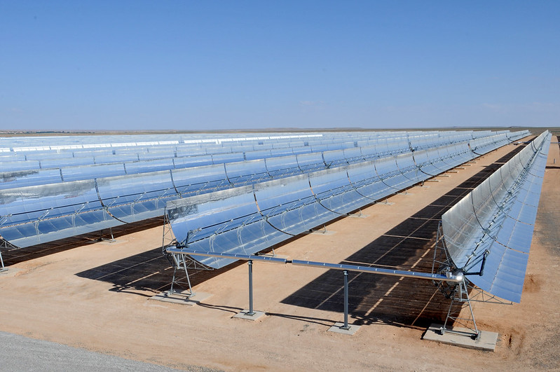
Part 3
Key Aspects of the Bank Project Cycle, ESF and Operations Procurement
Andy Cochrane

Slide 45
Introduction to Bank Project Cycle
Part 3: Learning Objectives
Stages of the Bank Project Cycle and key SPP steps at each stage
The Seven Stages of Operations Procurement’s fit with ESF
Roles and responsibilities across the Task Team in relation to implementing SPP
Responsibilities of the Contractor, the Borrower, the Supervising Engineer and the Task Team when implementing the project and managing the contract
Part One
Part Two
Part Three
Part Four
Part Five
Part Six

Slide 46
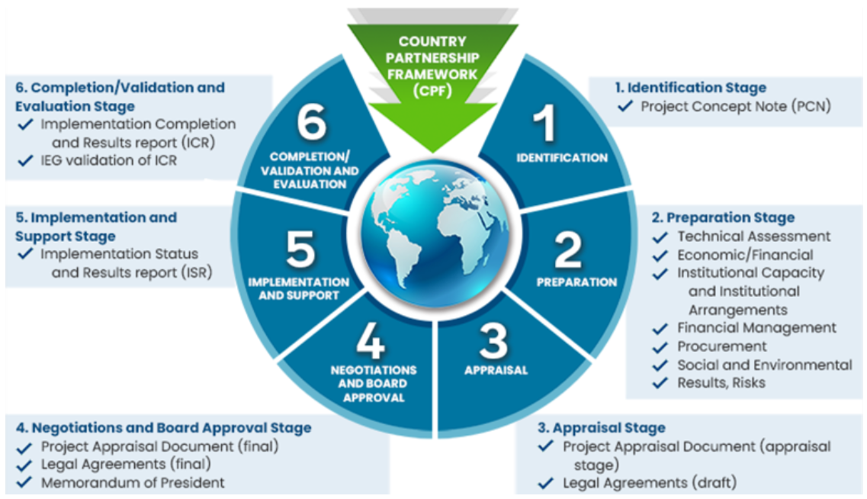
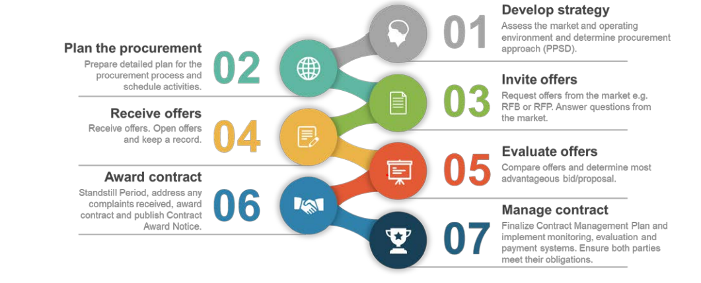
Project cycle and Operations Procurement

Slide 47
Overview of SPP Steps in Project Cycle
ESS1 identifies a number of ESF ‘instruments’ for the Borrower to use to help them identify, assess and mitigate E&S risks in the project e.g. C-ESRA, ESA, ESMP etc.
1a. Preparation (Identification / Concept)
1b. Preparation (Appraisal)
2. Negotiation
&
3. Approval
4. Implementation and Support
5. Completion and Evaluation
Concept-stage Environmental and Social Review Summary (C-ESRS)
Environmental and Social Management Plan (ESMP)
Targeted plans such as Biodiversity Management Plan or Resettlement Action Plan
E&S Reporting and Grievance Redress Mechanism
Appraisal-stage ESRS (A-ESRS)
Environmental and Social Assessment (ESA), which may involve developing public facing Environmental and Social Impact Assessment (ESIA)
Environmental and Social Commitment Plan (ESCP)
Contractor Environmental and Social Management Plan (C-ESMP)

Slide 48
Overview of SPP Steps in Project Cycle
Preparation (Identification / Concept)
Preparation (Appraisal)
Negotiation & Approval
Implementation and Support
Completion and Evaluation
Borrower develops project procurement strategy in PPSD
PPSD sets out procurement mitigations for E&S risks
Bank reviews PPSD and finalizes Procurement Plan
Sets out support provided by Bank, use of prior review, HEIS etc.
Borrower delivers the Procurement Plan
Bidding documents (either SPD or national) include E&S risks mitigations as contract clauses, specs or evaluation criteria
Bank procurement staff review success of Borrower’s procurement activity
Procurement activities
Early market engagement
Understand procurement risks
Consider alternatives
Bank and Borrower agree ESCP, setting out how Borrower will meet the ESSs
Project given E&S risk classification
PAD submitted to Board
Bank looks for outstanding E&S commitments for Borrower to fulfill
Bank evaluates project outcomes and results
E&S activities
Initial review of project E&S risks
Analysis to support development of PCN
Borrower carries out ESA process to review project E&S risks
Environmental and Social Management Plan details project risks and mitigations
Bank and Borrower discuss mitigations and additional controls such as third-party monitoring and role of Supervising Engineer

Slide 49
Key strengths of Procurement and E&S
Procurement
Understand supply market dynamics
Develop strategies for using the market to deliver project outcomes (PPSD)
Act as the interface between the project’s requirements and the market’s capabilities
Advise Borrower on appropriate process for managing risk and following good practice
Facilitate translation of requirements into specifications, evaluation criteria and KPIs
E&S
Understand environmental and social context of the project including key risks and constraints
Can identify E&S risks in relevant markets and sectors
Advise Borrower on mitigating E&S risks through tools such as audits, contract provisions, monitoring etc.
Have technical knowledge on E&S matters to facilitate development of appropriate actions

Slide 50
Bank roles | Task Team Leader Overall project leadership Coordinate Task Team, bring together experts and make internal linkages (E&S and Procurement) Lead determination Bank’s position on most project matters Interlocutor between the Bank, technical specialists and Borrower | Environmental & Social Specialists Technical E&S support and due diligence on ESF Advise on mitigating E&S risks, including criteria for bidders, performance measures etc. Work with procurement to incorporate E&S requirements in bidding docs Supervise Contractor against E&S commitments | Procurement Specialist Procurement advice to Task Team including application of Procurement Framework Recommend appropriate bid documents that use Bank standard E&S clauses Liaise with E&S Specialist to confirm E&S requirements have been incorporated throughout process Supervise procurement for alignment with PPSD
Borrower roles | Borrower implementing agency: Implements project in accordance with legal agreement, including ESF and Procurement Framework Assess, manage, and monitor E&S risks and impacts at each stage in the project Include relevant E&S obligations and legal remedies in appropriate contracts Manage Contractors to ensure they meet the ESSs, ensuring they also supervise Subcontractors and Suppliers | Supervising engineer (large works only): Borrower’s representative on site Monitor site operations Make day-to-day decisions in delegated areas and escalate / expedite Borrower decisions in non-delegated matters | Technical Specialist: Advise on technical elements of the project Analyze initial project options and advise on development of technical specifications and requirements, in liaison where appropriate with E&S and Procurement Key contributor to technical elements of bidding document Works with procurement to engage with Bidders, including early market engagement to get feedback on project approach

Slide 51
To sum up…
  Part 3: Key Aspects of the Bank Project Cycle and Operations Procurement
  Procurement activity typically takes place during Implementation, whereas bulk of E&S effort is applied during Preparation – Appraisal (E&S looking to switch this)
  Procurement and E&S Specialists have complementary expertise on SPP and ESF implementation, therefore collaboration at key stages of the project (including supervision) helps to deliver project development objectives
  The Concept and Appraisal stages are where E&S risks should be identified, mitigation strategies developed and incorporated in PPSD
  The Supervising Engineer, Task Team Leader, and leaders within the PIU need to be aware of SPP and the ESF, in particular the project’s specific E&S risks, and agree on suitable controls, mitigations, review, change and reporting mechanisms
Part One
Part Two
Part Three
Part Four
Part Five
Part Six

Slide 52
Key messages
Most procurement resource is focused on successful Implementation, whereas E&S is mostly focused on Preparation: Concept and Appraisal
Procurement and E&S Specialists need to work together throughout the process to achieve SPP and ESF goals
Good project outcomes will also require input from key Borrower roles, such as the Supervising Engineer and Technical Specialists
Part One
Part Two
Part Three
Part Four
Part Five
Part Six
52

Slide 53
Progress Group Exercises
Introduction:
    Implementing SPP: Challenges and Opportunities
    ESF cascade to Contractors
    Pop quiz on ESF
SPP Approach will be built step by step:
    Risk identification and mitigation
    Procurement-related actions
    Prepare bidding documents
    Engaging the Supervising Engineer

Slide 54
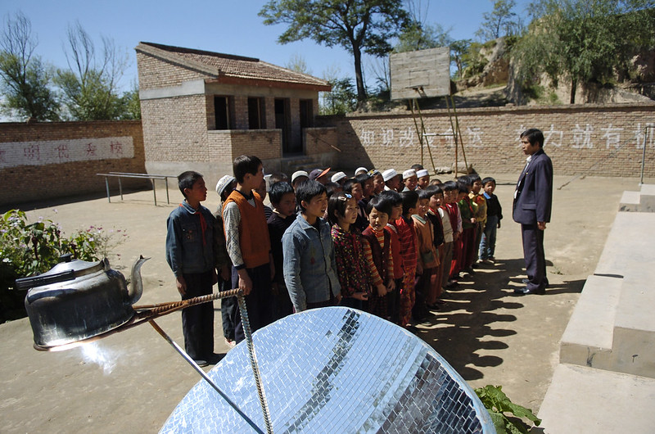
Part 4
Preparation Stage: identification/concept

Slide 55
Preparation Stage: identification/concept
Part 4: Learning Objectives
Key activities at identification/concept
How country context factors (e.g. national development objectives, CPF, CCDR, procurement settings) are relevant to SPP
Importance of delivery approach decisions made during identification/concept
Part One
Part Two
Part Three
Part Four
Part Five
Part Six

Slide 56
Overview of Preparation Stage: Identification/concept
Overview
The Borrower and the Bank are involved in defining the concept and scope of the project.
This activity is to ensure that the proposed project development objectives effectively contribute to the Borrower’s development objectives, are aligned with the Country Partnership Framework (CPF), support Paris Alignment and GRID objectives
  Key activities
Form Project Task Team
Borrower and Bank agree on initial project concept and beneficiaries (outlined in Project Concept Note)
Concept Stage Project Information Document (PID)
Concept Stage Environmental and Social Review Summary (ESRS)
Opportunities for SPP
To influence the scope, objectives and approach of the project in order to deliver sustainable outcomes, ideally the Procurement Specialist and E&S Specialist should collaborate to understand each others’ perspectives on key risks and issues. This should identify priority E&S issues that will need to be managed through the procurement process cognizant of market capacity, budget and achievability

Slide 57



Relevance of country context to procurement
Institutional settings – familiarity with SPP practice
Will the procurement system easily allow for the achievement of SPP (e.g. rules on use of rated criteria, quality of national bidding documents)?
Is there sufficient capacity to achieve SPP or will it need to be supplemented?
Have specific SPP objectives already been identified?
Borrower risks
Are there specific risks at the country-level that will impact the delivery of projects?
How attractive will the country be to the international market?
Will corruption or transparency risks impact a country’s perception of SPP?
Are there high incidences of SEA/SH?
Capacity of Borrower to implement ESF requirements (alignment of national E&S system with ESF, e g. national labor laws)
Country opportunities
Are there economically disadvantaged groups of business or workers (e.g. women, SMEs, disability-owned businesses, indigenous groups) that can be supported through procurement activity?
Do certain sectors require support and investment to be more green or resilient?

Slide 58
Country-level context and objectives
The World Bank aims to eliminate extreme poverty and promote shared prosperity
Operations will be aligned with the objectives of the UN Paris Agreement (i.e. reducing global emissions to limit temperature increases to 1.5 Degrees Celsius) by July 2023
Countries will be supported to achieve Green, Resilient and Inclusive Development
World Bank vision and objectives
The Country Partnership Framework (CPF) guides the Bank’s development work by agreeing with a country a set of medium- and long-term objectives that align with their development goals and the Bank’s goals
The Systematic Country Diagnostic (SCD) informs the CPF by identifying the most important challenges and opportunities a country faces
The Country Climate Development Report (CCDR) aligns development work with emissions reduction goals
Country-level priorities
Procurement system context
The health and effectiveness of a country’s procurement system is an important enabler for the successful delivery of projects.
It will be assessed either as part of the Methodology for Assessing Procurement Systems (MAPS), or as part of the CPF/SCD process

Slide 59
Project Concept Note
The Project Concept Note (PCN) sets out:
      Project development objectives
      Initial costing and phasing
      An overview of the Borrower’s capacity and any limitations that may impact implementation.
The PCN includes a summary of both procurement and E&S considerations for the project. The Procurement Plan is often not well advanced at this stage, but the high-level approach may be sufficiently advanced to include in the PCN
Procurement input may helpfully shape project objectives, the feasibility of options, and the delivery approach by asking questions such as:
      Is the supply market capable of delivering the project the way the Borrower wants delivered?
      Is there another way to achieve the same (or improved) objectives while reducing E&S risk or delivering other benefits?
      Does the supply market have knowledge, insight or innovative approaches that could help deliver this project in a better way?

Slide 60
Selecting a delivery/cost model
TTLs will consider the most effective delivery model for the project; this decision influences the procurement approach, risk allocation, the type of sustainability objectives that can be achieved, and how they are achieved
TTL leads conversations with the Borrower on the model, usually considering factors such as:
    Whether the Borrower requires support post construction, for example to operate and maintain the asset (e.g. is Design, Build, Operate an appropriate option)
    The degree of technical expertise that the Borrower has, versus the knowledge available within the market (e.g. should Borrower own the design process, meaning use of conformance as opposed to performance specifications; should design services be procured separately?)
    Whether the Borrower would prefer to finance the construction in partnership with the private sector (e.g. would a Public Private Partnership model be appropriate)
    The Borrower’s experience and expertise in using different types of delivery models
  These conversations inform many procurement-related actions

Slide 61
To sum up…
  Part 4: Preparation stage: Identification/concept
  While the Identification/ Concept stage may not yet involve any procurement activity, many decisions are made at this stage that influence the procurement approach
  Borrower’s procurement objectives will be influenced by many factors, including PDO’s, country’s procurement system, and the objectives agreed between the Bank and the country contained in the CPF
  The PCN includes an early indication of the project’s scope, approach, objectives, risks and opportunities, and integrity matters; procurement contributes its expertise to influence some of these critical factors
  Implementation model is informed by factors such as Borrower and market capacity

Slide 62
Key messages
Public procurement helps countries to achieve their development objectives
The Identification / Concept stage is where many big decisions are made, and there may be many implications for procurement
Project delivery model will influence the procurement approach and as a result, the way sustainability objectives are achieved
Part One
Part Two
Part Three
Part Four
Part Five
Part Six
62

Slide 63

Part 5
Preparation Stage: Appraisal
Julie Farmer

Slide 64
Preparation Stage: Appraisal
Part 5: Learning Objectives
Integrating sustainability considerations at each stage of procurement planning
How the Environmental and Social Assessment influences procurement strategy
The procurement tools used to mitigate different types of E&S risks
Sustainability implications of conformance and performance-based specifications
Structuring an evaluation process to select the right bidders to control E&S risk
Control implications of national versus international bidding
Part One
Part Two
Part Three
Part Four
Part Five
Part Six

Slide 65
Overview of Preparation Stage: Appraisal
Overview
The Borrower leads a more detailed project assessment, often engaging Consultants and other technical experts to conduct technical, economic, social and environmental assessments, prepare feasibility studies and technical designs, and undertake stakeholder engagement. The Bank provides technical expertise to support the Borrower to plan the project
  Key activities
Bank prepares and discloses:
  Project Appraisal Document (PAD)
  The Appraisal stage Environmental and Social Review Summary (ESRS)
Borrower develops Project Procurement Strategy for Development (PPSD), and the Procurement Plan
Procurement Plan is appended to the PAD
Opportunities for SPP
With the initial concept developed, this stage involves a more detailed assessment of project risks, and the development of the project’s overall strategy for mitigating risks and still achieving the project’s development objectives. The PPSD is an important step for procurement to identify relevant E&S risks and opportunities and develop a procurement strategy that can mitigate those risks and take advantage of potential opportunities.

Slide 66
Preparing sustainability elements of PPSD
    Identification of procurement risks and comparison with E&S risks identified during ESIA inform a joined-up view of procurement-related actions to manage E&S risk
    Assessment of Borrower capacity (does the Borrower have the institutional and procurement capacity to achieve the PDOs? and/or ESF obligations)
    Analysis of national and international markets to understand sustainability options and capacity of suppliers to manage the project’s E&S risks
    Development of procurement objectives to incorporate management of E&S risks, and opportunities to support CPF and other objectives
    Development of procurement approach options and recommendations, to ensure sustainability is incorporated into specifications and qualification requirements, market approach and selection method, evaluation approach, pricing considerations, selection and development of bidding documents, and contract management/KPIs etc.

Slide 67
Specific E&S risk areas
SEA/SH (GBV)
Description: Prevention of gender-based violence (GBV), including sexual exploitation and abuse (SEA) and sexual harassment (SH)
Mitigations:
Clauses included in SPDs setting out Contractor requirements for mitigation and response
Specific SPD must be selected for projects with high risk of SEA/SH
Includes training, induction and grievance redress
2-year disqualification mechanism
Forced labor in solar
Description: Allegations of forced labor in the solar industry has resulted in the Bank taking measures to help solar projects to identify and mitigate risks
Mitigations:
Procurement of panels where it is core to the project
Forced labor bidder declarations
Qualification requirements
Strengthened contractual provisions
Hardwired in SPDs
Accessibility
Description: The practice of making information, activities, and/or environments sensible, meaningful, and usable for as many people as possible
Mitigations:
‘Inclusive procurement’ means incorporating accessibility in design requirements
Involves incorporating broad needs as part of requirements
Will need to be incorporated into project approach as needed
Discrimination
Description: Elimination of discrimination against specific categories of disadvantaged people in terms of development outcomes and treatment of project workers
Mitigations:
SPDs guard against Contractor discriminating against potential beneficiaries of development outcomes and project workers.
Additional project-specific requirements can be added depending on need, e.g. gender

Slide 68
Procurement Risk Analysis
1
PPSD risk analysis covers:
Sustainability (environmental, economic, social)
Business and operating environment
2
Procurement and E&S Specialists can share or better discuss their risk findings together with the TTL:
The E&S Specialist could review findings of procurement risk assessment to consider materials, products and/or services where supply chains have high E&S risks e.g. solar, timber, lithium etc.
The Procurement Specialist could review relevant findings of E&S risk impact assessment to consider whether national and/or international Bidders have capacity to manage E&S risks

Slide 69
Understanding potential risk ‘hotspots’

Slide 70
Developing a risk management plan
1
Understand the cause of the risk
2
Develop effective mitigations
Contract clause?
Certification or accreditation?
Alternative design or product?
Highly skilled Contractor?
Code of conduct?
Tightly defined specifications?
Audit or verification?
Capacity building for Contractor or project workers?
Stakeholder / community engagement?
E&S provisional sum?
Pilot or testing?
E&S-focused rated criteria?
Lifecycle costing?

Slide 71
Allocate a risk owner (who can best manage?)
Example risk allocation – Occupational Health and Safety
 | Borrower | Contractor | Subcontractor | Borrower Technical Consultants | Primary Supplier
Ability to prepare for the risk in advance | H | M | L | H | L
Ability to control the risk during implementation | M | H | H | L | L
Benefits from risk avoidance | H | H | H | L | L

Slide 72
Progress Group Exercises
Introduction:
    Implementing SPP: Challenges and Opportunities
    ESF cascade to Contractors
    Pop quiz on ESF
SPP Approach will be built step by step:
    Risk identification and mitigation
    Procurement-related actions
    Prepare bidding documents
    Engaging the Supervising Engineer

Slide 73
Group Exercise No 1:
Risk identification and mitigation
In your groups, please spend 30 minutes on the case study:
Your project’s key E&S risks
The causes of the risk
Possible mitigations that will address the risk
An owner based on their ability to prepare for or control the risk
Tip! Take one risk at a time, and work through steps 1-4 above before moving onto the next risk

Slide 74
End of Day One
Closing remarks for day one:
Part One: Introduction to Sustainable Public Procurement
Part Two: Understanding the ESF and Procurement Framework
Part Three: The Bank’s Project Cycle, ESF vis a vis Operations Procurement
Part Four: Preparation Stage – Identification / Concept
Plan for day two:
Part Five: Preparation Stage – Appraisal (half-way done)
Part Six: Implementation
Plans for this evening
Start time tomorrow
Notes:
The instructor can share general housekeeping information, as desired and appropriate based on the training facility, including but not limited to emergency procedures, emergency exits, muting cell phones, location of restrooms, etc.

Slide 75
End of Day One

Slide 76
DAY 2
May 2023
Delivering ESF through
Sustainable Public Procurement
Andy Cochrane

Slide 77

Progress with Agenda
Day One
Part One: Introduction to Sustainable Public Procurement
Part Two: Understanding the ESF and Procurement Framework
Part Three: The Bank’s Project Cycle, ESF vis a vis Operations Procurement
Part Four: Preparation Stage – Identification / Concept
Day Two
Part Five: Preparation Stage – Appraisal
Part Six: Implementation

Slide 78
Progress Group Exercises
Introduction:
    Implementing SPP: Challenges and Opportunities
    ESF cascade to Contractors
    Pop quiz, ESF terminology
SPP Approach will be built step by step:
    Risk identification and mitigation
    Procurement-related actions
    Prepare bidding documents
    Engaging the Supervising Engineer

Slide 79
Part 5
Preparation Stage: Appraisal (continued)

Slide 80
Preparing sustainability elements of PPSD
    Identification of procurement risks and comparison with E&S risks identified during ESIA inform a joined-up view of procurement-related actions to manage E&S risk
    Assessment of Borrower capacity (does the Borrower have the institutional and procurement capacity to achieve the PDOs? and/or ESF obligations)
    Analysis of national and international markets to understand sustainability options and capacity of suppliers to manage the project’s E&S risks
    Development of procurement objectives to incorporate management of E&S risks, and opportunities to support CPF and other objectives
    Development of procurement approach options and recommendations, to ensure sustainability is incorporated into specifications and qualification requirements, market approach and selection method, evaluation approach, pricing considerations, selection and development of bidding documents, and contract management/KPIs etc.

Slide 81
Informing the Borrower’s capacity assessment
Strengths: SPP experience and/or capacity of Procurement and E&S staff Supportive policymakers/politicians/senior leaders Flexibility of procurement processes to incorporate SPP Examples of successful SPP in the country and/or internationally in a similar sector/context | Weaknesses: Would PIU team skillset need to be expanded/broadened Are there certain parts of the SPP process where the team lacks experience / capacity (e.g. market analysis, early market engagement, contract management?), Cost or policy barriers Bidder capacity to meet SPP requirements
Opportunities Recent/upcoming changes in government legislation or policy Trends towards SPP in neighboring countries Training opportunities available from national/international organizations Demand from domestic suppliers to consider SPP, or use more qualitative evaluation criteria Appetite to use SPP to broaden the pool of international suppliers | Threats Supplier complaints / remedies processes Lack of influence over potential Contractors / Suppliers Powerful industry or lobby groups that would argue against an SPP approach Fear of negative media attention Other government priorities that might conflict with the SPP approach

Slide 82
Incorporating SP into market analysis
Business practices
Controversial or high-risk practices within the sector
Emergence of E&S practices among sector businesses
Existence of environmental or social certifications or accreditations for businesses
Product specifications
Standards and/or labels related to sustainability credentials of products or services and their verification processes
Evolution of specifications of products or services in the sector to mitigate E&S risks
Scope for market-led innovation
National and international markets
Local contractors’ capacity to deliver the project and meet the ESSs
Specific skillsets that might be required to manage project E&S risks
Local SMEs with capacity to deliver some aspects
Topics
Desk research
Review of similar projects delivered by Bank, other MDBs and national governments
Analysis of certifications, labels and common business practices
New or innovative approaches for mitigating E&S risks
Common mitigations for project E&S risks
Independent expertise
Input from practitioners from Bank and other MDBs and governments to discuss challenges and contractor capacity
Experts with experience in delivering projects with similar E&S risks
Industry associations / trade body engagement
Early market engagement
Structured and transparent processes either face to face, using questionnaires or online
Share project approach and draft specifications with the market
Gather feedback on E&S risk mitigations, risk allocation, expected cost of mitigations, and form of contract
Methods

Slide 83
SPP Objectives
SPP-related procurement objectives can help:
    Retain focus on the key sustainability issues in procurement activities, where procurement can most strongly contribute to PDOs or manage greatest risks;
    Bring attention to issues beyond the project site such as indirect or transboundary risks or benefits that have been identified
    Inform the design of contract KPIs to measure the delivery by Contractors, Subcontractors, Consultants and Primary Suppliers of key E&S-related project measures; and
  Procurement objectives should be tailored Borrower’s market influence
  Where Borrowers have higher market influence, opportunities may exist to drive more innovation (e.g. Noor Quarzazate solar power station, India floating solar farm) as well as future-proofing (e.g. optimizing design for climate change resilience)
  May target specific socio-economic groups identified in ESIA or CPF (e.g. socio-economic benefits to the wellbeing of the community, jobs, training opportunities etc.)

Slide 84
Procurement Approach Options and Corresponding Techniques
Key E&S related questions for procurement approach | Procurement related technique
Do the bid/proposal documents clearly set out E&S-related procurement objectives, requirements, specifications, and risk allocation? | Specifications Additional sustainability requirements
How do we attract and identify a Bidder/Proposer with sufficient E&S capacity to address the risks and deliver the benefits we have outlined? | Market approach and selection method Qualification / evaluation selection method
How do we give Contractors appropriate accountability and sufficient incentives for managing the risks that have been assigned to them? | Pricing mechanism Contract type
How can we be assured that the Contractor understands and has enough resource for managing E&S risks? How much breakdown do we need of E&S related costs to provide assurance that the Contractor is credible? | Evaluation of price / cost breakdown
How do we make sure the Contractor follows through on what they have agreed to deliver? | Contract management plan / Third party monitoring KPIs E&S Performance Security

Slide 85
Key PPSD decisions (Part One)
Procurement tool | Decision | Sustainability considerations
Selection method | National or international | Will depend on level of capacity within national market to mitigate project’s E&S risks. Note: national documents may not address E&S risks.
 | RFP, RFB or RFQ | Complexity of requirements and potential size of market will determine the competitive approach that is taken. Rated criteria supports differentiation between bids. An RFP-type approach will typically allow bidders to innovate on aspects such as sustainability
 | Single stage or multi-stage | If a large pool of bidders is likely, a multi-stage process can be used to ensure only bidders with the required capacity, qualifications and/or experience in E&S matters are invited to participate in a more intensive second stage
Bidding document | SPD or national | The Bank’s SPDs have been updated to include contract clauses and other general E&S mitigations, whereas Bank staff will have to work with Borrowers to review national bidding documents for risk exposures

Slide 86
Key PPSD decisions (Part Two)
Procurement tool | Decision | Sustainability considerations
Specification | Conformance or performance | Conformance-based specifications have more defined requirements for bidders to respond to, as opposed to performance-based requirements which seek input and innovation from the market e.g. DBO. Sustainability objectives are achievable using both approaches, with conformance-based specifications putting the onus on the use of rated criteria to differentiate between similar bids, whereas performance-based rated criteria need to assess broader innovation, different designs and varying degrees of sustainability
Product standards and eco-labels | Define requirements in the specification and/or point to external standards | Borrowers may reference external standards and eco-labels that meet their sustainability requirements. Different standards have different approaches to verifying businesses, so Borrowers should seek assurance that verifications steps are in place. Rather than specifying one single label or standard, care should be taken to give flexibility to the market by allowing equivalent standards

Slide 87
Key PPSD decisions (Part Three)
Procurement tool | Decision | Sustainability considerations
Bidder/ Proposer credentials | Accreditations, qualifications, declarations and/or policies | Borrowers can look at attributes, including requiring certifications/ accreditations that demonstrate that sound business practices are used (for example the use of environmental management systems such as ISO 14001), staff are sufficiently qualified in relevant technical areas (including membership of professional institutions), and that business have environmental and social policies, such as those related to environmental management, emissions reduction, labor practices, diversity & inclusion, or community relations
Past performance | What do bidders/ proposers need to demonstrate / declare | To evidence they are experienced in delivering projects of a similar type, bidders can be asked to demonstrate whether they have been involved in delivering a project using sustainable materials in the past for example, or whether they have delivered training and apprenticeship programs that benefit the local community. Equally, bidders will have to declare any instances of contract breach or termination for poor performance in the past, including breaches related to E&S issues

Slide 88
Key PPSD decisions (Part Four)
Procurement tool | Decision | Sustainability considerations
Evaluation approach | Use of different evaluation criteria | Initial selection or qualifying criteria: often historic-looking, evaluating whether a bidder should progress based on qualifications and track record Pass/fail criteria: set minimum standards that bidders must achieve, such as complying with specifications Rated criteria: can evaluate more qualitative elements of the bid and allow Borrowers to emphasize importance of aspects such as sustainability
Financial Cost model | The scope of costs that should be taken into account | Different methodologies have been developed to assess the full and complete price of an asset, product or service. Life-cycle costing (LCC) means considering all the costs that will be incurred during an asset’s life, including purchase price (including delivery, installation, insurance, etc.), operating costs (including energy, fuel and water use, spares, and maintenance) and end-of-life costs (such as decommissioning or disposal) or residual value (i.e. revenue from sale of product). Borrowers should also consider how E&S elements will be priced into the bid, and whether tools such as an E&S provisional sum will be used/E&S cost breakdown

Slide 89
Financial cost model
 | Option A: Costs are integrated in the Bill of Quantities (BoQ) | Option B: Costs are included as specific E&S line items in the BoQ | Option C: Costs are set aside as provisional sums for E&S activities
Description | Costs are integrated into the broader construction delivery methodology | Mitigations priced independently and included as stand-alone line items | Provisional sums set aside for discrete E&S-related activities, such as SEA and SH awareness and sensitization
Pros | Can show that E&S activities are integrated as normal into project operations, (e.g. OHS considerations are key for all parts of the works methodology) | Borrowers can check that Bidders have allowed appropriate costs for E&S mitigations Enables triangulation of credibility of the bidder’s proposed E&S methodology/MSIP prior to award | Allows Contractor to propose additional sustainability outcomes beyond minimum requirements Borrower can hold onto provisional sum until mitigations are delivered Enables triangulation of credibility
Cons | No guarantee E&S is sufficiently included in the bid (difficult to assess credibility/triangulate) Can benefit Bidders who do not include costs for E&S mitigations | Bidders need detailed knowledge of E&S risks to accurately scope and cost mitigation actions/MSIP May lead to more queries and clarifications from bidders as they seek to understand project issues to inform their costing (however, may lead to less change post award)

Slide 90
APPROACH - OVERVIEW
To sum up…
  Preparation Stage: Appraisal
  The Borrower is responsible for preparing the PPSD
  PPSD analyzes Borrower capacity, risks, the market, the degree of influence, costing mechanisms, innovation and whether there is a gap between what is required and how the market is likely to respond
  PPSD needs to capture key E&S risks and proposed mitigations and assess whether the market is able to respond
  Strategy outlines how best to engage the market
  Key decisions are: international or national procurement, selection method (e.g. RFB, RFP, direct selection or quotation), pre-qualification, type of specification, cost model, contract conditions, evaluation approach (including rated criteria) and Bank support
02

Slide 91
Progress Group Exercises
Introduction:
    Implementing SPP: Challenges and Opportunities
    ESF cascade to Contractors
    Pop quiz on ESF
SPP Approach will be built step by step:
    Risk identification and mitigation
    Procurement-related actions
    Prepare bidding documents
    Engaging the Supervising Engineer

Slide 92
Group Exercise No 2:
Procurement-related actions
In your groups, spend 20 minutes on the case study:
For the risks that you outlined in the previous exercise, please categorize which stage of the procurement process the risk should best be addressed:
Specifications
Qualification criteria
Rated Criteria
Financial Cost Criteria
Other (please detail)
Tip! Examine one risk at a time, and work through steps 1-4 above before moving onto the next risk

Slide 93
Key messages
The PPSD needs to incorporate SPP into the procurement approach options and recommendations
Working with E&S Specialists on risk identification and mitigation helps to inform the appropriate procurement strategy
It’s important to ensure that the BoQ is constructed to give transparency to E&S-related costs
Part One
Part Two
Part Three
Part Four
Part Five
Part Six
93

Slide 94
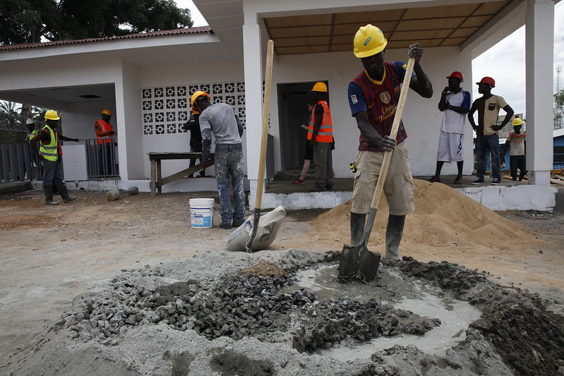
Part 6
Implementation
Julie Farmer

Slide 95
Implementation
Part 6: Learning Objectives
How E&S risks are accounted for in Bank SPDs
Corresponding E&S activities that take place during the Seven Stages of Operations Procurement
How different parts of the SPD give the Contractor responsibility for relevant E&S obligations
Importance of contract management and mechanisms for maximizing value from the contract
Part One
Part Two
Part Three
Part Four
Part Five
Part Six

Slide 96
Overview of Implementation Stage
Overview
Following Bank approval, the loan, credit or grant is declared effective, and implementation typically gets underway in the months after signing. Implementation is led by the Borrower, with the Task Team providing implementation support and monitoring to confirm if the project is implemented in accordance with the legal agreement, including the ESCP
  Key activities
PIU delivers the Procurement Plan, including preparing and issuing bidding documents
Contract Management Plan is implemented by the PIU, with onsite support from Supervising Engineer
Borrower reports to the Bank on project progress and in event of incidents
Bank provides project implementation support
Opportunities for SPP
With the SPP strategy (including key E&S risks and mitigations) identified during Appraisal, bidding documents are now brought together, cascading obligations to Contractors and others as required. The Bank’s SPD provides a template to help add project-specific requirements, whereas national documents will require the Task Team team to provide more intensive support to the Borrower. Mobilization and contract implementation will also be critical stages for ensuring value is not lost and that key obligations are delivered.

Slide 97
Seven stages of operations procurement
Stage 1, Develop strategy
Stage 2, Plan the procurement
Stage 3, Invite offers
    Understanding limits of E&S provisions in SPDs
    Developing sustainability-focused specifications
    Tips for working with the Borrower on national bidding documents
  Stage 4, Receive offers
  Stage 5, Evaluate offers
    Evaluating MSIPs
    Considering carbon emissions
    Things to look out for and ALBs
  Stage 6, Award contract
    Contractor’s Environmental and Social Management Plan
    Finalizing the Contract Management Plan
    Importance of Supervising Engineer
    Mobilization
    SEA/SH
  Stage 7, Manage contract
    Implementing the Contract management plan
    Contractor reporting
    Monitoring and Bank supervision

Slide 98

APPROACH - OVERVIEW
E&S Specialist’s Checklist for Procurement Collaboration
1. Develop strategy
Borrower and Market Capacity assessment
Risk Assessment
Procurement approach
PPSD (including selection of SPD) & Procurement Plan (lots, values, target market and Bank oversight/prior/post review)
✓
✓
✓
✓

2. Plan the procurement
3. Invite offers
E&S aspects in Works’ Requirements Specification and SPD
Structure of BoQ
Criteria for evaluation (Qualification Criteria and Rated Criteria)
4. Receive offers
5. Evaluate offers
Assessment of bidders’ approach to E&S risk management and adequacy of proposed costing
Assessment of E&S key personnel
Works methodology, proposed MSIP by the Contractors, Code of Conduct, Declarations etc.
6. Award contract
Make sure that the company selected adequately addresses E&S requirements
Make sure E&S provisions are included in the final contract (if not in contract doesn’t exist)
Note: C-ESMP (informed by MSIP) musty be approved prior to mobilization
7. Manage contract
Review contract management plan to ensure E&S is covered by reporting, KPIs, C-ESMP, etc.
Bank Supervision to involve appropriate monitoring activities
If high-risk SEA/SH then review progress of DAAB

Slide 99


APPROACH - OVERVIEW
How the SPD (large works) addresses E&S risks
E&S credentials
Past performance – bidders provide a declaration about past E&S performance. Used by Borrower to inform due diligence. Additional requirements for Solar and high-risk SEA/SH
Strategies & plans – bidders to submit initial E&S MSIPS which are assessed as part of Bid
E&S expert/s – bidders to name E&S specialist(s) in bid, Contractor appoints named specialist(s) as Key Personnel
E&S requirements
02
Specification – Borrower describes the E&S activities, obligations and performance standards in the E&S Requirements which are part of the Specification
Contract – the E&S Requirements form part of the contract and delivery by the contractor is legally binding. FIDIC used for large works which addresses general and E&S risks only
E&S performance standards
03
Code of conduct – bidders submit code that will apply to their Personnel, will include SEA/SH
Training plan– Demonstrates resources bidders are willing to put into training personnel on E&S
Grievance mechanism – Code of conduct to include a grievance mechanism for contractor’s Personnel and affected communities
Key performance indicators – measures important aspects of performance

Slide 100


APPROACH - OVERVIEW
How the SPD (large works) addresses E&S risks
E&S activity management
Monitoring and Reporting – Contractor to provide regular E&S progress reports and immediate reporting of serious E&S incidents including reporting against E&S KPIs
Review E&S MSIPs – Contractor to review and update E&S MSIPs (known as C-ESMP post contract award) every 6 months
Contract changes – Contractor to detail E&S implications in relation to contract variations
E&S breach

Contract remedies – Borrower can activate remedies for E&S breach, including removal of Personnel from site and withholding payments
E&S Performance Security – this can be called in for E&S breach/s
E&S Provisional Sum – failure to deliver a specified E&S activity can result in no payment of an E&S specified Provisional Sum
02
If project includes solar and/or high-risk SEA/SH, additional requirements apply
The E&S requirements can be different depending on what is being procured e.g. services, goods or consultants
warning

Slide 101
APPROACH - OVERVIEW
Integrating E&S into National procurement
Procurement Regulations (5.4(d)) require that National “Procurement Documents include sufficient provisions, as agreed with the Bank, to adequately mitigate against environmental and social (including SEA/SH), risks and impacts”
National documents are unlikely to reflect the ESF or include relevant national legal requirements (this is a worry for E&S Specialists)
Influence the Borrower to include appropriate E&S clauses in national procurement:
    Discuss with the Borrower the key risks that would be more effectively managed if appropriate E&S clause(s) are included in the national procurement contracts
    Advise Borrowers to identify applicable national laws and regulations that may be reinforced in contracts to address specific risks
    Share with Borrowers how the risk in question is addressed in SPDs as an example
  Note: OPCS developing model example clauses to give a base for Borrowers when drafting additional clauses to address ESF matters

Slide 102
APPROACH - OVERVIEW
Drafting sustainability-focused specifications
Engage as early as possible with key stakeholders for input (e.g. E&S Specialists) to support development, particularly where requirements are focused on mitigating identified E&S risks
Which Borrower’s requirements are ‘must haves’ versus ‘nice to haves’?
Ensure the specification is as enforceable and measurable as possible
Does what Borrower ask for makes sense, is realistic, attainable and can be verified
Performance-based | Conformance-based
Example: health and safety signage on site for workers and community
Require that signs are prominently placed, provide simple clear information, are available to users in their language, are readable from a reasonable distance and made from durable materials | Specify precise features and dimensions: where the signs should be placed, what the content should address, sign dimensions, languages, types of paint, background color, font type, materials etc.

Slide 103
Progress Group Exercises
Introduction:
    Implementing SPP: Challenges and Opportunities
    ESF cascade to Contractors
    Pop quiz on ESF
SPP Approach will be built step by step:
    Risk identification and mitigation
    Procurement-related actions
    Prepare bidding documents
    Engaging the Supervising Engineer

Slide 104
Group Exercise No 3:
Prepare bidding documents
In groups, please spend 30 minutes on the case study:
The Borrower has asked for procurement support to prepare bidding documents for the project. Considering the different contracts that are likely required and whether they will use SPDs or national bidding documents, prepare a presentation to advise the Borrower on:
What steps to take to ensure bidding documents are fit-for-purpose and include relevant E&S obligations
How to address relevant E&S risks for contracts that will use national documents
Tip! Ensure one of the contracts applies National Procurement (e.g., smaller support contracts) and consider how E&S may be addressed

Slide 105
APPROACH - OVERVIEW
Considering carbon emissions
Bidders can be asked to reduce emissions in a number of ways
Performance-based specifications allow bidders to innovate on design, materials, and construction methodology
Conformance-based specifications require Borrowers to develop detailed design and stipulate the materials used, however Bidders may still optimize a design and methodology, and submit proposals on emissions reduction options
A bidder’s emissions reduction approach can be evaluated in many ways, such as:
    Stipulating achievement of a green building/construction standard
    Including low-carbon materials in specifications (see previous example on cement)
    Asking bidders to submit information on their efforts to measure their business’ emissions and any work done to reduce emissions from themselves or their supply chains
    Require submission of a Carbon Reduction Plan, detailing the steps bidders would take to reduce project emissions

Slide 106
EXAMPLE: Items to identify in Contractor’s MSIPs during bid/proposal evaluation
Credible approach for managing Primary Suppliers, including obligations that cascade to Primary Suppliers (i.e. forced labor, child labor, sustainable natural resource use and serious safety concerns)
Includes SEA/SH Accountability and Response Framework, which demonstrates Contractor’s credible and thorough approach to prevent SEA/SH and respond appropriately if an incident happens.
Identifies products or materials that present increased E&S risk and how these will be minimized
Identifies relevant project stakeholders, how they might be affected by project activities, effective plans to mitigate impacts and appropriate communication/engagement approaches e.g. site safety, GBV etc.
Clearly assigns appropriate (senior and/or expert) owners to E&S control and mitigation activities
Demonstrates a thorough understanding of relevant local and national regulations and legislation relating to E&S aspects of the contract
Identifies appropriate E&S training needs and a training plan targeting laborers, site/project workers, subcontractors and others as required (including mobilization, site induction, toolbox talks as well as formal or mandatory training programs)
Identifies additional E&S benefits that can be delivered through the project in the MSIP, for example: Creating job opportunities for local community in the contract Targeting ethnic, gender or other types of diversity to widen inclusion Involving local or marginalized businesses as subcontractors in project implementation
Sets carbon reduction targets, or identifies techniques for reducing emissions during implementation

Slide 107
Stage 6: Award contract – Contractor’s ESMP
The successful Bidder’s MSIPs are finalized and become the C-ESMP
The C-ESMP contains Contractor-related elements of the Borrower’s Project-wide ESMP (which includes other matters such as resettlement, indigenous peoples)
Allows the PIU to hold the Contractor to account for delivering agreed E&S mitigations, including mitigations submitted by Bidder in MSIP
The C-ESMP may remain draft until site mobilization, the Supervising Engineer must approve the final C-ESMP before the site can be mobilized
Contractor’s actions need to be clearly detailed, including individual risk control and mitigation, and monitoring measures including the responsible person/party
The Borrower should ensure (through Supervising Engineer) that the Contractor includes relevant activities in contracts with Subcontractors and Primary Suppliers
The C-ESMP must be reviewed and updated at least every 6 months

Slide 108
Finalizing the Contract Management Plan
CMP may be developed in parallel with contract but should be completed at contract signing. The Borrower may involve Contractor in CMP development, advising their plan to administer the contract
Contract management plan should include the following key components:
    Assessment of Borrower’s contract management capacity including E&S and actions to deal with any deficits
    Risk management and mitigation plan, for all contract related risks including E&S e.g. ESMP
    Roles and responsibilities, including Borrower, Contractor, consultant, Supervising Engineer, etc.
    Governance of communication and reporting procedures
    Key contractual terms and conditions such as code of conduct
    KPIs
    Incentive mechanisms e.g. stage payment triggers, performance security
    Reporting requirements
    Use of DAAB etc.

Slide 109
Role of the Supervising Engineer
Supervising Engineer is Borrower’s representative on site, main duties include inter alia:
    Interlocutor between the Borrower, the contractor(s) and local stakeholders (key for E&S)
    Monitors the site, contractor(s) and personnel to make sure the agreed contract is followed
    Makes decisions on behalf of the Borrower in areas delegated for day-to-day control
    Escalates issues to the Borrower and expedites Borrower’s decisions
    Supervises and monitors E&S risks and impacts, reviews E&S reporting and acts
    Consider E&S impacts in relation to contract variations
    Measures contractor’s achievement against key performance indicators, completion stages and authorizes payments
    Invokes appropriate contract remedies
    Conducts (at least) 6 monthly review of C-ESMP (contractual)
    If high-risk SEA/SH, liaise with DAAB on regular review and control
  Pattern of poor ESF implementation issues, linked to a poor Supervision Engineer

Slide 110
Contract management (KPIs)
  Key Performance Indicators (KPIs) are important to incentivize better Contractor E&S management
  Not a substitute for contract provisions although KPIs may also be part of the contract
  If a KPI is not met, the underlying cause should be identified by the Supervising Engineer, discussed with the Contractor, and issues / bottlenecks addressed / resolved in accordance with the contract
  E&S reporting metrics and KPIs may include, inter alia:
  environmental incidents of pollution, damage to ground water etc.
  supervision of health & safety
  worker accommodation
  gender statistics in the workforce
  training
  grievances
  supply chain management
Objective: To deliver social and economic benefits for the region affected by the project
Project PDO | Measures
By (date), the project will have these goals annually: 10% of the total supply chain expenditure will be sourced from businesses operating within the local vicinity 5% of the total supply chain workforce on sites will be apprentices or trainees | Contractor will report: % of expenditure with businesses in the region % of local workforce (person days on site for local residents) % of workforce apprentices or trainees (inc. person days on site for apprentices or trainees)

Slide 111
Mobilization
Mobilization (or pre-construction) is where site is prepared for construction. Important for managing E&S risks as it establishes physical environment for the project (e.g. worker accommodation, site access, utilities and waste) and involves initiating lproject workers and engaging stakeholders
Effective mobilization phase ensures Contractor, key Subcontractors and key personnel understand relevant E&S risks and their commitments in the contract
Supervising Engineer must approve the C-ESMP/assure Key Personnel in place before mobilization
When developing the mobilization plan, Borrowers will need to consider:
    A training program for workers on relevant E&S topics, including more informal, regular interactions with workers (e.g. toolbox talks) on emerging issues, OHS risks etc.
    Inductions for workers and supervisors on E&S matters
    Getting project workers aware of and committed to Code of Conduct before commencement of works, potentially as part of site induction
    Community liaison / engagement plan
    Putting OHS measures in place, including activities to mobilize and prepare the project site
    Establishment of grievance mechanism and awareness raising in the community

Slide 112
Mobilization: High-risk SEA/SH
Bidders submit a declaration accepting disqualification from winning a Bank-financed contract for two years in the event of a breach of their SEA/SH obligations
IPF-financed works contracts that are high risk for SEA/SH must include measures including:
    SEA/SH conference prior to mobilization, training workers on SEA/SH prevention
    Code of Conduct of expected behaviors from workers and actions is there are breaches
    SEA/SH Response mechanism for receiving, investigating and addressing allegations
    Measures to prevent reprisals if SEA/SH reported
    Ongoing training and staff/labor induction on SEA/SH
    Subcontractors comply with SEA/SH prevention and response obligations
    Engaging SEA/SH expert/s for the duration of the contract
    Requirement for DAAB
    ADM for Contractor disqualification and specific Guidance on the mechanism

Slide 113
Contractor General E&S Reporting
1. IMMEDIATE NOTIFICATION
to the supervising engineer PC 4.20
2. REGULAR PROGRESS REPORTS
Metrics in PCs, Part D
  The contract describes the incidents which must be immediately notified to the Supervising Engineer. These include inter alia:
  any accident-causing serious injury or death
  any incident likely to have a significant adverse effect on the:
  environment
  affected communities or the public
  the employer’s personnel or contractor’s personnel
  GBV / SEA incidents
  damage to private property
  and any similar accident or incident on the sub-contractor’s premises
  The requirements and metrics for regular E&S reporting are described in the RFB / RFP and contract
  The contractor’s regular reporting is usually monthly
  E&S reporting metrics include inter alia:
  environmental incidents of pollution, damage to ground water etc.
  supervision of health & safety
  worker accommodation
  gender statistics in the workforce
  training
  grievances
  GBV / SEA incidents
113
Notes:
Note: the Bid Security may be forfeited/executed if:
the Bidder withdraws from the process, or
the successful Bidder fails to sign the contract or produced the Performance Security and, if required, the ES Performance Security
Note: if the successful Bidder fails to do the actions above, the award of contract can be annulled.
The borrower then offers the Contract to the next Most Advantageous Bid

Slide 114
Bank E&S Monitoring and Supervision
  Ensure E&S obligations are complied with according to legal agreement
  Prior review of material amendments to major contracts
  Exercise audit and inspection rights when needed
  Independent Inspection Panel can review any E&S issues that are escalated
  Implement tailored supervision and monitoring including:
  the use of independent third-party monitoring
  E&S audits
  Grievance Redress Service (GRS)
  End of project evaluation
  Project cannot be closed with outstanding E&S actions
  In many projects NGO’s and local community active (social media)
NGOs can misunderstand:
The Bank does not have a contractual relationship with the contractor.
The Bank’s relationship is with the Borrower, as set out in the Legal Agreement

Slide 115
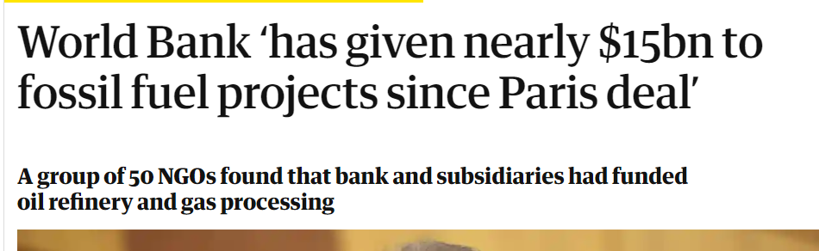
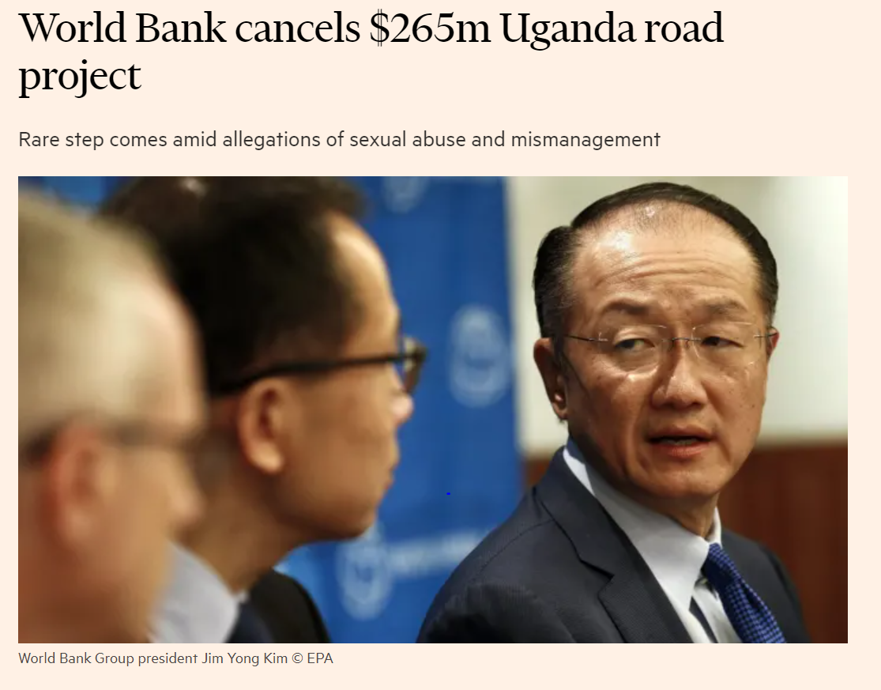
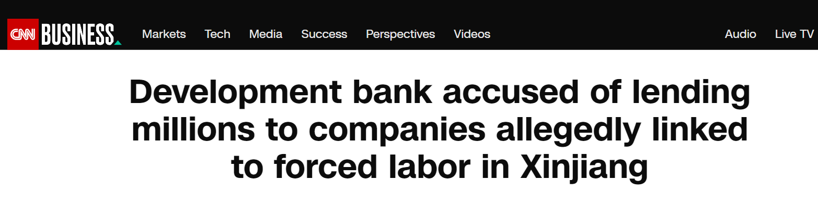
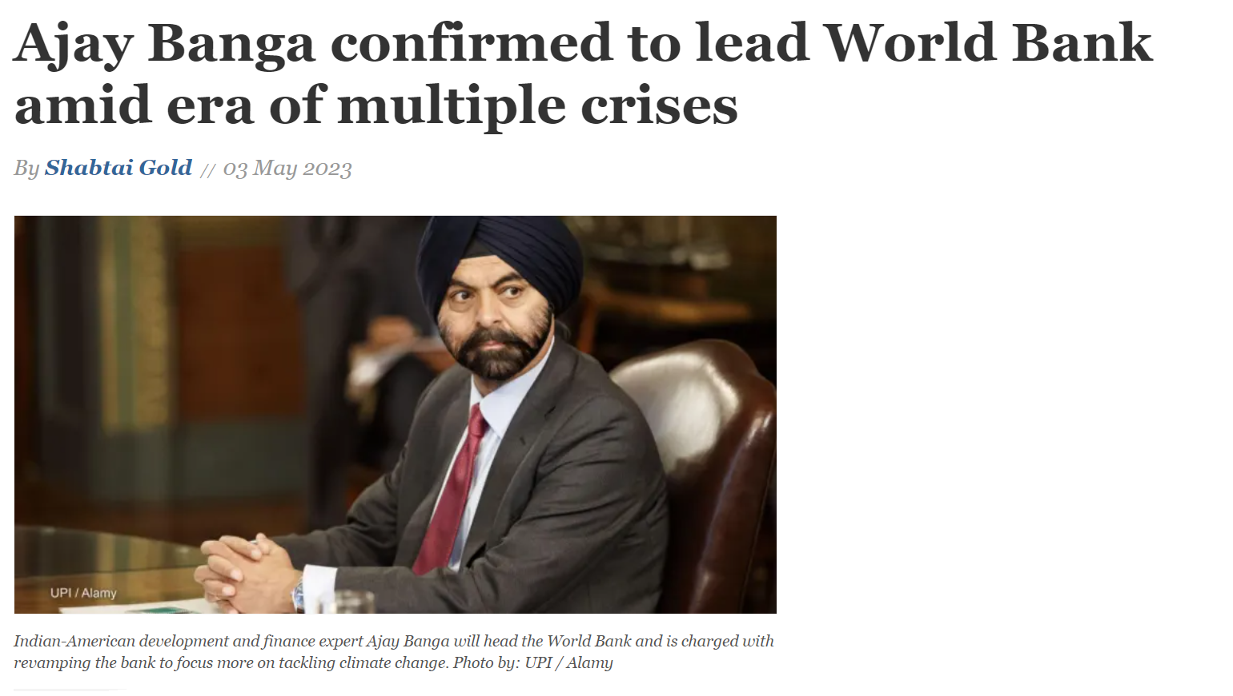
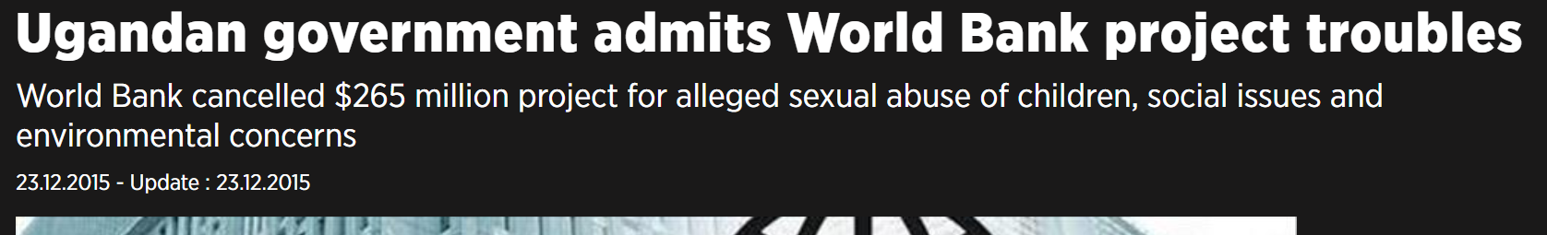
High external scrutiny of E&S matters

Slide 116
To sum up…
  Implementation Stage
  SPDs have a number of elements that can be used to hold the Contractor accountable for E&S
  Borrowers should have a contract management plan, including KPIs to monitor and manage contract delivery
  For E&S requirements the plan should focus on monitoring the implementation of the ESMP and reviewing reports, especially E&S KPIs / metrics
  The Supervising Engineer has a key role (on behalf of the Borrower) to manage the contract on a day-to-day basis
  Many actors monitor E&S matters and media interested
  Several escalation options if there are E&S matters e.g. GRS, Inspection Panel (+ if high SEA/SH DAAB etc.).
Part One
Part Two
Part Three
Part Four
Part Five
Part Six

Slide 117
Key messages
Implementation is when the strategy developed in the PPSD is implemented
Bank SPDs include a number of features that can be used to hold Contractors accountable for E&S performance
Effective contract mobilization relies on a comprehensive CMP and requires the Supervising Engineer to sign off the C-ESMP
The Task Team monitors performance by supervising mitigation of key risks through the Supervising Engineer, Contractor reporting and other methods
Part One
Part Two
Part Three
Part Four
Part Five
Part Six
117

Slide 118
Progress Group Exercises
Introduction:
    Implementing SPP: Challenges and Opportunities
    ESF cascade to Contractors
    Pop quiz on ESF
SPP Approach will be built step by step:
    Risk identification and mitigation
    Procurement-related actions
    Prepare bidding documents
    Engaging the Supervising Engineer

Slide 119
Group Exercise No 4:
Engaging the Supervising Engineer
In your groups, please spend 20 minutes on the case study:
Based on your knowledge of project E&S risks and Contractor’s mitigations, help the Borrower to prepare a ToR for the Supervising Engineer by outlining:
General activities they need to carry out onsite to identify any potential E&S issues
Targeted activities for monitoring the project’s key E&S risks
Any additional support that they might require in terms of audits, monitoring, or specific technical advice

Slide 120
Summary and Next Steps
Andy Cochrane

Slide 121
To sum up…
  Procurement will not achieve its potential or deliver sustainable development without help from E&S colleagues and vice versa
  SPP is a big part of the future of the profession, including procurement’s role in responding to climate change
  Early procurement involvement can shape project approach and objectives
  PPSD must incorporate SPP considerations if it is to be achieved
  Bidding documents are where the PPSD gets translated into requirements; SPDs require customization but national documents will require much more
  Monitor that the value that has been promised gets delivered
Part One
Part Two
Part Three
Part Four
Part Five
Part Six

Slide 122
Rollout of SPP Training and Support
Steps to integrate E&S thinking into procurement
Practitioners in both Procurement and E&S can benefit from support and advice on key steps for integration
Targeted Guidance
F2F and Online Learning
Practical Tools
‘Cascade Tool’ being developed to show how specific ESF topics are addressed in Project Cycle and Procurement e.g. Safety
Fact sheets to provide example KPIs, specifications, rated criteria etc.
Detail and content catered for audience
Documents targeting audience profiles, e.g.
  Borrower governments
  Procurement / E&S practitioners
  Contractors / suppliers
In-person 2-day training on SP/ESF initially targeting procurement practitioners
Summarized for e-Learning
In-person 2-day training on Procurement for E&S staff

Slide 123

One key message
Procurement is increasingly recognized as the key to policies / objectives being implemented. We don’t need to be the expert in all policy issues, we just need to help inform, prioritize and enable

Slide 124
Thank You!

