Slide 1

Optimizing Limited Resources for Social Impact:
Techniques from Multi-Agent Systems
MILIND TAMBE
Harvard University
&
Google Deepmind

Slide 2

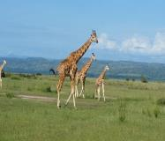

AI for Social Impact (AI4SI)
Public Health
Global Health
Conservation
Public Safety and Security
Optimize Our Limited Intervention Resources
Social Impact AI Innovation
Notes:
My team’s work on AI for Social Impact has focused on public health, conservation and public safety

Slide 3

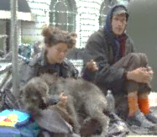
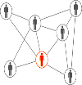


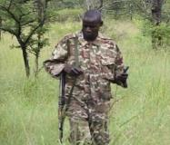
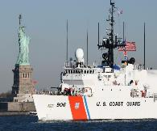
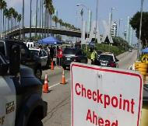
Previous Work in AI for Social Impact: Optimizing Limited Resources
Public Health
Social
Networks
Conservation
Public Safety
& Security
Green
security
games
Stackelberg
security
games
Notes:
In this talk, I will start by focusing on public health… One example of work I will discuss is work we have done in Los Angeles…
Third area of work we have done but I will not focus on today…

Slide 4
Outline: Bandit Algorithms, Agents
Bandit algorithms: World’s largest Maternal mHealth programs
mMitra in Mumbai (200K beneficiaries)
Kilkari across India (3.5 Million beneficiaries)
Network interventions: HIV prevention
Los Angeles
South Africa
MASSI: Multi-Agents for Speeding up Social Impact (LLM Agents)
Lead PhD student photo where their work is shown
Notes:
My team’s work on AI for Social Impact has focused on public health, conservation and public safety

Slide 5
Maternal Health Crisis
UN SDG (2030): Maternal mortality ratio below 70 per 100,000 live births
Maternal Mortality Ratios (2023)
UN Target
Credit:
https://www.gatesfoundation.org/goalkeepers/report/2024-report/#maternal-mortality
Notes:
Maternal mortality ratio:
The death of a mother during pregnancy, childbirth or post-partum
the annual number of female deaths from pregnancy-related cause during pregnancy and childbirth or within 42 days of termination of pregnancy* expressed per 100,000 live births
*irrespective of the duration and site of the pregnancy
https://data.unicef.org/indicator-profile/MNCH_MMR/
TOP IMAGE: Renu, in blue, with her 8-month old baby Raza. Renu is from Uttar Pradesh state, but comes to Haryana frequently as her husband works in construction on different job sites here. Because she is a migrant, she might normally not have access to health services. But an Indian campaign called "Mission Indradhanush" made a point of mapping communities like this one, in order to offer regular health outreach services. Renu's baby is up-to-date with vaccination, and she's planning to have him fully vaccinated when he is next due. Nadi settlement, Gurugram District, Haryana State, India. August 2019.
BOTTOM IMAGE: Paula Malale, from the Badjao indigenous group, watches her child sleep in a hammock after an immunization session at a health center in Cabanatuan, Nueva Ecija, Philippines, March 16th, 2021. Over 200 families moved to Luzon from Jolo, Sulu in search of a better life for their family.
Source for images, the WHO image database, which allows educational use with credit: https://whophotosearch.who.int/results?s%5Badv%5D=1&s%5Bkeywords%5D=maternal+health

Slide 6

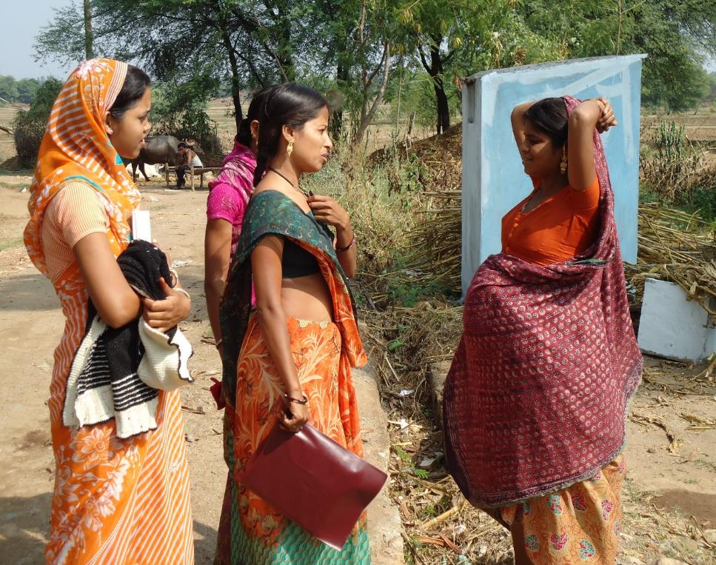
Maternal Health Crisis
UN SDG (2030): Maternal mortality ratio below 70 per 100,000 live births
Maternal Mortality Ratios (2023)
UN Target
Credit:
https://www.gatesfoundation.org/goalkeepers/report/2024-report/#maternal-mortality
Notes:
Maternal mortality ratio:
The death of a mother during pregnancy, childbirth or post-partum
the annual number of female deaths from pregnancy-related cause during pregnancy and childbirth or within 42 days of termination of pregnancy* expressed per 100,000 live births
*irrespective of the duration and site of the pregnancy
https://data.unicef.org/indicator-profile/MNCH_MMR/
TOP IMAGE: Renu, in blue, with her 8-month old baby Raza. Renu is from Uttar Pradesh state, but comes to Haryana frequently as her husband works in construction on different job sites here. Because she is a migrant, she might normally not have access to health services. But an Indian campaign called "Mission Indradhanush" made a point of mapping communities like this one, in order to offer regular health outreach services. Renu's baby is up-to-date with vaccination, and she's planning to have him fully vaccinated when he is next due. Nadi settlement, Gurugram District, Haryana State, India. August 2019.
BOTTOM IMAGE: Paula Malale, from the Badjao indigenous group, watches her child sleep in a hammock after an immunization session at a health center in Cabanatuan, Nueva Ecija, Philippines, March 16th, 2021. Over 200 families moved to Luzon from Jolo, Sulu in search of a better life for their family.
Source for images, the WHO image database, which allows educational use with credit: https://whophotosearch.who.int/results?s%5Badv%5D=1&s%5Bkeywords%5D=maternal+health

Slide 7
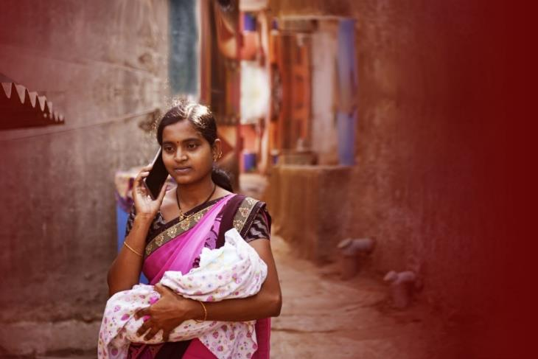

ARMMAN’s mMitra Mobile Health Program: For new/expecting mother
Weekly 2 minute automated health messages
141 voice messages
Over 3.6 million women have benefited
(snippet of audio message)
For you and your baby to be strong,
you need lots of iron. Iron-rich foods include
meat, jaggery and leafy green vegetables.

Slide 8
ARMMAN’s mMitra Mobile Health Program Adherence: For new/expecting mother
Weekly 2 minute automated health messages
141 voice messages
Over 3.6 million women have benefited
Unfortunately, 40% beneficiaries may become low-listeners
30%
29%
increase in infants with tripled birth weight at end of year
increase in women who had more than 4 ANC visits
*https://armman.org/research-studies/

Slide 9
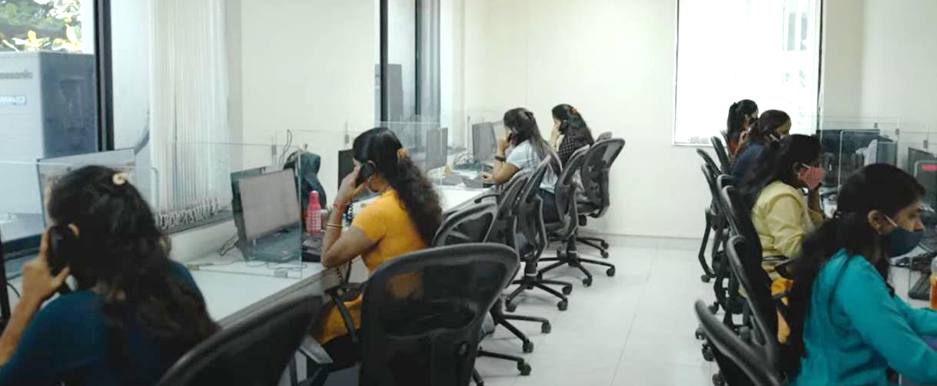


Intervention Scheduling with Limited Resources for Adherence: Preventing 40% drop-offs
Large number N beneficiaries: 200000
Automated health messages to all N each week
Choose K=1000 for live service call per week?
Maximize health messages listened to
Challenge of dynamic state:
Beneficiary may change state on their own
Live call may not change beneficiary state
Photo Credit: IntraHealth International (CC BY-NC-SA 3.0 via https://www.intrahealth.org/)

Slide 10
Intervention Scheduling with Limited Resources for Adherence: Preventing 40% drop-offs
Large number N beneficiaries: 200000
Automated health messages to all N each week
Choose K=1000 for live service call per week?
Maximize health messages listened to
Challenge of dynamic state:
Beneficiary may change state on their own
Live call may not change beneficiary state

Slide 11
Intervention Scheduling with Limited Resources: Motivating Restless Bandits
Large number N beneficiaries: 200000
Automated health messages to all N each week
Choose K=1000 for live service call per week?
Maximize health messages listened to
Challenge of dynamic state:
Beneficiary may change state on their own
Live call may not change beneficiary state
Restless bandit: Prioritize K of N beneficiaries with dynamic state

Slide 12


Restless Bandits: Each Mother modeled via an MDP (Markov Decision Problem)
Mate
States of MDP
Actions
Transition matrix
Good
Pbad→good
0.8 | 0.2
0.2 | 0.8
Bad
Good
Good
Pbad→bad
Pgood→good
Pgood→bad
Good
0.2 | 0.8
0.05 | 0.95
Intervene via service call
or
Not intervene
A“bad” state & a “good” state
Good

Slide 13
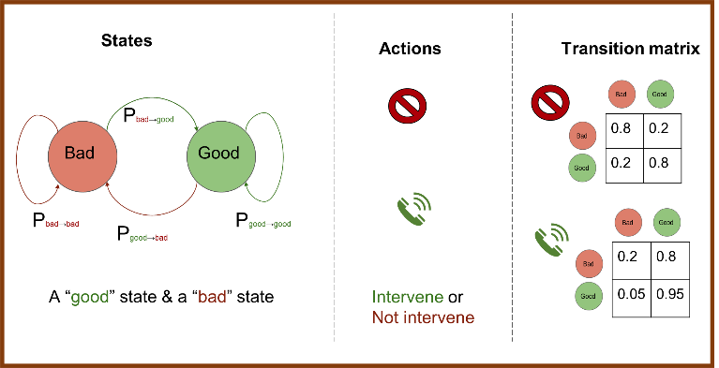
Restless Bandits Model Whittle Index: Efficiently Select K out of N Beneficiaries
(AAAI 2022)
Mate
N-choose-K policy to maximize beneficiaries in “Good” state? “Good” ➔ Reward
Compute Whittle index for current state of each arm (Qian et al, AAMAS 2016)
Computes benefit of intervention
$$W\left(s\right)={INF}_{γ }\left\{γ: Q_{γ}\left(s, \right)=Q_{γ}\left(s, \right)\right\}$$
From 200000 arms
Choose 1000
Notes:
and the smallest m that would
make passive action optimal for the current state is defined to be
the Whittle index for this arm at this state. Whittle index policy
chooses to activate the k arms with the highest Whittle indices. Intuitively, the larger the m is, the larger the gap is between active
action (activate) and passive action, the more attractive it is for the
player to activate this arm

Slide 14

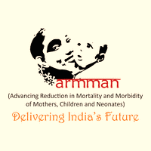
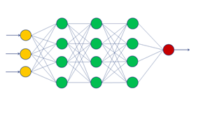
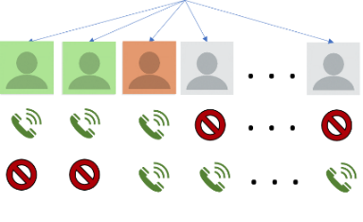
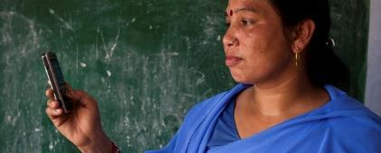
Challenge: Unknown Transition Probabilities
(AAAI 2022)
Wang
Mate
Previous beneficiary data: features f + engagement sequence {(s, a, s’) }
Learn: Mother’s features (age, income,…) → transition probabilities
TWO STAGES: Maximize learning accuracy, then maximize decision quality
Immersion
Data Collection
Machine
Learning
Features to transition probabilities
Optimize
Restless bandits:
Top K beneficiaries
Evaluation
& deployment
200 K mothers
Age | Income | Education | Probability
26 | 5000 | 8th grade | 0.3

Slide 15
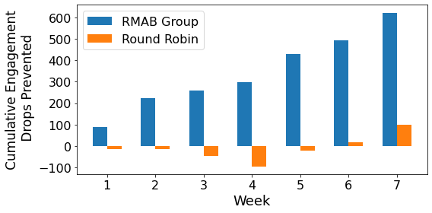
Results of 23000 Beneficiary Field Study
(AAAI 2022, ICML 2023, AAAI 2025)
Wang
Mate
Pulled 225 arms/week for seven weeks
(225 live service calls per week)
How many more health messages listened to over Current-Std-of-Care (CSOC) group
7667 beneficiaries per group:
RMAB, Round-robin,
Current-Standard-of-Care (CSOC)
All beneficiaries get automated health messages each week
Restless bandits optimize service calls
RMAB cuts drop off rate: 32%

Slide 16
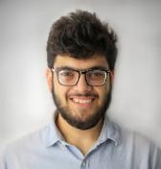
SAHELI: DFL + RMAB Deployed at ARMMAN Means “Friend” in Hindi, Also an acronym (IAAI 2023, AI Magazine 2023)
Verma
Number of beneficiaries served: 350,000+
Continuous use since: April 2022
Drop-offs prevented: 30%
Bottom 25 percentile, content exposure increase: 130%

Slide 17

SAHELI: DFL + RMAB Deployed at ARMMAN (PAIS/ECAI 2025)
Dasgupta
RMAB → higher listenership → Improved health behaviors:
21871 beneficiaries
Matched intervention vs control
Question | Percentage improvement | p value
Taking calcium tablets after delivery | 24.4% | p=0.04
Taking iron tablets after delivery | 18% | p=0.09
What was the baby’s weight at birth? | 9.2% | p=0.01
Ultimately, AI intervention is improving health behaviors!

Slide 18

SAHELI Deployment Youtube: “AI for Social Good in partnership with ARMMAN”

Slide 19
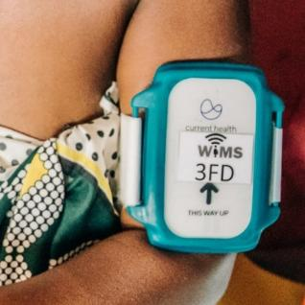
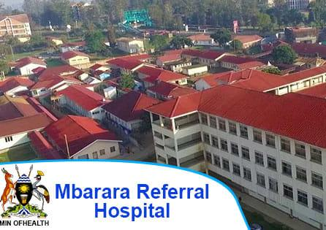
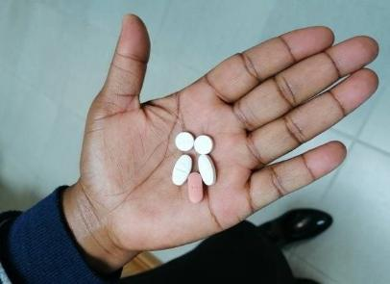

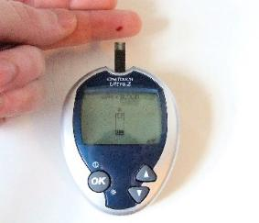
Restless Bandits for Limited Resource Allocation
(KDD 2019, NeurIPS 2020, AAMAS 2021, JMIR Diabetes 2024, IAAI 2025)
Maternity
ward
Allocate wireless
monitoring devices
TB Treatment
6 months of pills
Allocate health coaches to ensure adherence
Diabetes treatment: Log meals, blood sugar

Slide 20
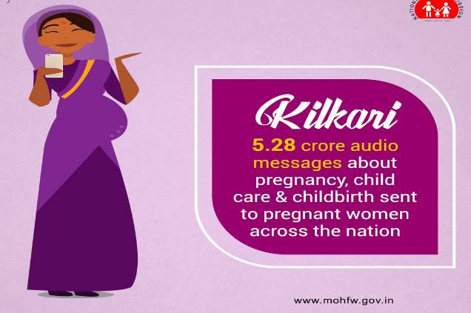

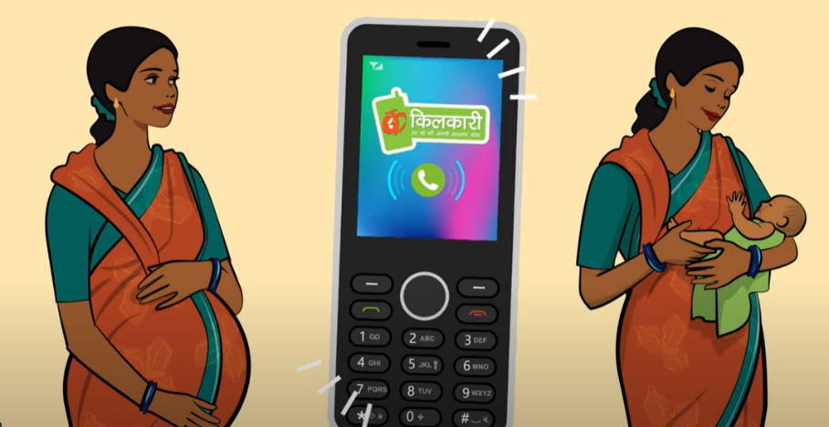
Kilkari: The Largest Mobile Health program in the world for maternal and child health
3.5 Million mothers enrolled at a time
Government of India program:
Similar to mMitra
Managed by ARMMAN
No features (age, income) available
Notes:
My team’s work on AI for Social Impact has focused on public health, conservation and public safety

Slide 21
Outline: Bandit Algorithms, Agents
Bandit algorithms: World’s largest Maternal mHealth programs
mMitra in Mumbai (200K beneficiaries)
Kilkari across India (3.5 Million beneficiaries)
Network interventions: HIV prevention
Los Angeles
South Africa
MASSI: Multi-Agents for Speeding up Social Impact (LLM Agents)
Lead PhD student photo where their work is shown
Notes:
My team’s work on AI for Social Impact has focused on public health, conservation and public safety

Slide 22
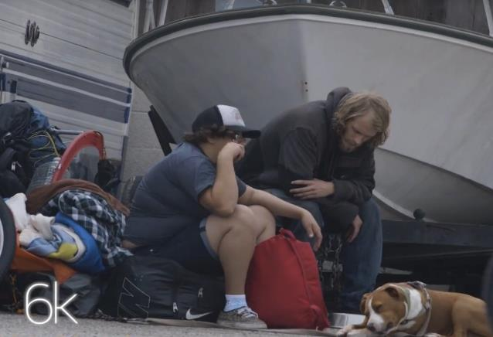
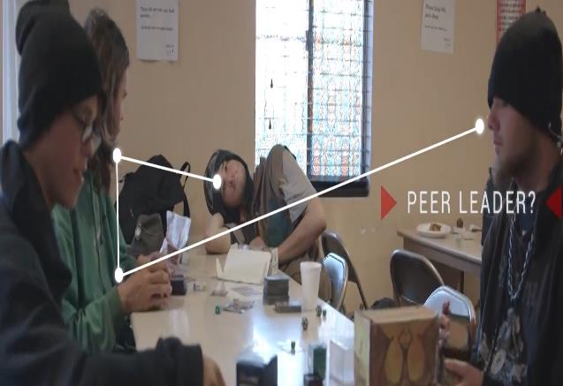
Information dissemination & behavior change Optimizing Limited Intervention (Social Worker) Resources
Prevent HIV in youth experiencing homelessness: HIV 10x housed population
Shelters: Limited number of peer leaders to spread HIV information in social networks
“Real” face-to-face interactions; not online

Slide 23
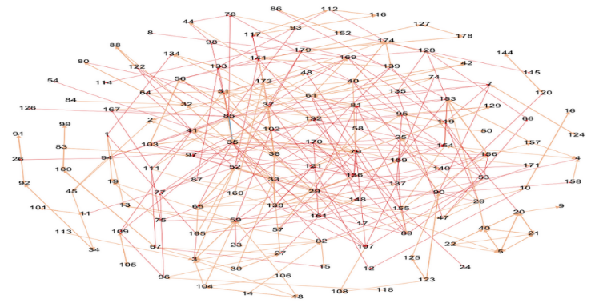
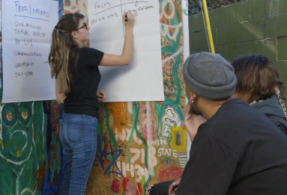
Influence Maximization in Social Networks
F
C
H
Select peer leader nodes to Maximize Expected Number of Influenced Nodes*
*With Prof. Eric Rice
Notes:
In the independent cascade model, we have a graph or network given by its vertices V and edges E. Further, the edge set E is disjointly divided into E_cert the set of certain edges (which consist of the friendships which we are sure about) and E_uncert, the set of uncertain edges, i.e., the set of edges/friendships which we are uncertain about. In order to specify the uncertainty precisely, we assume that every certain edge in the network is associated with one probability called the propagation probability

Slide 24
Key Challenge: Social Network is NOT known in advance
F
C
H
Select peer leader nodes to Maximize Expected Number of Influenced Nodes*
*With Prof. Eric Rice
Notes:
In the independent cascade model, we have a graph or network given by its vertices V and edges E. Further, the edge set E is disjointly divided into E_cert the set of certain edges (which consist of the friendships which we are sure about) and E_uncert, the set of uncertain edges, i.e., the set of edges/friendships which we are uncertain about. In order to specify the uncertainty precisely, we assume that every certain edge in the network is associated with one probability called the propagation probability

Slide 25
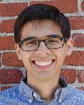
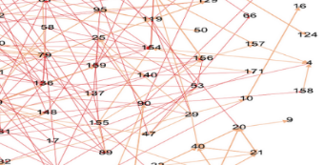
Key Challenge: Social Network is NOT known in advance (AAAI 2018, AAMAS 2018)
Wilder
C
H
F
Select peer leader nodes to Maximize Expected Number of Influenced Nodes*
*With Prof. Eric Rice
Notes:
In the independent cascade model, we have a graph or network given by its vertices V and edges E. Further, the edge set E is disjointly divided into E_cert the set of certain edges (which consist of the friendships which we are sure about) and E_uncert, the set of uncertain edges, i.e., the set of edges/friendships which we are uncertain about. In order to specify the uncertainty precisely, we assume that every certain edge in the network is associated with one probability called the propagation probability

Slide 26

“CHANGE” with Homeless Youth
(AAAI 2021)
Wilder
CHANGE
Network Sampling
Robust multi-step policy
Peer leader selection
750 youth study with Prof. Eric Rice
CHANGE vs Degree centrality vs Control
Actual reduction in HIV risk behaviors?

Slide 27




Results of 750 Youth Study [with Prof. Eric Rice] Actual reduction in HIV RISK Behavior? (AAAI 2021, Journal of AIDS/JAIDS 2021)
Wilder
Notes:
Time 0 Time 1 Time 2
AI 27% 18.10% 17.50%
DC 33.70% 34.70% 24.10%
OBS 21.50% 21.00% 23.70%

Slide 28



Results of 750 Youth Study [with Prof. Eric Rice] (AAAI 2021, Journal of AIDS/JAIDS 2021)
Wilder
*Statistical significance results in AAAI’21, JAIDS’21
Notes:
Time 0 Time 1 Time 2
AI 35.60% 29.80% 20.10%
DC 42.20% 42.70% 31.50%
OBS 46.20% 35.20% 40.10%

Slide 29
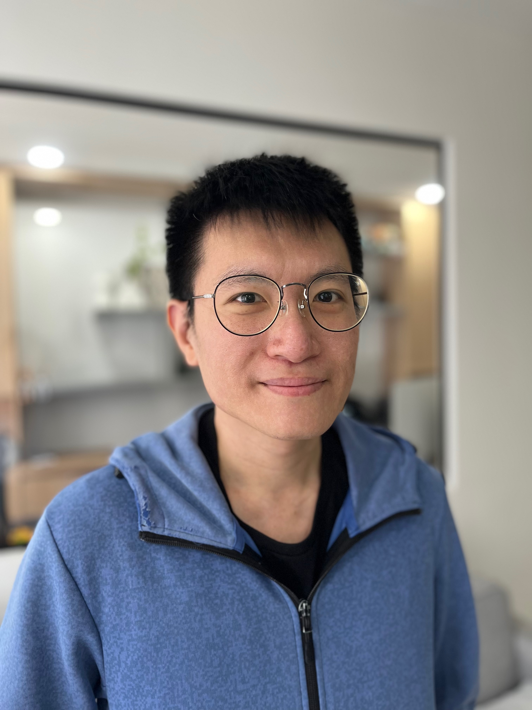
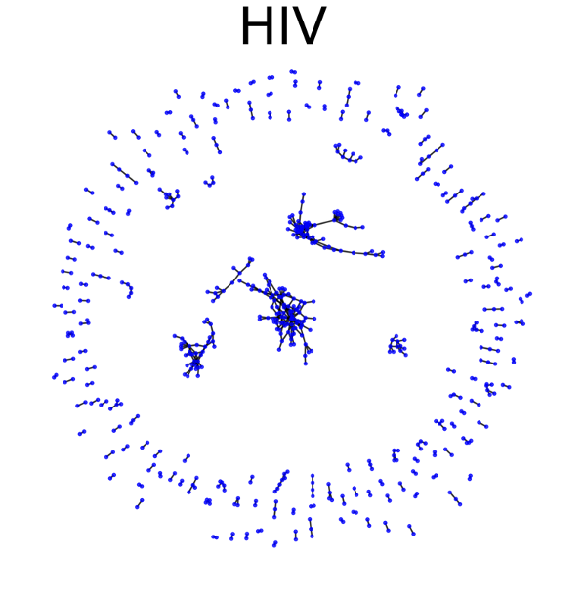
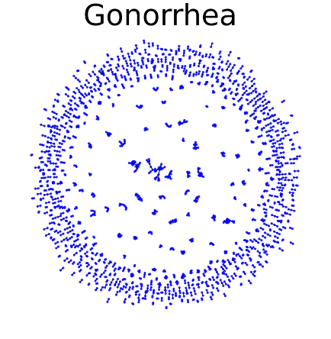
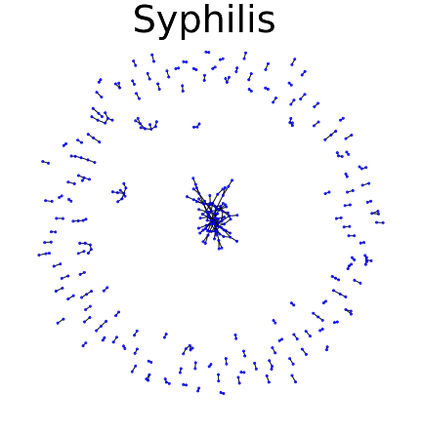
Network Based HIV testing In collaboration with WHO, WITS
Choo
Estimated ~6 Million people worldwide do not know HIV status*
Key resource challenges: Number of HIV tests, health worker time
WHO recommends network based testing
Key observation from real data: Sparse transmission networks
*UNAIDS. Global HIV&AIDS statistics—fact sheet. 2024. Accessed August 30, 2024.
**https://www.icpsr.umich.edu/web/ICPSR/studies/22140/summary
Notes:
In the independent cascade model, we have a graph or network given by its vertices V and edges E. Further, the edge set E is disjointly divided into E_cert the set of certain edges (which consist of the friendships which we are sure about) and E_uncert, the set of uncertain edges, i.e., the set of edges/friendships which we are uncertain about. In order to specify the uncertainty precisely, we assume that every certain edge in the network is associated with one probability called the propagation probability

Slide 30
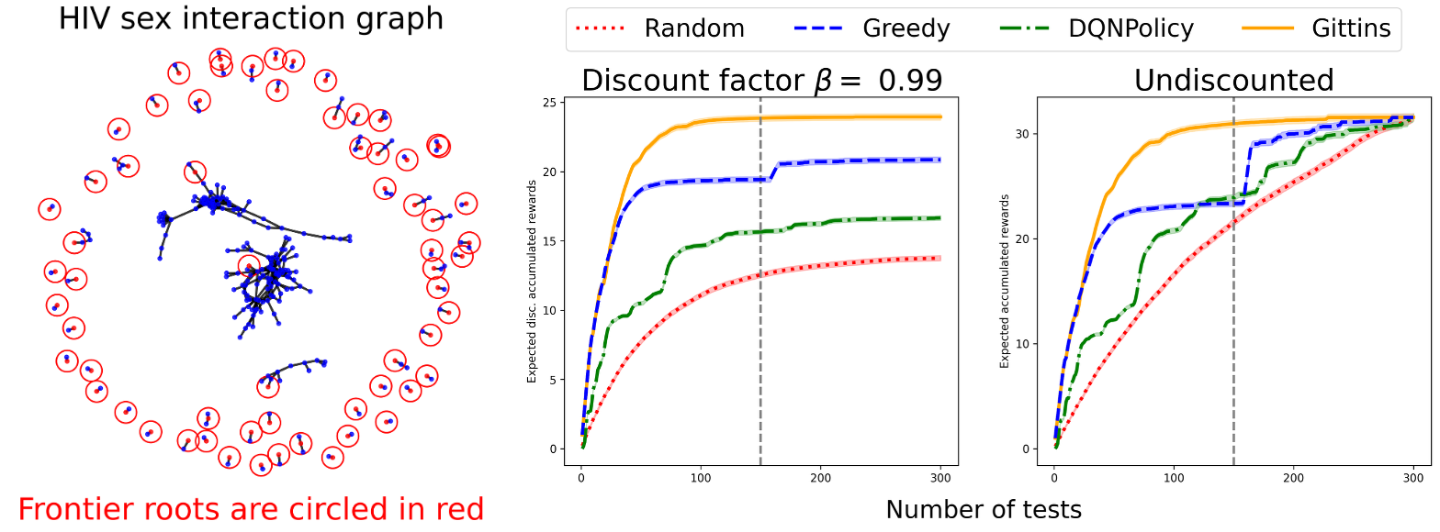
Simulation results
Choo
Algorithm to decide who to test when limited testing budget to find maximum positive cases

Slide 31
Outline: Bandit Algorithms, Agents
Bandit algorithms: World’s largest Maternal mHealth programs
mMitra in Mumbai (200K beneficiaries)
Kilkari across India (3.5 Million beneficiaries)
Network interventions: HIV prevention
Los Angeles
South Africa
MASSI: Multi-Agents for Speeding up Social Impact (LLM Agents)
Lead PhD student photo where their work is shown
Notes:
My team’s work on AI for Social Impact has focused on public health, conservation and public safety

Slide 32









Partnerships

Slide 33
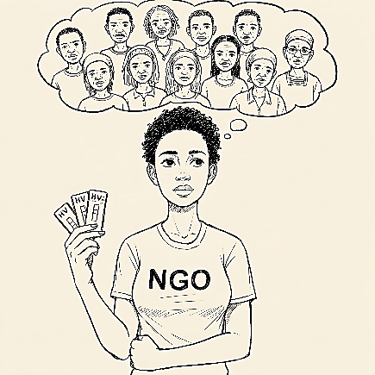

MASSI: Multi-Agents to Speed-up Social Impact (AAMAS 2025 Blue Sky)
Policy goal:
Maximize performance for all beneficiaries
Agents
Agents
LLM
LLM
LLM
Problem definition
Tailored Game/Bandit/MDP
Evaluation
Resource constraints
Generate Policy
Field trial/sim
Notes:
Total Number of Non-Profits: There are an estimated 10 million non-profits and non-governmental organizations (NGOs) worldwide. This figure includes organizations of all sizes.International NGOs (INGOs): While it's hard to get precise figures, estimates suggest there are at least 75,000 International NGOs globally, with around 42,000 of them actively operating. The "Yearbook of International Organizations" lists about 25,000 international non-governmental organizations.Large Non-Profits in the US: In the United States, a study identified 297 non-profits founded since 1990 with over $50 million in annual revenue. This gives a glimpse into what might be considered "large" in one country.

Slide 34
MASSI: Multi-Agents to Speed-up Social Impact (AAMAS 2025 Blue Sky)
Policy goal:
Maximize performance for all beneficiaries
Agents
LLM
Restless Bandit
(RMAB)
Generate Policy via Reinforcement Learning
Notes:
Total Number of Non-Profits: There are an estimated 10 million non-profits and non-governmental organizations (NGOs) worldwide. This figure includes organizations of all sizes.International NGOs (INGOs): While it's hard to get precise figures, estimates suggest there are at least 75,000 International NGOs globally, with around 42,000 of them actively operating. The "Yearbook of International Organizations" lists about 25,000 international non-governmental organizations.Large Non-Profits in the US: In the United States, a study identified 297 non-profits founded since 1990 with over $50 million in annual revenue. This gives a glimpse into what might be considered "large" in one country.

Slide 35
Initial Step in MASSI: Decision Language Agent to Shape RMAB Policies via Reward Design (NeurIPS 2024)
Changed policy goals
Maximize performance for all but slightly prioritize low income beneficiaries
Decision-Language agent
Generates new policy for changed goals
Autonomously search reward functions “R(s,a)”
LLM
Restless Bandit (RMAB)
Generates policy via
Reinforcement Learning

Slide 36
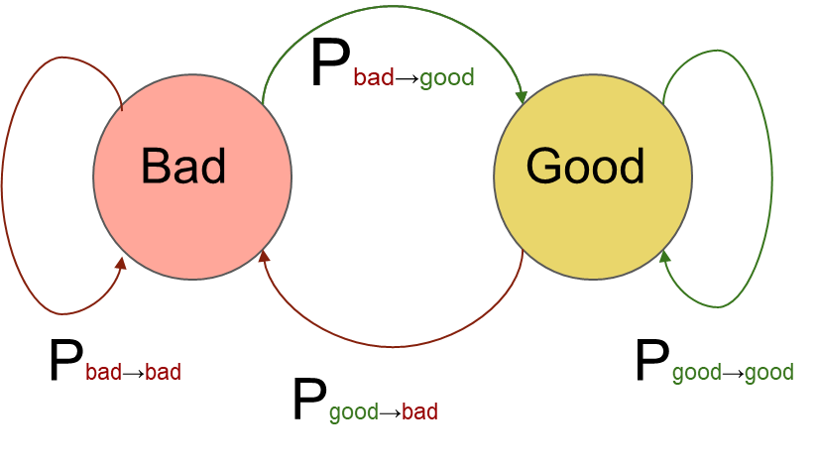
Initial Step in MASSI: Decision Language Agent to Shape RMAB Policies via Reward Design (NeurIPS 2024)
Changed policy goals
Maximize performance for all but slightly prioritize low income beneficiaries
Decision-Language agent
Generates new policy for changed goals
Autonomously search reward functions “R(s,a)”
LLM
Reward function search
R1: Good state
+ low income
+20% reward
Restless Bandit (RMAB)
Satisfactory policy?
R2: Good state
+ low income
-20% reward
…

Slide 37
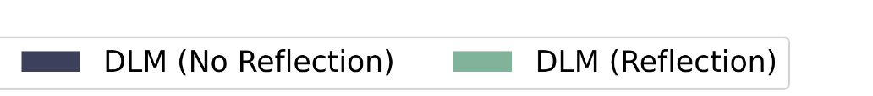
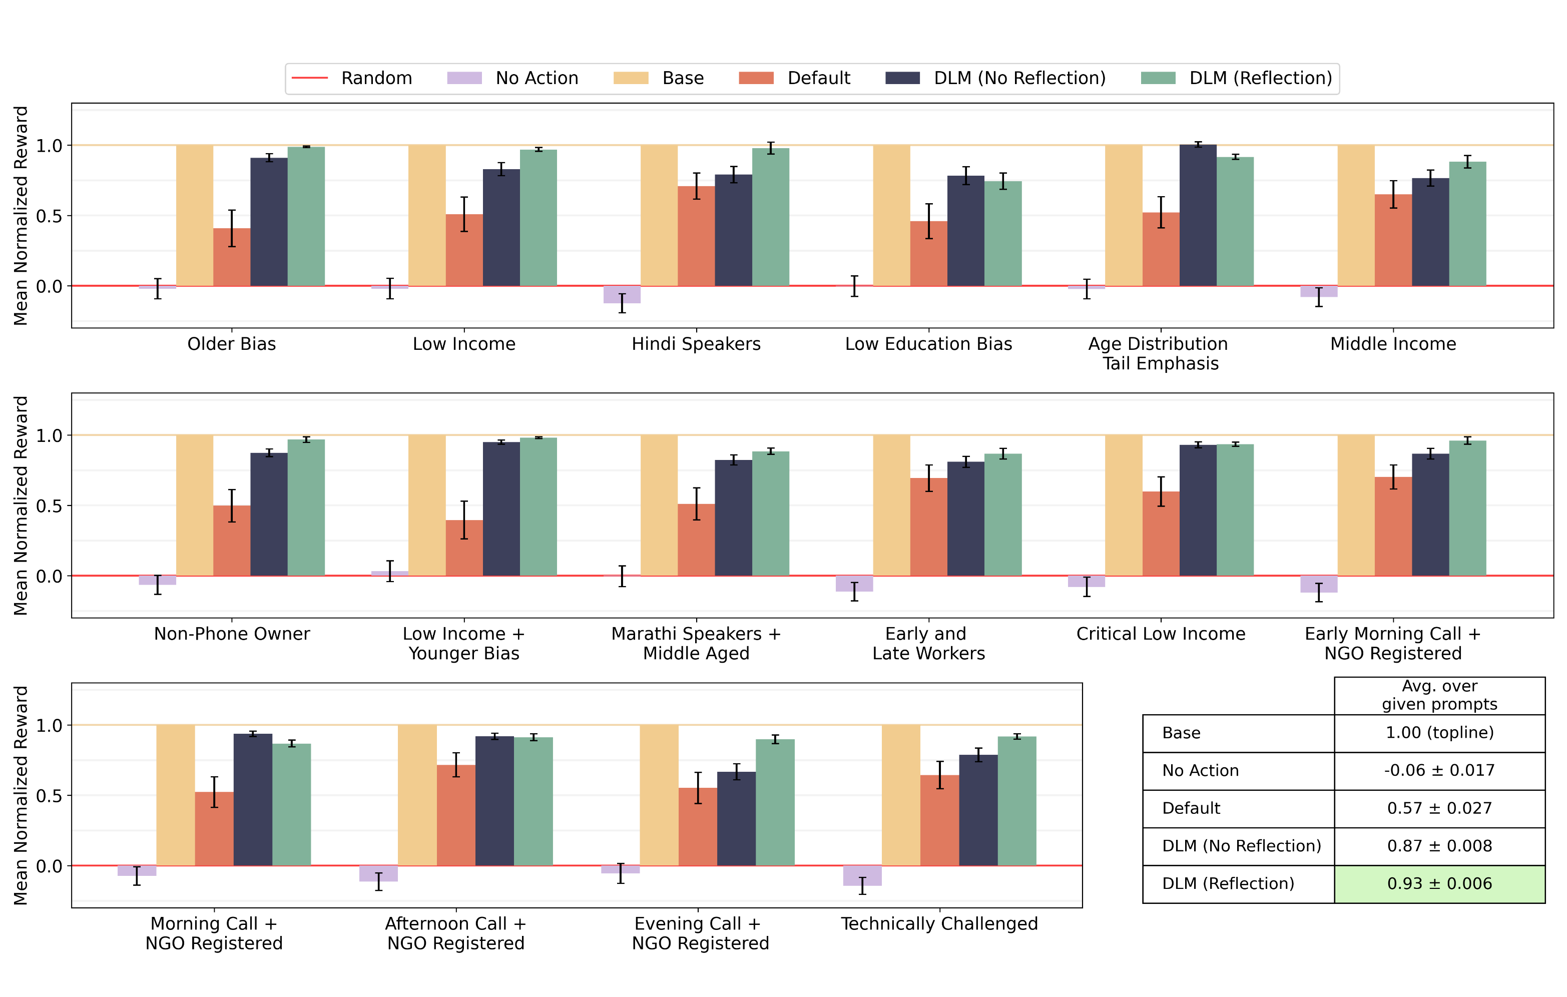
Decision-Language Agent: Simulation Results
Generating Different Reward Functions for Different Commands
(NeurIPS 2024)

Slide 38
Multi-objective Command for Meta Level Agents How to Tradeoff Among Competing Objectives? (ICML 2025)
Multi-objective commands:
“Prioritize low income beneficiaries,
and low age beneficiaries ”
Decision-Language agent
LLM
Tailored MDP
Generate policy via RL

Slide 39
Summary
Bandit algorithms optimize resource allocation in public health
World’s two largest maternal mHealth programs
TB, Diabetes, other resource allocation
Networks for HIV testing and prevention
MASSI: Multiagent Systems to Speed-up Social Impact
LLMs can enable instructible/configurable restless bandits
Decision language agent
Notes:
My team’s work on AI for Social Impact has focused on public health, conservation and public safety

Slide 40
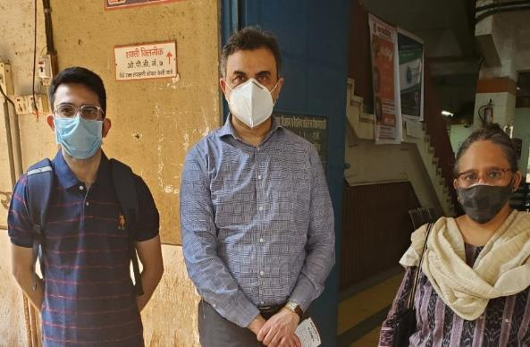
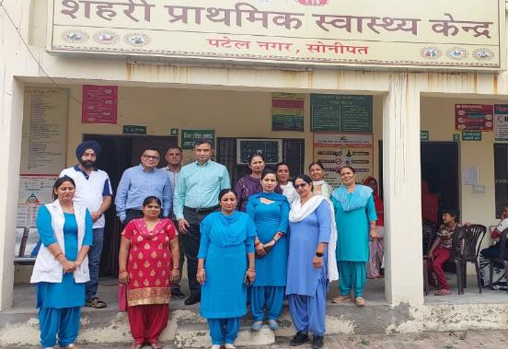
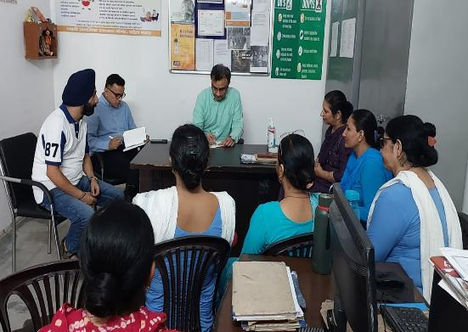
THANK YOU
@MilindTambe_AI
Milind_Tambe@Harvard.edu
milindtambe@google.com
Notes:
With NGOs in the social sector

