Slide 1

Using AI for Fair Resource Allocation with Noisy Signals
From Noisy Signals, Competing Objectives, .. to Law & Policy
AI & the Future of Human Capital in the Global South
29 September 2025
Dr. Swati Gupta
MIT Sloan School of Management
Notes:
Image from http://commons.wikimedia.org/wiki/File:Scales_of_Justice_%28PSF%29.png

Slide 2

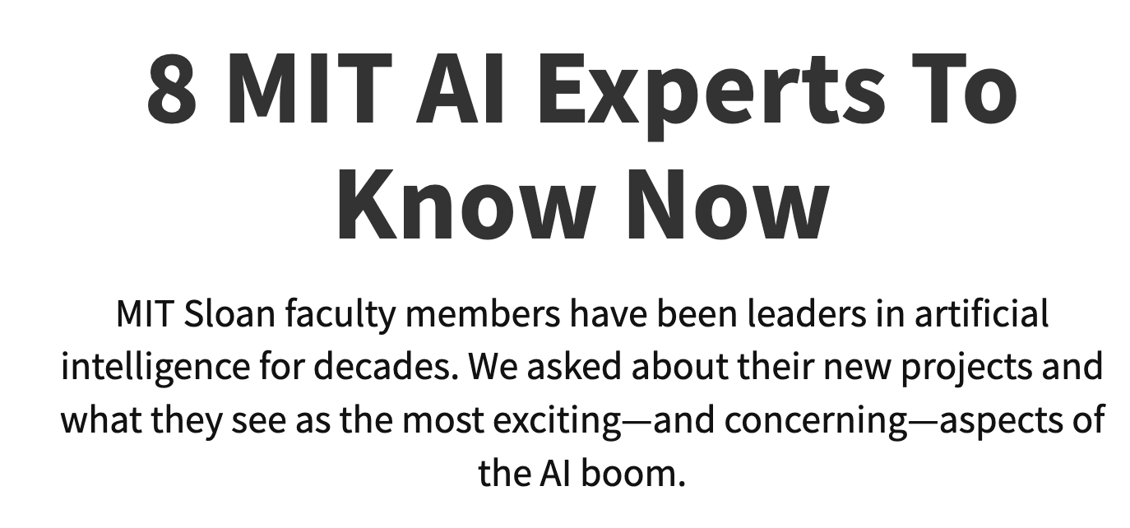
About me
Prof. Swati Gupta
Operations Research and Statistics
Background
Associate Professor, MIT Sloan, 2024+
Assistant Professor, MIT Sloan, 2023-2024
NSF CAREER Award 2023
Lead of Ethical AI in NSF AI Institute on Advances in AI (2021-2023)
Faculty at Georgia Institute of Technology 2018-2023
MIT (PhD in Operations Research, 2017) and IIT Delhi (Bachelors & Masters, 2011), Simons Institute, UC Berkeley from 2017-2018
Interests: Optimization, Machine Learning/AI, Ethical Decision-Making, Cross-disciplinary interactions
Sloan Activities
Committees: Faculty Searches, Graduate Admissions
SERC Action Group 2023-2024
Coordinates
swatig@mit.edu
E62-582
https://swatigupta.tech
Notes:
Very interested
Doubly interested

Slide 3



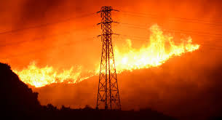

How can we allocate resources fairly and efficiently when the “signals” are noisy?
Hiring, Admissions, Recommendations for Jobs
Access to Facilities, Calls in a Call Center
Organ allocation, Workload Balancing
Climate Resilience, Disaster Response

Slide 4
Outline
I. Noise in Signals
Hiring
Healthcare
II. Competing Objectives
Facility Location
Human-AI Interaction
III. Towards Policy Design
Admissions
Climate Resilience
Summary

Slide 5
I. Noise in Signals

Slide 6

AI doesn’t have 20/20 vision..

Slide 7


.. and errors are often contextual
v/s
How can we still make reliable and fair decisions?

Slide 8
Predicting “Programming” Ability
Even though the original “Aspiring Minds” data (n = 2,212 applicants) did not reflect distributional differences across genders, the ML model picked a skew in favor of males. The model was more errored on males than females.

Slide 9
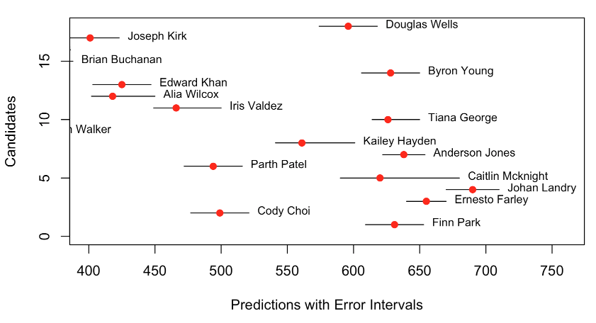
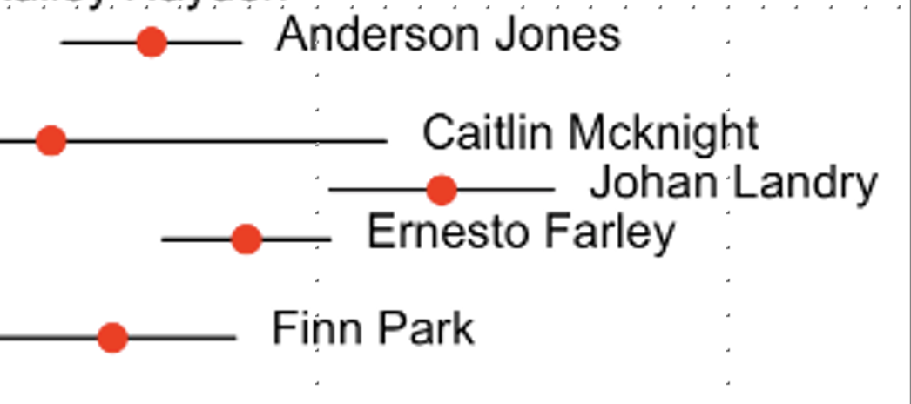
Error Quantification ▻ Resilient Decisions
Find intervals where the true score lies with high probability
Counterfactual estimation, conformal prediction, etc.
estimated error
ML output

Slide 10

Resilience to Contextual Noise in Data
Using “score intervals” to account for errors in model predictions can:
- Give the benefit of doubt to qualified people, on whom AI’s measurement is noisy
Not resort to quotas
Treat everyone equally in the pipeline
Jad Salem, Swati Gupta, “Secretary Problems with Biased Evaluations using Partial Ordinal Information”, Management Science 2023.
Is this approach compatible with Title VII? Yes!
Deven Desai, Swati Gupta, Jad Salem, “Using Algorithms to Tame Discrimination: A Path to Diversity, Equity, and Inclusion”, UC Davis Law Review 2023.

Slide 11
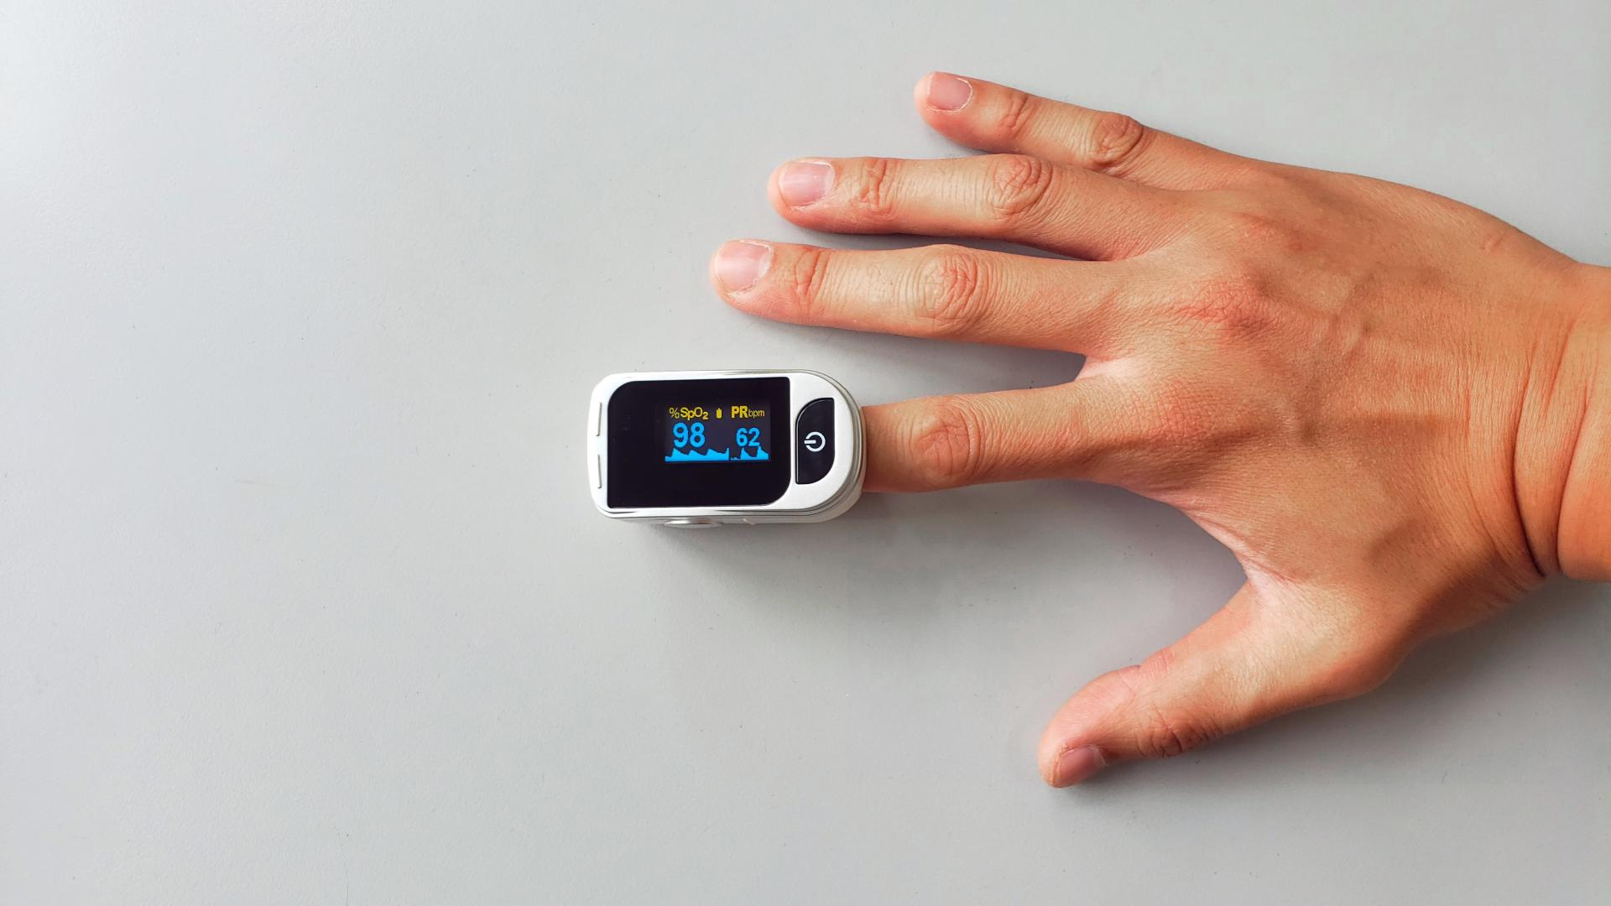
2. Errors in Healthcare Data
Pulse oximetry is a quick non-invasive monitoring technique that measures the oxygen saturation in the blood by shining light at specific wavelengths through tissue, most commonly the fingernail bed.

Slide 12
Pulse Oximetry: the “fifth vital sign” (after temperature, pulse rate, respiration rate, and blood pressure)
Pulse oximetry uses machines and algorithms.
The methodology is prone to some error.
The technology is such that errors are higher for darker skin tones.

Slide 13
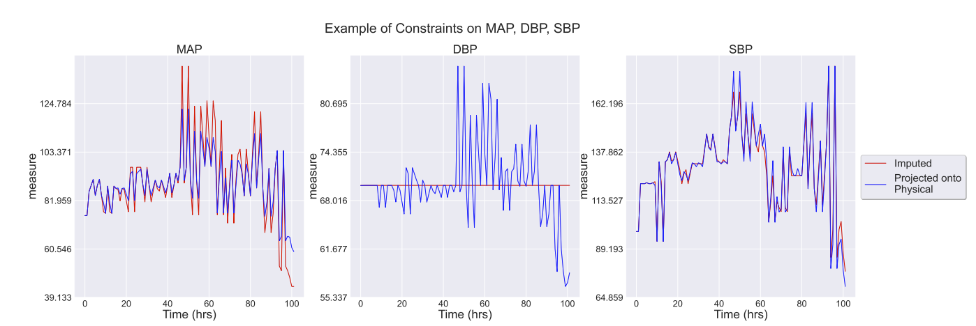


Building Domain-Expertise into AI
Can we teach AI to automatically correct data, just like physicians read charts of a patient, discounting unreliable labs?
$$If Lactate≥6, then HCO_{3}≤0$$
$$If pH≤7, then$$
$$PaCO_{2}≤35 or {HCO}_{3}≤10.$$
Notes:
Probabilities for comparison based on the size?
Overlap can be changed (if you have tiny intervals and they overlap, you know that it’s more likely that candidates are incomparable), and we’re doing some thresholding.

Slide 14
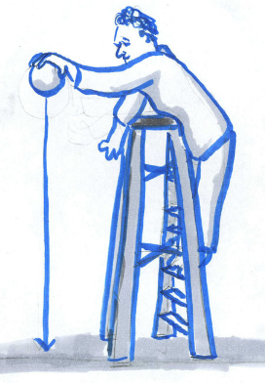
AI-enhanced Early Warning System
Turns out, yes! By modeling domain expertise into mathematical “if-then-else” constraints and finding “closest” compliant data to patient’s data.
Patient’s noisy data
Physically possible data
15% improvement for predicting sepsis 6 hours before onset,
using important indicators of sickness using corrected data
Mehak Arora, Hassan Mortagy, Nathan Dwarshuis, Jeffrey Wang, Philip Yang, Andre Holder, Swati Gupta, Rishi Kamaleswaran, “Improving Clinical Decision Support through Interpretable Machine Learning and Error Correction in Electronic Health Records”. Journal of the American Medical Informatics Association, 2025.
Notes:
Probabilities for comparison based on the size?
Overlap can be changed (if you have tiny intervals and they overlap, you know that it’s more likely that candidates are incomparable), and we’re doing some thresholding.

Slide 15

Noise-Resilient AI Systems
Human-AI collaborative pipelines,
that can account for uncertainty in the data and incorporate domain expertise are much more fairer and robust.

Slide 16
Outline
I. Noise in Signals
Hiring
Healthcare
II. Competing Objectives
Facility Location
Human-AI Interaction
III. Towards Policy Design
Admissions
Climate Resilience
Summary

Slide 17
II. Competing Objectives

Slide 18


Hypothetical: open a hospital
Where would you place it?
Option 2: prioritize farthest person
Option 1: prioritize average person
Notes:
- So let’s ask ourselves why choosing the right notion of fairness is challenging
One of the main – and perhaps the most important – reason is that different people disagree on what’s fair
Here’s a simple toy example. Suppose there are two groups of people who live in a city. The red group is the more populous group and the green group lives on the other side
The city admin decided to open a hospital. Where should this hospital be?
Let’s do this methodically; suppose we locate the hospital to minimize the distance that the average person travels to it. Is that fair?
Another option is to minimize the distance of the furthest person from the hospital. Is this fair?
Both solutions have downsides
ToDo: add hospital icon

Slide 19
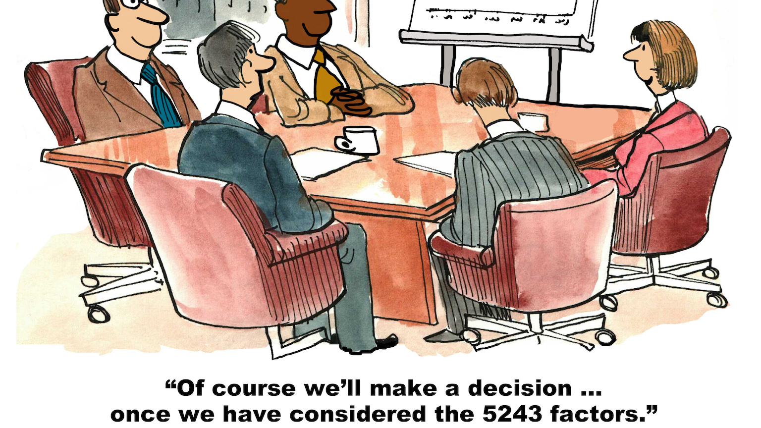
Decision Paralysis

Slide 20

Hypothetical: open a hospital
Lever to trade-off the objectives
Prioritize Average Person
Prioritize Furthest Person
Optimal solution
Example: open k = 1 facility based on various fairness objectives

Slide 21

Hypothetical: open a hospital
Lever to trade-off the objectives
Prioritize Average Person
Prioritize Furthest Person
Optimal solution
Example: open k = 1 facility based on various fairness objectives

Slide 22
Hypothetical: open a hospital
Lever to trade-off the objectives
Prioritize Average Person
Prioritize Furthest Person
Optimal solution
Example: open k = 1 facility based on various fairness objectives

Slide 23


“Portfolio” of good enough solutions
Lever to trade-off the objectives
Prioritize Average Person
Prioritize Furthest Person
Portfolio of two
solutions
Example: open k = 1 facility based on various fairness objectives

Slide 24

When we face a big decision—like where to build a hospital, who gets a scarce resource, or how to recover after a disaster—there isn’t just one right answer.
There’s a whole landscape of possible solutions, shaped by competing values and trade-offs.
Can AI help us summarize and navigate that complex landscape? Yes!

Slide 25
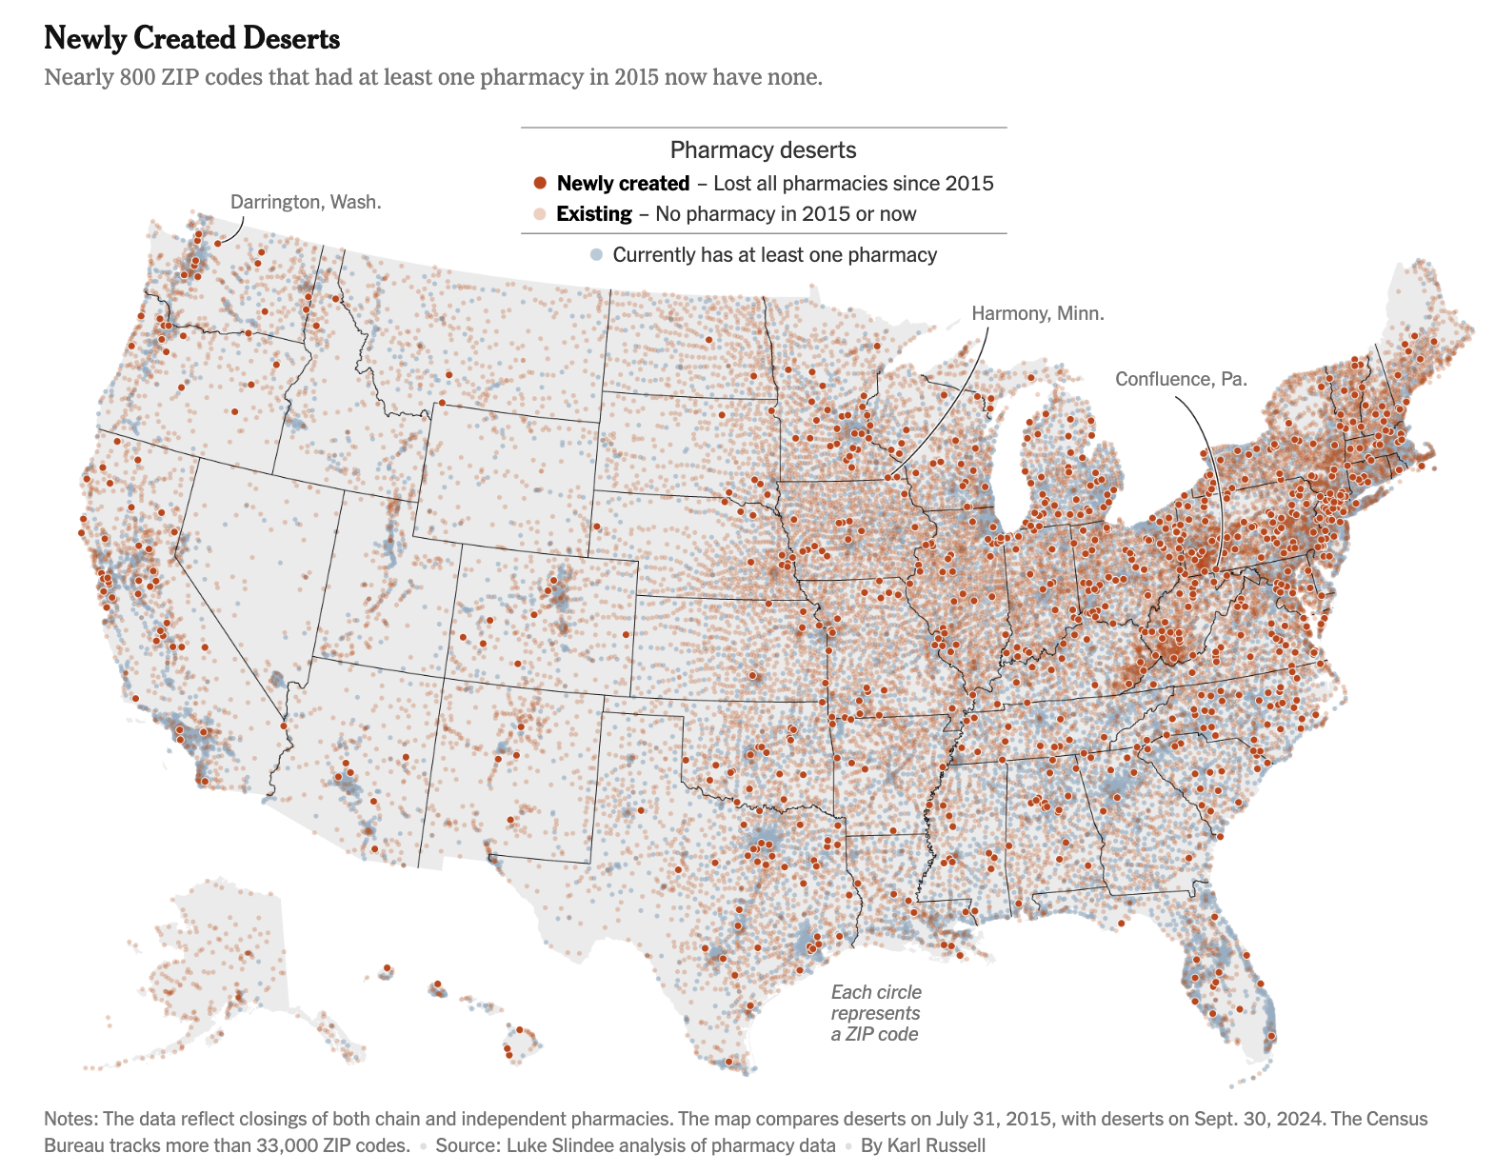
NYtimes 10/2024

Slide 26
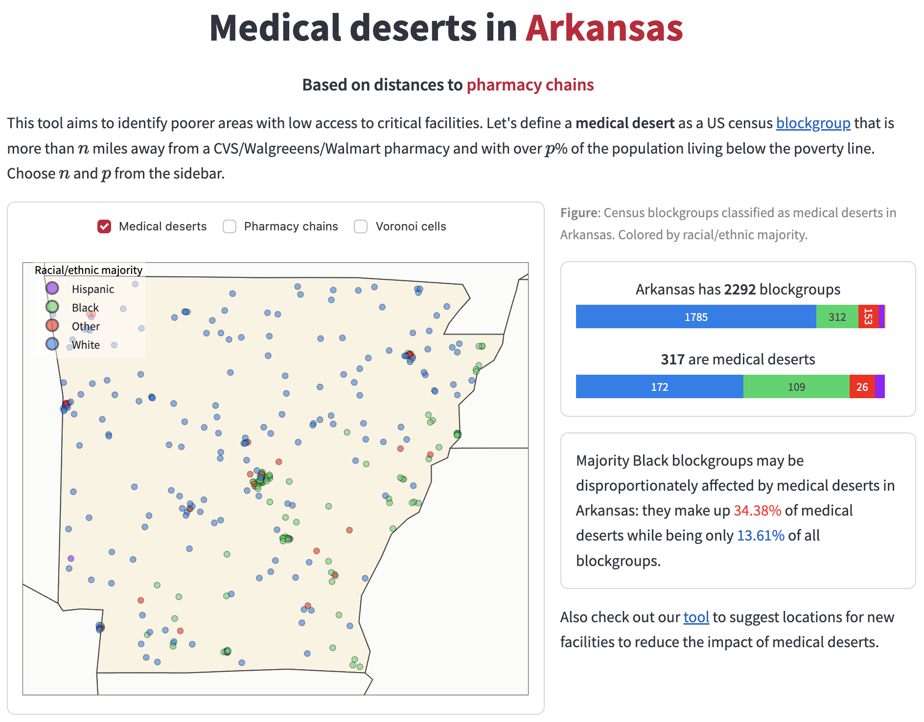
1. Reducing Medical Deserts
https://usa-medical-deserts.streamlit.app/

Slide 27
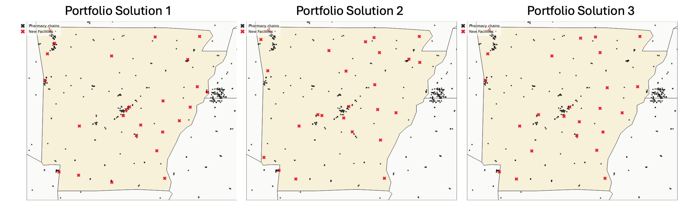
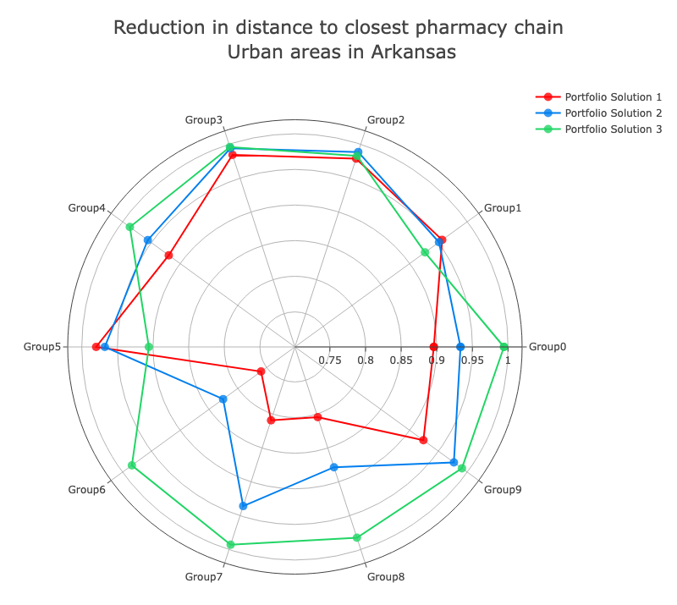
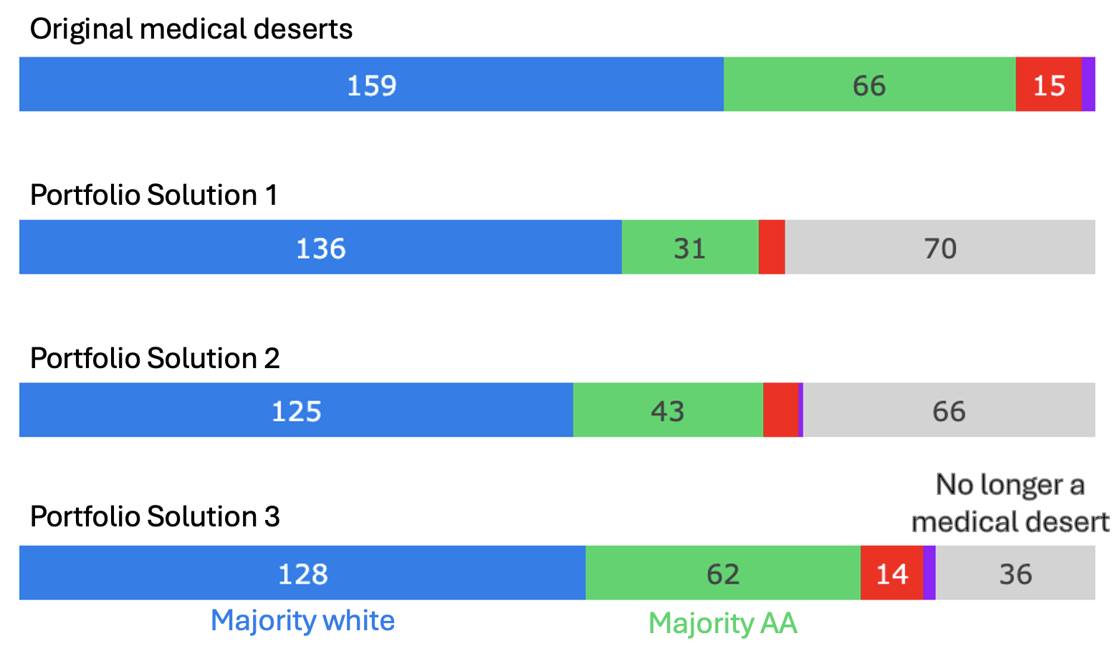
Planning Pharmacy Placement
“Which L_{p} norm is the fairest? Approximations for fair facility location across all “p”.” Swati Gupta, Jai Moondra, Mohit Singh, EC 2023.

Slide 28
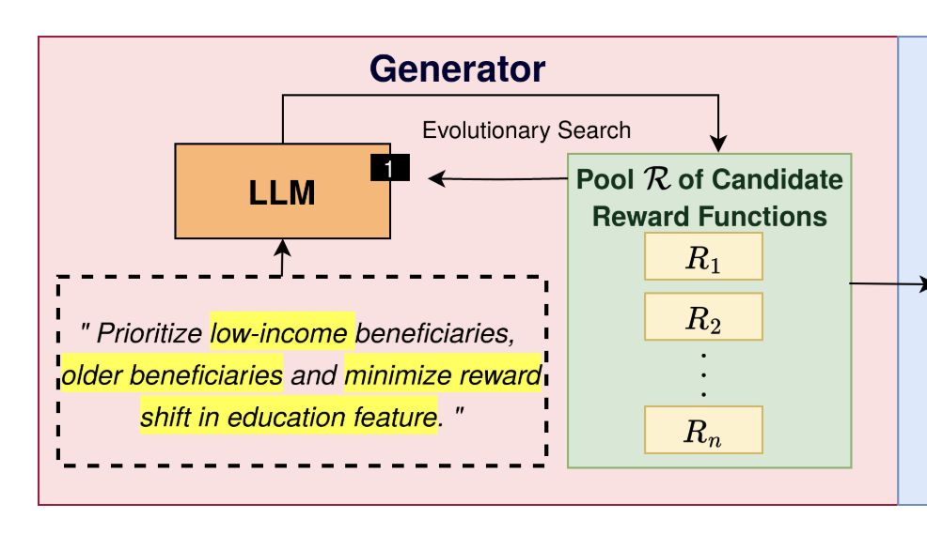
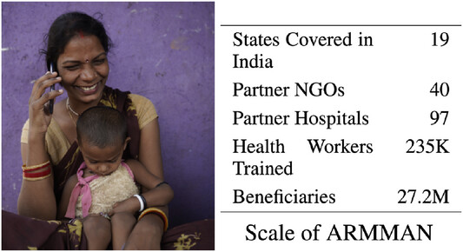
2. Human-AI Interactive Allocations
Which expecting mothers should be prioritized in the coming week? Engaged/disengaged, educated/uneducated, low income, young/old?
Verma, Shresth, et al. "Expanding impact of mobile health programs: SAHELI for maternal and child care." AI Magazine 44.4 (2023): 363-376.
Social Choice Language Model: Verma, Boehmer, Kong, Tambe. "Balancing Act: Prioritization Strategies for LLM-Designed Restless Bandit Rewards." Workshop on Socially Responsible Language Modelling Research, 2024.
https://teamcore.seas.harvard.edu/ai-assisting-ngos-improving-maternal-and-child-health-outcomes/

Slide 29

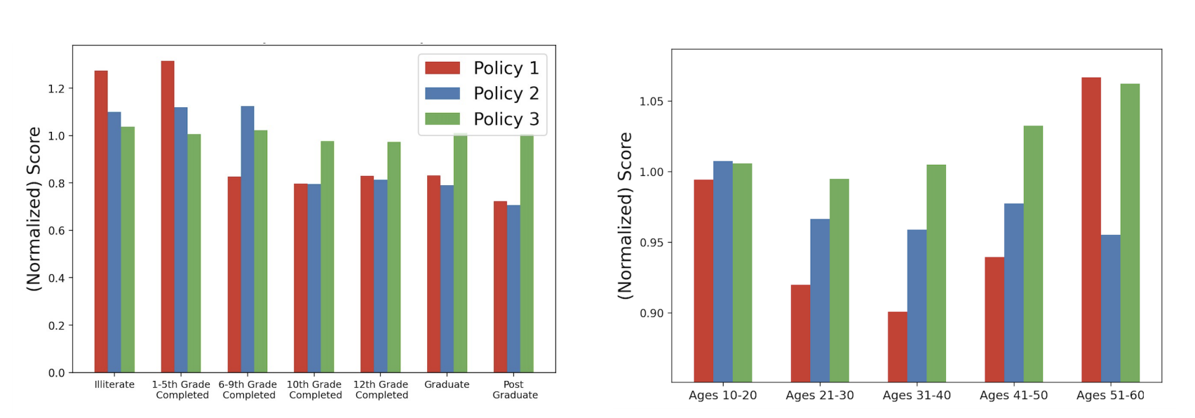
Portfolios for Allocating Calls
It’s not a pie! Impact is correlated.
AI can help us navigate the space of “aligned” policies
Adam Cheol Woo Kim, Jai Moondra, Shresth Verma, Madeleine Pollack, Lingkai Kong, Milind Tambe, Swati Gupta, “Preference Aggregation using Portfolios for Reinforcement Learning”. ICML 2025

Slide 30

Role of AI in “Effective” Summarization
?
Human in the loop
Noisy Data
Models: Opt → ML, ML → Opt
Data-driven decisions

Slide 31
Outline
I. Noise in Signals
Hiring
Healthcare
II. Competing Objectives
Facility Location
Human-AI Interaction
III. Towards Policy Design
Admissions
Climate Resilience
Summary

Slide 32
III. Towards Policy Design

Slide 33
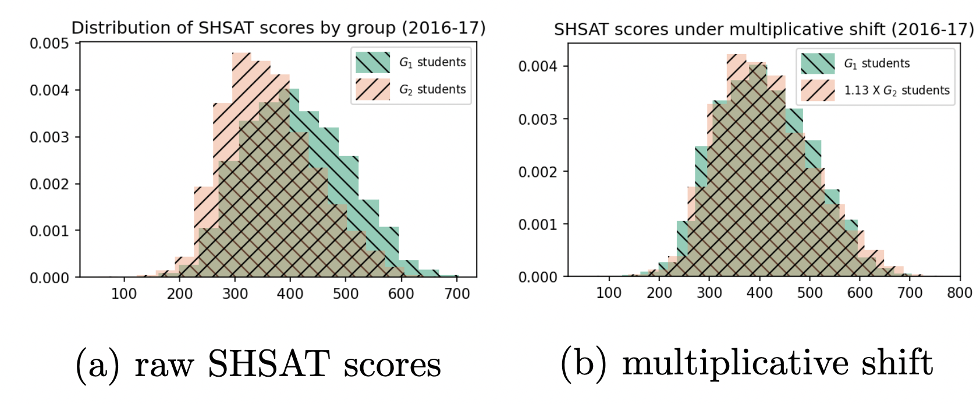
Admissions: Noisy SHSAT signal
Consistent differences in performance across schools with low v/s high economic need (12 years of data, New York’s DOE)
Interventions: which students are impacted most due to this gap?
Policy Design: scholarships are better targeted to top average students, to uplift students the maximum amount
Yuri Faenza, Swati Gupta, Xuan Zhang, Aapeli Vuorinen “Reducing the Filtering Effect in
Public School Admissions: A Bias-aware Analysis for Targeted Interventions”. ACDA 2023.

Slide 34
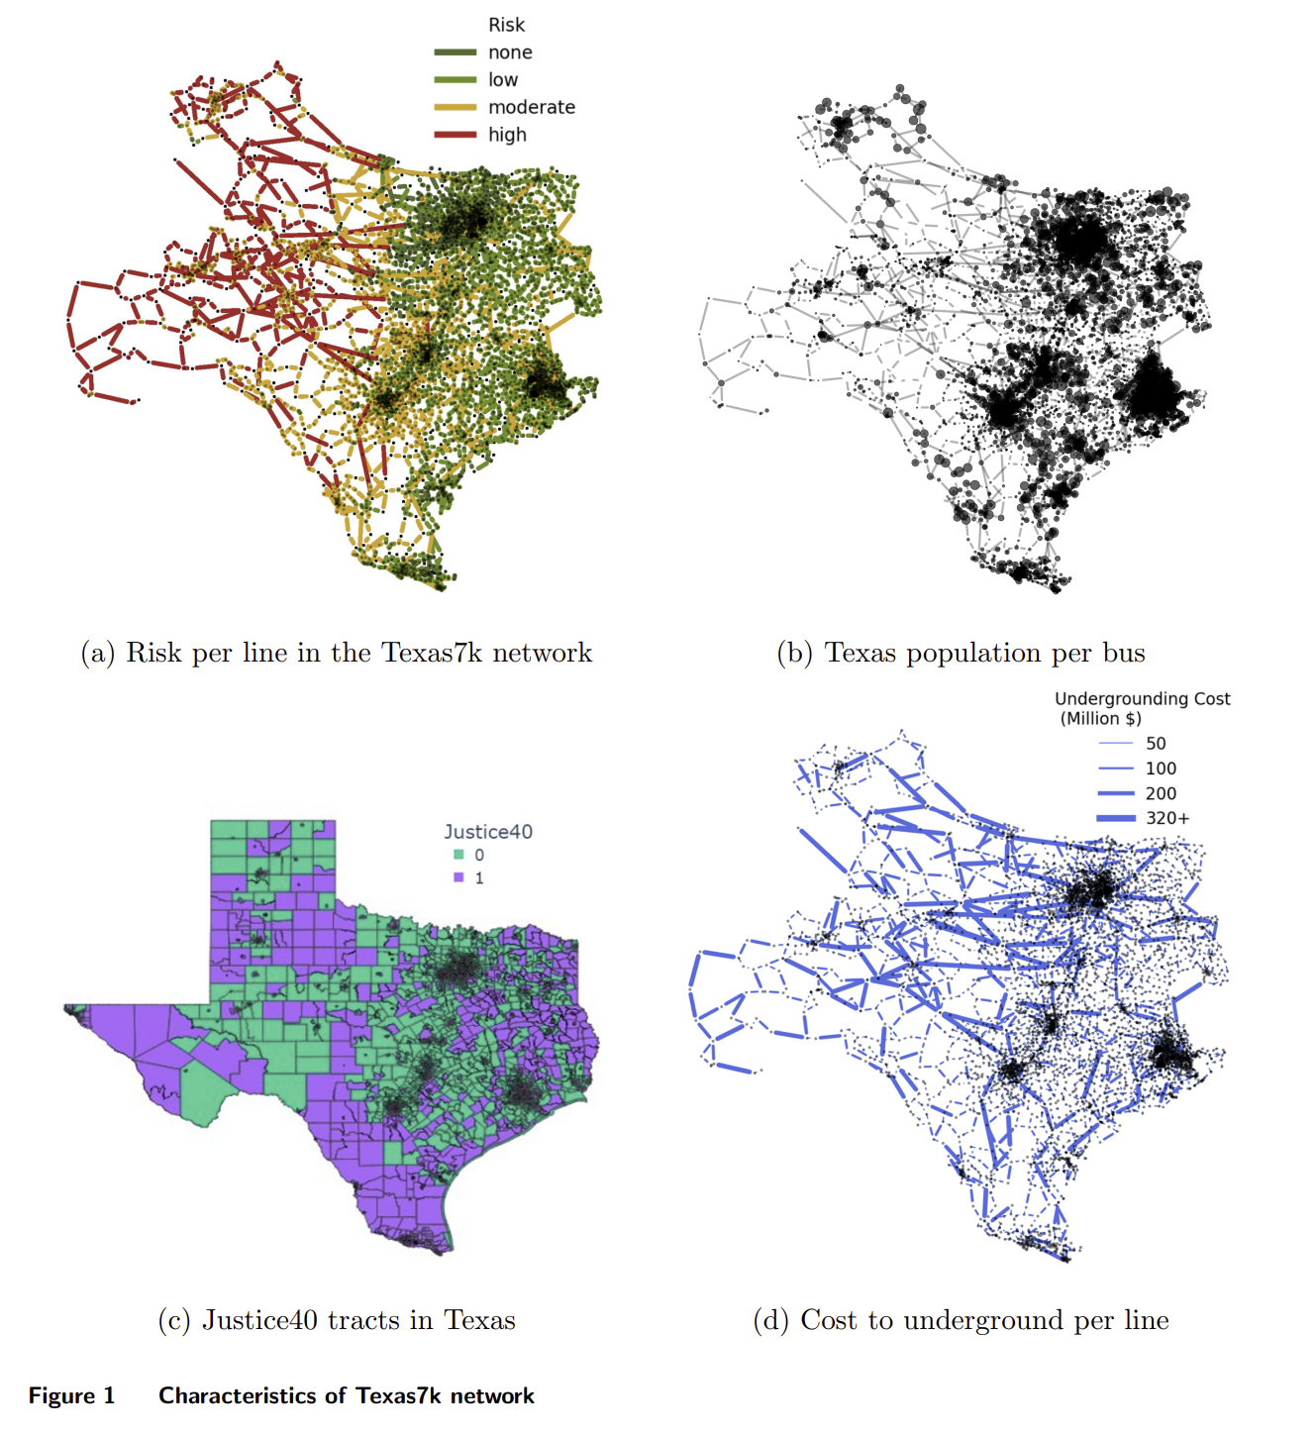
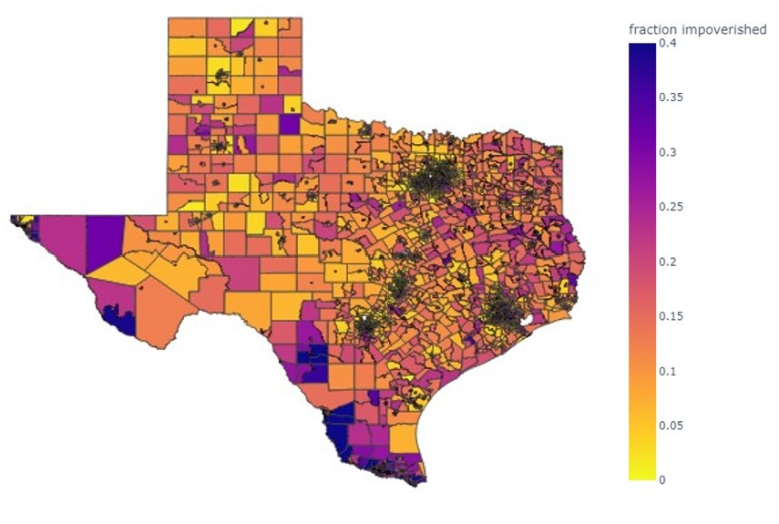
Wildfire Risk v/s Load Shedding
Impoverished communities live in high wildfire risk areas, where cost of underground transmission lines is also high!
Policy Design: explicit protections in climate investments are important to protect these communities (Justice40 indices are not enough)
Madeleine Pollack, Ryan Piansky, Swati Gupta, Daniel Molzahn, “Equitably Allocating Wild-fire Resilience Investments for Power Grids – The Curse of Aggregation and Vulnerability Indices”. Applied Energy, Volume 388, 2025.

Slide 35
Summary
I. Noise in Signals
AI built on noisy, incomplete data generated by humans will not be perfect
Quantifying error and providing domain’s context is critical in building noise-resilient AI.
II. Competing Objectives using Small Portfolios
Large number of possible objectives due to multiple stakeholders or underspecification by human-AI interaction
AI can help us navigate the complex landscape by highlighting key differentiating properties of solutions
III. Towards Policy Design
Admissions – interventions by using AI to quantify impact of noise
Climate Resilience – policy design by characterizing outcomes of various models involving vulnerability indices.

Slide 36
Thank you!
Contact: swatig@mit.edu
Website: www.swatigupta.tech

Slide 37
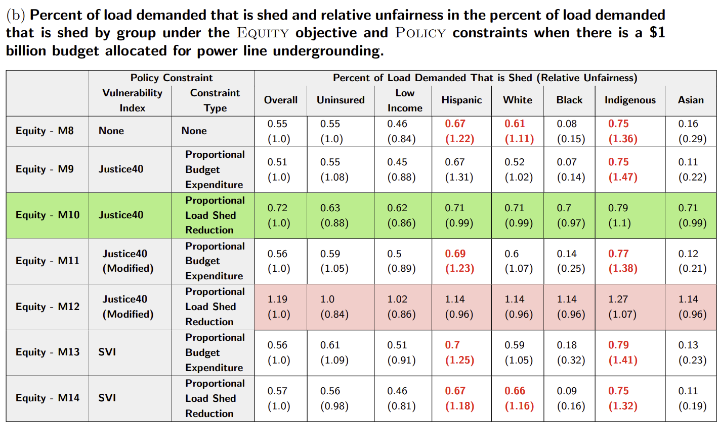
Use of the Justice40 initiative WITH an equitable objective, we can achieve relatively fair AND substantially low load shed
Why do we see improvements?
We use a percentage-based group-level fairness objective (no aggregation required)
When adding constraints for load shed reduction, we implicitly prioritize high-ignition risk areas

