Slide 1
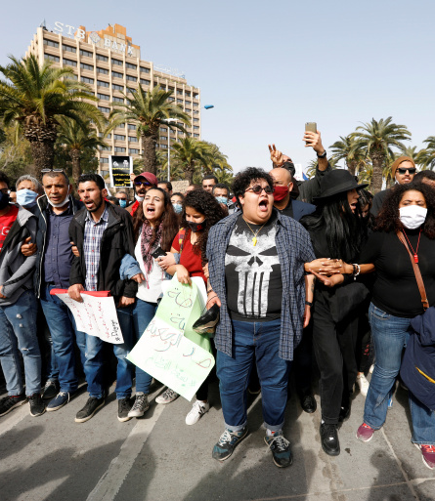
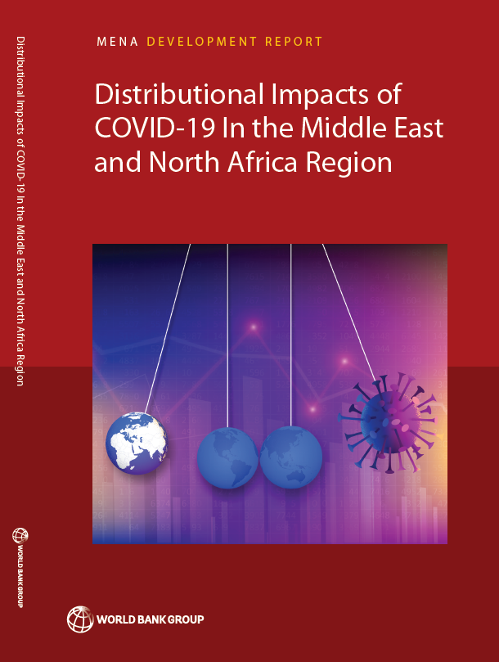
Distributional Impacts of COVID19 in the Middle East and North Africa Region
Notes:
Do you want to include this picture in the cover?

Slide 2
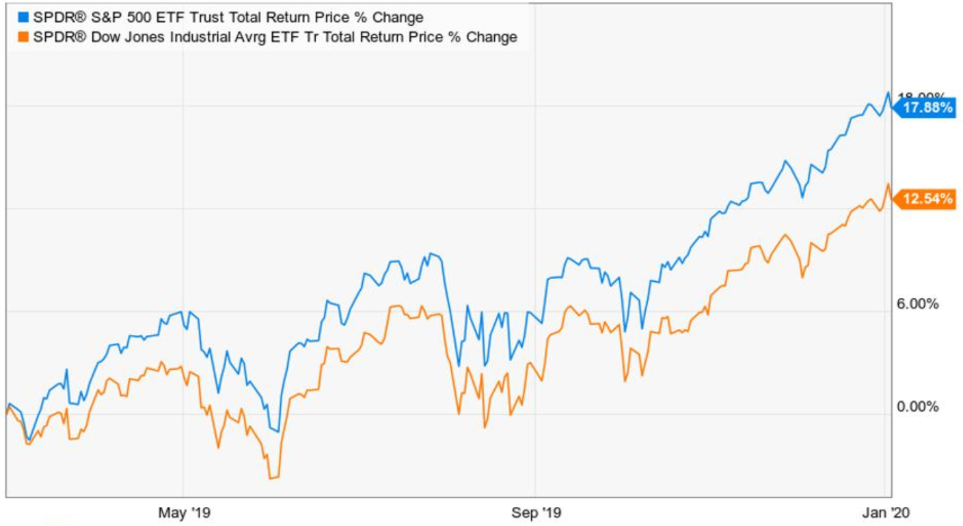
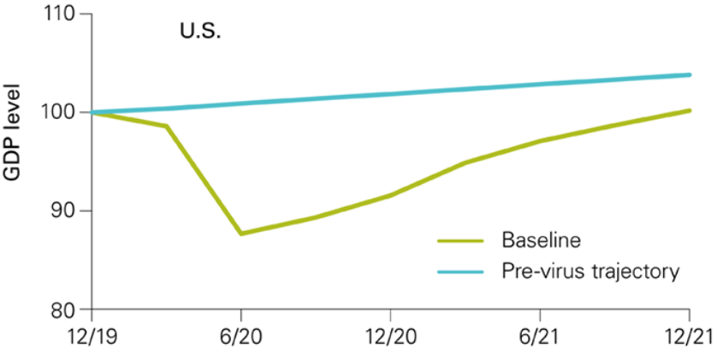
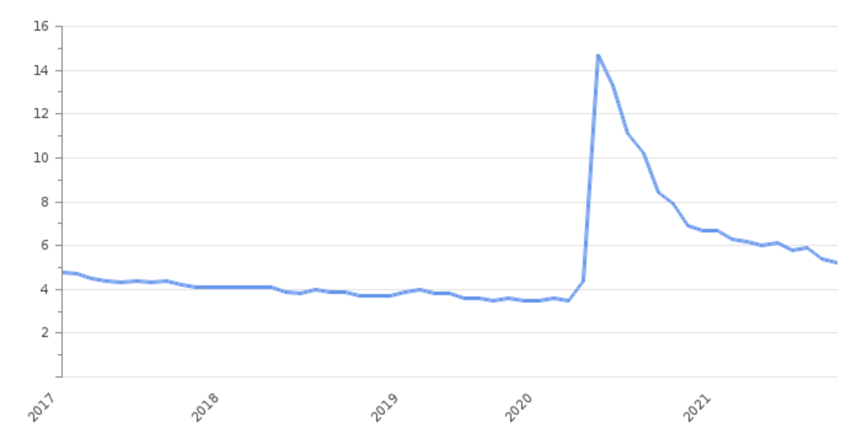
Pre-amble: COVID19 in the USA
Unemployment
What happened to poverty in the USA?
Notes:
Annual poverty rate projection for 2021 of 7.7 percent is well below the rate of 13.9 percent that we estimate for 2018.
The number of poor Americans is expected to have fallen by nearly 20 million from 2018 levels, a decline of almost 45%.The three programs that cut poverty most in the USA were stimulus checks, increased food stamps, and expanded unemployment insurance.

Slide 3
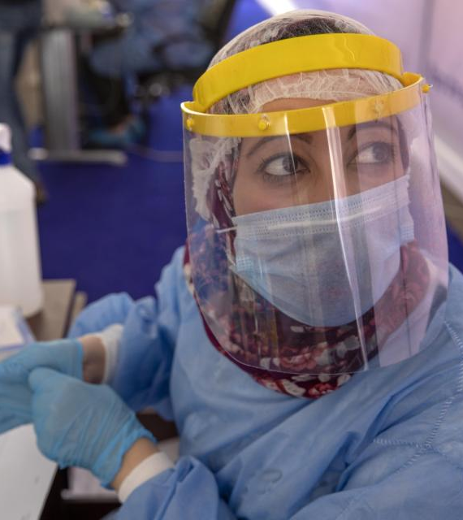
Main take-aways
COVID-19 has had unequal impacts, often affecting the poor and vulnerable disproportionately. The results suggest:
  a substantial rise in poverty;
  greater inequality;
  the emergence of a group of “new poor”;
  changes in the labor market at both the intensive (how hard people work) and extensive (how many people work) margins.
Besides the pandemic, some countries are struggling with: (i) inflation; (ii) macroeconomic crises; (iii) food insecurity; and (iv) fragility and conflict (with large refugee populations).
There is a risk that recoveries will further increase inequality, given that the informal sector – in which many less well-off people work – tends to recover more slowly.
More pandemics will occur, along with bigger, more frequent climate change shocks – hence, there is a need for adaptation
  Social protection
  Data
Notes:
Libya phone survey is good illustration of survey with bias.

Slide 4
Pre-COVID19, MENA already faced serious welfare challenges

Slide 5
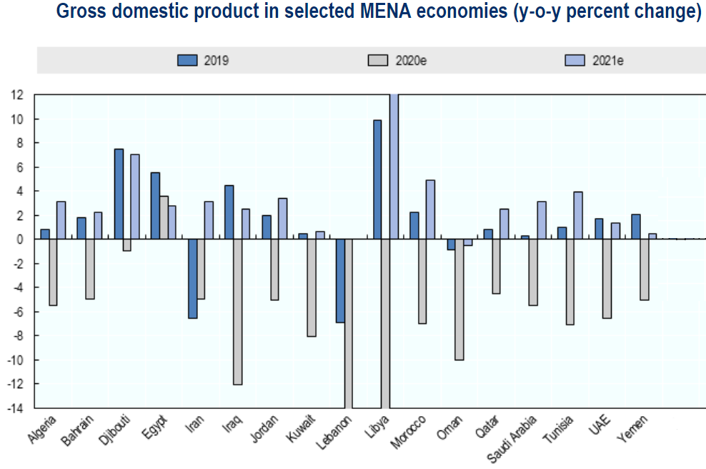
A sharp and varied economic impact since the onset of COVID19 (Feb 2021)
COVID19 stringency index

Slide 6
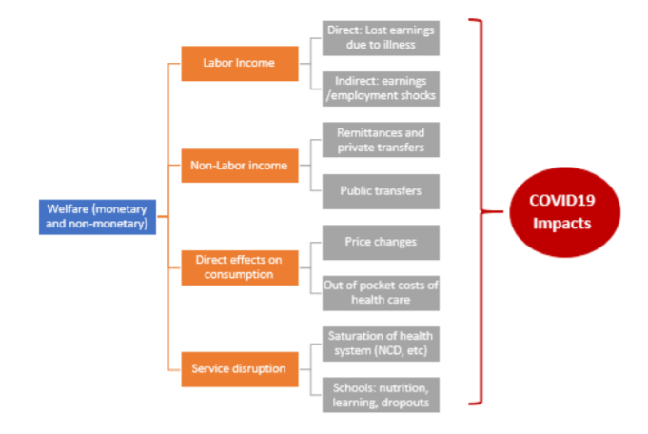
Main channels for short-term impacts of COVID19 on welfare
Notes:
Two ways to assess this: new data collection; simulation exercises

Slide 7
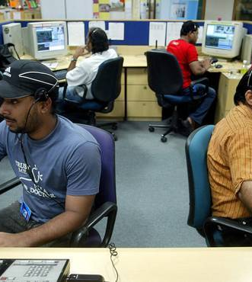
On phone surveys:
Provide quality data
Good alternative when face to face surveys cannot be used
Fast and inexpensive
Limitations
Length of questionnaire is limited; cannot estimate welfare accurately
Cost per question can be high
Small samples
Potential biases, not all of which can be corrected
Common errors
Compare data to pre-existing variables collected using a different approach
Data quality is overlooked
Phone surveys work better when
Draw from existing baseline
Have infrastructure ready
Are integrated in tool-box of statistical offices
Affordable panel data
Offer new opportunities (e.g. to follow migrants)
Notes:
Libya phone survey is good illustration of survey with bias. Short questionnaires are a challenge for doing distributional analysis

Slide 8
Timing of phone surveys matters for observed impact
Stringency index and timing of phone survey
Stringency index and percent who stopped working
Notes:
The timing of the survey, relative to the economic lockdown matters a great deal for the impact on finds on labor. Work stoppages very high, but also temporary

Slide 9
Focus on Djibouti
Recovery, but many who worked were not paid, or paid less
Refugees are more affected by partial or non-payment
Notes:
Tunisia had 5 rounds of phone surveys, drawn from a baseline survey (so poor were pre-identified). Evidence suggests that while the economy rebounds quickly (macro data support this), many households continue to report to be worse off, month after month. This holds especially for the poorest.

Slide 10
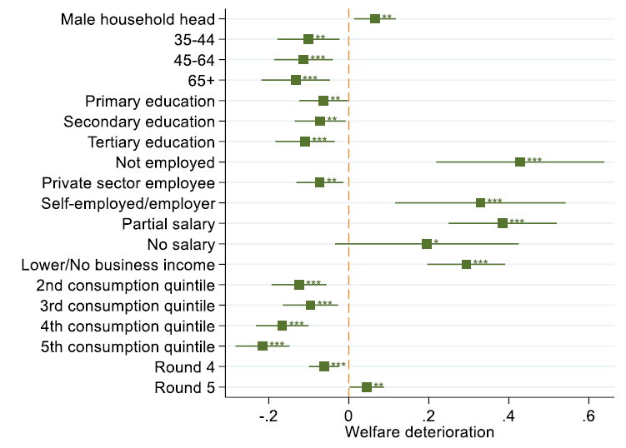
Focus on Tunisia
As the economy rebounds, many report to be worse off.
Especially the self-employed and the poorest
Probability of declaring a deterioration in living standards
Notes:
Tunisia had 5 rounds of phone surveys, drawn from a baseline survey (so poor were pre-identified). Evidence suggests that while the economy rebounds quickly (macro data support this), many households continue to report to be worse off, month after month. This holds especially for the poorest.

Slide 11
Focus on Palestine
Working poor more severely affected
Those who do work only paid in part
Large increase in food insecurity in West Bank but not in Gaza where it was already very high
Notes:
Palestine had a very large survey, allowing for a breakdown by many groups.

Slide 12
Other COVID19 impacts
COVID19 inequities carry over into access to testing.
Those with greatest exposure to risk of infection are tested least
Notes:
Of the respondents to the 4th round of the Djibouti phone survey, 29% indicated they were tested for COVID-19, yet only 22% of poor respondents were tested at least once for COVID-19 versus 30% of the non-poor. Those with greater exposure to the risk of infection, such as those working in the informal sector, were less likely to have been tested than those engaged in the public sector (25% versus 39%).

Slide 13
Other COVID19 impacts
Large impact on education of children, with children from the poorest households affected more
No clear relation between food security and stringency index
Stringency index and food security score
Notes:
Palestine had a very large survey, allowing for a breakdown by many groups.

Slide 14
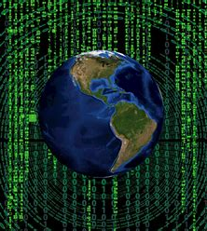
On simulations:
Advantages
Can estimate impact on poverty and inequality
Ability to separate out the impact of different shocks
Limitations
As good as the underlying data & realism of assumptions
Black box
Common errors
Compare data to pre-existing variables collected using a different approach
Simulations are more effective when …
Draw from existing baseline
Have basic simulation infrastructure ready
Static simulations, each one combines information on GDP growth projections by sector with household survey data to impute the loss of employment and income
Hard to deal with structural breaks
Good tool to assess different scenarios, incl. impact of mitigation measures
Notes:
Tunisia, Iran, West Bank and Gaza, and Lebanon

Slide 15
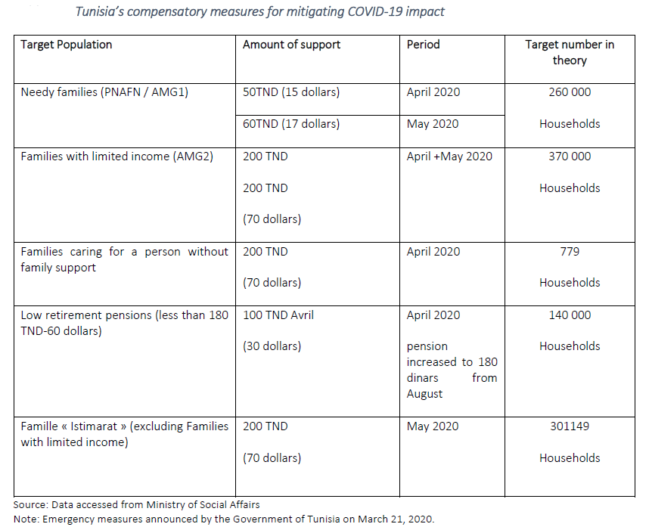
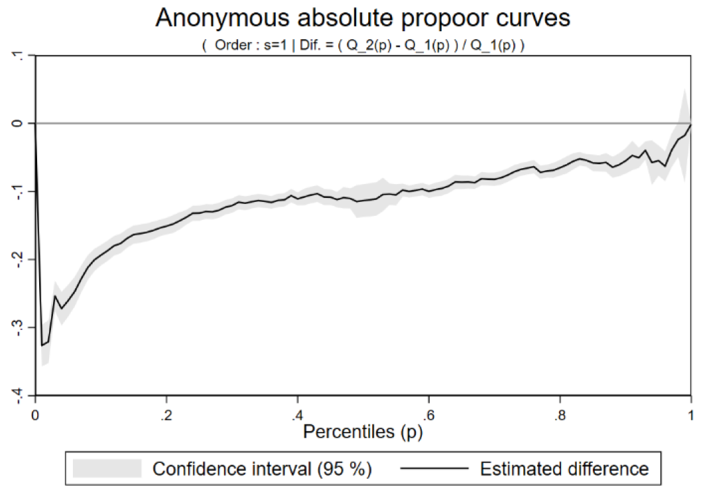
Focus on Tunisia
Model different sectoral growth rates, its impact on employment and consumption. Investigate the impact of mitigation measures
Large increase in poverty; limited impact of mitigation
Notes:
Tunisia had 5 rounds of phone surveys, drawn from a baseline survey (so poor were pre-identified). Evidence suggests that while the economy rebounds quickly (macro data support this), many households continue to report to be worse off, month after month. This holds especially for the poorest.

Slide 16
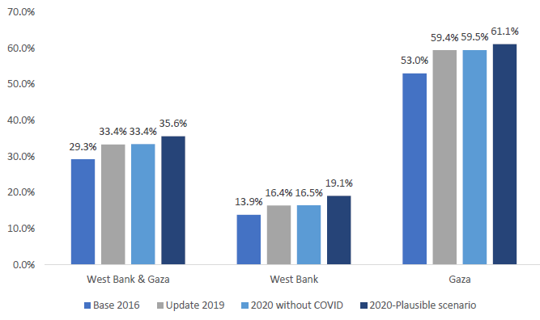
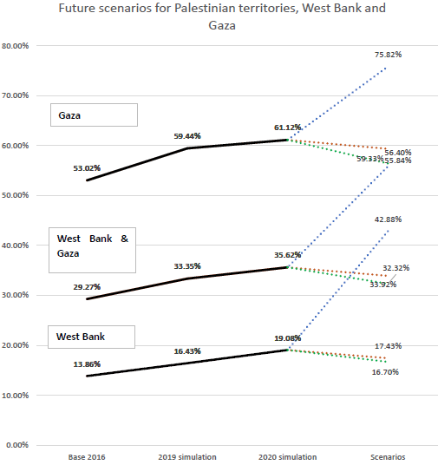
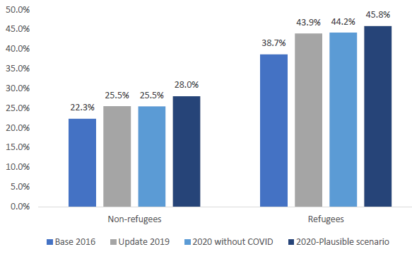
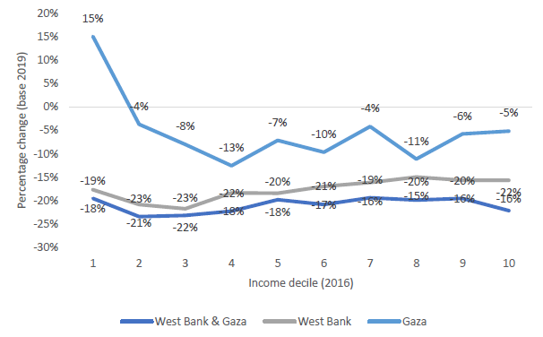
Focus on West Bank and Gaza
Simulation results: impact on poverty
Simulation results: incidence curve of income
Model employment shocks for workers with different characteristics and its impact on income & consumption for Palestinians and refugees
Notes:
The biggest impact is in the 2nd and 3rd decile. The future scenarios depend also on how one models coping mechanisms. So far, elasticity to income is used. But once coping runs out, the elasticity increases rapidly and poverty can increase quickly

Slide 17
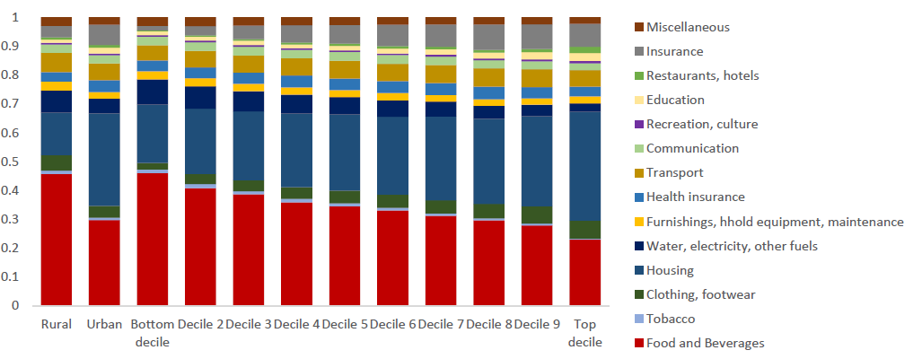
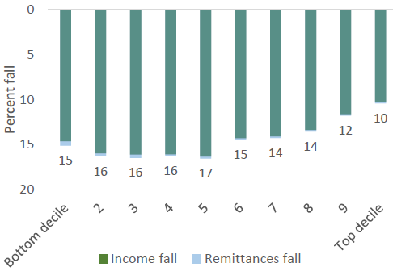
Focus on Iran
Expenditure shares by type
Model impact of income shocks for different categories of workers, along with changes in prices (for different categories of workers)
Poverty increases substantially as a result of the fall in income and high inflation.
Mitigation measures are effective in reducing the poverty increasing effects of COVID and inflation
Changes in income by decile

Slide 18
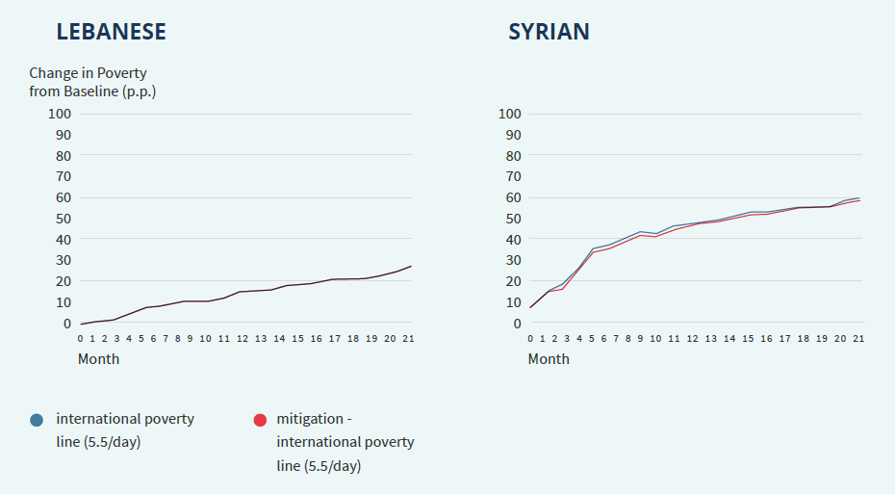
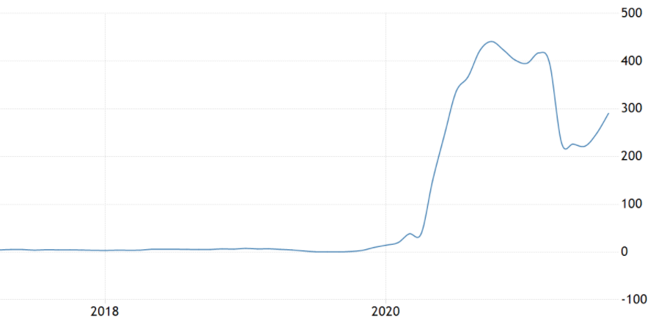
Focus on Lebanon
Model impact of multiple shocks:
COVID19
Port of Beirut blast
Recession
Inflation
and mitigation measures on host and refugees
Huge increase in poverty, largely driven by food price increases
Mitigation measures have limited impact
Change in poverty
Food price inflation
(y-o-y)

Slide 19
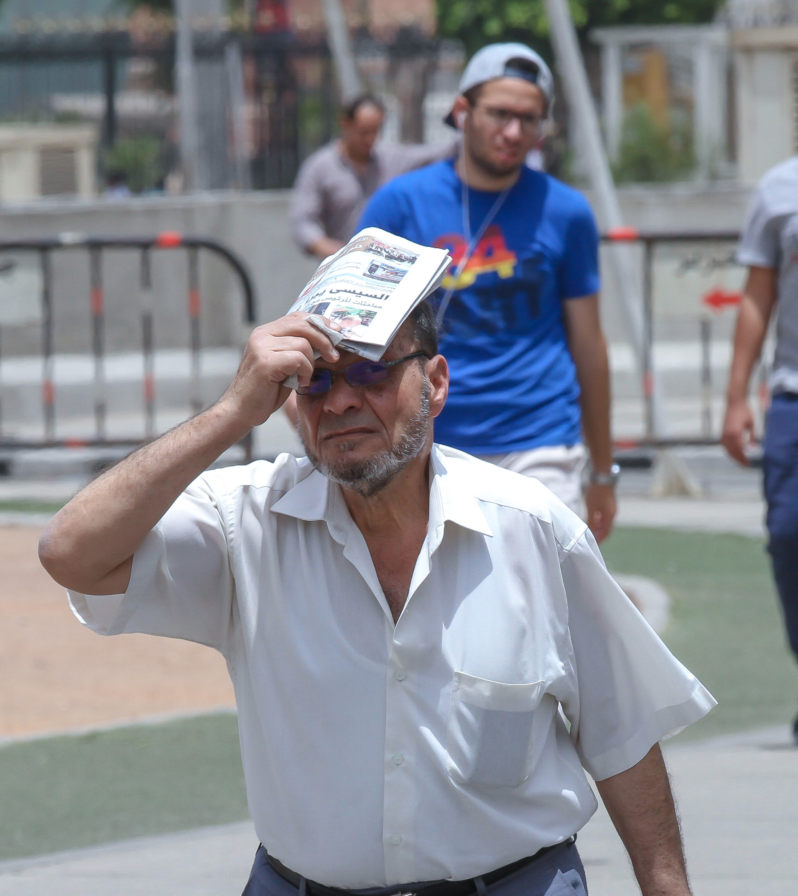
Key messages
COVID19 affected some groups much harder than others
  Those in public and private sector relatively protected
  Those already receiving benefits, better protected
COVID19 is often just one of various severe challenges
    Conflict
    Inflation
    Economic recession
Risk of Unequal recovery
  Mitigation measures fall short to undo the impact on poverty
  Most vulnerable are affected most and recover least
More work is needed to truly understand impact of COVID19
  Post-COVID19 new face-to-face welfare surveys are needed
  Ongoing in Algeria, Lebanon, Iraq, Jordan; advanced planning in Saudi Arabia and Palestine
Region needs to prepare better for future (climate) shocks
  Social safety nets
  Real-time data collection capacity
Notes:
Libya phone survey is good illustration of survey with bias.

