Slide 1
The Well-Being Effects of Digital Mental Health
M. Angelucci, R. Fabregas, and A. Vazquez
The University of Texas at Austin
Preliminary results - Ongoing project
AI & the Future of Human Capital in the Global South
Sept 29th, 2025

Slide 2
Global mental health care challenges
~ 970 million people experience a mental health disorder (WHO, 2023)
Many cases involve mild to moderate anxiety, depression, stress (Steel et al., 2014)
Poor mental health → source of suffering and linked to worse economic outcomes (Ridley et al., 2020)
Major supply and demand side barriers:
Scarcity of trained mental health professionals
High time, financial, and social costs of accessing care
Stigma and lack of awareness

Slide 3
Digital mental health care: a solution to the challenges
Potential to ↑ access to care
Mobile phone adoption
Flexible, private delivery
Reduces time, cost, and stigma barriers
AI-enabled tools
Improve responsiveness and engagement
Tailor content and adapt to symptoms
Also brings other challenges: digital literacy, connectivity gaps, unclear behavioral responses, equity concerns, low engagement

Slide 4
Digital mental health care: impacts on mental health and downstream outcomes
What are the…
… medium-term impacts on mental health?
… impacts on other downstream behaviors?
Other psychological outcomes, like isolation and self-efficacy?
Healthful behaviors (e.g., sleep, exercise, social media use, anger management, etc.)
… impacts on traditional psychotherapy use?
… patterns of engagement and use?

Slide 5
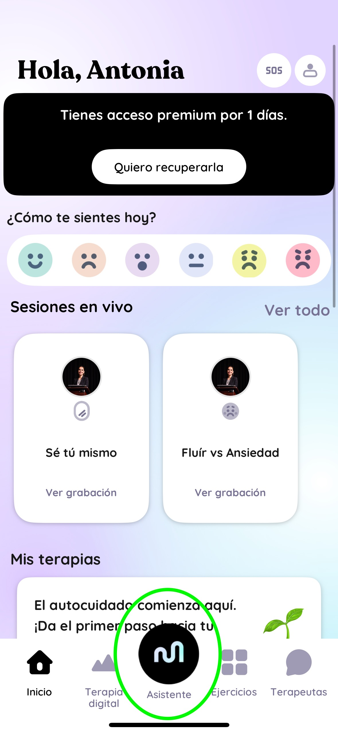
Large experiment with company Mindful
Mindsurf: mental health app
AI-powered chatbot (supervised model), mood tracker, guided exercises
2,000 women with psychological distress in MEX
Recruited online
Randomized access to the app
Data:
Admin: app engagement
Survey: at 4 and 8 weeks later
Weekly check-ins: mood

Slide 6
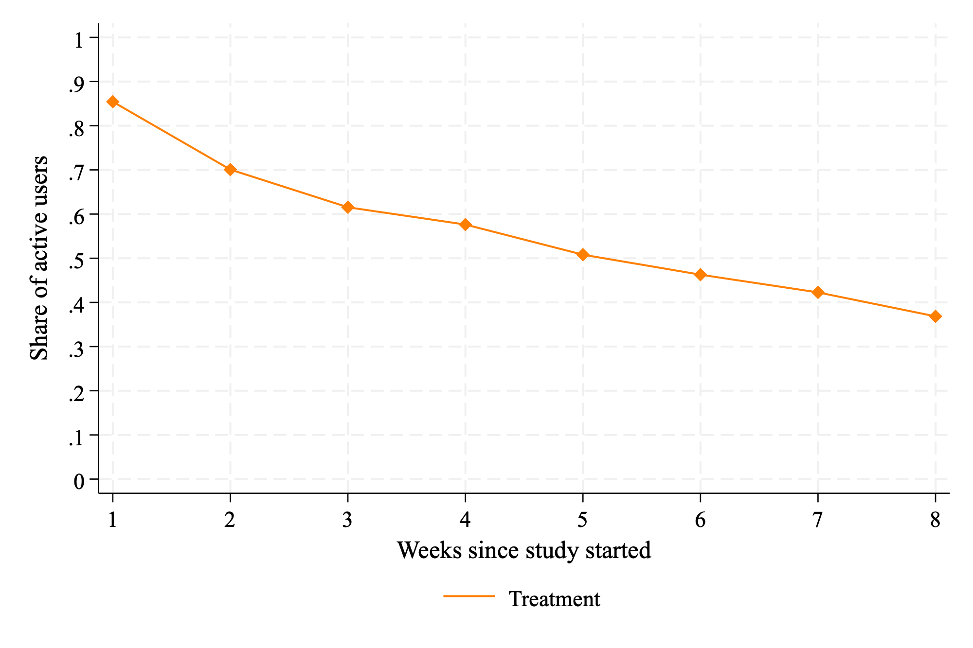
High engagement
85% used the app in week 1
37% still used it by week 8
Fig 1. Usage patterns over time

Slide 7
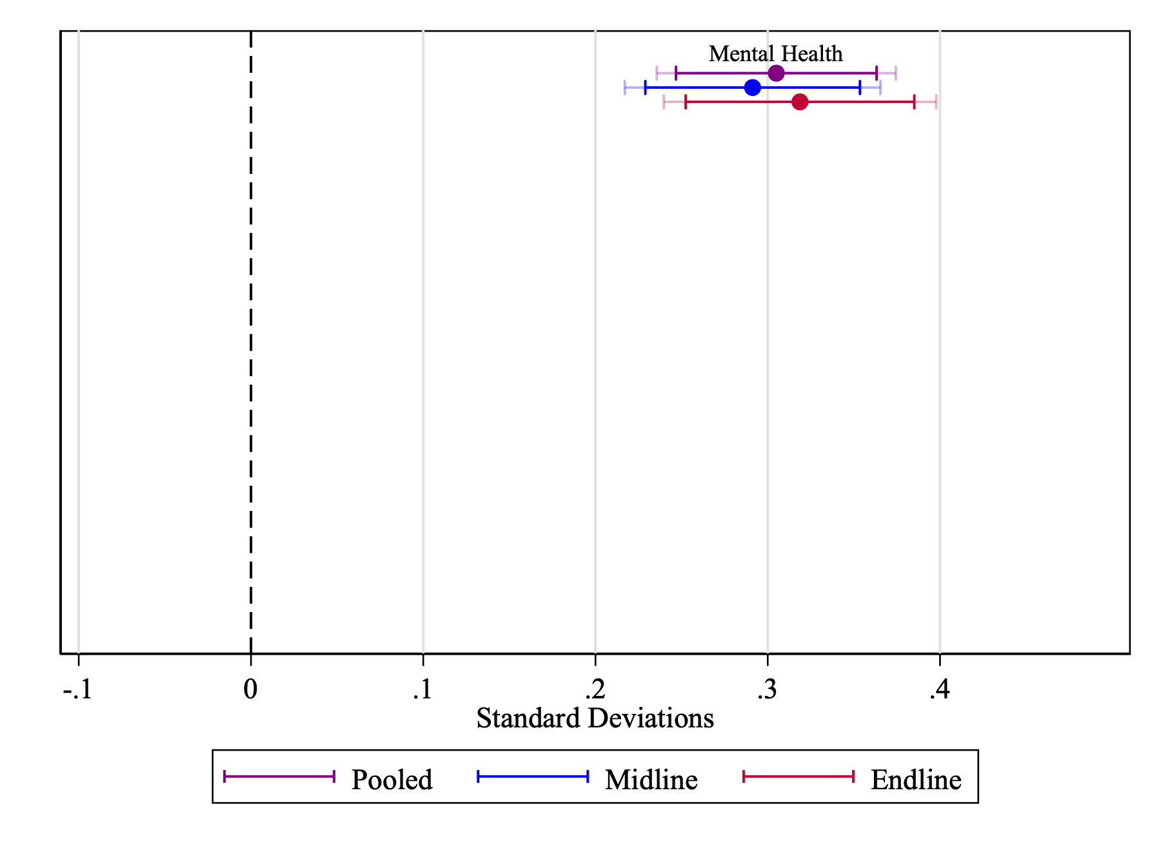
App access improves mental health
Improvements in well-being, symptoms of depression and anxiety, and perceived stress
Standardized index increased by ~0.3 SD
Effect sizes are stable at 4 and 8 weeks
Fig 2. Effects’ coefficients by survey round and pooled

Slide 8
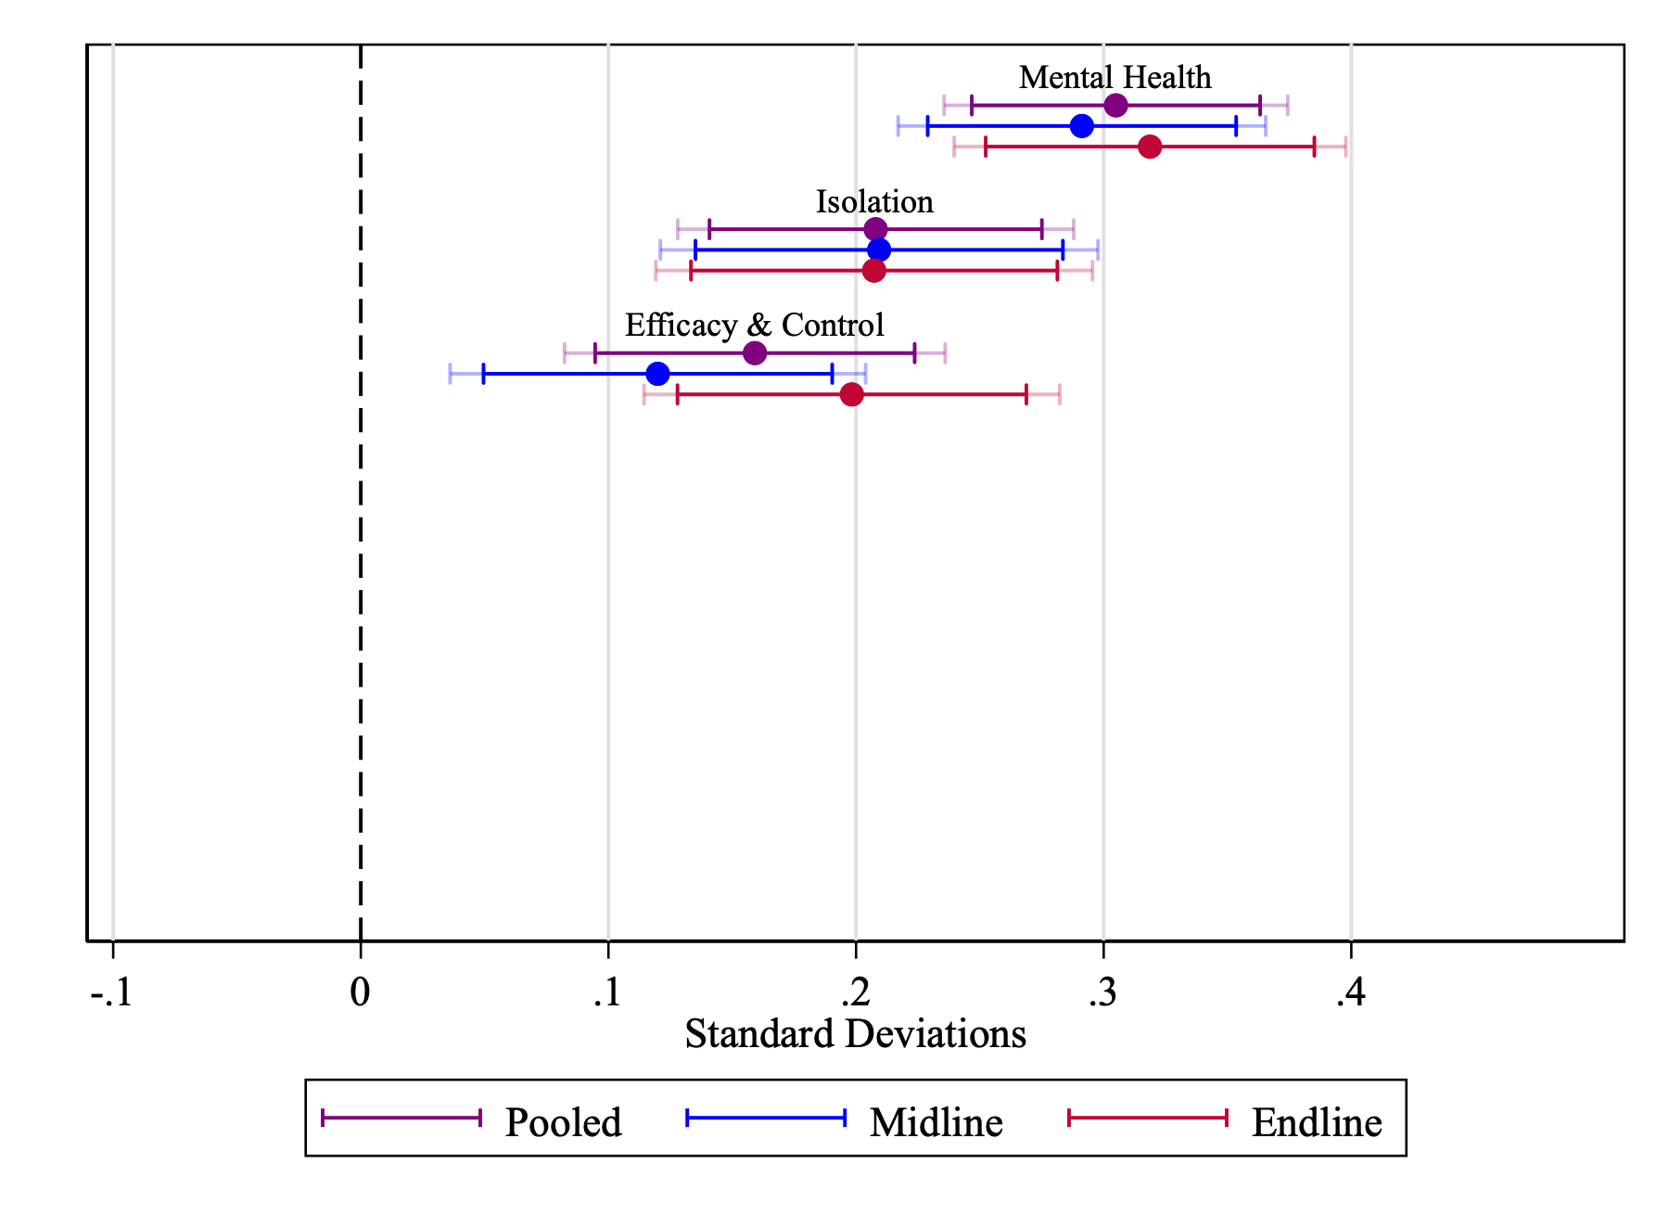
App access improves other wellbeing aspects
Improved feelings of social and emotional isolation
Felt more capable of managing challenges
More likely to attribute outcomes to their own actions
Standardized indexes improve by ~0.2 SD
Fig 2. Effects’ coefficients by survey round and pooled

Slide 9
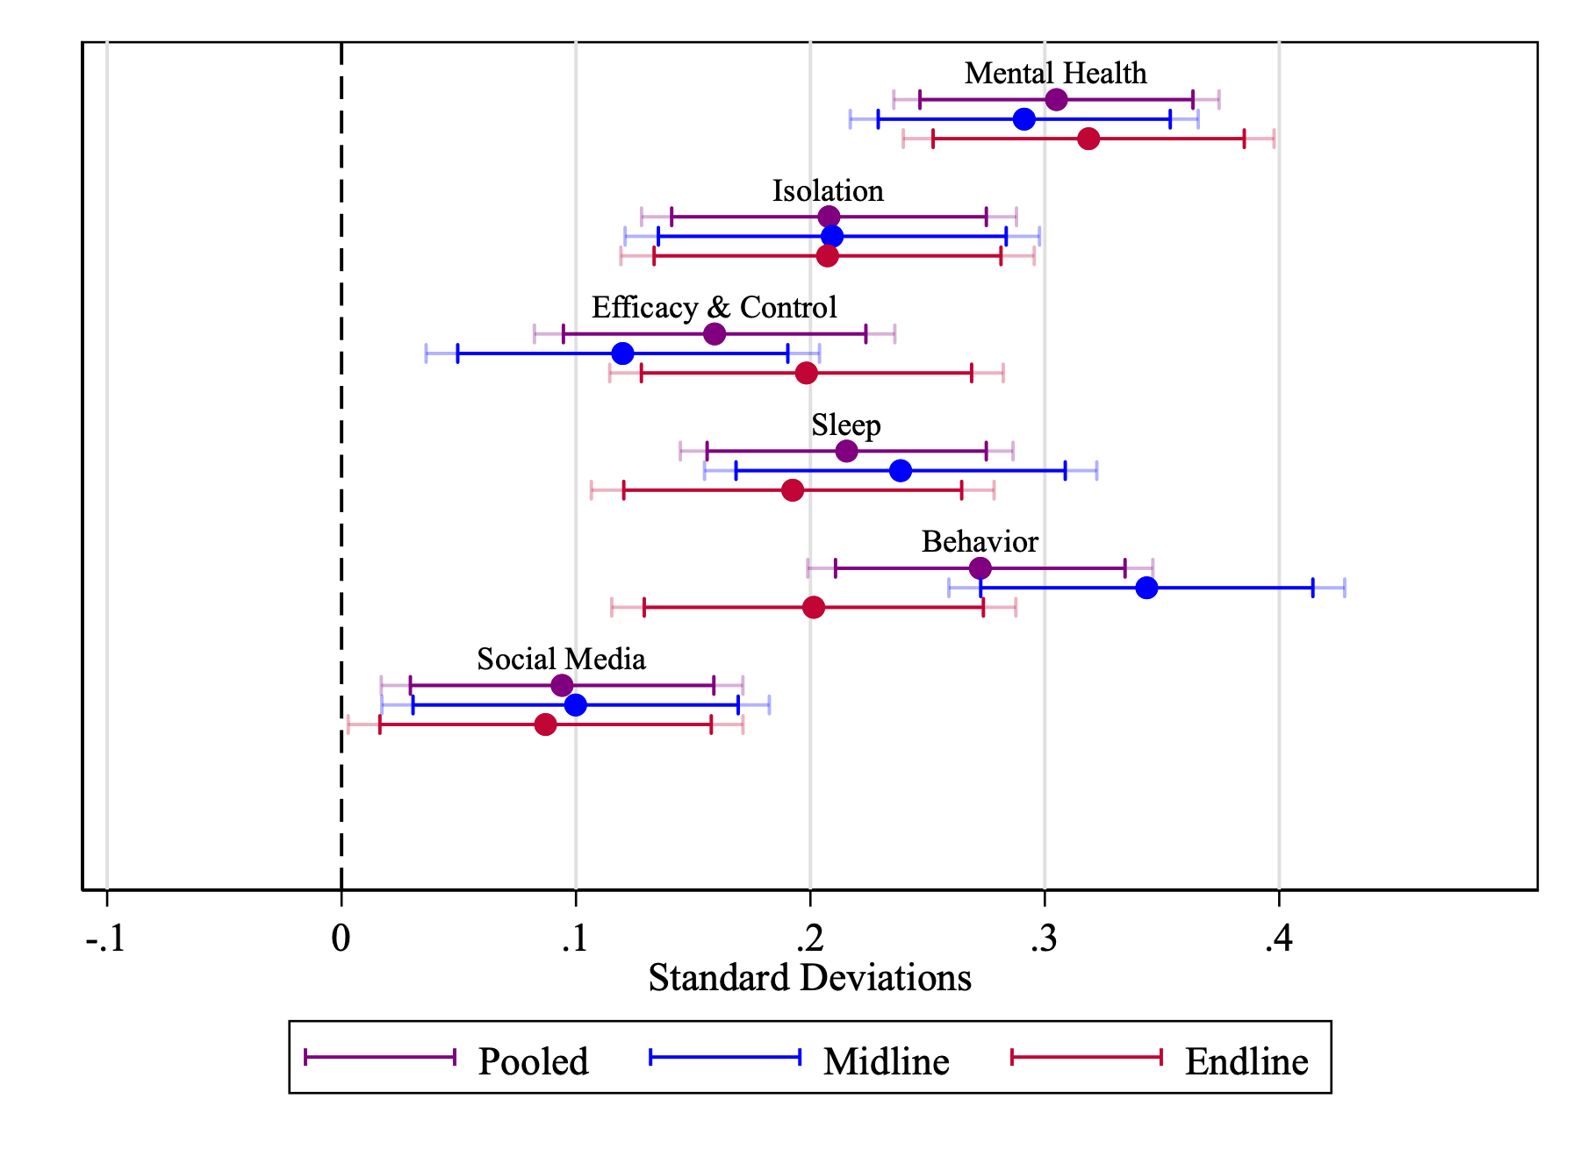
App access improves healthy behaviors
~0.2 SD better sleep
~0.27 SD more engagement on healthy behaviors
~0.1 SD fewer social media use
Fig 2. Effects’ coefficients by survey round and pooled

Slide 10
App access complements psychotherapy
 | Spoke with Psychologist
Panel A. Midline
Treated | 0.036**
 | (0.017)
Panel B. Endline
Treated | 0.056***
 | (0.018)
Panel C. Pooled
Treated | 0.045***
 | (0.015)
Standard errors in parentheses. *** p<0.01, ** p<0.05, * p<0.1
Psychotherapy sessions use ↑ by ~0.05 pp during the study
30% ↑ from the control baseline

Slide 11
Preliminary conclusions
High initial engagement, with decay over time, but a subset of users sustain use by week 8
Consistent improvements in mental health and related behaviors, even as engagement declines
It could suggest users may learn lasting coping tools through short-term exposure.
AI-powered mental health appears to be a gateway to psychotherapy
Potentially cost-effective way to expand access to mental health care at scale

Slide 12
Preliminary conclusions
High initial engagement, with decay over time, but a subset of users sustain use by week 8
Consistent improvements in mental health and related behaviors, even as engagement declines
It could suggest users may learn lasting coping tools through short-term exposure.
AI-powered mental health appears to be a gateway to psychotherapy
Potentially cost-effective way to expand access to mental health care at scale
Thank you!
Comments and feedback welcome:
antonia.vazquez@utexas.edu

