Slide 1











Using an AI Clinical Copilot to Enhance Patient Safety
Dr. Robert Korom
World Bank Symposium
29 Sept 2025
supports
SDG

Slide 2



We must confront errors in healthcare.
Diagnostic and Treatment Accuracy is Poor
Only 43% diagnostic accuracy in Nairobi County / 41% Treatment Adherence¹
Harm is Common
1 in 30 encounters has a medication-related harm. Most people will experience a diagnostic error in their lifetime! ²
Errors can be deadly
In LMICs, 4 in 100 people die from unsafe care. >3M deaths annually ²
¹Kenya Health Service Delivery Indicator Survey 2018 Report
²WHO Patient Safety Fact Sheet (2023)

Slide 3
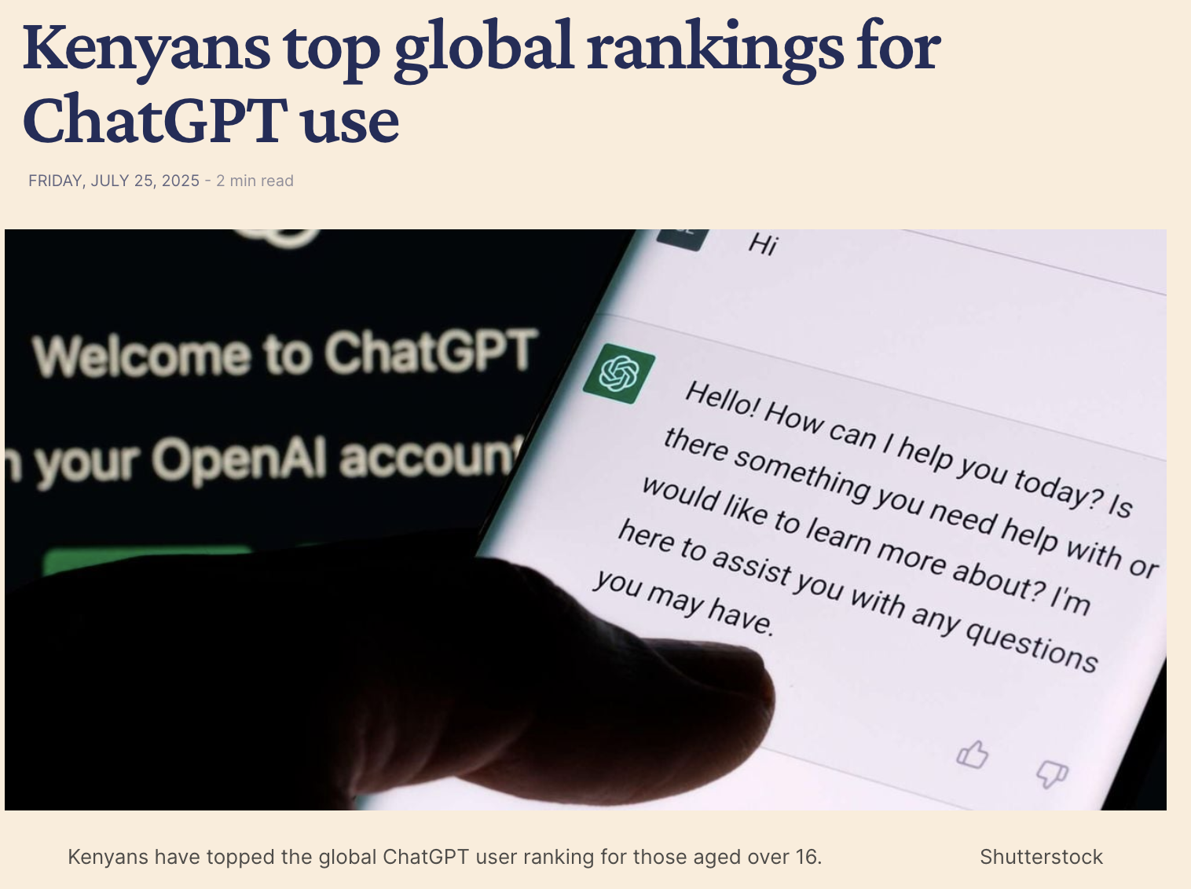
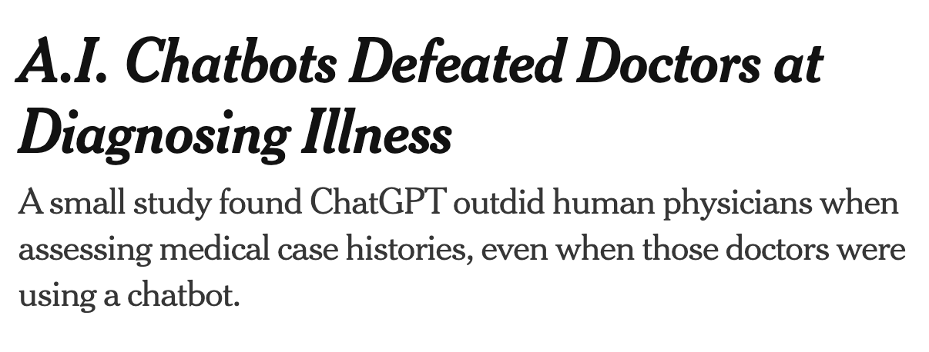
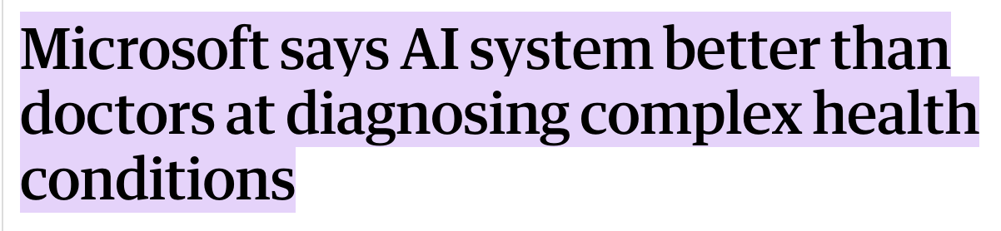
AI Model Performance is Strong
Notes:
Adoption comment?

Slide 4
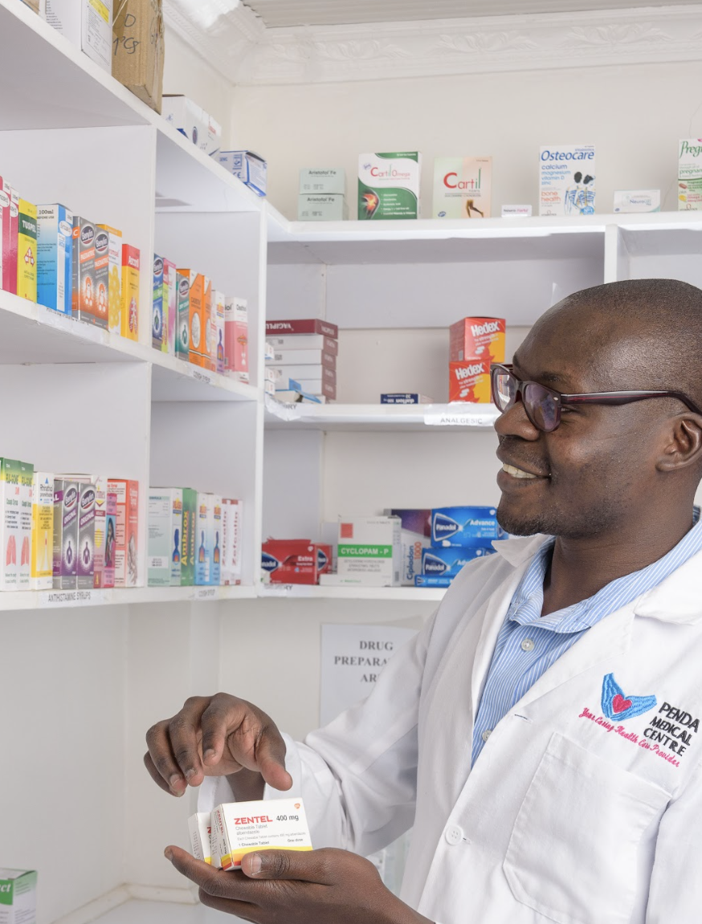
The Penda Model
16 outpatient Level 3b facilities + nationwide telemedicine – all equipped with:
Ultra-patient-centered culture
Clinical Officers + laboratory + pharmacy = affordable, comprehensive care
AI-powered quality systems = consistent, scalable experience
Built for trust. Built for scale.

Slide 5




Four decision-making moments
Clinical Documentation
Comprehensive History + Physical Exam
Guideline-based Treatment
Appropriate Testing
Diagnostic Accuracy
Notes:
Adoption comment?

Slide 6
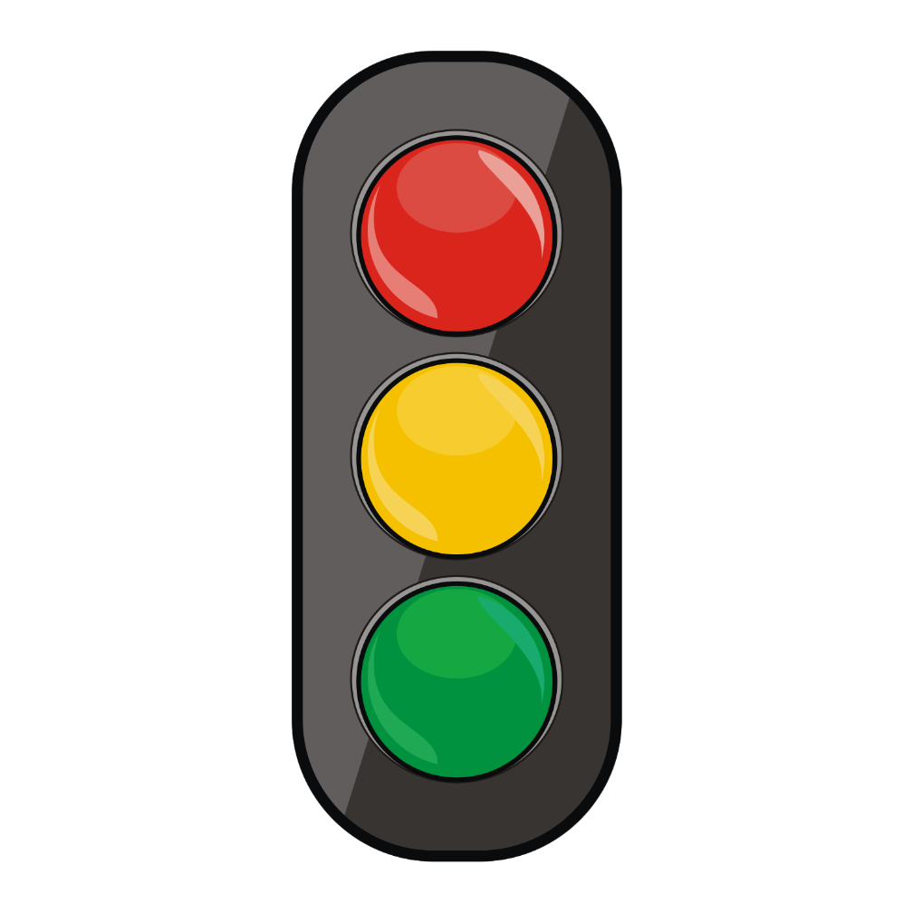
Penda's AI CDSS: Traffic Light System
Red: There is a serious problem​
--> Intrusive Pop-up​
Yellow: It could be better, but not life-threatening ​
--> Yellow Alert Bell​
Green: Documentation looks good!​
--> Green tick mark​
Notes:
Adoption comment?

Slide 7
Technical Implementation
Trigger:
"Focus-out Event"
System Prompt:
"You are an advanced CDSS supporting clinical officers in an urgent care setting in Nairobi…"
- Few-shot prompting to define R/Y/G thresholds.
- Structured JSON Output
JSON Output:
Severity (R/Y/G)
Reason: 1-2 sentences
Action: 1-2 sentences
Background API call to GPT-4o
User Prompt:
De-identified text-based clinical data
Notes:
Adoption comment?

Slide 8
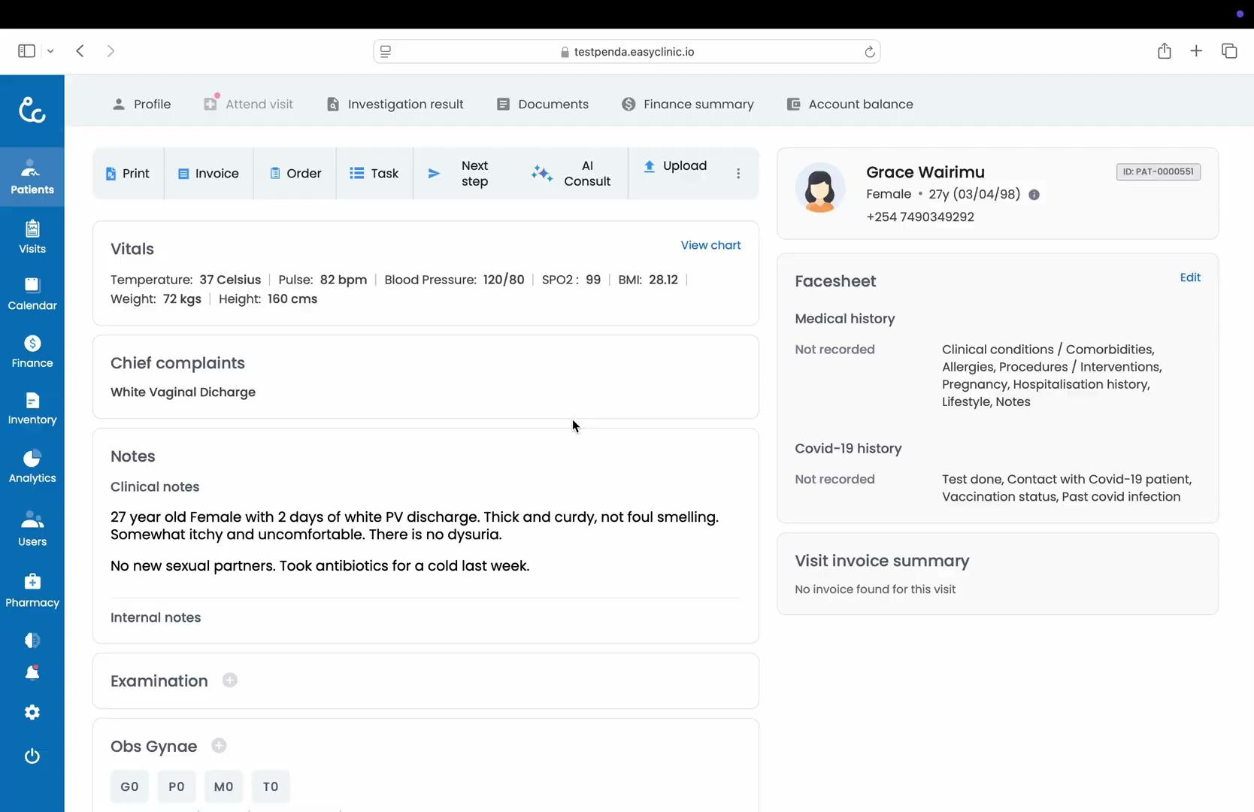
Notes:
Adoption comment?

Slide 9
New Clinical KPI: Left-in-Red
What it is: % of visits that end with a Red Alert (unresolved safety-critical issue) in any bucket (history / testing / diagnosis / treatment).
Why it matters: Visits that end in Red carry much higher error rates as measured by independent, blinded evaluators.
It moves with adoption: "Control" clinicians don't change. As "AI clinicians" increasingly adopt the tool, left-in-red falls.
Top performers reach close to 0% left-in-red. New, inexperienced clinicians have left-in-red rates well above the mean.

Slide 10
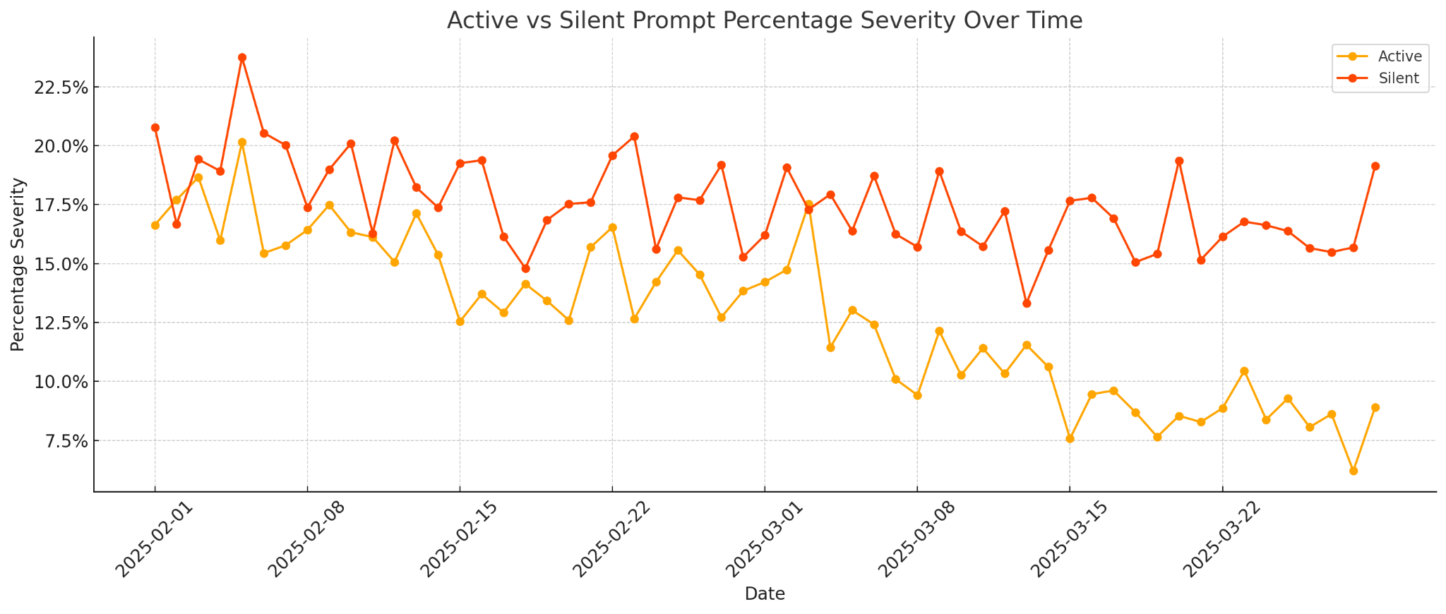
Active Change Management Drives Adoption
Active Deployment
Induction Period
% indicates clinic visits with at least one workflow stage left in "Red" state

Slide 11
Key Results from Pilot Study
39,849 patients enrolled over from Jan - April 2025
Clinicians randomized to either usual care (no AI alerts) or AI Consult Safety Net.
108 independent physicians (29 from Kenya) reviewed the final documentation, blinded to whether AI was used or not, and rated for quality in the four key areas.
32% fewer history errors
10% fewer diagnostic testing errors
16% fewer diagnostic errors
13% fewer treatment errors
Within Penda alone, the AI Consult tool could reduce more than 50,000 errors every year.

Slide 12


Additional Rigorous Evaluation Underway
Africa's first prospective RCT of AI CDSS in primary care
Design:
Clinician-level randomization
Intervention: AI CDSS vs Control (Usual Care)
Primary Outcomes:
Patient-reported health outcomes
Expert panel review of medical decision making
Enrollment:
> 10,000 patients
Expected results:
Pre-print October 2025

Slide 13



Key Takeaways
AI Model Performance is strong, implementation is the barrier
Call to Action: Health System Leaders should work toward digitization and implementation
Clinician Adoption and Change Management is Critical
Individual Feedback, Peer Champions, Buy-in
Clinicians of the future must blend empathy with tool use
"Human at heart. Tech in hand."

Slide 14


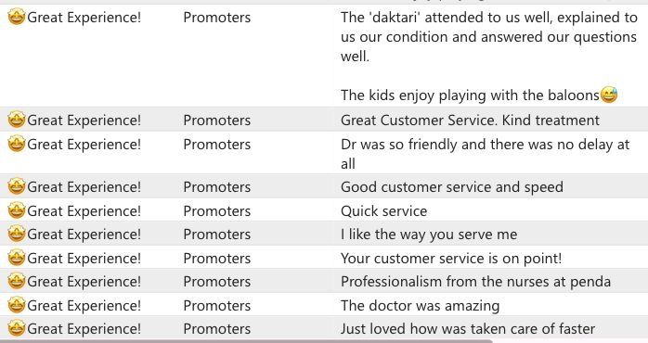
Patient-centeredness is foundational
Tech + clinician engagement + patient-centered culture
= sustainable high-quality model

Slide 15

Join us!
We aim to be the leader in patient-centered care in Kenya.
robert@pendahealth.com

Slide 16
Appendices

Slide 17
Data Confidentiality
What the model sees:
A 39 y/o M with chief complaint of headache, HR 68, BP 112/78, SpO2 99%...
Is "Migraine" a correct diagnosis given this information?
EMR Data
Name: Robert Korom
Phone Number: 0700123123
Address: 1 Karura Forest
Insurance: Britam Policy 123
Next of Kin: Stephanie
Next of Kin Contact: 0712312300
Complaint: Headache
VS: HR 68, BP 112/78, SpO2 99%
Notes: 39 y/o M with h/o…
Diagnosis: Migraines
Key Takeaway:
The model doesn't get access to any Personally Identifiable Information.

Slide 18
Retrospective Eval of v1 outputs
Study design:
Setting: 16 outpatient facilities in Nairobi
Sample: 1,469 clinical encounters from July - Sept 2024
Method: Independent physician panel review of:
Initial documentation
AI Consult output
Final documentation
Objective: Assess hallucinations, guideline alignment, harmful vs beneficial outputs, and clinician uptake
Notes:
Adoption comment?

Slide 19
Model Performance
Hallucinations rare (3.4%) – mostly acronyms / drug name errors
Nearly all guidance aligned with Kenyan guidelines (99%)
97% of outputs addressed issues in initial documentation
Novel diagnostic insights in 94% of cases
Notes:
Adoption comment?

Slide 20
Safety and Risk
7.8% of outputs contained potentially harmful recommendations. Most were inappropriate meds or missed differentials.
67 harmful outputs (4.6% of encounters) appeared in final documentation.
Conversely, risk in clinician's initial notes was fully mitigated in 118 encounters (8%).
Notes:
Adoption comment?

Slide 21
Implications for Safety Assessment
Safety is not just about hallucination rates – it's also about how clinicians use / ignore outputs.
Clinician trust and usability is key – 62% of encounters showed no change, even when guidance was beneficial.
Last mile workflow integration and building clinician trust and adoption is key to actualizing the benefits.
Notes:
Adoption comment?

Slide 22
Post-deployment Monitoring
1. Thumbs Down responses: Very rich data set for understanding unhelpful or risky AI outputs.
2. Patient Safety Reporting: Every patient complaint or internally-raised PSR results in a complete audit, including all AI responses.
3. High acuity patients: Randomly sample AI outputs from the sickest patient cohort (by dx / vital signs / etc.)
4. Which outputs were not adopted: Review suggestions that were ignored from the best cohort of clinicians.

Slide 23
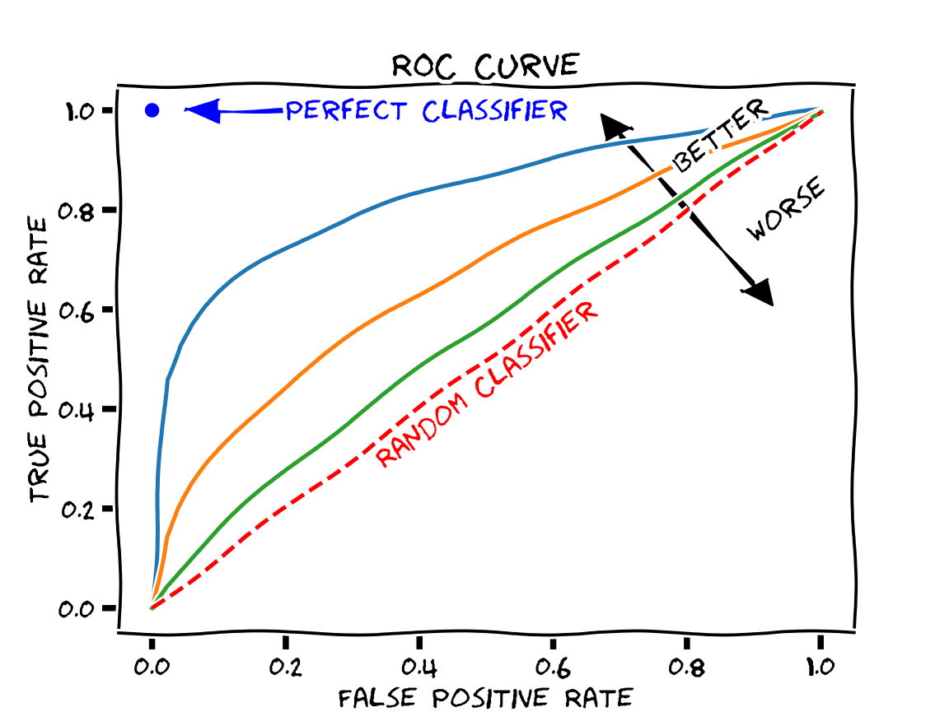
AI CDSS as an ROC Optimization Problem
 | AI Flags an Issue | AI does NOT flag
Clinically Relevant | True Positive: ✅ Most impactful | False Negative: ⚠️ Missed opportunity
Clinically Not Important | False Positive ⚠️ Alert Fatigue | True Negative ✅ Drives Efficiency

Slide 24
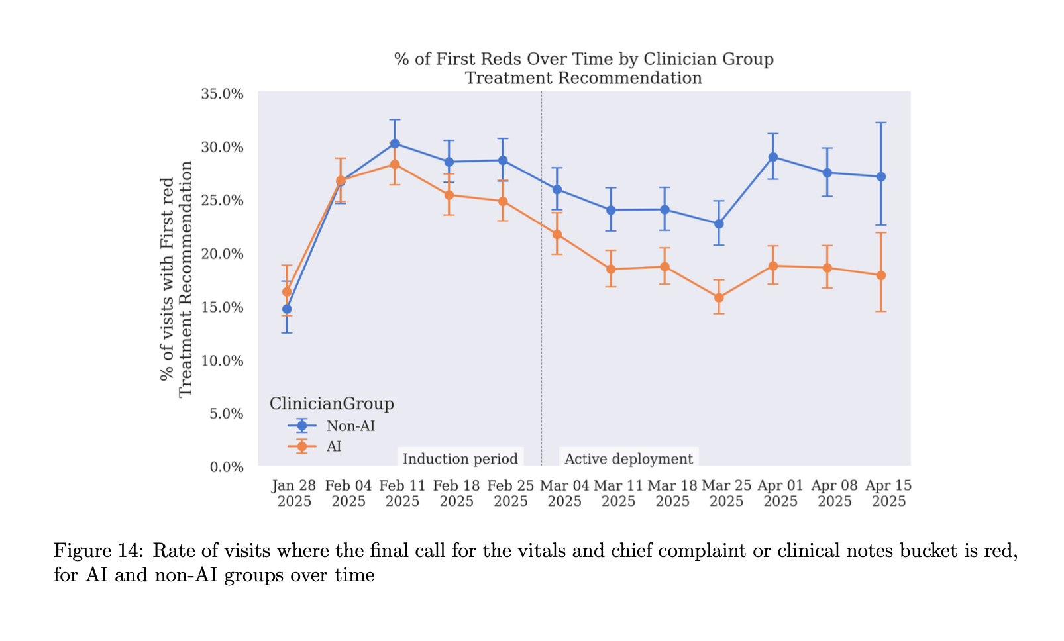
AI clinicians learned to avoid reds!

