Slide 1

Scaling teacher support:
Pilot results from “Profe Gabi,” an AI-powered chatbot for novice teachers in Chile
Ana Teresa del Toro Mijares¹, Gregory Elacqua¹, Catalina Hermosilla¹, Macarena Kutscher²
¹Inter-American Development Bank, Washington DC, USA; ²Universidad del Desarrollo, Santiago, Chile

Slide 2
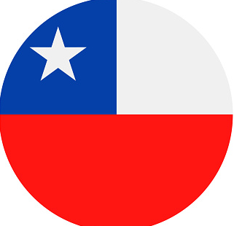
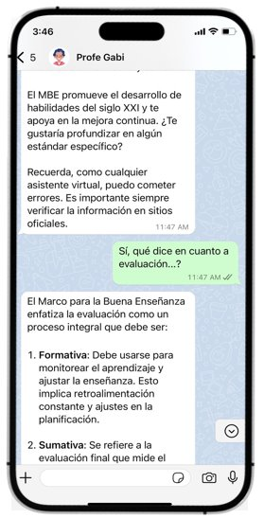




Why Profe Gabi?
36%
Of teachers leave the teaching profession in their first two years of teaching
Reaches less than 1% of novice teachers

Slide 3
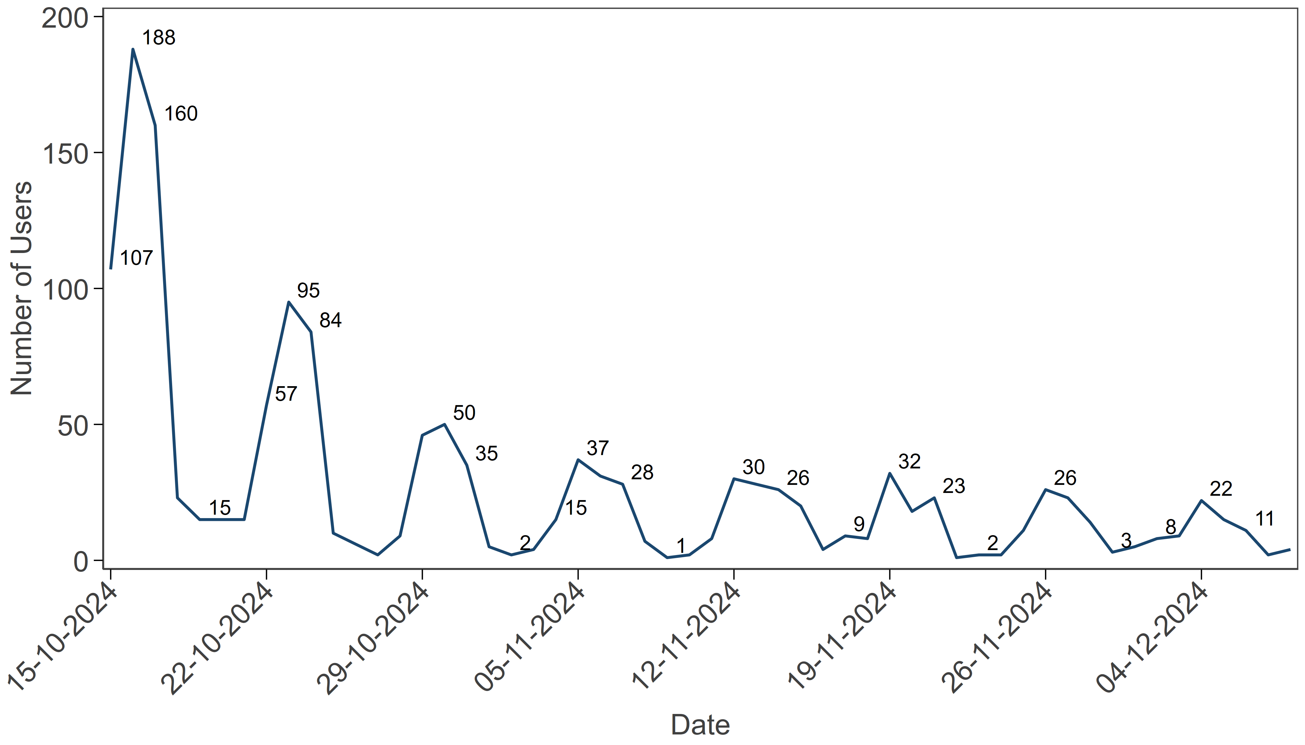
Pilot results (550 teachers in 2024)
How do teachers use Profe Gabi?
High satisfaction…
but diminishing engagement
Types of initial queries made to “Profe Gabi”
Dimension | (%) ​ | Example of queries (paraphrased)​
Pedagogical and instructional support | 72​% | "Can you suggest engaging activities for teaching fractions to 5th graders?"​ "I need a rubric to evaluate a literary podcast for 8th grade."​ "What strategies can I use with a talkative 7th grade class?"​ "How to help an ASD 2nd-grader who struggles with transitions?"​ "What digital tools do you recommend for interactive math lessons?"​
Career and professional development guidance | 11%​ | "When should I take my teacher evaluation if I started in May?"​ "Am I entitled to January-February pay as a substitute teacher?"​
Socio-emotional well-being | 9​% | "How can I better organize my time to avoid taking work home?"​
Other | 8​% | "How to write an effective note to a parent about behavior issues?"​ "What activities can I propose for an environmental science fair?"​
85% of participants satisfied or very satisfied
Number of users who interacted with “Profe Gabi”​

