Slide 1


Value-Added Based Algorithmic Matching of Mediators to Court Cases in Kenya
Sanmay Das, Antoine Deeb, Shafkat Farabi, Wei Lu, Didac Marti Pinto, Manuel Ramos Maqueda, Anja Sautmann

Slide 2
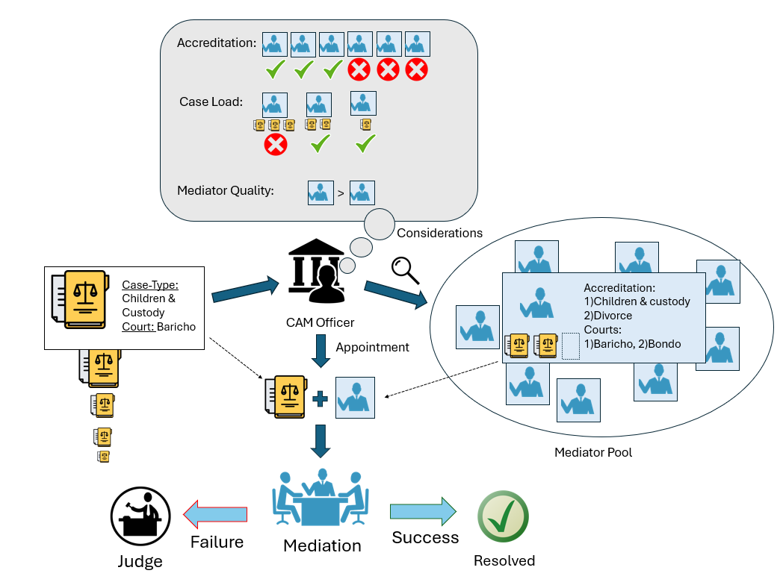
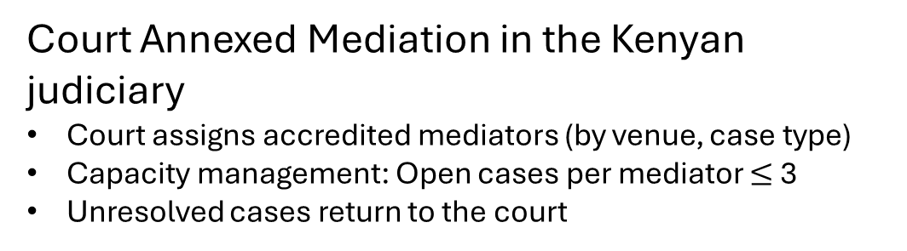
Introduction & Motivation
Court Annexed Mediation in the Kenyan judiciary
Court assigns accredited mediators (by venue, case type)
Capacity management: Open cases per mediator $≤$ 3
Unresolved cases return to the court
Observations from data:
58% cases return unresolved
Success rates vary widely by mediator
Which mediator is the most suitable?
Objective:
Automated assignment algorithm for maximizing case agreement rate while reducing mediator overload

Slide 3
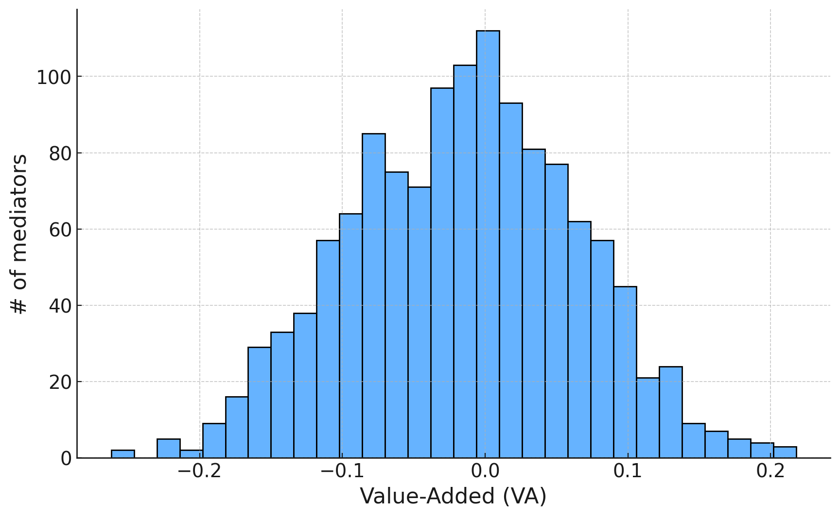
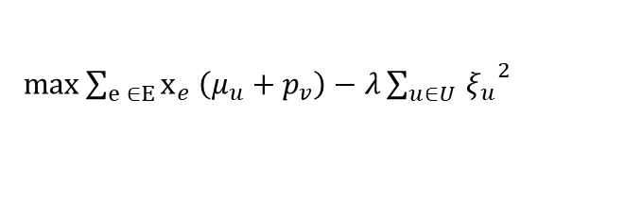

Our Approach
Mediator Value Added
Value Added model used to estimate mediator contributions to case agreement outcome
Validated with a 3-month long random assignment experiment
Reveals substantial heterogeneity in mediator skills
Allocation Strategy
Relaxed allocation problem is modeled as a Quadratic Program
  Locally approximated with an LP for efficiency
As cases arrive:
  Solve LP
  Use fractional solution to allocate mediator
  We can’t see the future, so sample “shadow cases”
Occasionally holding back best mediator is beneficial:
  Better caseload management at mediator-scarce courts
Mediators can be overloaded when deemed sufficiently beneficial
Quadratic Program
Maximize expected case resolutions
$\max{\sum_{e ∈E}{x_{e} \left(μ_{u}+p_{v}\right)−λ{\sum_{u∈U }{ξ_{u}}}^{2} } }$
Constraints:
Each case can be allocated once
Total cases assigned to a mediator $≤$ 3
Cases must be assigned on arrival
Constraint (2) allows violations using slack $ξ_{u}$
  $ξ_{u}$ is incorporated as a penalty in the objective

Slide 4
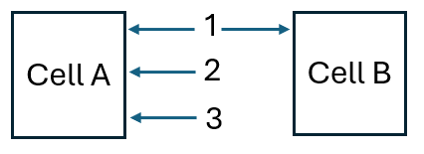
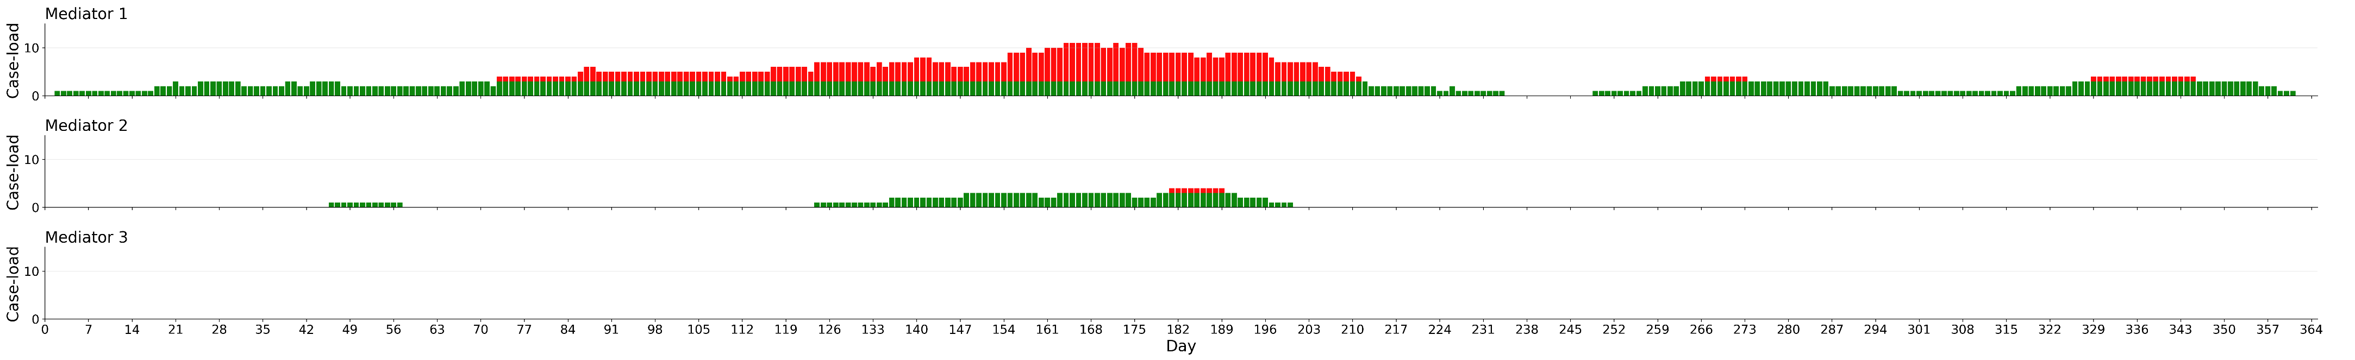
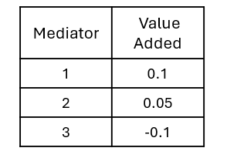
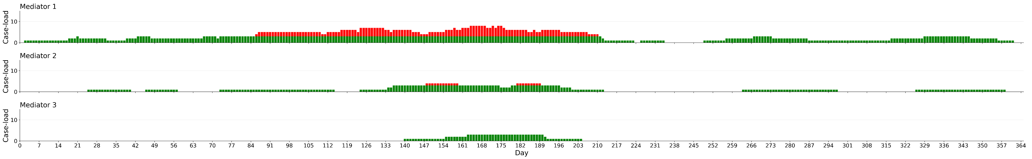
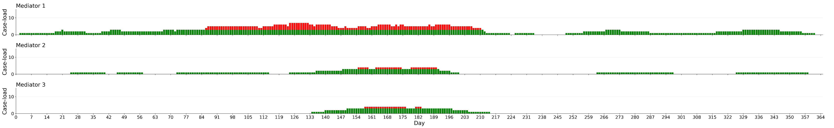
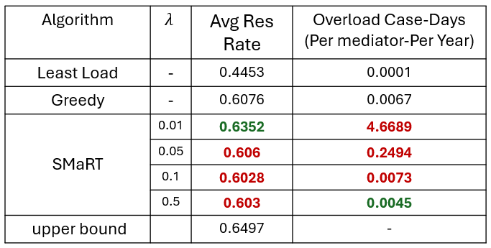
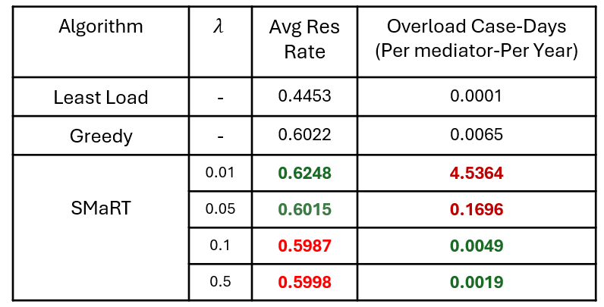



Simulations and Results
Simulation on a hand-crafted scenario:
Average Resolution Rate
Overload
Case-Days
(Per mediator)
Under Capacity
Overload
$λ$ = 0.01
0.4475
53.85
$λ$ = 0.05
0.4412
30.54
$λ$ = 0.5
0.4297
25.9
Simulation on real data:
Mediation data collected from Kenyan Judiciary
Simulation on cases during Jan 2022- Jan 2023
Next step: Deploy SMaRT in Kenyan Judiciary and perform RCT
Table 1: Using true VAs
Table 2: Must learn VAs

