Slide 1
Mapping the AI-Enabled Transformation of Labor in Autonomous Vehicle Taxi Services
Leah Kaplan, Zoe Szajnfarber, and John Paul Helveston
Presented by: Katie Gilligan
Department of Engineering Management and Systems Engineering
George Washington University
AI & The Future of Human Capital in the Global South Knowledge Symposium
September 29, 2025

Slide 2
What can we learn from autonomous vehicles (AVs)?
Refinement for labor impact analyses
Introduction of AI-tech spurs rebundling of tasks and labor roles
Occurs via 3 identifiable patterns: distributing, consolidating, scaffolding
Notes:
Why talk about autonomous vehicles? Afterall AVs aren’t really being implemented in the Global South at present. They’re mostly being designed and deployed in the United States and China.
Well, this research looked at AVs as case study of how emerging AI technologies can impact work systems centered around non-routine manual tasks, a category of work that is prevalent in the Global South and may be an area of focus for future AI implementation.
This research study looked at how the introduction of AI-enabled autonomous vehicles to a taxi work system reshaped tasks and frontline labor roles and its results provide insights that can generalize to other types of non-routine manual work systems.
Specifically, the findings from this research revealed that:
1) Researchers and policymakers need to refine their analyses of AI labor impacts because they may be overestimating impacts in some cases and underestimating impacts in others.
2) Rather than the substituting/complementing paradigm of labor impacts that people often discuss, the introduction of AI technology actually spurs a rebundling of tasks and labor roles.
3) And that this rebundling occurs via 3 identifiable patterns: distributing, consolidating, and scaffolding.

Slide 3
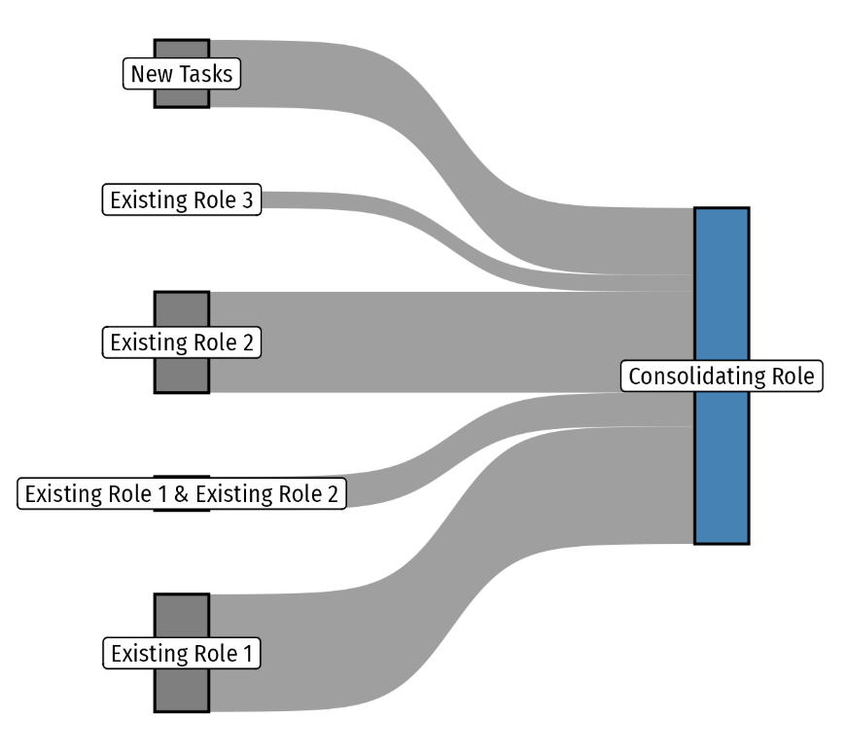
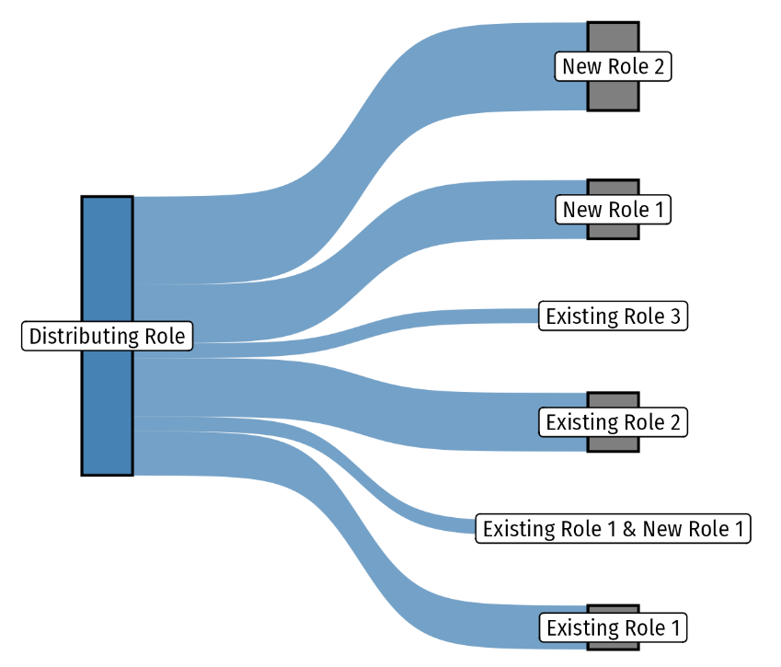
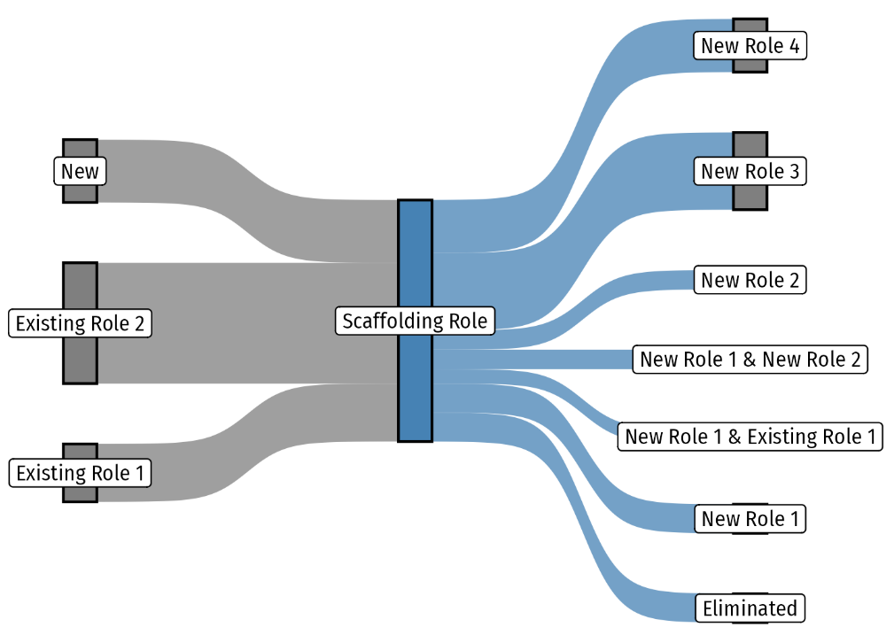
Rebundling occurs via archetypal patterns
Distributing
Consolidating
Scaffolding
Notes:
In the distributing patten, tasks are redistributed from a single role, with some tasks going to one new role while others are distributed to multiple roles that must subsequently coordinate with one another to perform that task
In the consolidating pattern, multiple tasks are rebundled into a new role.
In the scaffolding pattern, tasks are absorbed from roles in one phase and then are redistributing or shared in a later phase.
As we all continue to grapple with how AI technologies might impact the future of work, these patterns provide a structured way to examine and predict AI-induced labor impacts to work systems oriented around non-routine manual tasks. By studying AV work systems, this research provides new insights that can inform further research and decision-making around a type of work system that is prevalent in the Global South.

